Slide 1


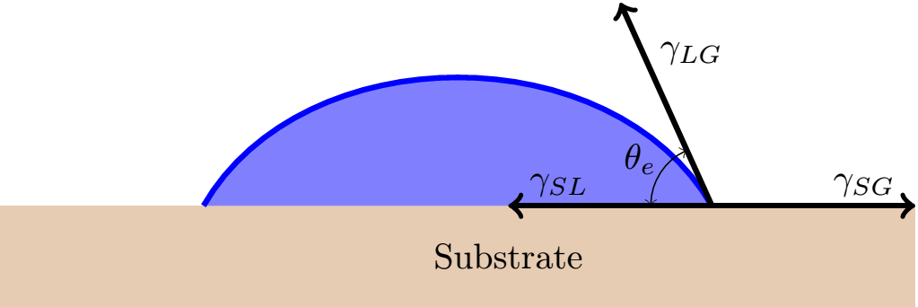
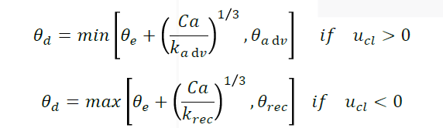

Modeling Dynamic Contact Angle in OpenFOAM
Collin Stevenson
Department of Mechanical Engineering, University of New Hampshire
Introduction
Results
Discussion
OpenFOAM is an open source cfd software used for numerical analysis for the solution of continuum mechanics, specifically fluid dynamics. This research project focused on capillary flow, which is when gravity's affect on the flow field becomes negligible and the surface forces acting on the fluid dominate. This process was done through DEKA Research, a company located in Manchester, NH. They are currently trying to find a way to model capillary flow while implementing a dynamic contact angle.
The end goal was to model a particular flow within a specific container. Videos and actual data depicting the exact flow cannot be shown due to legality issues within DEKA. Instead, an arbitrary presentation of the method used to model a dynamic contact angle is given. This will provide insight into what the final product will end up being. Before this new model was developed, the numerical model showed large air bubbles within the flow that was not accurate. This previous model was made using a constant contact angle. This technique is based on constants found through empirical experiments as well as the capillary number. This is a simplified model for numerical analysis and does not tell the full story. For DEKA’s purposes, this was accurate enough to model their flow.
Methods
Multiple different cases were run to try and get the most accurate model using different values for k
Image above represents a constant contact angle of 45 degrees
Contact angle can be seen progressively decreasing from the initial 90 degrees as the flow progresses
Results can then be applied to a more specific model for DEKA
Import geometry of DEKA pipe into OpenFOAM using STL files
Flow designed using an incompressible method called pimpleFoam
PimpleFoam implements a turbulent model when numerically modeling the flow
Fluid properties are appropriately assigned to a prescribed field
Combined case files from DEKA with newfound methods from researching various forums as well as combing knowledge of physical phenomenon's occurring
Model based on contact angle when flow is progressing forward as well as when flow is receding
$$θ_{adv}^{3}−θ_{rec}^{3}\sim u$$
Contacts
.
References
      For more information contact:
      Ivaylo Nedyalkov
      DEKA Research
Cox, R. G. "The dynamics of the spreading of liquids on a solid surface. Part 1. Viscous
flow."Journal of Fluid Mechanics 168 (1986): 169-194.
Yokoi, Kensuke, Damien Vadillo, John Hinch, and Ian Hutchings. "Numerical studies of the
influence of the dynamic contact angle on a droplet impacting on a dry surface." Physics of
Fluids (1994-present) 21, no. 7 (2009): 072102.

Slide 2
