Slide 1
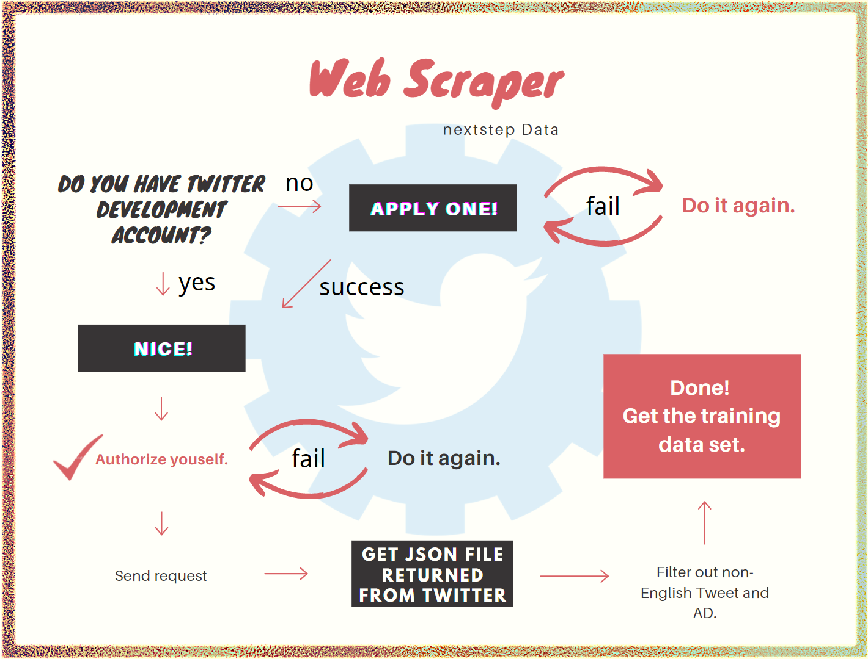
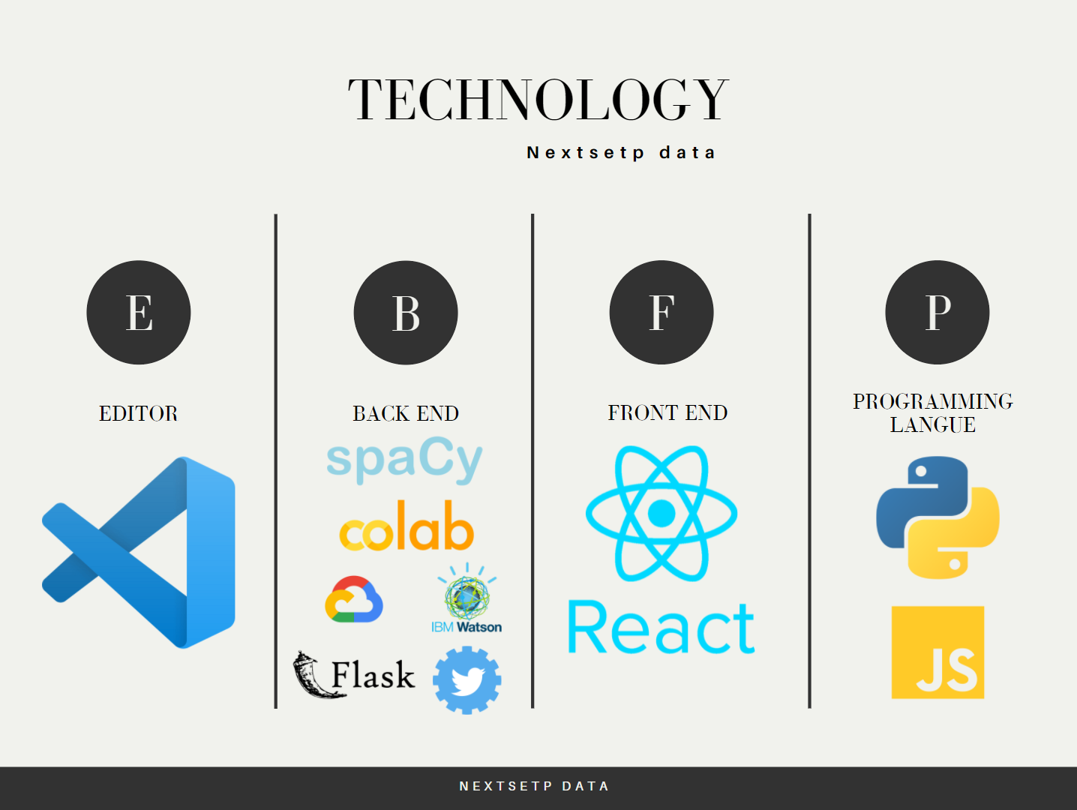
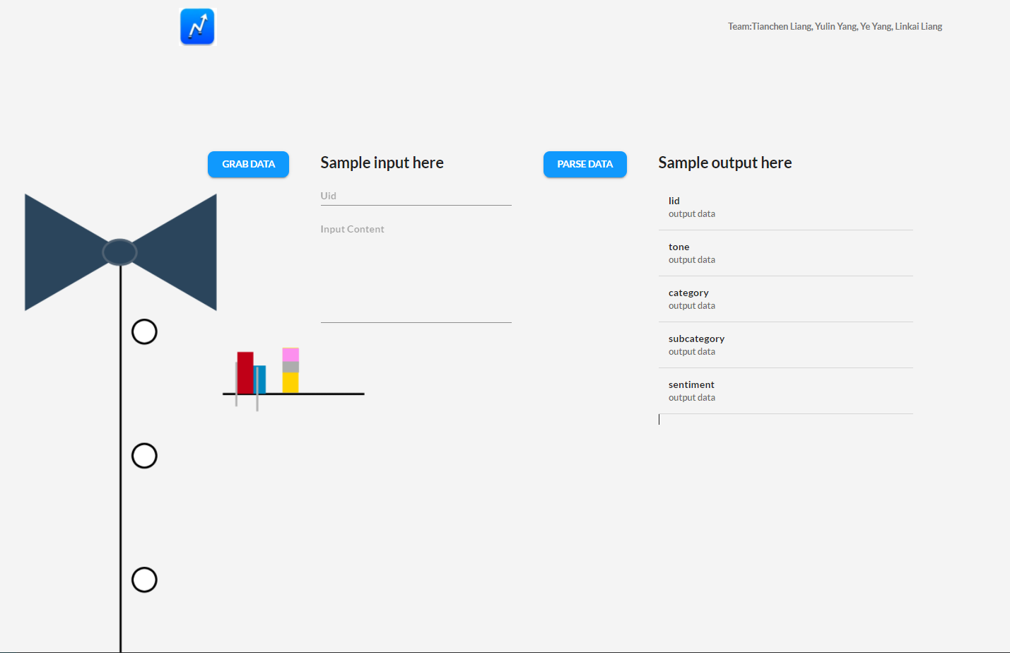
NextStep Data Analysis Natural Language Processing Development Ye Yang, Linkai Liang, Yulin Yang & Tiancheng Liang Department of Computer Science, University of New Hampshire
Introduction
Design and Result
Process
GOAL: This project’s primary target is to analyze the content from a social application and offer a dashboard to read a categorization of posts from 8 columns. Each column has its own sub columns, which could provide a more precise categorization.
FOCUS: We more focus on data analysis rather than designing a flat UI. So, we may not be able to deliver a perfect commercial UI to users.
ANALYSIS: Our analysis is about classifying content in category, subcategory, and sentiment.
Terms
NLP: Natural Language Processing. How the computer process the human languages.
True Positive: The model made a correct predict
False Positive: The model made a positive predict but were in fact negative
True Negative: The model made a correct negative predict.
False Negative: The model made a negative predict but were in fact Positive
Precision = True Positive/(True Positive + False Positive)
Recall = True Positive/(True Positive + False Negative)
F_score = 2*(Precision*Recall)/(precision + recall)
F_score is the way how we eventually evaluate our model,
it ranges from 0 to 1, with 1 signifying the highest performance and 0 the lowest.
Using a group of processed data (including Category and subcategory) to train our NLP model. Then test it with raw data. F-score is a measurement of the model accuracy
With IBM Watson, we can analyze tones of content.
Initial Idea: For the input dataset, we have two attributes called category and subcategory. Our first goal in this project is to use these two category cooperates with the content using SpaCy library to build a NLP model and make the model to learn which content belongs to which categories. Once the model was done, we could use this model to classify a raw content to a certain category and subcategory.
Evaluate Model: Each time SpaCy will predict a content to a certain category and subcategory and it will give us its predicted score. If spaCy give its prediction a 0.5 or bigger score on the certain category label, we will check what the true label of category in this content. If spacy predicted label is same with the true label, we will make True Positive value add 1, otherwise we make false positive add 1. If spaCy made a prediction less than 0.5 which means spaCy does not think this certain category belongs to this content, and the real category label in this content is not the current label. We make True Negative Value add 1, and vice versa. Once we get all values, we use these data to calculate the Precision and Recall. Finally, we can obtain the value of F_score.
Result: After training our model using input dataset and we evaluate the model. Finally, our NLP model has 0,98 or higher F_score which means most of the time our NLP model made a correct prediction on category and subcategory.
Sentiment & Tone: For the sentiment and tone, we are using an existing model from different library to predict our data.
Technology
Application
Conclusion
References
We created NLP model, we successfully predicted input contents to certain category and subcategory. We also correctly used certain library to analyze tone and sentiment.
We successfully build the web page that can display the input context and output result from NLP model.
We build a functional web scraper that can obtain Tweets from Twitter to improve training NLP model.
Thanks:
NextStep for providing us with a great opportunity to work on this fantastic application.
Professor David give us so many useful advices, so that we can finish the project easily.
Our teammates, without you, the project will never be achieved.
User Dashborad

