Slide 1
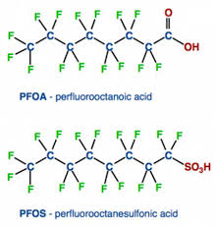
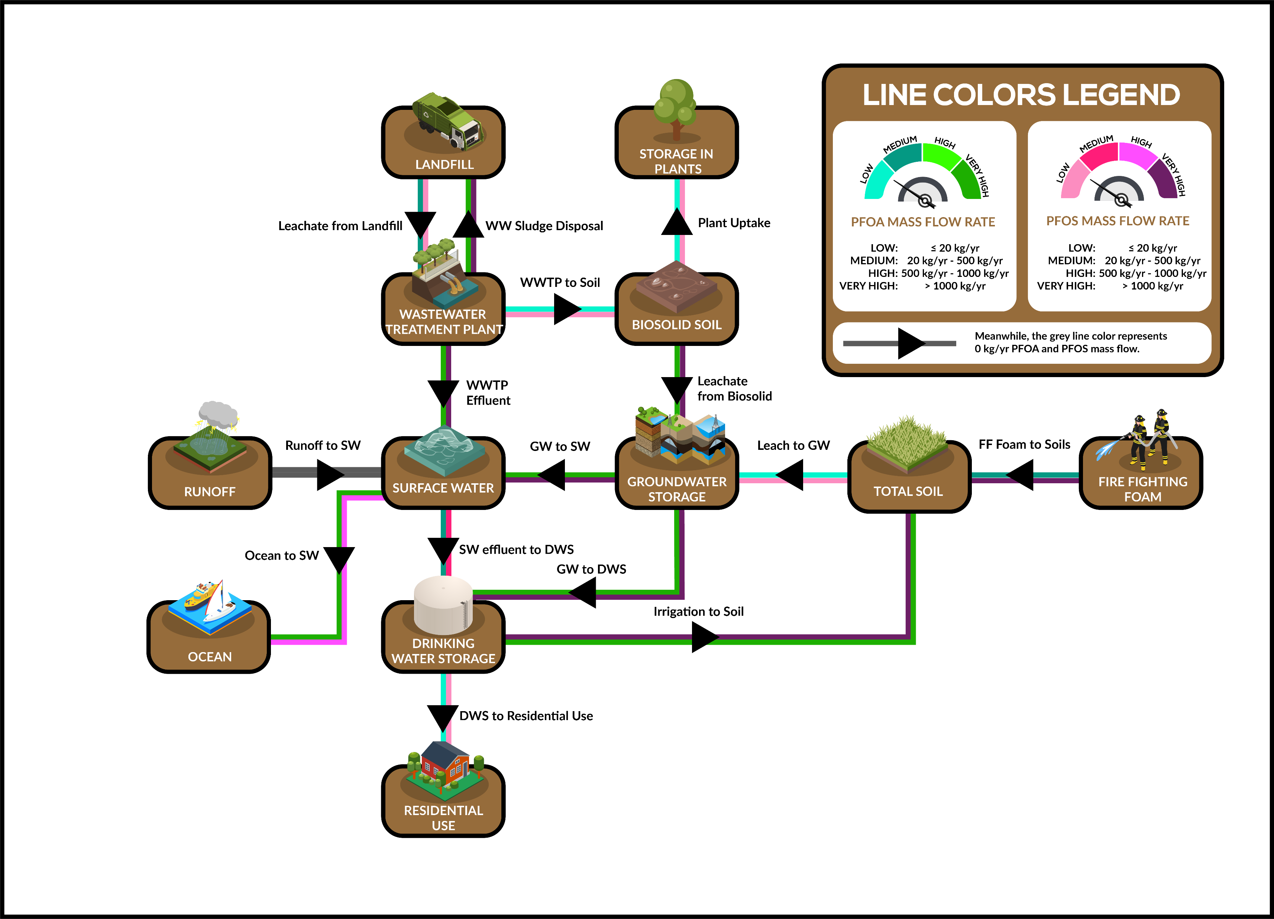
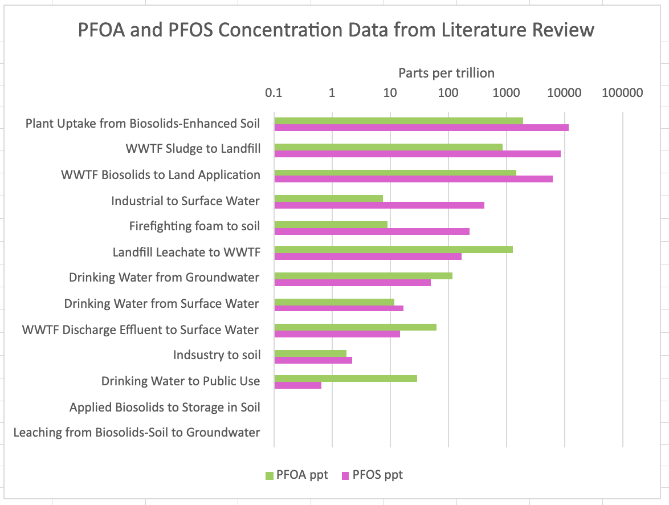
Quantifying the PFAS Cycle
Sara Murcko (PM), Gregory Bush, Garry Yapto
Project Sponsor: Harrison Roakes, PE (Sanborn Head) | Faculty Advisor: Dr. Jim Malley
Civil and Environmental Engineering Capstone
Introduction
Results
Figure 3: Chemical Structure of PFOA and PFOS
Per- and polyfluoroalkyl substances (PFAS) are a group of thousands of man-made chemicals used worldwide. Categorized as an emerging contaminant, they have become a considerable concern in many communities as attempts to remediate these persistent contaminants become more prevalent. It has become clear that PFAS are present in many locations and media, and that they have their own cycle throughout the environment. Since PFAS degrade minimally over time, identifying and quantifying where they may end up in the environment will help to provide context for future research, data collection, and regulation.
Perfluorooctanoic acid (PFOA) and perfluorooctane sulfonate (PFOS) are two types of PFAS contaminants that are focused on due to their abundance in the environment. While there have been numerous studies that have focused on PFOA and PFOS flow through specific sectors and specific locations around the United States, there are none that we are aware of that have attempted to quantify these chemicals across multiple diverse sectors and regions. Therefore, this project aims to establish mass flow values for PFOA and PFOS pathways in the United States as they move through the environment, such as from biosolids to farmland or firefighting foam to soils, through literature review of available data.
Acknowledgements
Thank you to Dr. Jim Malley, Dr. Paula Mouser, and Harrison Roakes for support and guidance throughout this project.
References
Numerous sources were utilized throughout this project, and are available upon request
Project Scope & Objectives
Collect existing data on PFOA and PFOS concentrations and flows in the environment
Build a quantitative model of PFOA/PFOS mass flow and long-term storage between major natural and man-made environmental sectors
Review this model for errors that can help explain data gaps and potentially inaccurate values found in our research.
Figure 1: PFOA and PFOS mass flow diagram
Not applicable
Results and Recommendations for Future Work
Not applicable
Methods
The top four greatest mass flows found included wastewater treatment sludge to landfills and wastewater treatment discharge to surface water, as well as irrigation and ground water to surface water mass flows.
This indicates that wastewater treatment plants are key managers of PFAS in the environment
The data gathered in this project are from widely diverse geographical locations and environmental sectors, and therefore each calculated and extrapolated value brings with it a high degree of uncertainty.
Establishing mass flows of PFOA and PFOS was challenging for the following reasons:
Concentration and flow data were often found to be from localized or specific studies; thus, it was difficult to extrapolate these data to be applicable on a national scale.
The magnitudes of flows (e.g., tons of biosolids landfilled per day) were difficult to estimate on a national scale because most of these statistics are not readily available.
Because the project necessarily focused on a simplified flow network and there is some uncertainty in the mass flows, we found that there were some cases where there are unexpected storage and significant missing links (e.g., industry and consumer wastes).
Figure 2: PFOA and PFOS Concentrations in parts per trillion (ppt)
Reviewed literature on PFAS fate and transport, and mass flow between significant environmental sectors
Extrapolated data found to magnitudes that represent the entire United States
Created a conceptual model of industries and sectors where PFOA and PFOS are found
Organized findings into a series of calculation worksheets
Built a quantitative model using Stella Professional to visualize mass flows and predict storage in sectors
There are multiple sectors missing from the model that are known to have an important impact on the PFAS cycle. More research on PFAS mass flow in/out of these sectors would likely reduce the number of data gaps. Known examples of these data gaps include the following:
Industrial/commercial releases to the environment
Non-leachate inflows to wastewater treatment plants
Residential/consumer product flow into landfills
Releases into the air from any source, and subsequent deposition into the known cycle
Data management was crucial in calculating the mass flows values. For future research, it is highly advised to plan in advanced by making a streamlined data sheet or utilizing a mass flow software. This will minimize any miscalculations and save time.

