Slide 1

Scada Design
Presented by: John Ward, Sam Goudreault, and Owen Baillargeon
Project Advisor: Dr. Nicholas Kirsch
Note: Audio has been imbedded into each slide for this presentation. Each audio file can be heard by clicking on the icon in the top left.

Slide 2
Abstract
SCADA systems are used throughout the field of engineering and utilities due to its monitoring and control capabilities of remote field devices. The goal for this project was to create our own SCADA system for UNH’s power grid and construct remote phasor measurement units (PMU) that would measure AC voltage directly from a wall outlet. This would allow us to determine the quality of power supplied around campus and provide instantaneous data to the SCADA operator via the created HMI SCADA screen. These remote devices were designed and programmed with cost effective raspberry pi computers. Although the group was able to record some of this continuous data from wall outlets across campus, the team was unsuccessful with transferring the data from the raspberry pi to the SCADA system. If the group was successful in transferring the data to the system, the SCADA operator would have access to information such as voltage, frequency, and other data in real time. The operator would also then be able to monitor, log and control the raspberry pi computers remotely. It was also possible to demonstrate the wide range of uses with this technology with additional temperature, humidity, and light sensing data to be collected that could be implemented in other facets of engineering.

Slide 3
Background
Supervisory Control and Data Acquisition (SCADA) is a computer system built for gathering and analyzing real time data, as well as issuing controls to field devices. SCADA systems utilize an operations control center for monitoring data sent through communication links that operators can utilize to control devices in remote substations, as well as receive and interpret the data remotely.
A phasor measurement unit (PMU) is a device that measures the voltage and phase of an AC signal. Using time synchronization provided by a GPS device, the PMU is able to capture samples of the signal and plot the waveform using angle and magnitude measurements creating synchrophasor data. With this data, the operator can look for abnormal waveforms between the AC signal and the synchrophasor indicating a potential problem occurring in the system.

Slide 4
Motivation & Goals
Electrical grids for SCADA systems aren’t providing real time data in terms of their power quality. This delayed response of information slows down response time to new changes in the equipment, lower customer satisfaction, and limits the information for the overall system. The team designed a phasor measurement unit (PMU) that would be plugged into wall outlets creating rapid data transfer from remote devices to the SCADA server. Instant data transfer would allow the SCADA system to be run on real time data and allow operators to better process and monitor their electrical grid for potential hazards. The team used UNH’s power grid to demonstrate the workings of a SCADA system. The PMU device was then placed into the electrical grid. From the HMI SCADA screen the operator could monitor any alarms for phase and magnitude among other parameters that would indicate a future issue on the grid. With the ability to actively monitor and track power quality along an electrical grid, electrical distribution companies would have a more efficient and informative SCADA system going forward.

Slide 5
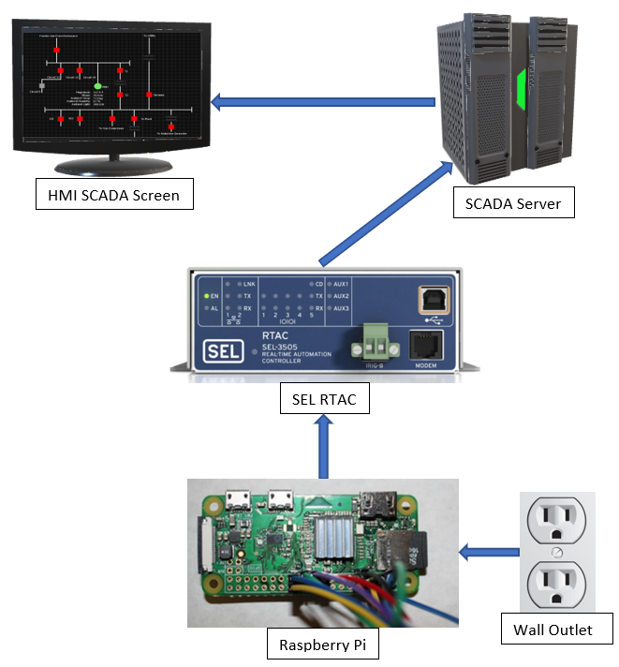
Overall Design - System
Our overall system consists of several main parts that work in conjunction with each other in order to measure, transfer, and display the data that is desired.
A Raspberry Pi is used as our main measurement device that will gain the readings of the electrical signal from the wall outlet.
A SEL Real Time Automation Controller (RTAC) is implemented to receive and convert the data from the Raspberry Pi so that it can then be successfully sent to the SCADA Server.
Finally, our HMI SCADA screen was designed to display the data sent in from the RTAC and issue alarms if the data was out of our set thresholds.

Slide 6
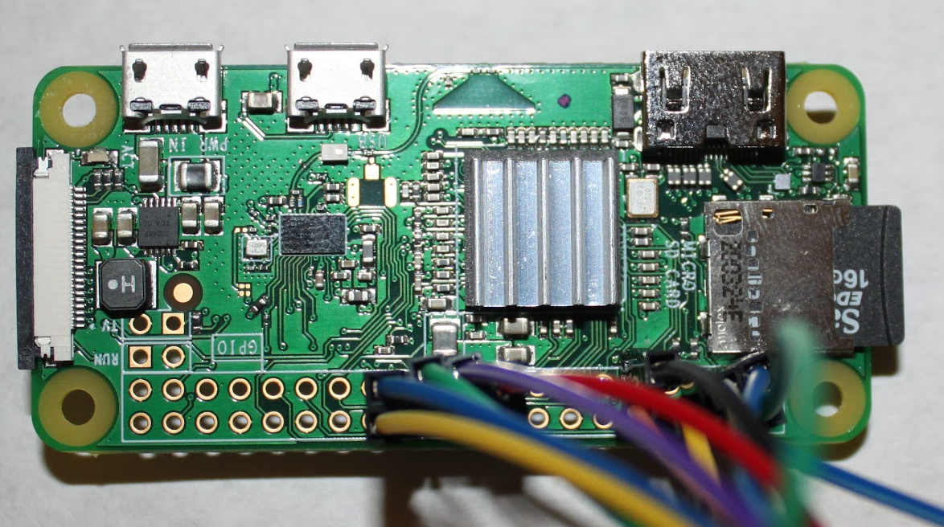
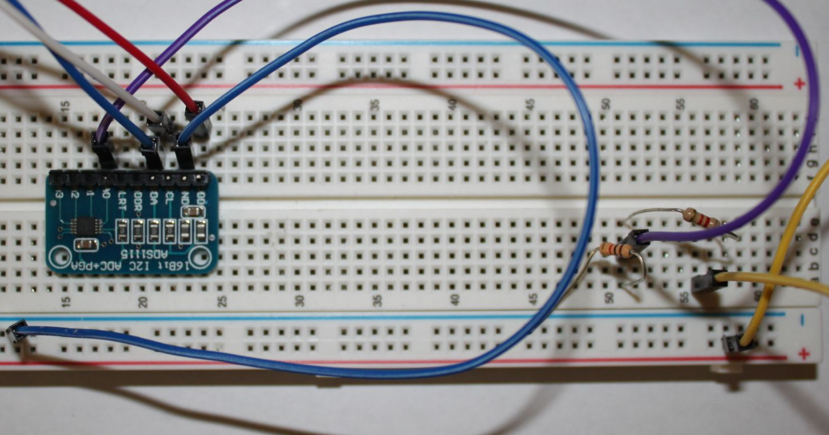
Overall Design - PMU
The PMU consists of four main components: an 18 volt power supply, a voltage divider circuit, an ADS1115 analog-to-digital converter, and a Raspberry Pi Zero W.
The wall outlet plug in power supply utilizes a power adapter transformer to convert the 120V AC, 0.2A, 60Hz coming out of the outlet to 18V AC, 500mA, 60HZ.
A voltage divider circuit, consisting of one 1 Kohm resistor and one 8.2 Kohm resistor, further drops the 18 volts from the power supply to around 2.6 volts with the purpose of not damaging the ADC.
The ADS1115 analog-to-digital converter changes the AC signal to a digital signal that can be processed by the Raspberry Pi.
The Raspberry Pi Zero W connects to the ADC via the GPIO I2C bus and processes the data to send to the RTAC.

Slide 7
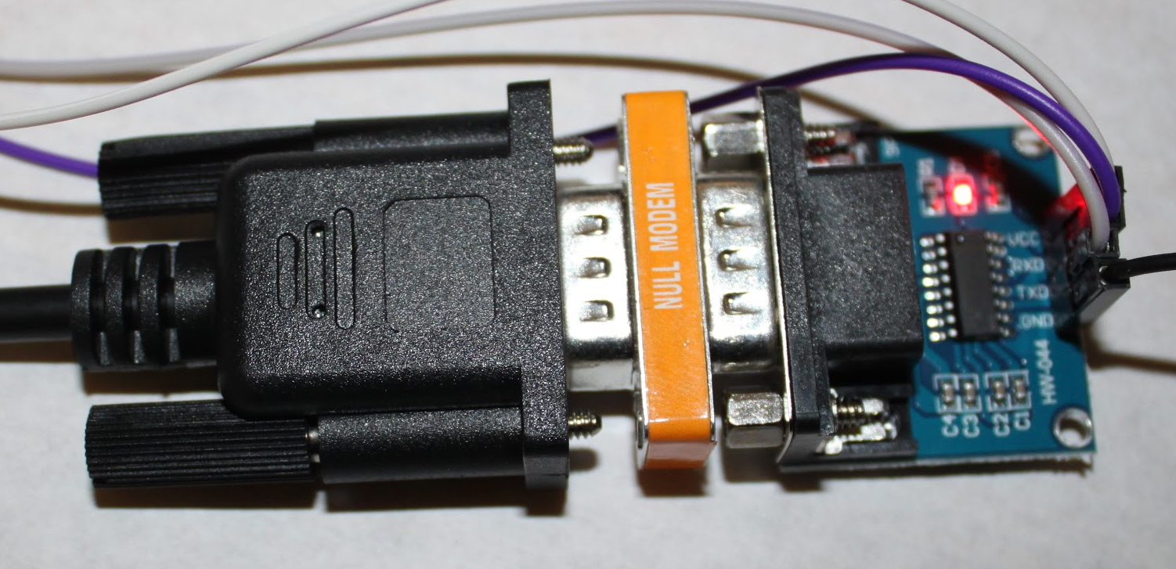
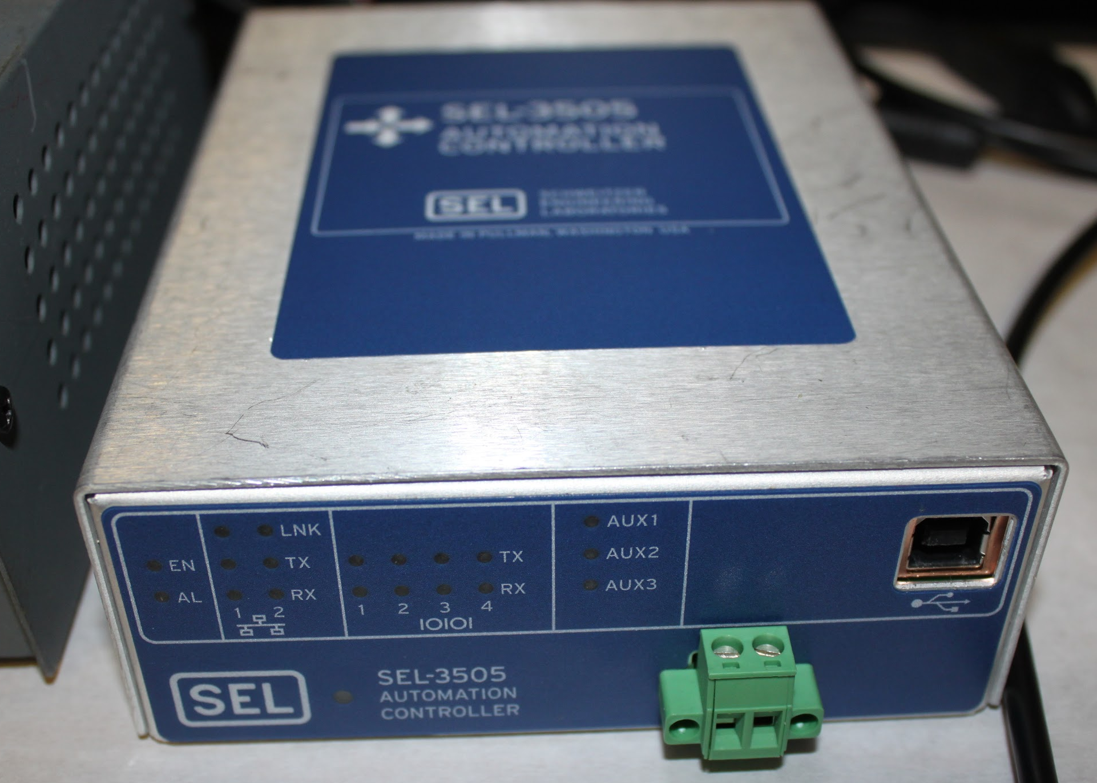
Overall Design - Communications
The communications aspect involves the SEL RTAC as the main piece of equipment, which was powered by a 13.8V power supply. This piece of equipment will be used to transfer data between the Raspberry Pi and the SCADA system.
A RS232 to TTL converter was used to transmit data from the Raspberry Pi to the RTAC over a serial connection.
This required a DB9 serial cable in conjunction with a Null modem adapter so data could be transferred successfully.
In order for the RTAC to send data to the SCADA server, a wired internet or cellular connection is required.

Slide 8
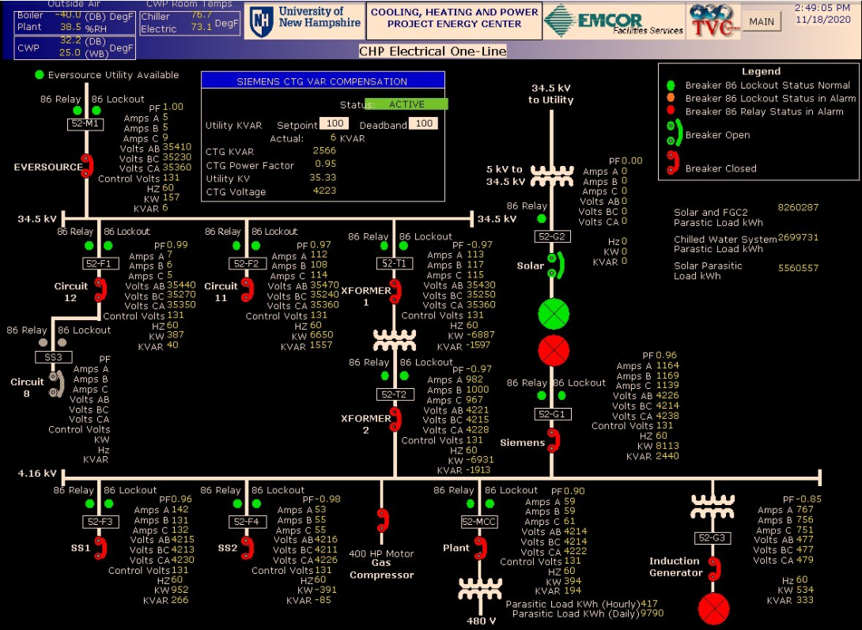
Overall Design - SCADA
Our own SCADA design was to be modeled and recreated after UNH’s current One-Line diagram that was provided.
Research showed that the placement of the PMU in one of our group member’s dorm rooms would reside on Circuit 11 of UNH’s system.
Considering this, our modeled SCADA screen includes the PMU at this location.
With the addition of more PMU devices, the inclusion of other circuits could be involved on the system.

Slide 9
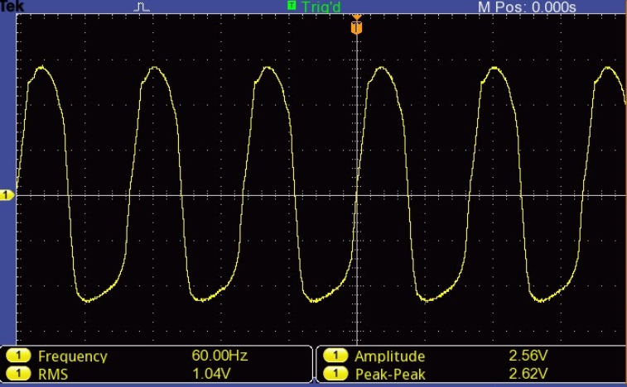
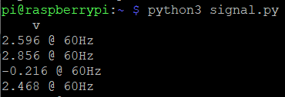
Results - PMU

Slide 10
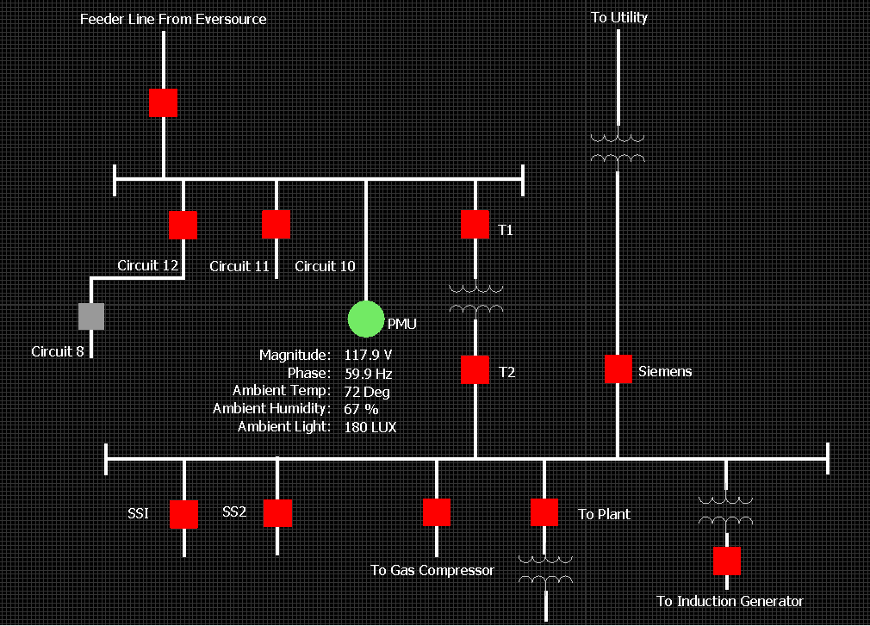
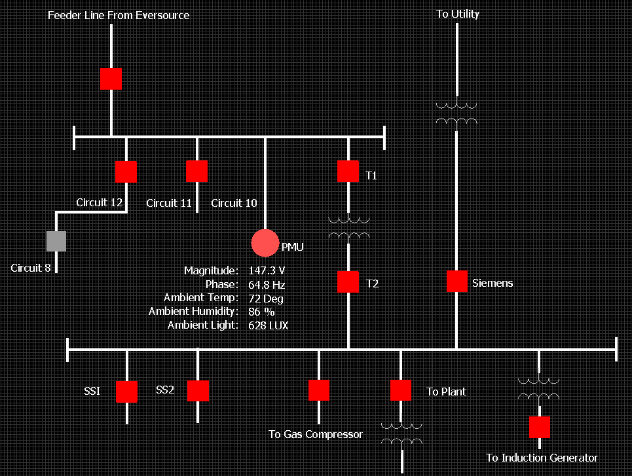
Results - SCADA

Slide 11
Conclusions and Further Development
Although the initial goal of implementing multiple phasor measurement units around UNH campus, sending data from the raspberry pi to the SCADA master was unsuccessful. This was due to the failure of transferring data from the Raspberry Pi to the SEL RTAC, inhibiting data from reaching the SCADA system. The group was able to construct the phasor measurement unit measuring voltage and phase from an AC signal. With more programming knowledge for data transfer, the original goal would have been met. Additionally, the implementation of the humidity, temperature, and light sensor could be added to the raspberry pi to demonstrate the broad range of uses for these devices.
For instance, HVAC systems could implement a similar device to measure the humidity and temperature of their vents. A light and temperature sensing device could be utilized for spark detection indicating a potential fire or for security, which can monitor break ins. Raspberry pi computers with monitoring devices sending real time data to SCADA systems could be implemented in any field or industry.

Slide 12
Credits and Acknowledgements
We would like to thank Unitil for the use of the SEL RTAC hardware and access to our SCADA system. We would also like to give thanks to Dr. Kirsch, our family, and friends for their overall support and guidance.

