Slide 1
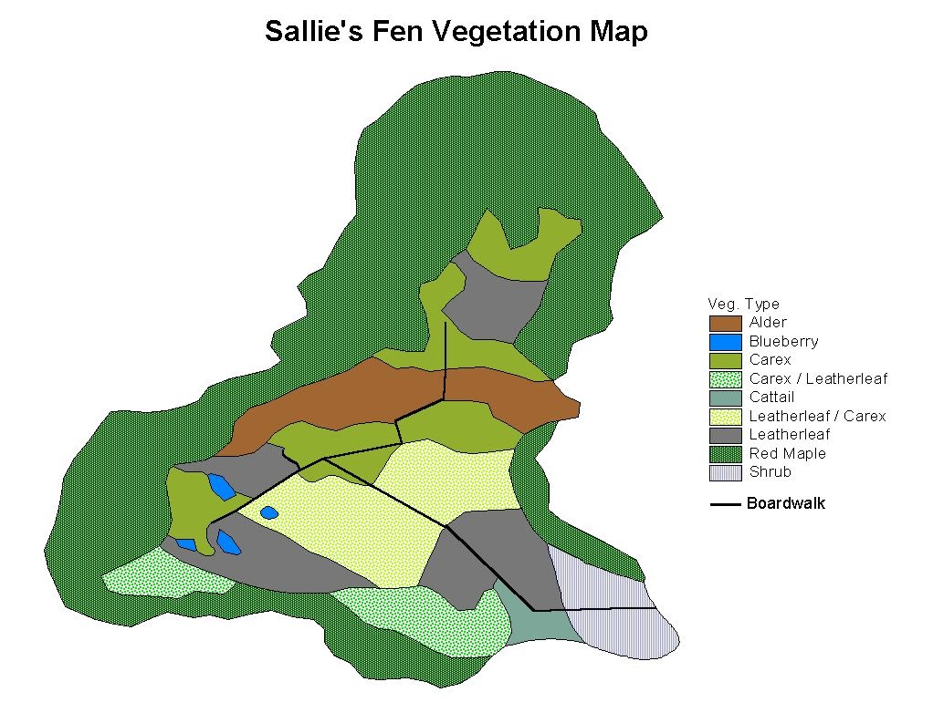
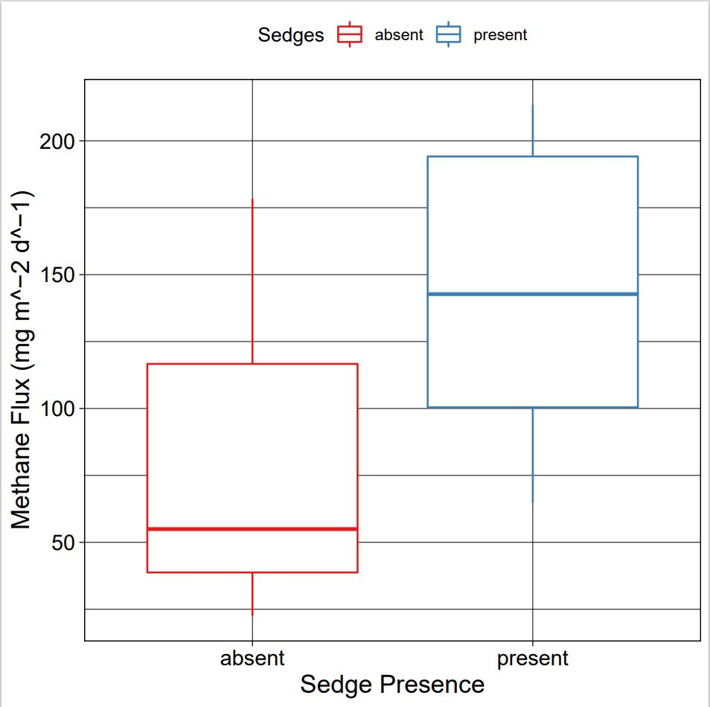
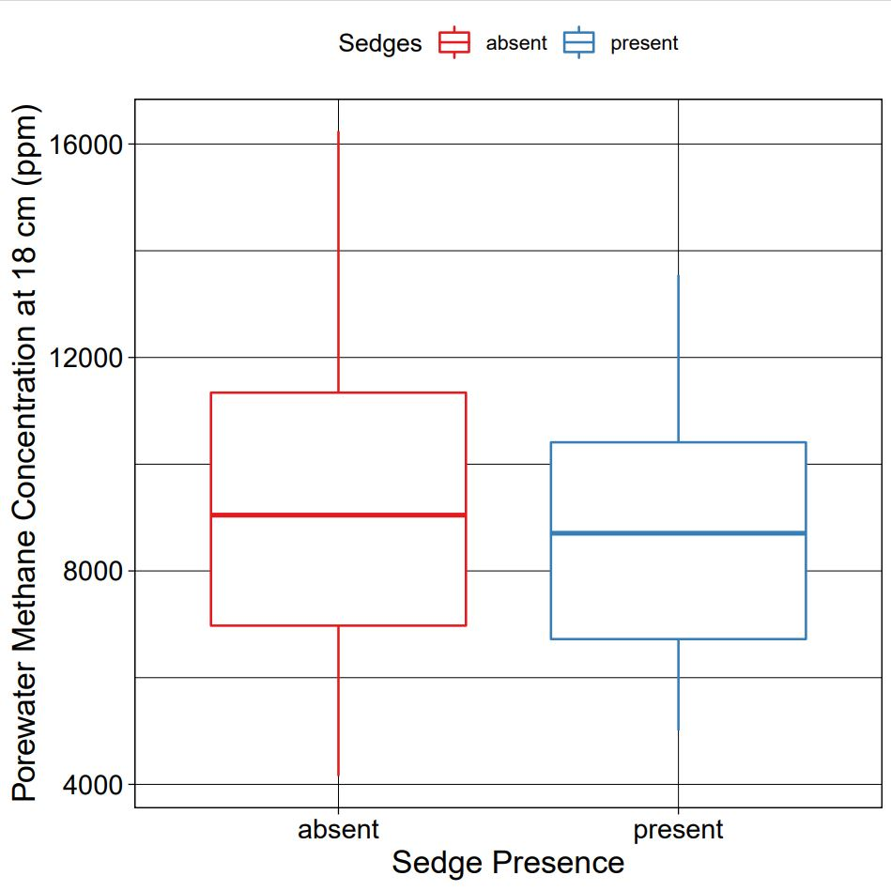
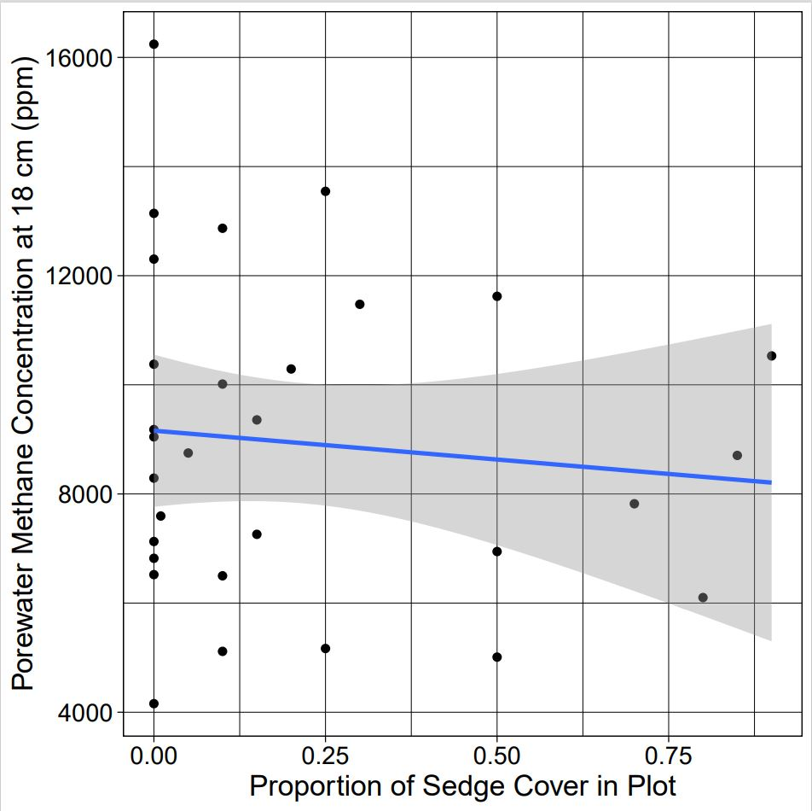
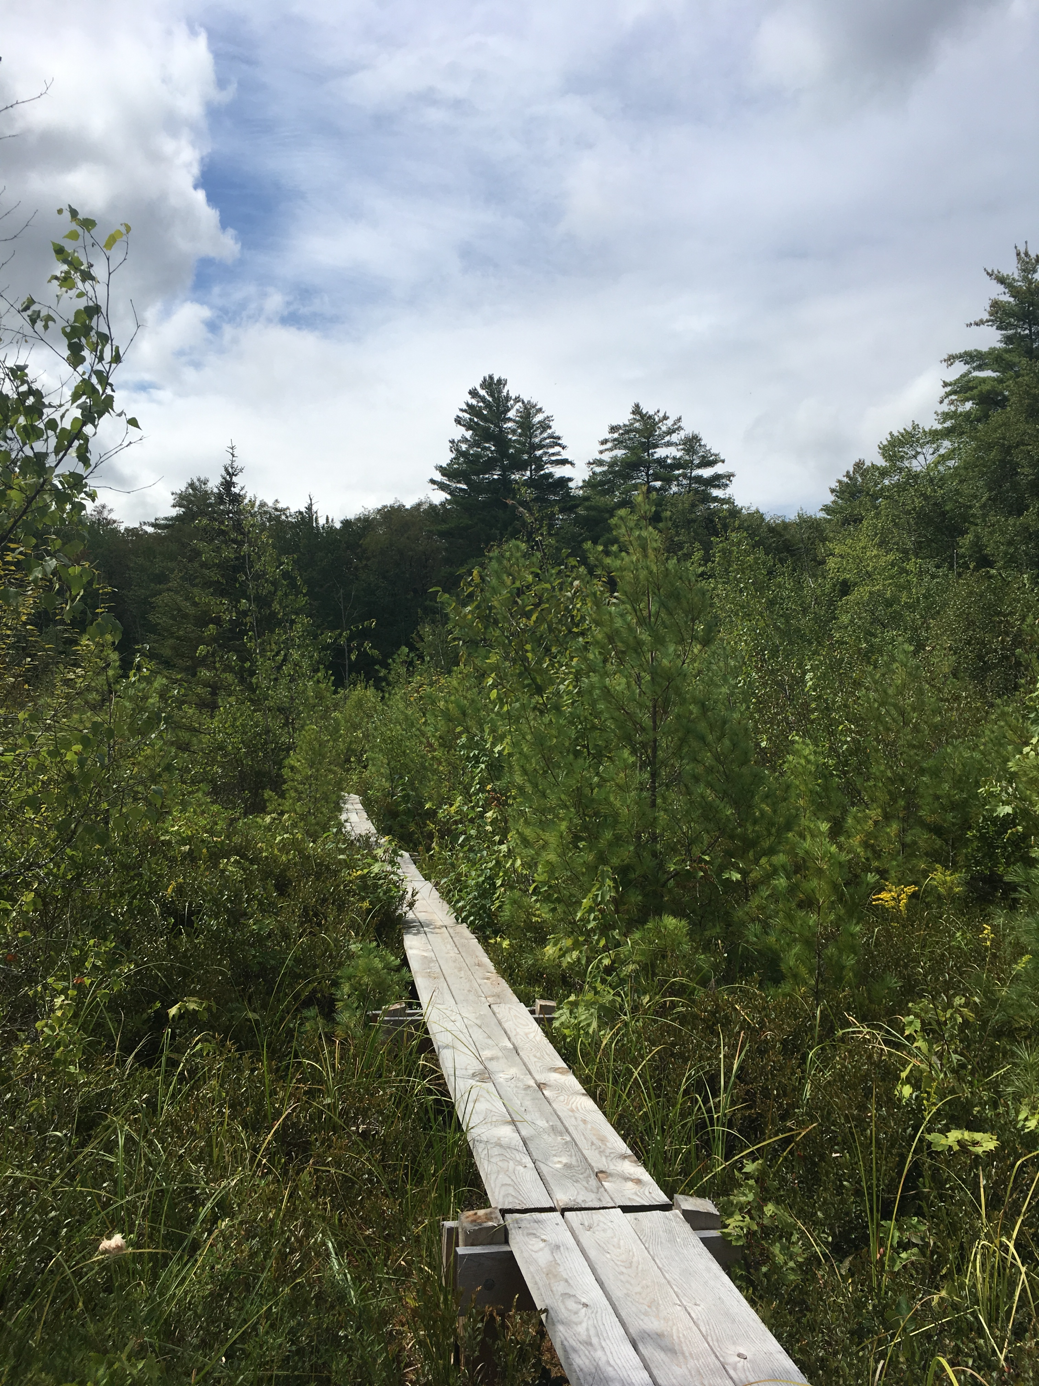
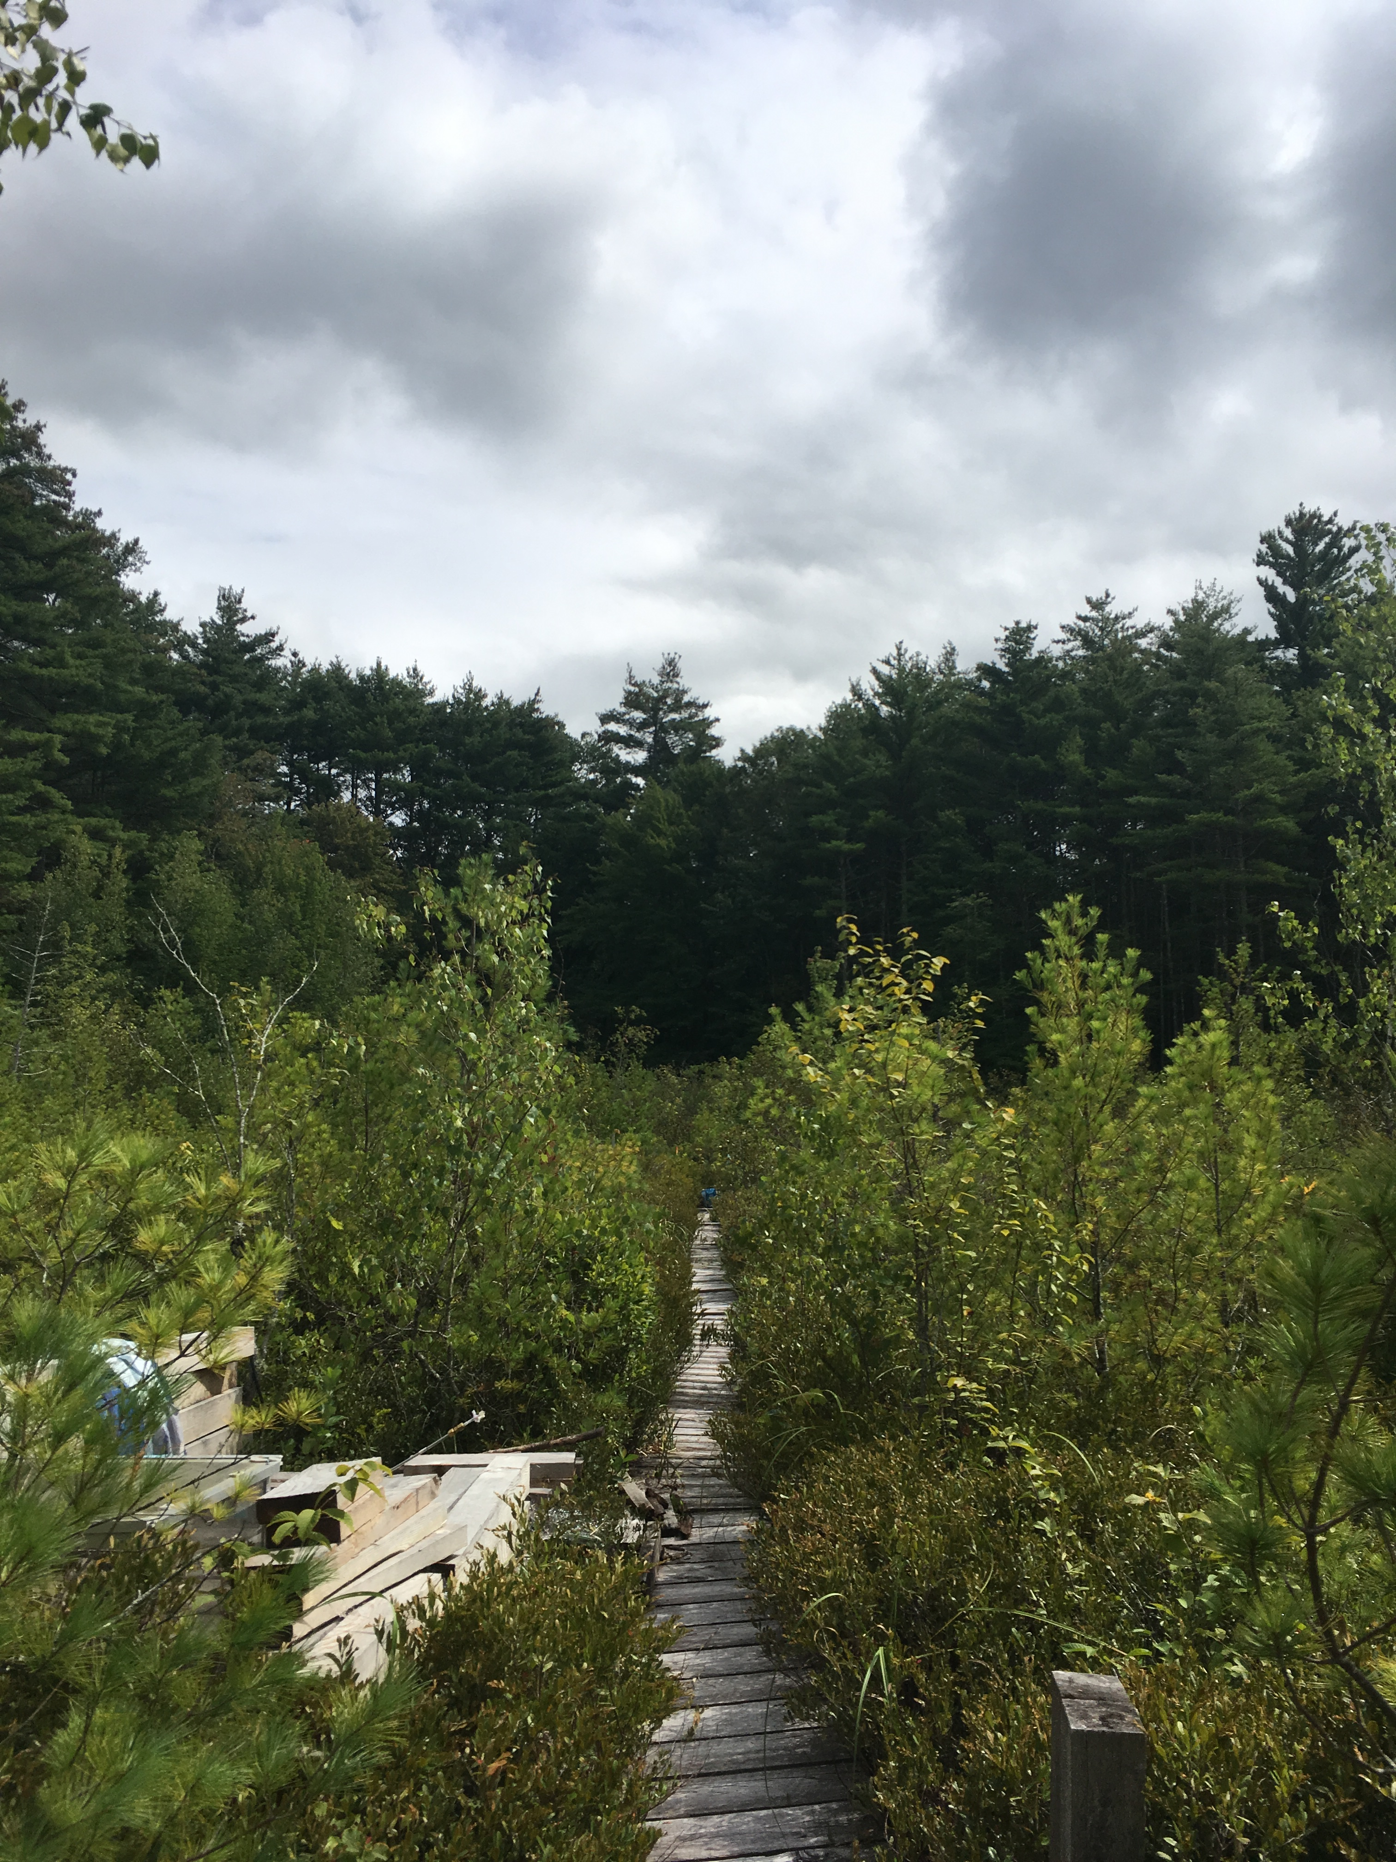
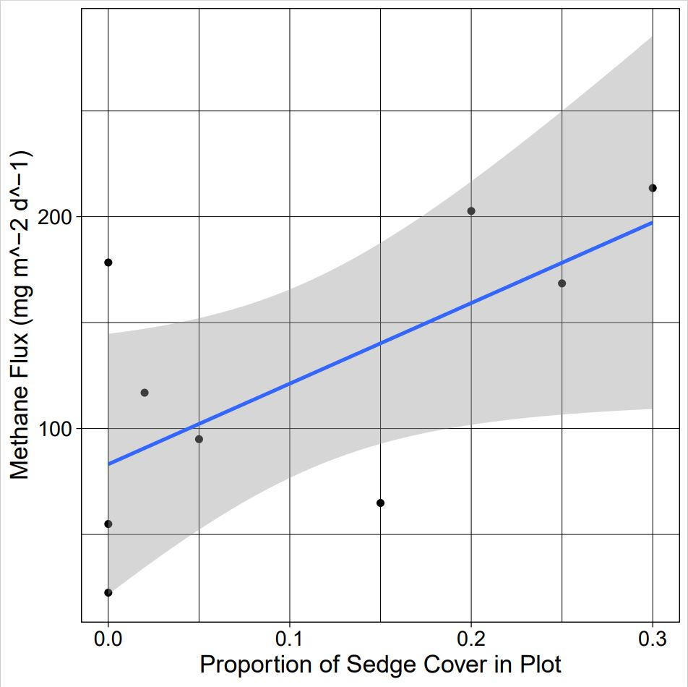
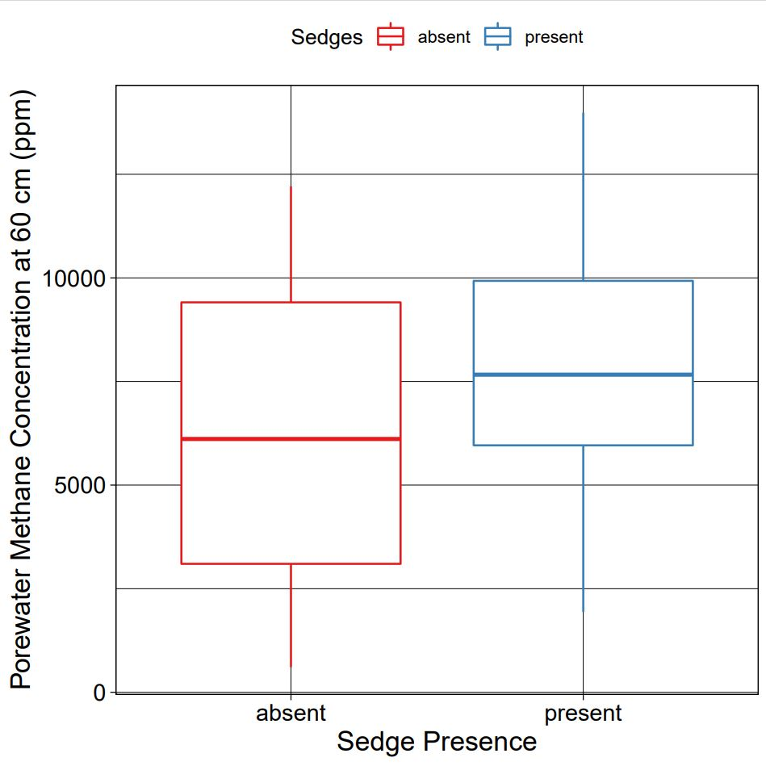
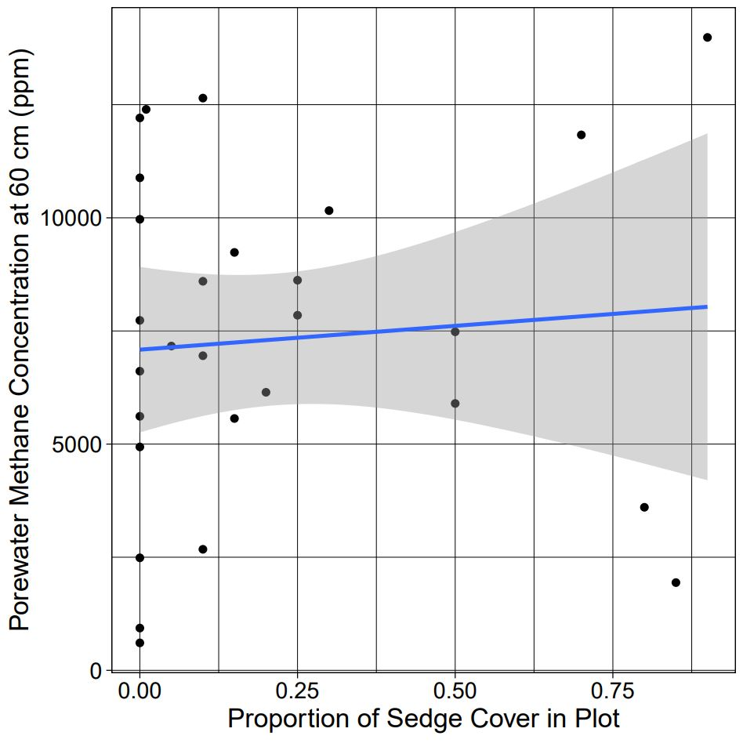
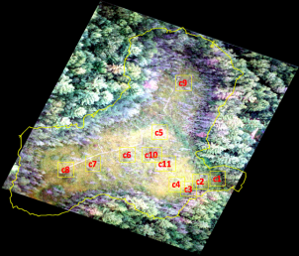
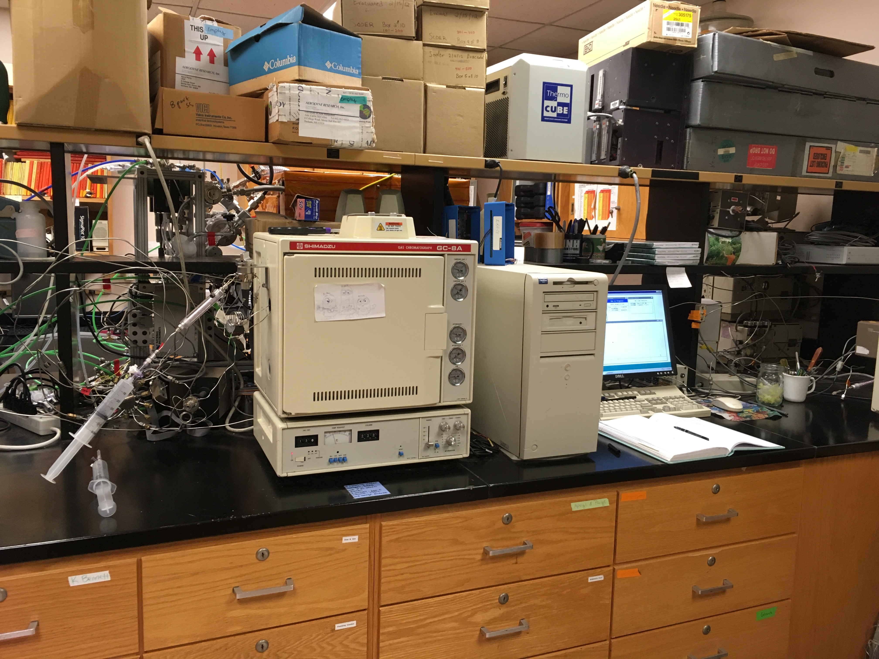
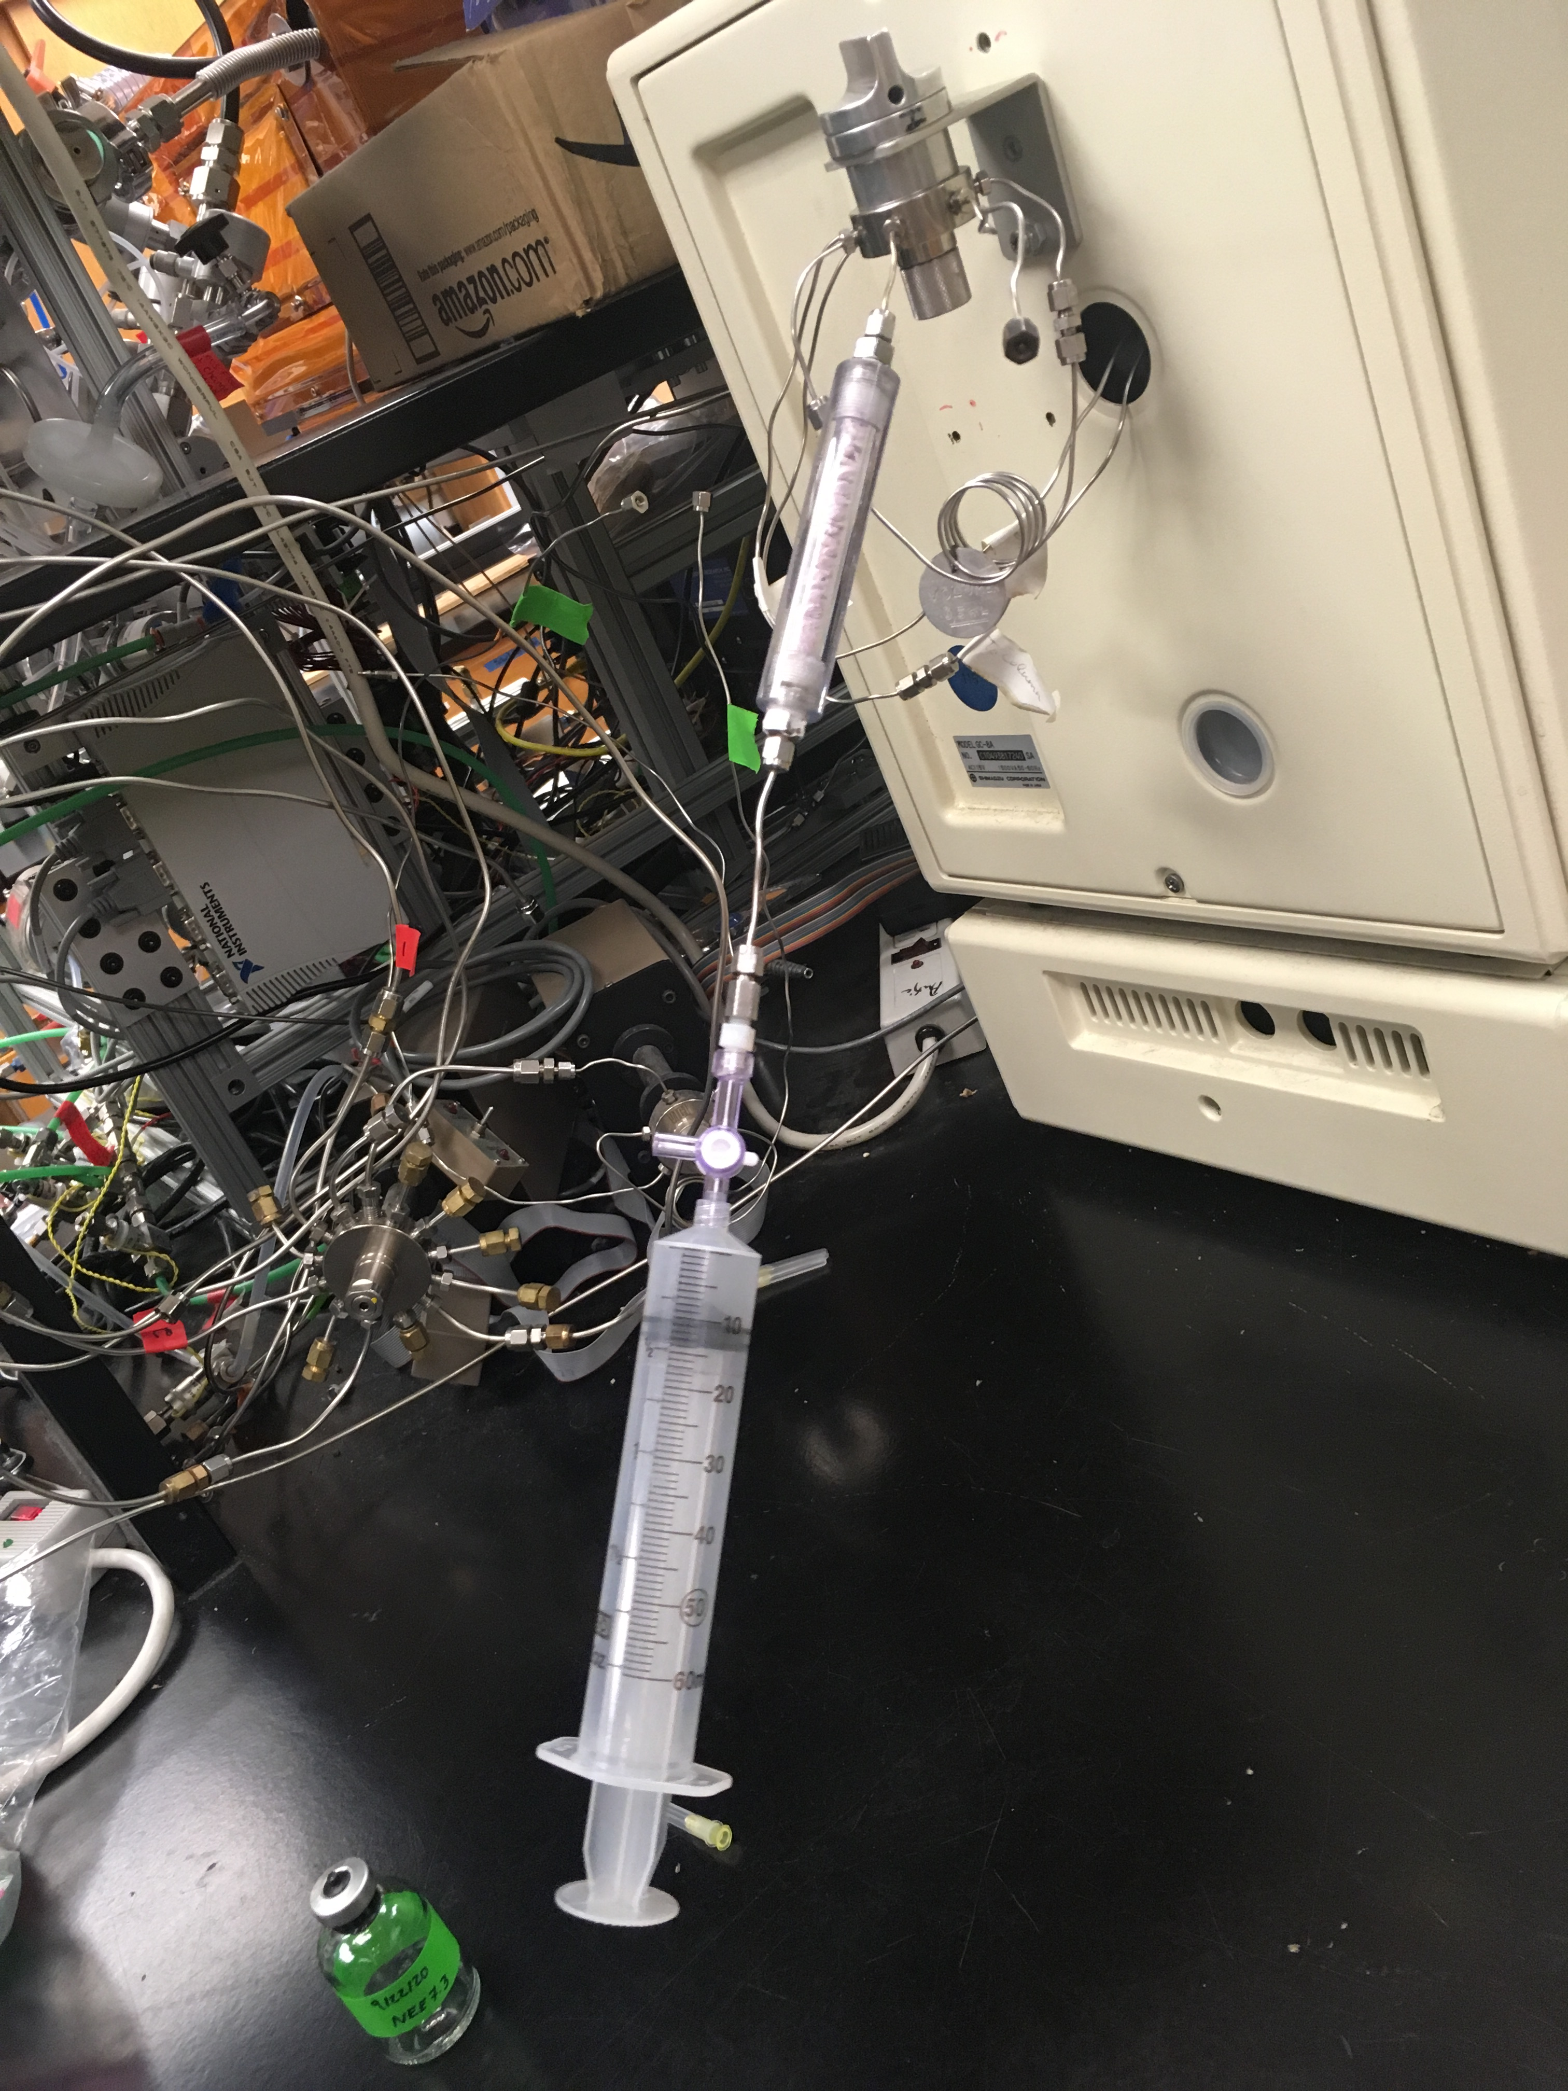
The Impact of Sedges on Belowground Methane Concentration and Emissions in a Temperate Peatland
Angelica Dziurzynski^{1,2}, Clarice R. Perryman^{2,3}, Ruth K. Varner^{2,3}
¹Department of Biological Sciences, University of New Hampshire, Durham, USA, ²Department of Earth Sciences, University of New Hampshire, Durham, USA, ³Institute for the Study of Earth, Oceans, and Space, University of New Hampshire, Durham, USA
Background:
Methane (CH₄) has a warming potential 32x that of CO₂ ²
Northern wetlands are a major source of atmospheric CH₄ ⁶
Emissions occur through diffusion, plant-mediated transport, and ebullition (bubbling)^{1,4}
Plant-mediated transport through sedges accounts for about 40-70% of CH₄ emissions⁴
Results:
Fig. 1. Vegetation map of Sallie’s Fen, Barrington, NH.⁵
Research question:
How does the presence and proportion of sedges impact CH₄ emissions and belowground CH₄ concentration?
Fig. 5. Average porewater CH₄ concentration (ppm) at 18cm grouped depending on the presence of absence of sedges and compared to the proportion of sedge cover within the collar site.
Study Site:
Sallie’s Fen, Barrington, NH (Fig. 2)
Temperate wetland with seasonal biological activity
Longest running emissions dataset in northern wetlands with over 30 years of data collection⁴
Dominated by Sphagnum spp. and vascular plants, including the sedge Carex spp.
Fig. 4. Average CH₄ emissions (mg⁻²d⁻¹) grouped depending on presence or absence of sedges.
Fig. 2. Sections of boardwalk at Sallie’s Fen, Barrington, NH.
Methods:
CH₄ Flux Measurements:
Weekly CH₄ flux measurements collected from 10 sites (Fig. 3)
Five 60mL headspace samples taken per site over 10 minute time period
Environmental Measurements:
Air temperature, temperature of sediment surface, and temperature 10cm below the peat surface were recorded
Porewater Measurements:
  Weekly porewater samples collected from surface (0cm) and at a depth of 10cm
  Used additional porewater data from previous SURF project³
Trace Gas Analysis:
Fluxes and porewater samples analyzed on a GC-FID
CH₄ flux calculations analyzed using R-Coding and Excel
Fig. 7. Average porewater CH₄ concentration (ppm) at 60cm grouped depending on the presence of absence of sedges and compared to the proportion of sedge cover within the collar site.
Fig. 6. Average CH₄ emissions (mg⁻²d⁻¹) compared to the proportion of sedge cover within the collar site.
Discussion:
Average CH₄ emissions were highest at chambers with sedges present
CH₄ emissions increased as sedge proportion increased
Average porewater CH₄ concentration (ppm) at 18cm was higher when sedges were absent
Average porewater CH₄ concentration (ppm) at 60cm was higher when sedges were present
Future Work:
CH₄ fluxes will continued to be measured this summer
Aerial map can be made to scale fluxes across the fen using vegetation data
CH₄ fluxes will be measured at inland water sites to better understand methane emissions as the climate changes
(a)
(b)
(c)
Acknowledgements: This work was supported by the Hamel Center for Undergraduate Research through the University of New Hampshire. Thank you to the UNH Trace Gas Biogeochemistry Laboratory for the use of their facilities. Special thanks to Dr. Ruth K. Varner for her guidance and mentorship throughout this project. Also special thanks to Ms. Clarice Perryman for her assistance with field work, lab sampling, and data analysis.
References: ¹Goodrich et al. (2011), Geophysical Research Letters.; ²Holmes et al. (2013), Atmospheric Chemistry and Physics.; ³Juffras et al. (2019), Presented at Undergraduate Research Conference.; ⁴Noyce et al. (2014), Journal of Geophysical Research.; ⁵Noyce, G. (2008).; ⁶Turetsky et al. (2014), Global Change Biology.; ⁷Varner et al. (2008), Presented at American Geophysical Union.
Fig. 3. (a) Map of static flux chamber locations at Sallie’s Fen,⁷ (b) headspace sample being analyzed on the GC-FID, (c) vacuum sealed vial containing sample and syringe.

