Slide 1

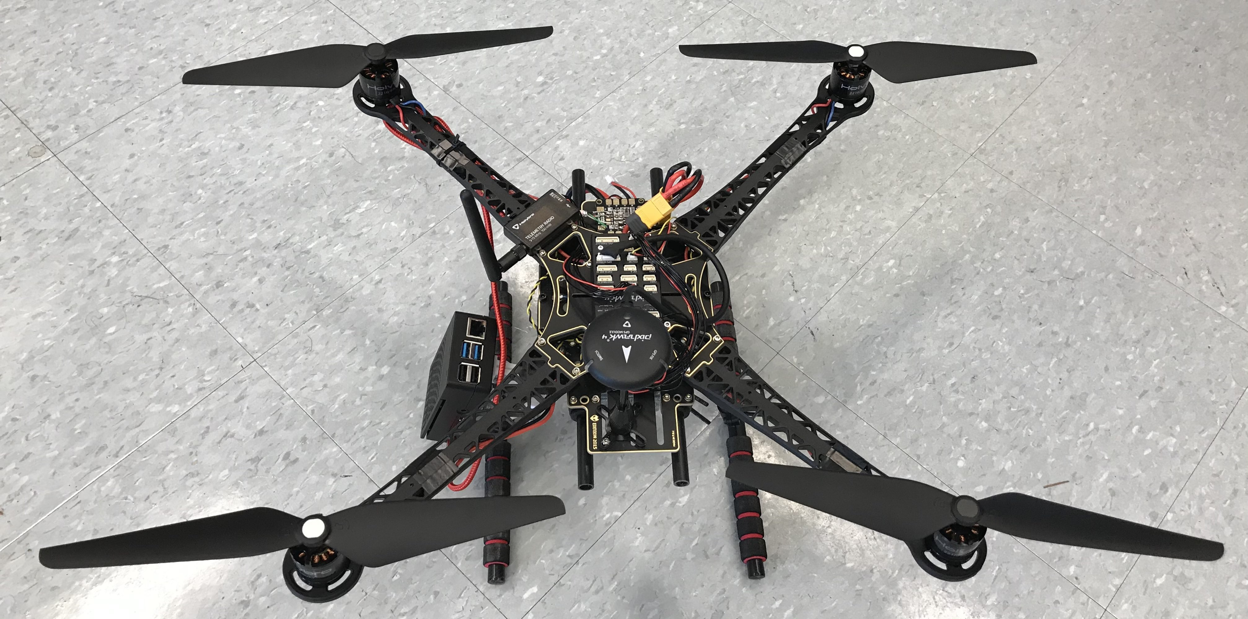
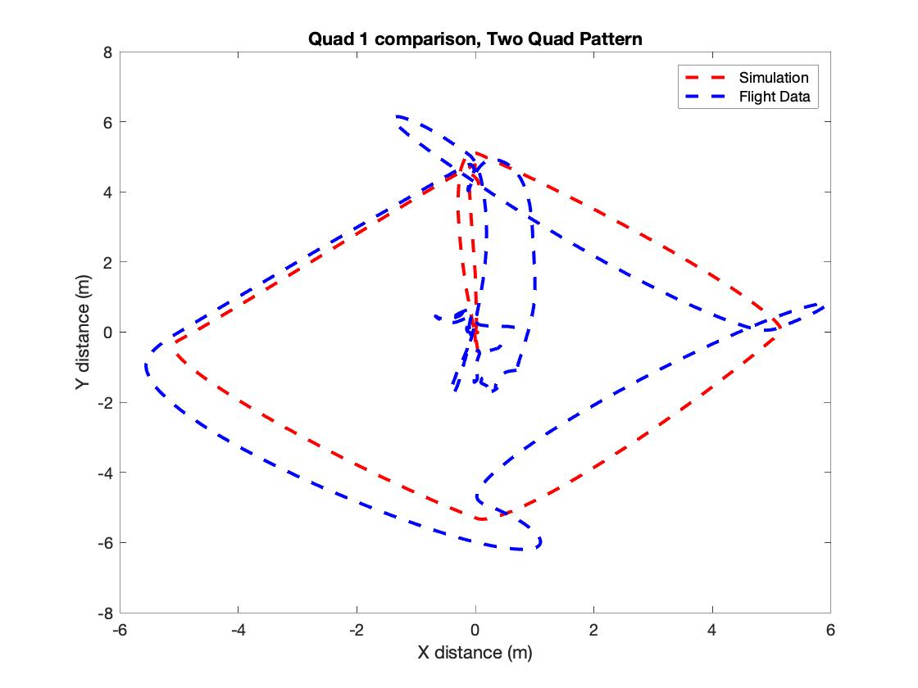
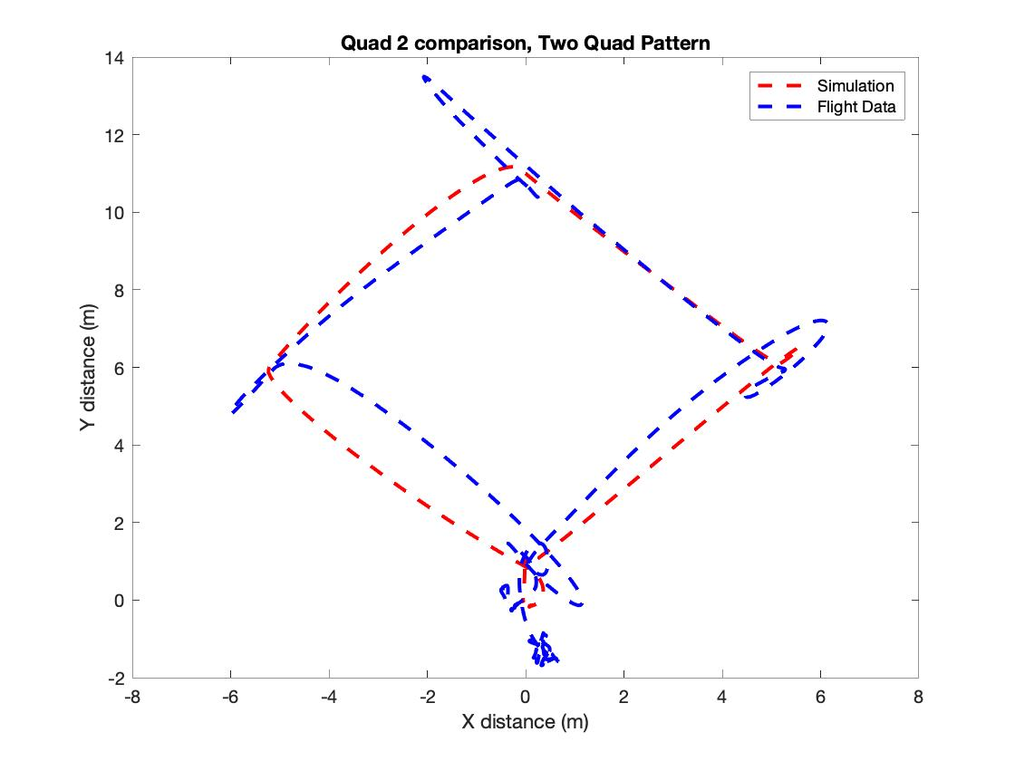

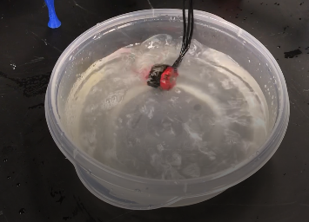
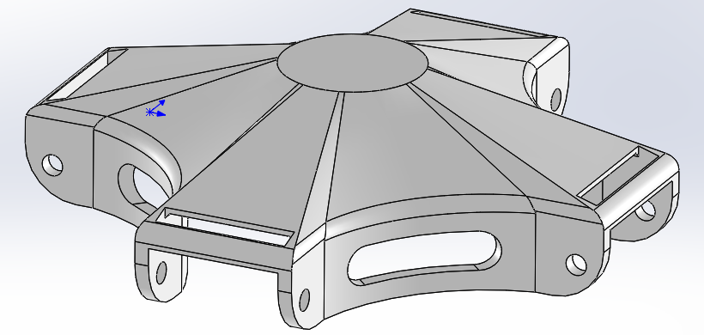
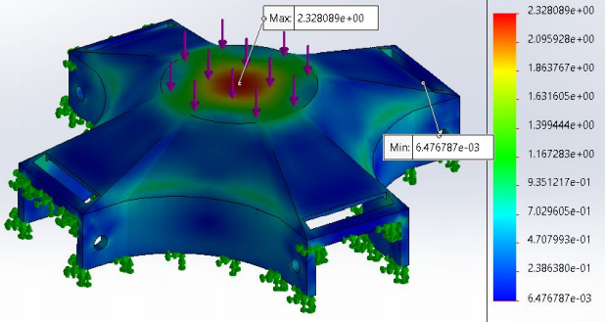
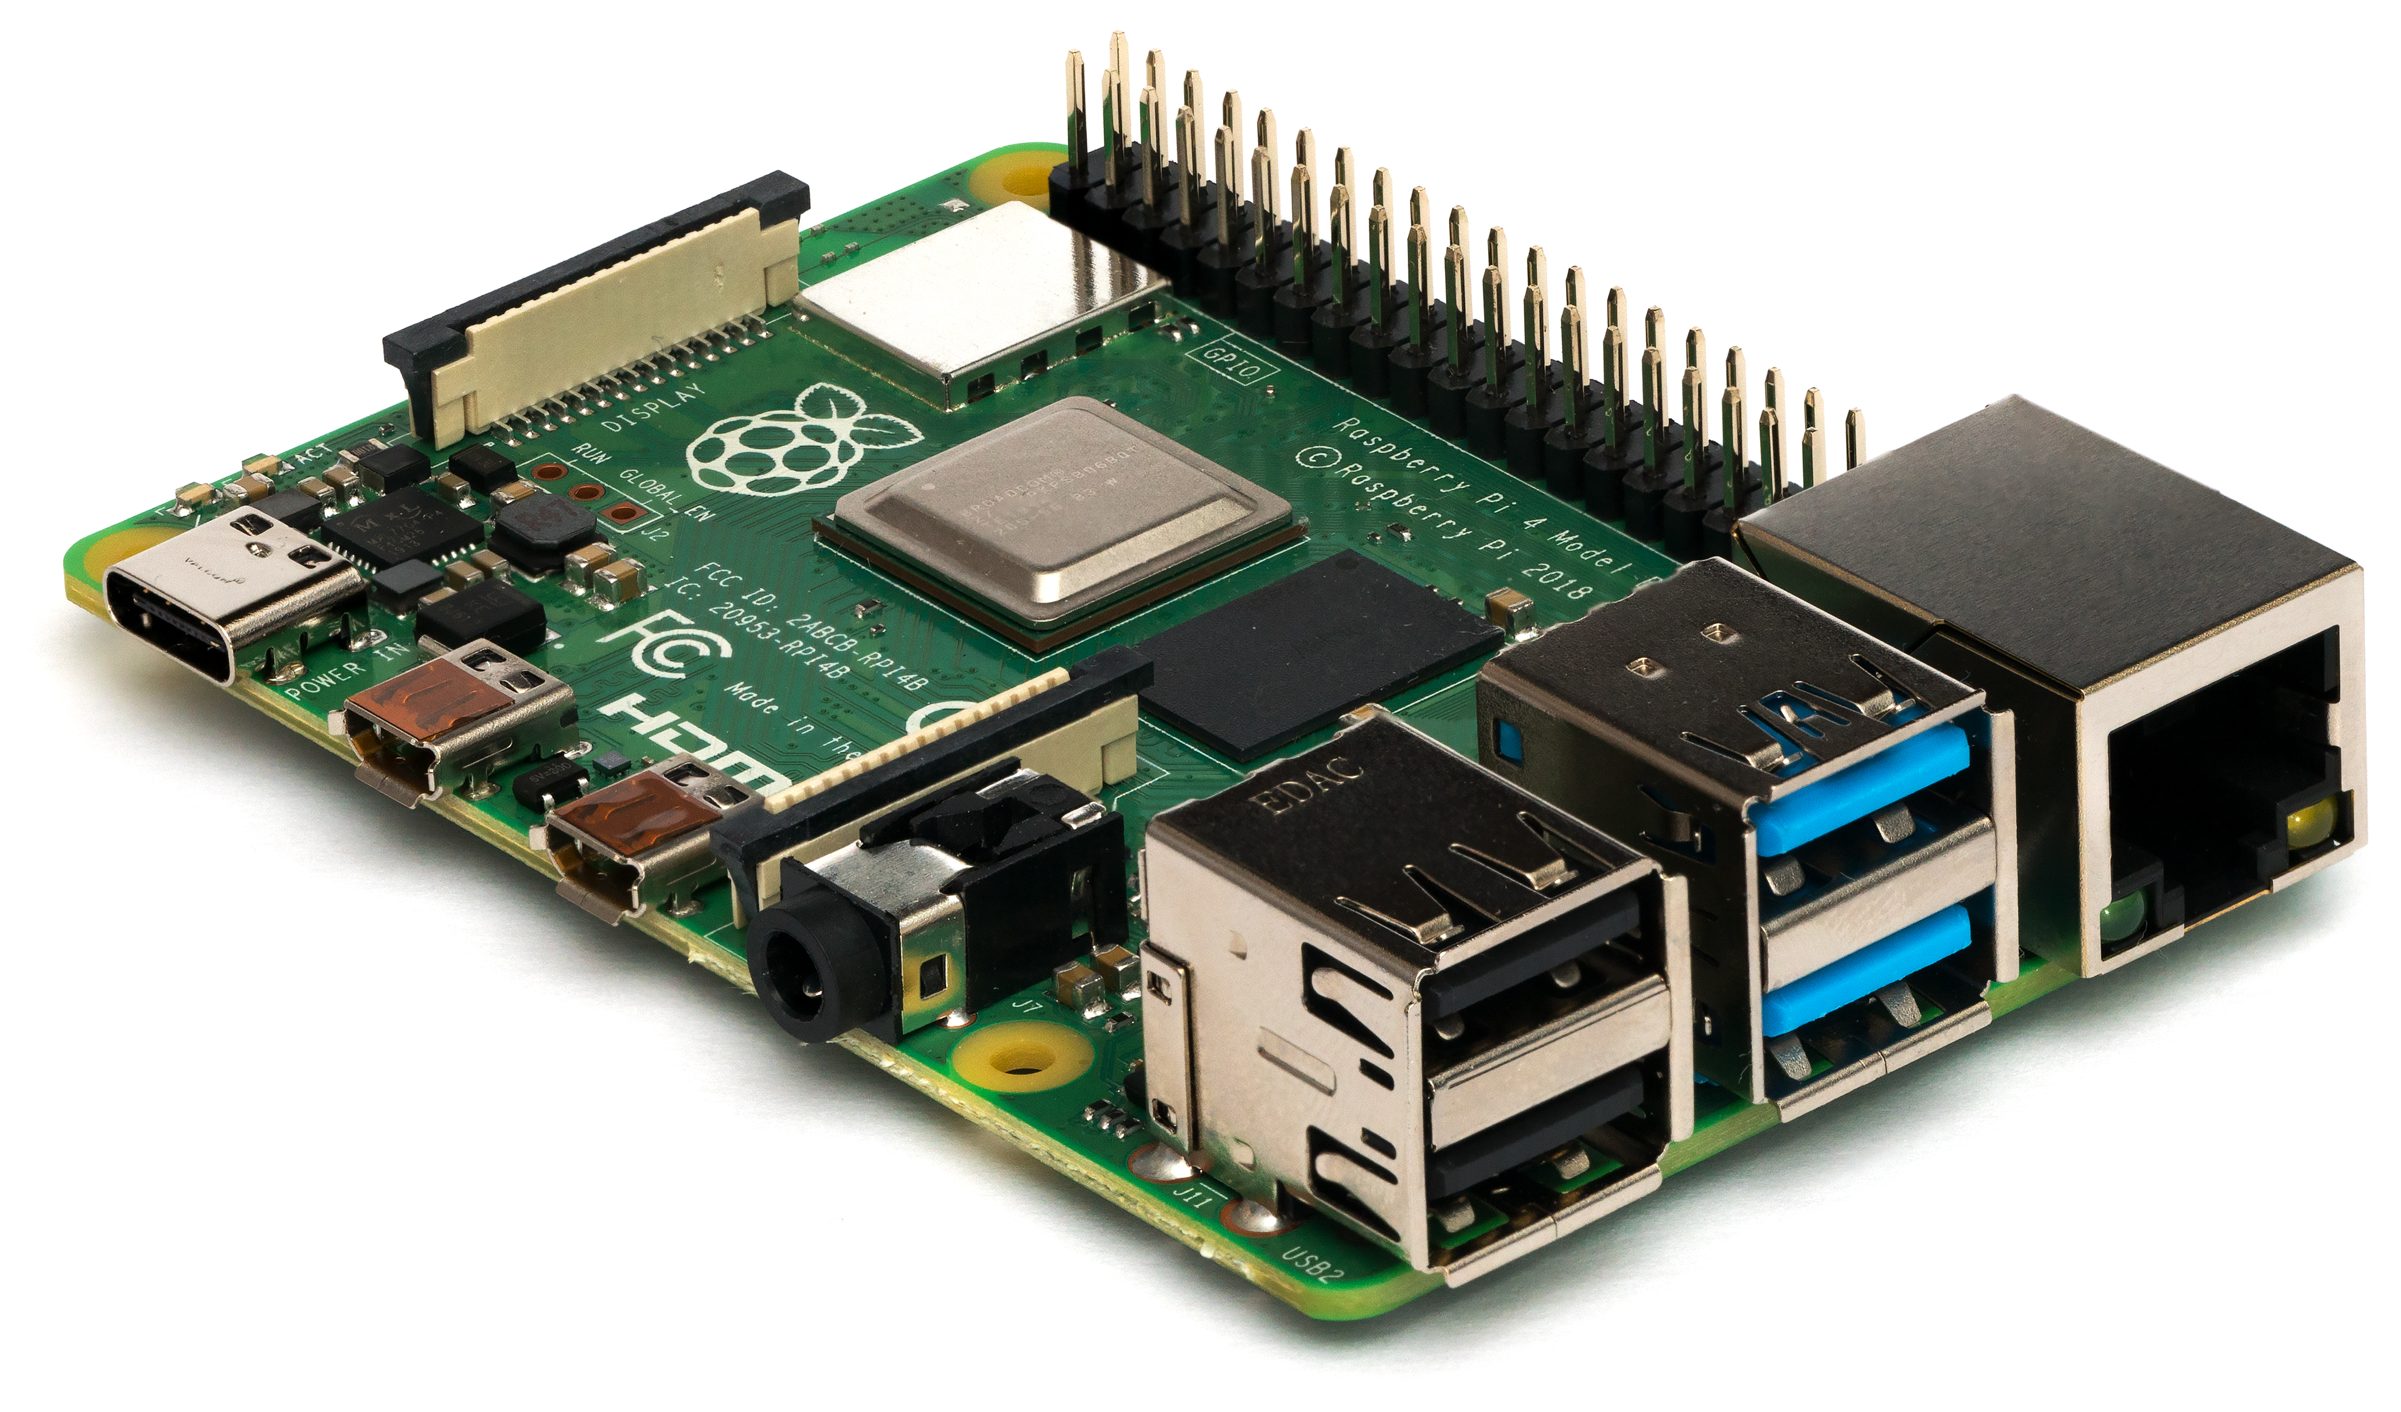
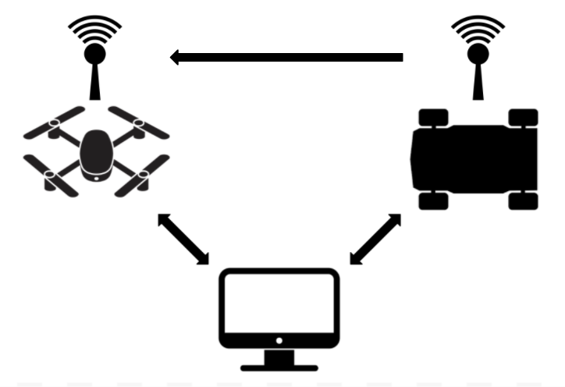
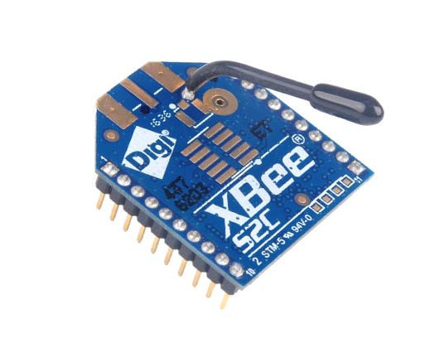
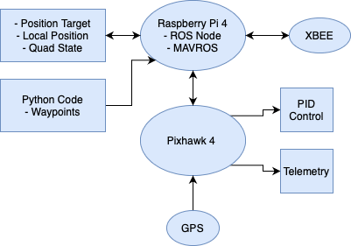
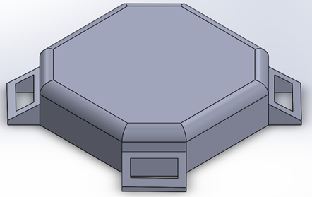
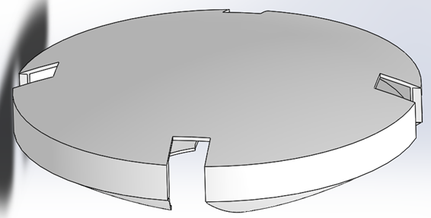
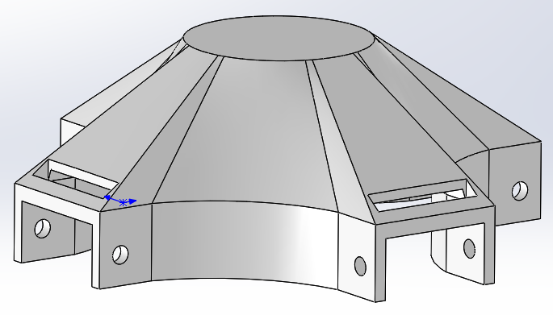
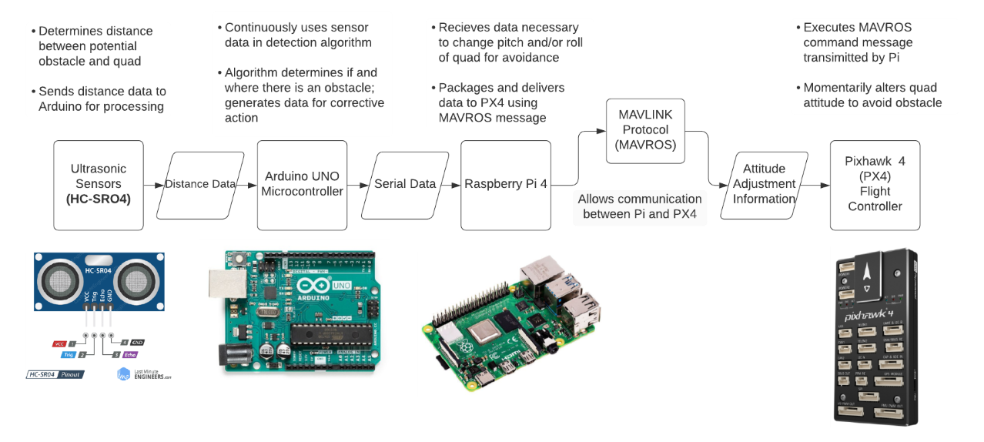
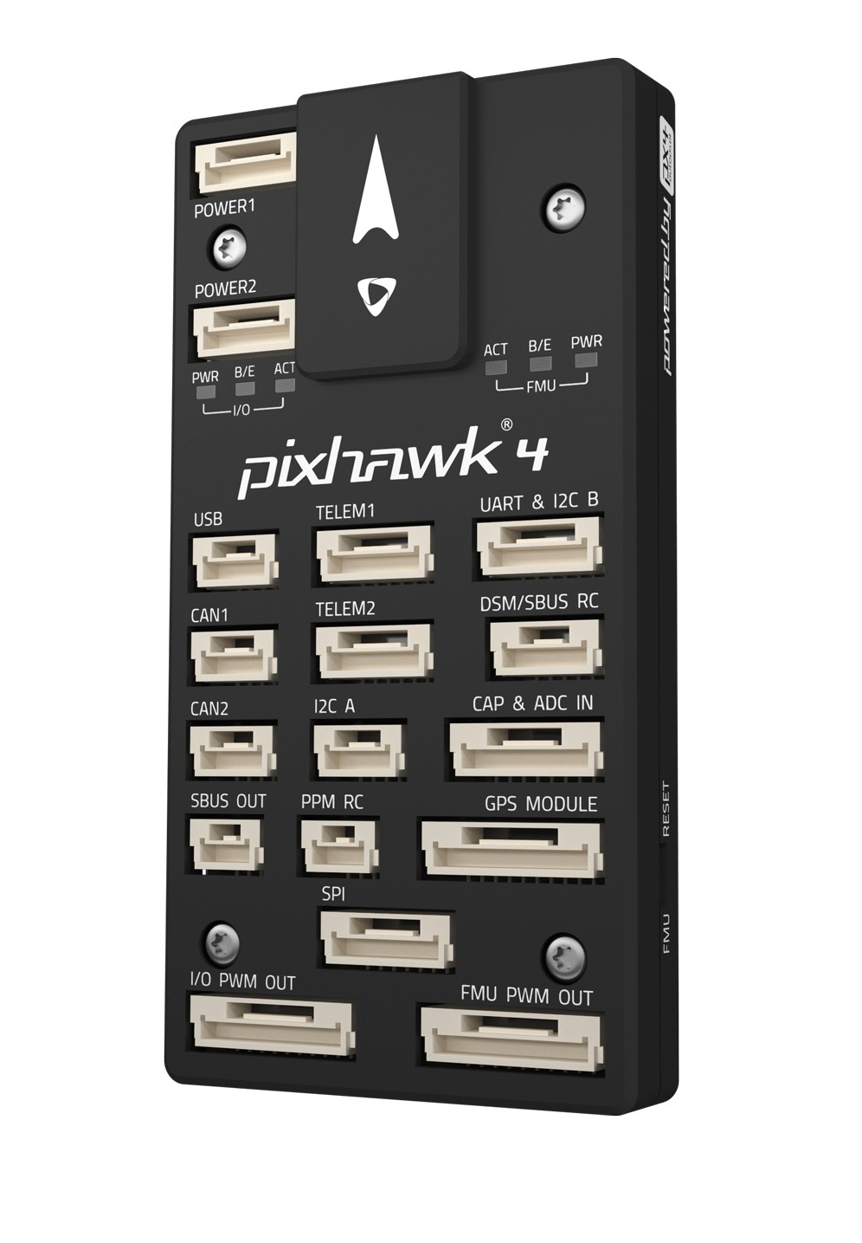
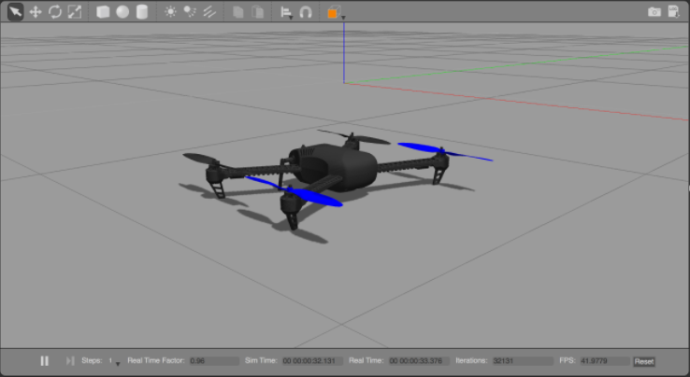
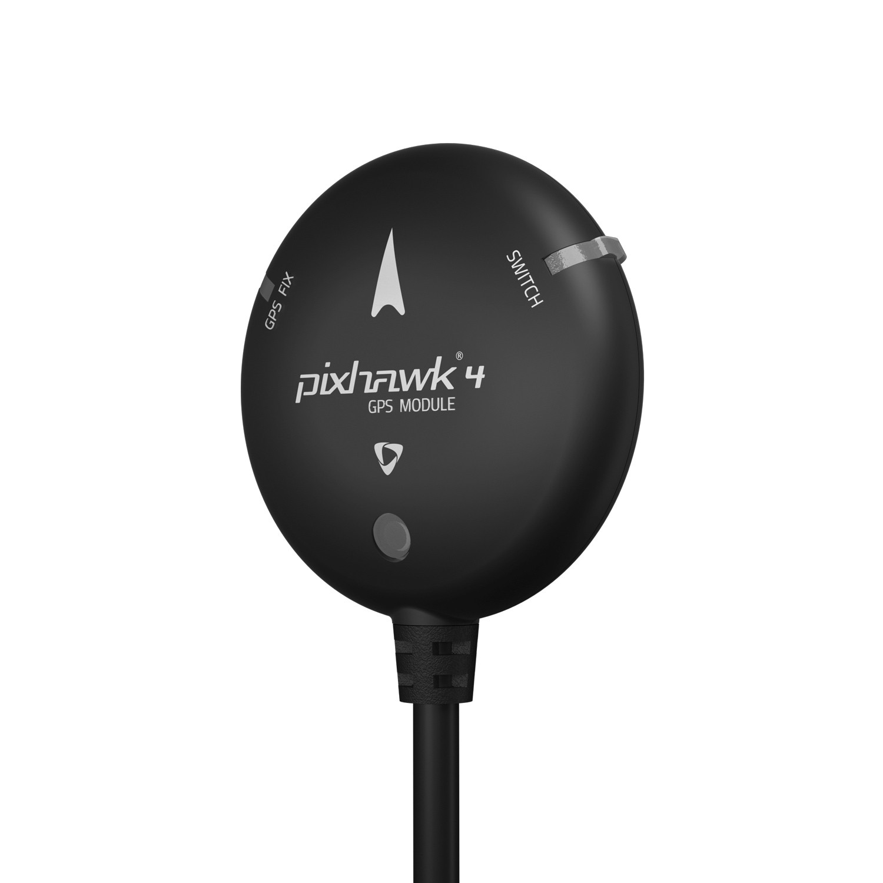
QuadX Swarm
Faculty Advisor: Dr. May-Win Thein
ME: Matthew Bowring, Griffith Comtois, Samuel Cranford, Tommy Cranmer,
Patricia Goodwin, Colleen Kelly, Devon Kraemer-Roberts, Shane Monahan, Michael Tung, Cameron Ugolini
CS: Noah Bonneau, Brandon Hanson, Timothy Underhill
EE: Bartlett Hooper, Andrew Nguyen, Christian Talmo, Jeffrey Wansley III
Project Overview
Swarm Formation and Control
QuadX Swarm is an interdisciplinary project which aims to create a swarm of durable
quadcopters capable of autonomous flight. Additionally, the team assists in graduate
research pertaining to particle swarm optimization and unexploded ordnance searches.
By splitting into two subgroups, this year's team aims to accomplish the following
goals;
Make It and Break It
Improve the robustness of the quadcopter to ensure that all electronics and instruments remain safe in the instance of a rough landing or crash.
Ensure that the quadcopter is capable of operating in inclement weather such as rain, sleet, or snow.
Communications/Controls
Complete autonomous multi-quad missions that are programmed in Python using the Robot Operating System (ROS) and run using an on-board Raspberry Pi and Pixhawk flight controller.
Scripted autonomous flight for multi quad missions
Adaptable search algorithm
Simulated data using Gazebo
Make it and Break it
Completed autonomous mission with two quads
Design Criteria
I. Payload does not exceed 125g threshold
II. Flight accuracy is not hindered (resultant drag)
III. Provide impact protection up to 10 meters
IV. Electronics are water resistant
V. Shell does not cause overheating issues
Robot Operating System (ROS)
Open-source middleware suite for robotic software development
Uses MAVROS; an extendable communication package for devices running ROS
Multi-Vehicle Communication
Final Design - 110g
Digi XBee Radio Units and SSH
Transceiver:
Ground Robot
Initial Designs
Receiver: Quadcopter
Collision Avoidance
Simulation Environment
Our simulation environment was implemented using a combination of ROS, Gazebo, PX4, and Python programming within a virtual machine.

