Slide 1
Learning to Teach: What Do Prospective Mathematics Teachers Learn from Reflecting on Video Recordings of Their Own Classroom Teaching?
Sophie Brisard

Slide 2
Introduction
Problems that prospective teachers face:
  Minimal classroom experience while obtaining their degree in education.
  lack practice in linking pedagogical knowledge from the universities and actual classroom practice.
  do not have a good sense of what aspects of classroom practice to pay attention to.
Possible fix - digital recordings of a classroom:
  Helps teachers better learn what to notice in a classroom
  Helps prospective teachers connect their university knowledge of teaching to classroom experience.
  Research suggest that analyzing a video recording of one’s own practice can help prospective mathematics teachers learn to become better teachers.

Slide 3
Research Questions
What do prospective secondary teachers notice when they watch digital recordings of their own teaching?
What exactly do they learn in the process of reflecting on their teaching?

Slide 4
Teacher Noticing
  General Definition: Act of observing or recognizing something (Cambridge Dictionary).
  Teacher Noticing: “the process through which teachers manage the ‘blooming, buzzing confusion of sensory data’ with which they are faced, that is, the ongoing information with which they are presented during instruction” (Mason, 2011)
  Promotes adaptive and responsive teaching (Luna et al.)
  Influenced by several different factors (Luna et al.)
    Prior experience
    Context

Slide 5
Data
9 Prospective Teachers enrolled in MATH 797: Senior Seminar in 2019
Each Prospective Teacher had . . .
  50-minute digital recording of them teaching a group of students from a local high-school
    360° camera to capture both the teacher and the students
  Written comments made by the PSTs while watching the video recordings
  Implementation report on their teaching
  End of semester essay summarizing the course experiences

Slide 6
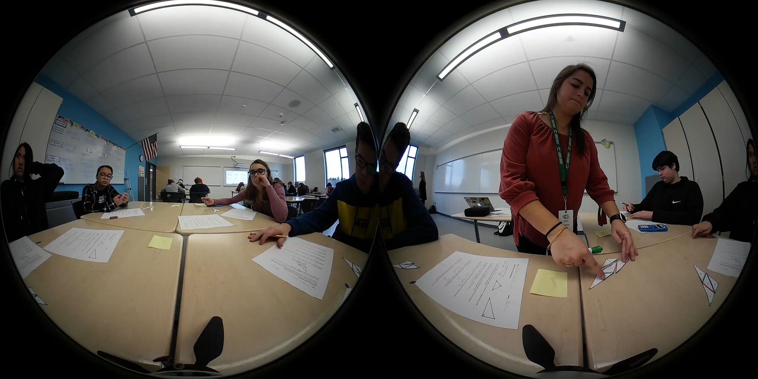
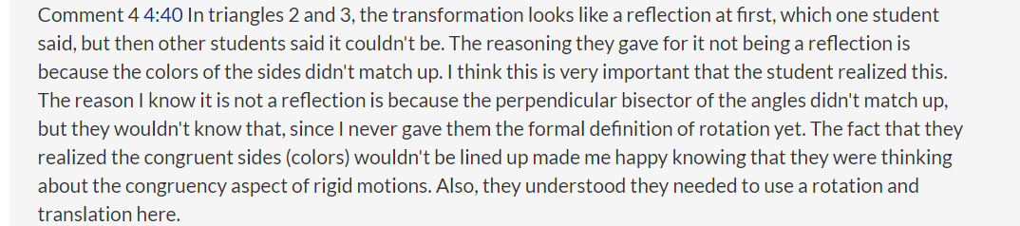
Sample of Video and Comments made by PSTs

Slide 7
Francesca
My Noticing | Francesca’s Comments | Interpretation of Francesca’s Comments
Francesca_Nov7_1 1:30 – Francesca tells the students what they will be doing today. 2:20 – Francesca has her students complete the first activity. 2:30 – A student is confused and asks Francesca that doesn’t the first problem already solved for x. Francesca tells him that he must show his work on how he got x. 4:20 – Francesca notices that a student got x=5 for the first equation in the first problem. The student got this by thinking what plus 8 equals 13, instead of isolating the variable. Francesca tries to probe her thinking by asking how she could isolate the variable. The student is confused and doesn’t know. So, she explains to the student to subtract the 8 on both side. The student continues to do the problem with some issues. 5:50 – A student in another group asks her peers if x can be anything for the equation 3x=9. I wonder what her thought process was here. The groups discuss the answer. 7:15 – Francesca goes over to a group and asks how a group is doing. They are confused. She tells them to erase what they have, not even asking what they were thinking. She walks through the group on how to do the problem. 10:14 – Francesca asks a group who is struggling if they remember PEMDAS. They all say yes. She tells them to start with distributing the 2 in the last problem on the first page. This is confusing since the next step would be subtraction not multiplication or division. So, its more reverse PEMDAS. 11:00 -Francesca asks a student how they got zero as one of the answers. The student didn’t show any work. Show Francsca tells the student she wants her to show work. The student says, “I’m Stupid!” and immediately gives up. Francesca quickly replies, “now you aren’t, you haven’t done this in a year, so you just don’t remember.” I thought this fast reply was good and helped this student gain more confidence. | 5:20 - So far I began by introducing the topics we were going to be working on in our lesson. Then, we began a worksheet and I asked the students to determine if the two equations in each part were equivalent or not. The students quickly understood the first problem as they were able to do it in their heads without actually solving using the steps to isolate variables in linear equations. In this moment I see that one girl is particularly struggling with understanding how to show the steps of isolating, and with this I start to walk through step by step with her until she successfully isolated the variable. It was interesting to me to see how the children quickly could do it in their head but could not express their work. 11:00 - The students are still working on the same part of the worksheet as before, isolating the variables and deciding if the equations are equivalent. They struggled more with this than anticipated and with this I had to devote more attention than planned to help students successfully complete the steps. In this moment a girl who has already completed two correctly was struggling and because she didn't know the answer called herself stupid. I attempted to quickly redirect this comment as she was actually doing a good job in regards to the fact that they hadn't done this material in a year. | Francesca explains that her students are completing the first page of the packet. Most students easily complete the first problem, but Francesca notices one student struggles with isolating the variable. Francesca helps this step-by-step. I also noticed this! Francesca redirected a comment made by a student who called herself stupid.

Slide 8
Categories of Noticing
Category Name | Category Description
Content | Prospective teacher reflects on a specific part of their lesson. This includes explaining what the PST planned and why the PST put it in the lesson.
Teaching of Content | The prospective teacher makes a comment on how they taught their lesson to the students. This is a reflection piece that the PST comments. This could be a critique or praise.
Interaction Between Teacher and Students | Prospective Teacher makes a comment about a specific encounter they had with a student, or, if the class is split into groups, a group. The PST reflects on this experience.
Interaction Between Students | Prospective teacher notices a conversation between their students. Here, the teacher is not in the conversation, only overhearing it. This also includes if the teacher notices a specific detail of a student’s answer or their understanding with the material.
Class Discussion | The prospective teacher makes a comment about a class discussion they had during the lesson. They reflect on how the discussion helped or did not help the lesson.
Student Participation | The prospective teacher comments about their student participation. This could be an individual student or the class. Participation could mean if the student(s) are doing the work, speaking in discussions or their groups. The PST reflects on this student participation and how it impacted the lesson.
Student Knowledge | Prospective teacher mentions their student’s prior knowledge they had before the lesson of the material they have worked on. The PST explains how the prior student knowledge affects their lesson.

Slide 9
Categories of Noticing Example
Category | Category Description | Example
Interaction Between Teacher and Student | Prospective Teacher makes a comment about a specific encounter they had with a student, or, if the class is split into groups, a group. The PST reflects on this experience. | “A student asks for help on the first problem. I guide him through it by telling him we have to work backwards, and I asked him what do we have to get rid of first. He is able to answer my question and move on to the next step. Eventually we come to an answer together. Overall, I think going over this problem step by step with him really helped him because then it refreshed his brain of how to solve for X and he now can move on to the other problems.” Wendy - Video 1 – Comment 1

Slide 10
Categories of Learning Instances
Categories | Category Description
Making a decision in the moment | The prospective teacher makes a comment about a specific decision they had to make during their lesson. This is an unplanned situation.
“I noticed”, “I learned”, or “I think” | This is where the prospective teacher is explicitly saying that they learned something. Here, teachers reflect on a moment in the video and what it has taught them.
Connecting a teacher move to student learning | This is where the PST notices that a specific teaching move either helped or didn’t help student learning and explains why.
Reflection on student knowledge | The PST makes a comment about students’ progress with the lesson. This can be an observation of either one students or the class. This shows that the teacher notices what the students understand, which may affect their lesson.
Reflection on one’s Teaching | The PST reflects on a specific teaching move they did. This can either be a praise or critique. If PSTs are critiquing one’s own teaching strategies, they provide tips to improve next time.

Slide 11
Categories of Learning Instances Example
Category | Category Description | Example
Making a decision in the moment | The prospective secondary teacher makes a comment about a specific decision they had to make during their lesson. This is an unplanned situation. | “I ask students ‘What happens when I subtract the 5x on both sides?’ I had students shout you get x, 0, and 𝑥2. Since I was hearing various answers, I called on each student to tell me what they think you obtain when you subtract 5x-5x. I think I made the correct teacher move when I decided to take a vote to see how many people thought it was x, 0, or 𝑥2. . . . For the student’s level of understanding I think I made the correct move by going into a mini lecture explaining why x-x is 0.” Pam – Implementation Report

Slide 12
Francesca
My Noticing | Francesca’s Comments | Interpretation of Francesca’s Comments | Comments
Francesca_Nov7_1 1:30 – Francesca tells the students what they will be doing today. 2:20 – Francesca has her students complete the first activity. 2:30 – A student is confused and asks Francesca that doesn’t the first problem already solved for x. Francesca tells him that he must show his work on how he got x. 4:20 – Francesca notices that a student got x=5 for the first equation in the first problem. The student got this by thinking what plus 8 equals 13, instead of isolating the variable. Francesca tries to probe her thinking by asking how she could isolate the variable. The student is confused and doesn’t know. So, she explains to the student to subtract the 8 on both side. The student continues to do the problem with some issues. 5:50 – A student in another group asks her peers if x can be anything for the equation 3x=9. I wonder what her thought process was here. The groups discuss the answer. 7:15 – Francesca goes over to a group and asks how a group is doing. They are confused. She tells them to erase what they have, not even asking what they were thinking. She walks through the group on how to do the problem. 10:14 – Francesca asks a group who is struggling if they remember PEMDAS. They all say yes. She tells them to start with distributing the 2 in the last problem on the first page. This is confusing since the next step would be subtraction not multiplication or division. So, its more reverse PEMDAS. 11:00 -Francesca asks a student how they got zero as one of the answers. The student didn’t show any work. Show Francsca tells the student she wants her to show work. The student says, “I’m Stupid!” and immediately gives up. Francesca quickly replies, “now you aren’t, you haven’t done this in a year, so you just don’t remember.” I thought this fast reply was good and helped this student gain more confidence. | 5:20 - So far I began by introducing the topics we were going to be working on in our lesson. Then, we began a worksheet and I asked the students to determine if the two equations in each part were equivalent or not. The students quickly understood the first problem as they were able to do it in their heads without actually solving using the steps to isolate variables in linear equations. In this moment I see that one girl is particularly struggling with understanding how to show the steps of isolating, and with this I start to walk through step by step with her until she successfully isolated the variable. It was interesting to me to see how the children quickly could do it in their head but could not express their work. 11:00 - The students are still working on the same part of the worksheet as before, isolating the variables and deciding if the equations are equivalent. They struggled more with this than anticipated and with this I had to devote more attention than planned to help students successfully complete the steps. In this moment a girl who has already completed two correctly was struggling and because she didn't know the answer called herself stupid. I attempted to quickly redirect this comment as she was actually doing a good job in regards to the fact that they hadn't done this material in a year. | Francesca explains that her students are completing the first page of the packet. Most students easily complete the first problem, but Francesca notices one student struggles with isolating the variable. Francesca helps this step-by-step. I also noticed this! Francesca redirected a comment made by a student who called herself stupid. | Content Francesca begins by explaining what she teaches her students. Interaction between students Francesca reflects on her students ability to do the first problem. Interaction with teacher and student Francesca comments about a student who struggles with isolating the variable. She describes how she helps the student. Student Knowledge Francesca mentions that her students struggled more than she anticipated Interaction Between Teacher and Student Francesca reflects on a moment where a student called themselves stupid and how she dealt with it.

Slide 13
Results of Categories of PST Noticing
Categories of Noticing | Number of times present in Data | Percent | Percent of category type
Content | 13 | 8.90% | 31.5%
Teaching of Content | 33 | 22.60%
Interaction Between Teacher and Students | 33 | 22.60% | 54.11%
Interaction between Students | 18 | 12.33%
Class Discussion | 28 | 19.18%
Student Participation | 8 | 5.48% | 14.38%
Student Knowledge | 13 | 8.90%
Total Number of Categories of Noticing Present in Data | 146 | 100% | 100%

Slide 14
Results of Categories of PST Learning Instances
Categories of Learning Moments | Number of Times Present in Data | Percent
Making a decision in the moment | 11 | 8.46%
Flat out saying “I noticed . . .”, “I learned . . .” or “I think . . .” | 24 | 18.46%
Connecting a teacher move to student learning | 44 | 33.85%
Reflection on student knowledge | 37 | 28.46%
Reflection on one’s Teaching | 14 | 10.77%
Total Number of Categories of Learning | 130 | 100%

Slide 15
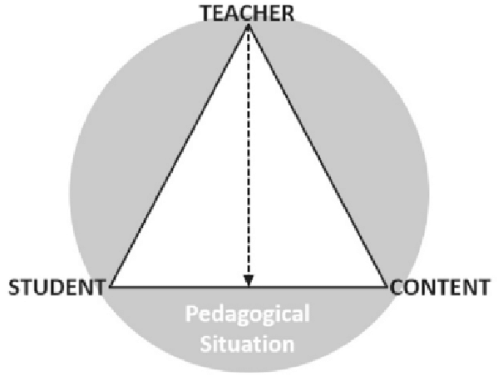
Conclusions
PSTs noticed situations pertaining to teacher moves, student interactions among themselves, the teacher and mathematical content
  Instructional triangle
Over half of PST noticing was on situations that included different interactions in the classroom.
Prospective teachers failed to notice situations on classroom management, more specifically student misbehavior.
PST showed several different learning instances from reflecting on the digital recordings of their own teaching.

Slide 16
Being able to implement it into the classroom was very beneficial but being able to take time after to re-watch it was really where I learned the most. I was able to listen clearly to my student’s answers, the way I interacted with them, my body language, how I wrote on the board, how I questioned the students, and areas where I did well and could improve.
  Bella
Having and watching the video recordings of my implementations allowed me to reflect on my lesson in a unique way. With the cameras, I was able to go back and see not only how I presented the material but also how students responded. In the moment, it is difficult to process or catch everything that is going on, but the camera allows for my ability to do that, giving me the opportunity to reflect on each individual part of the lesson even when I wasn’t able to in the moment.
  Francesca

Slide 17
Recommendations for Better Learning From the Videos
To better help PSTs learn from video, there can be parts added to the study to accomplish this.
  Interviews
    Asking series of questions that guide teachers through a process of lesson analysis to give them ideas what they should be concentrating on.
  Have the preservice teachers focus on one aspect of the lesson at a time.
  Share clips from the video with peers.
  Have prospective teachers watch the video multiple time.

Slide 18
Questions?

Slide 19
References
Cambridge Dictionary. (n.d.). NOTICE | definition in the Cambridge English Dictionary. https://dictionary.cambridge.org/us/dictionary/english/notice.
Friesen, N., & Osguthorpe, R. (2017). Tact and the Pedagogical Triangle: The authenticity of teachers in relation. Teaching and Teacher Education, 70, 255-264. doi:10.1016/j.tate.2017.11.023
Luna, M. J., Russ, R. S., & Colestock, A. A. (n.d.). TEACHER NOTICING IN-THE-MOMENT OF INSTRUCTION: THE CASE OF ONE HIGH-SCHOOL SCIENCE TEACHER. Northwestern.
Korthagen, F. A. J., & Kessels, J. P. A. M. (1999). Linking theory and practice: changing the pedagogy of teacher education. Educational Researcher, 28(4), 4e17.
Mason, J. (2011). Noticing: Roots and Branches. In M. G. Sherin, V. R. Jacobs, & R. A. Philipp (Authors), Mathematics teacher noticing: Seeing through teachers' eyes (pp. 3-14). New York, NY: Routledge.
Sherin, M. G., & Han, S. Y. (2004). Teacher learning in the context of a video club.
Teaching and Teacher Education, 20,163e183
Sherin, B., & Star, J. R. (2011). Reflections on the Study of Teacher Noticing. In M. G. Sherin, V. R. Jacobs, & R. A. Philipp (Authors), Mathematics teacher noticing: Seeing through teachers' eyes (pp. 66-78). New York, NY: Routledge.

