Slide 1
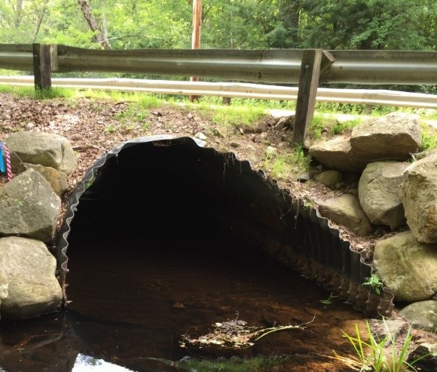
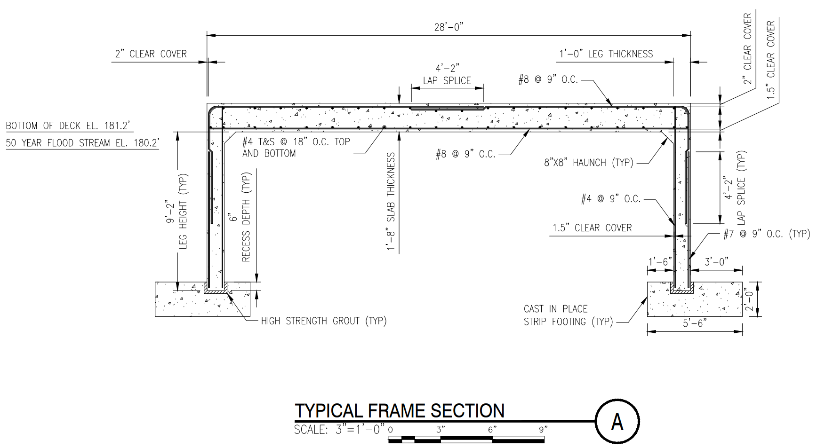
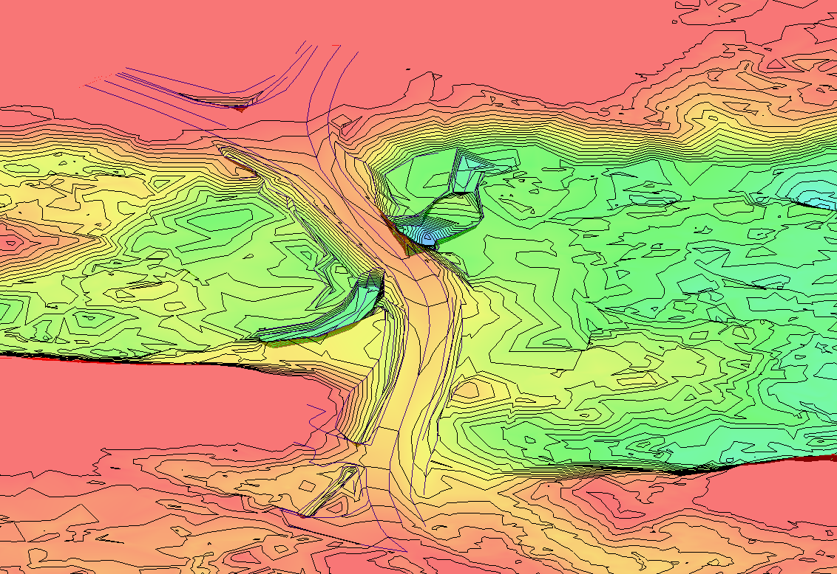
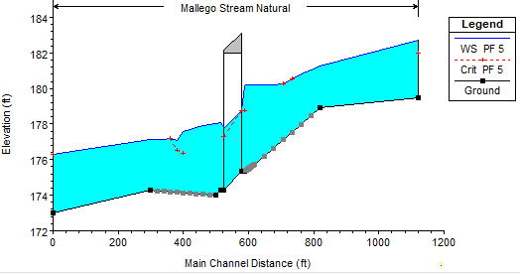
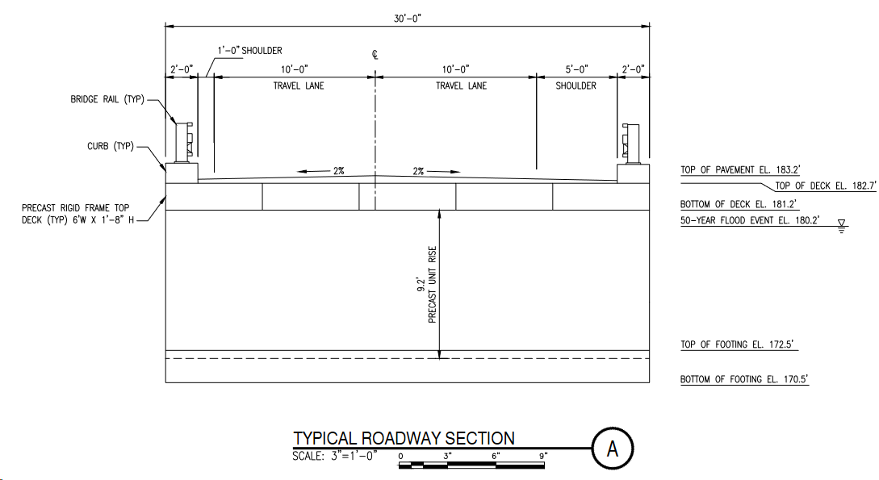
Mallego Road Bridge Replacement Barrington, New Hampshire Gabriel Archambault, Gordon Hoyt, and Tyler Moore Department of Civil/Environmental Engineering, University of New Hampshire
Introduction
Hydraulic Analysis
Proposed Bridge Geometry
The Mallego Road Bridge is a 6’ diameter corrugated metal pipe culvert (CMP) that services Mallego Road in Barrington, New Hampshire.
The culvert was constructed in 1970. It is 50’ long with a 49⁰ skew.
Flooding has been occurring upstream and downstream of the culvert along with water overtopping the south side of the road during heavy storm events.
This project aims to replace the CMP with a structure which will safely carry traffic across Mallego Brook, with the additional benefits of increasing hydraulic capacity and returning the stream to a more natural state.
The scope of the project will include an alternatives study, a 1-D and 2-D hydraulic analysis, the design of a replacement structure, a detailed cost estimate and a planset for the proposed structure.
Proposed Hydraulics | 50-Year | 100-Year
Drainage Area (square miles) | 4.88 | 4.88
Flow (cubic feet per second) | 523.0 | 636.0
Roadway Surface Elevation (ft) | 183.2 | 183.2
Water Surface Elevation (ft) | 180.1 | 180.7
Freeboard (ft) | 181.2 | 181.2
Max Velocity at Bridge (feet per seconds- fps) | 2.19 | 2.06
Bridge Opening (square feet) | 476.7 | 476.7
Flow Area Through Bridge during Flood (square feet) | 361.7 | 474.5
% Opening Full During Flood | 76 | 99
Scour Depth Calculation Approach | Scour Depth (ft)
NCHRP 24-20 | 7.1
Longitudinal Scour | 5.7
26-foot clear span​
45-degree skew
39-foot span relative to skew ​
9.2-foot frame leg height​, top of footing to bottom of deck
1-foot thick frame leg wall
30-foot width perpendicular to skew, outside edge to outside edge
(2) 10-foot lanes, a 5-foot shoulder, and a 1-foot shoulder
1-foot 8-inch deep slab
2-foot footing depth
5.5-foot footing width, with a 1-foot toe
Methods
Hydraulic analysis of the stream flows in 2-D with the Bureau of Reclamation’s Sedimentation and River Hydraulics – Two-Dimensional model (SRH-2D).
1-D Hydraulic analysis using HEC-RAS
Scour/Countermeasures for the bridge have been designed using the National Highway Institute Manual and Federal Highway Administration’s Hydraulic Engineering Circulars (FHWA HEC-18 / HEC-23).
Bridge design calculations were performed using guidance form New Hampshire Department of Transportation (NHDOT) Bridge Design Manual and American Association of State Highway and Transportation Official’s AASHTO LRFD Bridge Design Specifications (AASHTO).
Structural analysis employed VisualAnalysis software.
Conceptual drawings were created for the proposed recommended alternative design in AutoCAD 2021.
Cost Estimates
Two cost estimates were performed for this project. There was a preliminary cost estimate , done to assist selection of a super structure. There was also a detailed estimate, done for the final bridge design.
The preliminary cost estimate was performed using NHDOT’s Type, Size & Location Estimation Format. This estimate format only considers the three factors in the format’s title. It is therefore fairly inaccurate, but it is sufficient for the early project stages.
The detailed estimate is in progress and is based off material quantities and their per-unit costs. The estimate will be aided by the NHDOT Master Item List, and cost estimates for similar superstructure types provided by our Sponsors.
Structural Analysis and Design
A concrete rigid frame bridge was chosen as the super structure type for this project in the Alternatives Study.
AASHTO standards were used to develop the bridge loading, including the design tandem load, lane load, structure dead load, and earth loads.
These loads were applied to the structure in VisualAnalysis to determine their force effects. Strength and Service load cases were checked.
AASHTO was used once again to determine the required member dimensions, flexural reinforcement, shear reinforcement, and temperature/shrinkage reinforcing steel.
A spread footing was chosen in the Alternatives Study. The footing was sized to prevent overturning, bearing capacity failure, and sliding.
The footing was reinforced to prevent it’s failure in shear or flexure.
References
New Hampshire Department of Transportation. (2015). Bridge Design Manual, Chapter 2, Bridge Selection
University of New Hampshire. (2009). New Hampshire Stream Crossing Guidelines
National Cooperative Highway Research Program. (2010). LRFD Design and Construction of Shallow Foundations for Highway Bridge Structures
AASHTO LRFD Bridge Design Specifications, 8th Edition, November 2017
Hydraulic Engineering Circular No.18, Evaluating Scour at Bridges, 5th Edition, April 2012
Hydraulic Engineering Circular No. 23, Bridge Scour and Stream Instability Countermeasures, 3rd Edition, September 2009
New Hampshire Department of Transportation. (2016). Standard Specifications for Road and Bridge Construction.
Contacts
Project Sponsors: Kayla Hampe and Jillian Semprini from Hoyle, Tanner and Associates
Faculty Advisor: Yashar Eftekhar Azam

