Slide 1
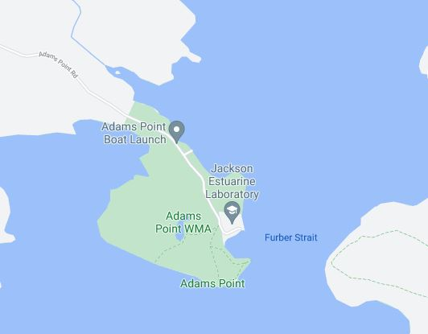
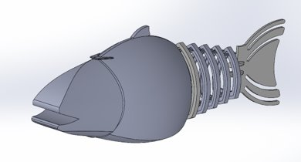
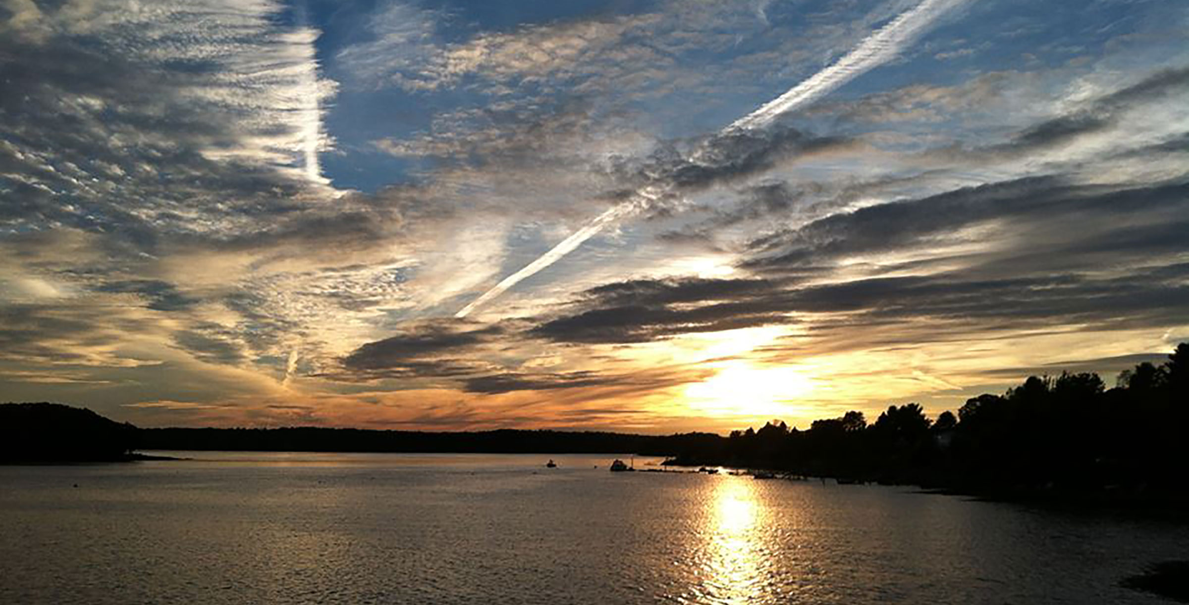
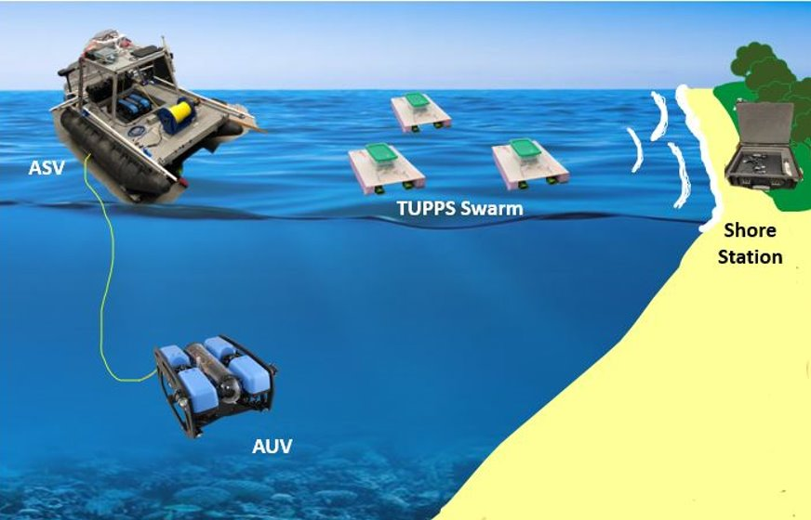
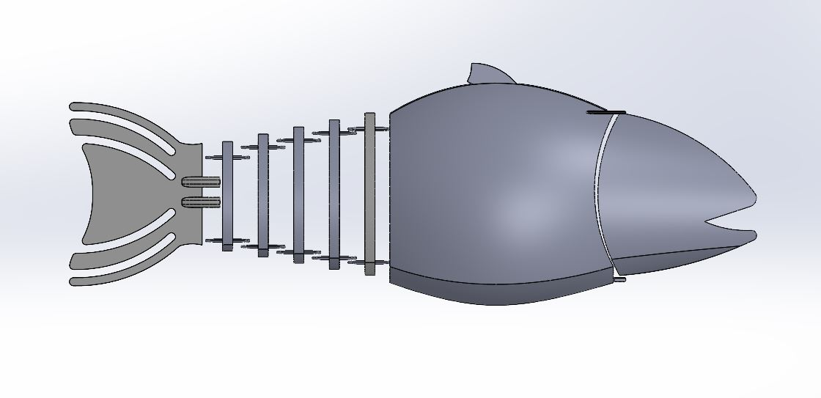
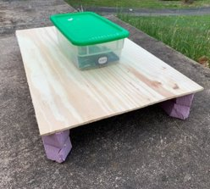
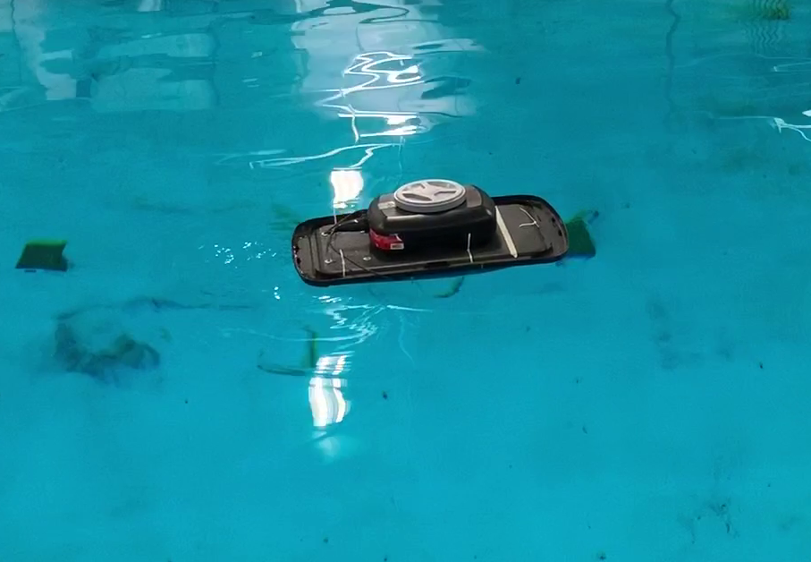
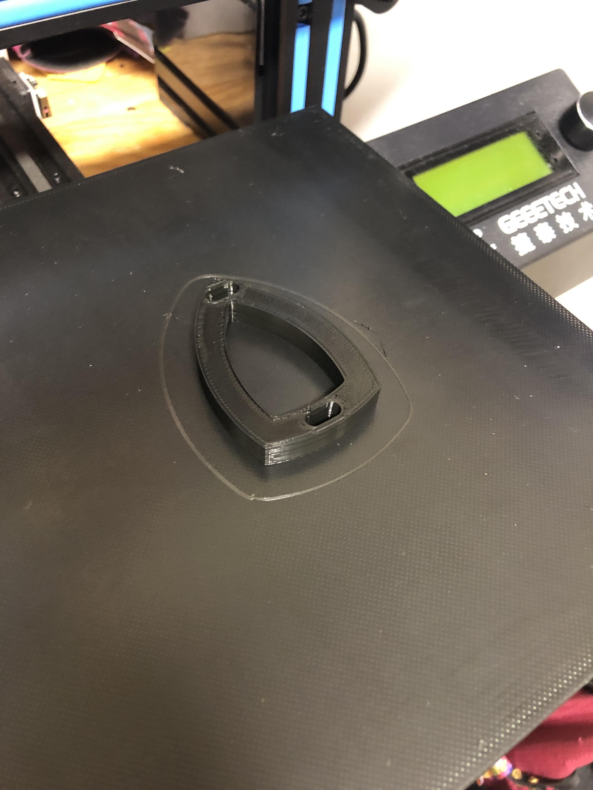
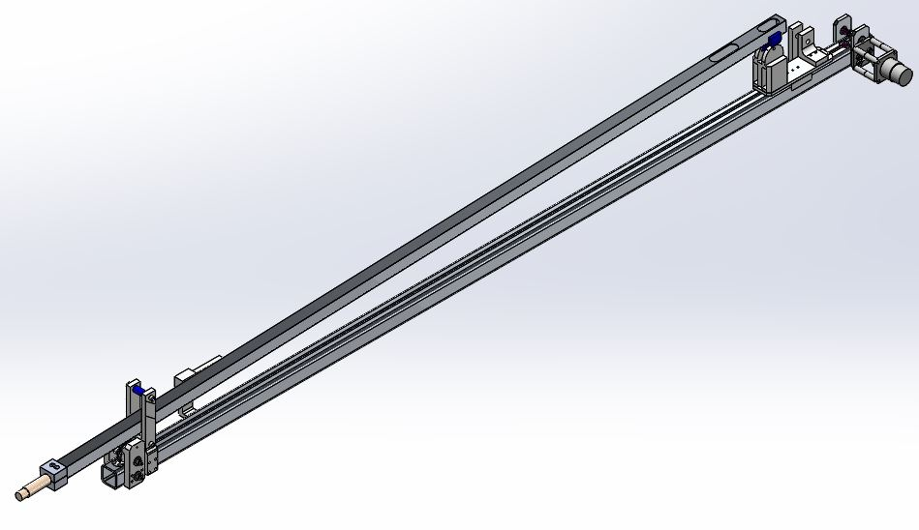
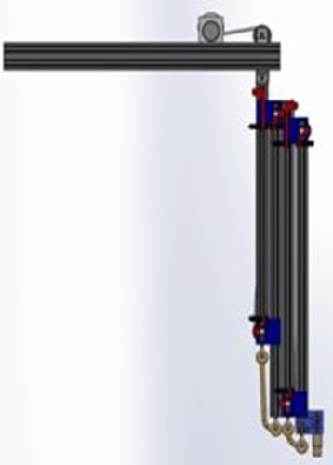
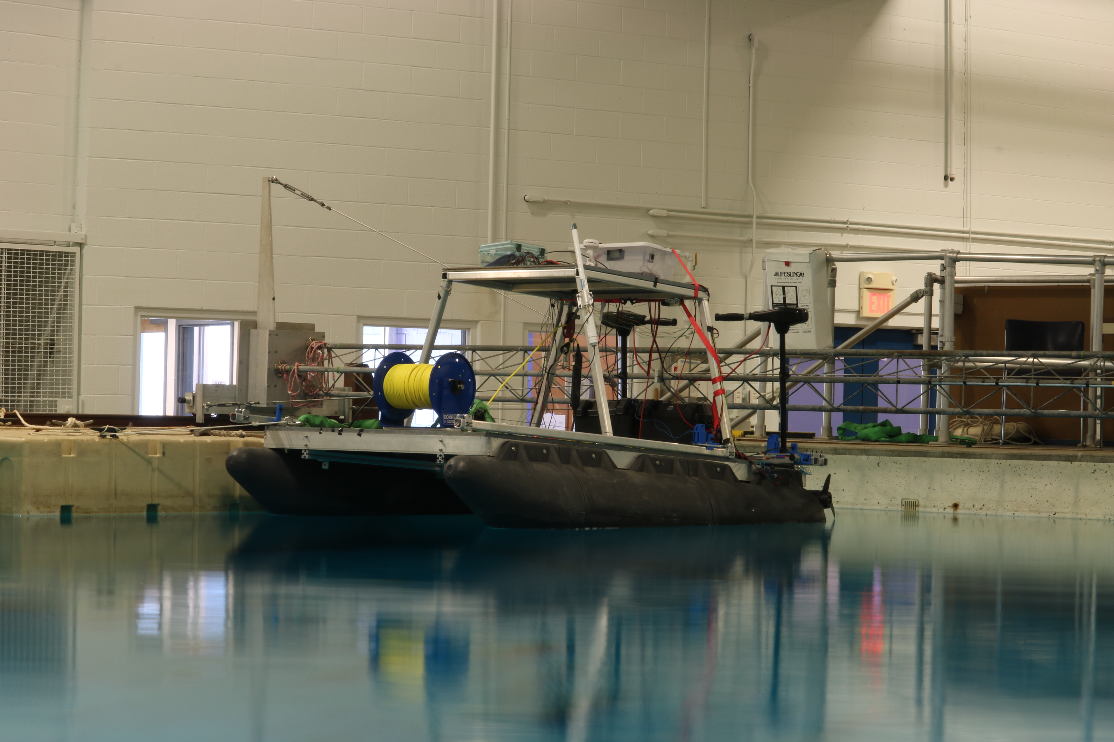
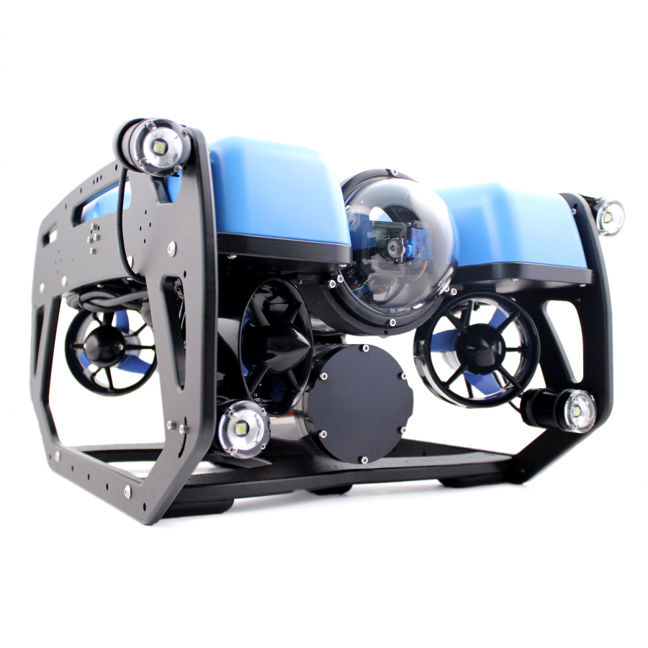
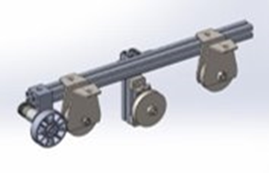
ASV/UUV/RoboFish
Team Members: Vincent Dejana(ME) and Richard Randall (ME)
Project Advisors: Dr. May-Win Thein, Dr. Yuri Rzhanov, Dr. Elizabeth Fairchild, DR. Michael Chambers
Graduate Advisors: Hannah Arnholt, Lee CuRtis, Allisa Dalpe, & Oguzhan Oruc
In collaboration with Team MANTA RAY
Special Thanks to Dr. Martin Renken, John Ahern, Scott Campbell, Laura Gustafson, Sheri Milllette
Proof of Concept mission
Mission
Robo-fish overview
Perform a seafloor mapping mission using the ASV and ROV.
Mission will take place in Jackson Marine Estuary, at Adam's Point.
Mission was planned to be completed last year but was delayed due to the pandemic.
Mission will be performed this spring.
ASV performs point to point navigation, and the UUV is operated to take a photo of a point of interest, return to the ASV. ASV will then return to shore.
There are three main goals for the project this year. The first is to finish the proof-of-concept mission of having an Autonomous Surface Vehicle (ASV) go to a location and deploy an Unmanned Underwater Vehicle (UUV). The Second goal is to implement autonomous path planning on various platforms the team has. The third design and build a new platform called Robo-Fish
Robo-Fish is the newest platform to the marine robotics swarm
Designed after a steel head trout to aid with UNH Aquaculture program (AquaFort)
Carries sensors to monitor the trout
Early models will be tethered, later will be wireless
Adams Point, Jackson Marine Estuary
Robo-fish design
TUPPS Testing
Designed in Solidworks
Robo-Fish is designed to move through the water like a fish
Tail provides locomotion of the robot
Length $\sim$ 1.5’
Width $\sim$ 4.75”
Height $\sim$ 6”
TUPPs functions as a mini-ASV
Useful for testing sensors and controls/autonomy
Tested Tele-Op functionality of the TUPPs code, as well as old autonomy code (PID control)
Shifted to testing the graduate research automated path planning on a more sophisticated TUPPs.
Path planning should theoretically be able to be applied to ASV
Robo-Fish
Robo-fish construction
Current TUPPs Platform
Current Platforms
Robo-Fish is currently being 3D printed in PLA plastic
First one will only use three tail pieces and 1 servo
Future iterations will be printed using PETG plastic and will use all pieces with 2 servos
ASV
Catamaran-style Design
Length: 7' 9"
Beam: 5' 6"
Twin Electric Motors
4 arms for deploying UGPS sensors
Trapdoor for deploying Unmanned Underwater Vehicle (UUV)
Built by 2017-2018 ASV Team
UUV
Blue Robotics BlueROV2 Heavy
Length: 18”
Width: 13.3”
Height: 10”
8 Blue Robotics T200 Thrusters
Live HD Camera and Lighting
TUPPs
Testing Unmanned Performance Platform
Built with Styrofoam and plywood
Two Blue Robotics T200 Thrusters
Powered by a LiPo battery
Controlled through a Raspberry Pi and Arduino
Has keyboard control
Point to point autonomy is being developed
TUPPs with Path Planning
ASV Subsystems
Assisted in the design and construction of the new UGPS arms
Uses a Waterlinked® Underwater GPS© System
4 submersible transducers (on ASV), 1 receiver (on ROV), and an Electronics dry box (on ASV deck)
Detachable for transportation of ASV
Uses cascading arm design
Helped construct new Tether Tensioning System
Applies tension to UUV tether to fix back spooling during deployment and retraction.
Uses rotary encoder to measure the distance of tether deployed, rather than time.
Robo-fish testing
Old UGPS Arm Design
Currently creating code to move the servo to create a fish like motion
Once Robo-Fish is constructed can put the servo on and make sure the tail moves correctly
Planning on testing how the tail moves in water by end of school year
Tether Tensioning System
New UGPS Arm design
Notes:
To change this poster, replace our sample content with your own. Or, if you'd rather start from a clean slate, use the New Slide button on the Home tab to insert a new page, then enter your text and content in the empty placeholders. If you need more placeholders for titles, subtitles or body text, copy any of the existing placeholders, then drag the new one into place.

