Slide 1

Senior Project
In-Home Data Collection for Experiments with Human Participants
Presented by Charity Reed
Notes:
Hello, my name is Charity Reed and today I will be talking to you about my senior project.
My project is a prototype for an In-Home Data Collection Kit to be used for Experiments with Human Participants.

Slide 2
Motivations
COVID-19 impacts research
Performing research remotely
Benefits even after the pandemic
What can be done?
Notes:
Due to the pandemic there is a reduced ability to conduct research with human subjects in the lab in the same manner and at the same volume as prior to the pandemic.
The current COVID-19 pandemic has highlighted a need for the ability to perform research with human subjects in a remote setting.
However, even after COVID-19 restrictions subside, the ability to perform research that requires physical participation of the subject remotely will still benefit the research community as a whole.
Being able to conduct this research remotely will allow for a more diverse set of research participants, less limited to geographic restrictions than in the past.
In order to accomplish this, researchers need a way to obtain data from subjects in a reliable manner.
These were the motivations behind this project.

Slide 3
Project Goal
Design a prototype for a kit to be sent to research participants for remote experiments
  Collect data from sensors in the kit
  Be able to synchronize time between two such kits
  Should be easy for participants to set up the kit
Notes:
The main goal of this project was to design a prototype for a kit that could be sent to research participants for remote experiments.
The kit should be able to collect and store timestamped data from its sensors so that researchers can analyze this data later.
In order to accomplish this, it is important that the ability exists to synchronize time between two such kits.
The kit should eventually be no more difficult to set up than a stand alone webcam or other peripheral device.

Slide 4
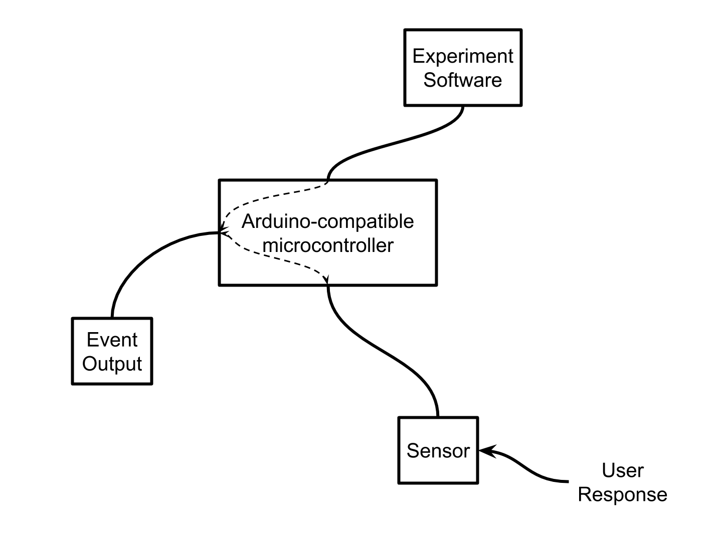
Basic Block Diagram of Kit
Project
Notes:
What you see here is a basic block diagram for the Data Collection kit.
Using an arduino-compatible microcontroller, based on an event determined by the experiment the microcontroller produces an output which alerts the research participant that they need to respond.
The sensor detects the participants responses and the microcontroller logs the relevant data points and stores them.
In the next slides I will show you the actual hardware setup before diving into what the hardware does.

Slide 5
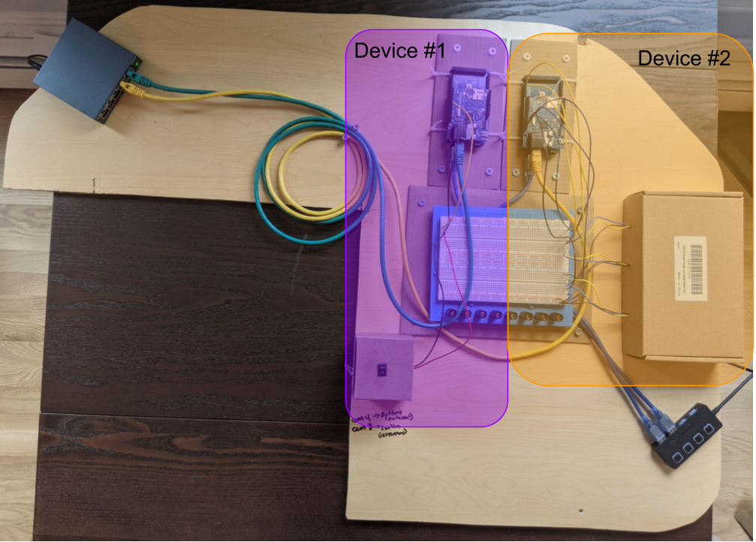
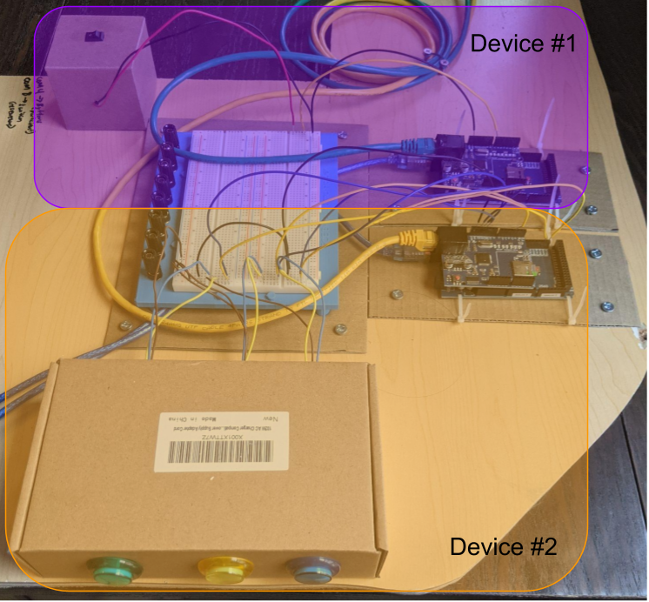
Hardware Setup
Notes:
Here you can see two different views of the hardware setup. On the next slide I'll show what each component is.

Slide 6
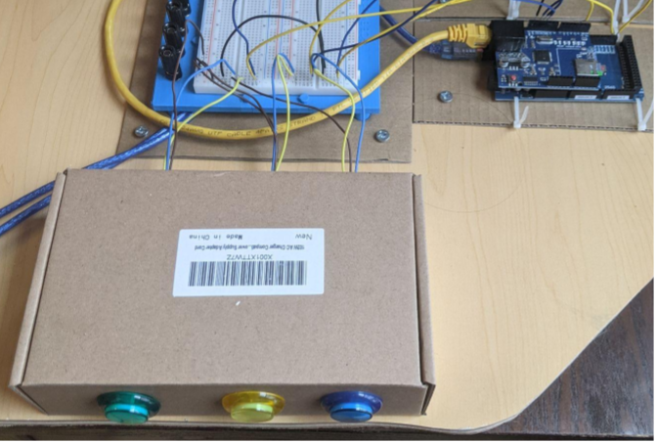
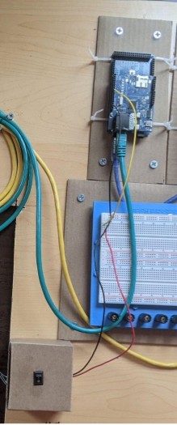
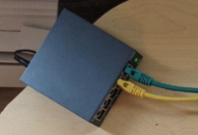
Main Components
Device #2
Device #1
Microcontroller and Ethernet shield
LED Buttons
Switch to send command
Ethernet Switch
Notes:
On the left you see the hardware for the first device and on the right is the hardware for the second device. Both setups include a microcontroller with an ethernet shield attached, in order to access the internet for communications between the two devices and obtaining the time from the Network Time Protocol or (NTP) server.
The first device includes a switch that would allow the researcher to send a binary command to the second device. While the setup here has both devices near eachother physically this command is sent over ethernet and as such the two devices do not need to be near eachother.
The second device includes LED buttons used to both alert the participant (via LED patterns) and retrieve response data (via the buttons) from the participant.
On each of the ethernet shields is an SD card slot used for storing timestamped data for later analysis.
Now that you know what the hardware setup includes lets discuss what these components actually achieve.

Slide 7
Synchronizing Time Between Two Devices
What was explored
  Real-Time Clocks (RTCs)
  RTCs with Network Time Protocol (NTP) updates
  Purely NTP
Notes:
Throughout this project the most challenging piece proved to be synchronizing time between two devices
The three avenues investigated were
the use of a real-time clock, which would be set once and then all time would be based on these clocks
Utilizing real-time clocks and updating them twice daily with NTP time
And finally using purely NTP time each time the time was needed
Ultimately the decision was made not to use real-time clocks

Slide 8
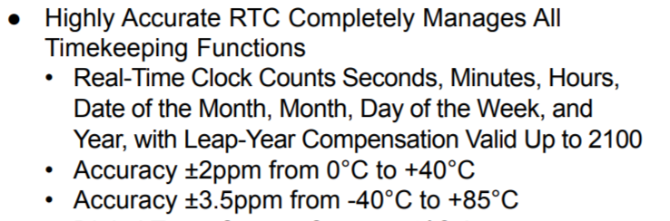
Problems with RTCs
Granularity
  Most RTCs on the market only report out to seconds
https://datasheets.maximintegrated.com/en/ds/DS3231.pdf
Notes:
While most RTCs are able to maintain accuracy to sub-second granularity they do not natively report time in sub-second increments.
Once this was discovered the plan was to use the 1 Hz output pin on the DS3231 RTC to count seconds within the program, however this approach did not work and time did not allow for debugging to the point of rectifying the issue.
There are RTCs which can report in sub-second intervals, specifically the DS1388 and DS1393 by Maxim Integrated, however these real-time clocks do not have integrated crystal oscillators in the IC and again time did not allow for investigating this approach fully.

Slide 9
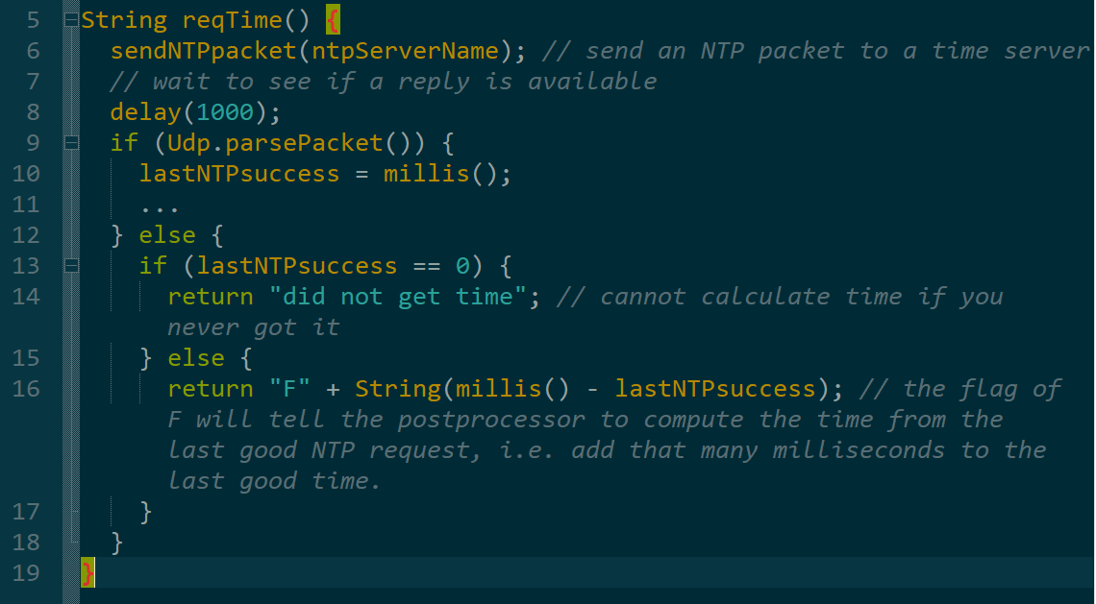
Problem with NTP
Sometimes the datetime request is not successful
  Need a backup in these instances
Notes:
Ultimately the decision was made to go with just requesting the time from the NTP server anytime it was needed. However the NTP server has its own issue. Occasionally the NTP server request will fail and in these instances the time is computed from an internal variable which tracks the number of milliseconds since the last successful NTP server request. While this is not as accurate as the NTP server it is better than logging unknown for the time. Additionally it is not expected that this will happen multiple times in a row given a stable internet connection. Additionally this data is flagged such that the post-processor can identify any timestamps computed in this manner.

Slide 10
Final Time Synchronization Implementation
Event | Datetime GMT+0
Command Sent From Device #1 | 2021-04-06 0:17:39.014
Command Received From Device #2 | 2021-04-06 0:17:40.015
Notes:
Here you can see the result of the final time synchronization implementation. In the first row it shows one microcontroller logging that a command has been sent to the second device and in the second row it shows the second microcontroller logging that the command was received. As expected the time stamp for sending the command occurs before the time stamp for receiving the command.
Once the ability to accurately log time from both devices was accomplished the next step was to create an implementation that would at least simulate one possible use case for the kit.

Slide 11
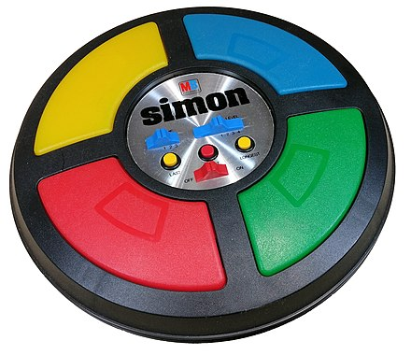
Prototype Implementation
Virtual Meeting
  One participant will be "distracted" by needing to interact with the research kit by playing a simplified version of the Simon game
https://en.wikipedia.org/wiki/Simon_(game)
Notes:
So…., let's talk about a possible implementation of this kit…., keeping in mind..., that it is the hope that this kit would eventually be adaptable to a number of different experiments.
Imagine a virtual meeting, much like the many virtual meetings we all participate in every week right now.
During this meeting one participant will be intentionally distracted.
That distraction will come in the form of needing to interact with the Data Collection Kit by playing a simplified version of the Simon game.
The Simon game, if you are unaware, is a classic '80's and '90's children's game in which the goal is to remember and repeat a colored light pattern which iteratively increases in length.

Slide 12
Prototype Implementation
Researcher starts the distraction by operating a switch
  This will send a communication to the distracted participant's kit
  A light on the kit will flash alerting the participant that it is time to play the game
Notes:
SLOW DOWN
When the researcher desires to start the distraction, they will operate the switch on their end which will send the command to the distracted participant's Data Collection Kit.
The blue LED on the participant's kit will flash 3 times, informing the participant that they must play the game.
SLOW DOWN

Slide 13
Prototype Implementation
For the next 30-60 seconds the participant will attempt to copy the pattern output by the kit
Notes:
SLOW DOWN
For the next 30-60 seconds the participant will need to copy the pattern output by the kit. This will not be the exact same implementation as the Original Simon Game but it will require similar retention and repetition of a colored light pattern.
SLOW DOWN

Slide 14

Prototype Implementation
Information about the participants interaction will be stored and from this the following information can be extracted:
  Incorrect responses
  Missed responses
  Time to respond
Notes:
SLOW DOWN
Time-stamped data points about when the pattern was provided to the participant and what buttons they pressed in response to the patter will be stored in the Data Collection Kit.
From this basic data information about the participant's time to respond, the number of incorrect responses, the number of missed responses can be computed in post-processing.
This data can later be analyzed by the researcher.
SLOW DOWN
On the next slide is a video of this implementation.

Slide 15
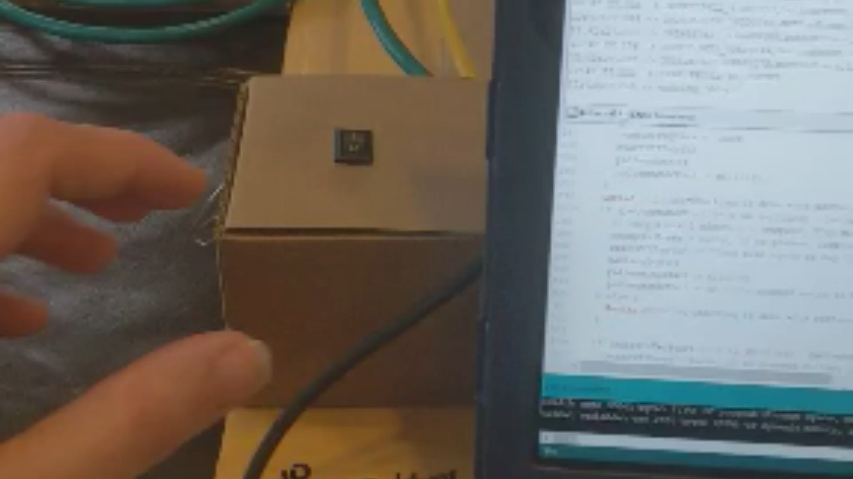
The Pattern in Action
Notes:
In this video you see the light pattern being initiated by a switch on Device #1. Shortly after the blue LED on Device #2 flashes 3 times to alert the participant. Once the pattern is provided the participant attempts to copy the pattern. There are currently 2 patterns programmed into the kit so once the first provided and a chance to copy it given, some time later the blue LED flashes 3 times again to alert the participant that another pattern is coming. The process is then repeated for the second pattern. You see in this video that the second pattern is repeated back incorrectly. This will all be captured by the SD card on Device #2.

Slide 16
Post-Processing of Data
full datetime GMT+0 | Event | Notes
2021-04-25 16:42:53.0178 | Pattern 1 Provided | If the datetime is highlighted blue then the attempt to get the time from the NTP server failed and this time is based on the microcontroller clock time passed since the last successful pull from the NTP server. The timestamps for "Pattern X Provided" are after the last light of the pattern has been displayed to the user, however do note there is some processing time to store this data and a user cannot immediately start repeating the pattern back, however it is not a long delay til they can. The currently (as of 4/18/2021) programmed patterns are as follows: PATTERN 1: YELLOW, GREEN, BLUE PATTERN 2: YELLOW, YELLOW, BLUE, GREEN, GREEN This is provided so you can determine correct pattern copying vs incorrect pattern copying.
2021-04-25 16:42:53.9978 | Yellow Button Pressed
2021-04-25 16:42:55.0208 | Green Button Pressed
2021-04-25 16:42:56.0222 | Blue Button Pressed
2021-04-25 16:42:58.0040 | Pattern 2 Provided
2021-04-25 16:44:10.0007 | Yellow Button Pressed
2021-04-25 16:44:12.0216 | Yellow Button Pressed
2021-04-25 16:44:13.0212 | Blue Button Pressed
2021-04-25 16:44:15.0038 | Blue Button Pressed
2021-04-25 16:44:16.0007 | Green Button Pressed
Notes:
The data recorded on the SD card is just minimal strings and the raw numbers retrieved from the NTP server, however that data can be decoded into the following human readable data.
As we see here you can determine how quickly the participant responded to the given pattern and whether they repeated it back correctly (by knowing the pattern that was given).
Also the postprocessing highlights the second row timestamp to alert the reviewer that the time provided here is based on the internal milliseconds since the last successful NTP request. All the other timestamps were obtained directly from the NTP server, this reinforces the idea that the NTP request will usually succeed.

Slide 17
Future Work
Design the circuit to use the sub-second RTCs
  RTCs continue tracking time even if there is a lapse in internet
FPGAs or Raspberry Pi could provide a better platform than microcontrollers
Additional sensors/alternate use cases
Creating a compact kit that meets the goal of ease of setup
Notes:
This project could benefit from the following future work:
Designing the circuit for implementing the subsecond real-time clocks
Utilizing FPGAs or Raspberry Pi's instead of arduino-compatible microcontrollers
Adding additional sensor options and alternate use cases
Packaging the components in a compact form to meet the ease of setup goal
WHY FPGA or Raspberry Pi, the Arduino is great for testing various implementations but its not very fast. A Raspberry pi has the benefit of having a RTC already onboard. An FPGA is faster than the Arduino implementation

Slide 18
Summary
Performing research remotely
Benefits even after the pandemic
Notes:
In summary,
This In-Home Data Collection Kit prototype starts the path to allow researchers to perform certain experiments in a remote setting.
and
This can benefit the research community both during the current pandemic as well as after it subsides.

Slide 19
Questions?
Notes:
I look forward to your questions on Wednesday Morning.

Slide 20
References
https://datasheets.maximintegrated.com/en/ds/DS3231.pdf
https://en.wikipedia.org/wiki/Simon_(game)

