Slide 1
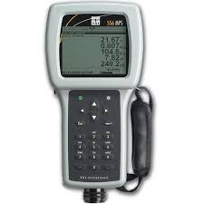
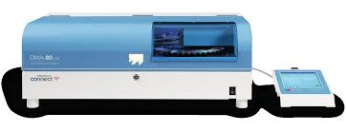
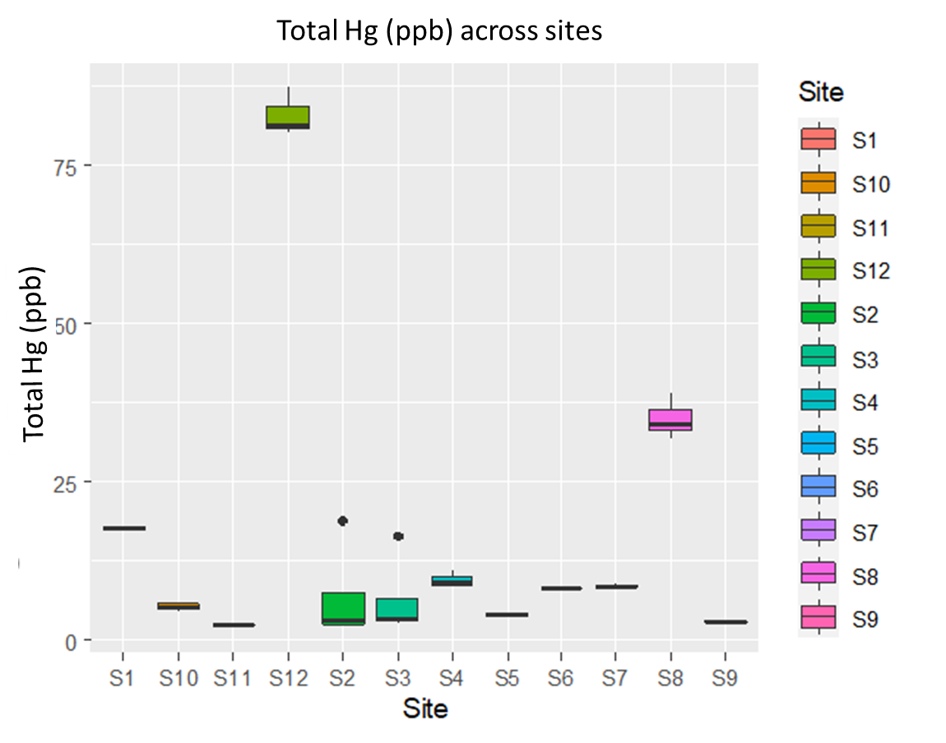
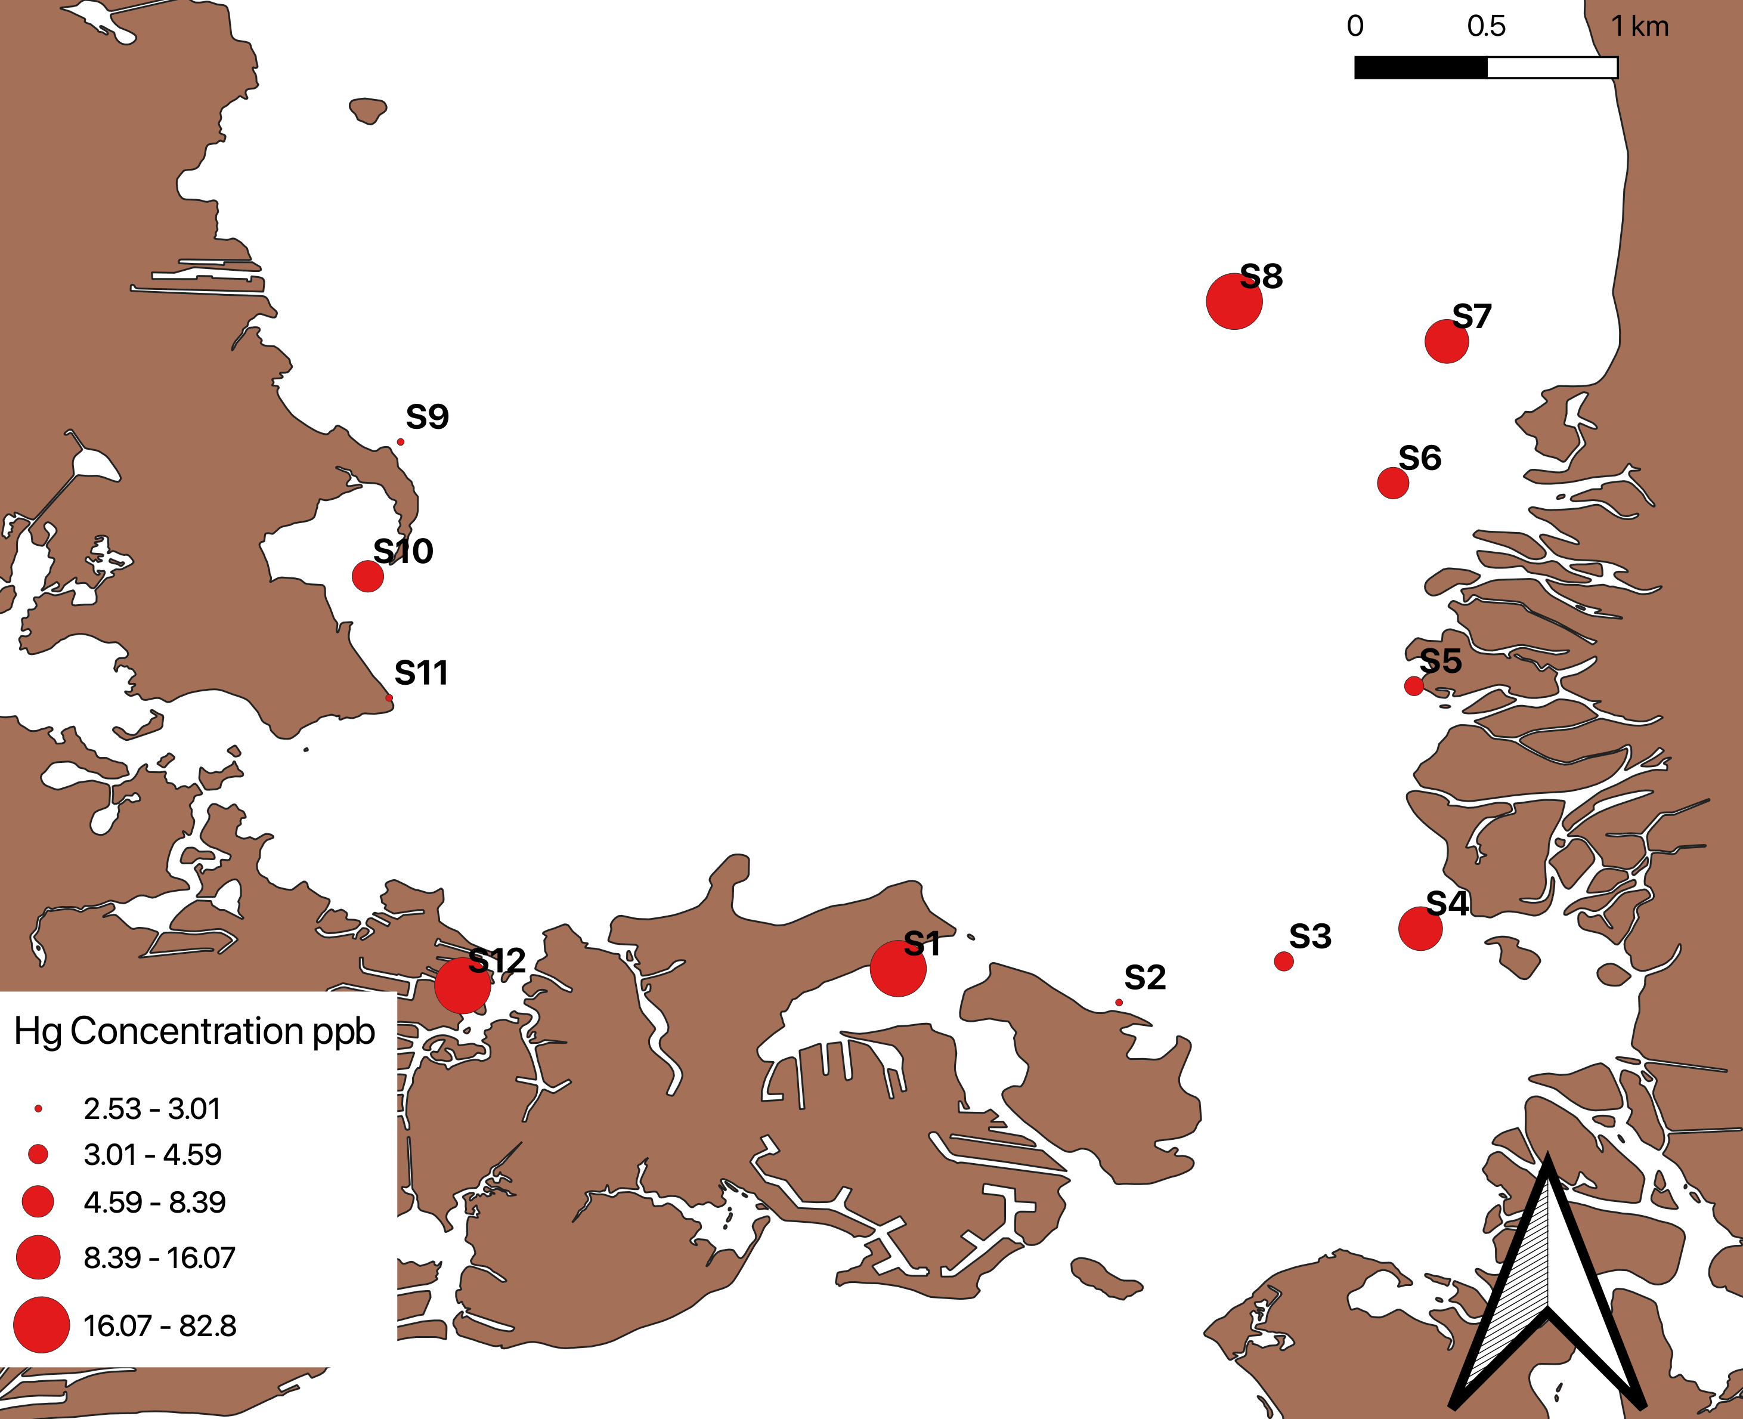
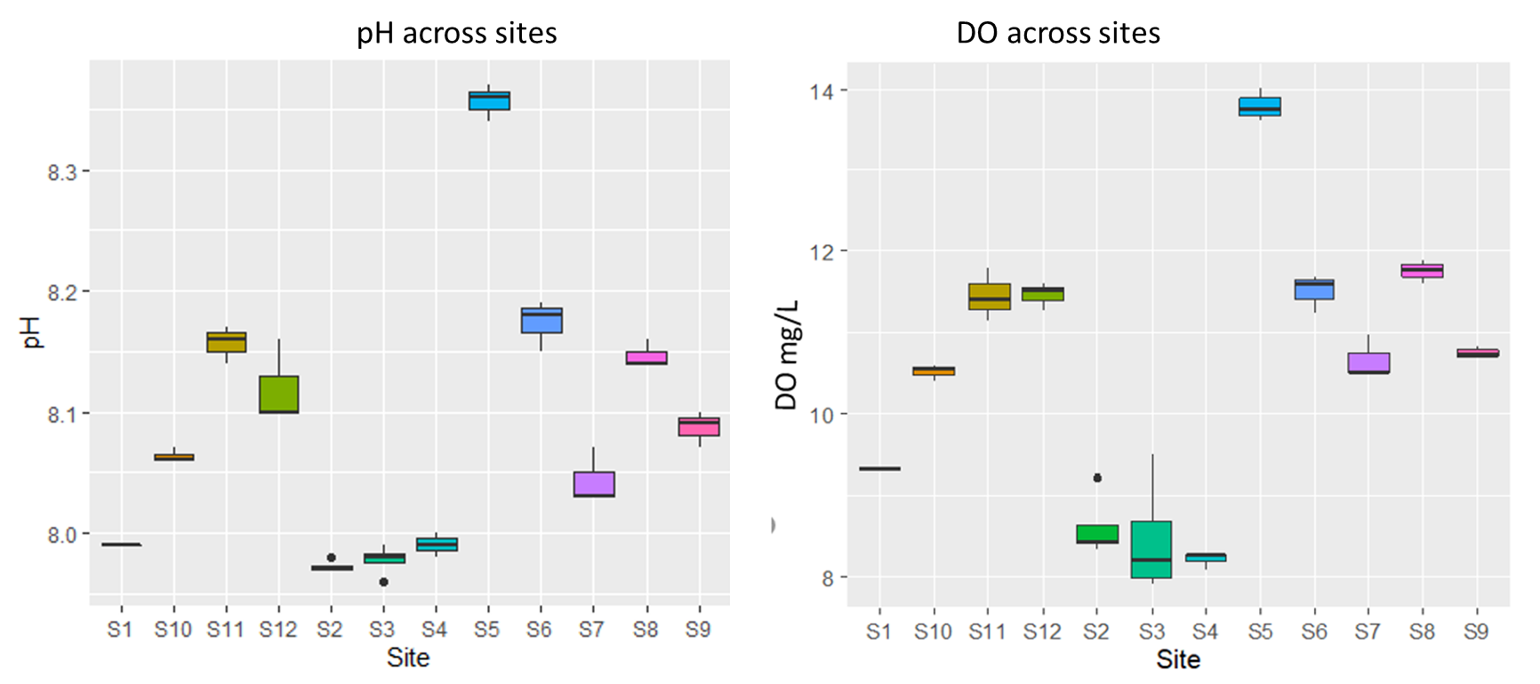
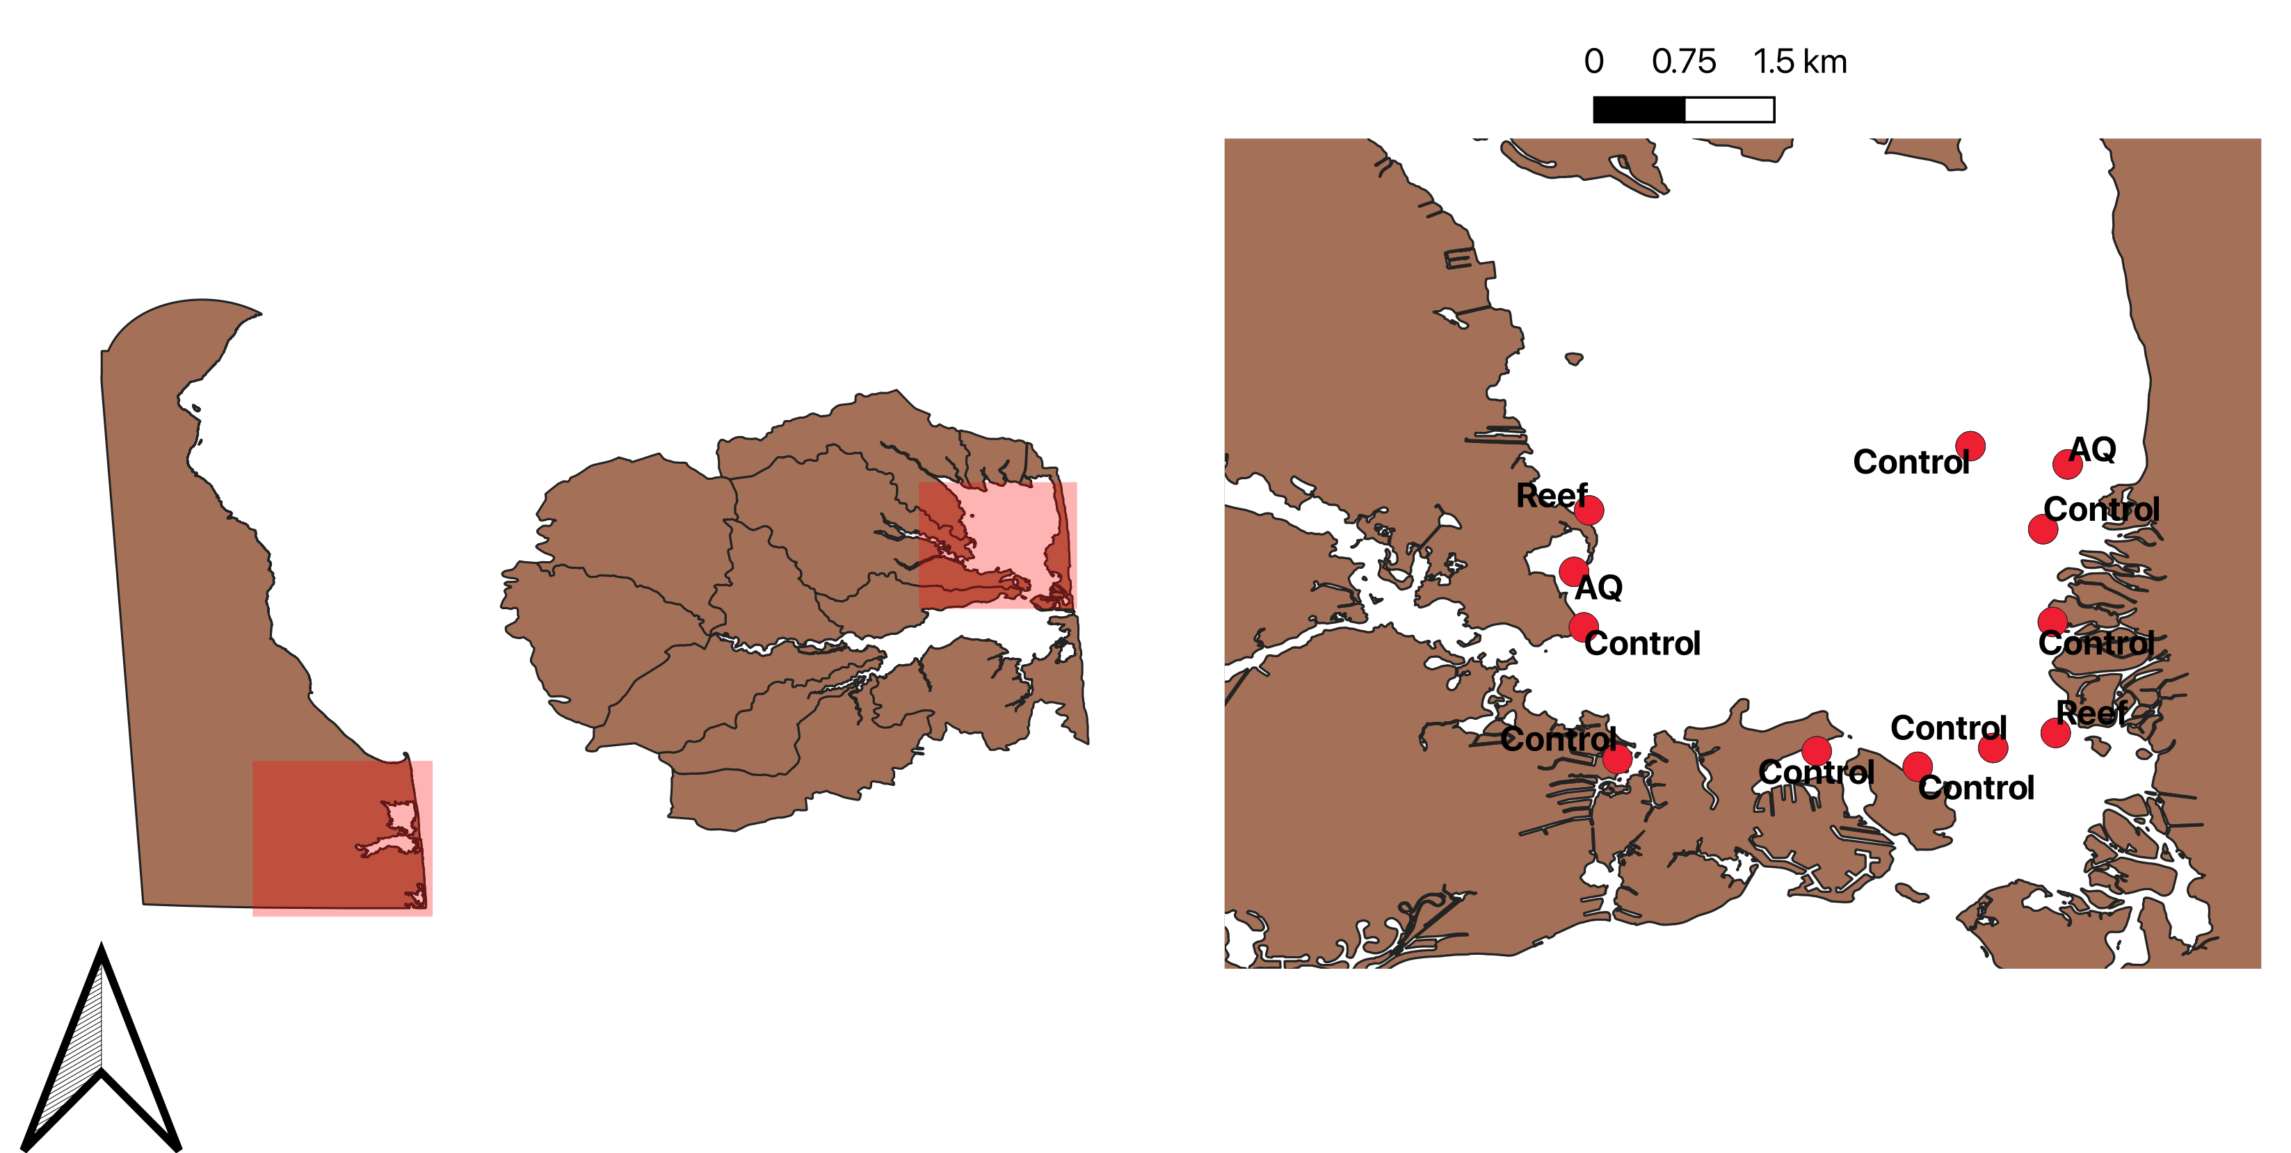
Investigating Relationships between Mercury Concentrations and Water Quality Parameters in Rehoboth Bay, Delaware Miranda Adcock ¹*,Elisha Bunch ¹, Dallis Jones ¹, Jacquiline Maina ¹, Mohana Gadde ¹, Memory Nakazwe ¹, Florencia Fahnestock ² Gulnihal Ozbay ¹ and 2020 CLOSES GAP ² ¹ Department of Agriculture and Natural Resources, Delaware State University, Dover, DE ² Earth Science Department, University of New Hampshire, Durham NH
Introduction
Materials and Methods
Results
Delaware Inland Bays is a 32 square miles of bay that drain 320 square mile watershed. Shallow water with little tidal movement makes them sensitive to environmental changes (CIB 2021).
Mercury(Hg) is a bioaccumulative (Driscoll et al 2007) and toxic pollutant that can accumulate in sediments in water (Ulrich et al 2001). It is highly toxic to the nervous system (Krabbenhoft 2018).
Some water quality parameters have been known to influence the mercury concentration in aquatic environments ( Regnell, 1992; Ahn et al., 2010).
Physical water quality parameters recorded in the field using YSI Multiprobe 556 for pH and dissolved oxygen (DO, mg/L).
Sediment samples were taken using Van Veen grab and placed in 50mL centrifuge tubes. They were analyzed using DMA-80 for Total Mercury at UNH.
Total Mercury ranged from 2.3 to 87.1ppb
Highest mercury at sites 1, 8, 12 which are all control sites
There was a significant difference in Total Mercury concentration across sites (p <0.05)
pH ranged from 7.96 to 8.37
Dissolved Oxygen ranged from 7.92-14.01mg/L
There was a significant difference in DO and pH values across sites (p<0.05)
Sites 8 and 12 have similar values for pH and dissolved oxygen
Control:S1,S2,S3,S5,S6,S8,S11,S12
Reef:S4,S9
AQ: S7,S10
Figure 2: YSI Multiprobe 556
Figure 4: Direct Mercury Analyzer
Figure 3: Sediment sampling done in
the field using the Van Veen grab
Objectives and Hypotheses
Results
Compare mercury concentrations across different sites in Rehoboth Bay.
H_{a}1: There is a significant difference in mercury levels across sites.
Examine the relationship between mercury concentration and pH.
H_{a}2 : pH has a significant effect on mercury concentration.
Establish the relationship between dissolved oxygen and mercury.
H_{a}3: DO has a significant effect on mercury concentration.
Discussion
Chart #2 Sub-Title Here
The mercury concentrations were within regulatory ranges 130ppb for marine and 170ppb for freshwater (CCME 1999).
Continued monitoring of the sites is recommended due to the low flushing rates and sensitivity in the bay.
Chart #1 Caption Here
Chart #2 Caption Here
Acknowledgements
Figure 5: Total Hg in sediment by site demonstrating ANOVA results of P<0.05
NSF and Delaware EPSCoR program for funding
CLOSES GAP Team 2020
Florencia Fahnestock and Dr. Gulnihal Ozbay
Elisha Bunch, Jaquiline Maina, Mohanna Gadde, Memory Nakazwe and Aaron Bland of the Aquatic Sciences Lab at DSU
Study Sites
Figure 6: A map of Rehoboth Bay correlating point size with Hg concentration at study sites.
12 study sites categorized as control, reef or aquaculture
Figure 1: The state of Delaware outline demonstrating the location of the 12 study sites.
References
Krabbenhoft, David. “Mercury .” United States Geological Survey, 2018
Regnell O (2010). The Effect Of Ph And Dissolved Oxygen Levels On Methylation And Partitioning Of Mercury In Freshwater Model Systems Environmental Pollution, 7-13
Delaware Center for the Inland Bays. “About the Bays.” DE Center for the Inland Bays, 2021.
Ulrich SM, Tanton TW, Abdrashitova SA. 2001. Mercury in the aquatic environment: a review of factors affecting methylation. Crit Rev Environ Sci Technol. 31: 241-293. Driscoll, C. T. et al. Mercury Contamination in Forest and Freshwater Ecosystems in the Northeastern United States. Bioscience 57, 17–28 (2007).
Figure 7: pH by site demonstrating ANOVA results of P<0.05
Figure 8: DO by site demonstrating ANOVA results of P<0.05

