Slide 1
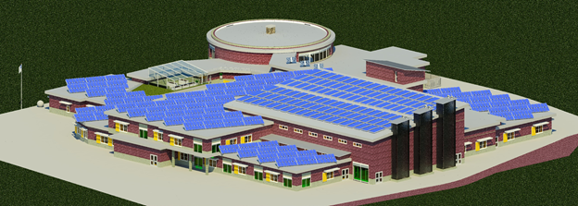
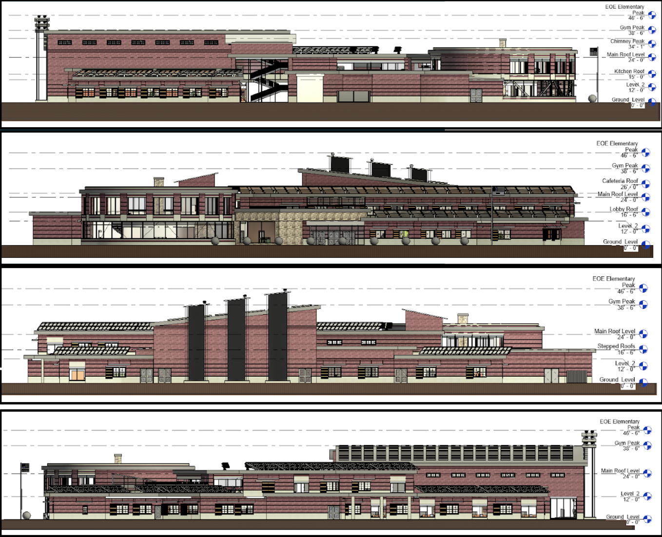
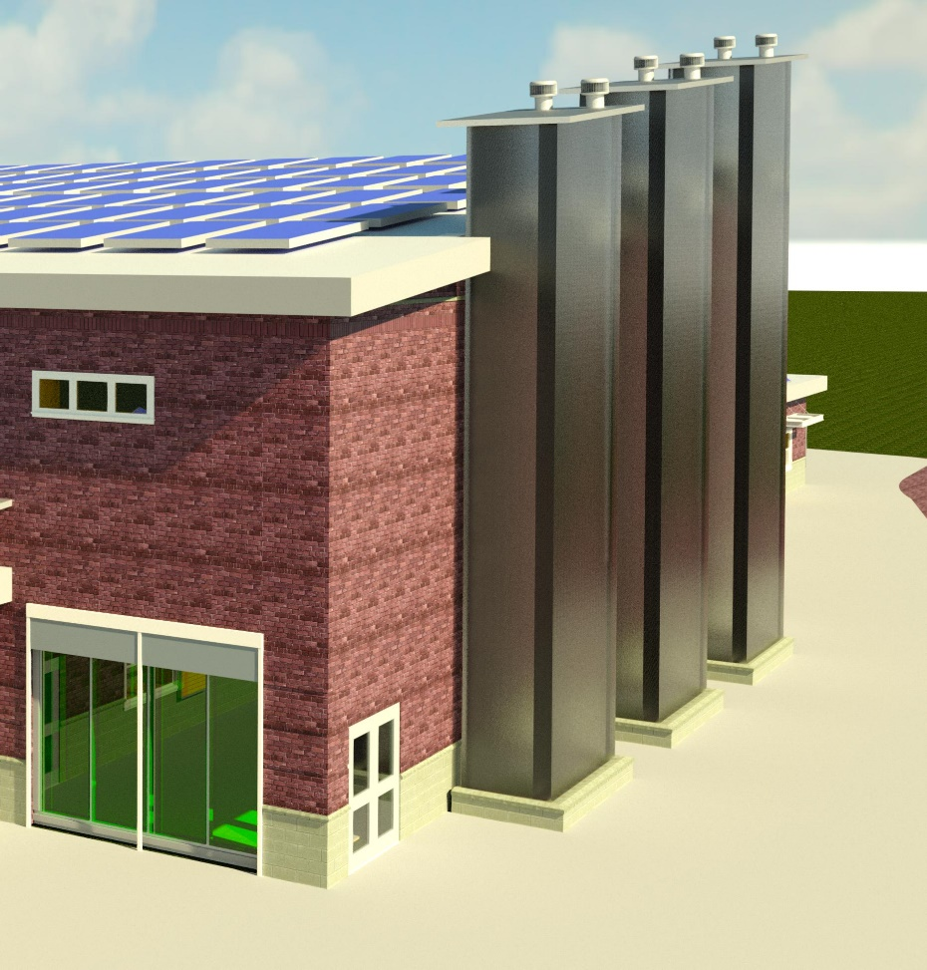
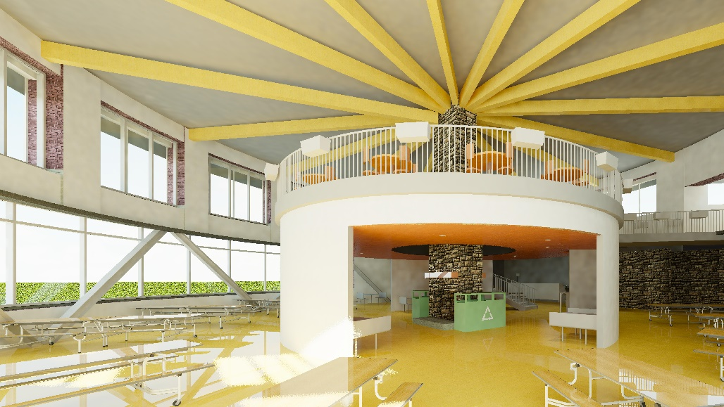
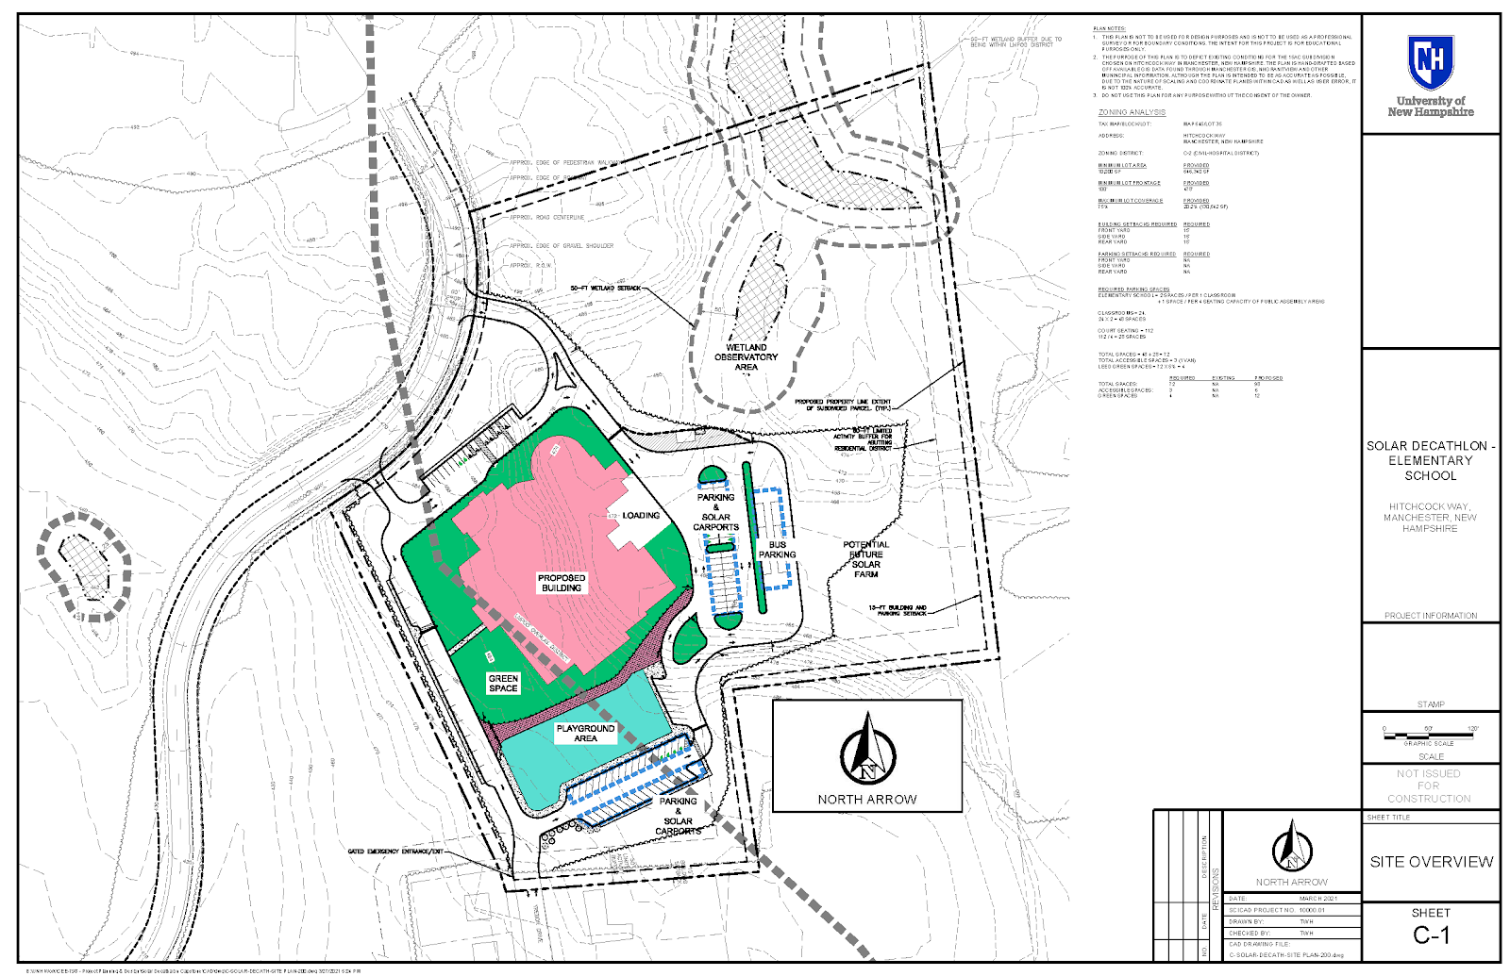
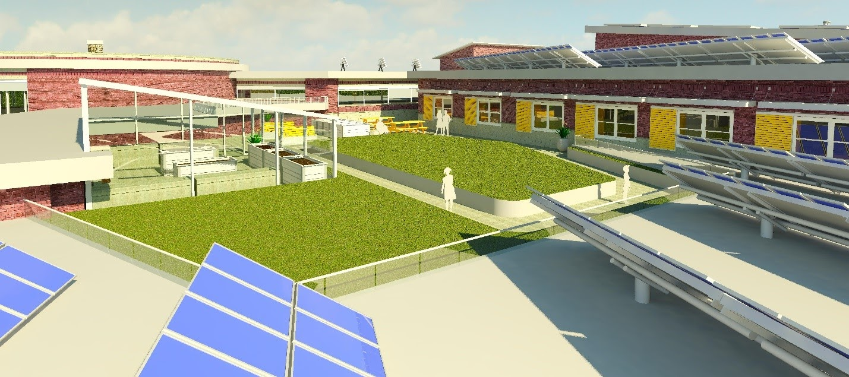
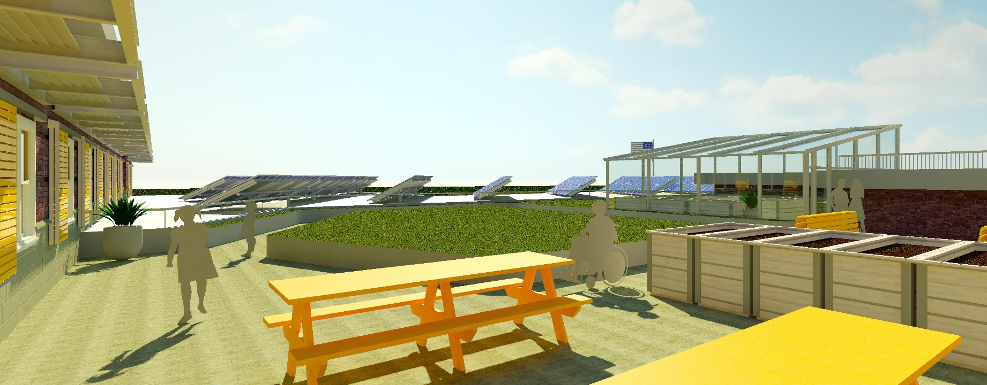
U.S. Department of Energy Solar Decathlon Jacey Chavez, Hannah Gagne, Tyler Heymans, John Plifka, Luke Zuchowski, Meredith Madden, Michael Pasciuto, Nicole Ramaker, Jonathan Stahl, Nicholas Thum Departments of Civil, Environmental, & Mechanical Engineering, University of New Hampshire, Durham, NH 03824
Place your Project Logo Here
Introduction
Design Renderings
Architecture
The U.S. Department of Energy Solar Decathlon is a global collegiate engineering competition, where teams compete to design the best building offering cutting edge and sustainable technology. Teams are judged in 10 equal-weight categories: architecture, engineering, market analysis, durability and resilience, embodied environmental impact, comfort and environmental quality, energy performance, and presentation.
This team chose to participate in the Elementary School Division, wining “Best of Show/Outstanding Showcase” in the final round of the competition.
Southern Exterior
Solar Chimneys, Algae Panels, 1MW Solar Array
Building Elevations
E.O.E Elementary is a 2 floor, 72,000 SF, type 2A construction project, designed to educate a student body of 600 students. The space offers architectural features such as the cafeteria rotunda and mezzanine, algae panels, solar chimneys, and a rooftop learning patio. The overall building form was created to consolidate the structure within the site to meet the desired energy goals, creating common central spaces, with classrooms placed on the exterior. Daylighting was improved through a stepped roofline, window shelves, and fiber optic lighting systems. A significant amount of the roof space was dedicated to solar, with the rooftop patio providing easy observation, along with an atrium and green roof to fully integrate renewable principles into the classroom.
Cafeteria Rotunda
Civil Site
Design Renderings
Mechanical Systems
Location
Manchester, NH
Lot Size
14.83 ac
Zoning
(C-2) Civic-Hospital District
Parking
93,000 SF, 98 total spaces (12 green)
Features
Solar carports, all-inclusive playground area, two drop off locations, wetland observatory area
Civil Site
Rooftop Patio, Atrium, Green Roof
The mechanical systems of the school were designed to be fully renewable.
Plumbing
Rainwater collection and localized on-demand water heaters decrease water usage and energy load.
Electrical
Designed to be fully automatic, integrated, and interactive to minimize energy load when not needed. Consists of three modes to ensure proper operations even in adverse conditions.
HVAC
Utilizes traditional mechanically forced and passive ventilation via solar chimneys. Heating and cooling loads carried by ground sourced heat pumps.
Renewables
sTAMD Simulations
Acknowledgements
Charts
E.O.E Elementary centered its energy practices around dual use, most notably as a peak shedding power plant. This was in line with forward thinking policies, such as the Massachusetts Clean Peak Standard and FERC Order 2222. The electric bus fleet in combination with battery storage tout a capacity of 2.76 MW. The on-site solar generation yields 1.036MW of generation capacity and produces 1, 317, 736 kWh/yr. Through full vehicle to grid capabilities, our devices charge when electricity costs are low and discharge back into the grid when prices are high, earning the school a maximum revenue of $32.03 per day.
Calculated EUI
Cost Analysis
Felix DeVito, Registered Architect
Martin Wosnik,
PROCON Inc,
Competition Requirement | 63 kBTU/gsf
Summer Max Load Target | 31.26 kBTU/gsf
Winter Max Load Target | 27.38 kBTU/gsf
Average Max Load Target | 28.67 kBTU/gsf
Estimated Produced Energy | 62.64 kBTU/gsf
Estimated Total Energy | -33.97 kBTU/gsf
Building Material & Labor | $6,700,000
Civil Site | $2,300,000
Solar Panels & Heat Pumps | $1,300,000
Electric Bus Fleet | $600,000
Mechanical Systems | $900,000
Estimated Engineering & Architecture Fees | $1,800,000
Yearly Operation & Maintenance | $400,000
Estimated Initial Build Total | $13,600,000
References
National Renewable Energy Laboratory
Federal Energy Regulatory Commission
American Society of Heating, Refrigerating, and Air-Conditioning Engineers
National Fire Protection Association
Illuminating Engineering Society

