Slide 1

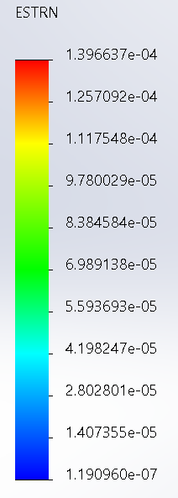
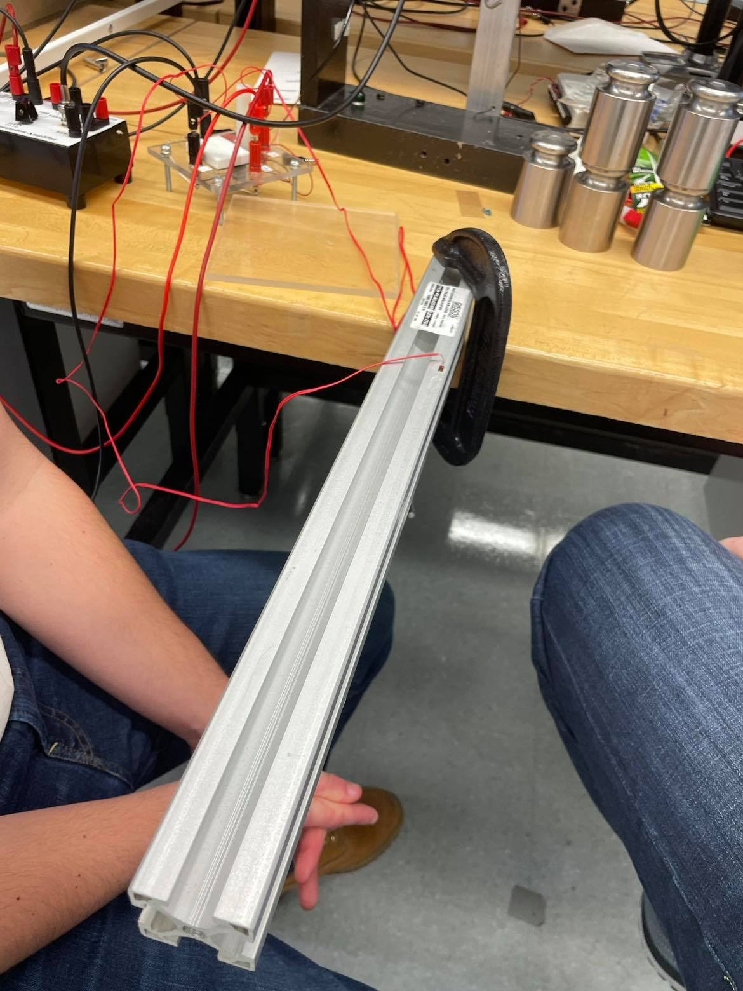
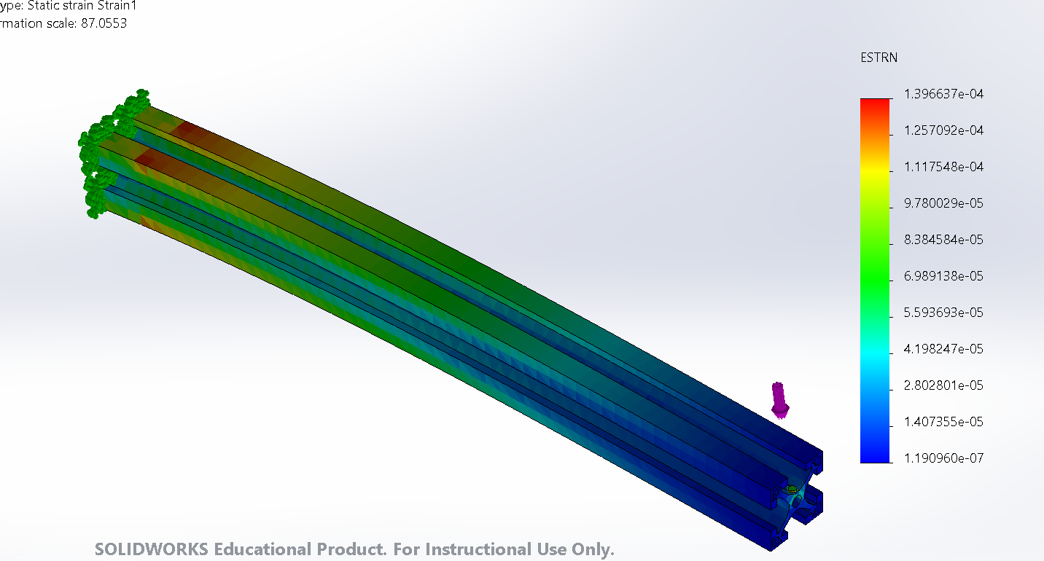
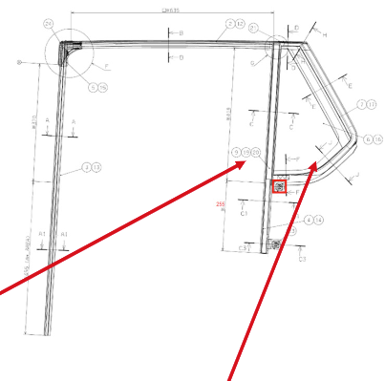
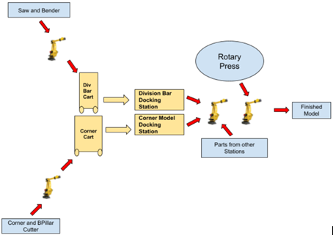
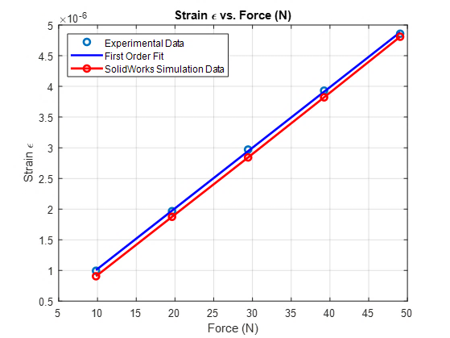
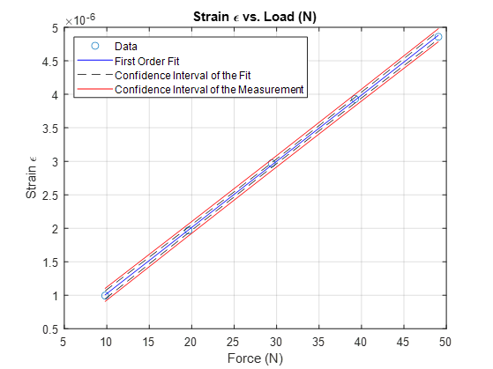
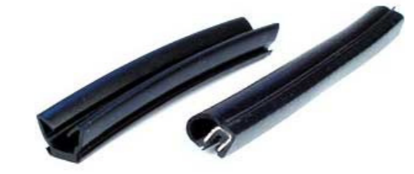
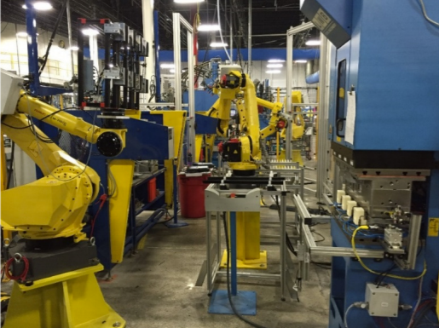
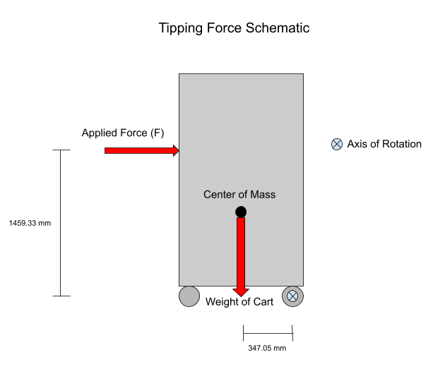
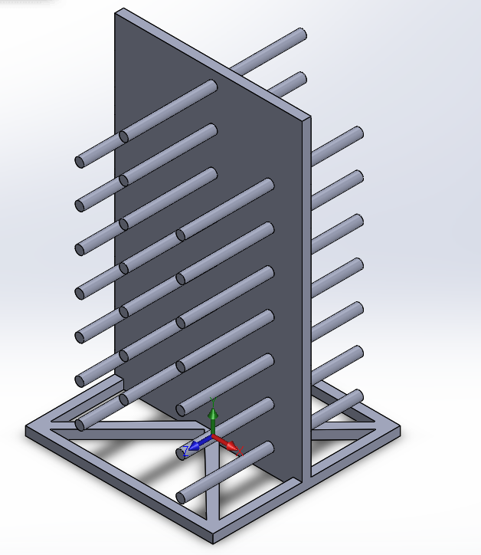
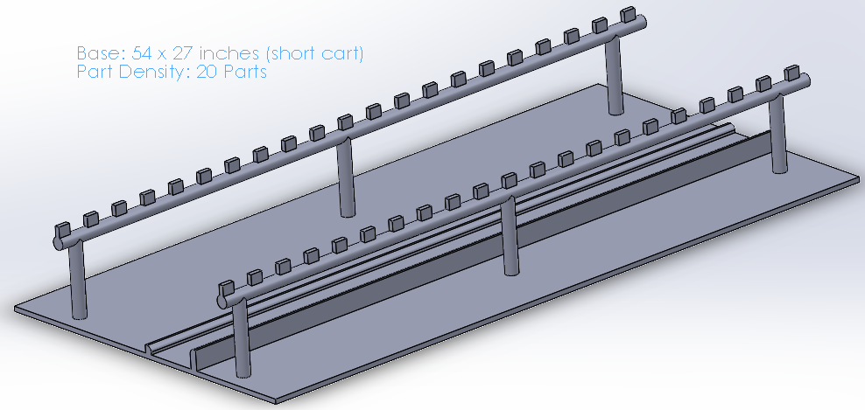
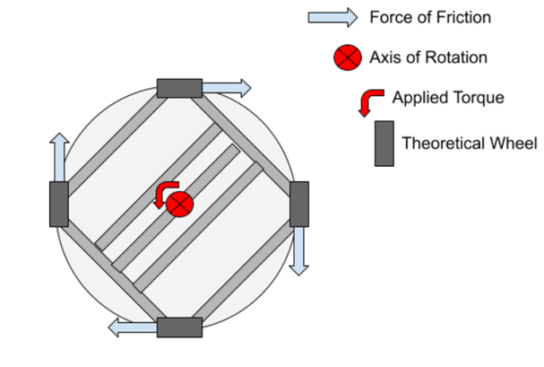
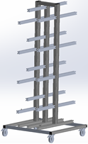
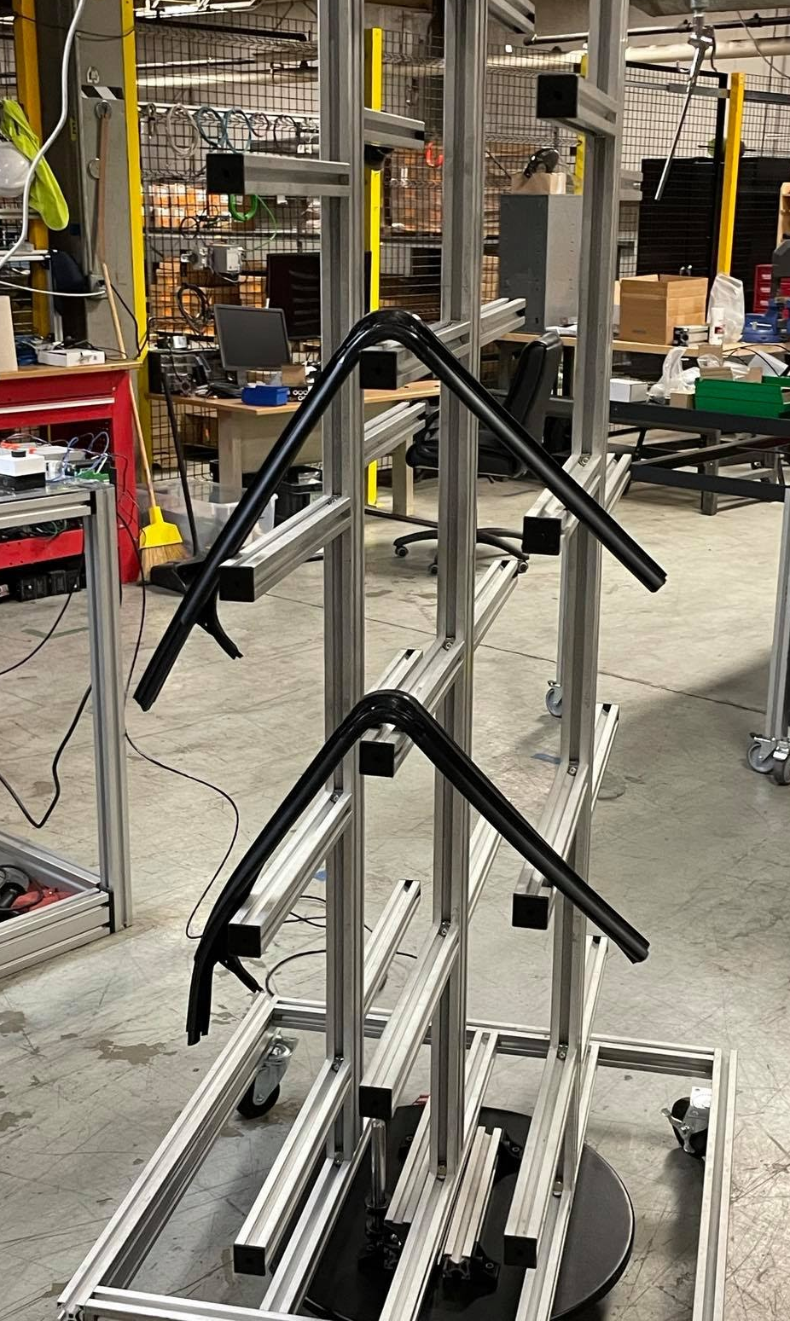
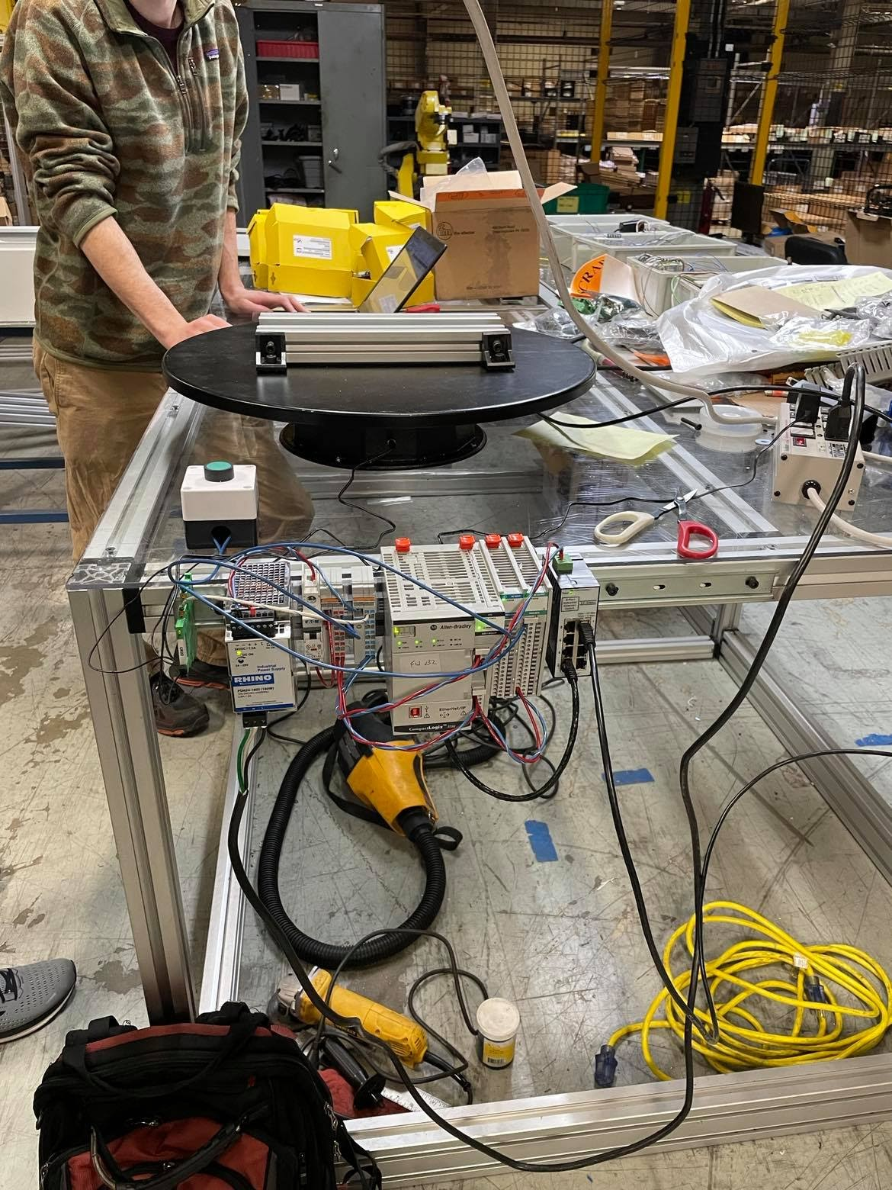
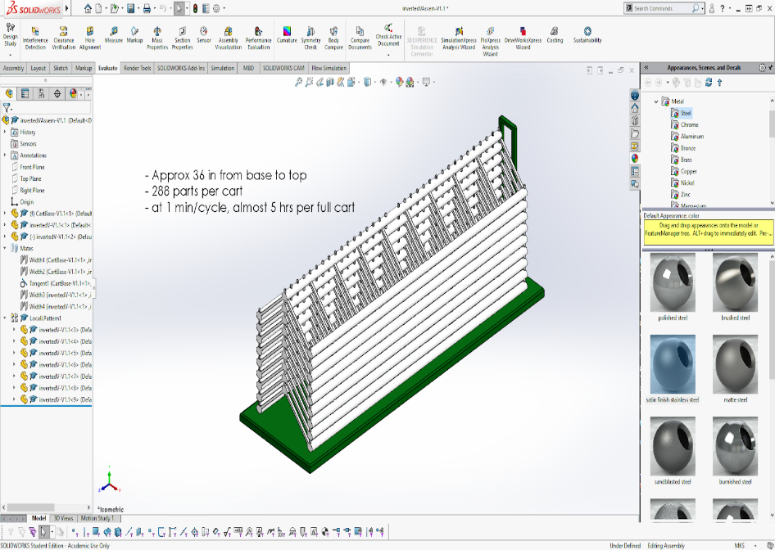
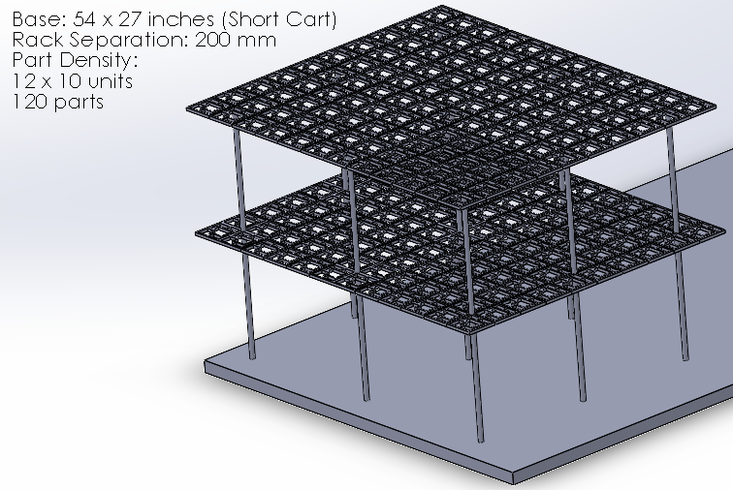
Hutchinson Material Handling in Robotic Manufacturing Cell
Matthew Dunbar, Timothy Morris, & Jackson Tarrant
Department of Mechanical Engineering, University of New Hampshire
Academic Advisor: Professor Alireza Ebadi
Industry Advisors: Saman Nouri & Samuel Cole
Overview
Analysis
Results
One of the highest priorities in manufacturing is making the system as efficient as possible, maximizing output, and minimizing the time and cost. Hutchinson Sealing Systems Co. is preparing to make window seals for the new 2021 Honda Pilot model. To do this, automated robotic cells need to be reformatted to meet the new part criteria. The main objective was to transport two different rubber seals between automated cells.
A worst-case scenario load was simulated using SolidWorks.
The strain was measured experimentally, as shown on the right.
The plot below compares the simulation results to the experimental results with a first order fit.
SolidWorks Static Simulation: Fixed end and 110 N load at the end of the beam
Strain test results with 95% confidence interval
Design Criteria
Minimize human interaction
  Minimum ~ 60 minutes
Maximize part density
  Minimum ~ 60 parts
Robot compatibility
Cost efficient
Easy load/unload
Minimize floor space
  Maximum ~ 1.4 x 1.4 meters
Solution
Tipping Force Schematic: Axis of rotation located at the front wheel axle
Applied force located at average applied height from ground.
Maximum applied force = 257 N
Double-sided rolling rack
  12 extrusions mounted to either side
  3 central column supports
  Extrusions oriented in four iterations of a triangle on which corner model rests (seen in the figure below)
64-88 parts
Rotates via the docking station 180 degrees following the automated loading/unloading
  Rotation controlled by a time-based PLC machine code
Alternative Designs
Docking Station Schematic: Central axis of rotation
Cart weight distributed equally between four wheels
Required Torque = 530 Nm

