Slide 1

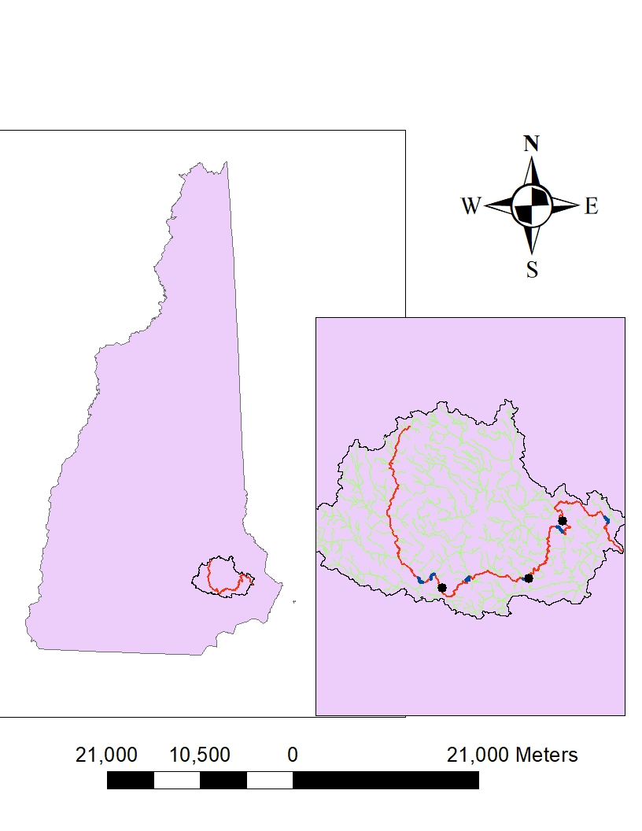
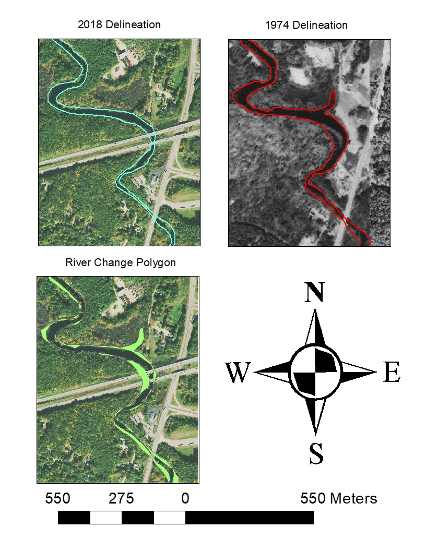
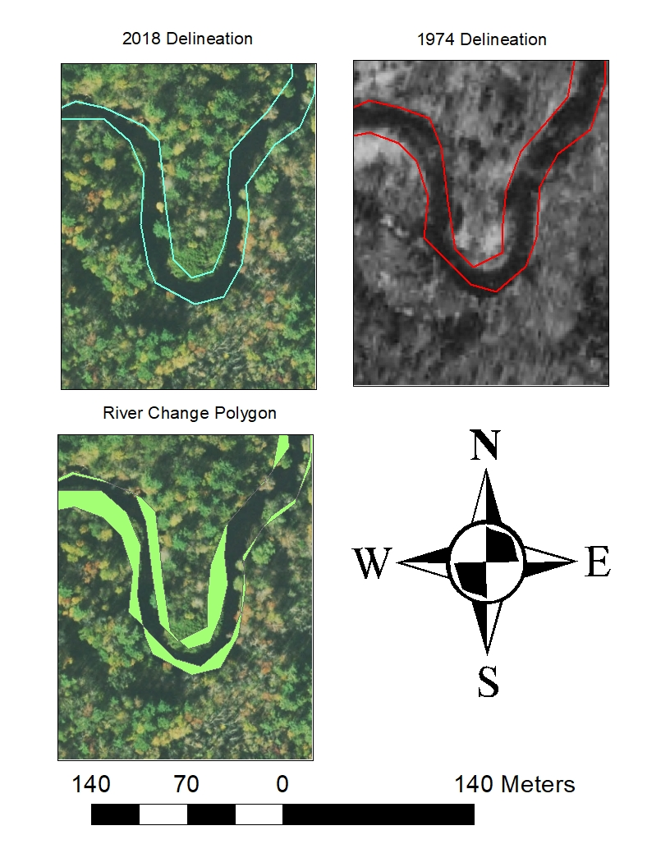
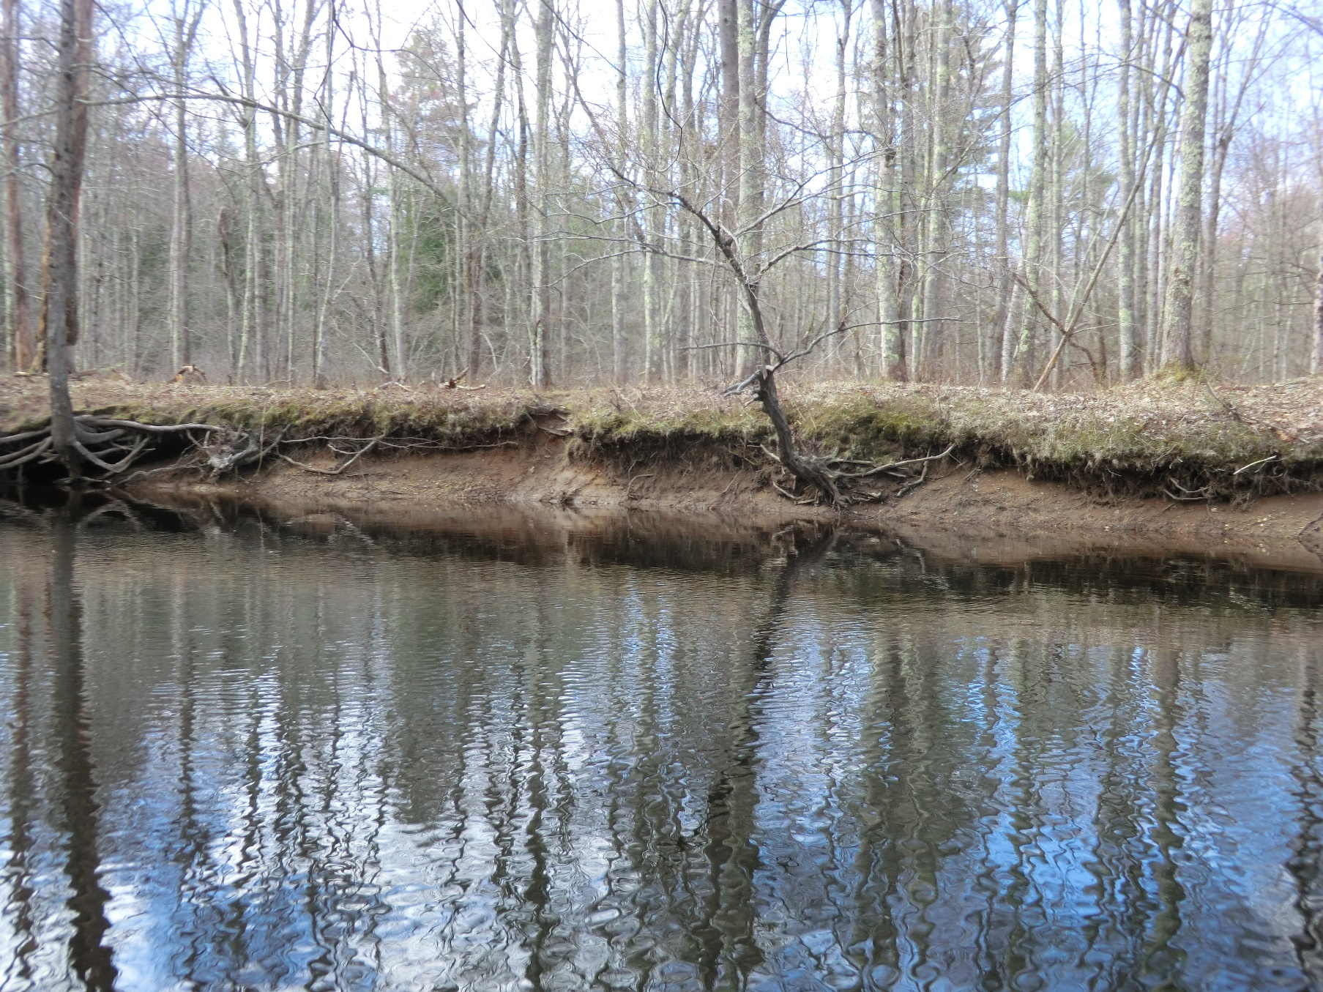
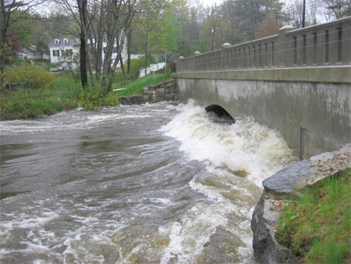
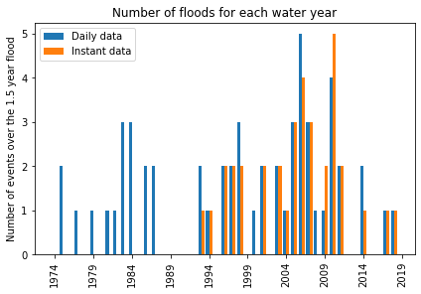
An Analysis of River Channel Change Over Time in the Lamprey River
Trevor Fenoff, Advisor: Anne Lightbody
Department of Earth Sciences, University of New Hampshire, Durham, NH 03824
Background
River Channel Delineation
Meandering river channels change and migrate over time (1).
Flood frequencies have increased in the Lamprey river (2).
Climate change has been shown to cause an increase in flood frequencies (3, 4).
Increased channelization and urban land cover has been shown to increase runoff and flood magnitudes (4, 5).
NAIP imagery obtained at different dates
Hand delineation completed in ArcMap on both sides of the river channel
1:10,000 scale
Converted each delineation to a polygon
Compared the two polygons to determine the change
Looked at difference for each kilometer of the river
Significance
Figure 2: Map showing the location of the Lamprey River in NH, and a section zoomed in on the watershed.
Figure 3: Map showing the 1974 and 2018 delineations and the river change polygon.
Flood Frequency Analysis
A change in flood frequency may increase river change through erosion and deposition.
River channel change can potentially harm private property and public infrastructure on the riverbanks.
Daily and 15-min discharge data obtained from USGS
Peaks-over-threshold analysis
1.5-year flood magnitude
Compared daily and 15-min peak results
Figure 1: Flooding on the Lamprey River (6).
Results
Figure 4: Map showing the 1974 and 2018 delineations and the river change polygon.
Figure 5: Picture I took of the Lamprey River showing bank erosion.
References
Increasing flood frequency over time
River delineation method can work to determine river channel change, but can be impacted by inundation and tree crowns
(1) Joanna Zawiejska, Bartłomiej Wyżga, Twentieth-century channel change on the Dunajec River, southern Poland: Patterns, causes and controls, Geomorphology, Volume 117, Issues 3–4, 2010, Pages 234-246, ISSN 0169-555X, https://doi.org/10.1016/j.geomorph.2009.01.014. (https://www.sciencedirect.com/science/article/pii/S0169555X09002414)
(2) Wake, Cameron P.; Miller, Steve; Roseen, Robert; Scholz, Ann; Rubin, Fay; Simpson, Michael; Sinnott, Cliff; Peterson, Julia; and Townson, Lisa, "Assessing the Risk of 100-year Freshwater Floods in the Lamprey River Watershed of New Hampshire Resulting from Changes in Climate and Land Use" (2013). The Sustainability Institute. 19. https://scholars.unh.edu/sustainability/19
(3) Cameron, D., Beven, K., and Naden, P.: Flood frequency estimation by continuous simulation under climate change (with uncertainty), Hydrol. Earth Syst. Sci., 4, 393–405, https://doi.org/10.5194/hess-4-393-2000, 2000.
(4) Woltemade, C.J., Hawkins, T.W., Jantz, C., and Drzyzga, S.. 2020. " Impact of Changing Climate and Land Cover on Flood Magnitudes in the Delaware River Basin, USA." Journal of the American Water Resources Association 56 ( 3): 507– 527. https://doi.org/10.1111/1752-1688.12835.
(5) Brookes, A. (1987), River channel adjustments downstream from channelization works in England and Wales. Earth Surf. Process. Landforms, 12: 337-351. https://doi.org/10.1002/esp.3290120402
(6) Consequences to Flooding ALONG Lamprey River. 12 Sept. 2016, www.unh.edu/unhsc/recent-projects/consequences-flooding-along-lamprey-river.
Future Work
Undergraduate: Improve method to reduce introduced error. Delineate more (3-4) images to relate flood occurrence to channel change
Masters: Expand to focus on the impact of bank revetment and riparian vegetation to look for change from background channel change local to these structures. Expand to include another study river and further analysis using LiDAR data.
Figure 6: Lateral river channel change from 1974 to 2018, as well as channel width in 2018.
Figure 7: Bar plot created showing the number of events over the 1.5-year flood magnitude in the Lamprey River from 1974 to 2018.
Notes:
Attempting to correlate the number of floods to the amount of river channel change. First 3 points are below MacAllen Dam. 58 km of river delineatied. Only section that has reason for larger increase. Other jumps are due to error or a larger river area. Bankfull widths are much tired that calculated widths, due to the nature of bankfull widths and tree cover.19 floods in first 22 years, 36 in second 22 years. Increasing floods over time. R=0.92

