Slide 1
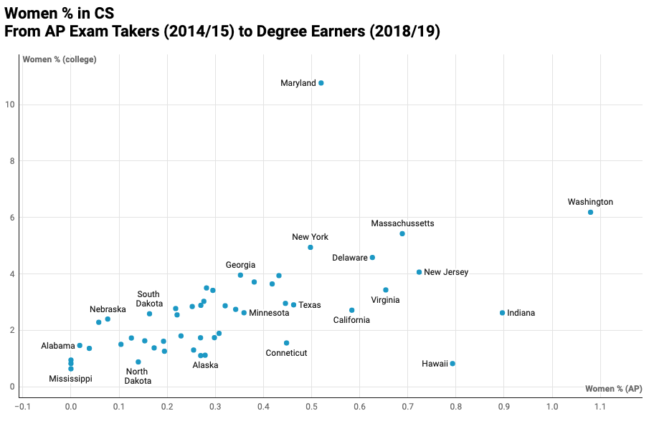
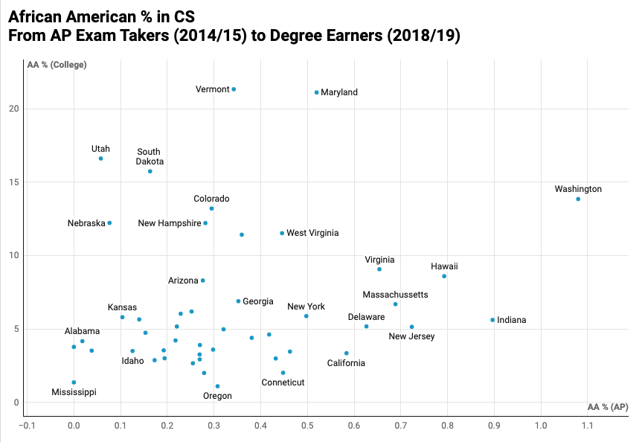
Gender and Racial Diversity in Computing Dakota Bagley, Abhilekh Adhikari, Ashley Martin Department of Computer Science, University of New Hampshire, Durham, NH 03824
Abstract
Gender: Women in Computing
Findings
The computing industry has long been lacking both gender and racial diversity at the professional and college levels. Nationally, approximately 82% of computing degrees are being awarded to White and Asian males. This research studies the diversity in computing the computing industry by analyzing computer science program enrollment at the high school and college levels. Our research addresses three essential questions. First, what percentage of college computing majors are female and/or from a minority race nationally? How do these percentages compare to the University of New Hampshire’s statistics? Next, how does exposure to STEM in early and secondary education relate to the diversity in students in computing majors in college? Finally, what factors contribute most to success in computing majors and jobs for females and minority race students? To address these questions, we collected data from the Integrated Postsecondary Education Data System and the College Board for AP Exams to analyze the relationship between college and high school computing enrollment. We also reviewed previous research to incorporate what is known about factors for success and failure of minority students in computing. This research will contribute to the understanding of the lack of diversity in computing so solutions can be found.
In 2018/2019, 15% of UNH computing degree graduates were female identifying and 1.3% were African American. The national average numbers are 24.4% and 8.3% respectively.
The greatest factor for success in computing for female and minority race students is prior exposure to computing. States with dedicated compter science education funding and legislation requiring computer science education see higher diversity in AP CS exam participation and college CS degree completion.
Maryland has required K-12 computing education and 83% of public high schools teach a computer science course. Louisiana in contrast only has 23% of high schools teaching computer science and has no required education or dedicated funding. There is a significant amount of diversity in CS graduates in Maryland and a lack of diversity in graduates in Louisiana.
Methodology
Future Directions
This project utilizes secondary data analysis and archival study of both quantitative and qualitative information.
Quantitative information was gathered from online data stores for the 2018/2019 school year. Qualitative information was gathered via various peer reviewed articles from sources such as the IEEE.
The quantitative and qualitative were used together to form the findings and conclusions.
Percentage of people identifying as female who graduated with a computer science degree in 2018/2019 versus female AP CS exam takers in 2014/2015
The data collected is from a small sample, only the 2018/2019 and 2014/2015 school years. Collecting data from additional years will provide a better sample size to perform analysis and may change the results of the findings. A potential issue with this being that the Race and Ethnicity statistics gathered by universities and the College Board vary by category names in previous years. This data would need to be normalized across all years sampled.
Collecting data on middle and high school CTE program participation in computing coursework would provide a larger sample for finding the link between educational exposure prior to post-secondary education and computing major graduation rates among minorities.
Race: African Americans in Computing
Data
Data for analysis was extracted from two sources, the Integrated Postsecondary Education System (IPEDS) and the College Board.
Data from IPEDS contains the number of computing majors for each college and university in the nation. The data further breaks down into the number of computing majors that are of a given gender or race for each college and university. The data is grouped by state and region.
The data from the College Board contains a breakdown of the number of AP computer science exam takers of each gender and race.
References
[1] https://codeorg.medium.com/is-diversity-in-computing-jobs-improving-32f30068b7de
[2] The Integrated Postsecondary Education Data System, 2019. [Online]. Available: https://nces.ed.gov/ipeds/use-the-data.
[3] Page, S. (2020). The diversity bonus : how great teams pay off in the knowledge economy . Princeton University Press.
[4] Nh.gov. 2020. Age, Race, And Gender Estimates | State Data Center | NH Office Of Strategic Initiatives. [online] Available: https://www.nh.gov/osi/data-center/age-race-gender.htm
[5] “Updated 2020 AP Exam Dates and Fees: College Board,” AP Central, 03-Nov-2020. [Online]. Available: https://apcentral.collegeboard.org/courses/exam-dates-and-fees. [Accessed: 14-Dec-2020].
[6] J. C. Prey and A. C. Weaver, "Fostering Gender Diversity in Computing," in Computer, vol. 46, no. 3, pp. 22-23, March 2013, doi: 10.1109/MC.2013.97.
[7] T. Whitney, D. Gammal, B. Gee, J. Mahoney and C. Simard, "Priming the Pipeline: Addressing Gender-Based Barriers in Computing," in Computer, vol. 46, no. 3, pp. 30-36, March 2013, doi: 10.1109/MC.2013.40.
[8] J. Denner and S. Bean, "The Role of Relationships in Engaging Latino/a High School Students in Computer Science," 2018 Research on Equity and Sustained Participation in Engineering, Computing, and Technology (RESPECT), Baltimore, MD, 2018, pp. 1-5, doi: 10.1109/RESPECT.2018.8491715.
Percentage of people identifying as African Americane who graduated with a computer science degree in 2018/2019 versus African American AP CS exam takers in 2014/2015

