Slide 1
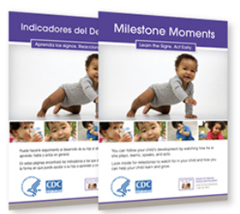
Watching them Grow: Importance of Early Developmental Screening
Bianca McAfee, B.A., Communication Sciences and Disorders
Background
Data Collection and Analysis
WMG
Watch Me Grow
Developmental screening, referral and information system for families of children ages birth to 6 years old
LTSAE
Learn the Signs, Act Early
Provides parents, caregivers and professionals with information about developmental monitoring and development
NHFV
New Hampshire Family Voices
Houses these materials and promotes a community-based system of services that is family-centered, comprehensive, coordinated and culturally competent
Project Outcome to Date
A distribution plan including:
Methods of sharing WMG and LTSAE materials
Specific organizations/places
Highlighted materials (e.g., handbooks, tracker)
Qualtrics Survey Questions
1) Settings that young children go to
2) Organizations that would benefit from the materials
3) Three contacts to reach out about the materials
4) Best way to share these materials to families (e.g., through mail, placing at center, etc.)
5) Specific materials that NH families would benefit from most
Checklists to NH Families in September
Small # of organizations for 3 months
Expand to NH statewide
Prior to this leadership project, there had not been a plan to distribute these materials in New Hampshire
Description of Project Activities
LTSAE materials increase caregiver’s and professional’s knowledge on the developmental milestones to bring awareness to how a child’s development is progressing. A plan to distribute these materials across NH is crucial to fulfill this effort.
Survey Results
1
2
3
4
Settings that Children Go To:
Gymboree
Organizations:
Pediatricians and family offices
Contacts:
WIC
Best Method to Share:
Mail
Specific Materials:
Milestone Moments Checklists
Retail stores/mall
Parks
Childcare centers
Museums
WIC
EI home health
Child-care programs
DCYF
OBGYN
Developmen-tal Pediatric physicians
Early Intervention members
Social media (FB and Instagram)
Placing them at childcare centers/doctor’s offices
Children’s Books
Milestone Moments Handbook
Tracker App
5
Reviewed and organized the LTSAE materials
Created a survey of questions
Met and collaborated with professionals around NH
Analyzed information from survey and interviews
Assembled distribution plan
Take-Aways and Next Steps
WMG and LTSAE materials help parents and caregivers understand the importance of developmental milestones as their child grows and develops
Many organizations around NH are open to receiving and sharing materials with families
The WMG and LTSAE materials distribution plan is set to pilot in the fall of 2021

