Slide 1

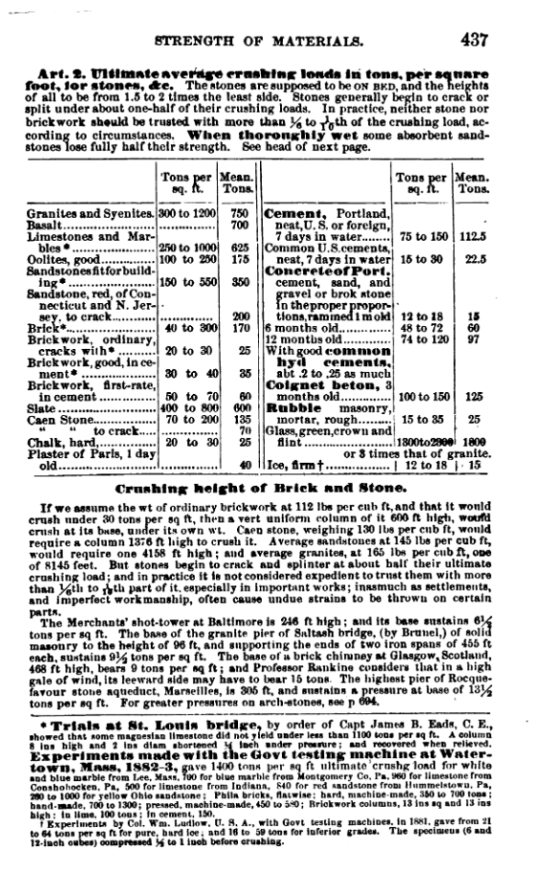
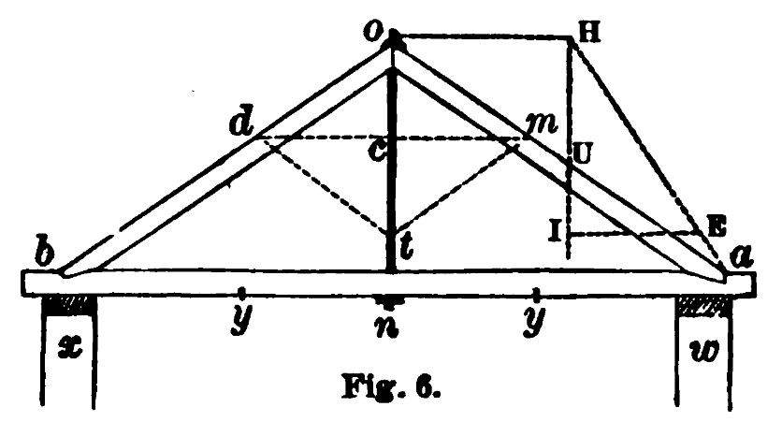
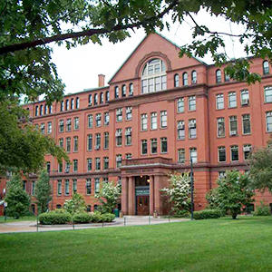
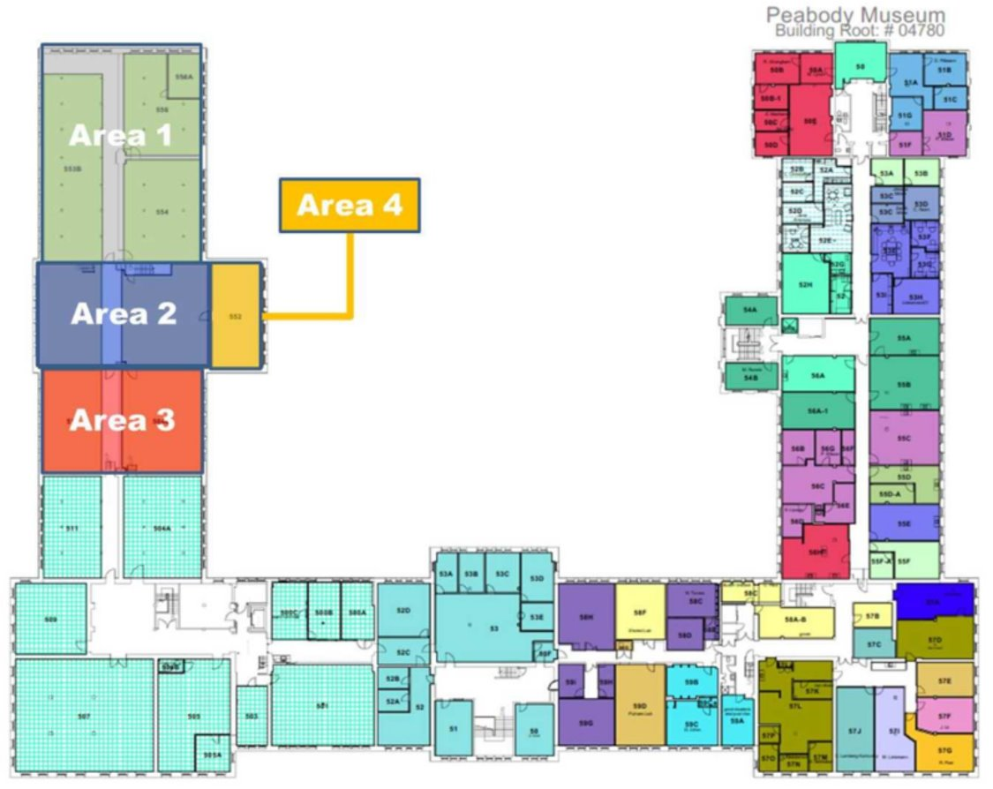
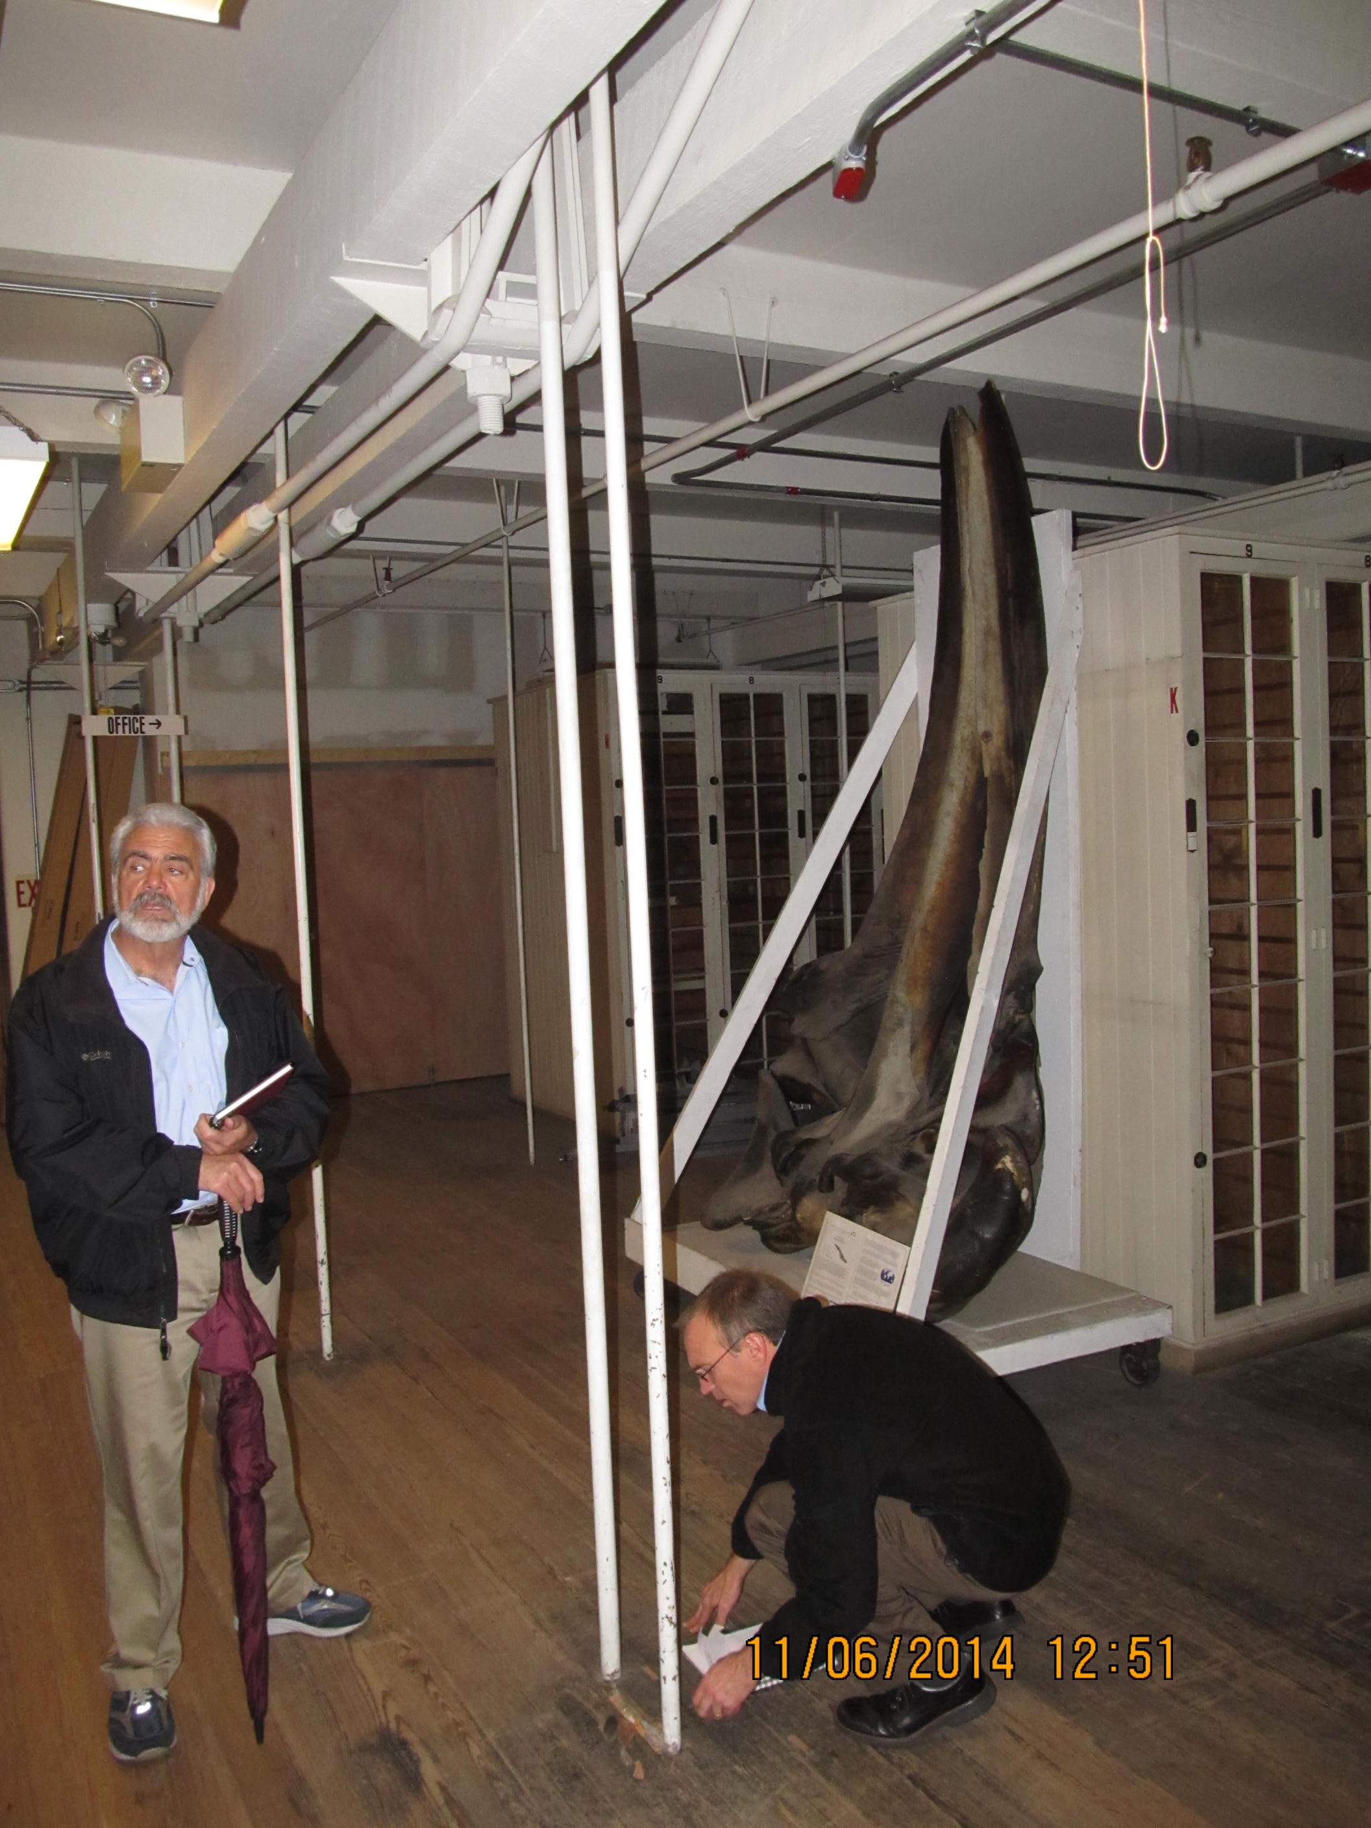
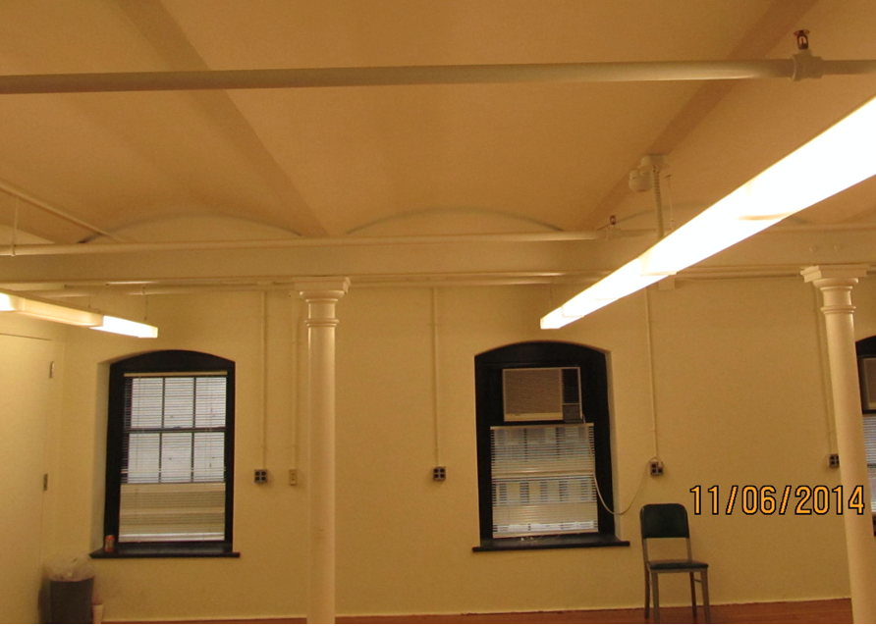
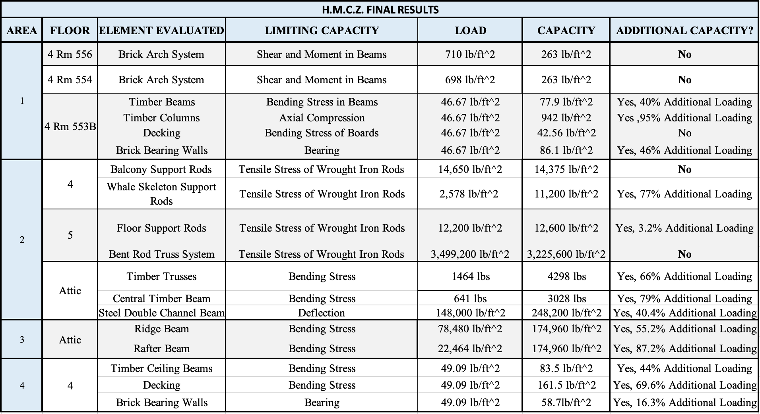
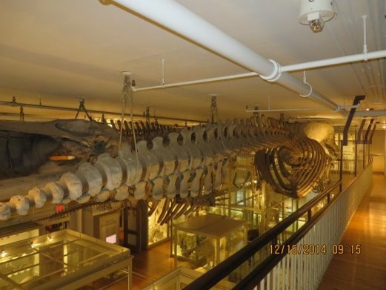
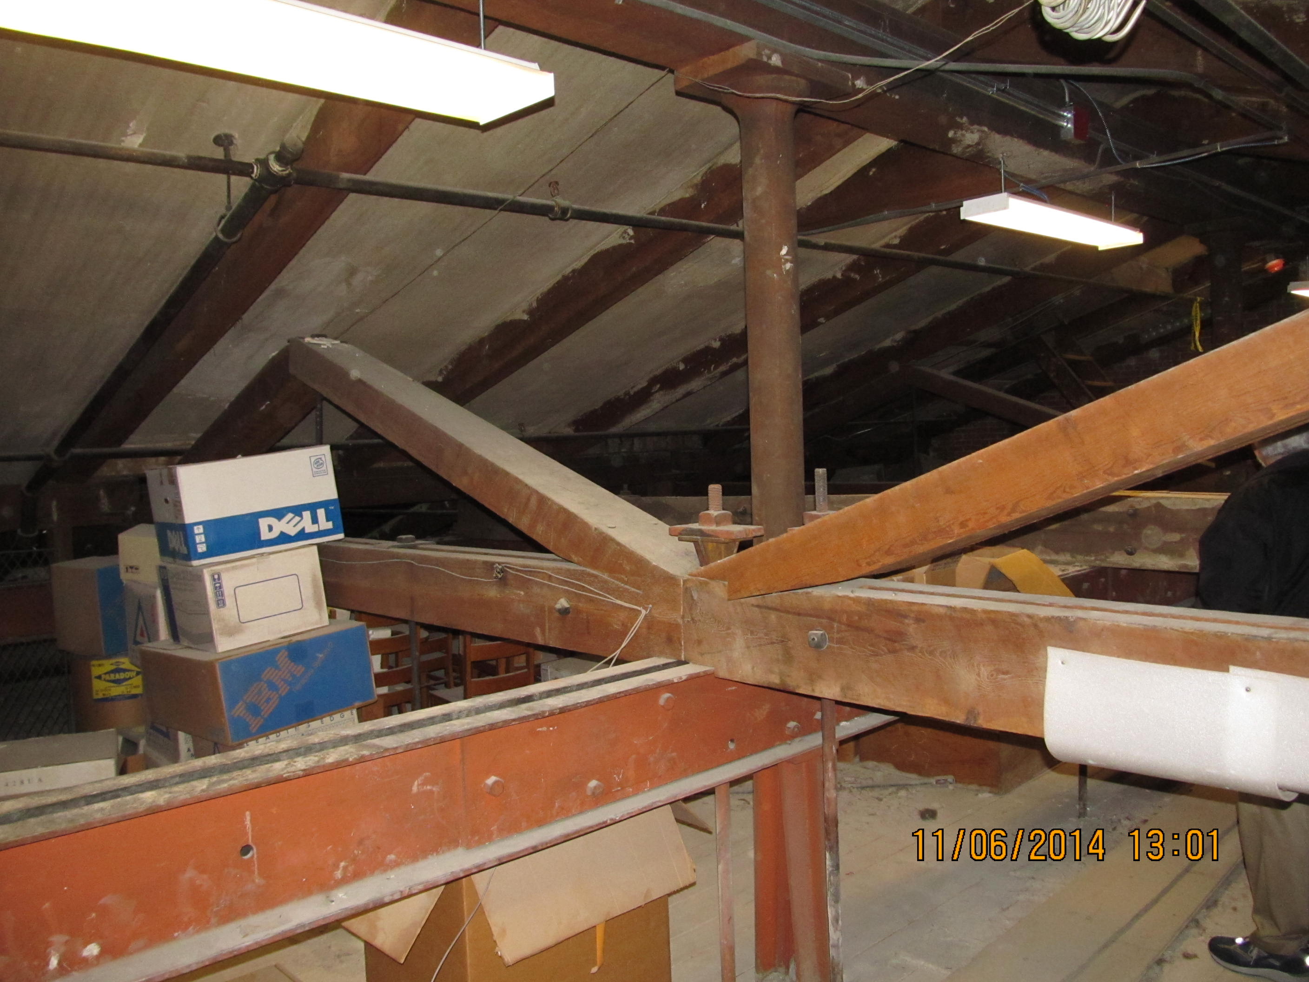
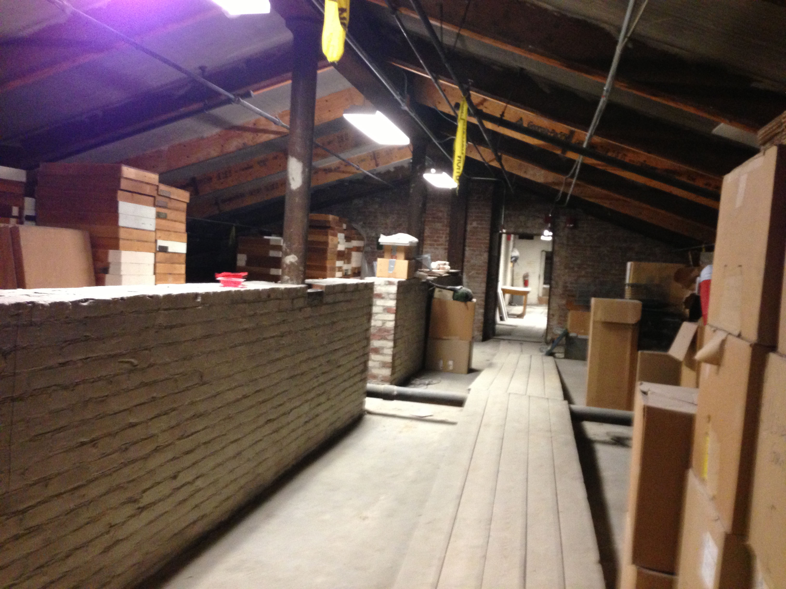
Harvard Museum of Comparative Zoology
Ryan Daley, Ailish Bozzo, and Alden Blais, Civil Engineering, University of New Hampshire
background
Analysis methods
Historical Research
The Harvard Museum of Comparative Zoology was constructed and opened in 1859.
Harvard has become concerned with the structural integrity of several fifth-floor rooms and their ability to support additional loading.
The goal of this project was to determine the load capacity of the areas of interest and determine if the existing structure is able to support current and additional loading.
Through a virtual site visit, sketches of current condition and load paths were developed. With spreadsheets and hand calculations, service loads, current capacities, and additional loading were calculated.
Utilized manuals dating from 1876 to 1923 that held information regarding steel materials, iron materials, timber materials, and more.
Results
Four areas were inspected throughout this project. Structural elements included cast-iron beams, wrought-iron columns, wrought-iron tension rods, timber trusses, timber beams, timber rafters, and a bent-rod truss system.
When comparing calculated service loads and structural capacities, high factors of safety were used in concurrence with historical research. Due to this, service loads greater than capacities does not indicate building failure or collapse.
conclusions
Through historical research and a virtual site visit, a virtual structural analysis of the Harvard Museum of Comparative Zoology was completed to determine current service loads, capacity loads, and retrofit schemes for the necessary areas.
In conclusion, out of the eight areas investigated, five structural elements required a retrofit design.
Retrofit designs were based on the calculated service and capacity loads.
Key elements investigated
Bent Rod Truss
Brick Arch
Attic Timber Truss
Attic Area 3

