Slide 1
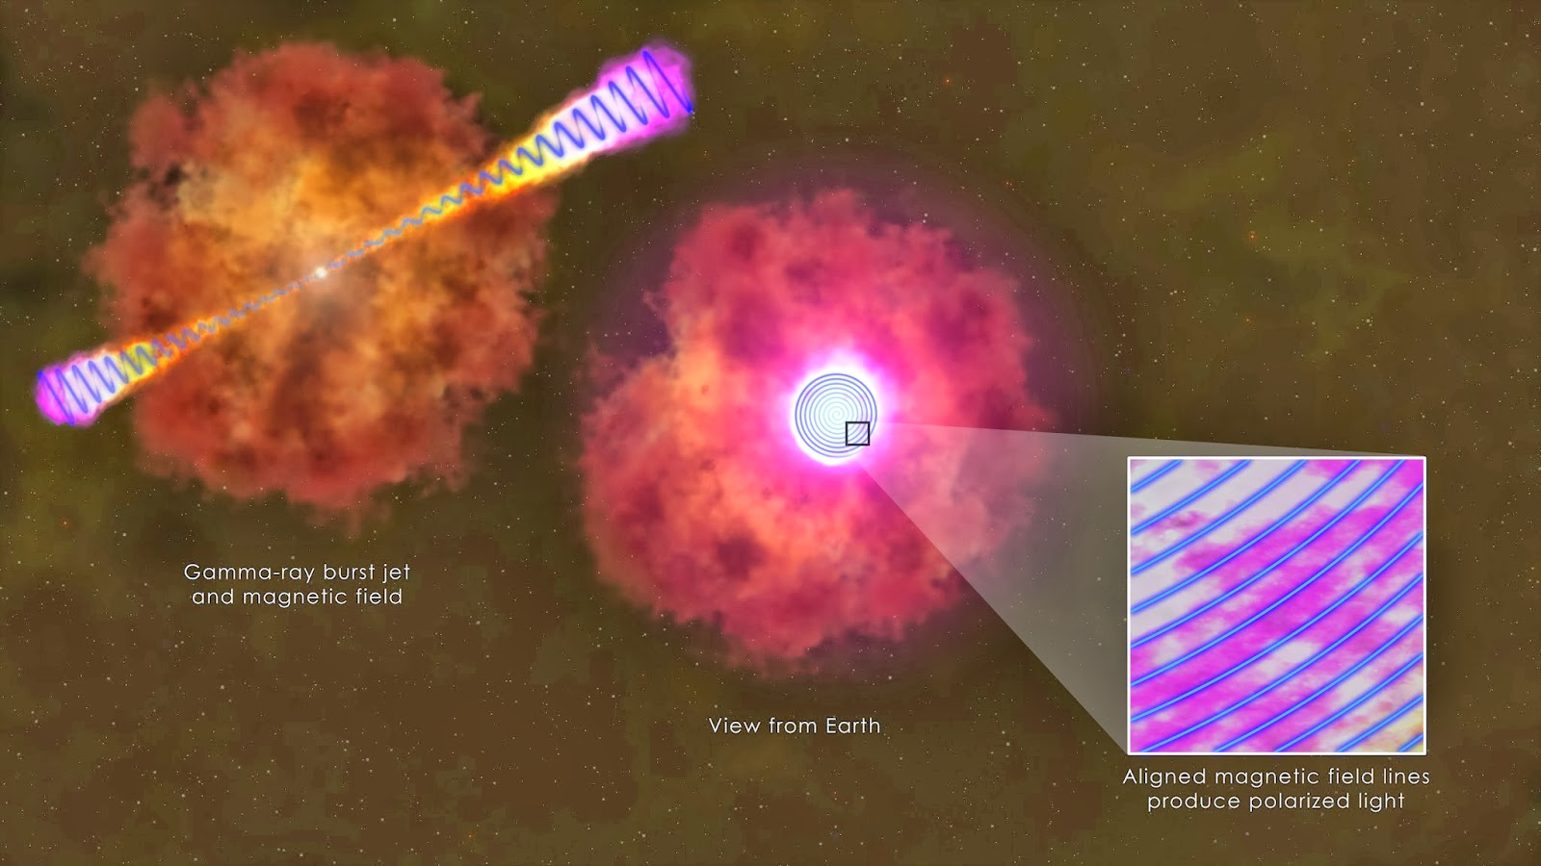
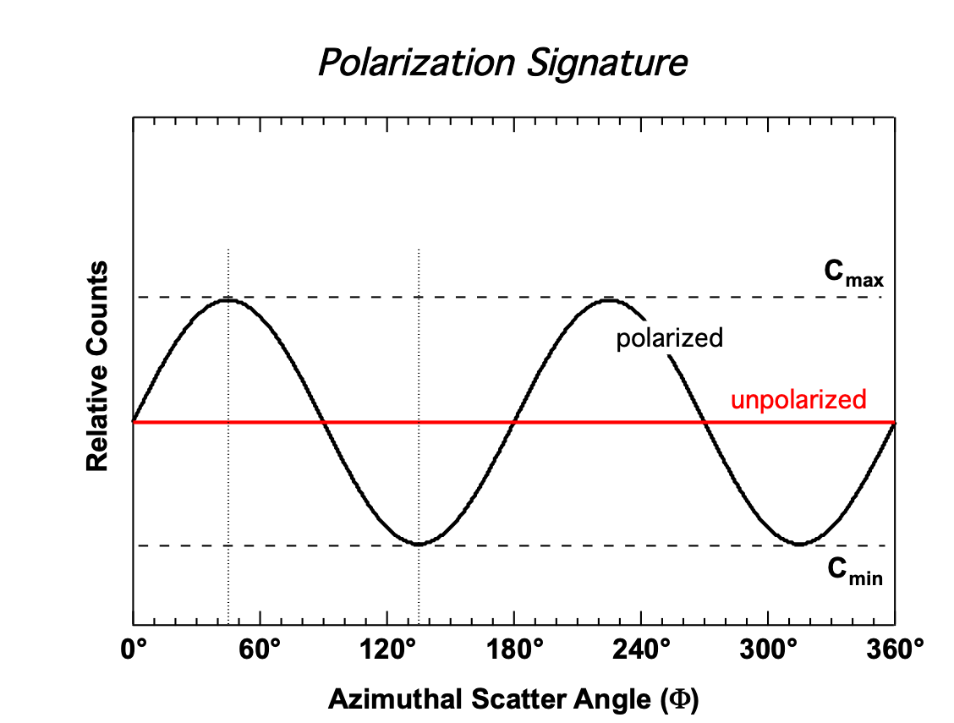
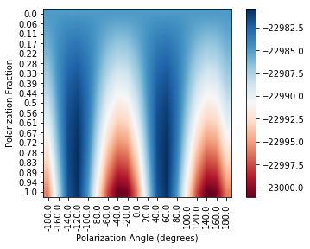
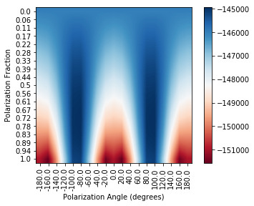
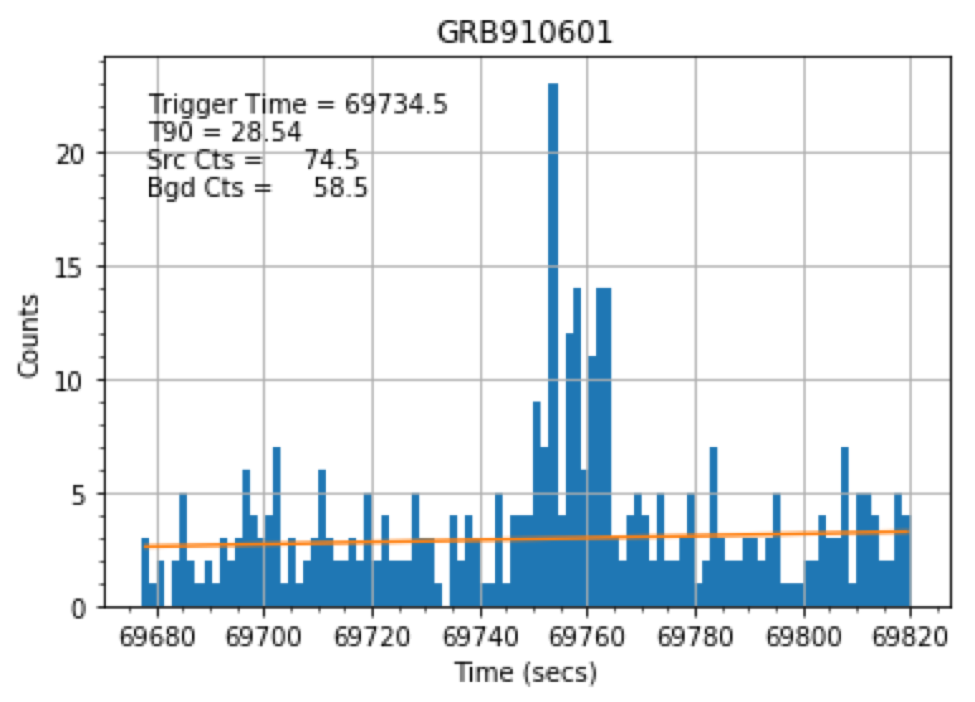
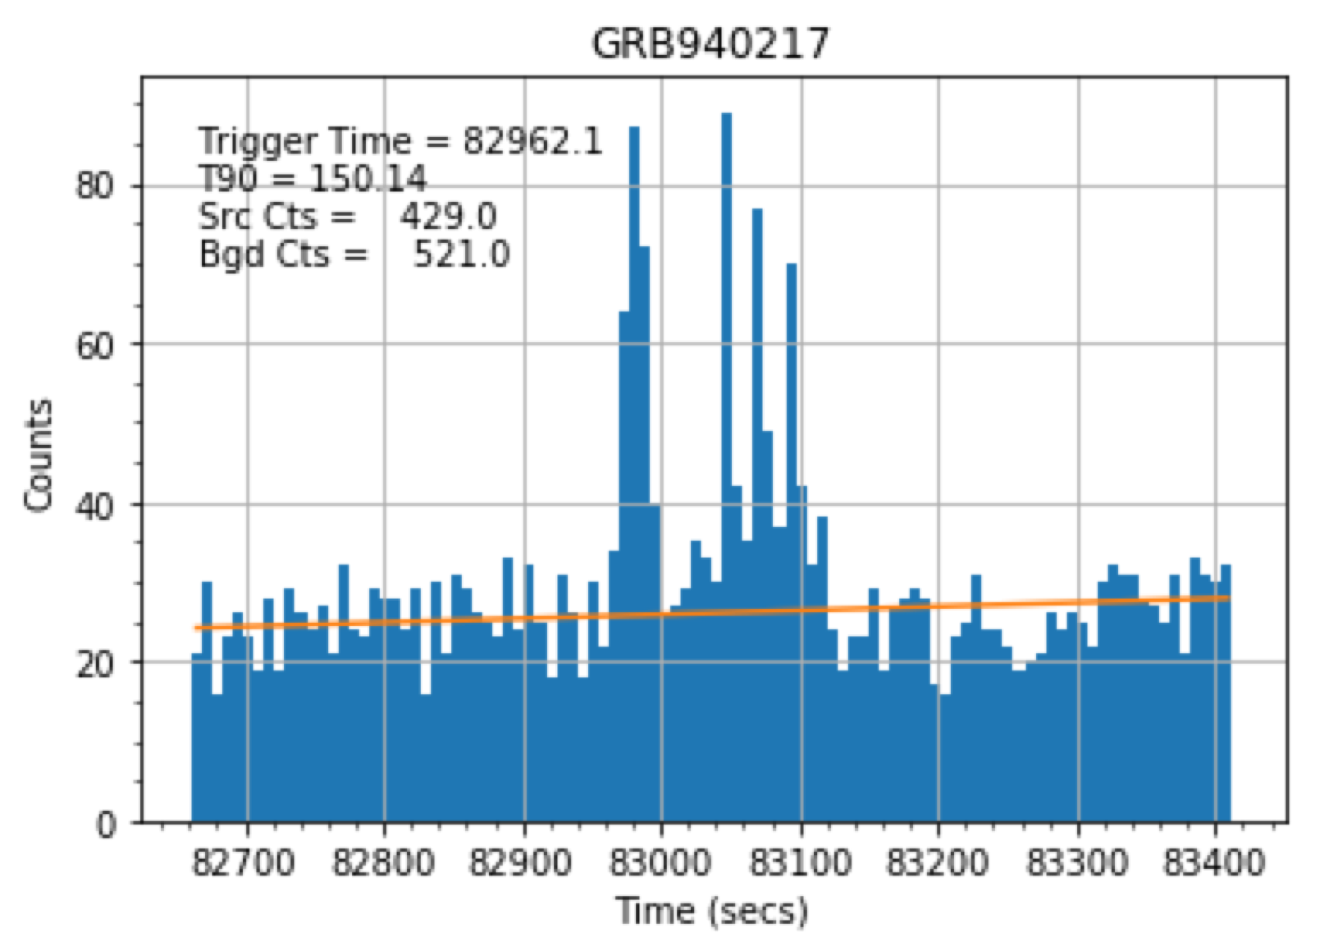
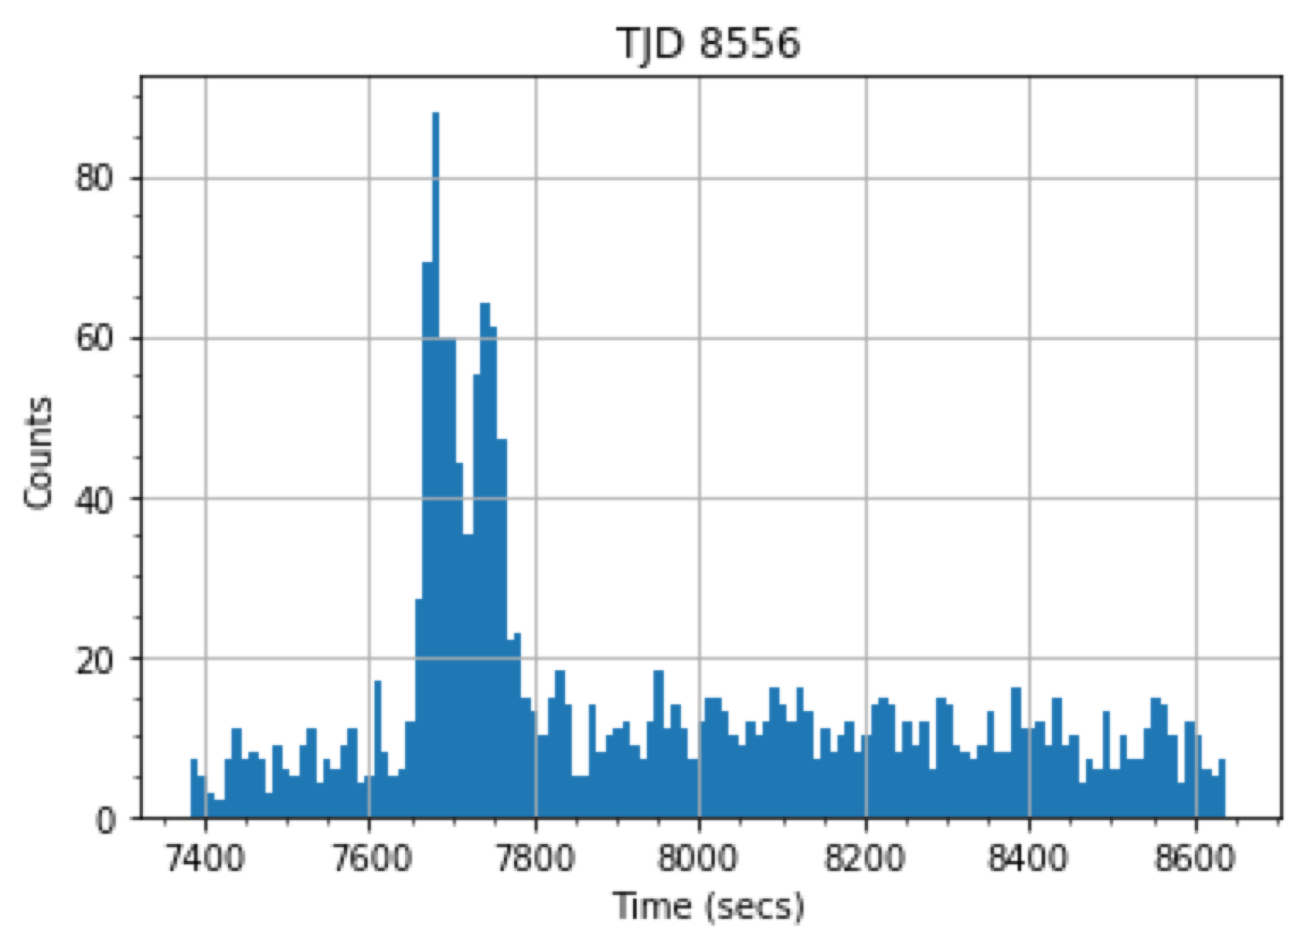
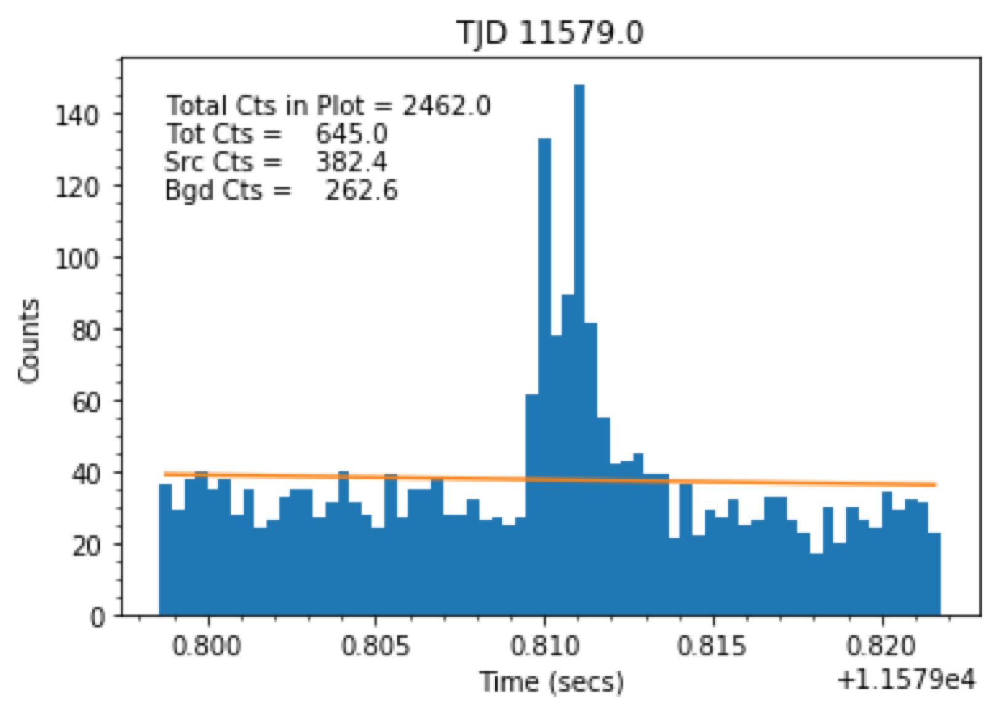
Assessing the Applicability of the Maximum Likelihood Method for LEAP Using COMPTEL Data Audrey Coleman¹, Mark McConnell^{1,2}, Karla Oñate Melecio¹, Camden Ertley¹ ¹University of New Hampshire, ²Southwest Research Institute
Polarization
Compton Polarimetry Methods
When gamma rays, or high-energy photons, are created in the presence of a magnetic field, they retain information about the magnetic field in a process called polarization. Magnetic fields play an important role in many explosive events such as gamma-ray bursts (GRBs) and solar flares. Polarization measurements are thus useful in determining the properties of these events.
In Compton scattering, the incident photon tends to scatter at right angles to the incident electric field vector. For polarized photons, the distribution of azimuthal scatter angles will be sinusoidally distributed. The energy-dependent modulation factor (µ) characterizes the polarization signature and can be used to estimate the minimum detectable polarization (MDP). This represents the minimum level of polarization that can be detected
Standard Method
Using the Standard Method, the MDP is given by
where µ₁₀₀ is the modulation factor corresponding to fully polarized radiation, C_{src} is the total number of source counts during the observation time interval, and C_{bgd} is the total number of background counts during the observation time interval.
Maximum Likelihood Method
The maximum likelihood method is expected to improve polarization sensitivity because it does not involve binning the data and includes Compton scattering angles in its analysis.
Results
CGRO/COMPTEL
Standard Method: All MDPs were greater than 1, meaning COMPTEL was not sensitive enough to detect polarization.
Maximum Likelihood Method: Our results show that COMPTEL was not sensitive enough to detect polarization using this method. Preliminary simulated data from the Large Area Burst Polarimeter (LEAP) have been more promising.
The COMPTEL instrument on the Compton Gamma Ray Observatory (CGRO) was a double-scatter instrument (D1 - liquid scintillator / D2 - NaI(Tl)) capable of imaging 0.75-30 MeV gamma rays.
Our work employs the MEGAlib software package. MEGAlib provides a more user-friendly interface to the GEANT4 software. One of the advantages of using this package was the ready availability of a detailed COMPTEL mass model (seen here).
We tested the maximum likelihood method using simulated COMTPEL and LEAP data that was 100% polarized with a polarization angle of 0 degrees.
For the simulated COMPTEL data, the angle is incorrect. This is likely because COMPTEL itself was not sensitive enough to polarization.
Simulated COMPTEL Data (100% Polarized)
We next used the maximum likelihood method to analyze LEAP data. LEAP will be more sensitive to polarization than COMPTEL and is thus a good test to ensure that an error in method itself is not to blame for inaccuracies.
The polarization angle is again incorrect, but this inaccuracy is symmetric about the correct angle of 0 degrees. Further study is needed.
Simulated LEAP Data (100% Polarized)
COMPTEL Data
We have looked at all GRBs and flares that took place within ±30° from the pointing direction in order to determine the estimated MDP for each event. The analysis was performed over the energy range from 750 keV to 3 MeV. Several events showed significant signal, some of which are shown here.
Conclusions
COMPTEL was not sensitive enough to detect polarization using either method
The maximum likelihood method may be a better method of analysis for the future Large Area Burst Polarimeter (LEAP) mission.
Acknowledgements
X1.9 Flare 1991 Oct 27
X1.2 Flare 2000 Feb 5
I would like to thank Prof. Mark McConnell, Prof. Fabian Kislat, Karla Oñate Melecio, and Camden Ertley for their assistance on this project.
References
Lowell, A., Boggs, S., Chiu, J. L., et al. 2017, ApJ, 848, 119 (Paper I)
Lowell, A., Boggs, S., Chiu, J. L., et al. 2017, ApJ, 848, 120 (Paper II)

