Slide 1
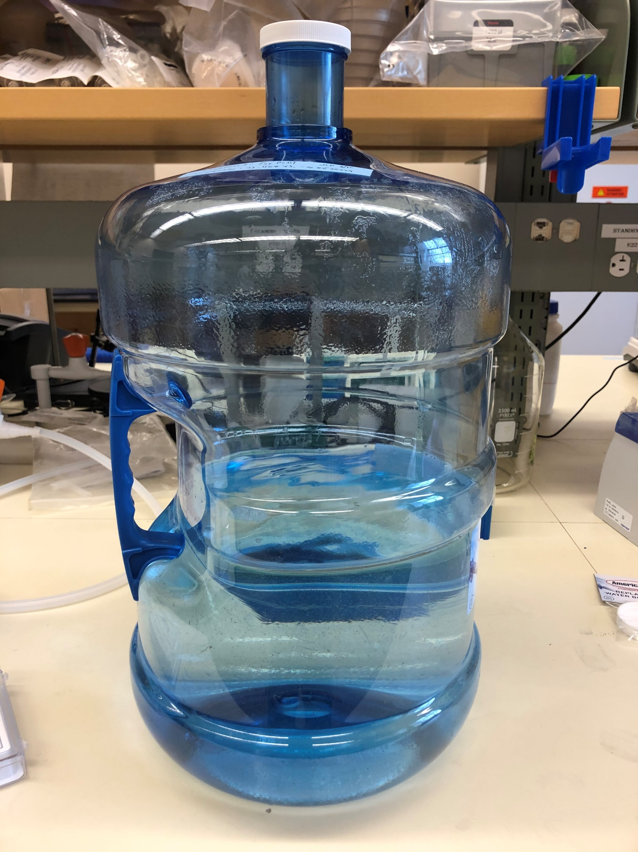
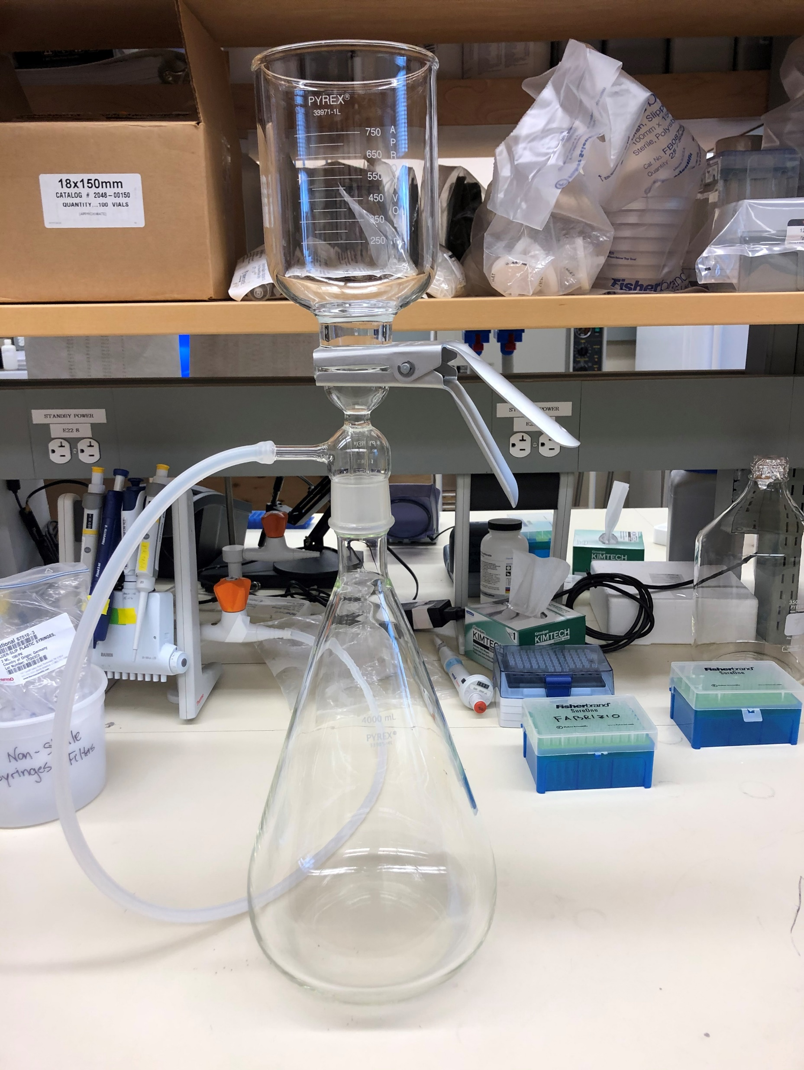
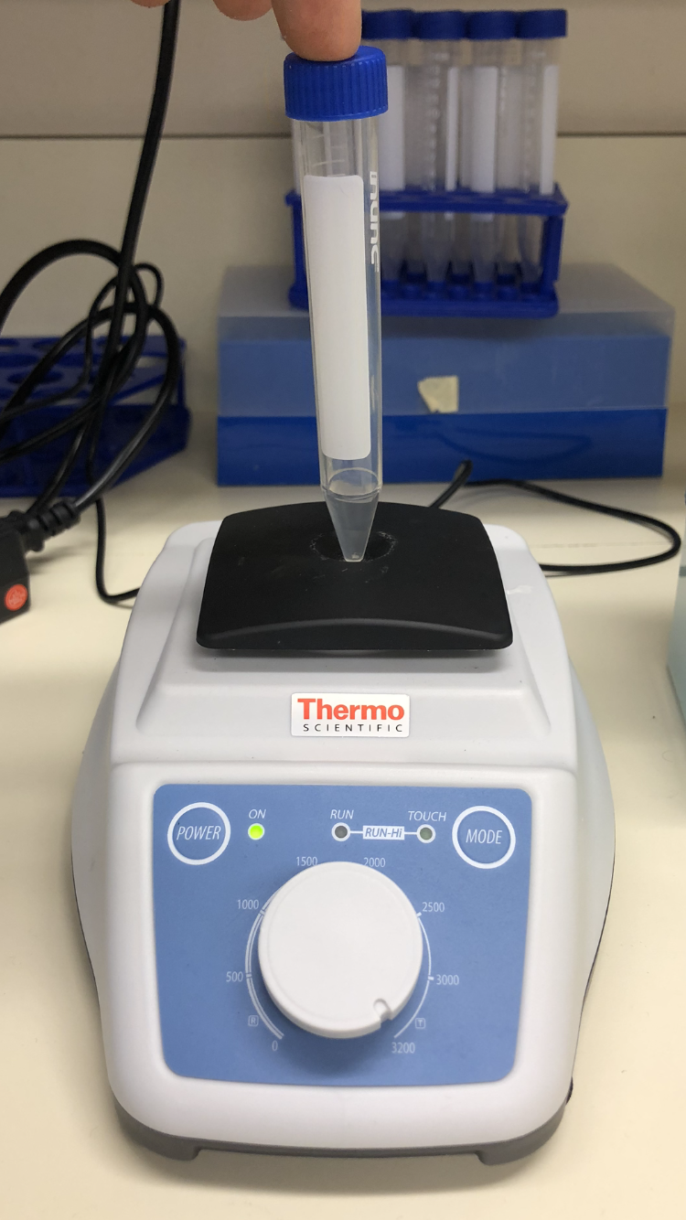
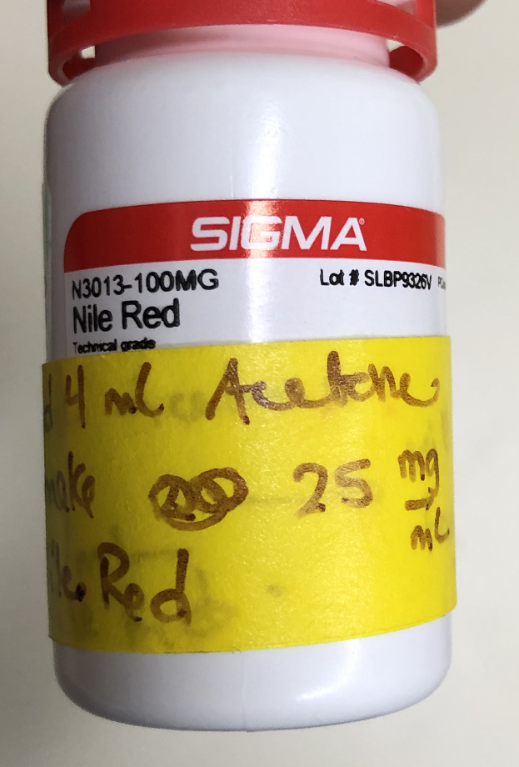
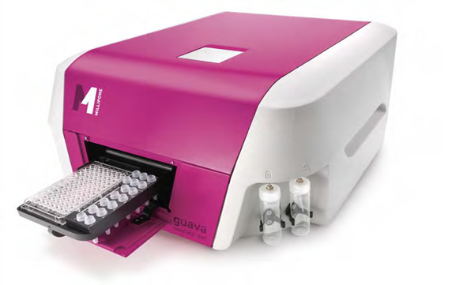
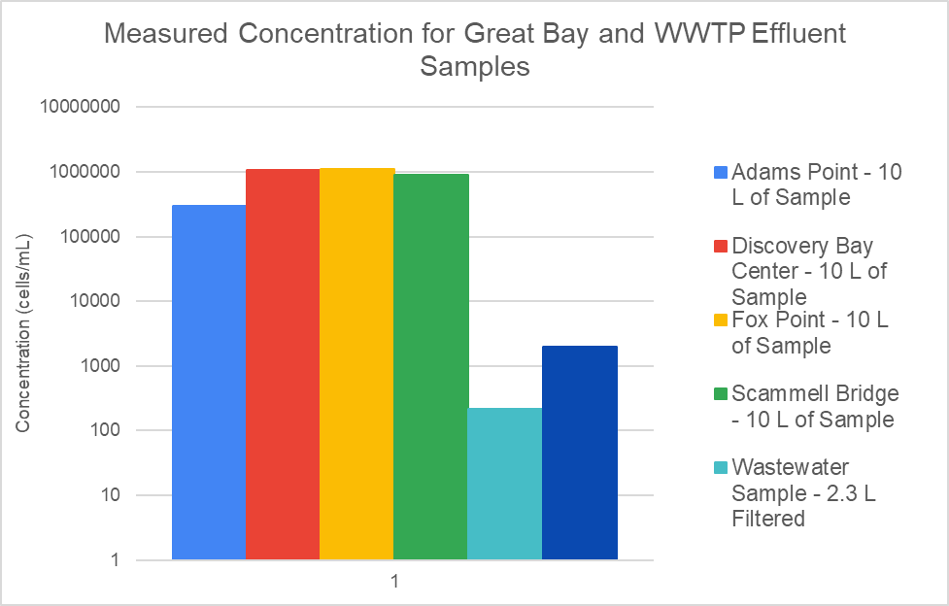
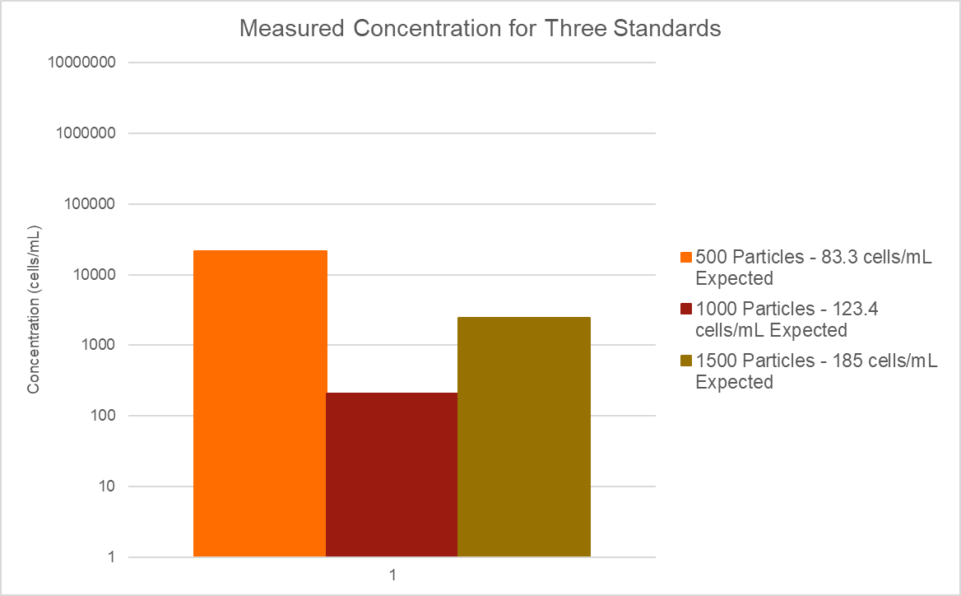
Initial Characterization of Microplastic Contamination in the Great Bay Estuary
Joe DeGregorio Advisor: Dr. Paula Mouser
College of Engineering and Physical Science, University of New Hampshire
Summer Undergraduate Research Fellowship
Introduction
Standard Method
Microplastics are plastics less than 5 mm in length
Emerging pollutant
Undercharacterized in the environment
Harmful to marine environments and organisms
Travels up the food chain to larger mammals and humans
Despite the importance of marine environments to NH communities, little research has been conducted to quantify microplastic contamination
Objectives
Standards with known MP concentrations were prepared in the range of what was expected in the Great Bay
Four samples were collected from the Great Bay
Microplastic concentration by filtering large volumes of sample
20-micron pre-filter
.4-micron capture filer
Particle range for study is .4-20 microns
Vortex machine
Used to remove microplastic particles concentrated on the filter and suspend in fluid
Filter particle shearing accounted in controls
Filter removed after vortex
Area of uncertainty
Organic matter digestion via potassium hydroxide
pH of solution increases to roughly 13
pH neutralization via hydrochloric acid
Only substance remaining is microplastic particles
Microplastic particle staining via Nile red dye
Nile red adsorbs onto microplastic surfaces
Fluoresces when exposed to blue light
Sample analysis via guava flow cytometer
The fluorescence of the microplastic particles is recorded and plotted against forward light scatter.
Records concentration of samples in cells/mL
To develop a standard method that accurately quantifies the concentration of microplastics in surface water samples and apply this method to samples collected from the Great Bay and its estuaries.
To characterize the level of microplastic contamination in the Great Bay using the data from samples that were analyzed.
Results
Next Steps
Uncertainty
The 500 particle standards measured concentration is 3 order of magnitude greater than expected
Lack of consistency between flow cytometer runs
Lack of consistency between triplicates for the samples
Number of particles dislodged from filter isn’t consistent for each trial
Contribution from filter shearing isn’t consistent
Abundance of noise in the samples which was not observed in other runs for wastewater effluent samples, standards, and controls (See Figure 2)
Sample concentrations were greater than wastewater effluent samples (See Figures 3 and 4)
Further evaluation of the method using more standards and controls to account for particle shearing from filters.
Minimize error by testing standards further on flow cytometer using triplicates of multiple different standards.
Develop a three-plus point curve using standards with concentrations in the range of what is expected in the Great Bay.
Develop a sampling plan for collecting at least twenty samples in the Great Bay and its estuaries.
Collect the necessary samples with the necessary volume to accumulate microplastics to the concentration fitting the range of the three-plus point curve.
Analyze samples and using the three-plus point curve, quantify microplastic contamination in each of the samples.
Figure 1
Figure 2
Figure 1 depicts the location where the 10-micron standard shows up on the flow cytometer. This is the region chosen for gating on all field samples.
Figure 2 depicts the results on flow cytometer for a Great Bay sample. The black scatter dots represent noise.
Figure 3 depicts the measured concentration for all environmental samples, which include two wastewater effluent samples and four samples collected from the Great Bay
Figure 4 depicts the measured concentrations for three standards which are in the range of expected concentrations for Great Bay samples
Figure 3
Figure 4
Special Acknowledgements
Dr. Paula Mouser
Dr. Elizabeth Harvey
UNH Hamel Center
Mr. Dana Hamel
Chloe Carter
Fabrizio Colosimo
Jishnu Adhikari

