Slide 1
AWQuaS
Analytic Water Quality Sensor
Phil Breton, Kathryn Carlson, Alexis Eaton, and Katie O’Brien

Slide 2
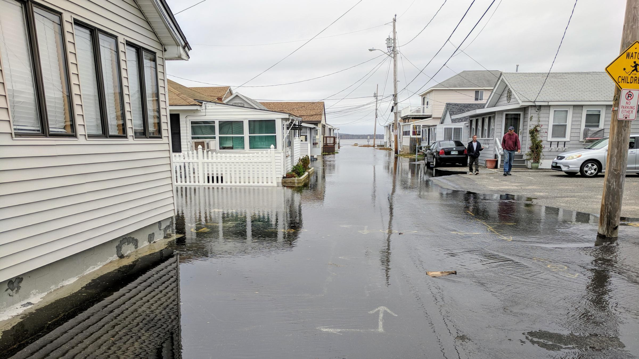
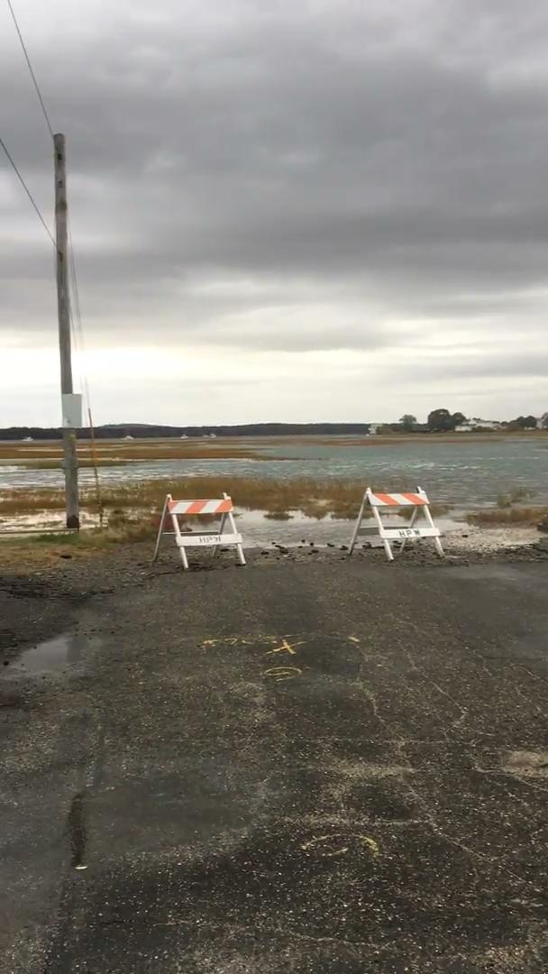
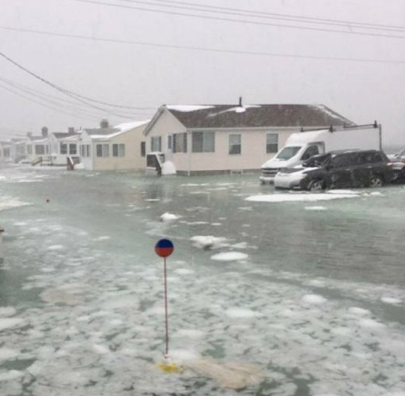
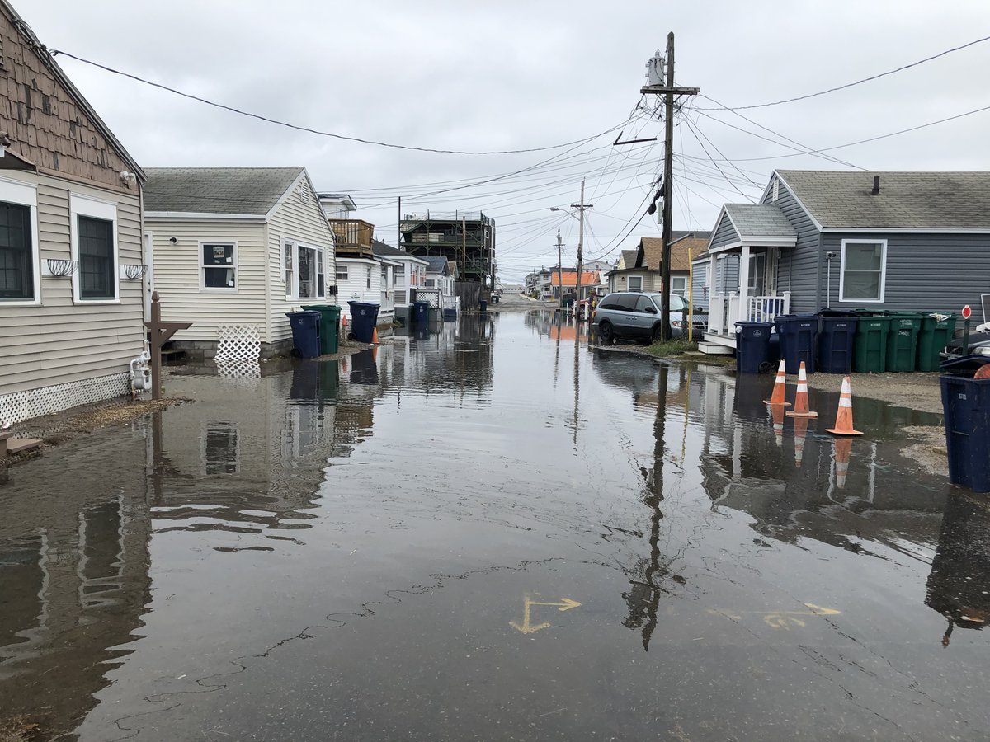
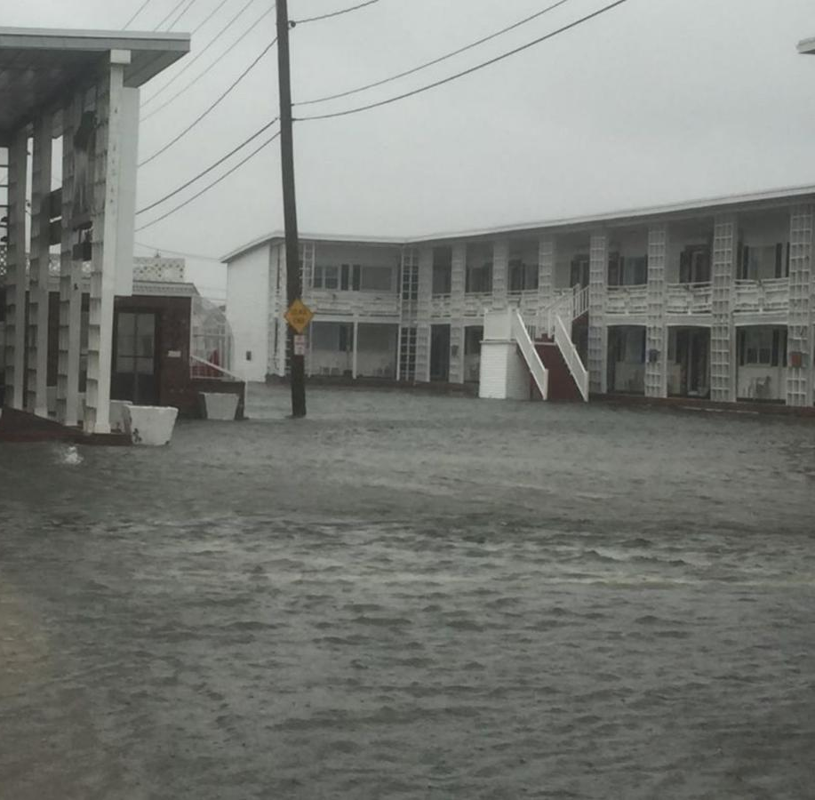
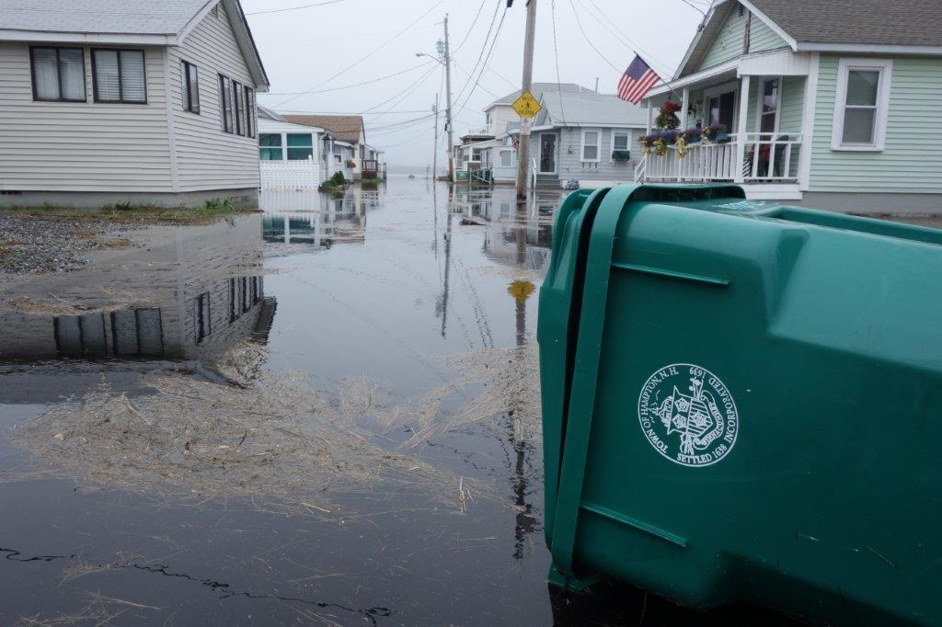
Inspiration:
-Hampton Beach Field Trip
Sunny day flooding
-Portions of streets were underwater
-People’s backyards and fences were submerged
Foundations of homes are crumbling
Property values have been depleted
Residents are tired and stressed
“No flooding parties”

Slide 3
Purpose:
-sensor will help homeowners make informed decisions regarding which materials are viable options for their home foundations
Four Components:
pH transducer
Salinity probe
Ultrasonic sensor
Temperature probe

Slide 4
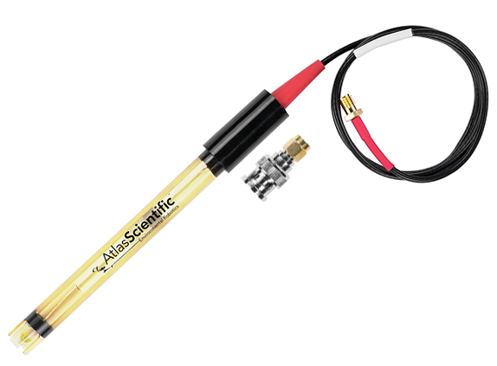
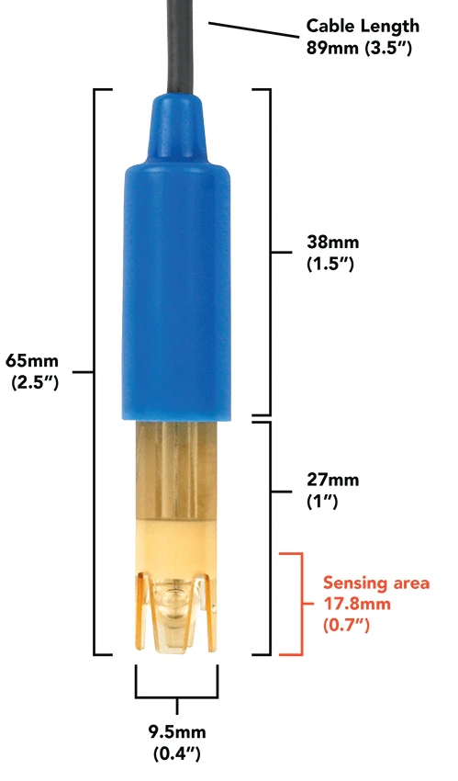
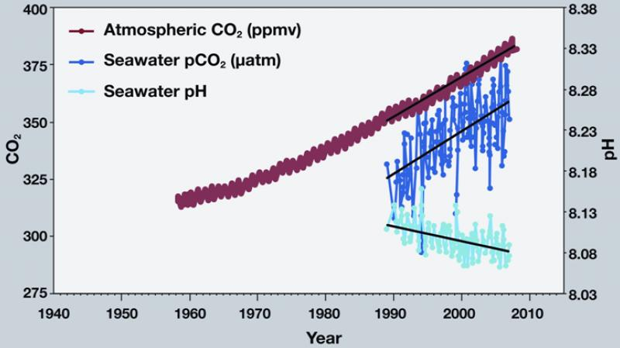
pH Transducer
Ocean acidification- direct consequence of increased CO2 levels in the atmosphere
Extremely acidic environments cause substructural materials (i.e. concrete) to dissolve
Atlas Scientific Lab Grade pH Probe

Slide 5
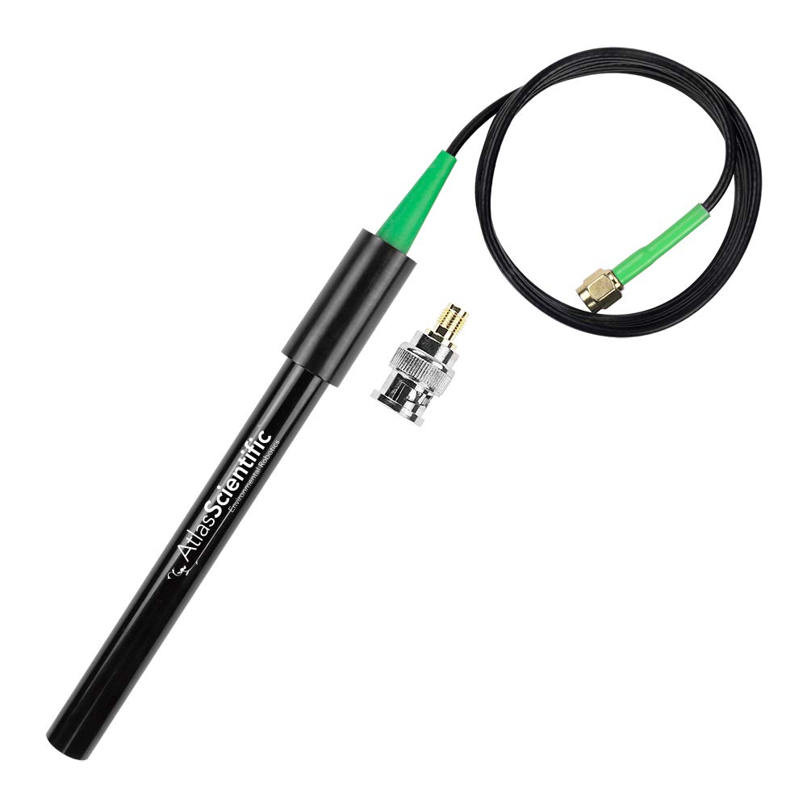
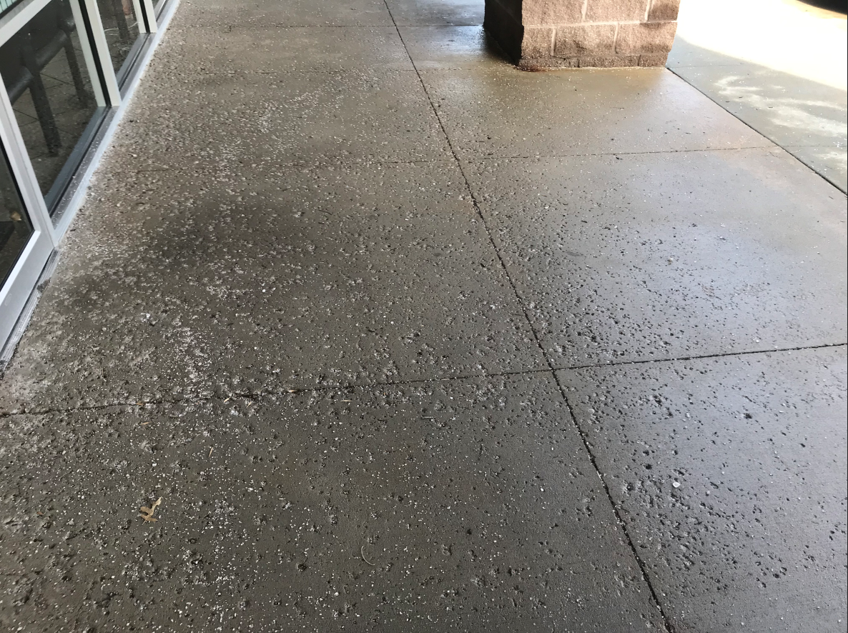
Conductivity Probe
Used to measure salinity
Salt concentration can influence the efficacy of materials used in solid foundations
Ex: salt corrodes concrete
Concrete sidewalk damaged by salt
Atlas Scientific Conductivity Probe K 1.0

Slide 6
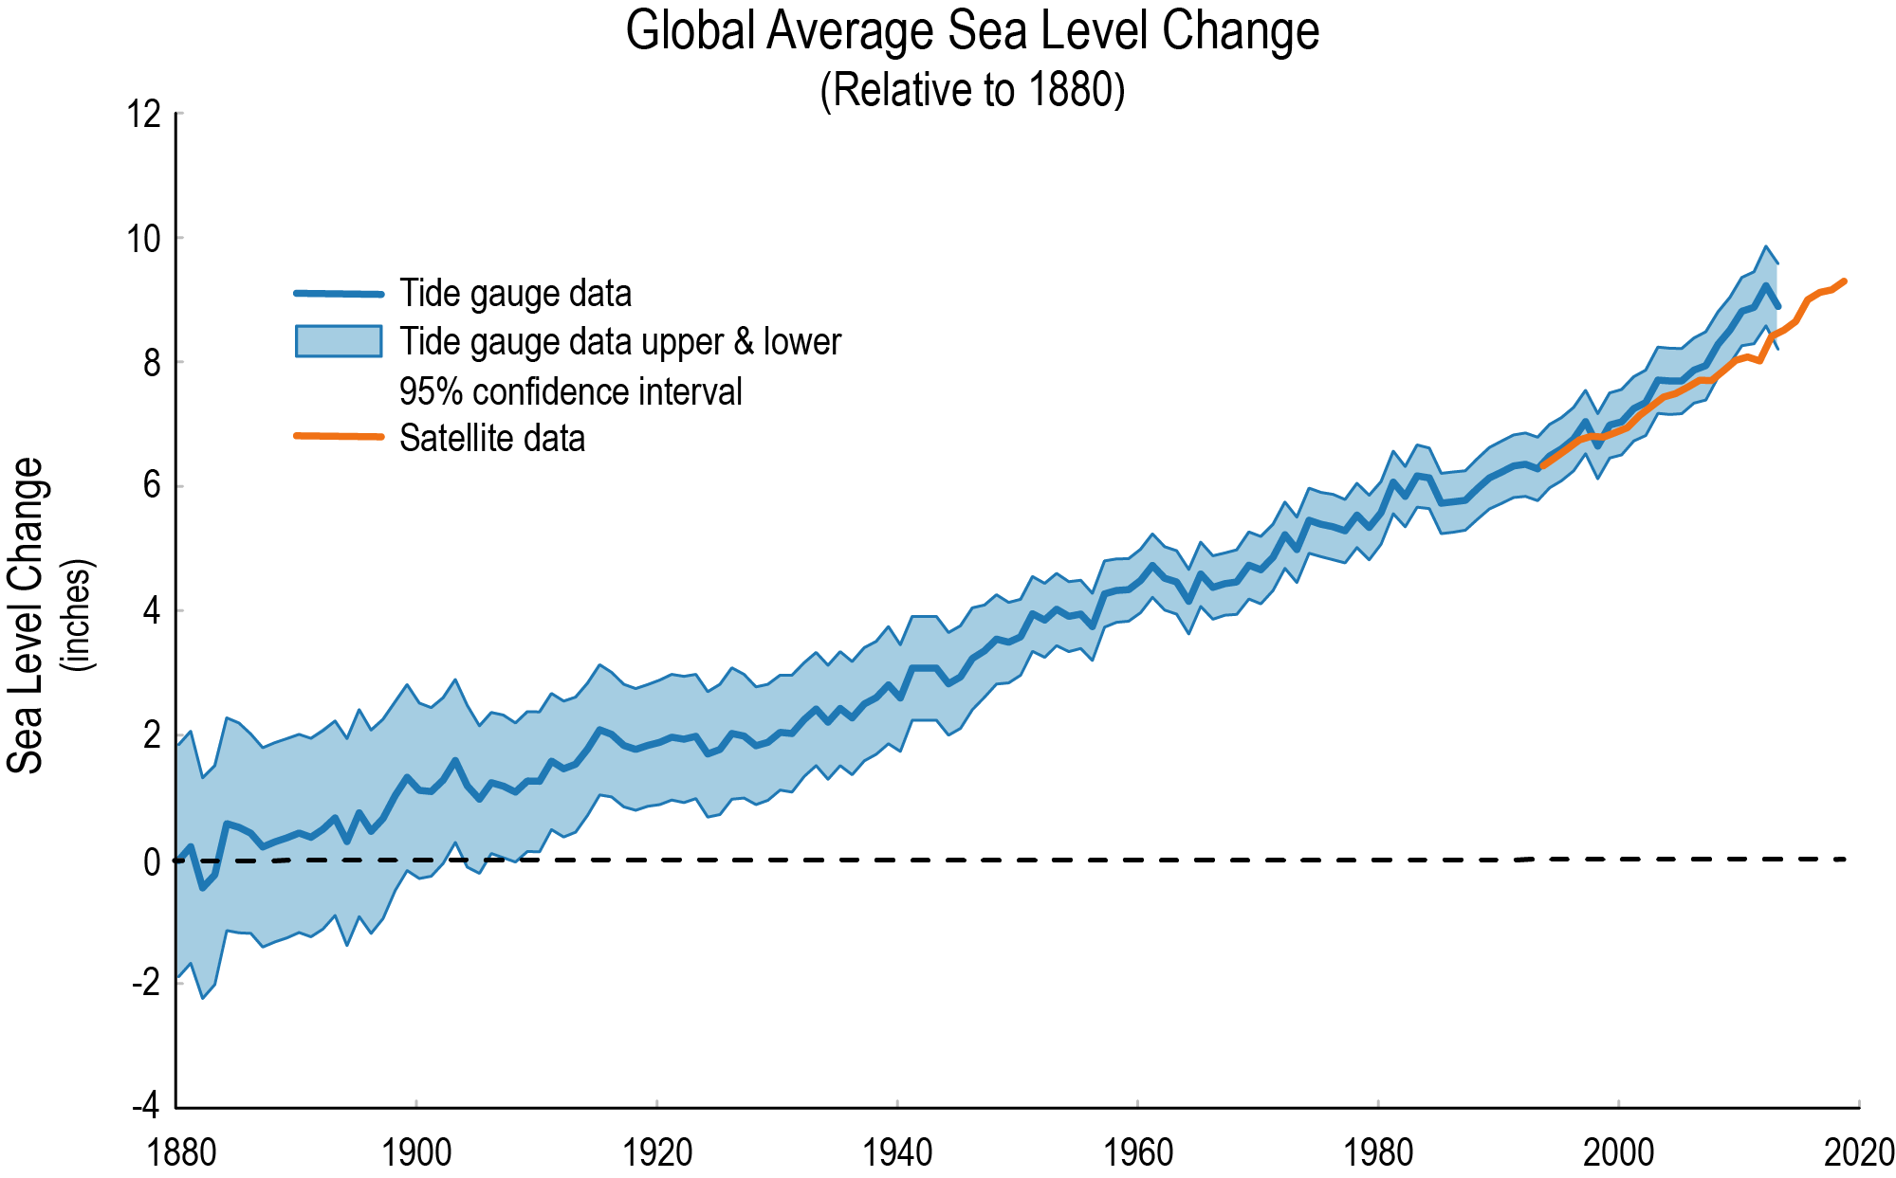
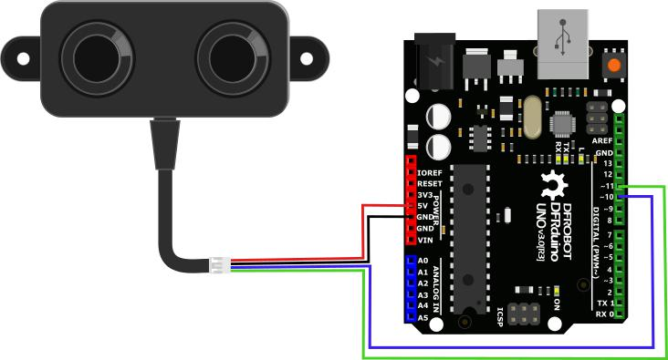
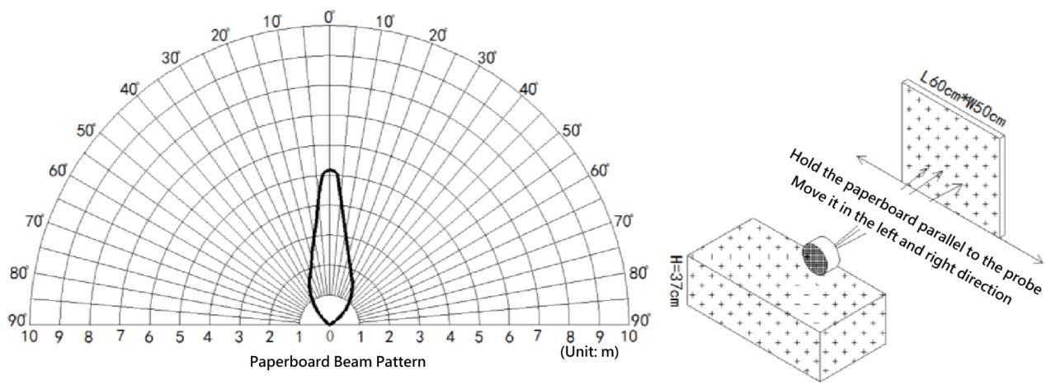
Ultrasonic Sensor
Measures the height of the water
Indicative of sea level rise
Beam Directionalities Diagram
A02YYUW Waterproof Ultrasonic Sensor

Slide 7
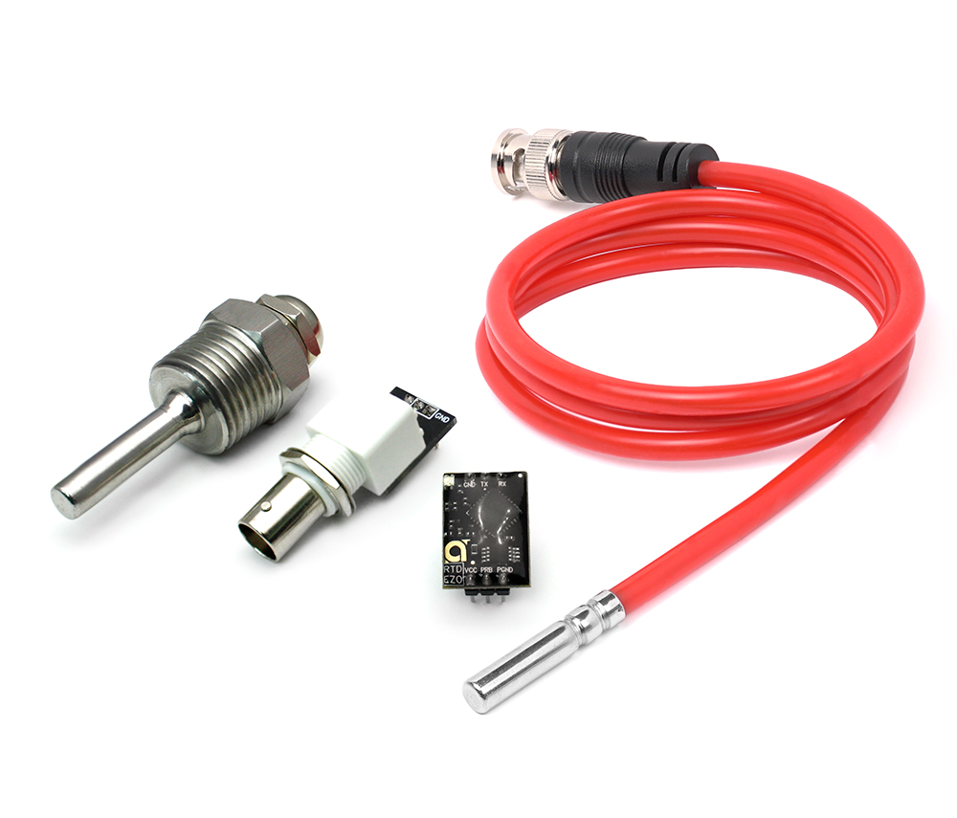
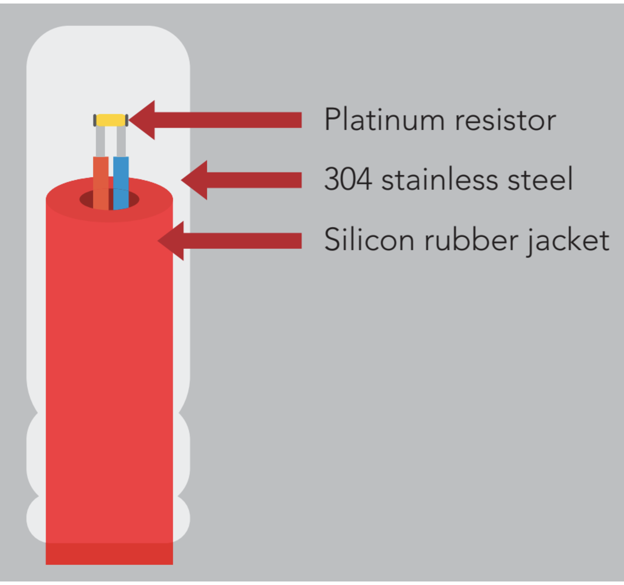
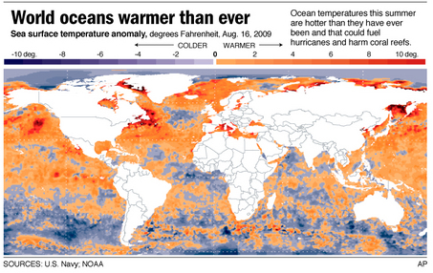
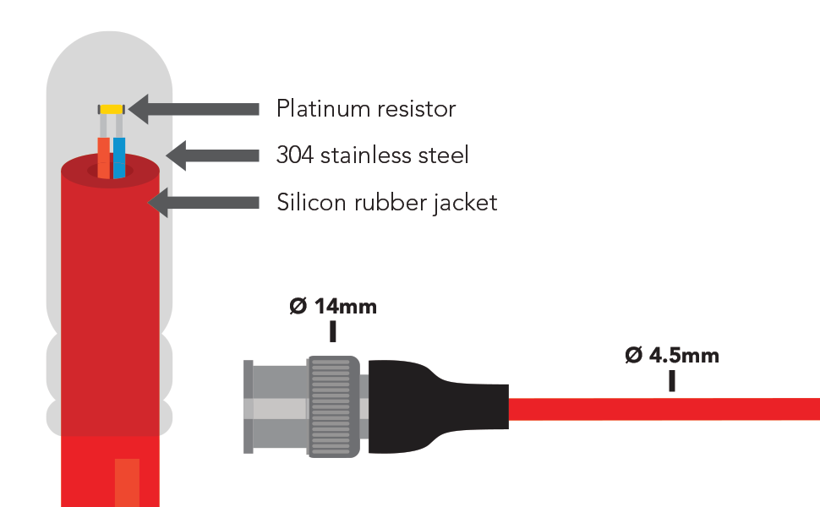
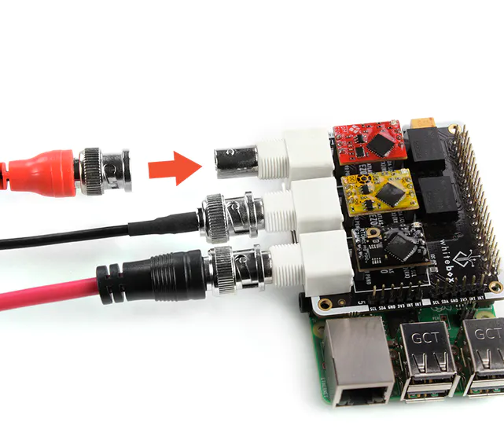
Temperature Probe
Included for contextual purposes
Indicative of ocean warming
Atlas Scientific PT-1000 Temperature Probe

Slide 8
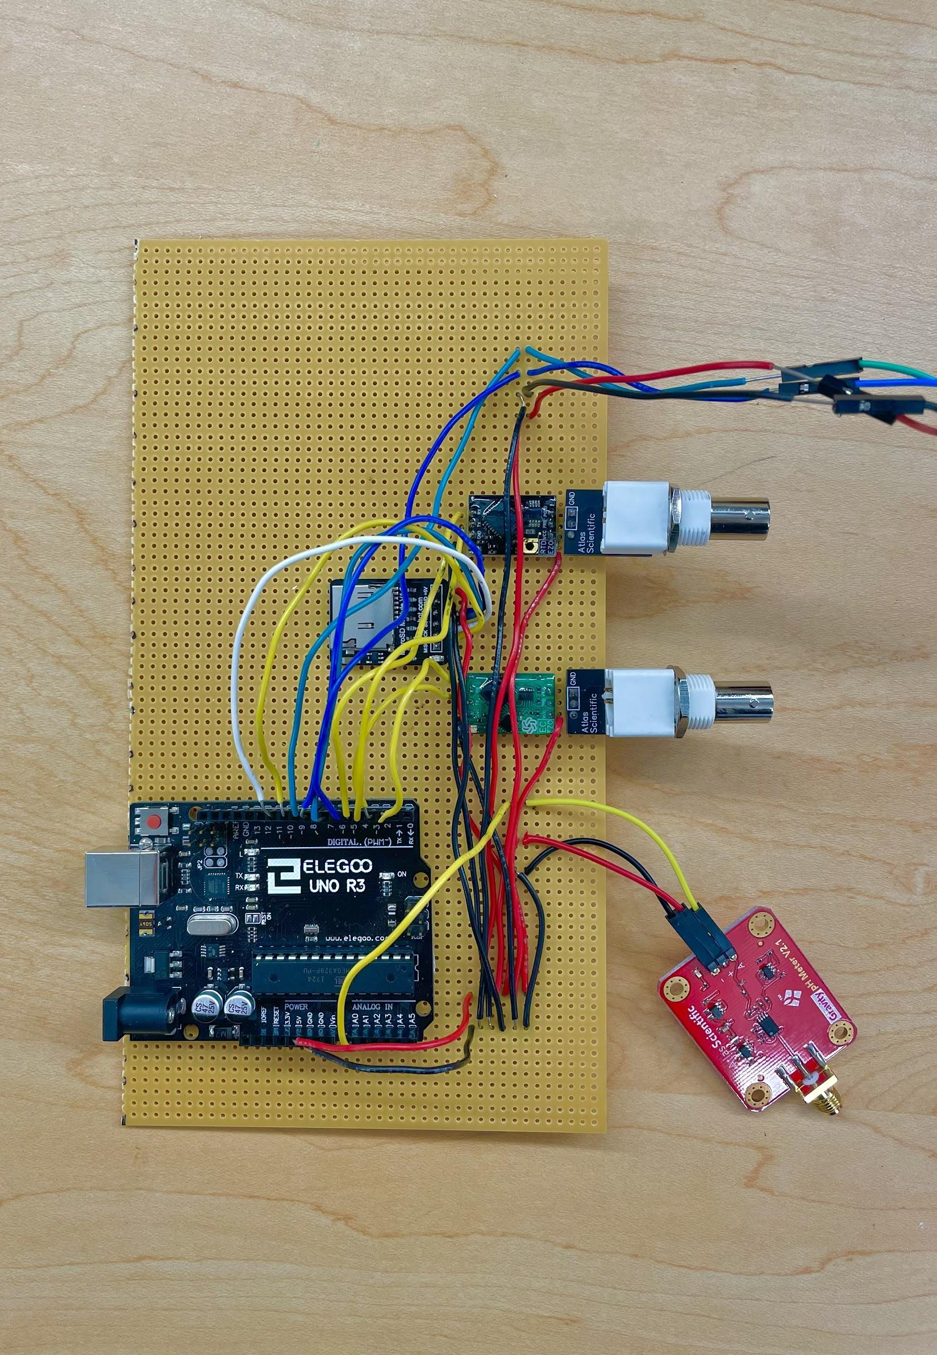
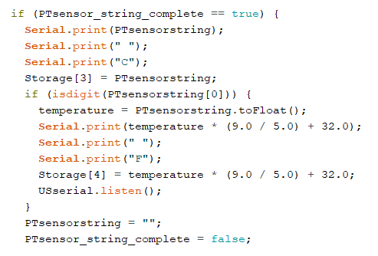
Arduino Programming:
Our
Circuitry
SoftwareSerial Library
Structure
SD Datalogging
Technical Difficulties

Slide 9
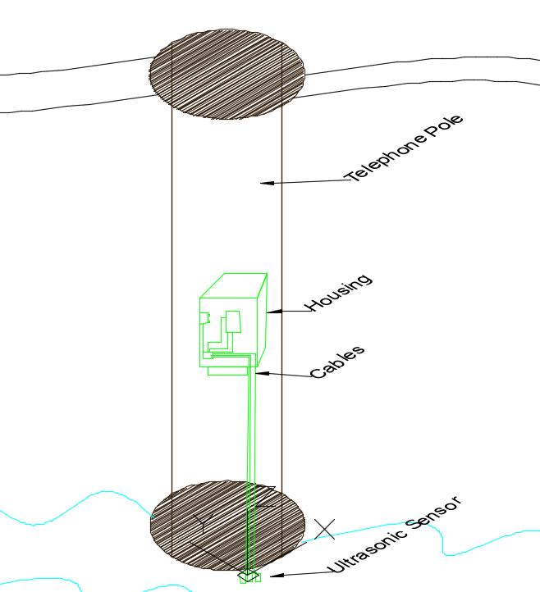
Housing Design:
sensors and wires stored in airtight, waterproof case
instrument will be mounted on a telephone pole
probes come out of housing and run down the telephone pole to the water level

Slide 10
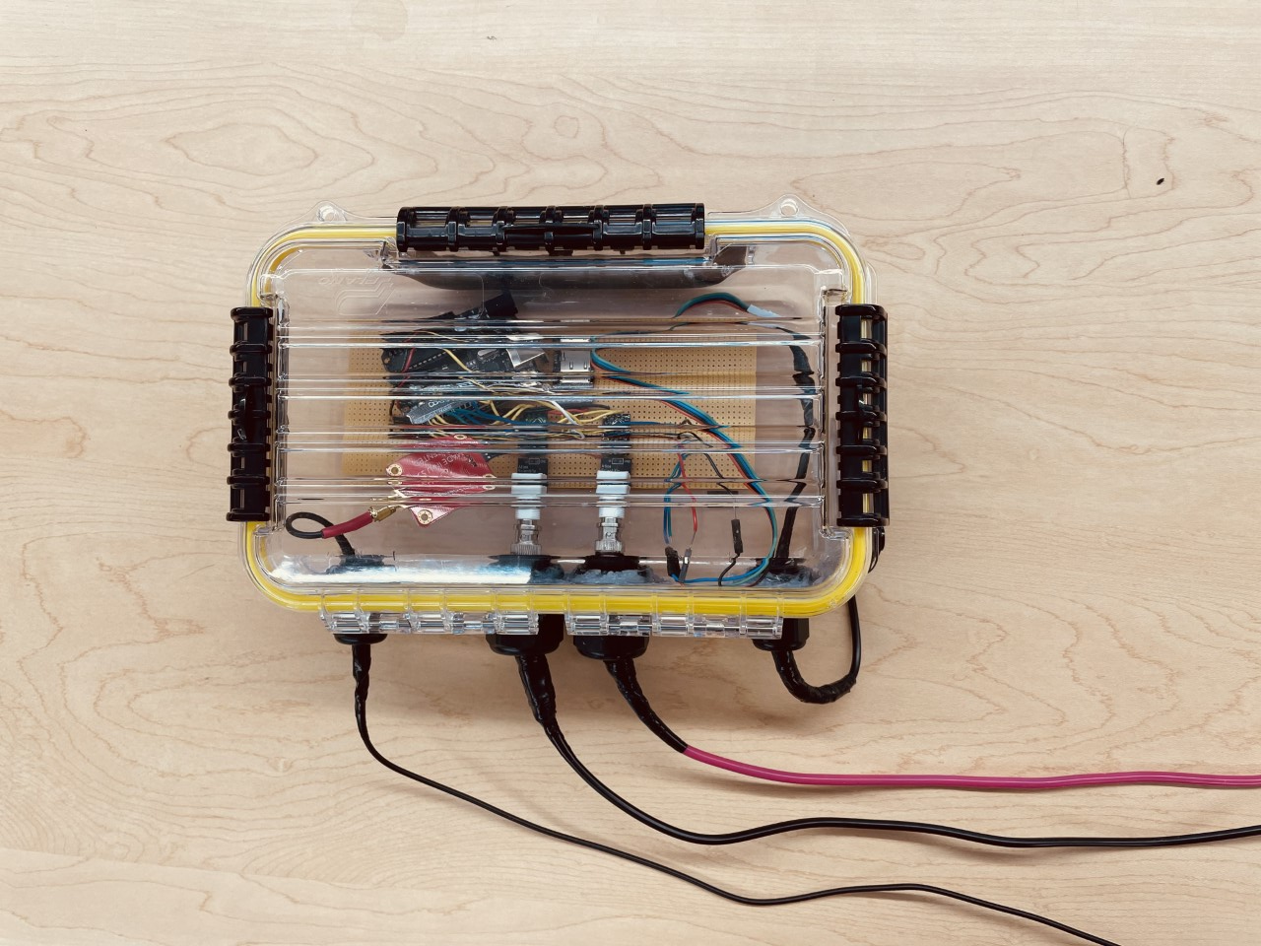
Final Product:
Sensors in waterproof housing
Mounted on a faux “utility pole” in Chase

Slide 11
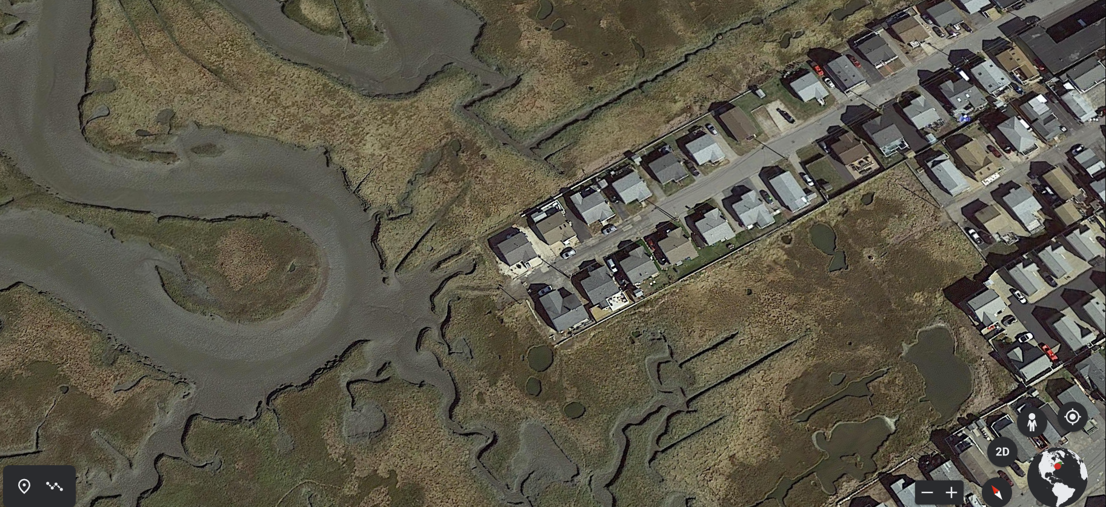
Deployment Plan:
April 30th: Deployment Date
May 1st: Retrieval Date
High tides: April 30 2:47 pm (9.13 ft);
May 1 2:57 am (10.13 ft); May 1 3:46 pm (8.71 ft)
Instrument will be deployed on the telephone pole at the the end of Hobson Avenue in Hampton, NH

Slide 12
Thank You
Special Thanks to: Savannah DeVoe Tim Noonis of Until Electric
Norman Carpentier
Kateri Nahabedian
Alyson Eberhardt
Malin Clyde

Slide 13
Works Cited
“A02YYUW Waterproof Ultrasonic Sensor.” DFRobot, www.dfrobot.com/product-1935.html.
“Concrete-Sidewalk-Sealing-Salt-Damage: Rock Solid Seal.” Rock Solid Seal | Concrete, Driveway Sealing, and Epoxy Sealing in Kansas City. Call (816) 406-5995, Concrete | Driveway Sealing Kansas City, 17 Jan. 2020, www.rocksolidseal.com/annotation-2020-01-17-105741/.
“Conductivity Probe K 1.0.” Atlas Scientific Environmental Robotics, Atlas Scientific, 2021, atlas-scientific.com/probes/conductivity-probe-k-1-0/.
“How Do Warmer Temperatures Affect Fish?” Climate Change Categories, 2011, earthtosky.org/climate-change-categories?tmpl=component&id=20.
“Lab Grade PH Probe.” Atlas Scientific Environmental Robotics, Atlas Scientific, 2021, atlas-scientific.com/probes/ph-probe/.
“Ocean Acidification.” Smithsonian Ocean, The Ocean Portal Team at NOAA, 20 June 2019, ocean.si.edu/ocean-life/invertebrates/ocean-acidification.
“PT-1000 Temperature Probe.” Atlas Scientific Environmental Robotics, Atlas Scientific, 2021, atlas-scientific.com/probes/pt-1000-temperature-probe/.
“USGCRP Indicator Details: Sea Level Rise.” GlobalChange.gov, NOAA, EPA, 2018, www.globalchange.gov/browse/indicators/global-sea-level-rise.

