Slide 1
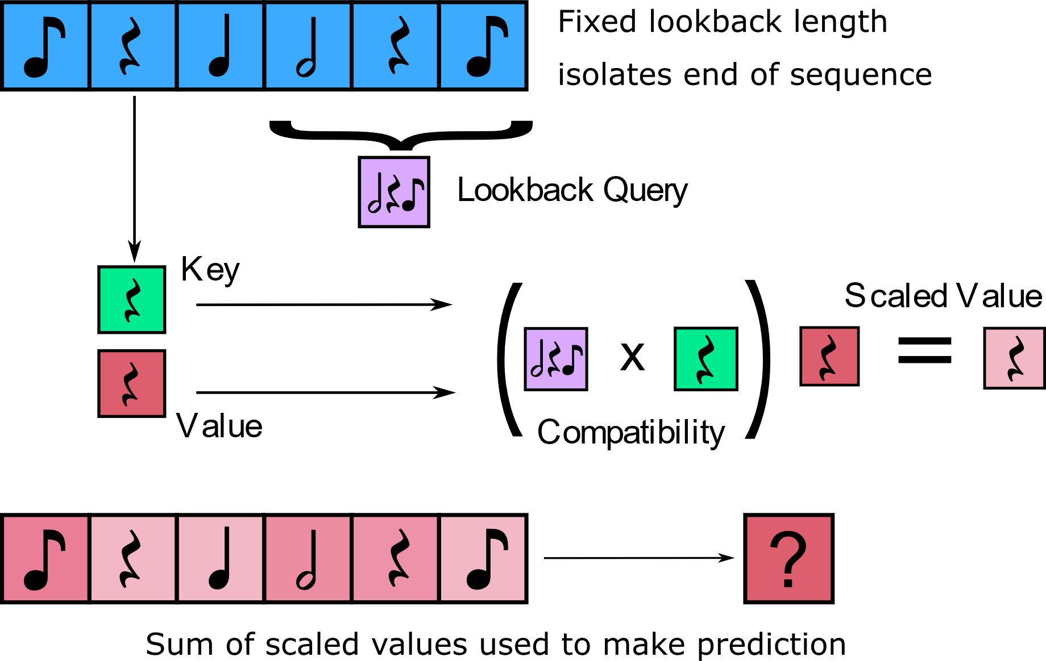
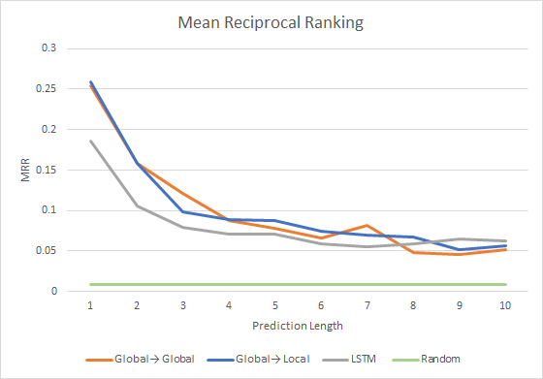
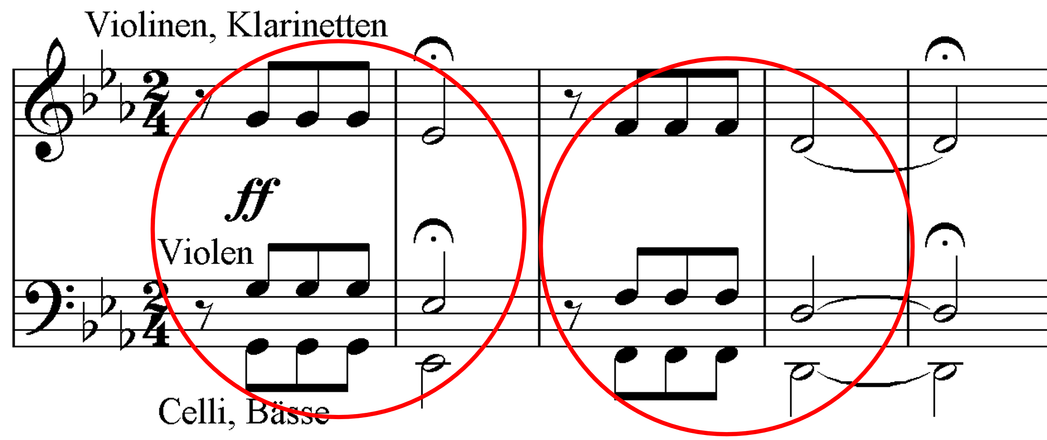
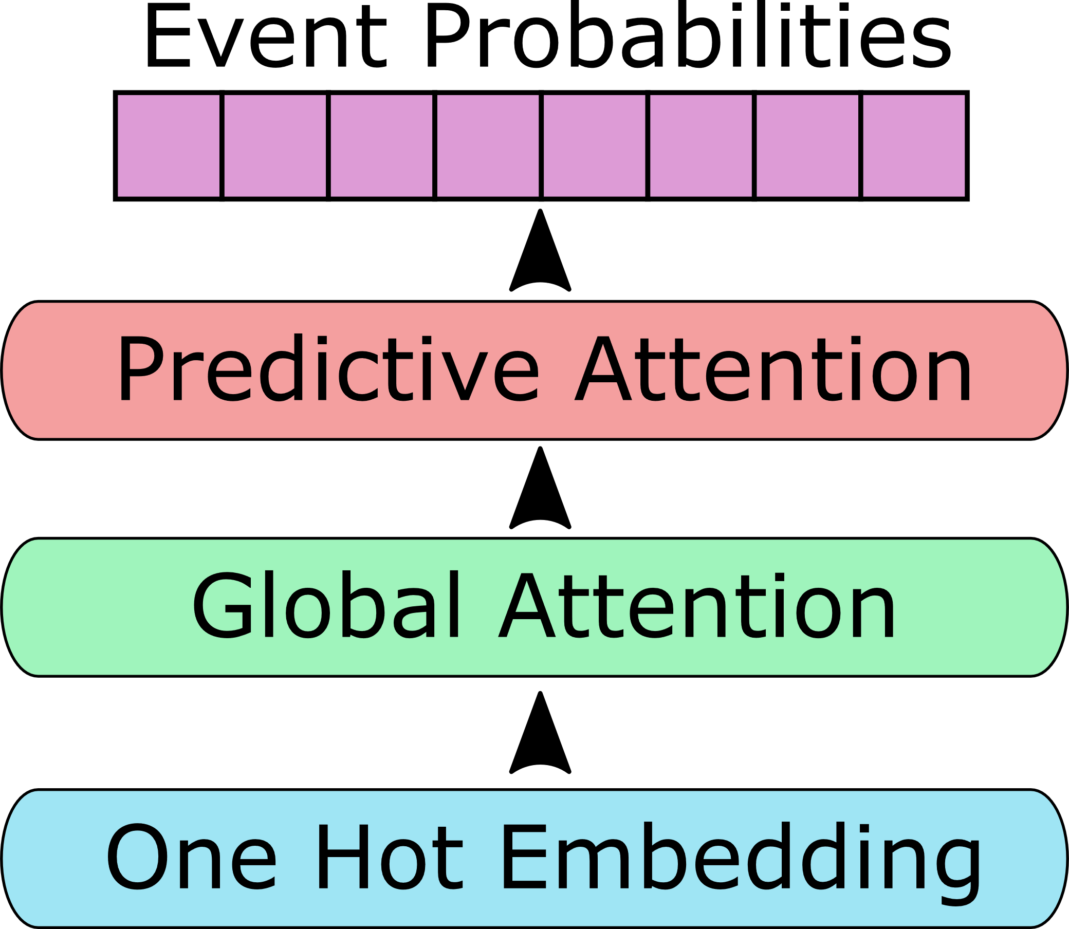
Impromptune: Symbolic Music Generation with Relative Attention Mechanisms
Connor Lennox Advisor: Laura Dietz
Department of Computer Science, University of New Hampshire
Abstract
Predictive Attention
Results
By combining attention-based mechanisms that have proved beneficial in the field of natural language processing with domain-specific knowledge about the structure of music, better predictions about piece continuations can be made. The goal of this work is to adapt current natural language processing techniques to a musical domain, and to generate new music by predicting continuations on a sequence of notes. An adaptation of traditional attention mechanisms to create a single prediction from sequential input is used to extend musical pieces by appending new elements repeatedly.
A novel attention mechanism that produces a single output from an entire input sequence
Query generated from end of input forces output to be well informed by final elements
Music benefits from the usage of late elements when creating continuations
Compatibility-scaled values are summed to produce a new output element
Evaluation performed with a subset of the MAESTRO dataset, containing solo piano music
Attention models outperform the baseline recurrent LSTM implementation
Significant difference with early predictions, converges later
Sharp decline in performance due to the compounding error problem, in which incorrect predictions are still added to the input as per the autoregressive procedure
Problem Statement
Create new music extensions of prefixes that follow two main criteria:
In accordance with standard music theory
Generally pleasant to listen to
Figure 2: The calculations done by the Predictive Attention mechanism
Figure 1: An example of repeated structures, or motifs, in a piece of music
Each output element corresponds to event probability
Model Design
Condense sequence into single predictive vector
Conclusion
Attention based model that allows for autoregressive generation of sequence elements
Initial attention layers gather context about the current state of the input sequence
Predictive attention generates new elements based on result of other layers
Attention mechanisms allow for suitable consideration of all sequence elements
Music features long distance relations that benefit from attention
Generation can suffer over long distances
Learn context about the input sequence
Break relations between adjacent events
Figure 3: A linear representation of the Impromptune model structure

