Slide 1

Formaldehyde
The
Slide
Monitoring Air Quality at UNH
By Camden Guay

Slide 2
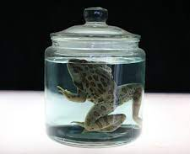
Formaldehyde (HCHO)
Pungent-smelling, toxic, colorless gas/chemical
Poses a risk to human health because of its widespread...
  Use:
    Soaps, sunscreens, cosmetics, cleaning products, industrial resins, particle board, coating,and preservatives
  Toxicity:
    Has been shown to cause cancer in lab animals
    Breathing problems and immune system response in humans
  Volatility
Occurs naturally in atmosphere and through metabolic processes in low levels
Average for indoor and outdoor air is 0.03ppm
Total Volatile Organic Compounds (TVOC) are compounds that have high vapor pressure and convert easily into vapor/gas.
  Could pose adverse health effects
  Average levels are are about 0.10 ppm
  Formaldehyde is a VOC

Slide 3
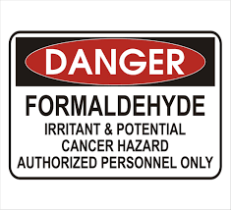
The Hypothesis:
It was hypothesized that as the temperature and humidity increase as it gets warmer in the spring, then formaldehyde and other pollutant levels will show a positive, linear trend.

Slide 4
The Experiment
Spanned from transitional February-April months
Data such as temperature, humidity, formaldehyde levels (HCHO) and TVOC were recorded
Gathered using an air quality detector by waiting three minutes for calibration and then recording the values given
Recorded at a variety of indoor and outdoor spots on the UNH campus.
Outside temperatures and humidities were used for all comparisons and plotted against the pollutant levels.
The goal of the experiment is to determine whether outside temperature, humidity, and the indoor/outdoor setting have an effect on the formaldehyde levels in the air (ppm).

Slide 5
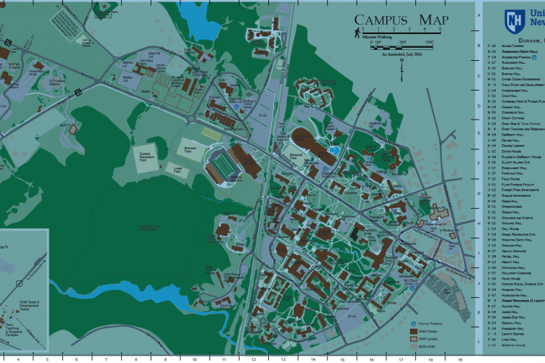

Slide 6
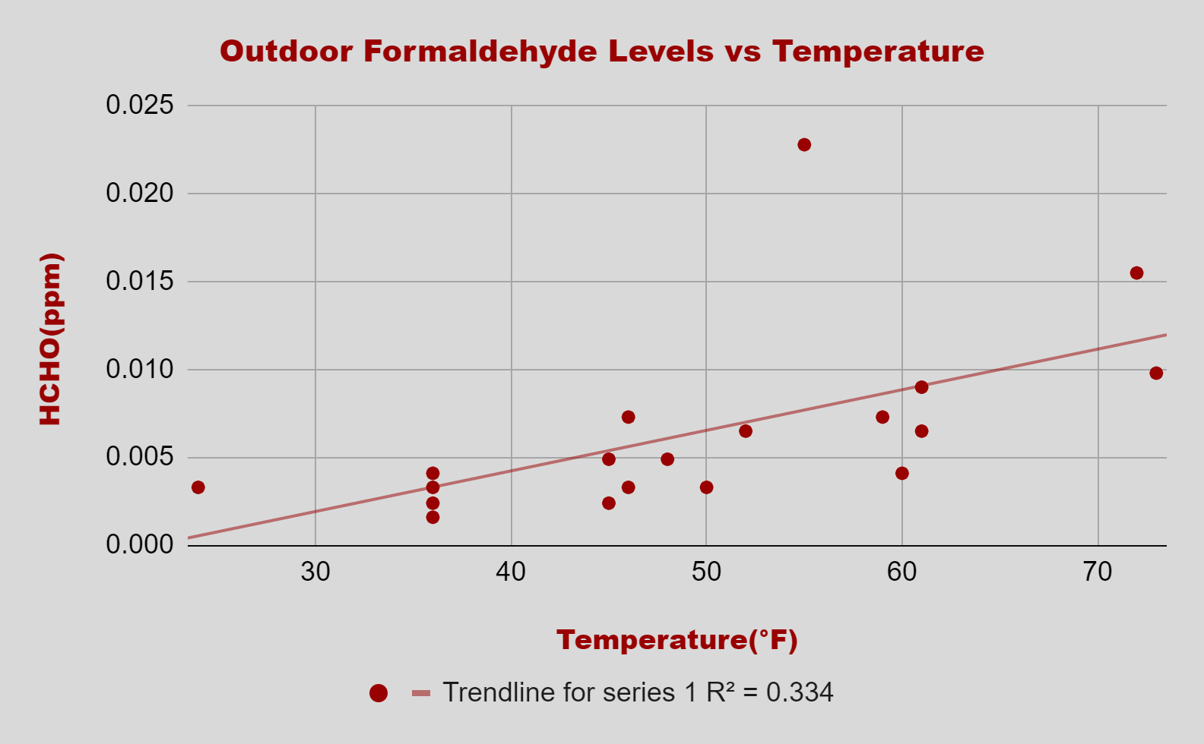
Results
Outlier
33.4% of the changes in Outdoor Formaldehyde are dependent on the changes in Temperature

Slide 7
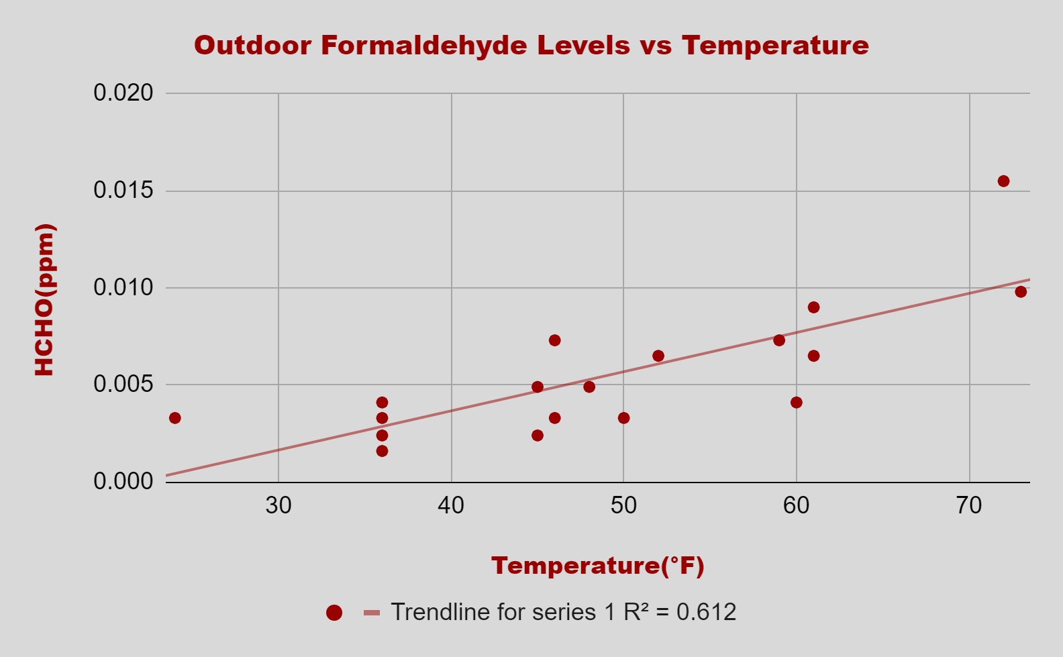
Results
61.2% of the changes in Outdoor Formaldehyde are dependent on the changes in Temperature

Slide 8
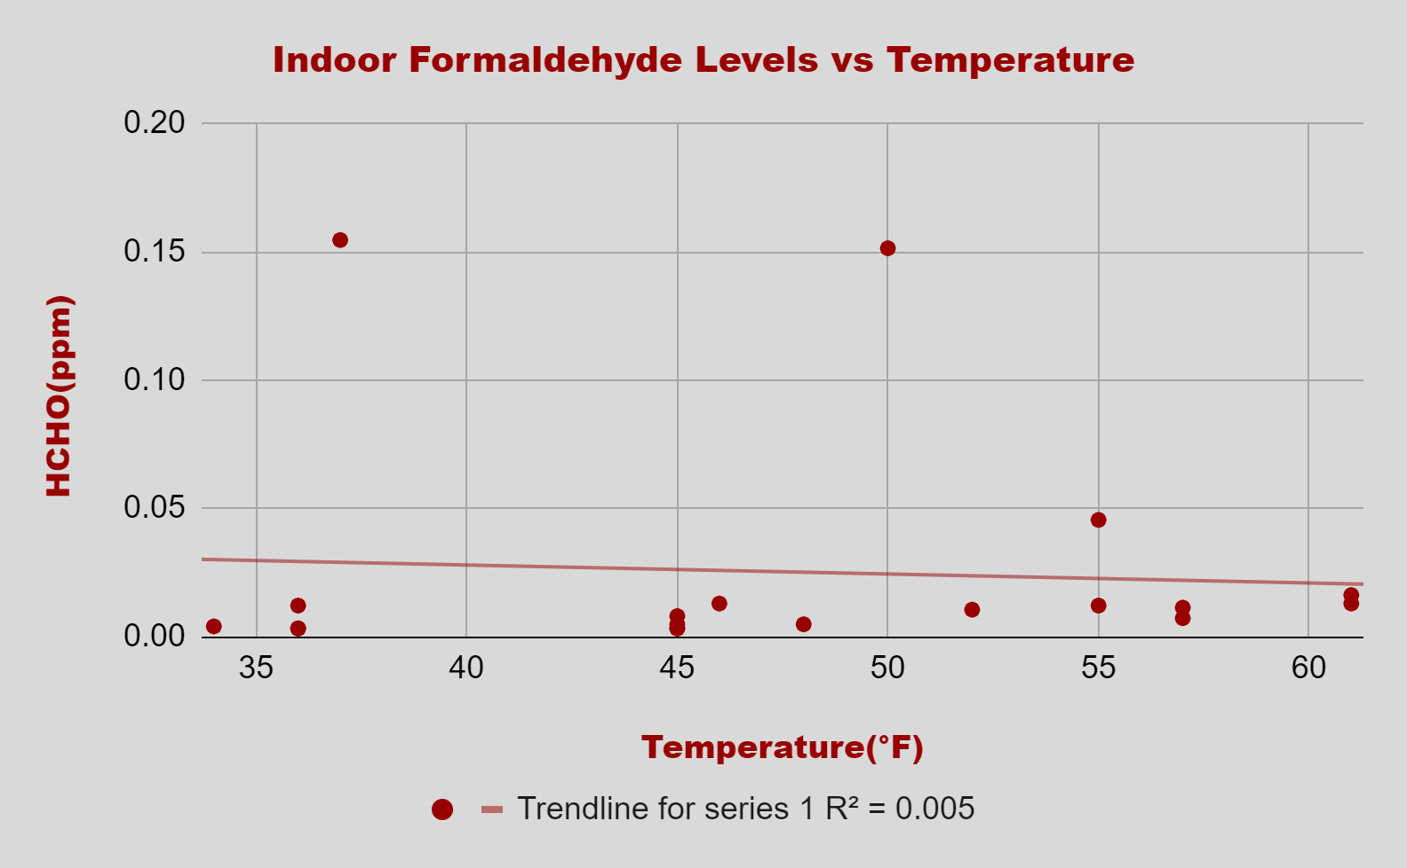
Results
Outlier
Outlier
0.5% of the changes in Indoor Formaldehyde are dependent on the changes in Temperature

Slide 9
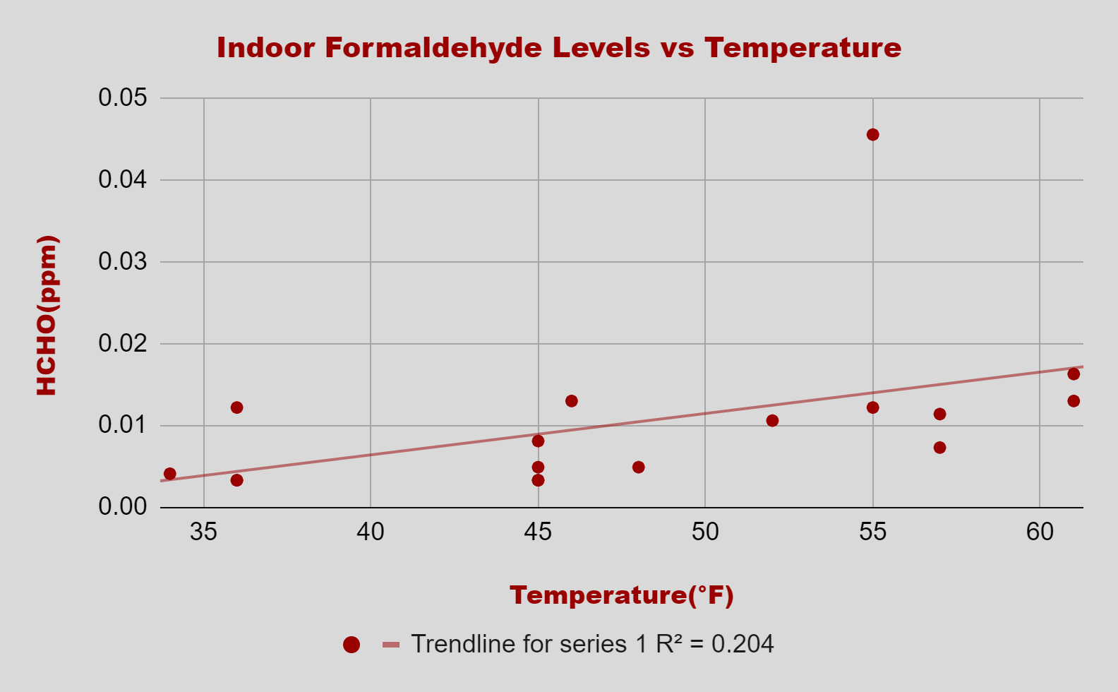
Results
0.5% of the changes in Indoor Formaldehyde are dependent on the changes in Temperature

Slide 10
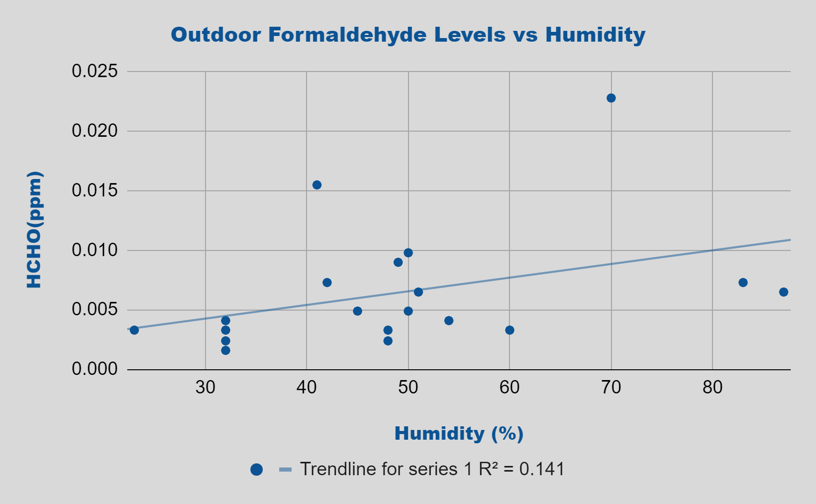
Results
14.6% of the changes in Outdoor Formaldehyde are dependent on the changes in Humidity

Slide 11
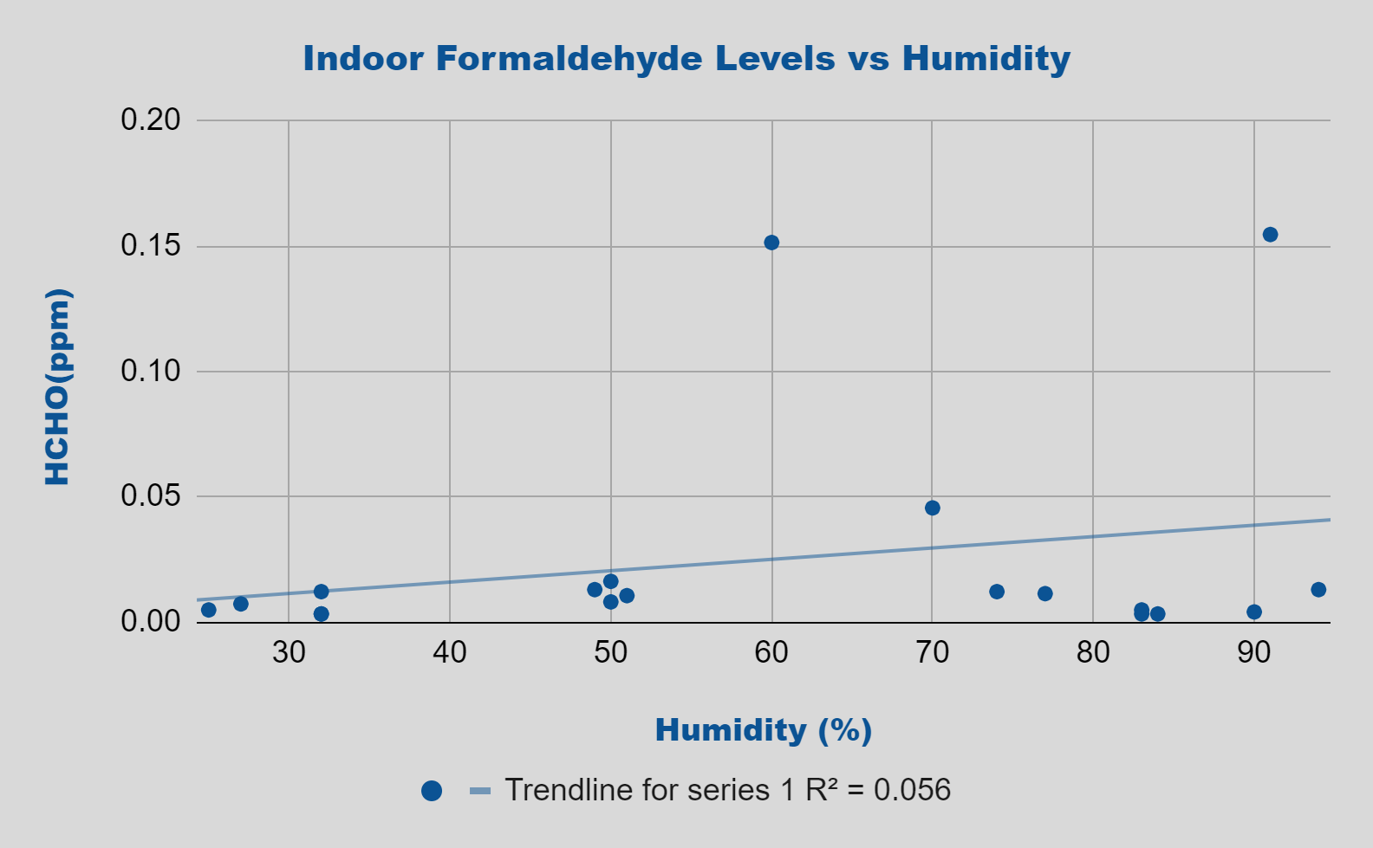
Results
5.6% of the changes in Outdoor Formaldehyde are dependent on the changes in Humidity

Slide 12
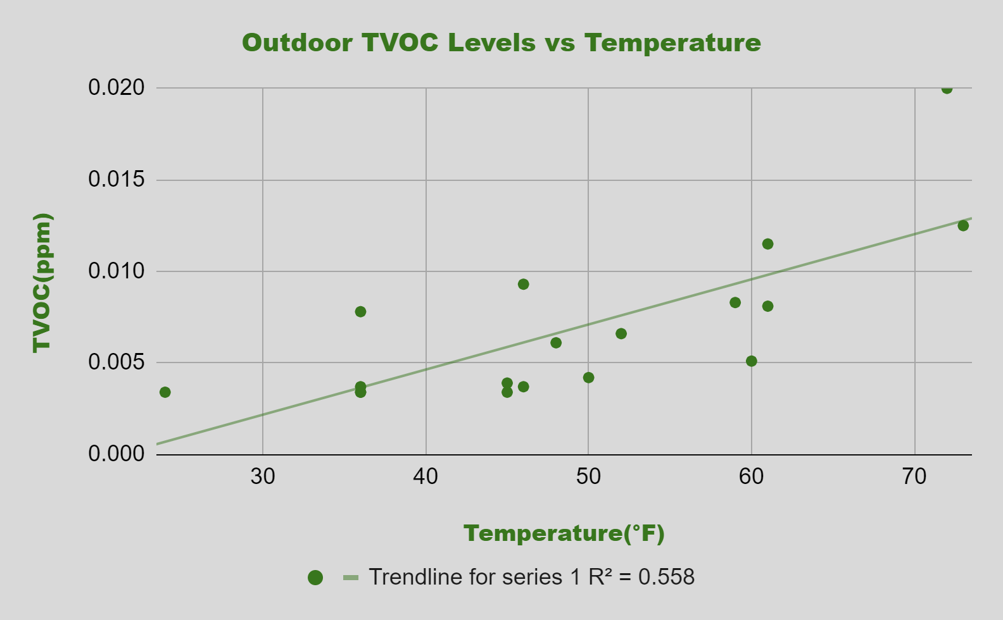
Results (TVOC)
Outliers emitted
Weak, positive, linear trend
Outside TVOC/Temp reflects Outside Form./Temp
Other Form. graphs similar to other TVOC graphs (little to no association)
55.8% of the changes in Outdoor TVOC are dependent on the changes in Temperature

Slide 13

Areas of Concern
Different detectors used during data
Locations not randomized
Inconsistent dates
Inconsistent time of day

Slide 14
Interpretation/Implications
It appears that only outside formaldehyde levels and temperature exhibited a weak, positive, and linear trend.
The r^2 value suggests that a good 40% of the changes in outside formaldehyde cannot be explained by the model.
The other three comparisons showed little to no correlation, especially the indoor measurements, which likely are not affected by outdoor temps.
This study vaguely implies that as weather gets warmer in the spring and summer months, outdoor formaldehyde levels will increase with it. On a planet that is increasingly influenced by global warming, increasing formaldehyde could prove to be another cause for concern for human well being.

Slide 15
Sources
https://www.builderonline.com/products/green-products/get-the-facts-about-formaldehyde_o
https://www.teesing.com/en/page/library/tools/ppm-mg3-converter
https://www.cancer.org/cancer/cancer-causes/formaldehyde.html#:~:text=The%20US%20Occupational%20Safety%20and,over%20an%208%20hour%20workday.
https://www.tecamgroup.com/acceptable-voc-levels/

Slide 16

Contact
Camden Guay
UNH ‘24 Mathematics and Statistics
Email: camdenguay12@gmail.com
cdg1031@wildcats.unh.edu

