Slide 1

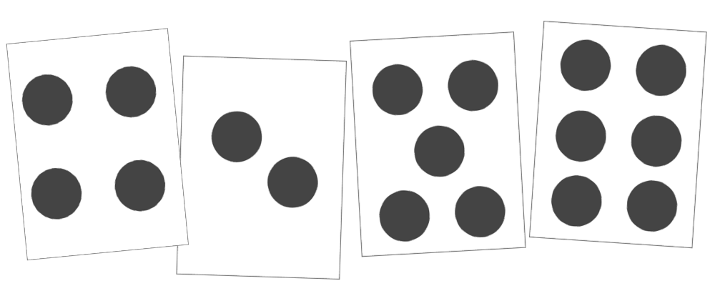

Mathematics Education for Students with Down Syndrome
Research Study: Down Syndrome Students Learn by Counting on
Research on mathematics education for students with Down Syndrome shows that early intervention, descriptive praise, and outside assistance lead to student success.
Catherine Dennis
Irwin (1991) performed a study on middle school students with Down Syndrome and found they did not know how to add. With intervention they learned by a method of “counting on”
Why Research?
Mean IQ for DS students is 50
There exists a lot of research on children with intellectual disabilities in general but we need more on Down syndrome in particular
Mental age gaps of about 5.3 years on average in the upper grades in mathematics
Methods
1 week with 8 students 11-13 year
All adding by counting starting from 1
Used cards with dot quantities and written numbers to add
Methods
Interviews
Observations (Whole class and one on one)
Performance scores
Results/Discussion
  Mastered by the end of the week
  This skill is usually mastered by general students without intervention
  Concluded that students with Down Syndrome need interventions earlier on
  Responded well to descriptive praise
  Worked well with visual manipulatives
  Quantity identification through visuals is strong
Results
DS students respond well to verbal, descriptive praise
Early intervention
Parent/outside help has positive impact
Discussion/Looking ahead
Consider DS students in written curriculum
Educators hope to see further study on how to best differentiate DS mathematics education with other ID mathematics education
Call for increased quality and quantity of research

Slide 2
References
Brady, J., Barbara, C., Gernasoni, A. (2008). Chidlren with Down syndrome learning mathematics: Can they do it? Yes they can! Australian Primary Mathematics Classroom, 13.4. 10-15.
Browder, D.M., Spooner, F., Ahlgrim-Delzell, L., Harris A.A., & Wakeman, S. (2008). A meta-analysis on teaching mathematics to students with significant cognitive disabilities. Exceptional Children, 74, 407-432.
Bynner, J., & Parsons, S. (1997). Does Numeracy Matter? Evidence from the National Child Development study on the Impact of Poor Numeracy on Adult Life. The Basic Skills Agency, London.
Chapman, R.C., & Hesketh, L.J. (2000). Behavioral phenotype of individuals with Down Syndrome. Mental Retardation and Developmental Disabilities Research Reviews, 6, 84-95.
Faragher, R., Stratford, M., & Clarke, B. (2017) Teaching Children with Down syndrome in inclusive primary mathematics classrooms. Australian Primary Mathematics Classroom, 22.4. 13-16.
Fidler, D.J. (2005). The emerging Down syndrome behavioral phenotype in children: Implications for practice. Infants and Young Children, 18, 86-103.
Fidler, D.J., Most, D. E., & Philofsky, A.D. (2009). The Down syndrome behavioral phenotype: Taking a developmental approach. Down syndrome Research and Practice, 12(3), 37-44.
Fuchs, L. S., Geary, D. C., Fuchs D., Compton D. & Hamlett, C. L. (2013). Sources of individual differences in emerging competence with numeration understanding versus multidigit calculation skill. Journal of Education Psychology 106, 482-498.
Gersten, R., Fuchs, L.S., Compton, D., Coyne, M., Greenwood, C., & Innocenti, M. S. (2005). Quality indicators for group experimental and quasi-experimental research in special education. Exceptional Children, 71, 149-164.
Hick, R. F., Botting, N., & Conti-Ramsden, G. (2005). Short term memory and vocabulary development in children with Down syndrome and children with specific language impairment. Developmental Medicine and Child Neurology, 47, 532-538.
History of NADS (2018) Retrieved from https://www.nads.org/about-us/history-of-nads/.
Irwin, K. (1991). TEACHING CHILDREN WITH DOWN SYNDROME TO ADD BY COUNTING-ON. Education and Treatment of Children, 14(2), 128-141. Retrieved from www.jstor.org/stable/42900452
King, S. A., Powell, S.R., Lemons, C.J., & Davidson, K. A. (2017). Comparison of mathematics performance of children and adolescents with and without Down syndrome. Education and Training in Autism and Developmental Disabilities, 52(2), 208-222.
Lemons, C. J., Powell, S.R., King, S.A.,& Davidson, K.A., (2015). Mathematics intervention for children with Down syndrome: a research synthesis. Journal of Intellectual Disability Research, 59, 767-783.
Martinez, E. M., & Pellegrini, K. (2010). Algebra and problem-solving in Down syndrome: a study with 15 teenagers. European Journal of Special needs Education, 25, 13-29.

