Slide 1
Object Detection and Classification for 3-D Lidar Mapping System
Honors Thesis Research
Kevin Healey
Capstone Advisor:
Se Young Yoon, Ph.D

Slide 2
Is it possible to implement an effective object detection and classification method to the associated system with MATLAB?

Slide 3
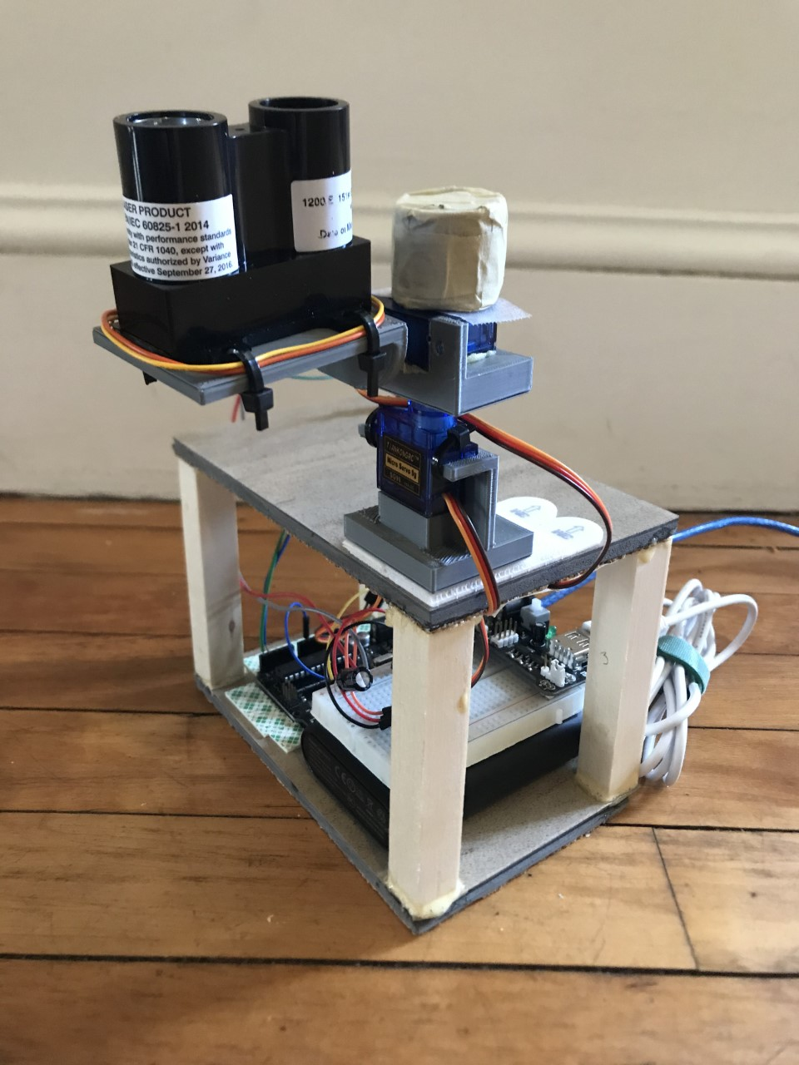
The 3D Lidar Mapping System
Utilizes Arduino-Based Microcontroller
Takes distance measurements using Garmin LidarLite v3
Changes direction of measurement using servo motors
Provides a three-dimensional plot of one hemisphere of information
Variable Resolution

Slide 4
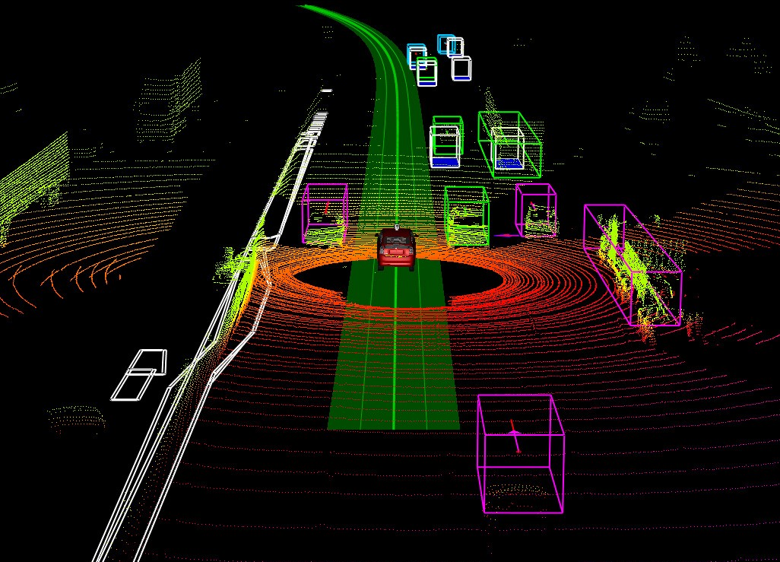
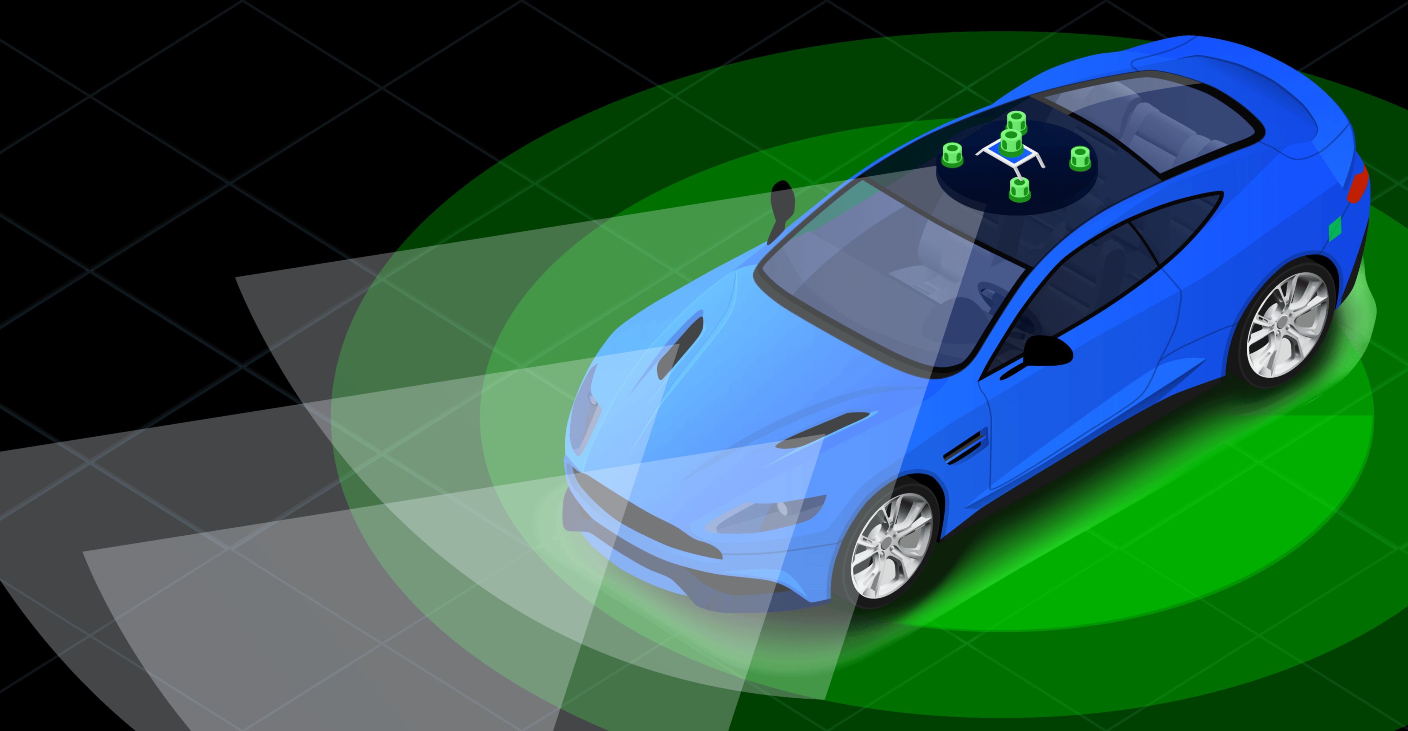
Object Detection Overview
Defined: A series of computer vision tasks that coordinate to identify, locate, and classify objects
High relevance to the Autonomy of Vehicles
Neural Networking and Deep Learning
Typical Processes
Feature Extraction
Object Detection
Object Classification
Segmentation

Slide 5
The Environment without objects

Slide 6
The Environment with objects
Object 1
Object 2

Slide 7
MATLAB Lidar Toolbox™
Deep Learning for Lidar
Lidar-Camera Calibration
Lidar Data Processing
2D Lidar Processing
Streaming, Reading, and Writing Lidar Data
Feature Extraction and Recognition

Slide 8
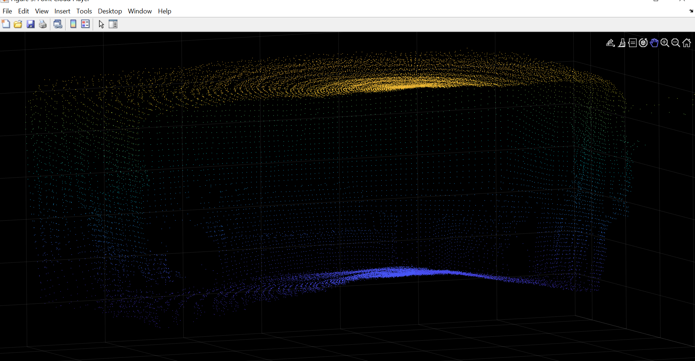
32,400 point scan of Environment without Objects

Slide 9
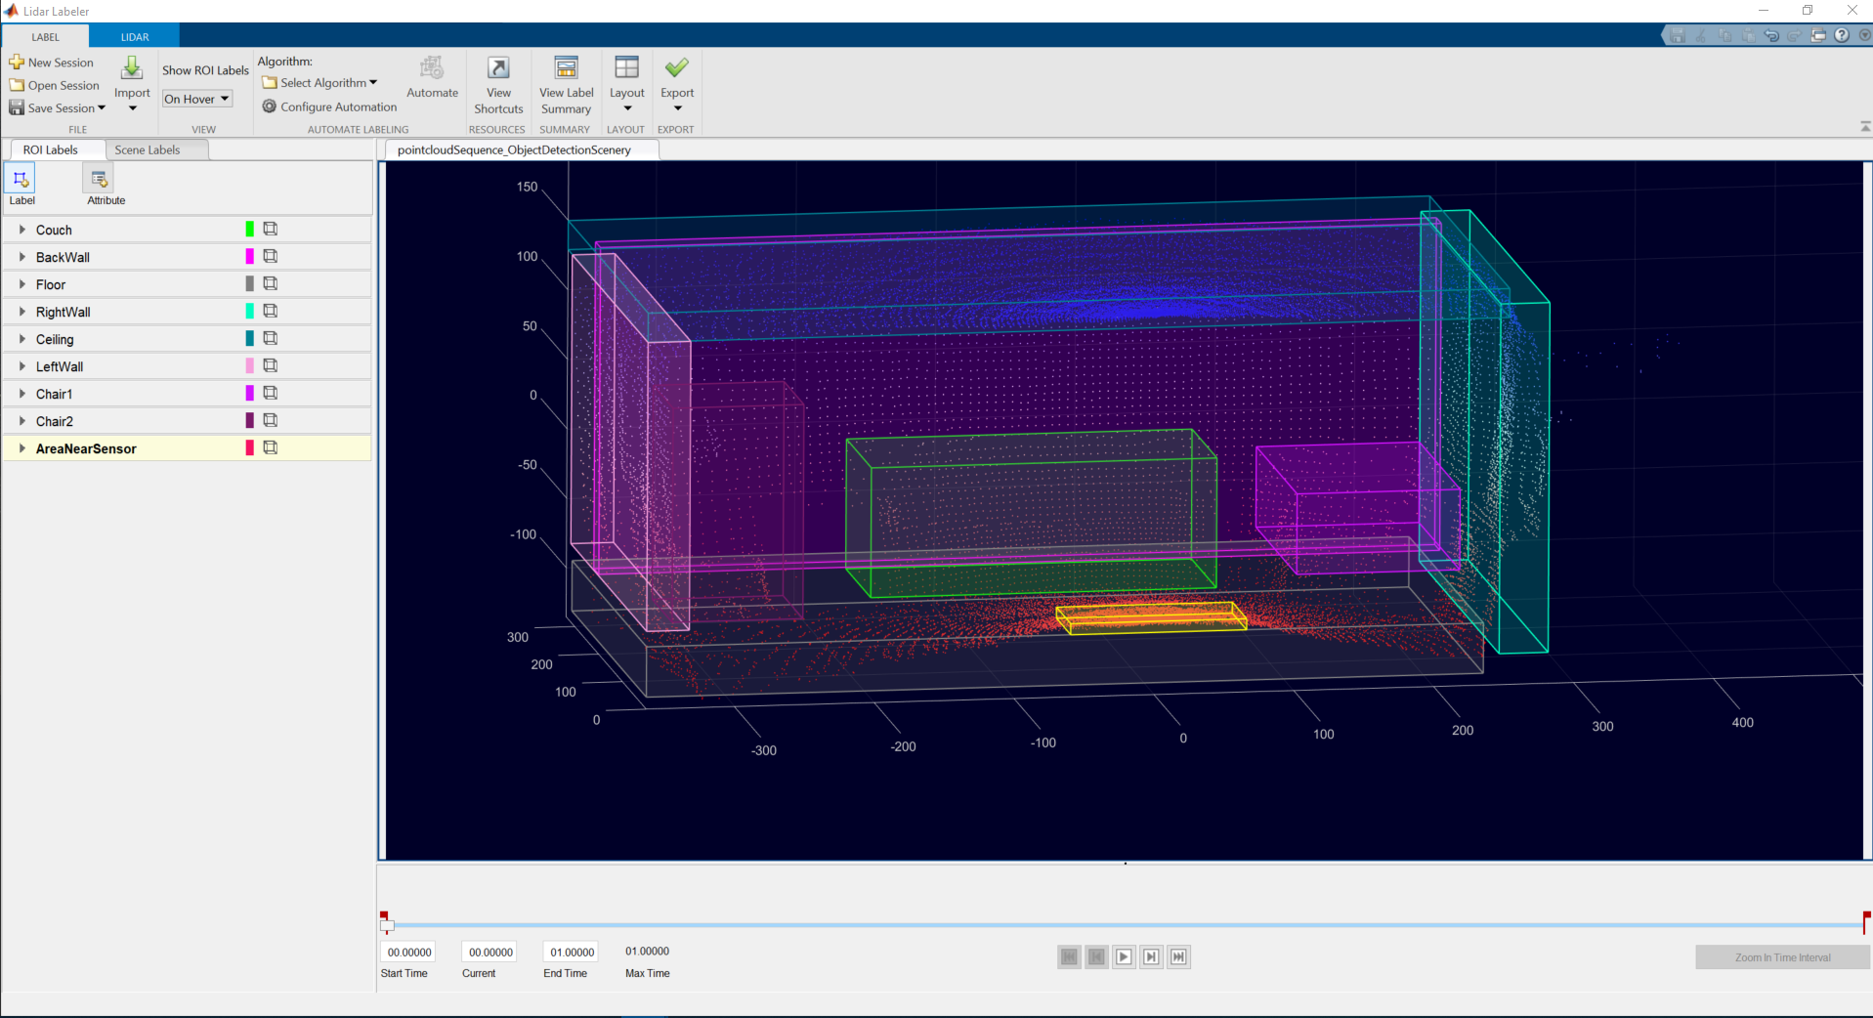

Slide 10
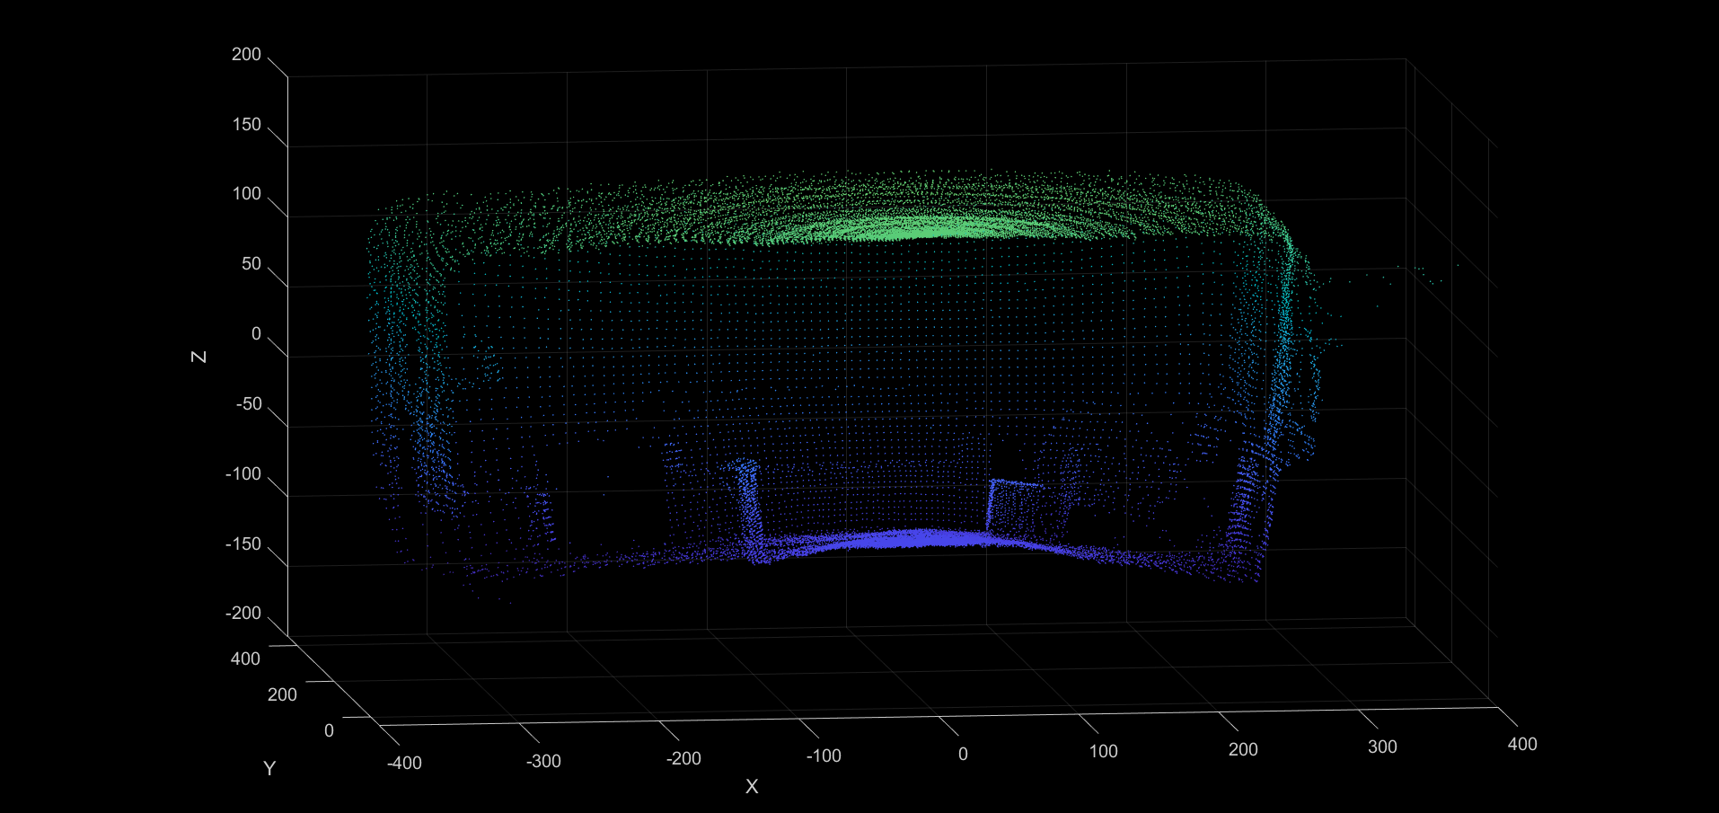
32,400 point scan of Environment with Objects

Slide 11
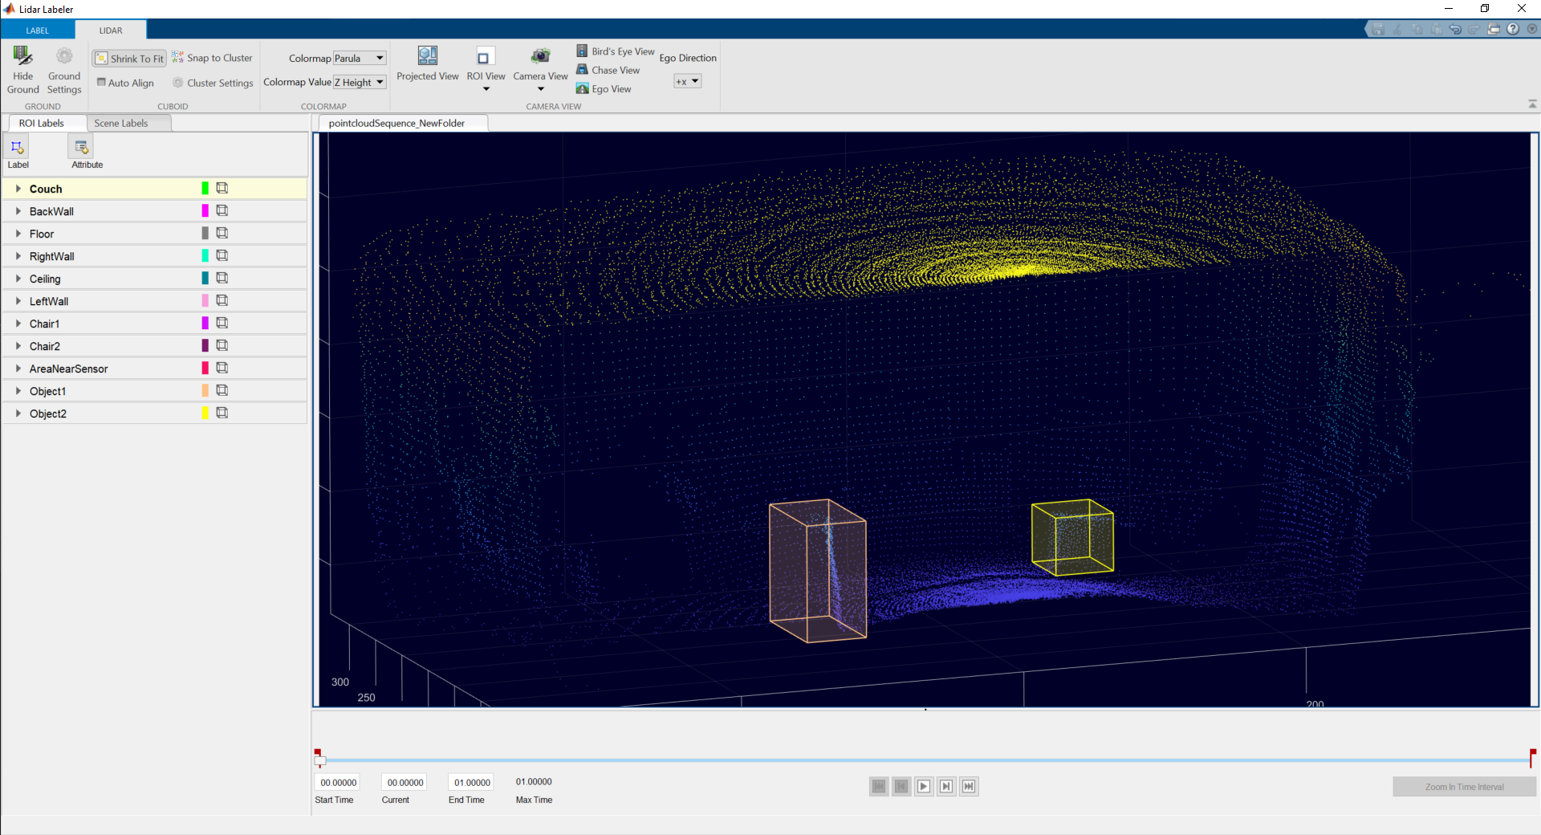

Slide 12
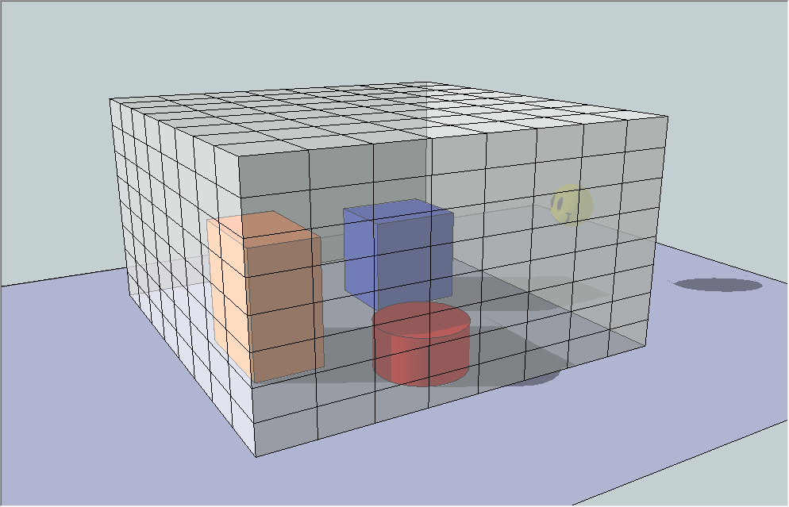
MATLAB Voxelization
Processing technique intended to restrict a large amount of geometric data into a smaller discrete grid
Simplifies the data contained to point density
Allows neural network to focus on shifts in density values to track movement
Equal-Sized Cuboid shapes
Sizes Varied
Maximum limits of x, y, and z were set to be constant
X: -400 to 400
Y: -50 to 450
Z: -200 to 200

Slide 13
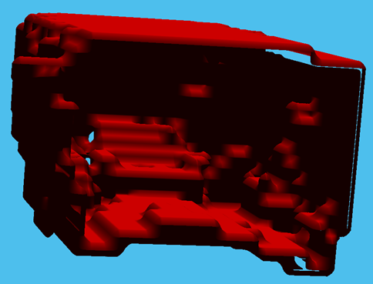
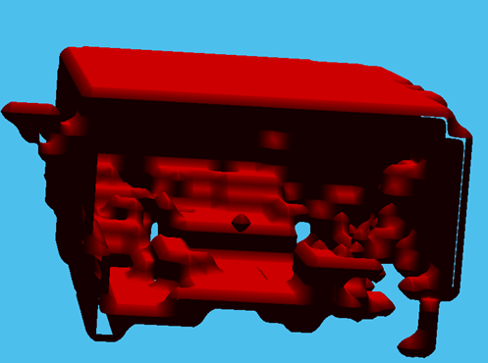
20x20x20 cm cuboids

Slide 14
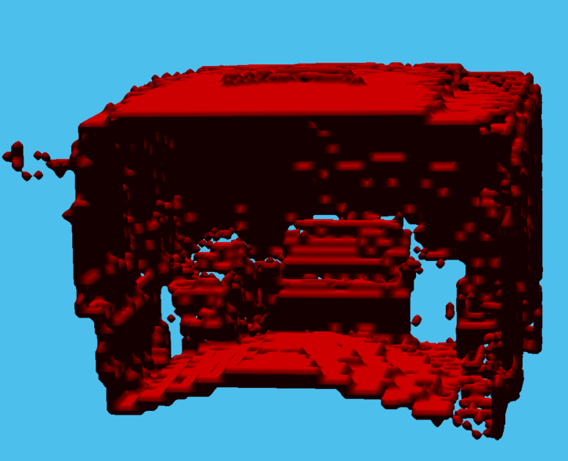
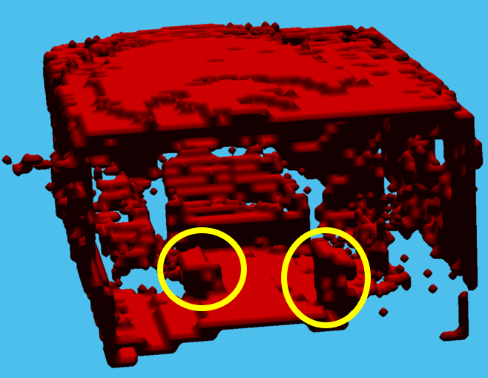
10x10x10 cm cuboids

Slide 15
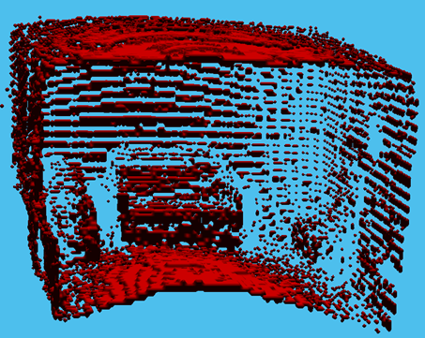
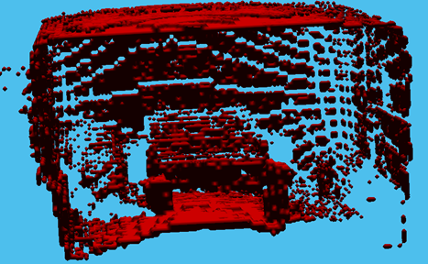
5x5x5 cm cuboids

Slide 16
Computer Vision Toolbox™
Allows for In-Depth Analysis of Point Cloud Data
Read/Write Point Clouds
Store Point Clouds
Visualize Point Clouds
Process Point Clouds
Segment Point Clouds
Fit Point Clouds to Geometric Models

Slide 17
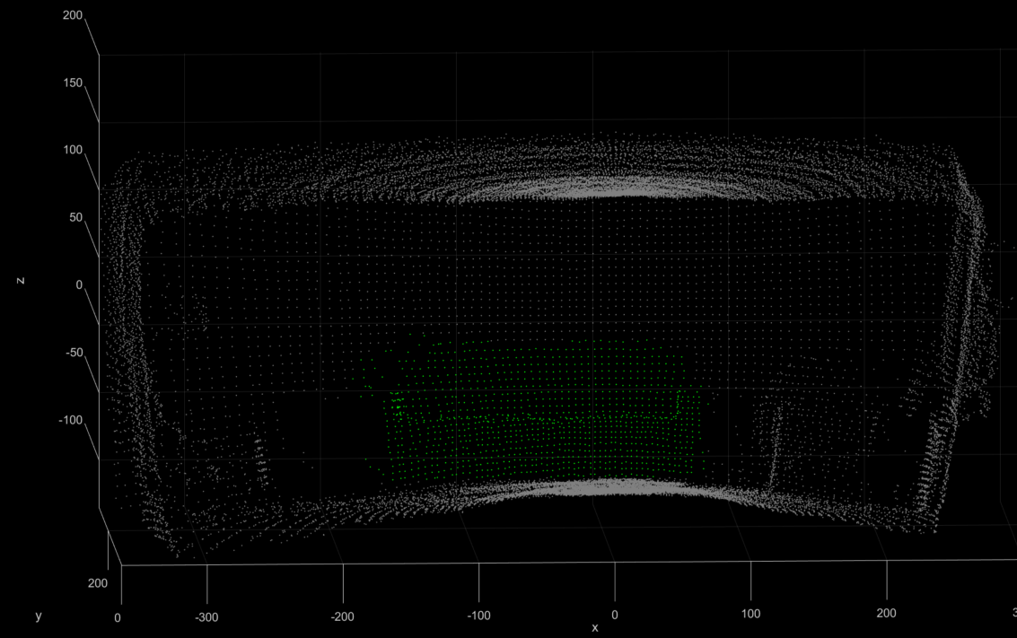

Slide 18
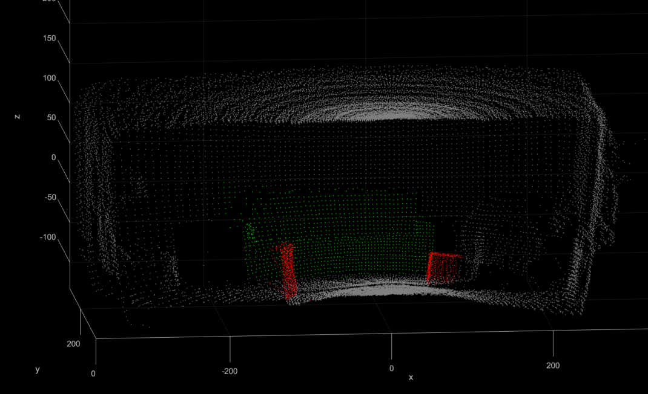

Slide 19
Conclusion
Does MATLAB offer the capability to effectively implement an object detection and classification strategy?
YES
Can an automated object detection and classification strategy be implemented to this system right now?
NO
What can be done to change that?
Upgrade the system’s ability to map a three-dimensional area quickly
Transfer the focus of the project to implement a 2D SLAM objective

Slide 20
Acknowledgements
I would like to express my extreme gratitude to the following people
for their key advice, contributions, and assistance
during both the creation of my final Honors Research
and the duration of my undergraduate experience
at the University of New Hampshire:
Capstone Advisor:
Professor Se Young Yoon, Ph.D

