Slide 1
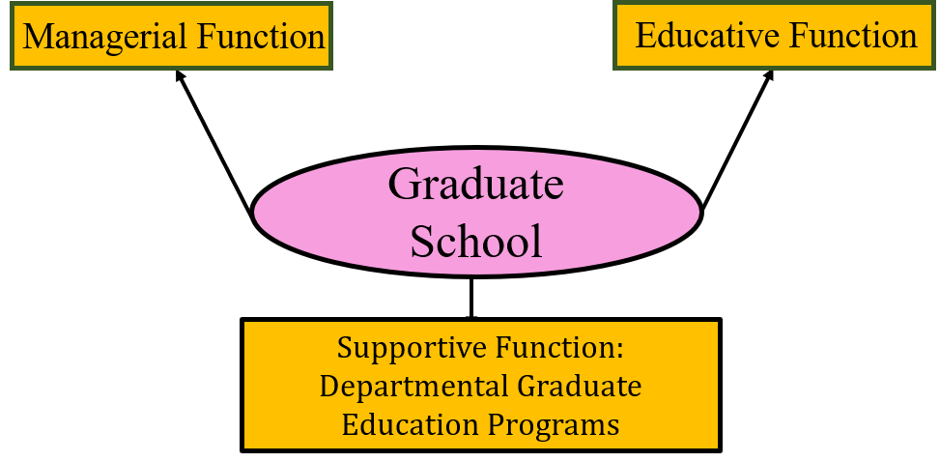
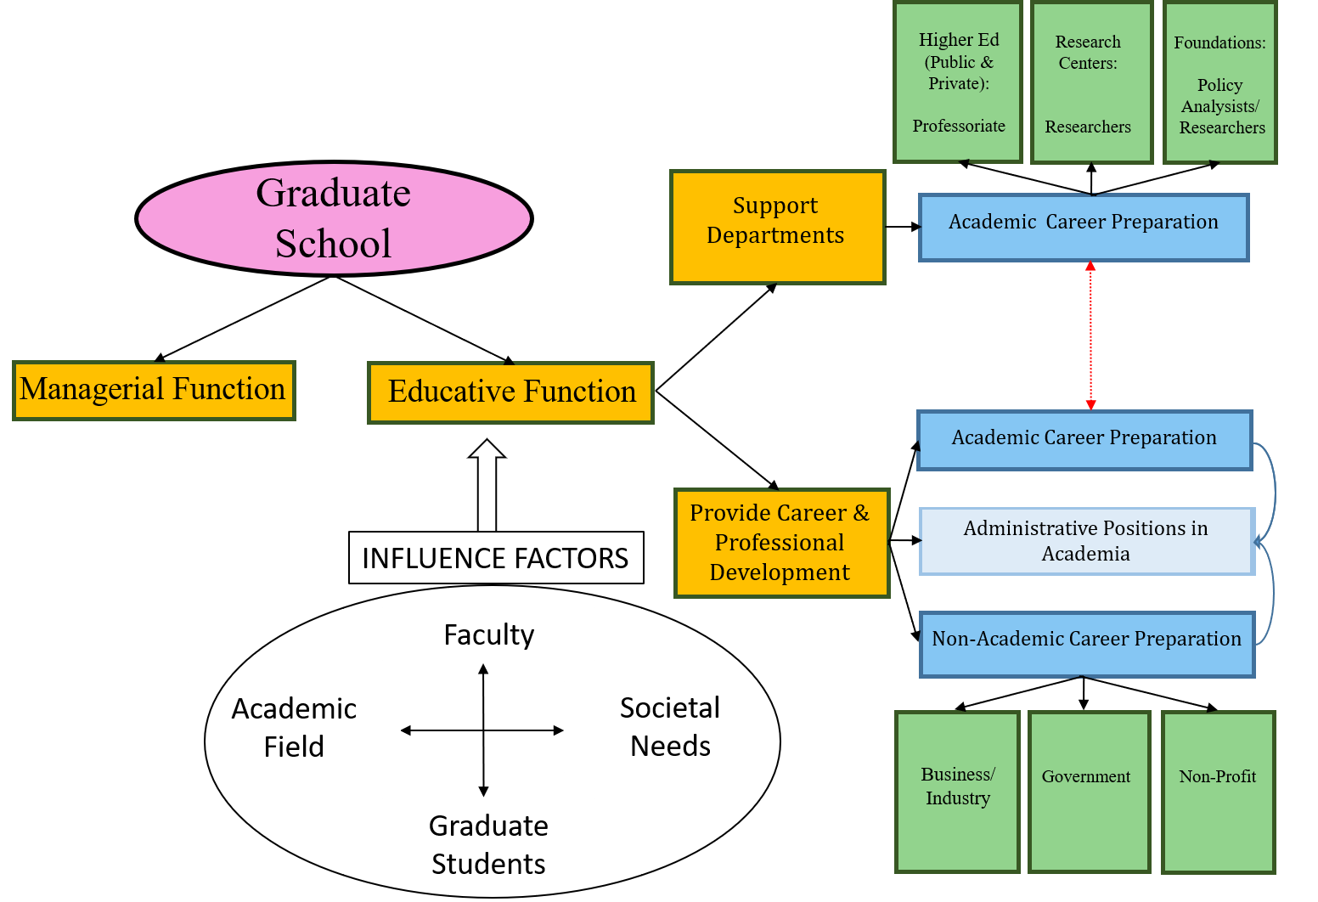
Graduate Education: A Model for Career Diversification What Can You Be With a Graduate Degree?
Jovana Milosavljevic Ardeljan, Education Department, University of New Hampshire
background
methods
Research question
Traditional graduate training prepares students for communication within their field of study; however, it often fails to provide skill development opportunities needed for addressing more general audiences in diverse careers (Coleman, 2018).
Three-part study included collecting data through:
Archival analysis
Interviews with Graduate School official (e.g., Deans)
Interviews with Ph.D. students who participated in communication skill development program(s)
This research focuses on broadly-based oral and written communication programs, how they are organized, who creates them, and what students gain from them? Ultimately, it investigates whether communication support could help in diversifying career options.
Recommendations
Proposed approach to graduate education
Current model of operation of graduate education
results
In their educative function Graduate Schools provide career & professional development, including broadly-based communication support programming. However, it’s rarely systematically organized and provided regularly.
Coleman, M.S. (2018, June 4). The three Vs of Graduate Education [newsletter issued by Mary Sue’s desk]. Retrieved from https://www.aau.edu/newsroom/mary-sues-desk/three-vs-graduate-education

