Slide 1

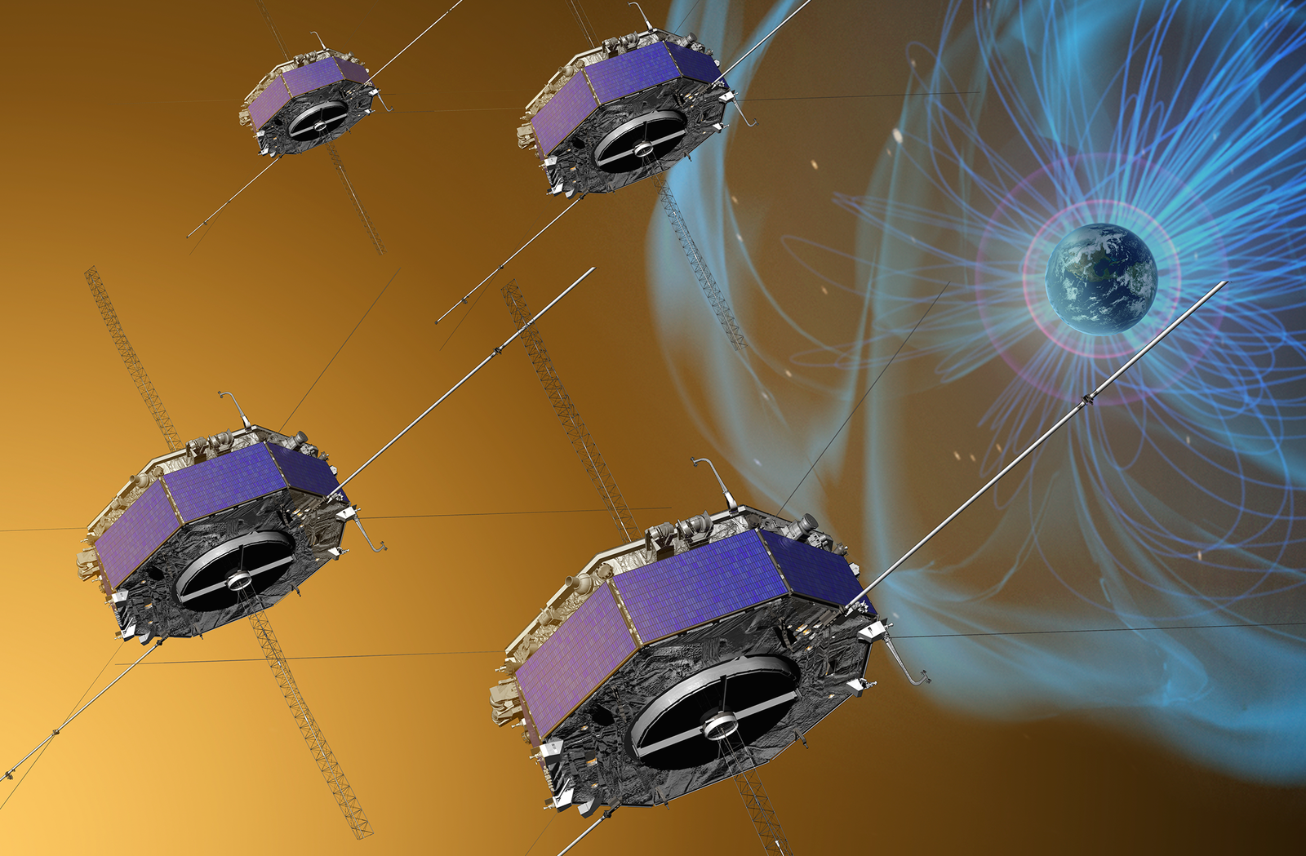
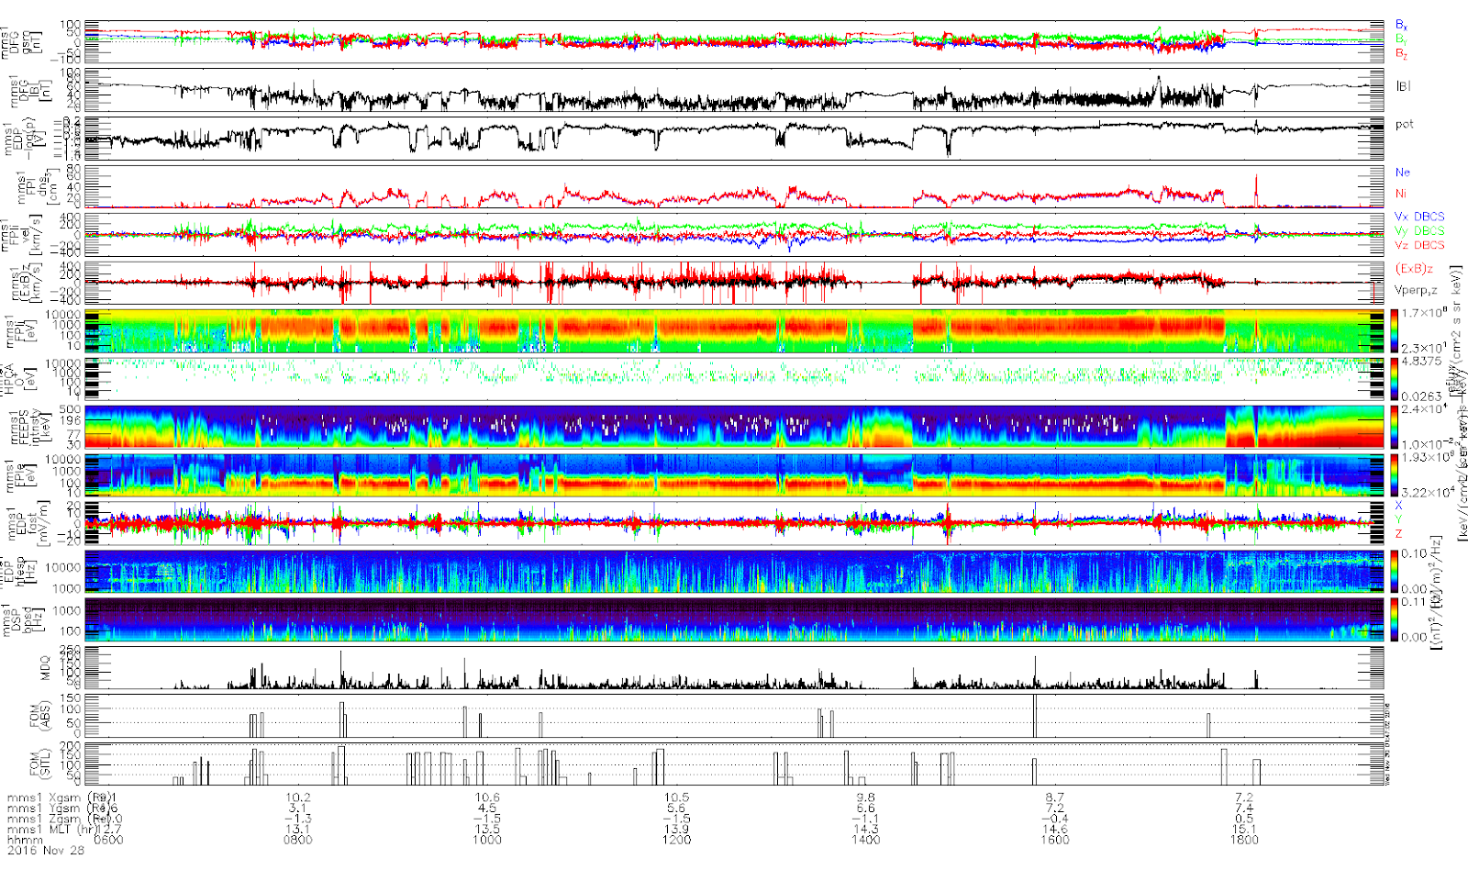
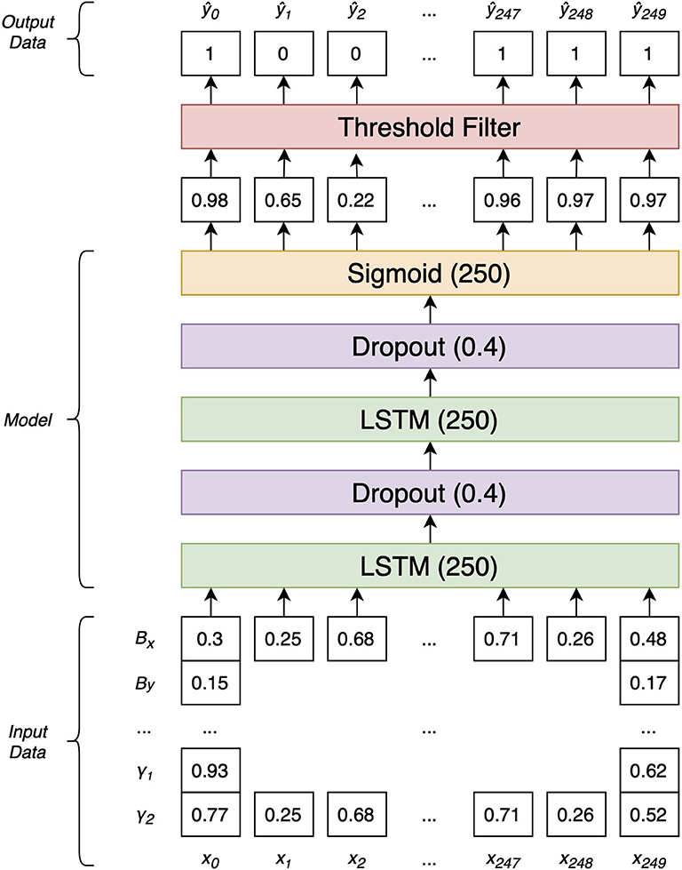
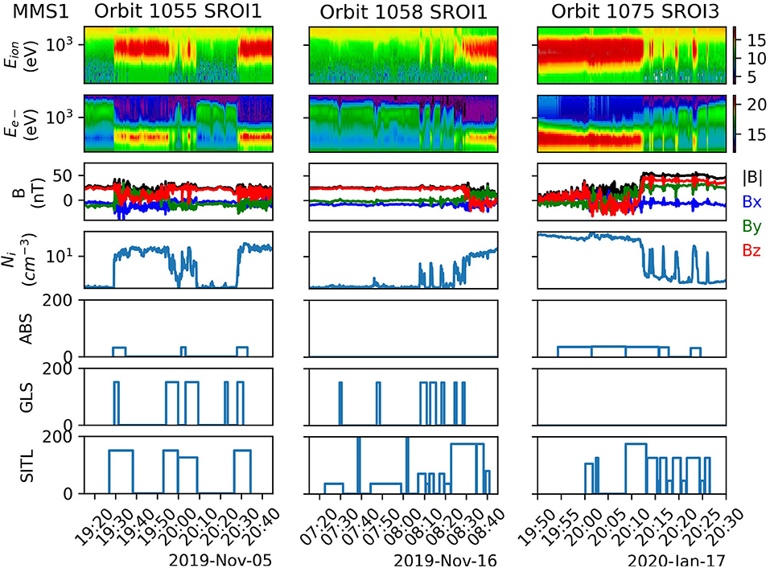
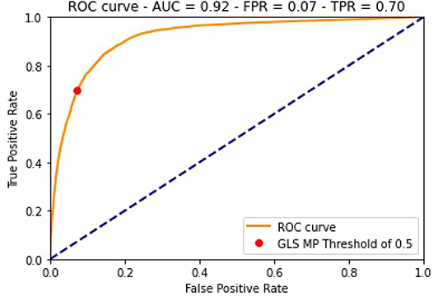
SITL Ground Loop: Automated Selection of MP Crossings in the SITL Workflow
Colin Small, Dr. Matthew Argall, Dr. Marek Petrik
Department of Computer Science, University of New Hampshire, Durham, NH 03824
Introduction
Motivation
The Magnetospheric Multiscale Mission (MMS) is a constellation of four spacecraft orbiting the Earth collecting data about magnetic reconnection, a phenomena that drives space weather such as the appearance of aurora.
Certain regions and physical phenomena the spacecraft experience throughout their orbit, such as magnetopause crossings, are rich in scientific data.
Spacecraft collect two levels of data: survey mode that is quick to transmit but too low resolution to perform science, and burst mode that is slow to transmit but fit for performing science.
Problem: Due to memory and data transmission limitations, MMS spacecraft cannot transmit all data in survey mode, requiring human scientists to select regions of data to download. Existing automatic selection system (ABS) underselects relevant regions.
Solution: Train a neural network to automatically classify regions of interests. We focused our initial model to identify magnetopause crossings.
The scientist-in-the-loop (SITL) team is a team of 73 volunteer scientists who look through the available survey data and choose which specific windows to download in burst mode
SITLs are given only 48 hours to make their selections once survey data is available. After 48 hours, the burst mode data saved on the spacecraft will be overwritten by newly-collected data.
Source: NASA/GSFC
Conclusions
The GLS has been successfully running at NASA’s Science Data Center, the home of the MMS mission and SITL team since October of 2019. The model has selected 78% of all SITL-selected magnetopause crossings, 44% more than the ABS. This indicates both its value to the SITL and its accuracy in selecting magnetopause crossings.
The GLS model can be easily adapted to identifying other events and phenomena. Future work will be devoted to developing a full suite of event-identifying models.
Figure 1. What a SITL sees when making selections. The last and second from last rows show selections made by the SITL and the ABS, respectively. The ABS row shows the existing selection system clearly underperforms. The rows above ABS show relevant data collected by the satellite used by the GLS and SITLs to make their decisions.
Model Architecture
Model Development
We pass the output of the sigmoid layer through a threshold filter, setting all values above 0.5 to 1 (meaning we think it is part of a magnetopause crossing) and all others to 0 (meaning we do not think it is part of a magnetopause crossing).
We developed the Ground Loop System (GLS), a bidirectional long short-term memory recurrent neural network (LSTM) to identify magnetopause crossings. LSTMs excel at learning complex signatures in sequential data.
Our model was trained on data from 1 January 2017 to 30 January 2017. Each datapoint in this range was labeled as either ”selected” (1) or “not selected” (0), and the GLS was trained to recreate these labels. 80% of the datapoints were used in training the model and 20% of the datapoints were reserved for testing.
We implemented and trained our model using Google Colab, a remotely-hosted Jupyter-notebook based code editor that provides users free access to GPUs for GPU-accelerated model training.
The sigmoid layer outputs a final value between 0 and 1, inclusive, that represents the model’s confidence that an individual point was part of a magnetopause crossing.
Dropout layers help reduce overfitting, which in turn helps the model generalize what it learns about magnetopause crossings to new data.
Two bidirectional LSTM layers learn complex signatures in the data that are indicative of magnetopause crossings.
Figure 3. Highlighted GLS performance for three example orbits. The columns in the GLS and SITL rows indicate selected windows containing suspected magnetopause crossings. We show an orbit where the GLS performs similarly to the ABS, outperforms the ABS, and underperforms the ABS in the first, second, and third column, respectively. The rows above ABS show relevant data collected by the satellite.
Data composed of the same data that SITLs see and use to make selections on is vectorized and fed as input to our model. In training, we use sequences of 250 consecutive data points, hence the (250) suffix on the LSTM and Sigmoid layers above.
References
Acknowledgements
M.R. Argall, C. Small, S. Piatt, L. Breen, M. Petrik, J. Barnum, K. Kokkonen, K. Larsen, F.D. Wilder, M. Oka, R.B. Torbert, R.E. Ergun, T. Phan, B.L. Giles, J.L. Burch. MMS SITL Ground Loop: Automating the burst data selection process. Front. Astron. Space Sci., 7
Small, C., M.R. Argall. Automated Detection of Magnetopause Crossings. In M.G. Bobra, & J.P. Mason (Eds.), Machine Learning, Statistics, and Data Mining for Heliophysics. https://doi.org/10.5281/zenodo.1412824.
Figure 3. Diagram of the model architecture. The sigmoid layer outputs a value between 0 and 1 that represents the model’s certainty of a point being in the magnetopause.
Dr. Matthew Argall and Dr. Marek Petrik for their exceptional mentorship and support over the past three years of the project.
The MMS SITL team for their volunteered time.
The NASA SDC team for support and advice in the development of the GLS pipeline.
Figure 2. ROC curve of the trained model on validation data shows favorable performance. For model selections, a threshold of 0.5 gives a true positive rate of 0.7 and a false positive rate of 0.07.

Slide 2
This poster template provided courtesy of
UNH ESRC Poster Printing Services
Trust us to make your poster look GREAT!
Website: http://posters.unh.edu
Poster Guide: http://goo.gl/1E7TJY
DELETE THIS SLIDE BEFORE PRINTING

