Slide 1
Disability, friendship, and educational Outcomes: What’s the connection?
Donna McNiff Brown
PhD Student, Education Dept.
Curriculum & Instruction/Teacher Preparation
UNH Graduate Research Conference, 2021
donnamcbrown@gmail.com

Slide 2
Friendship and Education?
In education, we care about academic, social, communication, and behavioral outcomes for all. Friendships and meaningful social relationships are essential components of these outcomes, impacting students’ learning potential, academic achievements, future employment and independence (Benner, 2011; Newcomb & Bagwell, 1996).
People with friends are more likely to be self-assured and to feel a sense of belonging (Bukowski, Newcomb, & Hartup, 1996; Thompson & Grace, 2001; Vaquera & Kao, 2008). In addition, people’s social relationships and their level of self-esteem are reciprocal in all developmental stages across the life span (Harris & Orth, 2020).
Children and adolescents with disabilities often have poor educational outcomes. They also often lack meaningful relationships with peers, further hindering learning and life outcomes. To better understand these two realities, I embarked on a project with individuals with disability labels to explore their lived experiences of friendship.

Slide 3
The study of friendship is haunted by the problem of definition. (Killick & Desai, 2010, 1)
There’s been quite a lot of research in social sciences about the phenomena of children’s and adults’ friendships, resulting in numerous variations of friendship definitions around the world (e.g., Killick & Desai, 2010). Precise characteristics and inclusion/exclusion criteria vary (e.g., family are not friends).
Within disability scholarship, friendship has been defined as meaningful relationships that are:
reciprocal,
chosen individually,
occur outside of friendship or peer buddy programs,
based on shared interests,
and not based on benevolence or a one-way relationship of “helping the handicapped”
(A. Amado, 2004; Kunc, 1992; Snell & Janney, 2000; Taylor & Bogdan, 1989).

Slide 4
Questions guiding this research
How do people with disability labels define “friendship”?
How do they describe and represent their friendships?
How are they enacted?
What are the factors that encourage them?
What are the factors that get in the way?

Slide 5
Methodology
Participants were recruited from the previous “Friendship Survey,” as well as “snowball sampling” (Biernacki & Waldorf, 1981) which is a popular method for researchers of sensitive topics (Lee, 1993).
Thirteen people were interviewed: seven individuals with labels of disability, five parents of children or adults with disabilities, and one sibling of an adult with disabilities.
Participants lived across the United States, including people from Texas, California, New Hampshire, Arizona, Idaho, Massachusetts, Virginia, Oklahoma, and New York.
Ages of people with disabilities ranged from 8 to 57 years old.
All interviews took place using “Zoom” video conferencing technology. Participant consent and assent was confirmed. All interviews were recorded.

Slide 6
Methodology
Using a semi-structured interview format, participants responded to prepared questions, sharing their stories and ideas.
Prepared questions included, “Will you tell me how you define friendship?”, “Do you have a best friend?”, “How did you meet?”, “What do you do together?”, “Why do you think the friendship lasted/ended?”.
At this point in the project, all interviews have been transcribed and de-identified.
I will use grounded theory methods to code and analyze my data (Glaser & Strauss, 1967; Charmaz, 2000). Grounded theory is well-suited to research that is inductive in nature. Through a coding process that organizes and examines data in multiple and dynamic ways, grounded theory enables the researcher to deconstruct, reorganize, and form conclusions about complex social processes (Strauss, & Corbin, 1994; LaRossa 2005).

Slide 7
Emerging themes
INCLUSION (AND EXCLUSION)
“We were in (general education) class together, did Halloween together, and played on a soccer team.”
SAFETY “[It’s] incredibly important to have friends, and it’s important to have safe friends. (…) Most of [my sister’s] able-bodied friends that were not through [family] unfortunately have been exploitative relationships.”
COMMUNICATION
Another parent advisedly said, “Be patient” –wait for a response from a peer with difficulties in processing or producing language.
TEACHER EXPECTATIONS
“I did not want somebody (a teacher) with preconceived ideas about what he could or couldn't learn.”

Slide 8
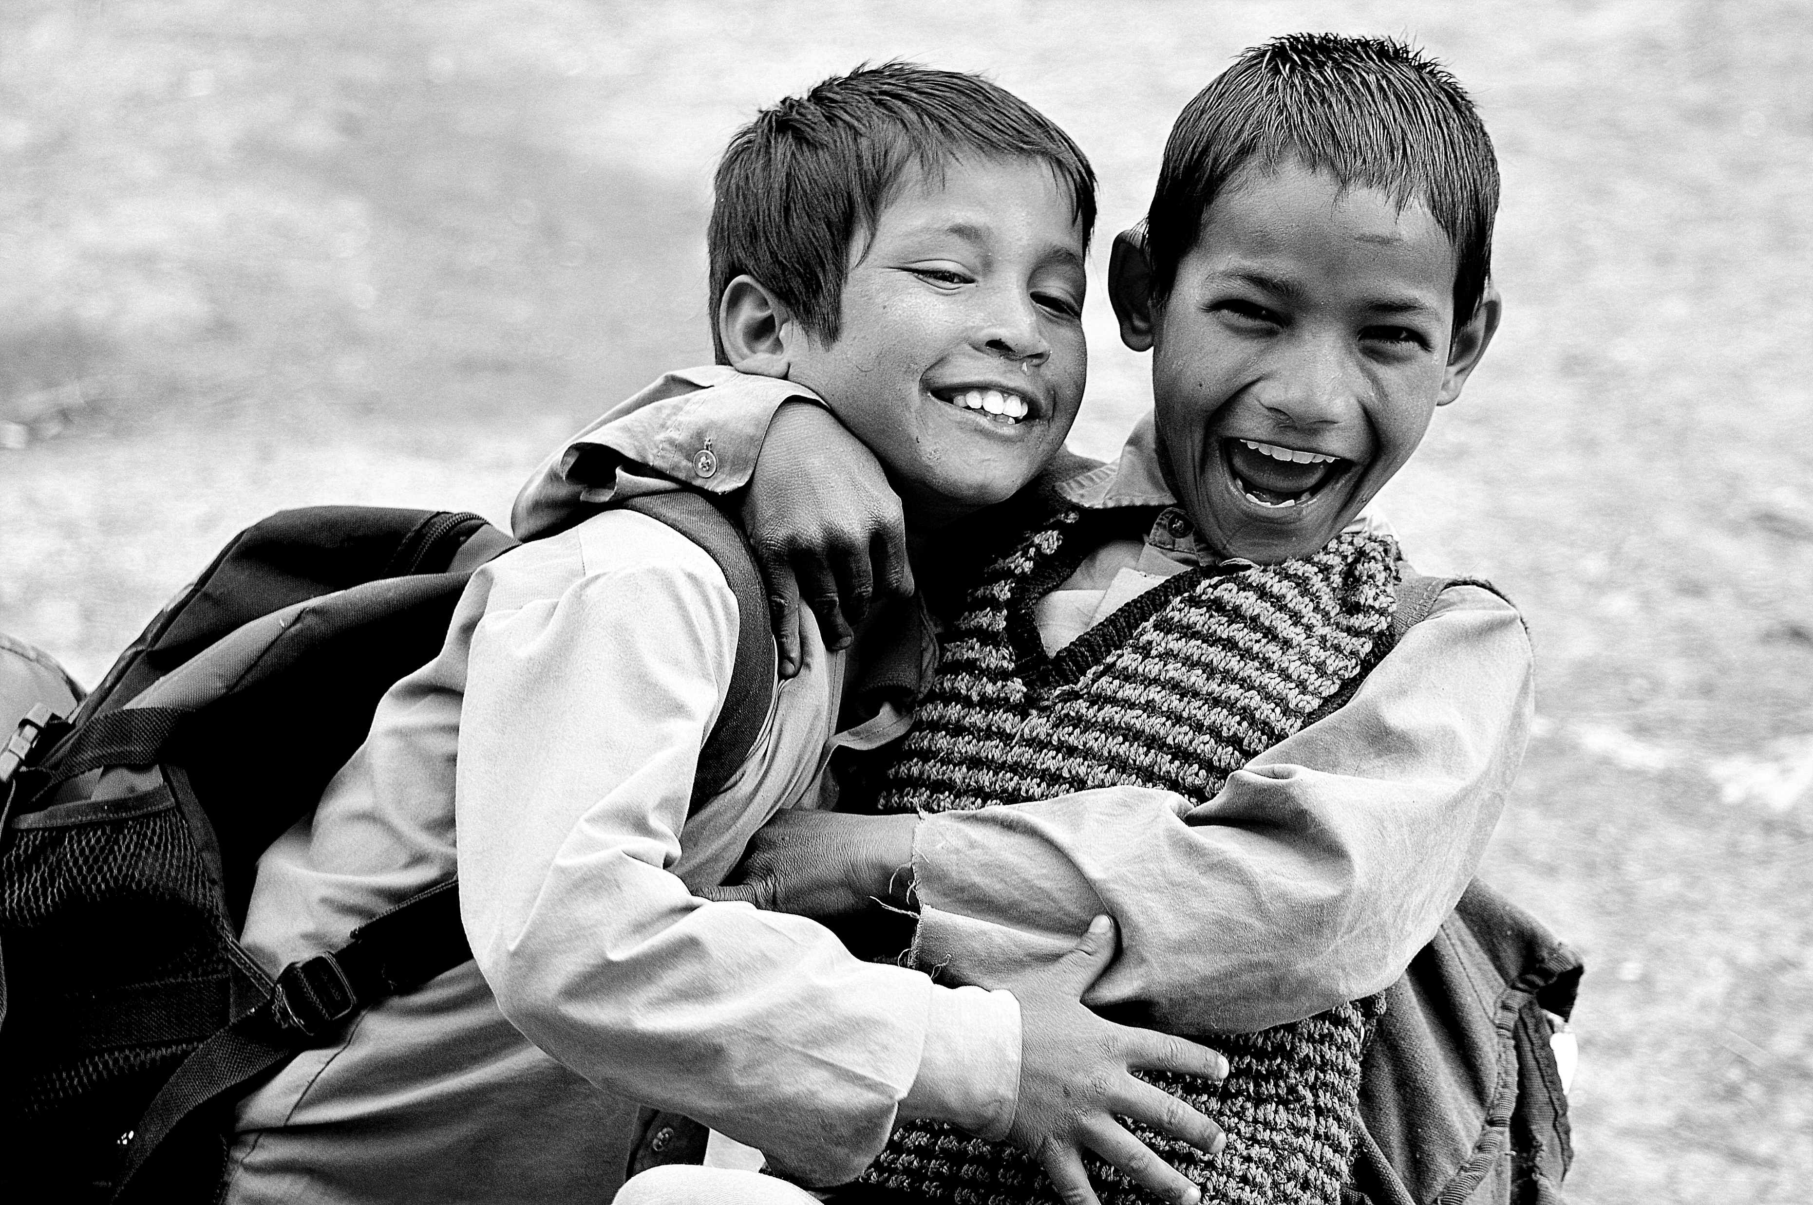
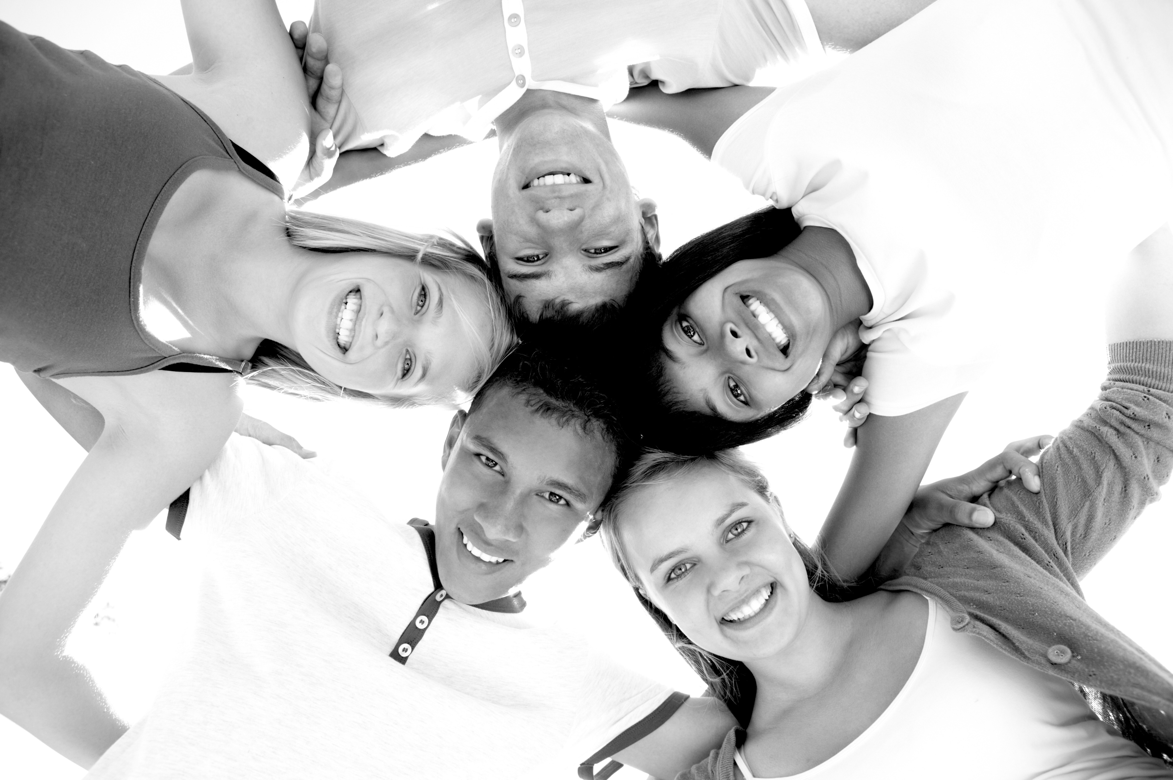
Friendship

Slide 9
Thank you for being here today!
Please contact me with any questions or comments
At donnamcbrown@gmail.com

Slide 10
References
Amado, A. (2004). Lessons learned about promoting friendship. TASH Connections, 30, 8–12.
Baron-Cohen, S., & Wheelwright, S. (2003). The Friendship Questionnaire: An investigation of adults with Asperger syndrome or high-functioning autism, and normal sex differences. Journal of autism and developmental disorders, 33(5), 509-517.
Benner, A. D. (2011). Latino adolescents’ loneliness, academic performance, and the buffering nature of friendships. Journal of Youth and Adolescence, 40(5), 556-567.
Biernacki, P., & Waldorf, D. (1981). Snowball sampling: Problems and techniques of chain referral sampling. Sociological methods & research, 10(2), 141-163.
Bukowski, W. M., Newcomb, A., & Hartup, W. (Eds.). (1996). The company they keep: Friendships in childhood and adolescence. New York, NY: Cambridge University Press.
Charmaz, K. (2000). Grounded theory: Objectivist and contructivist methods. In N. K. Denzin & Y. S. Lincoln (Eds.), Handbook of Qualitative Research (2nd ed.) (pp. 509-535). Thousand Oakes, CA: Sage.
Glaser, B. G., & Struass, A. L. (1967). The discovery of grounded theory: Strategies for qualitative research. Chicago: Aldine.
Harris, M. A., & Orth, U. (2020). The link between self-esteem and social relationships: A meta-analysis of longitudinal studies. Journal of personality and social psychology, 119(6), 1459.
Killick, E., & Desai, A. (2010). Introduction: Valuing friendship. In E. Killick & A. Desai (Eds), The ways of friendship: Anthropological perspectives (pp. 1-19). New York: Berghahn Books.
Kunc, N. (1992). The need to belong: Rediscovering Maslow’s hierarchy of needs. In R. Villa,J. Thousand, W. Stainback, & S. Stainback (Eds.), Restructuring for caring and effective education: An administrative guide to creating heterogeneous schools (pp. 25–39). Baltimore, MD: Paul H. Brookes.
LaRossa, R. (2005). Grounded theory methods and qualitative family research. Journal of Marriage and Family, 67, 837-857.
Lee, R. M. (1993). Doing research on sensitive topics. Sage.
Newcomb, A. F., & Bagwell, C. L. (1996). The developmental significance of children’s friendship relations. In W. M. Bukowski, A. F. Newcomb, & W. W. Hartup (Eds.), The company they keep: Friendship in childhood and adolescence (pp. 289–321). New York, NY: Cambridge University Press.
Parker, J. G., & Asher, S. R. (1989). Friendship quality questionnaire-revised: Instrument and administration manual. Ann Arbor: University of Michigan.
Rossetti, Z. (2011). “That’s how we do it”: Friendship work between high school students with and without autism or developmental disability. Research and Practice for Persons with Severe Disabilities, 36, 23–33.
Schuh, M., Hagner, D., & Sundar, V. (2014). Friendship is the ocean: Importance of friendship, acceptance, and leadership in the transition to adulthood. Career Development and Transition for Exceptional Individuals, 37, 1-10. DOI:10.1177/2165143414528031
Singleton, R. A., Jr. & Straits, B. C.. (2010). Approaches to Social Research (5th Ed). New York: Oxford, University Press.
Snell, M. E., & Janney, R. (2000). Social relationships and peer support. Baltimore, MD: Paul H. Brookes.
Strauss, A., & Corbin, J. (1994). Grounded theory methodology. Handbook of Qualitative Research, 17, 273-85.
Taylor, S. J., & Bogdan, R. (1989). On accepting relationships between people with mental retardation and non-disabled people: Towards an understanding of acceptance. Disability, Handicap, & Society, 4, 21–35.
Test, D. W., Mazzotti, V. L., Mustian, A. L., Fowler, C. H., Kortering, L., & Kohler, P. (2009). Evidence-based secondary transition predictors for improving postschool outcomes for students with disabilities. Career Development for Exceptional Individuals, 32, 160–181.
Vaquera, E., & Kao, G. (2008). Do you like me as much as I like you? Friendship reciprocity and its effects on school outcomes among adolescents. Social Science Research, 37, 55–72. doi:10.1016/j.ssresearch.2006.11.002

