Slide 1
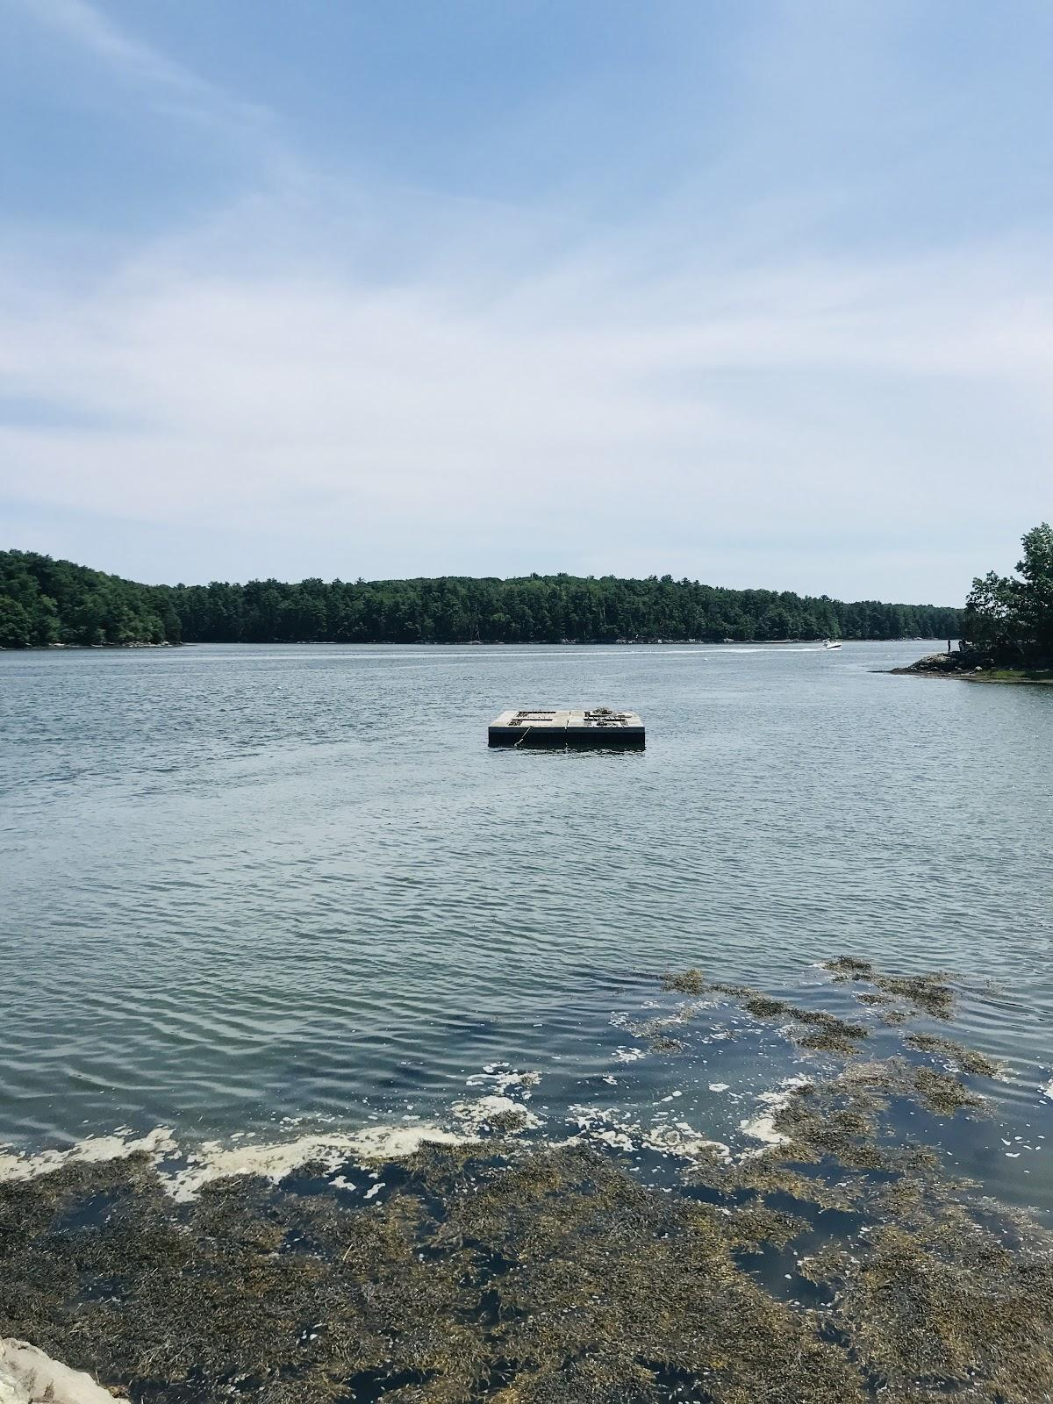
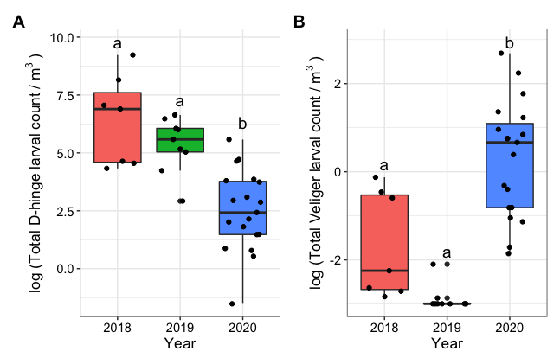
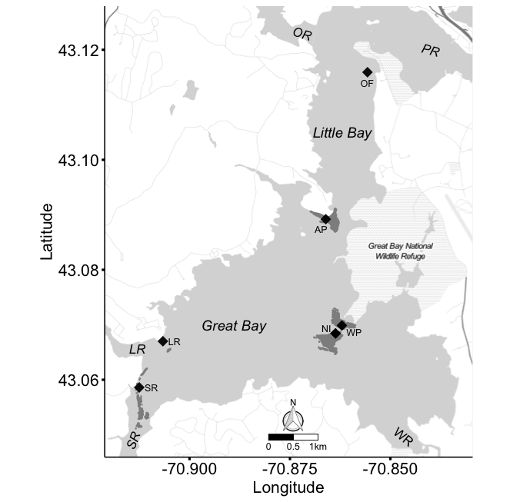
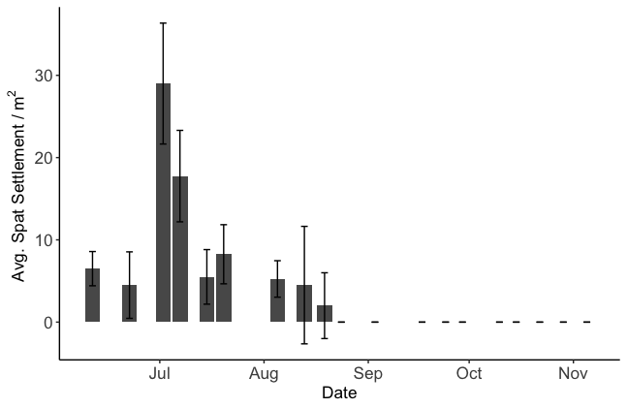
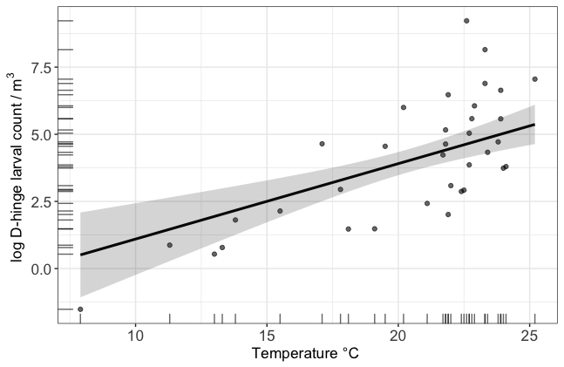
Evaluation of Oyster Larval Abundance in the Great Bay Estuary
Alyssa Stasse, Kelsey Meyer, Nicole Bumbera, Matthew LH. Cheng, Kaitlin Van Volkom, Alix M. Laferriere, Jennifer A. Dijkstra, Bonnie Brown
Department of Biological Sciences (Brown Lab) | The Center for Coastal and Ocean Mapping (Dijkstra Lab)
Introduction
Methods
Results
Drastic declines in Eastern oyster, Crassostrea virginica, abundances (Kirby 2006; Beck et al., 2011; Rick et al., 2016) have led to a loss of ecosystem services provided throughout its North American range. In the face of the decline in oysters in New England, specifically in New Hampshire (NH), efforts toward oyster reef restoration have become increasingly common (Grizzle and Ward 2016). Oyster reefs previously existed throughout much of New Hampshire’s estuaries, which include the Great Bay Estuary (GBE), but current oyster populations in NH now are at <10% of what was present in the 1980s (Grizzle and Ward 2016). Larval recruitment to wild populations is critical to the sustainable restoration of Eastern oysters, and this recruitment ultimately depends on production of larvae that survive to metamorphosis and settle on reef surfaces. Currently, spatial and temporal preferences of larval dispersal remain largely unknown.
Physicochemical data: Temperature, salinity, and pH were collected for each tow sampling week to assess the potential relationships between abiotic factors and oyster larvae abundance (NOAA NERR SWMP database)
Enumeration of larval samples: Formalin-preserved water samples collected from larval tows were poured into a graduated cylinder to ascertain total and settled volume. These water samples were then transferred and filtered onto a set of metal sieves that ranged from 2000 μm - 45 μm (isolate oyster 106 μm - 45 μm). Samples were enumerated using an optical microscope and a Flow Camera.
Results
A consistent baseline of approximately 2000 D-hinge and 1 veliger larvae in 2018, 300 D-hinge and 1 veliger larvae in 2019, and 50 D-hinge and 3 veliger larvae in 2020 were observed with no significant differences among sites for D-hinge larvae or veligers throughout each sampling season. A MANOVA showed significant differences in the number of larvae observed across sampling years for D-hinge and veliger larvae (F = 14.501, p = 1.753*10⁻⁸) (Fig. 4). For D-hinge larvae, only temperature was significantly (positively) correlated with abundance (p = 5.18*10⁻⁵, R² adjusted = 0.6246) (Fig. 3). Increases in oyster larvae also were observed when pH was ~7.8, albeit not to a significant degree. There was no significant difference among sites regarding the quantity of spat settled ( χ²= 1.5649, df = 3, p = 0.6674) (Fig. 2).
Objectives
Reveal the dynamics of abundance of C. virgincia larvae in GBE from 2018-2020.
2) ascertain differences in settlement across representative sites where oysters previously were abundant.
Fig. 4 Crassostrea virginica larval counts (D-hinge and veliger) in 2018, 2019, and 2020 collected from waters in Great Bay Estuary, NH.
Study area
The Great Bay Estuary (43°04'0.60" N, 70°52’4.19” W) located on the southern New Hampshire-Maine border
The four sites sampled throughout our study encompasses a large area of the GBE (Fig 1), reflecting conditions throughout the estuary during our sampling period.
Discussion
From our results thus far, we concluded that D-hinge larval abundances are decreasing in GBE, while veliger larval abundance seems to be slightly increasing. While an increase in D-hinge larvae positively correlated with rising temperature, it cannot be said that physicochemical factors are influencing the larval abundances in GBE. Spat settlement peaks during peak larval abundance (about July), then starts to diminish, which was expected. Based on these studies, larvae is seen as early as March and may suggest we are missing the first spawning event in oysters. Starting recruitment events sooner in the season would help catch this first spawning event and could lead to higher success of oysters in GBE. Future studies will focus on the relationship between larval abundances and adult oyster quantity in the location they were sampled to determine if there are enough adult oysters spawning. In addition, looking at phytoplankton composition, surface area competition, and predation would be useful studies to explore how oyster larval abundance relates.
Fig. 2 Crassostrea virginica spat settlement m⁻² observed in 2020 in GBE. The sites were located at Adams Point, Woodman’s Point, Nannie Island, and an oyster farm in Little Bay. Error bars show standard error.
Fig. 3 Significant results from the linear model between physicochemical data (temperature, salinity, pH, year) and D-hinge and veliger oyster larvae with corresponding trendlines.
References
Fig. 1. Map of the Great Bay Estuary and the four sites (black diamonds) where spat collectors were deployed, and larval tows were conducted. S
Haney, J.F., Hall, D.J., 1973. Sugar-coated Daphnia: A preservation technique for Cladocera1. Limnology and Oceanography 18. 331–333. https://doi.org/10.4319/lo.1973.18.2.0331
Higgins, Colleen B. et al., Nutrient Bioassimilation Capacity of Aquacultured Oysters: Quantification of an Ecosystem Service. 2011.
Higgins, Colleen B. et al., Effect of aquacultured oyster biodeposition on Sediment N₂ production in Chesapeake Bay. 2013.
NOAA Fisheries Eastern Oyster Biological Review Team 2007. Status Review of the Eastern Oyster (Crassostrea virginica).
Brumbaugh, Robert D. et al., A Practitioners Guide to Design & Monitoring of Shellfish Restoration. The Nature Conservancy and NOAA. 2005.
Konisky, Ray; Grizzle, Raymond E.; and Ward, Krystin M., "Restoring Native Oysters in Great Bay Estuary, NH (2011)" (2011). PREP Reports & Publications. 15. https://scholars.unh.edu/prep/15.
Mills, Kathy et al., Ecological Trends in the Great Bay Estuary. Great Bay National Estuarine Research Reserve.
Grabowski, J. H., T. C., Gouhier, J. E. Byers, L. F., Dodd, A. R., Hughes, M. F., Piehler, and D. L., Kimbro. 2019. Regional environmental variation and local species interactions influence biogeographic structure on oyster reefs. Ecology 00(00):e02921. 10.1002/ecy.2921.
NOAA National Estuarine Research Reserve System (NERRS). System-wide Monitoring Program. Data accessed from the NOAA NERRS Centralized Data Management Office website: http://www.nerrsdata.org; accessed June-November 2020.
Grizzle, Raymond E. and Ward, Krystin M., "Assessment of recent eastern oyster (Crassostrea virginica) reef restoration projects in the Great Bay Estuary, New Hampshire: Planning for the future" (2016). PREP Reports & Publications. 353. https://scholars.unh.edu/prep/353
Atwood, Robert L., and Grizzle, Raymond E. 2020. Eastern Oyster Recruitment Patterns on and Near Natural Reefs: Implications for the Design of Oyster Restoration Projects. Journal of Shellfish Research, 39(2): 283-298. https://doi.org/10.2983/035.039.0209
Baggett, L.P., Powers, S.P., Brumbaugh, R.D., Coen, L.D., DeAngelis, B.M., Greene, J.K., Hancock, B.T., Morlock, S.M., Allen, B.L., Breitburg, D.L., Bushek, D., Grabowski, J.H., Grizzle, R.E., Grosholz, E.D., La Peyre, M.K., Luckenbach, M.W., McGraw, K.A., Piehler, M.F., Westby, S.R. and zu Ermgassen, P.S.E. (2015), Guidelines for evaluating performance of oyster habitat restoration. Restor Ecol, 23: 737-745. https://doi.org/10.1111/rec.12262
Rodriguez-Perez, Ana, Sanderson William G., Moller, Lene Friis , Henry, Theodore B., and James, Mark 2020. Return to Sender: The Influence of Larval Behaviour on the Distribution and Settlement of the European Oyster Ostrea edulis. Aquatic Conserv: Mar Freshw Ecosyst. 2020; 30:2116–2132. DOI: 10.1002/aqc.34292116
Jonathan H. Grabowski, Robert D. Brumbaugh, Robert F. Conrad, Andrew G. Keeler, James J. Opaluch, Charles H. Peterson, Michael F. Piehler, Sean P. Powers, Ashley R. Smyth, Economic Valuation of Ecosystem Services Provided by Oyster Reefs, BioScience, Volume 62, Issue 10, October 2012, Pages 900–909, https://doi.org/10.1525/bio.2012.62.10.10
Jonathan H. Grabowski, and Charles H. Peterson. Restoring Oyster Reefs to Recover Ecosystem Services. Ecosystem Engineers Plants to Protists, 2007, Pages 281-294.
Loren D. Coen, Robert D. Brumbaugh2, David Bushek, Ray Grizzle, Mark W. Luckenbach, Martin H. Posey, Sean P. Powers, S. Gregory Tolley. Ecosystem Services Related to Oyster Restoration. Mar Ecol Prog Ser. Volume 341: 303–307, 2007.
Torben C. Rick, Leslie A. Reeder-Myers, Courtney A. Hofman,, Denise Breitburg, Rowan Lockwood, Gregory Henkes, Lisa Kellogg, Darrin Lowery, Mark W. Luckenbach, Roger Mann, Matthew B. Ogburn, Melissa Southworth, John Wah, James Wesson, and Anson H. Hines. Millennial-scale sustainability of the Chesapeake Bay Native American oyster fishery. PNAS. Volume 113. No. 23. Pages 6568-6573. 2016. www.pnas.org/cgi/doi/10.1073/pnas.1600019113
Michael W. Beck, Robert D. Brumbaugh, Laura Airoldi, Alvar Carranza, Loren D. Coen, Christine Crawford, Omar Defeo, Graham J. Edgar, Boze Hancock, Matthew C. Kay, Hunter S. Lenihan, Mark W. Luckenbach, Caitlyn L. Toropova, Guofan Zhang, Ximing Guo, Oyster Reefs at Risk and Recommendations for Conservation, Restoration, and Management, BioScience, Volume 61, Issue 2, February 2011, Pages 107–116, https://doi.org/10.1525/bio.2011.61.2.5
zu Ermgassen, P.S.E., Spalding, M.D., Grizzle, R.E. et al. Quantifying the Loss of a Marine Ecosystem Service: Filtration by the Eastern Oyster in US Estuaries. Estuaries and Coasts 36, 36–43 (2013). https://doi.org/10.1007/s12237-012-9559-y
Scyphers SB, Powers SP, Heck KL Jr, Byron D (2011) Oyster Reefs as Natural Breakwaters Mitigate Shoreline Loss and Facilitate Fisheries. PLOS ONE 6(8): e22396.https://doi.org/10.1371/journal.pone.0022396
Brad S. Baldwin, and Roger I. E. Newell. Relative importance of different size food particles in the natural diet of oyster larvae (Crassostrea virginica). Mar. Ecol. Prog. Ser. Volume 120: 135-145. 1995.
Short, Frederick T., "The ecology of the Great Bay Estuary, New Hampshire and Maine: An Estuarine Profile and Bibliography" (1992). PREP Reports & Publications. 376. https://scholars.unh.edu/prep/376
Methods
Acknowledgments
We thank the other members of the Brown Lab Team: Shimaa Ghazal, Taja Sims-Harper, and Grant Milne. We would also like to thank JEL and especially, Dave Shay for boat vessel use. Thank you to Krystin Ward for allowing us to utilize your oyster farm for a site. Thank you to Ray Grizzle and Colleen Sturges for your help in our project. Finally thank you to UNH and the Hatch 1023564 (nh00697) project for making this possible.
Spat Collectors: three 21.5” x 12” x 0.25” ceramic tiles enclosed within a 22” x 13” x 16” cage (3 cages per site, 12 cage spat collectors)
Larval Tows: 2 larval tows (2 minutes each at 1-2 kts) concurrent with weekly spat collections per site. A 64um mesh bongo net was used for collecting larval samples. Samples preserved in formalin sucrose.

