Slide 1

The Involvement of Gli2 in Class Switch Recombination
Laura Kehoe

Slide 2
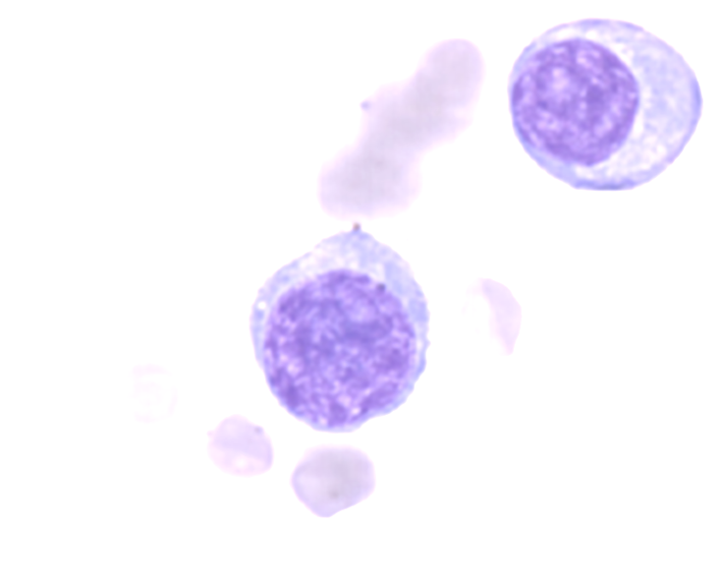







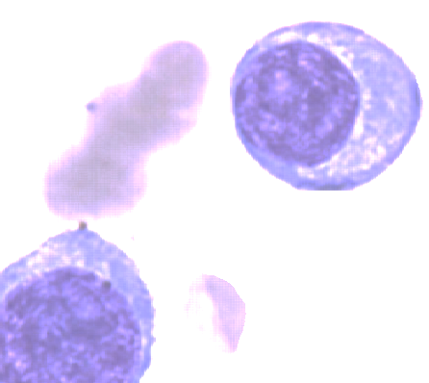
B cell Activation
Stimulation
Naïve B Cell
Antigen
Pathogen that causes an immune response
Notes:
Stimulation with an antigen and then stimulation often but not always from heper T cells that then specializes the antibody that is being made in which the antibody cn then target the invading pathogen such as bacteria, viruses, parasites, or even thing that you don’t want them to target such as allegries or autoimmune responses

Slide 3
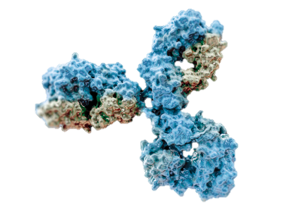

Antigen-binding sites
Heavy Chain Constant Region

Slide 4
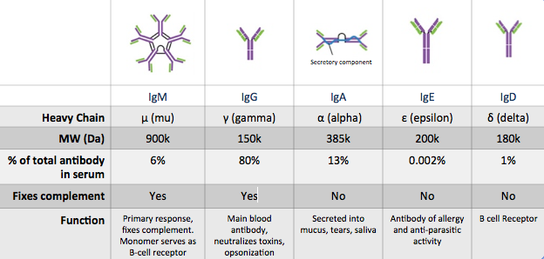
B cell antibody explanation

Slide 5
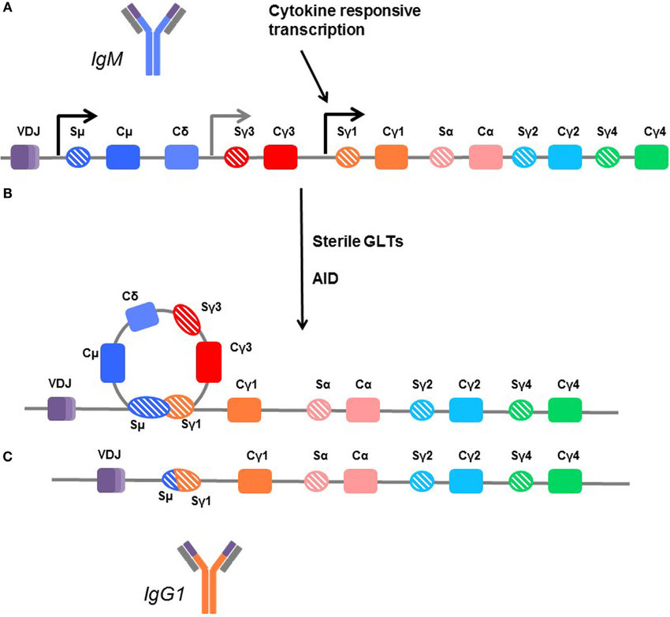
Class switch recombination
Antibody Subclass Repertoire and Graft Outcome Following Solid Organ Transplantation

Slide 6
Class switch recombination
IgD
IgG3
IgG1
IgA
IgG2
IgG4
IgM
Antibody Subclass Repertoire and Graft Outcome Following Solid Organ Transplantation

Slide 7
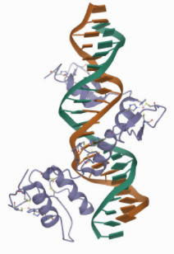
How Gli2 comes in
Transcription factor protein
Upregulated in many types of cancers
Shown to modulate IgM secretion in malignant B cells
Notes:
RCSB protein data bank

Slide 8
Question
Determine if Gli2 is involved in CSR

Slide 9


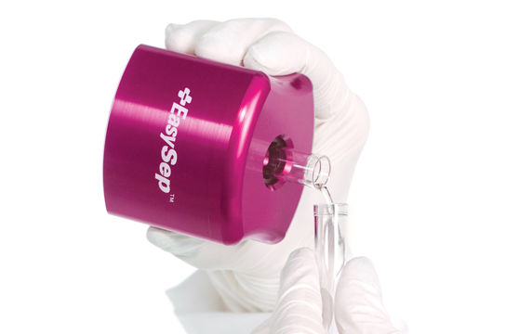
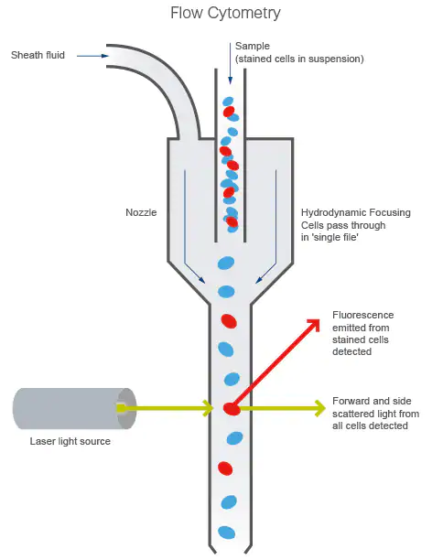
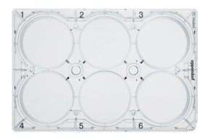
WT
B-cell Gli2-/-
CSR Assay
CTR
IgG1
IgG1
IgG2b
IgG3
IgA
ABCAM research product
Notes:
Stain for IgM and the class type being stimulated for and run through flow

Slide 10
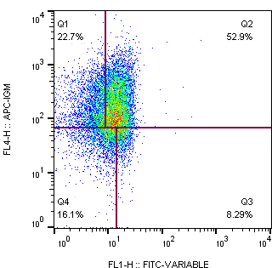
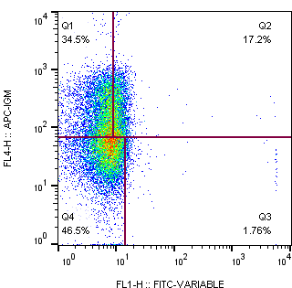
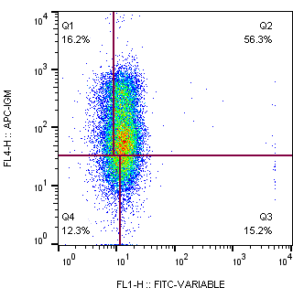
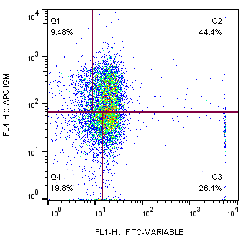
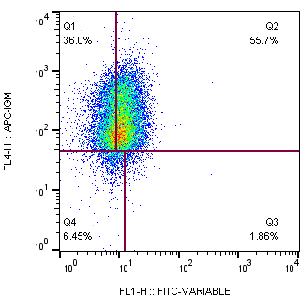
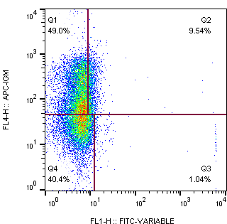
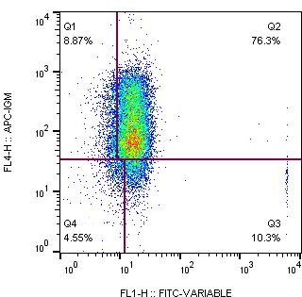
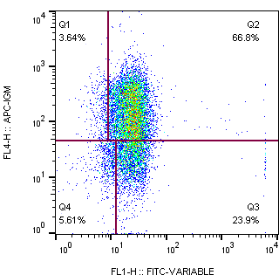
IgG1
IgG2b
IgG3
IgA
WT mouse
IgM
B cell Gli2-/-

Slide 11
Notes:
MFI mean flouresent data
Show sample of of each preentative

Slide 12
Future directions
Quantify the amount of secreted antibodies measured with ELSIA
Relative abundance of common CSR proteins
Survival proliferation studies

Slide 13
Acknowledgements
Dr. Sherine Elsawa (advisor)
Current lab members:
Mono Karbalivand
Storm Gardner
Travis Fisher
Ava Boutilier
Past Lab Members
Stephan Matissek
Weigua Han

