Slide 1

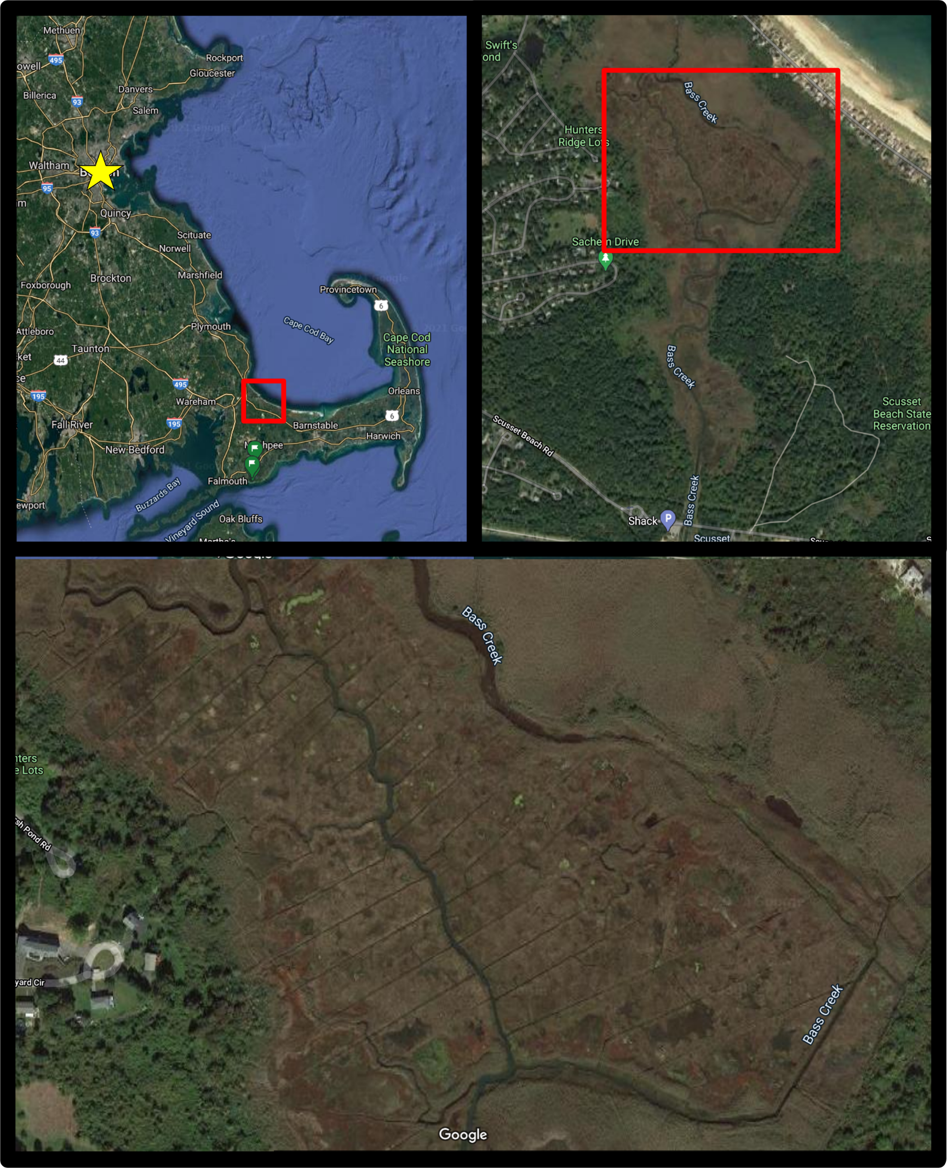
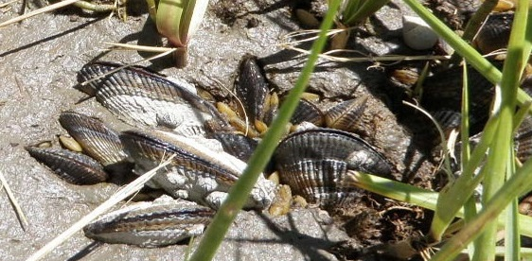
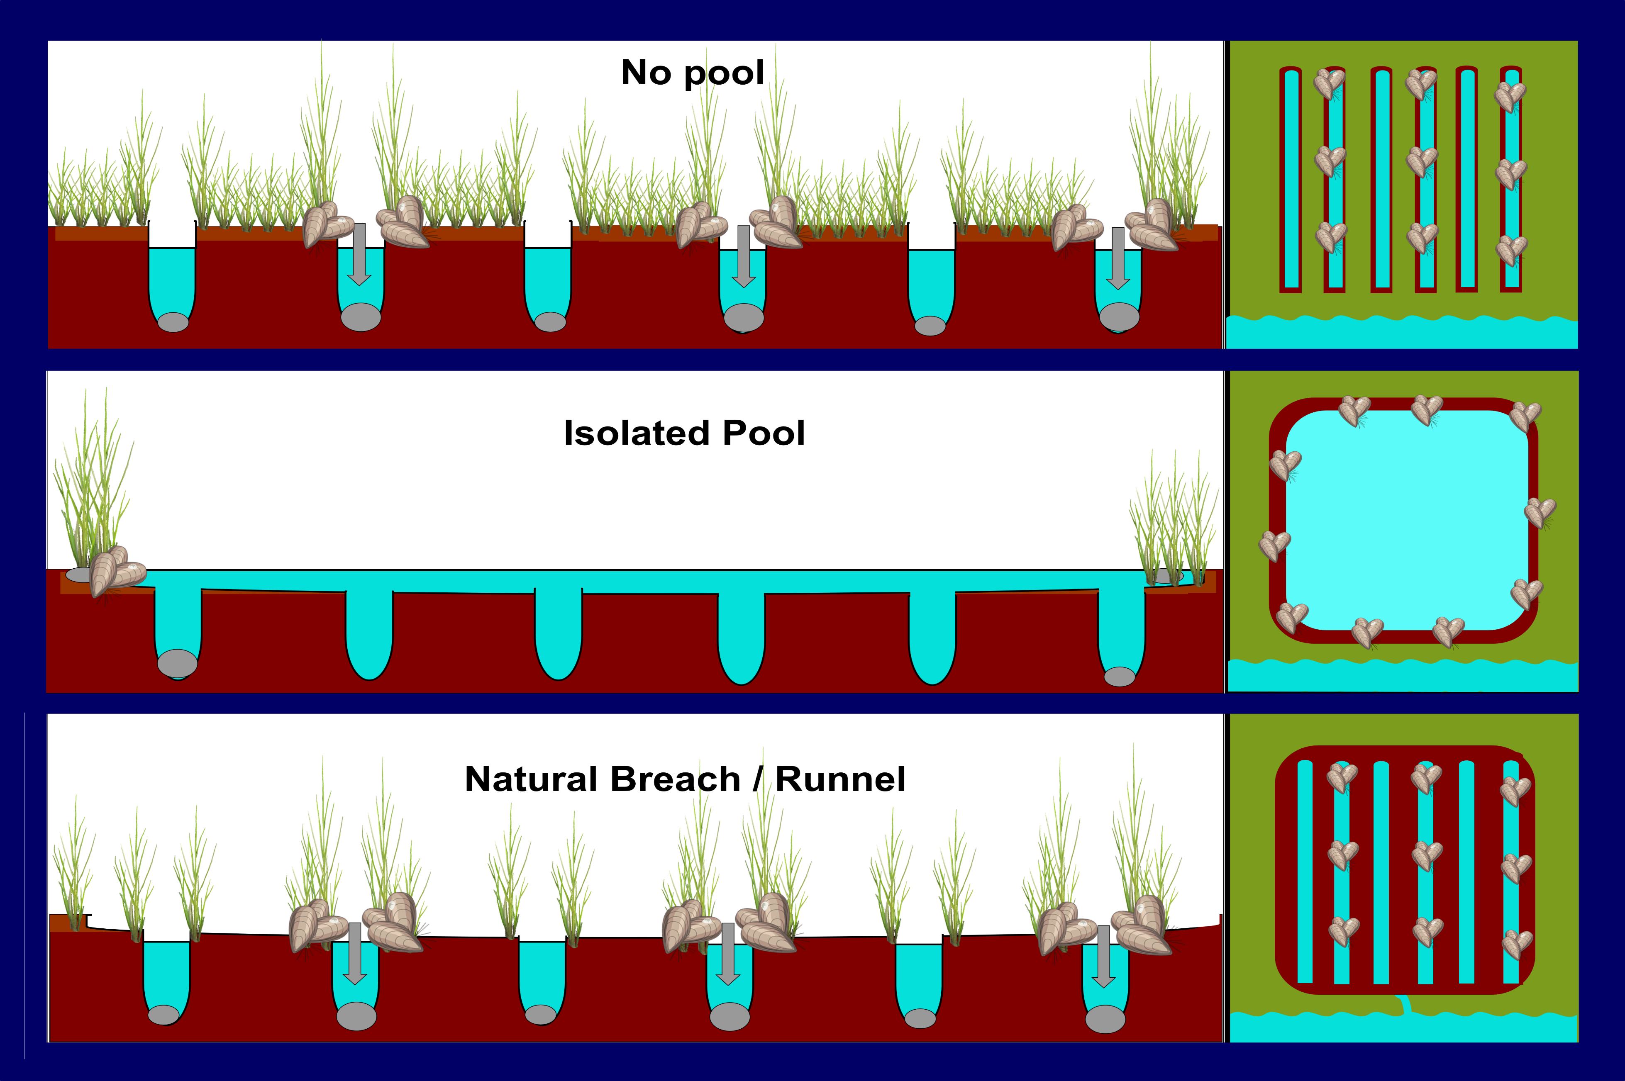
Put Some Mussel into It: Examining the Role of Ribbed Mussels (Geukensia demissa) in the Restoration of New England Salt Marshes f
Jennifer Soukup and Gregg Moore
Department of Biological Sciences, University of New Hampshire, Durham, NH
Introduction
Methodology
Study Site
A century of intense mosquito control has created a parallel network of deep channels or ditches in over 90% of New England’s salt marshes. By draining and oxygenating the soils, these ditches stimulate decomposition thereby creating large depressions that span across and connect multiple ditches. Over time, these depressions become pools of stagnant water that leave large areas of the marsh unvegetated. To reduce surface water accumulation, managers are using spoon-shaped shallow channels, or runnels, to connect these pools to nearby creeks. Although promising, a major concern is potential loss of sediment from draining these pools. One potential solution is using the ribbed mussel (Geukensia demissa) to facilitate ameliorate this complication. Attached to the base of smooth cordgrass (Spartina alterniflora), this filter feeder deposits nutrients and sediments facilitating vegetation growth and elevation.
  Sedimentation and Stability
  Four treatments: 1) no pool, 2) isolated pool, 3) pool reconnected to tidal creek naturally, 4) pool reconnected to tidal creek via runneling
  Perpendicular transects to determine elevation profile using RTK
  Parallel transects on each side of the ditch (and/or along northward and westward edge of pool, as applicable) with a 30 cm x 30 cm quadrat placed every five meters over the ditch edge and in between the ditches. The following will be collected from each quadrat:
        Number of mussels, random five measured for length and age
        Stem height will be gathered for the 10 tallest stems
        Core sample to determine grain size and organic matter
  Additional cores will be collected in between and along the edge of the ditches (and/or along edge of pool, as applicable) to determine below ground biomass production.
  Revegetation
  Four treatments: 1) nothing added, 2) empty mussel shells added, 3) one live mussel, 4) three live mussels
  1m x 1m permanent quadrats with three S. alterniflora plugs will planted in the center
  Data collected: vegetation coverage, stem height, mussel count, mussel length, mussel age, and below ground biomass will all be measured as described above.
Figure 3: Map of study site Bass Creek, MA – Small isolated marsh, heavily ditched and experiencing ponding. Ribbed mussels have been previously spotted along this region of Massachusetts. Study area highlighted in red square for both top images. City of Boston indicated by yellow star.
Management Implication
Easy to transplant with low mortality, these native mussels provide a hands-off solution to increasing soil stabilization, revegetation, and sedimentation. By re-establishing these natural processes, we will increase our efficacy and success while spending less time and fewer resources.
Acknowledgements
I would like to acknowledge my advisor, Gregg Moore, for all his advice and guidance. I would like to also acknowledge the members of the Moore lab and the University of New Hampshire for their support throughout this process.
Figure 1: Ribbed mussels around cordgrass Photo: Virginia Institute of Marine Science
Objectives
References
Q: How does the presence of G. demissa affect stability, sedimentation, and revegetation in heavily ditched marshes in New England?
H1: Ditches with G. demissa will be shallower and have reduced peat subsidence.
H2: Revegetation will be faster and more pronounced in areas with G. demissa
.
Breitfuss, Connolly, & Dale (2004) Densities and aperture sizes of burrows constructed by Helograpsus haswellianus (decapoda: varunidae) in salt marshes with and without mosquito-control runnels. Wetlands 24 , 14.
Bourn & Cottam (1950) Some Biological Effects of Ditching Tidewater Marshes. U.S. Dep. Int. Fish Wildl. Serv. Res. Rep . 19..
Ewanchuk & Bertness (2004) The Role of Waterlogging in Maintaining Forb Pannes in Northern New England Salt Marshes. Ecology 85 , 1568–1574.
Gedan et al (2009). Centuries of Human-Driven Change in Salt Marsh Ecosystems. Annual Review of Marine Science 1 , 117–141.
Hulsman et al (1989) The runnelling method of habitat modification: An environment focused tool for salt marsh mosquito management” J. Am. Mosq. Control Assoc. 5 , 226-2341.
Morris et al (2002) Responses of Coastal Wetlands to Rising Sea Level. Ecology 83 , 2869–2877.
Portnoy (1999) Salt Marsh Diking and Restoration: Biogeochemical Implications of Altered Wetland Hydrology. Environmental Management 24 , 111–120.
Provost (1977) Source reduction in salt-marsh mosquito control: past and future. Mosq. News 37 , 689–98.
Reef, et al (2018) The effect of vegetation height and biomass on the sediment budget of a European saltmarsh. Estuarine, Coastal and Shelf Science 202 , 125–133.
Figure 2: Side and aerial view of ditch treatments – both natural breach and runnel represent a pool that has been drained naturally and artificially, respectively

