Slide 1


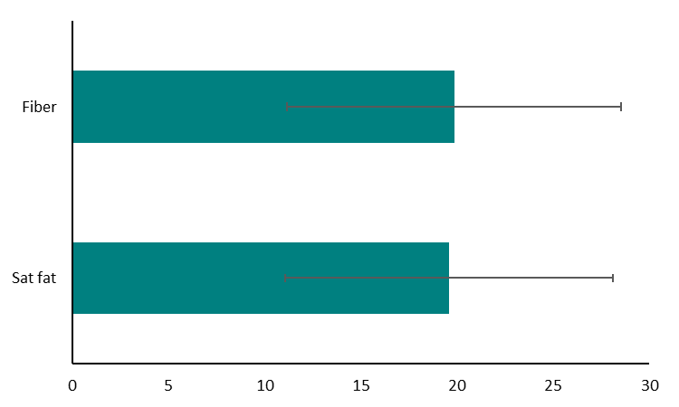
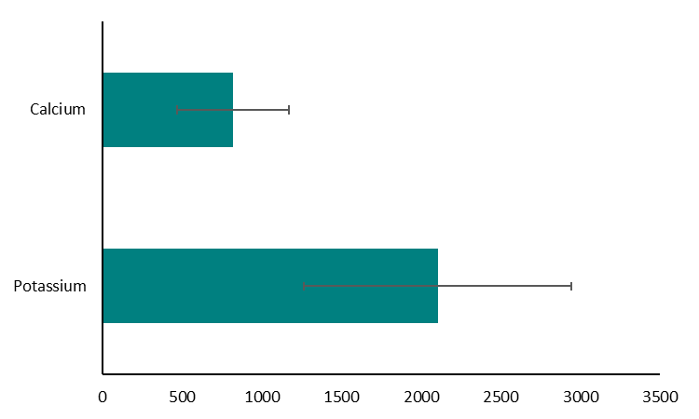
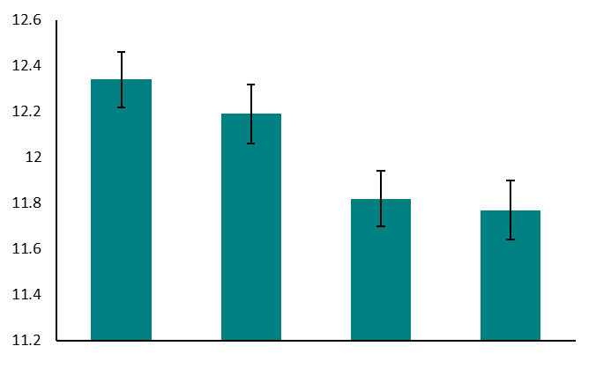
Perceived Stress and Diet Quality in College Females
Nicole Culligan, BS & Jesse Stabile Morrell, PhD
Department of Agriculture, Nutrition, and Food Systems, University of New Hampshire
Please send any questions to nac1025@wildcats.unh.edu
Introduction
At any given point in time approximately 20-25% of all college students globally, are experiencing high levels of stress (1,2). Reasons for this include large amounts of schoolwork, financial burden, and potential food insecurity among many others (1–3). This high stress rate more than doubles when focus is shifted to look only at females, where the percentage feeling extreme stress jumps to 45-65% (4). Studies have shown that female college students are much more prone to stress than their male counterparts.
High stress levels also have been shown to increase cortisol in the body which can lead to increased food intake, particularly increasing cravings for energy dense foods or sweets (2). While females typically have healthier diets, they are more likely to choose to consume energy dense foods in times of high stress as a coping mechanism (4). This topic deserves attention because the US sees the greatest jump in obesity rates in populations between the ages of 18-29 in those with at least some college education (2). The World Health Organization has investigated young adult patterns and has established that poor choices at this life stage are a large factor in disease risk later in life (3,5).
Mean intakes of Assessed Nutrients
Recommended intake for females
Three-day average intake in g/day
Key Findings
Mean age of participants was 18.7 (59% freshmen and 94% white)
Only 34% of students were meeting the preset definition of a healthy diet and mean PSS was 16.79±0.12
About half (51%) of the students fell into the moderate or higher stress categories
Diet scores were higher among students in the lowest vs. highest and moderate/high PSS quartile (12.3±0.12 vs. 11.8±0.13 and 11.8±0.12, respectively, p<0.01)
Objective
To explore the relationship between perceived stress on the diet quality of college females, age 18-24.
Three-day average intake in mg/day
Perceived Stress Categories and Overall Diet Quality Score
Methods
Cross-sectional data collected from female students (n=3113) between 2012-2020 from the College Health and Nutrition Assessment Survey (CHANAS)
Perceived stress measured via online questionnaire using Cohen’s 10-item Perceived Stress Scale (PSS) in the 3rd or 4th week of the semester
Quartiles created (low to high stress) from PSS scores
Self-reported three-day food records collected and analyzed (DietAnalysis+) to assess diet quality
Calcium, fiber, potassium, and saturated fat intake used to create diet quality scores ranging from 4-20 with scores >13 characterized as a healthy diet (6).
Association between diet quality and perceived stress examined using ANCOVA with anxiety medication, BMI, major, and living arrangement considered as covariates.
A
Conclusion
Our findings suggest that higher perceived stress is associated with modestly poorer diet quality in college women . Research in this area may provide evidence of the importance of wellness programs for students as they navigate the college environment.
A
Total Diet Quality Score
B
B
Low (n=797)
Low/Mod (n=654)
Mod/High (n=825)
High (n=695)
References
1.Haidar SA, de Vries NK, Karavetian M, El-Rassi R. Stress, Anxiety, and Weight Gain among University and College Students: A Systematic Review. J Acad Nutr Diet. 2018
2. Alfreeh L, Abulmeaty MMA, Abudawood M, Aljaser F, Shivappa N, Hebert JR, Almuammar M, Al-Sheikh Y, Aljuraiban GS. Association between the Inflammatory Potential of Diet and Stress among Female College Students. Nutrients. 2020
3. Wattick R, Hagedorn R, Olfert M. Relationship between Diet and Mental Health in a Young Adult Appalachian College Population. Nutrients. 2018
4. Liu H, Yang Q, Luo J, Ouyang Y, Sun M, Xi Y, Yong C, Xiang C, Lin Q. Association between Emotional Eating, Depressive Symptoms and Laryngopharyngeal Reflux Symptoms in College Students: A Cross-Sectional Study in Hunan. Nutrients. 2020
5. Sogari G, Velez-Argumedo C, Gómez M, Mora C. College Students and Eating Habits: A Study Using An Ecological Model for Healthy Behavior. Nutrients. 2018
6. Liu K, Daviglus ML, Loria CM, Colangelo LA, Spring B, Moller AC, Lloyd-Jones DM. Healthy Lifestyle Through Young Adulthood and the Presence of Low Cardiovascular Disease Risk Profile in Middle Age. 2012
Perceived stress categories
Total diet quality score is based on a scale of 4-20 with >13 being considered “healthy”. Perceived stress was broken down into quartiles. Different letter represent significance (p<0.01) between groups.
Funding source
New Hampshire Agriculture Experiment Station and USDA National Institute of Food and Agriculture Hatch Project 1010738

