Slide 1
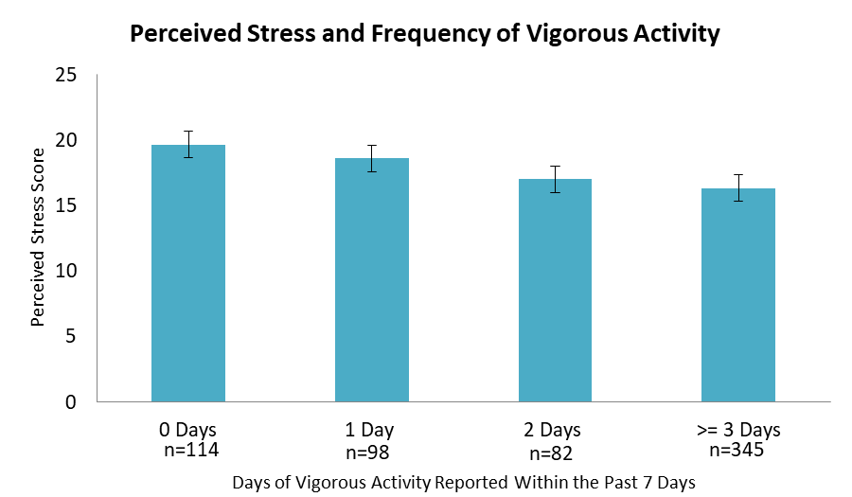
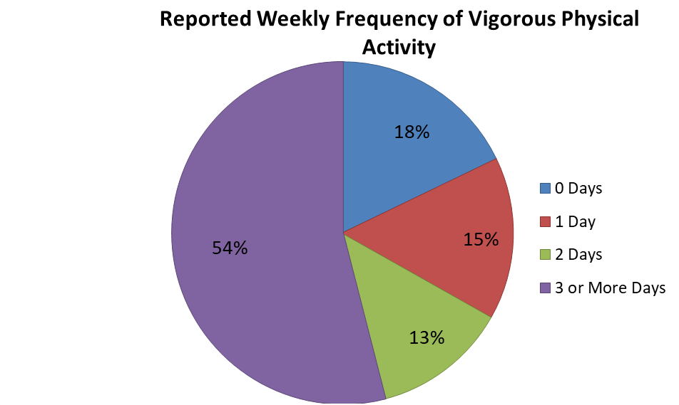

Association Between Vigorous Activity and Perceived Stress in
Female College Students With Overweight or Obesity
Marisa Tassi BS, Jesse Stabile Morrell PhD
Department of Agriculture, Nutrition and Food Systems University of New Hampshire
Introduction
Results
Subject Characteristics
• Literature suggests that female college students experience high levels of stress, and students are at risk for high stress levels due to moving through a transition period in life¹.
• A higher BMI also correlates with increased stress levels in women².
• Vigorous activity may reduce stress, especially when done multiple times per week³.
Age | N (%)
18 | 301 (46.5)
19 | 222 (34.3)
20 | 68 (10.5)
21+ | 56 (8.7)
Class
Freshmen | 360 (55.6)
Sophomore | 188 (29.1)
Junior | 62 (9.6)
Senior | 32 (4.9)
Other | 5 (0.8)
Race
White | 595 (94.9)
Races Other Than White | 32 (5.1)
Health Related Major
Yes | 174 (26.9)
No | 473 (73.1)
a
abc
• Between 20120-2020, 21.6% (622 out of 2879) of female participants recruited had a BMI > 25.0 kg/m2 and included in study.
• Participants had a mean age of 18.8 ± 0.4 years and mean BMI of 28.1 ± 0.1 kg/m2
• 17.8% of students reported no days of vigorous activity, 15.3% reported one day, 12.8% reported 2 days, and 54% reported 3 or more days of vigorous activity
• PSS scores were negatively related to # of vigorous activity days (p <0.001).
• Those who participated in no days of vigorous activity had higher perceived stress scores than those who participated in 2 days or 3 or more days of vigorous activity (19.7 ± 0.6 vs. 17.0 ± 0.7 and 16.3 ± 0.4, respectively, p <0.01).
b
c
Bars with different letters indicate mean group differences, p<0.05
Objective
To examine the relationship between reported vigorous aerobic exercise and perceived stress scores (PSS) among female college students ages 18-24 with overweight or obesity.
Methods
Conclusion
• Perceived stress was self-reported via questionnaire using Cohen’s 10-item Perceived Stress Scale. A higher score indicates a higher level of stress, with a maximum of 40⁴.
• Frequency of vigorous activity was self-reported using the International Physical Activity Questionnaire (IPAQ)
• Height and weight were measured in duplicate during health assessment week. Inclusion criteria included a BMI of ≥25
• Mean differences between activity groups were examined via ANCOVA using age and major as covariates.
• Students provided written consent; methods reviewed by UNH’s IRB (#5524).
These findings support the inclusion of physical activity recommendations or interventions to broadly support the health and wellness of university students.
n = 622
References
Acknowledgements
¹Baghurst T, Kelley BC. An Examination of Stress in College Students Over the Course of a Semester. Health Promot Pract. 2013;15:438-447.
²Jorm AF, Korten AE, Christensen H, Jacomb PA, Rodgers B, Parslow RA. Association of obesity with anxiety, depression and emotional well-being: a community survey. Aust N Z J Public Health. 2003;27:434-440.
³LeBouthillier DM, Asmundson GJG. A Single Bout of Aerobic Exercise Reduces Anxiety Sensitivity But Not Intolerance of Uncertainty or Distress Tolerance: A Randomized Controlled Trial. Cogn Behav Ther. 2015;44:252-263.
⁴Baik SH, Fox RS, Mills SD, et al. Reliability and validity of the Perceived Stress Scale-10 in Hispanic Americans with English or Spanish language preference. J Health Psychol. 2019;24:628-639.
Funded by The New Hampshire Agriculture Experiment Station and the USDA National Institute of Food and Agriculture Hatch Project 1010738.
Notes:
Introduction of myself and project
Literature suggests that female college students experience high levels of stress, and college students are at risk for high levels of stress due to moving through a transition period in life.
Literature also shows that A higher BMI also correlates with increased stress levels in women and Female students and students have higher stress levels than male students. Stress in students may reduce academic achievement or lead to anxiety. Vigorous activity, especially when done multiple times a week may reduce stress levels. The college population is understudied and overlooked in policymaking, and as a result research regarding stress reduction in students can be used to create interventions that benefit this population.
My objective
Methods- students filled out a questionnaire which included Cohens 10-iten perceived stress scale, which measures how much someone perceives their life as stressful. It gives a perceived stress score which goes from 0-40, with 40 being the highest level of perceived stress.
This questionnaire also asked students how many days of vigorous activity they participated in within the past week.
During health assessment week, students had their height and weight measured in duplicated by trained technicians, and BMI was calculated. and for this research I only included female students with a BMI of 25 or higher.
Students were split into 4 groups by days of PA, 0 days, 1 day, 2 or 3 or more days. Mean differences between the Perceived stress scores these groups were examined via ANCOVA. Age and major as covariates (health major vs. not health major).
Final sample of 622 students, mostly freshmen with an average age of 18.8 years and BMI of 28.1kg/m^2
As shown in this graph, 17.8% of students reported no days of vigorous activity, 15.3% reported one day, 12.8% reported 2 days, and 54% reported 3 or more days of vigorous activity
PSS scores were negatively related to # of vigorous activity days (p <0.001).
Those who participated in no days of vigorous activity had higher perceived stress scores than those who participated in 2 days or 3 or more days of vigorous activity (19.7 vs. 17.0 and 16.3, respectively, p <0.01). These findings also showed that those who participated in three or more days had the lowest PSS.
These findings support the inclusion of physical activity recommendations or interventions to broadly support the health and wellness of university students.

