Slide 1
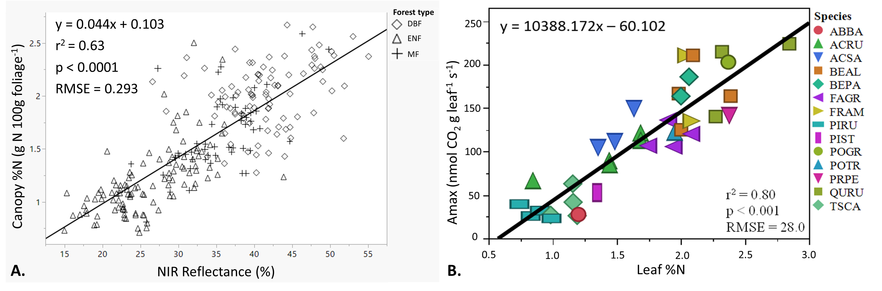
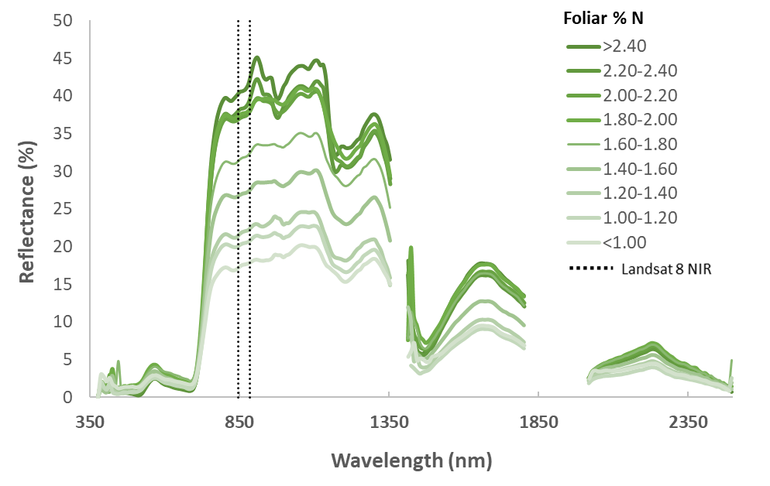
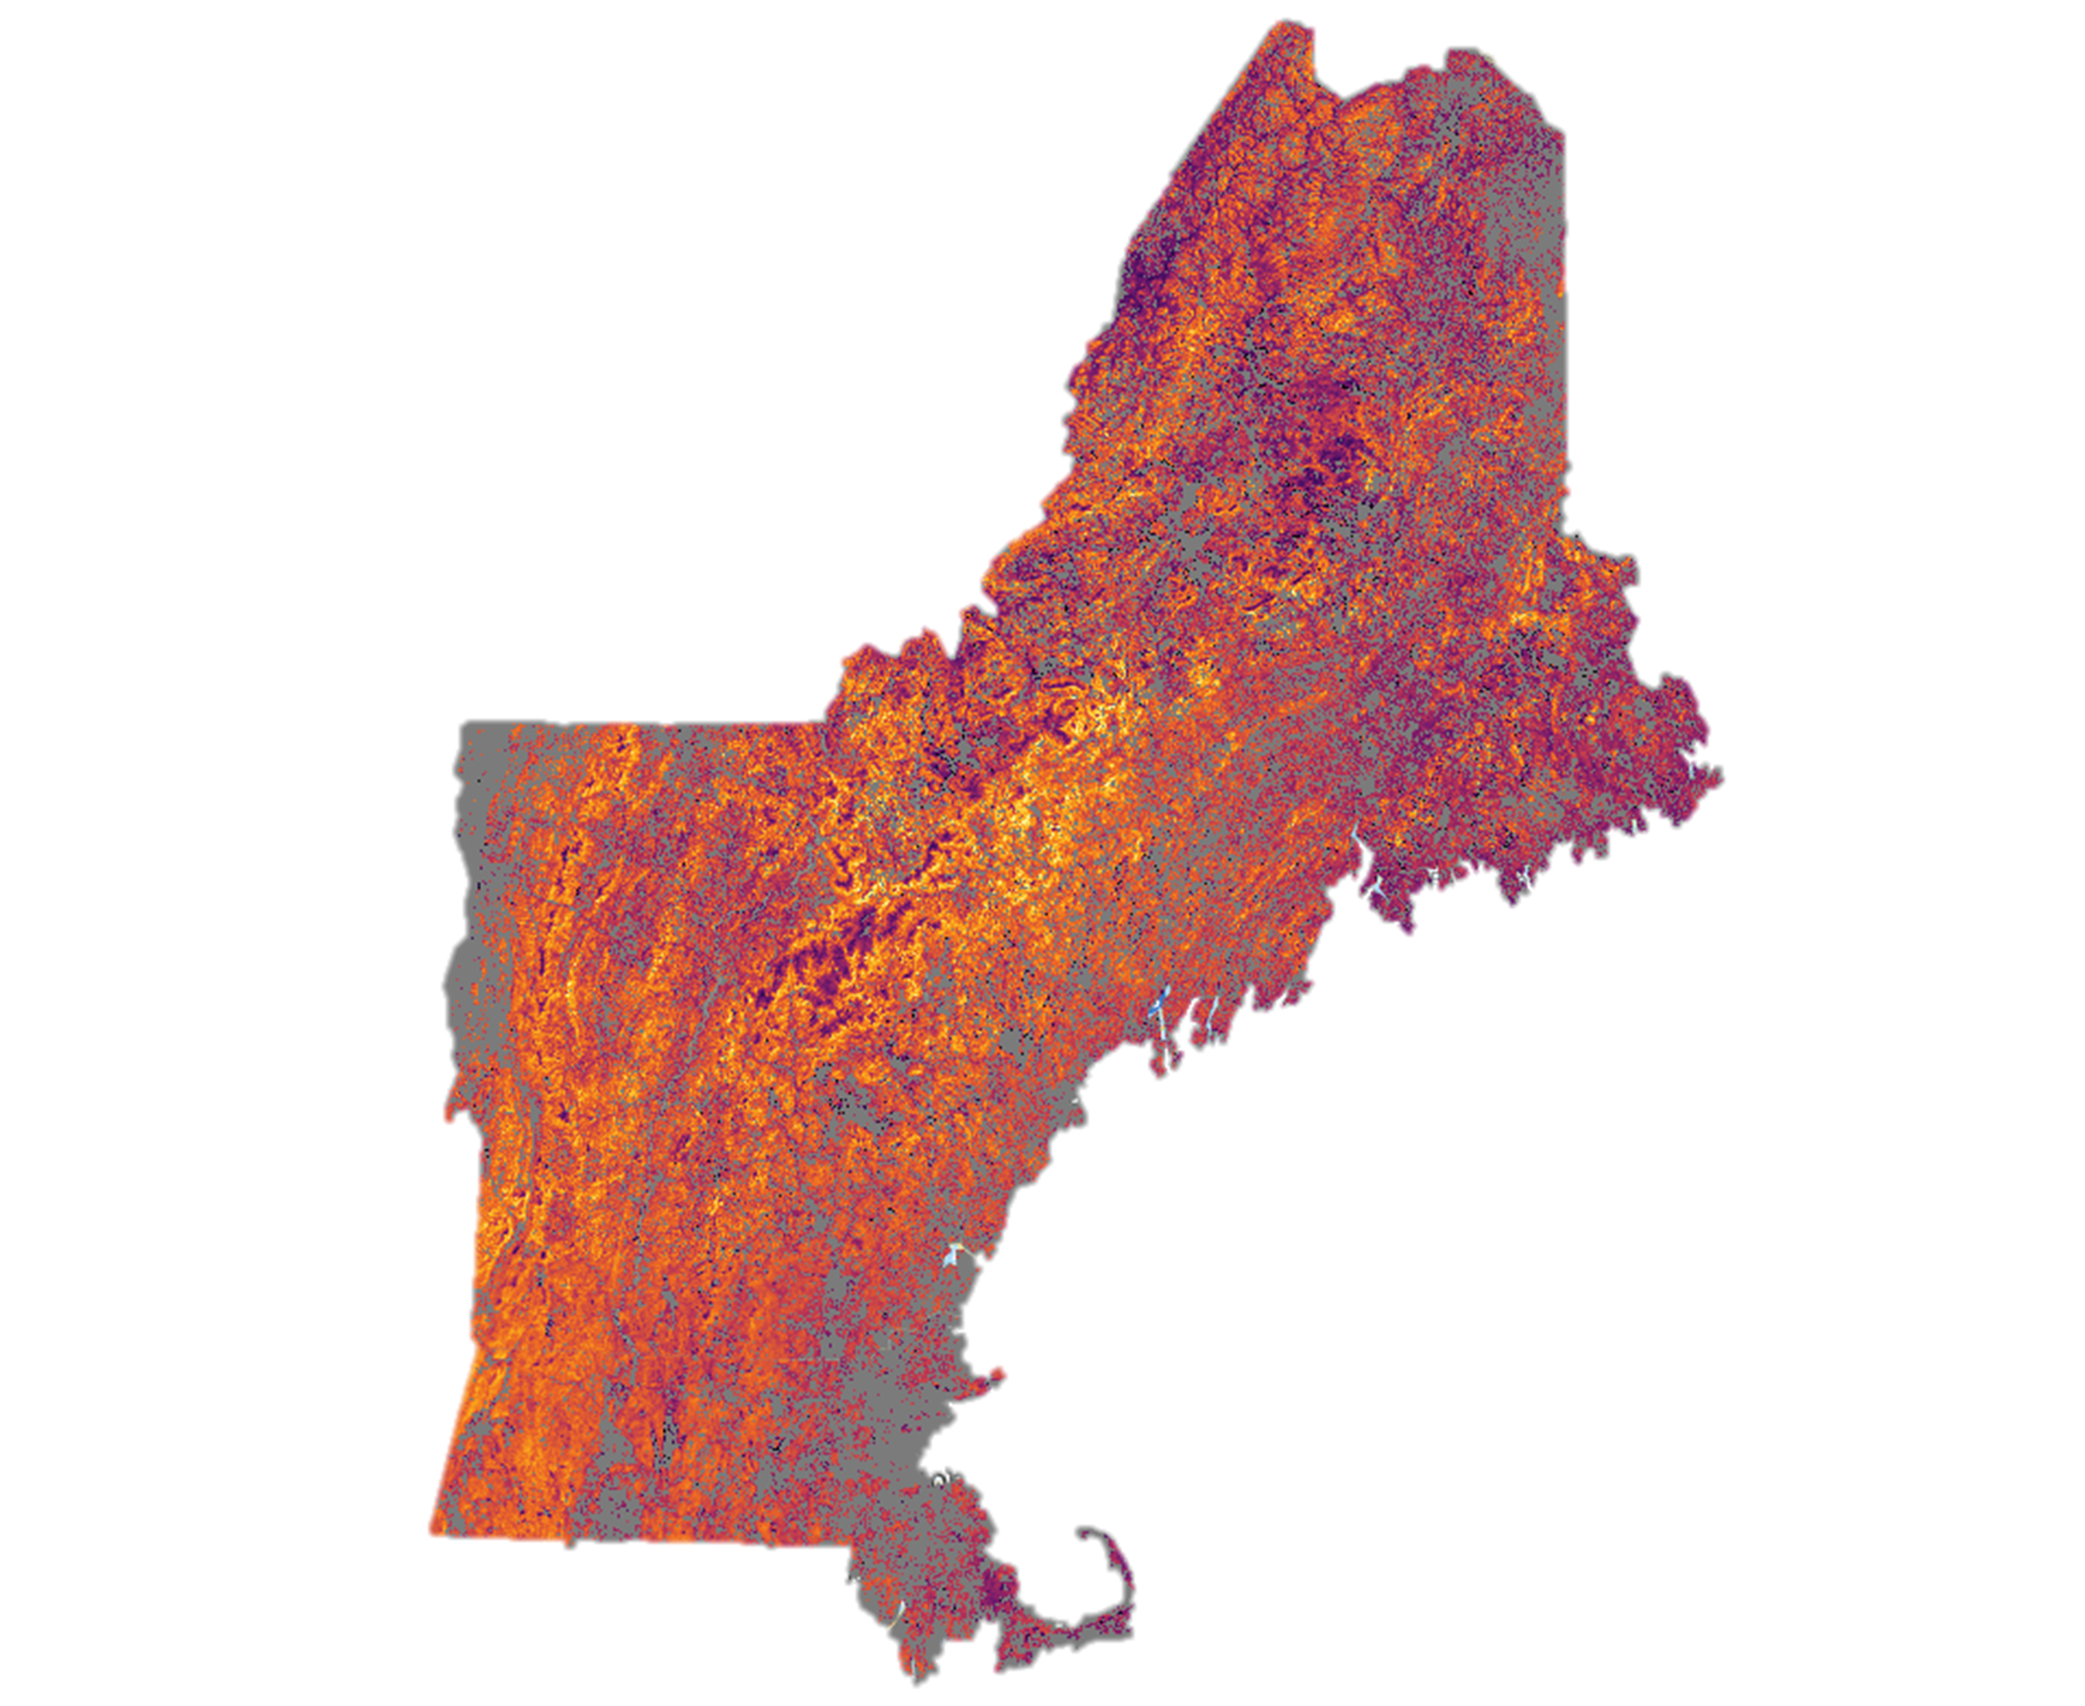
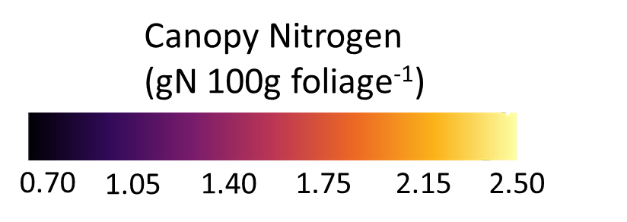
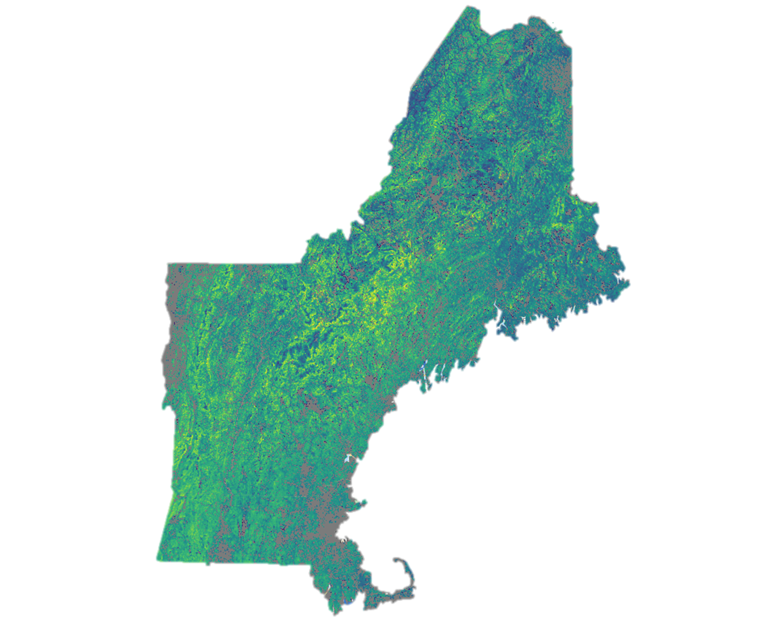
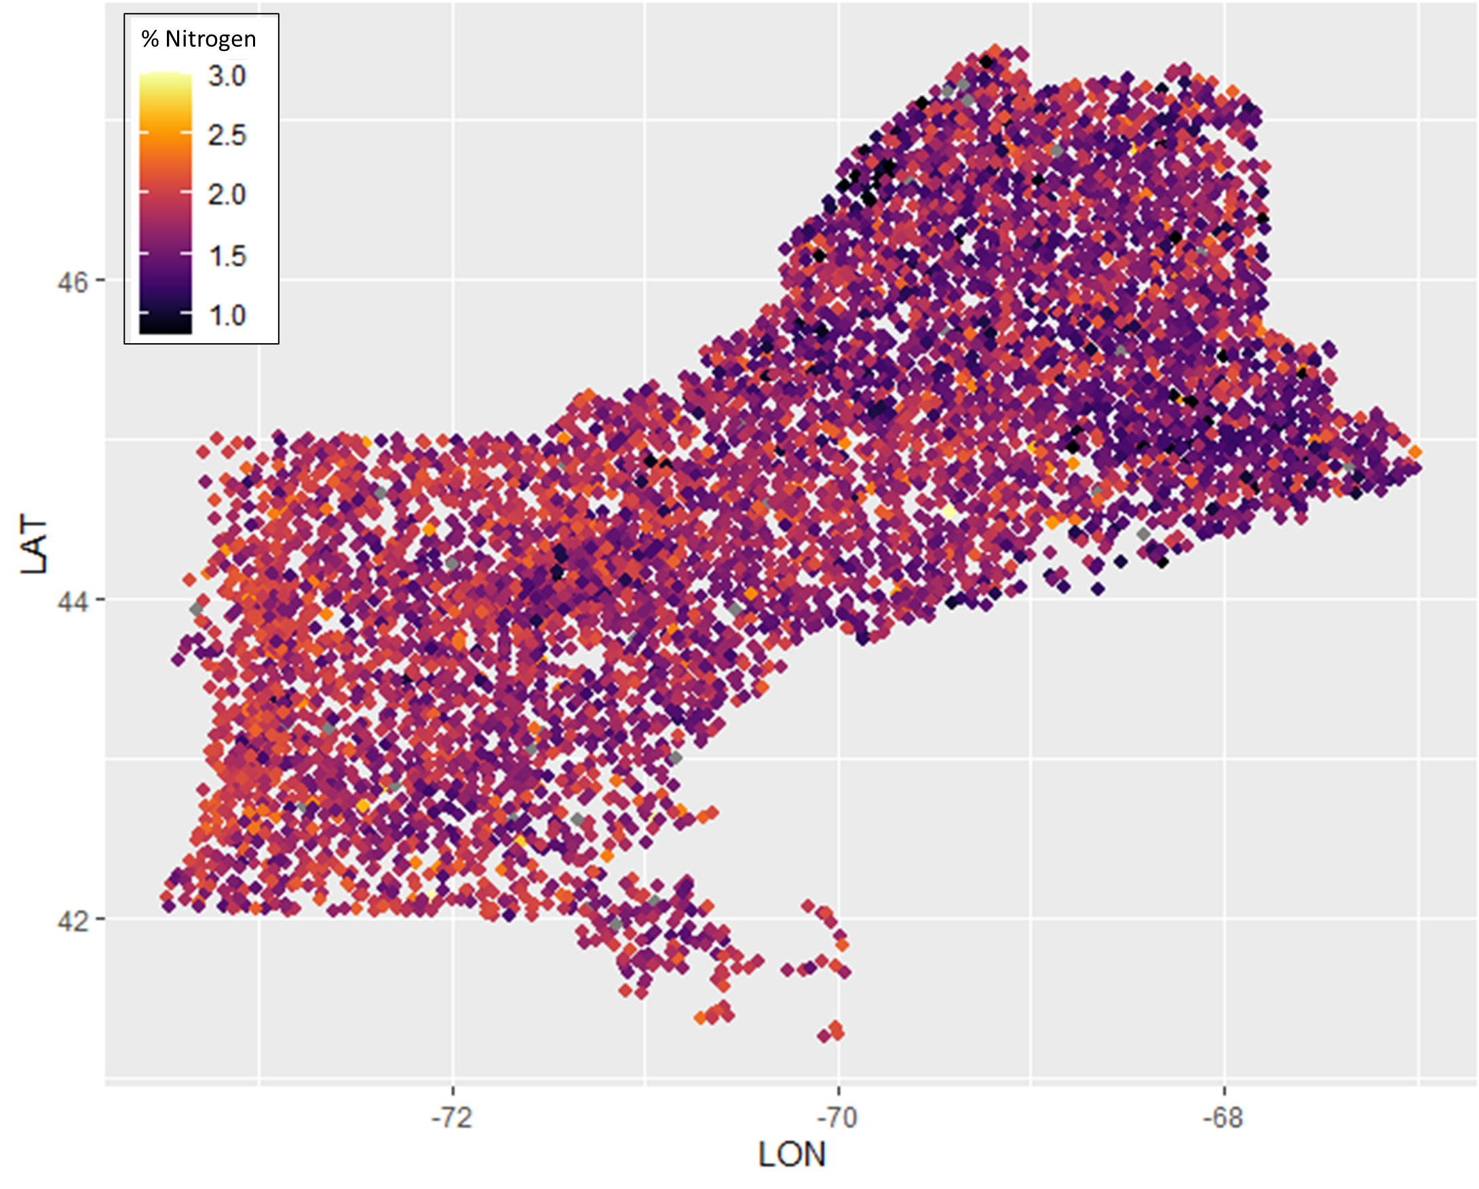
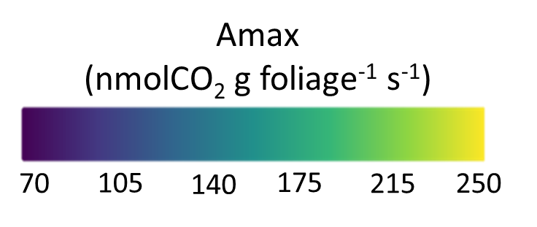
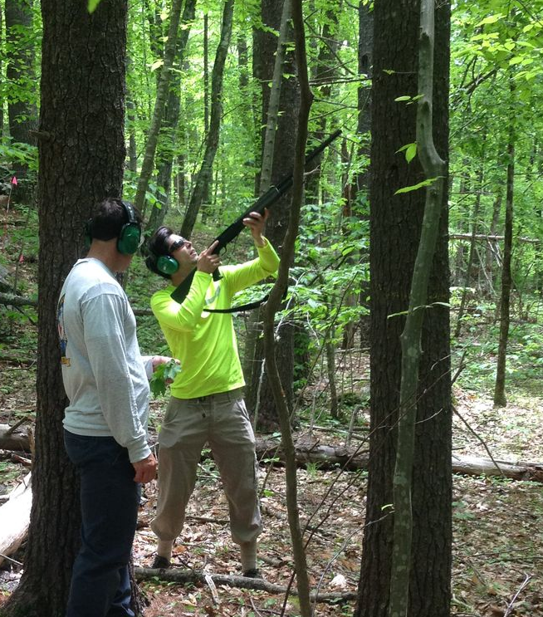
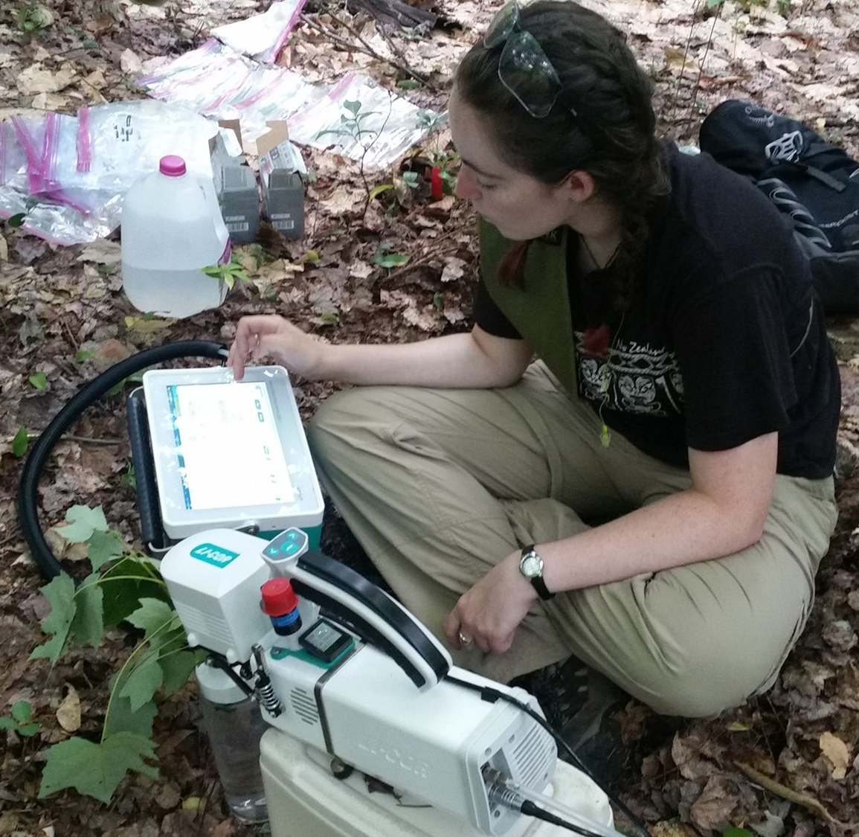
Can Broad-Band Remote Sensing Provide Regional Estimates of Foliar Nitrogen and Photosynthetic Capacity?
Jack Hastings (jhc33@wildcats.unh.edu) Scott V. Ollinger, Andrew Ouimette, and Lucie Lepine
Earth Systems Research Center, University of New Hampshire, Durham, NH
Background
Results
Empirical estimation of foliar nitrogen (N) across a range of ecosystem types using airborne imaging spectroscopy has been well demonstrated, though nearly all this work has been constrained to localized scales.
Multiple studies have shown that common regression analyses used to predict foliar N are largely driven by reflectance over broad portions of the near infrared (NIR) region. Lepine et al. (2016) demonstrated that the relationship between NIR and foliar N could likely be exploited by broad-band sensors to produce continuous regional estimates of foliar N in closed-canopy forests at relatively high spatial resolution (Figure 1).
Here, we examine the potential to make regional estimates of foliar N derived from Landsat-8, using the northeastern United States as a test case. We also examine the relationship between foliar N and photosynthetic capacity (Amax), and the potential of estimating Amax regionally.
Foliar Nitrogen
Our dataset spanned a large range of canopy N (0.71 – 2.67 %N)
Although the dataset included field data collected before the beginning of the Landsat-8 record (pre-2013), we found a strong relationship between Landsat-8 NIR reflectance and canopy %N (R²: 0.63, p <0.0001) (Figure 3A). This relationship was significant across and within forest type.
A three parameter step-wise modeling including NIR, green, and the SWIR2 band did not yield a substantially stronger relationship than NIR alone (R²: 71) and NIR dominated this model.
Photosynthetic Capacity
Our dataset of Amax measurements consisted of over 600 individual leaf samples from common species in the northeastern US. We found a strong relationship between foliar %N and Amax (R²: 0.80, p <0.001) (Figure 3B)
Figure 3: (A) Relationship between Landsat-8 NIR reflectance and canopy nitrogen. The relationship was significant across forest types and within forest types individually (deciduous, r²: 0.089, p = 0.0039; evergreen, r²: 0.394, p <0.0001; mixed-forest, r²: 0.347, p < 0.0001). (B) Relationship between leaf nitrogen and photosynthetic capacity (Amax) for common species in the northeastern US. Plotted points are mean values grouped by species, site, and year.
Figure 1: Full spectrum (375 – 2500 nm) reflectance grouped by foliar % nitrogen. The vertical lines demarcate the Landsat-8 near infrared (NIR) band (845 – 885 nm).
Regional Estimates
Figure 4: Estimates of (A) foliar nitrogen and (B) photosynthetic capacity derived from Landsat-8 NIR reflectance across the Northeast US. Grey areas are non-forested regions.
Conclusion and Future Directions
A.
Broad-band satellite imagery appears promising for regional estimating of foliar N and Amax.
Reliable remote sensing estimates of foliar N and Amax will help drive and validate modeling efforts in the region.
Despite including field data collected before Landsat-8, we found a strong relationship between NIR and foliar N.
We measured a strong relationship between foliar N and Amax in common tree species in the Northeast.
More work is needed to understand uncertainty of these estimates and to improve regional calibrations, especially in managed forests.
We plan to explore the potential of linking USFS Forest Inventory and Analysis (FIA) data with regional leaf chemistry measurements to improve our estimates of canopy N and Amax across the Northeast US (Figure 5).
Method overview
B.
Field Measurements
We compiled a dataset of canopy % nitrogen (g N 100 g foliage⁻¹) for 250 forested plots from field work occurring between 2001 and 2018 (Figure 2A). Plots are located across the conterminous US and southern Canada.
Amax measurements (nmol CO₂ g foliage⁻¹ s⁻¹) were made on a subset of leaves during field campaigns in the Northeast (Figure 2B).
Remote Sensing and Statistical Analysis
Using Google Earth Engine, we acquired growing season Landsat-8 surface reflectance scenes for each field campaign. For field campaigns occurring from 2013 – 2018, scenes were selected from the sampling year. For pre-2013 campaigns, we selected the first available scene that met our data standards. Landsat-8 was chosen over other Landsat missions because of improved signal-to-noise.
We extracted pixels correspond to each field plot. We also extracted forest type (deciduous broadleaf, needleleaf evergreen, or mixed forest) from the National Landcover Database 2016 Layer.
We performed stepwise and simple linear regressions to examine the ability to predict canopy N with Landsat-8 bands and common spectral indices (e.g., NDVI, NIRv, EVI). Variables were entered into the stepwise model by forward selection, and the stopping rule was minimum BIC.
Figure 5: Basal area scaled estimates of canopy %N derived from USDA Forest Inventory and Analysis (FIA) stem data and regional leaf chemistry measurements. FIA basal area weighted N estimates may be useful remote sensing training and validation data for regional leaf chemistry estimates.
A.
B.
We applied our relationship between NIR reflectance and canopy %N (Figure 3A) to make estimates of canopy nitrogen across the northeastern US (Figure 4A).
We then used our estimates of canopy %N and the observed relationship between Amax and %N (Figure 3B) to make regional estimates of Amax (Figure 4B).
Further work is needed to understand the uncertainty of our preliminary estimates. In particular:
  Northern Maine, where intensive timber management practices may alter the observed NIR-N relationship
  Mountainous terrain; despite topographic and terrain corrections, plots in mountainous terrain showed more variability.
Acknowledgements: We thank the many students, technicians, and researchers involved in the collection of the field data used in this analysis. This work was funded by the National Sciences Foundation (NSF Grants #1638688, 1920908) and USDA NHAES (Hatch NH00671), and is part of the Harvard Forest LTER program (NSF Grant #1832210).
References:
Lepine, L.C., Ollinger, S.V., Ouimette, A.P., Martin, M.E. 2016. Examining spectral reflectance features related to foliar nitrogen in forests: Implications for broad-scale nitrogen mapping. Remote Sensing of Environment. 173: 174-186
Figure 2: (A) We used shotguns to sample sunlit leaves from the top of canopy trees. (B) Photosynthetic capacity measurements were made in the field with a LI-6800 portable photosynthesis machine.

