Slide 1


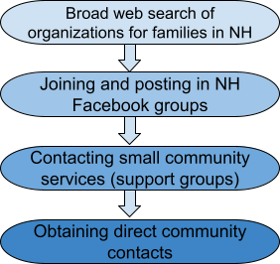


Accessing Critical Healthcare and Educational Information During a Pandemic
Madison Gorrasi, B.S., Communication Sciences and Disorders
NH-ME LEND, Institute on Disability, University of New Hampshire
Overview:
Leadership Skills:
Community Partner:
Parent Information Center (PIC) is a statewide family organization that provides families and youth (focus on children/youth with disabilities/special health care needs) and the providers who serve them, with the knowledge and support they need to make informed decisions that enhance each child’s development and overall well-being.
Critical thinking
Self
awareness
Clear communication
Problem solving
Active listening
Findings:
Barriers to finding organizations that can reach vulnerable families:
Information on websites being out of date
Families not knowing where to start their search for resources
Information provided isn’t always easy to understand or navigate for families
Limited access to reliable transportation
Barriers families experience in receiving timely information:
Needing information to come via text (more accessible methods that they prefer)
COVID-19 pandemic further restricting access to services that would share critical information
Language barriers
Internet equity in rural areas/rural resettlement for refugees
Housing insecurity
Background of Project:
The purpose of this project was to create a repository of strong community contacts that would be able to disperse critical healthcare and education information to vulnerable families in NH in a time like the COVID-19 pandemic. The following population categories were chosen for this project: kinship care, food and housing insecurity, and culturally diverse groups. The goal of the project was to determine barriers these groups face and how we can overcome them in order to provide fair and equal access to critical information.
Possible Solutions:
Interactive PDF or website of resources for families
App for parents to download to have information at their fingertips
Implementing texting applications through agencies that regularly communicate with vulnerable populations so information can be distributed in a quick and accessible way
Texting “trees” in rural areas of NH to reach all people living in rural areas of the state that lack easy access to resources.
More meaningful family engagement
Project Activities:
References:
Photos retrieved from: www.Dreamstime.com , www.istockphoto.com. , and www.Freepik.com

