Slide 1
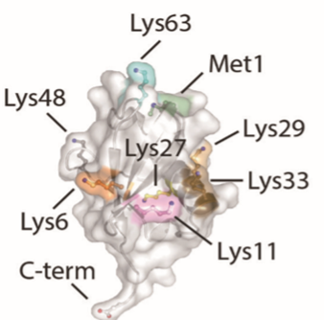
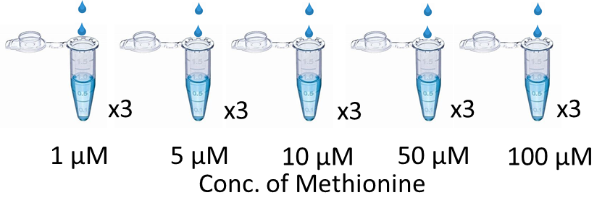
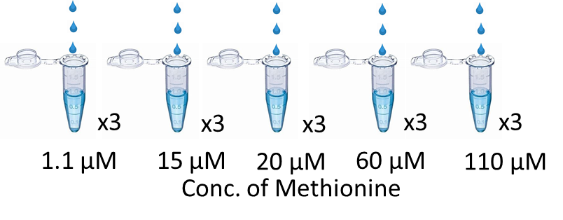
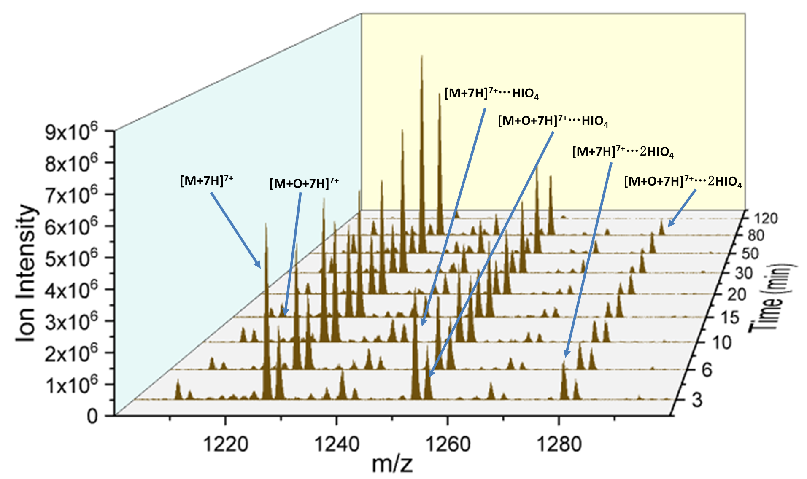
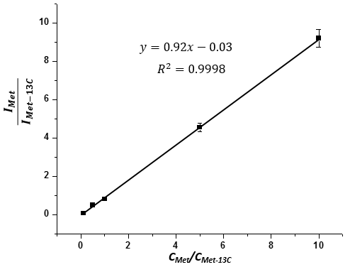
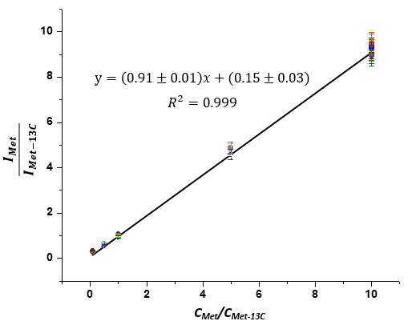
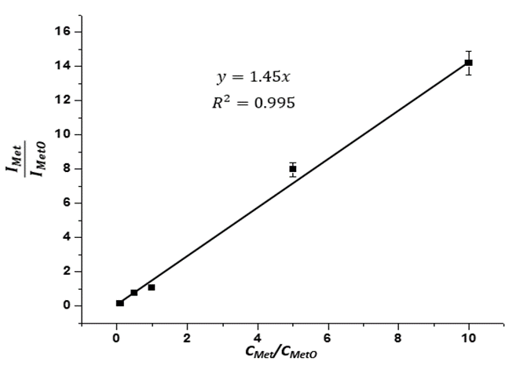
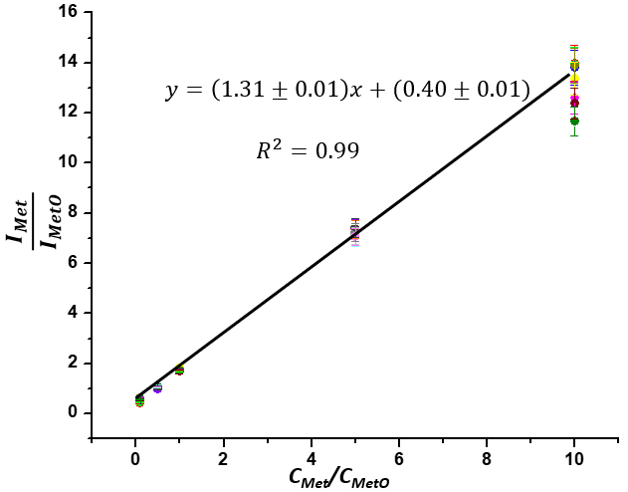
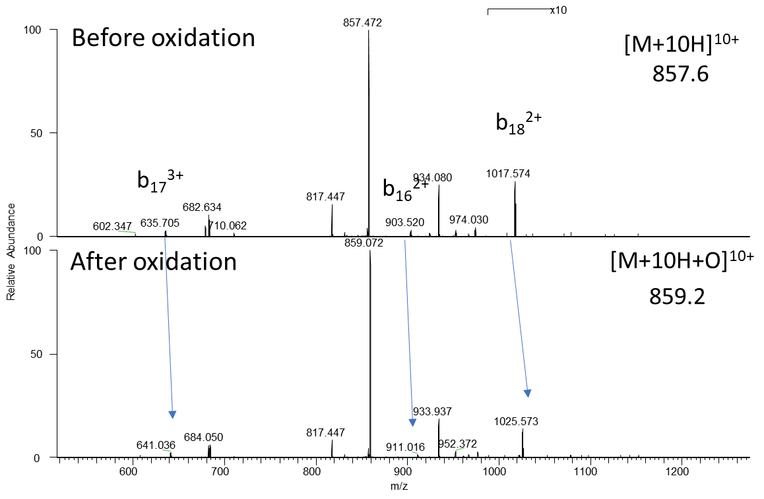
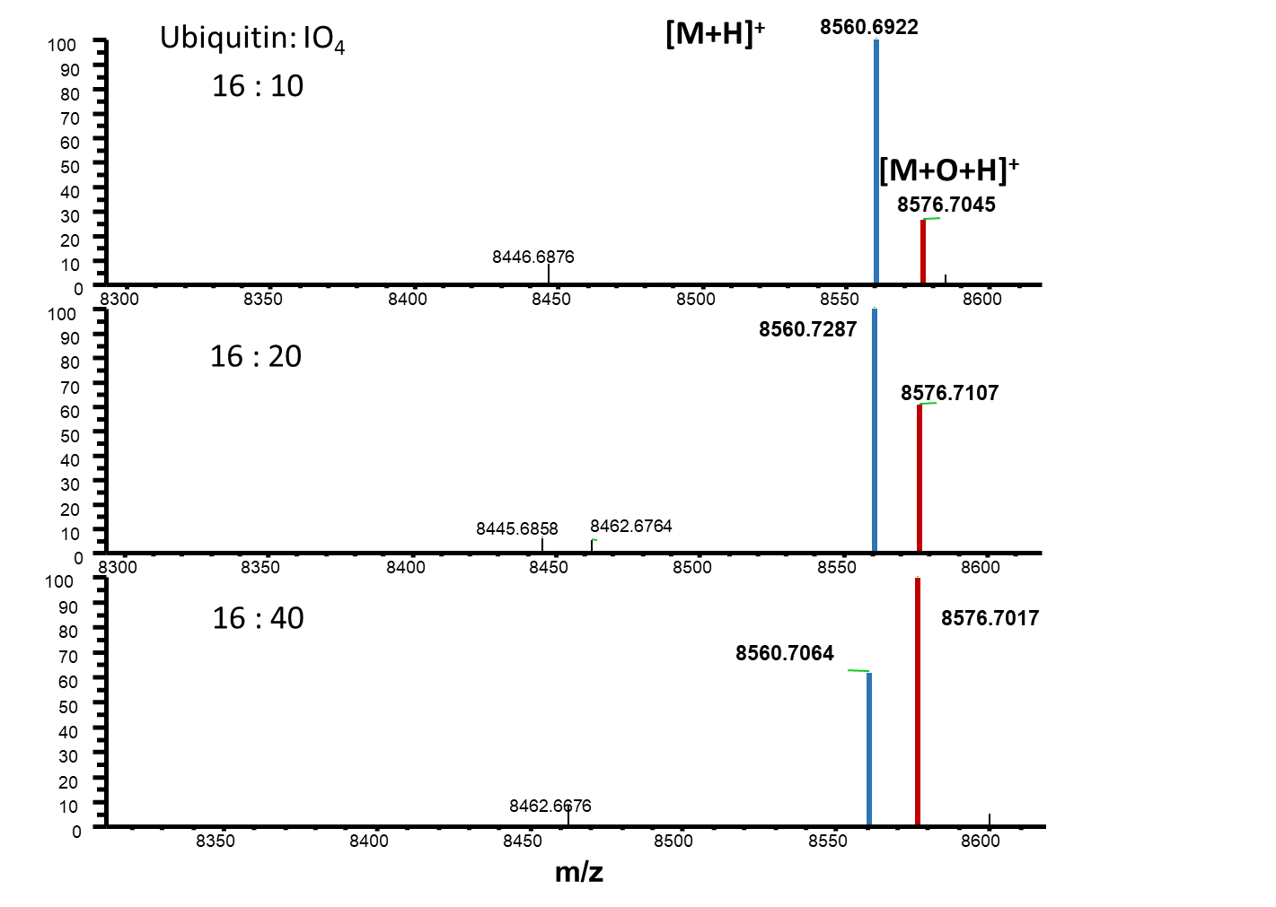
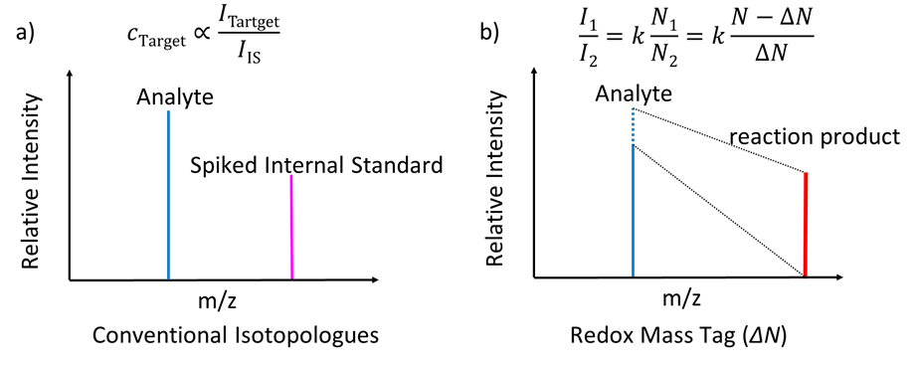
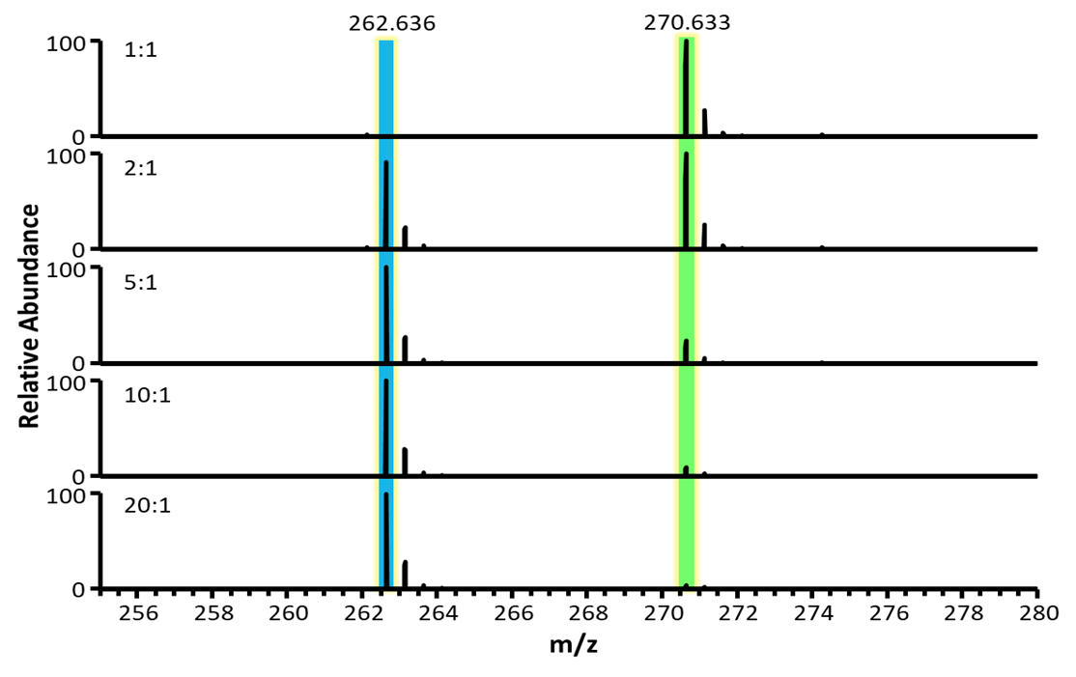
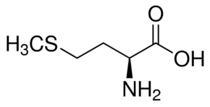
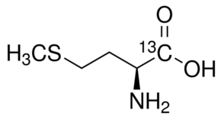
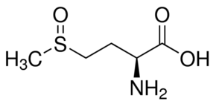
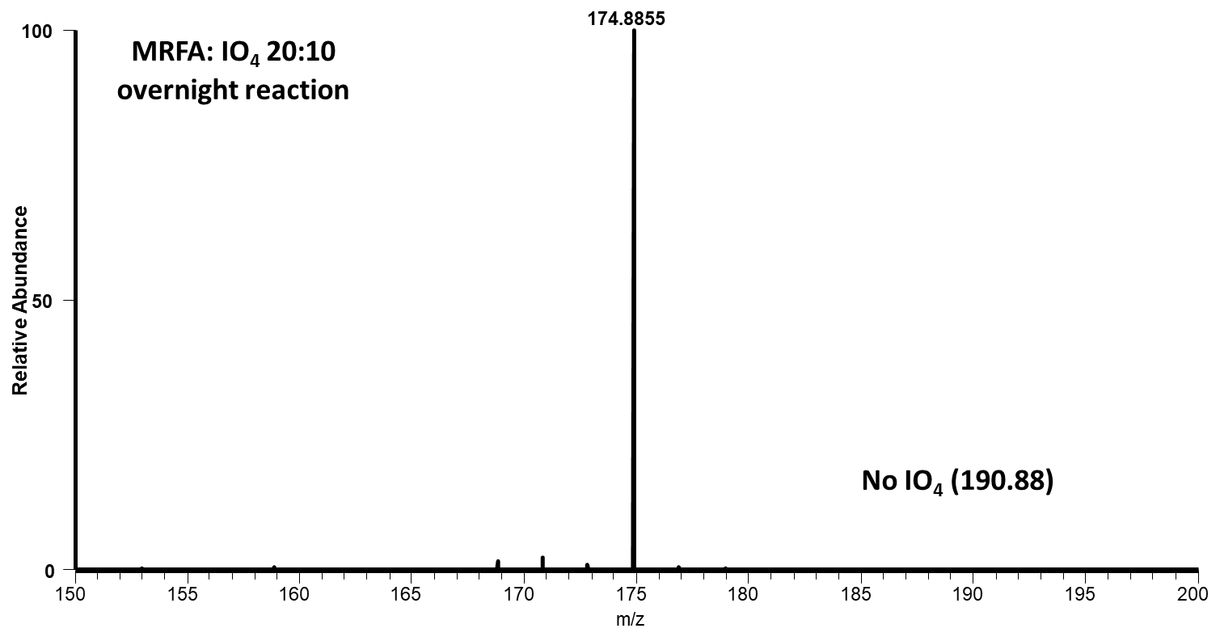
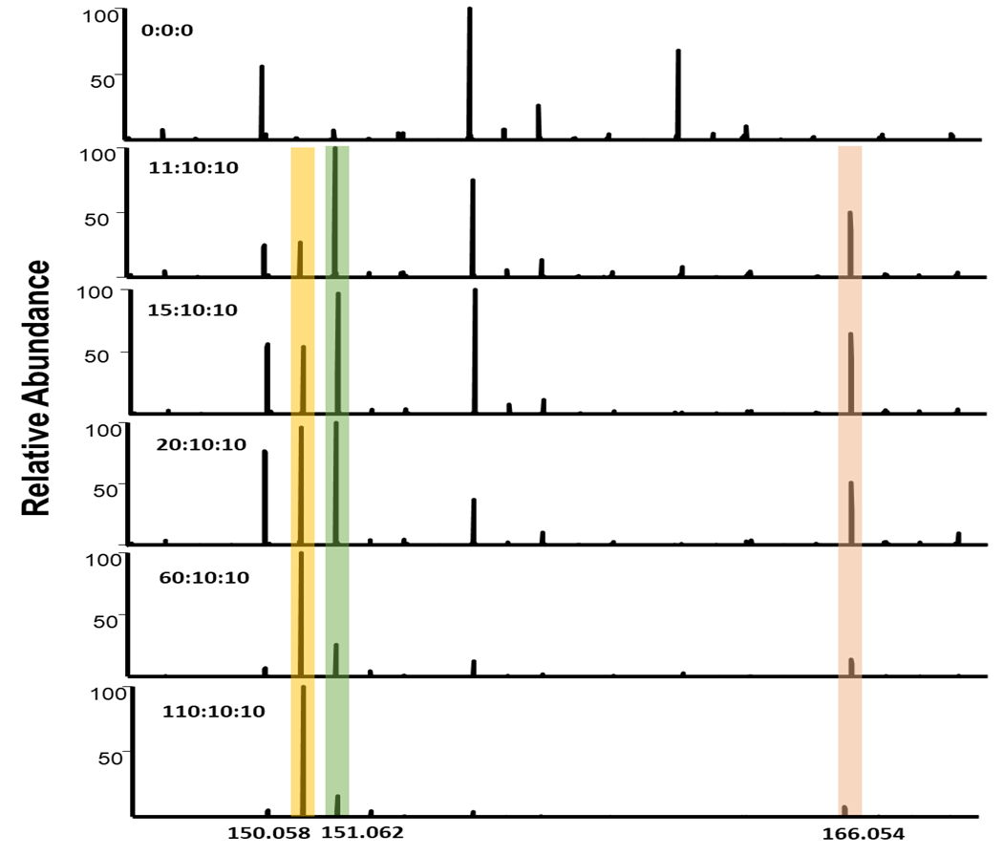
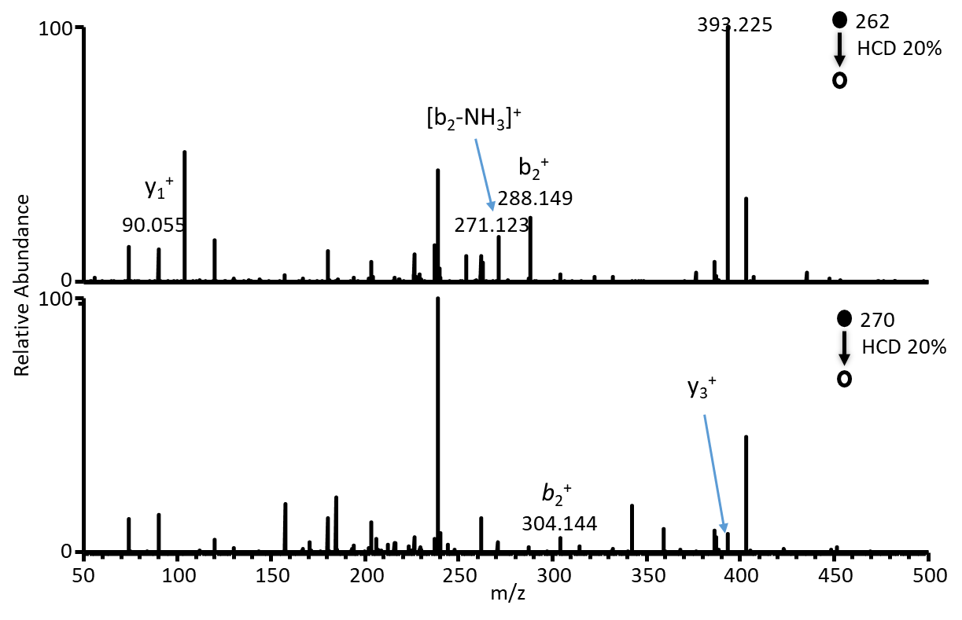
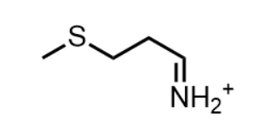
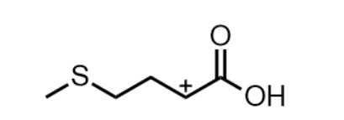
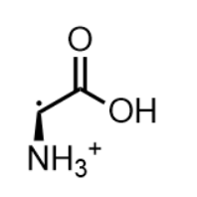
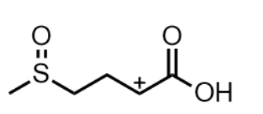
Absolute Quantitative Method in Mass Spectrometry
2019 ASMS
Atlanta, GA
Xing Xu^{1,}, Ran Qiu¹, Anyin Li^{1*}
¹Department of Chemistry, University of New Hampshire, Durham 03824, NH
Control group
Overview
Control group
Experimental group
Case 3: Ubiquitin
A new absolute quantitative method in MS without using any standards or isotope-labeled compounds.
Successfully quantify several organic compounds from small molecules (containing methylthio group) to large biomolecules (proteins) with the quantification error ranging from 10%~30% .
Kinetic Study of Ubiquitin
Analyte: Methionine (1-100 µM)
IS₁: Methionine sulfoxide (10 µM)
IS₂: Methionine ¹³C (10 µM)
Analyte: Methionine (1-100 µM)
Oxidant: NaIO₄ (10 µM)
IS₂: Methionine ¹³C (10 µM)
When the conc. of NaIO₄ is higher than ubiquitin, the adducts will be observed;
A₁
B₁
High conc. of NaIO₄ may cause ubiquitin decomposition;
Introduction
VS
Oxidation yield is 100%: 190.88 (IO₄⁻) was not observed in negative mode;
Traditionally, internal standards (IS), either stable isotope labelled internal standard (SILIS) or analogs of the analytes, are utilized for quantitation based on the ratios of their respective MS peak intensities including TMT, SILAC.
SILIS requires extra labor/time cost to synthesize SILIS, especially for newly discovered compound.
Comparing B with A, Met-O is able to use as an internal standard;
The oxidized ubiquitin was observed once NaIO₄ was added and the highest intensity of Ubiquitin-O was observed at 50 min.
A₂
B₂
Tandem MS of Ubiquitin
Ubiquitin Oxidation
VS
Met-O generated in situ by NaIO₄ has no significant difference with the standard reagent.
Method: MS quantitation based on redox mass-shift
Change C_{NaIO4}
Constant C_{met} 20 µM
$$y=41.8C_{total Met}−2.35$$
$$C_{total Met}=\frac{41.8}{2.35}=18 µM$$
Ubiquitin [M+H]⁺ (monoisotopic mass m/z 8560) shift to Ubiqitin-O [M+H+O]⁺ (monoisotopic mass m/z 8576) with the change of +16 Da.
The adducts ([M+HIO₄+7H]⁷⁺, e.g.) were observed.
The oxidation reaction is rapid.
The oxidized ubiquitin may decompose after 50 min.
1. Adding the known amount of NaIO₄, methionine is oxidized to methionine sulfoxide with 16 Da mass-shift.
2. The calibration curve is established by I_{[M]}/I_{[M+16]} and concentration of oxidant.
Error
$$\frac{\left|18−20\right|}{20}×100\%=10\%$$
Working Curve
- + - + - + - + - - - - - + - + - - + + + + + +Configuration II
Case 2: MRFA
[MRFA+2H]²⁺
Case 1: Methionine
Proposed mechanism
[MRFA+O+2H]²⁺
Met-Arg-Phe-Ala
Conclusions
Methionine and MRFA were successfully quantified using “mass-shift” method without an isotopically labelled internal standard;
This absolute quantitation method can be achieved in the range of 10%~30%.
Future work
To study the protein containing several met or other amino acids (tryptophan, tyrosine, histidine, and cysteine).
To establish the ubiquitin calibration curve with oxidant.
[MRFA+H]⁺/[MRFA+O+H]⁺
[MRFA+2H]²⁺/[MRFA+O+2H]²⁺
MRFA-O MS2
Methionine sulfoxide MS2
133.032
150
Reference
100
CID 25%
1. Alice L. Pilo, Scott A. McLuckey. J. Am. Soc. Mass Spectrom. (2014) 25:1049-1057.
2. Xu, C., Zheng, Q., Zhao, P. et al. J. Am. Soc. Mass Spectrom. (2019) 30: 685.
0
104.053
Relative Abundance
Met
Met¹³C
Met-O
100
149.027
166
When the relative amount of NaIO₄ is increasing, the relative intensity of Met-O is increasing.
75.026
CID 25%
$$y=36.8x−2.56$$
$$y=28.5x−1.78$$
The error for quantitation is near 20%~30%.
The oxidation yield is 100%.
The intensity of [M]²⁺ is higher than that of [M]⁺ and [M]²⁺ has less error.
0
100
150
200
$$C_{t MR}=\frac{36.8}{2.56}=14 µM$$
$$C_{t MR}=\frac{28.5}{1.78}=16 µM$$
Acknowledgements:
m/z
Error
$$\frac{\left|14−20\right|}{20}×100\%=30\%$$
$$\frac{\left|16−20\right|}{20}×100\%=20\%$$
Start-up fund, University of New Hampshire
Methionine sulfoxide is generated by NaIO₄

