Slide 1




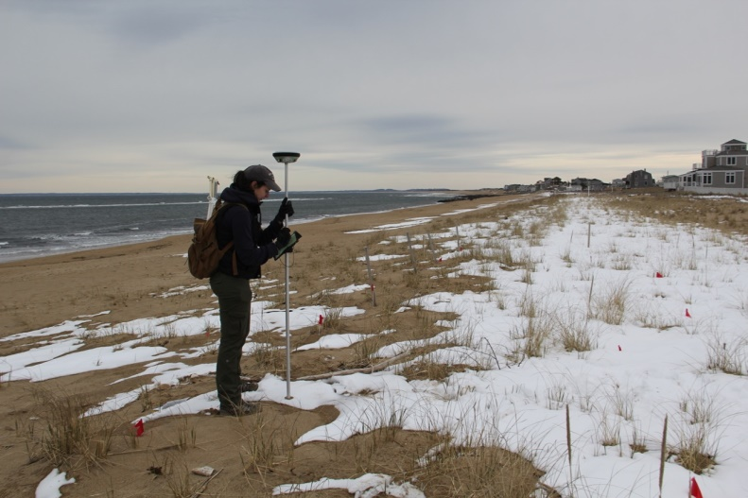
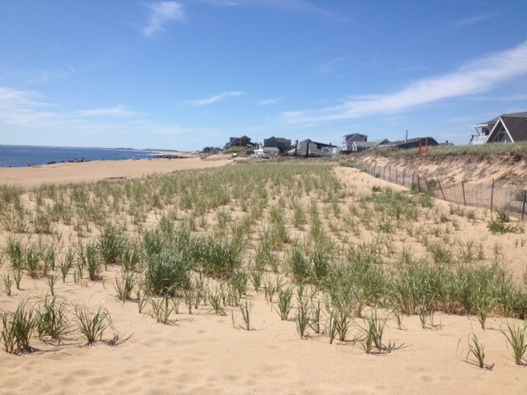
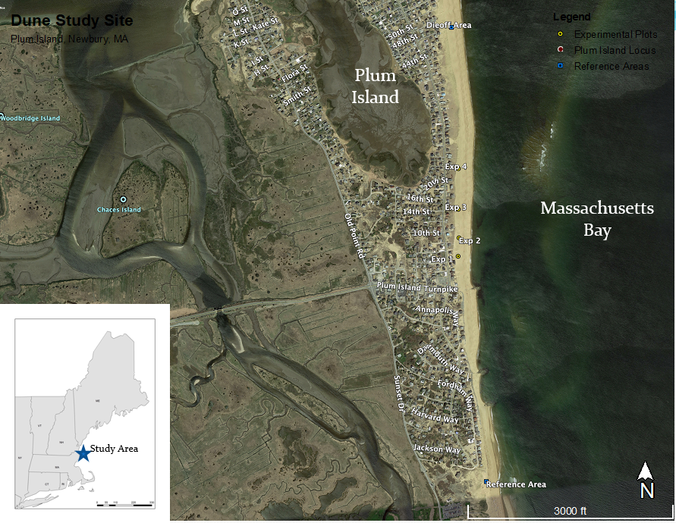
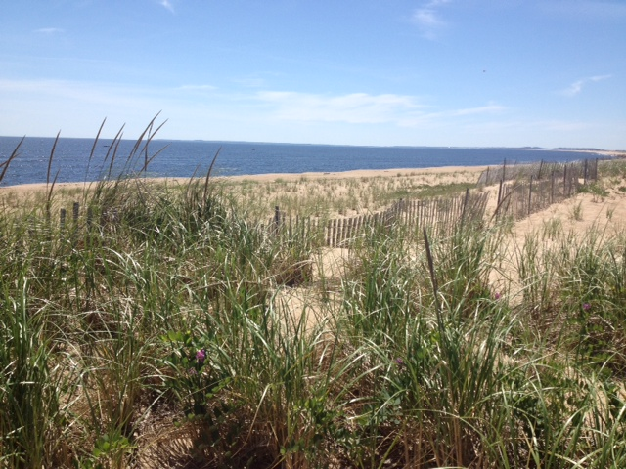
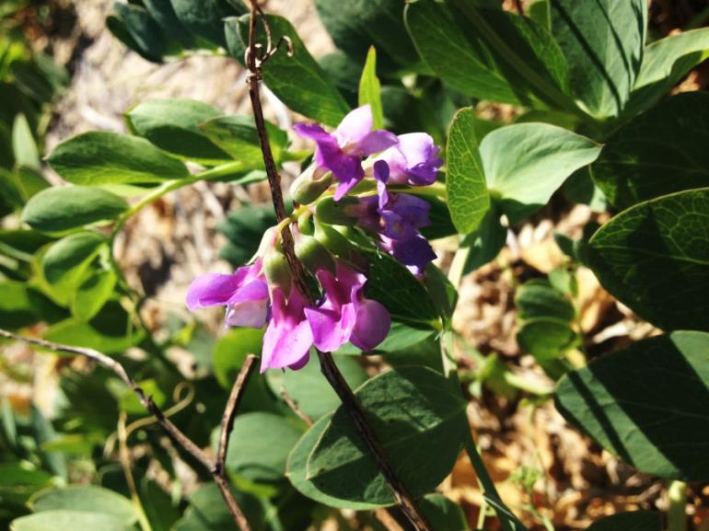
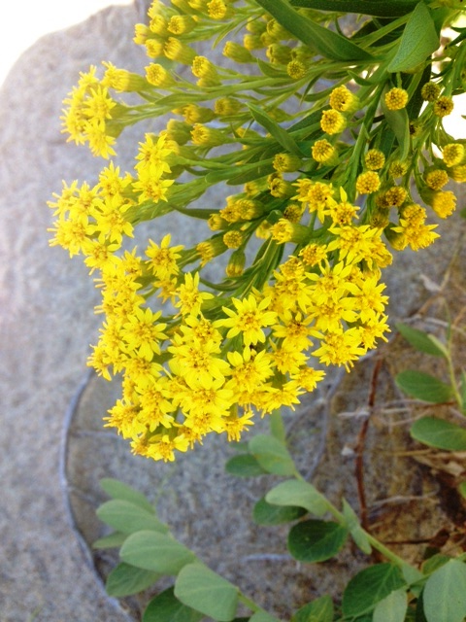
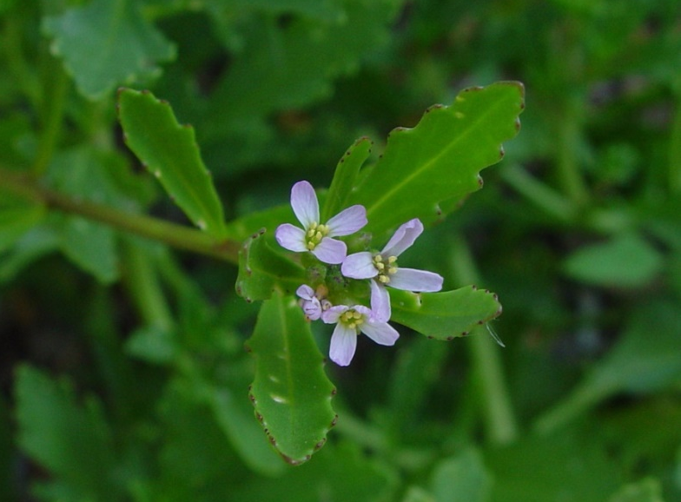
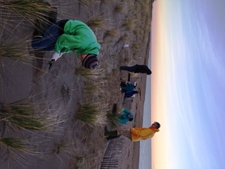
Restoration of Native Plant Communities in Sand Dune Systems
of Plum Island, Newbury, Massachusetts
Natalie A. Feldsine^{I}, Gregg E. Moore^{I}, David M. Burdick^{II}, and Susan C. Adamowicz^{III}
I) UNH Department of Biological Sciences, II) UNH Department of Natural Resources, III) USFWS Rachel Carson National Wildlife Refuge
INTRODUCTION
METHODS
DISCUSSION
Importance of Coastal Dunes
Essential for protecting coastal communities from storm surges and less expensive to maintain than manmade structures.
Habitat for specialized plants and animals¹ including the federally endangered piping plover.
Threats include superstorms, coastal development, beachgrass die-off.
Dune sand accretion relies on plant growth because sand accumulation increases as plant size, density, and root depth increases (Feagin et. al., 2010).
Hypotheses
Greater increases in elevation and percent cover will be observed in high diversity plots than in than low diversity or control plots.
Reference dunes will have greater species diversity and percent cover than restoration dunes or dunes that have experience beachgrass dieout.
Additional Goals
Increase community involvement engagement with local schools.
Develop a restoration plan that can be implemented by coastal communities.
Flora Survey: In late summer and fall of 2014, walking transects were conducted in the reference, dieout and restoration areas. Additional species occurrence records were obtained from herbarium records and a prior study.
Experimental Plantings: Treatments included High Diversity (HD) plantings with S. sempervirens, C. edentula, and L. japonicus. Low Diversity (LD) plantings with S. sempervirens. Control plots were comprised of beachgrass planted during prior restoration efforts. Percentage cover and elevation change were compared between HD and LD treatments as well as between plot locations.
Native Species Propagation: L. japonicus and C. edentula were propagated from locally harvested seeds. S. sempervirens was sourced from a local vendor. Success of plantings measured by percent cover and transplant survival.
Dune Profiles: Elevation measured with a Leica Viva real time kinematic (RTK) GPS (± 1cm) to determine sand accretion.
Interpretation of Results
Elevation was most influenced by relative position in the foredune, rather than treatment. Plots on the seaward edge showed a trend toward more sand accretion. In addition, elevation changes may differ greatly based on site location depending on the age of dunes, wind patterns, and available sand for transport.
Impacts of species diversity on elevation may also integrate over greater temporal scales and may need more time to become evident.
It appears that fall plantings are much more successful than spring plantings of herbaceous forbs within the context of the weather patterns experienced at this site during the experimental period.
S. sempervirens had the greatest transplant success and is easy to access from local nurseries, whereas L. japonicus and C. edentula seeds must be harvested and grown out for plantings.
The stretches of dune impacted by dieout had the greatest species diversity when compared with the reference and restored areas. The most common plants in these areas were the selected experimental species, which demonstrates that L. japonicus, C. edentula, and S. sempervirens are good choices for diversity plantings.
Dunes are dynamic and the environmental stresses of these habitats made for interesting challenges in field study.
Recommendations
Examine the effects of higher density diversity plantings and/or the success of seeding restoration areas directly compared to growing plants for transplanting. Alternatively, diversity species could be transplanted into donor gardens which would serve as a resource for local restoration projects.
Weather conditions and time between germination and transplant may be factors to consider in future efforts.
Restoration efforts anticipate dune planting and elevation monitoring for 3-5 years, as that is the typical time frame for the recovery of dune communities¹¹.
Figure 3. Collecting elevation data with RTK differential GPS
SITE DESCRIPTION
Plum Island, Massachusetts
Barrier island located just south of the mouth of the Merrimack River
Impacted by coastal development and disturbances (erosion, major storms e.g., Hurricane Sandy)
Sites with ongoing dune restoration and beachgrass plantings, natural dunes, and dieout zones.
Experimental plantings occurred in restoration areas where beachgrass was previously planted.
Figure 4. Dune restoration area within the foredune zone with previously planted A. breviligulata.
RESULTS
Figure 1 . Map of study areas on Plum Island, Newbury, MA
NATIVE DUNE SPECIES
OUTREACH & STEM EDUCATION
In order to better translate research to the public, an outreach program was developed and shared with the Dover Middle School STEAM Academy.
Middle school students learned how UNH researchers are working to protect New England’s coastlines through restoration of coastal dunes.
Topics included plant diversity, pollinator relationships, nematode predation, dune stabilization, erosion, storm effects, and green infrastructure.
Educational activities included the observation of dune and beachgrass growth microcosms, creation of herbarium specimens, examination of nematodes using compound light microscopes, and field trip for dune restoration plantings.
Figure 5. Dominant vegetation of the three different sampling areas, as demonstrated by average percentage cover (%) ± SE.
Figure 6. Transplant survival (%) with standard error (SE). The asterisk (*) represents no data collected.
Figure 2. From left: Ammophila breviligulata, Lathyrus japonicus, Solidago sempervirens, Cakile edentula
American Beachgrass (Ammophila breviligulata)²
Highly tolerant of burial by sand & coastal stress
Common dune stabilizing plant
Susceptible to nematode predation
Beach Pea (Lathyrus japonicus)³
Perennial
Nitrogen-fixing
Bee and butterfly pollinated
Seaside Goldenrod (Solidago sempervirens)⁴
Perennial halophyte
Tolerant of drought, salt spray & burial by sand
Bee and butterfly pollinated
Cakile edentula (American sea rocket)⁵
Succulent; tolerant of drought
Summer annual
Bee and butterfly pollinated
Figure 10. Dover STEAM Academy students transplanting beachgrass and goldenrod
REFERENCES
1 - Sperduto, D. D., & Kimball, B. (2011). The nature of New Hampshire: natural communities of the granite state. Durham, N.H.: University of New Hampshire Press.
2 - Miller, C., & Peterson, J. (n.d.). American Beach Grass Plant Guide.
3 - Brightmore, D., & White, P. (1963). Lathyrus Japonicus Willd. The Journal of Ecology, 51(3), 795-795.
4 - Snell, S. 2010. Plant fact sheet for Seaside Goldenrod (Solidago sempervirens). USDA-Natural Resources Conservation Service, Plant Materials Center. Cape May, NJ.
5 - Sea Rocket (Cakile edentula lacustris). (n.d.). http://www.illinoiswildflowers.info/prairie/plantx/sea_rocket.html
6 - Brinkman, E. P., H. Duyts, W.H. van der Putten, and H. Setälä. (2005). Consequences of variation in species diversity in a community of root-feeding herbivores for nematode dynamics and host plant biomass. Oikos 110(3): 417-427.
7 - Maun, M.A. (1984). Colonizing ability of Ammophila breviligulata through vegetative regeneration. Journal of Ecology 72(2): 565-574.
8 - Clifford, B. (2015). Piping Plover. New Hampshire Wildlife Action Plan, 110-120.
9 - Kearns, C.A. and D.W. Inouye. (1997). Pollinators, flowering plants, and conservation biology. BioScience, 47(5): 297-307.
10 - Potts, S.G., B.A. Woodcock, S.P.M. Roberts, T. Tscheulin, E.S. Pilgrim, V.K. Brown, and J.R. Tallowin. (2009). Enhancing pollinator biodiversity in intensive grasslands. Journal of Applied Ecology, 46(2): 369-379.
11 - Miller, T.E., E.S. Gornish, and H.L. Buckley. (2010). Climate and coastal dune vegetation: disturbance, recovery, and succession. Plant Ecology 206(1): 97-104.
Figure 7. Pre- to post-planting elevation change ± SE at each diversity level within seaward and landward plots
Figure 8. Pre- to post-planting elevation change ± SE at each experimental location

