Slide 1




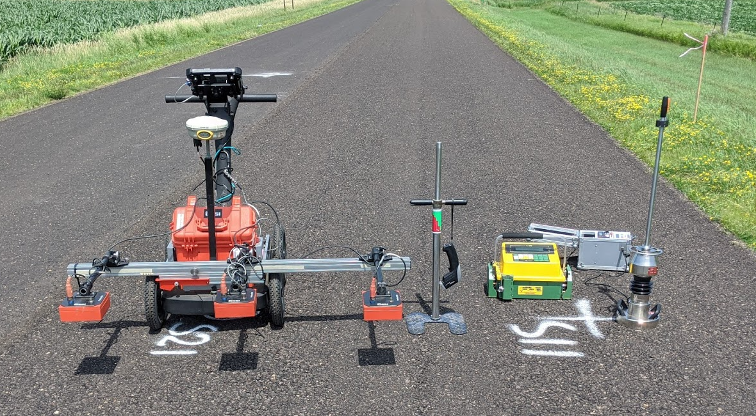

Evaluation of Curing Effects on Cold In-place Recycled Materials
Ph.D. Student: Chibuike Ogbo (cuo1001@wildcats.unh.edu), Faculty Advisors: Jo E. Sias, Eshan V. Dave
Department of Civil and Environmental Engineering, University of New Hampshire
Introduction
Materials
Selected Results
Cold In-place Recycling (CIR) is a flexible pavement rehabilitation technique. Its benefits include:
  in-place use of existing pavement materials.
  elimination of existing cracks in the pavement to prevent reflective cracking.
Most CIR construction use asphalt emulsion or foamed asphalt with or without active fillers as stabilizing agents, which require curing prior to traffic exposure.
CSAH 8
Parameters | Attributes
 | CSAH 8 | CSAH 11/21 | TH 28 | TH 30 | TH 75 | TH 95
Method of Bitumen Delivery | EE | EE | Foam | EE | EE | EE
Target Amount of Bituminous Material | 1.5% | 1.9% | 2.5% | 2% | 1.7% | 2%
Type and Amount of Mineral Stabilizing Agent | N/A | N/A | N/A | 0.5% Cement | 0.5% Cement | N/A
Added Amount of Moisture | 1.5% | 1.5% | 3-4% | 1% | 1.5% | 1.5%
Stabilizing Depth | 3 in | 3 in | 3 in | 3 in | 3 in | 3 in
Target Density (pcf) | 122.3 | 120.9 | 128 | 123.4 | 128.6 | 128.5
Motivation
TH 28
There is lack of a fast and reliable procedure to determine the extent of in-situ curing and this increases the risk of premature damage.
Present construction specifications often rely on empirically based time recommendations to ensure sufficient curing and these do not account for material variations, climatic conditions and construction process differences.
Objectives
In-situ Tests
  Develop a reliable and practical methodology to monitor and predict the extent of curing and strength gain for CIR layers
  Lightweight Deflectometer (LWD)
  Rapid Compaction Control Device (RCCD)
  Density Profiling System (DPS)
  Nuclear Density and Moisture Gauge (NDMG)
TH 30
Methodology
Field Material Sampling, Data Collection and Testing
Laboratory Testing of Sampled Materials
Data Analysis and Model Development
TH 75
Field Projects
Key Findings
  4 State Highways and 2 County Highways
NDMG and DPS show similar trends in moisture content change as related to curing. However, the DPS has a higher propensity of detecting increase in moisture content as a result of rainfall events.
Rainfall did not seem to significantly affect the moisture content change in projects that employed active filler.
Moisture content change resulting from rainfall events did not appear to significantly alter stiffness gain in the CIR mixtures stabilized using emulsion but seem to affect the project with foamed asphalt.
The LWD and RCCD were efficient in assessing the stiffness evolution as it pertains to curing. However, there is less measurement variability associated with the RCCD as opposed to the LWD.
Temperature corrections may be required for RCCD measurements, but it is beyond the scope of the study.
Ongoing and Future Work
Laboratory testing of sampled materials (Resilient Modulus, Indirect Tensile Strength, Triaxial, Semi-circular Bend).
Extensive statistical analysis of field and laboratory results to develop prediction model.
Acknowledgement
Thomas Calhoon, Dr Eyoab Zegeye-Teshale, Dr. Shongtao Dai (Office of Materials and Road Research, Minnesota Department of Transportation)

