Slide 1
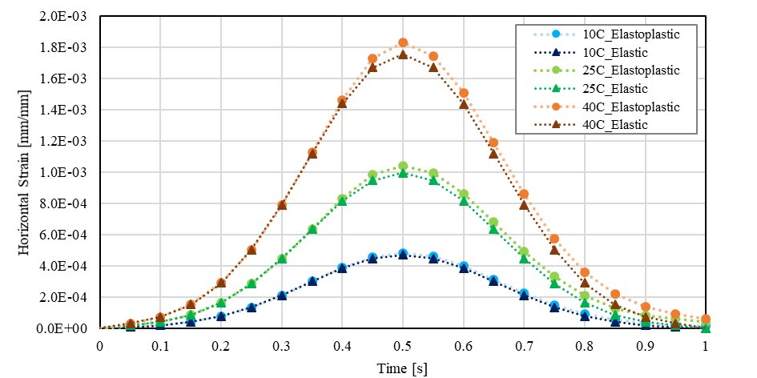
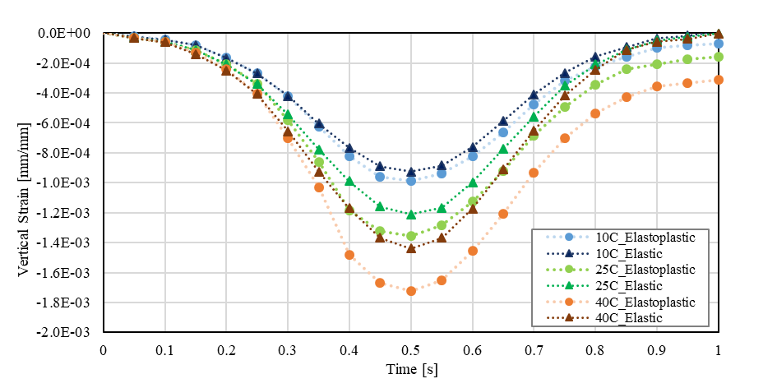
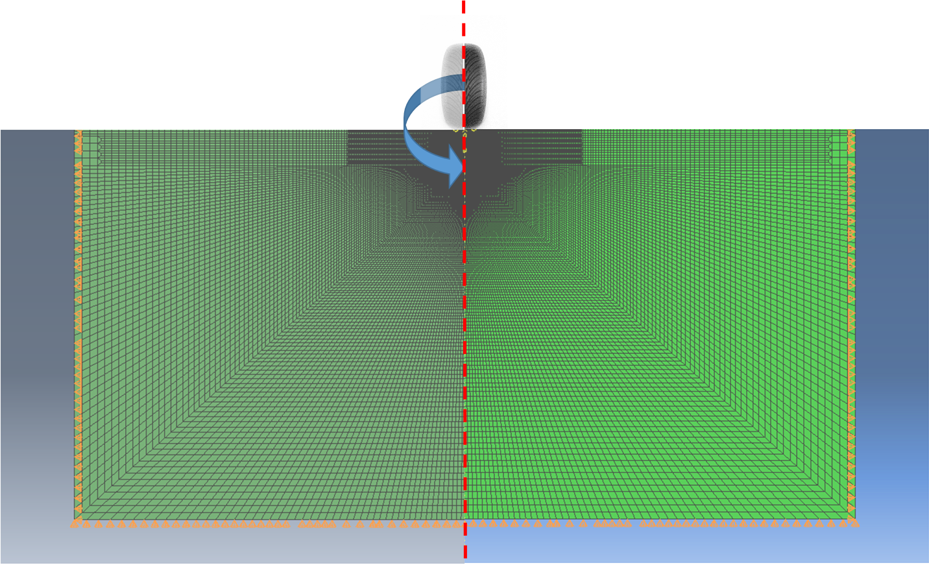
Temperature dependent plastic response in the design and analysis of pavement structures with cold in-place recycled layer Francesco Preti^{a,b}, Miranda Chiappini^{b}, Eshan V. Daveª, Jo E. Siasª, Elena Romeo^{b}, Gabriele Tebaldi^{b} a. University of New Hampshire, Durham, NH, United States; b. University of Parma, Parma, Italy fp1021@wildcats.unh.edu
Introduction
Results from numerical simulations
Cold In-Place Recycling (CIR) is an increasingly popular rehabilitation technique; it allows the surface layers of the pavement structure to be recycled with minimum energy usage to heat materials (unlike traditional hot recycled of RAP in asphalt mixtures) and without need for transporting in-situ materials. This technique is recognized in road construction for its environmental, economic and structural benefits [1]. The milled material from the existing pavement is directly mixed on site with an asphalt stabilizer, either asphalt emulsion or foamed asphalt, and in some cases with active fillers [2]. The mixture that is generated by CIR process is a partially bonded material containing a relatively low amount of new asphalt binder, usually up to 2% of weight of total mixture.
Motivation:
In current pavement design procedures, the main property of CIR that is taken into consideration is stiffness, or capacity of the material to carry load; in reality, the dominant failure mechanism for this type of pavement layer is permanent deformation from plastic behavior.
Objectives:
Demonstrate that the plastic behavior of partially-bonded and unbounded materials needs to be considered for pavement design and analysis.
Demonstrate that temperature susceptibility of CIR material mechanical properties cannot be neglected for an accurate prediction of rehabilitated pavement structures performance.
Plasticity effect at different temperatures: Elastoplastic model vs Elastic model
Comparisons are made between structures with different layer thicknesses both in terms of horizontal strains at the bottom of HMA layer and vertical strain at the top of subgrade, and of maximum allowable loading repetitions before fatigue and rutting failure of the pavement.
Plasticity effect comparison with different temperature distributions
The two additional scenarios with only HMA layer temperature variation are introduced and the responses from those simulations are compared to the previous cases.
Multilayer elastoplastic finite element pavement model
HMA Temperature [°C] | CIR Temperature [°C] | N_{F} | Difference between Reference and Other Cases N_{F} [%] | N_{R} | Difference between Reference and Other Cases N_{R} [%]
10 | 10 | 581,568 | 77.16 | 418,770* | 52.80
10 | 25 | 322,442 | 58.81 | 299,177* | 33.94
25 (Reference) | 25 (Reference) | 132,808* | 0 | 197,623 | 0
40 | 25 | 109,909* | -17.24 | 152,167 | -23.00
40 | 40 | 37,507* | -71.75 | 112,265 | -43.19
The 2D axisymmetric model was designed with dimensions of 6 m width and 6 m depth on the basis of a model extent analysis that allowed identification of the necessary minimum dimensions to avoid artifact effects coming from the boundary conditions. The elements used to build the model are 4 node quadrilateral axisymmetric explicit elements and dimensions were varied using an one-way graded transition approach resulting in smaller element sizes in the area close to the applied load. The cross section for the pavement structure was designed to replicate the CIR project taking place on TH 30 in Minnesota.
CIR response under different temperature conditions
Lastly, the Deviator Stress Ratio (DSR) was adopted as the critical response. This was done to evaluate the CIR material rutting potential and DSR was calculated for the CIR layer under all the above mentioned scenarios.
MnDOT TH30 CIR Project [Stevens County; District 7]
Layer | Description | Thickness [mm]
HMA | 12.5 mm nominal maximum aggregate size, Binder: PG58-34 | 75
CIR | 2% RB + 2% HL | 75
Granular Base | MnDOT Class 6 | 250
Subgrade | Silty Loam | Semi-infinite
HMA Temperature [°C] | CIR Temperature [°C] | Structure | DSR [%]
10 | 10 | Thin | 33%
 |  | Reference | 16%
10 | 25 | Reference | 21%
25 | 25 | Thin | 49%
 |  | Reference | 36%
 |  | Thick | 8%
40 | 25 | Reference | 61%
40 | 40 | Reference | 65%
 |  | Thick | 11%
The model was verified following two steps:
Linear elastic behavior was simulated for all pavement layers with moduli values corresponding to a constant reference temperature of 25 °C throughout the whole pavement structure and the pavement response from ABAQUS model was then compared to the LEA software JULEA.
Plasticity response was introduced in all the sub-surface layers (CIR, aggregate base, and subgrade)using a constant temperature of 25 °C. The results predicted from the ABAQUS elastoplastic model were compared with the nonlinear finite element software ILLIPAVE [11].
Plastic properties for all the sub-surface layers were input in terms of Cohesion and Internal Friction Angle following the Mohr-Coulomb theory, HMA layer was assumed to give a linear elastic response in all the simulated scenarios. In addition, function able to adjust material mechanical properties based on the layer temperature was introduced for HMA and CIR.
Based on researech by Jenkins et al. [14], the maximum allowable DSR for CIR layer is 35% for a design reliability of 95% (Highways with heavy traffic); for a design reliability of 80-90% it is of 40% (Arterials with moderate traffic).
Conclusions
Based on the analysis conducted, the main conclusions from this research study are as follows:
The plasticity effect needs to be considered for pavement design and analysis; this can be done introducing cohesion and friction angle properties for the partially bounded and unbounded layers.
The effect of temperature on mechanical properties of CIR material are not negligible; this means that elastic modulus and cohesion properties need to be evaluated in the laboratory under different temperature conditions.
Rutting and fatigue life calculations based on linear elastic simulations can lead to an overestimated life for the pavement structure. The inclusion of plasticity is most important for thinner (HMA and CIR layers under 75 mm thickness such as in low volume roadways) pavement structures and primarily in warmer regions (where the CIR layers may approach temperatures of 40 °C for a significant portion of the year).
The thickness of the HMA overlay is of fundamental importance for limiting the stress concentration in the CIR layer. Use of DSR as a design parameter to determine suitable overlay thickness is recommended.
Layer | Temperature [°C] | Elastic Modulus [MPa] | Poisson’s ratio | Cohesion [MPa] | Friction Angle [°] | Density [kg/m³]
HMA | 10 | 3395 | 0.30 | N/A | N/A | 2400
 | 25 | 1004 | 0.41 | N/A | N/A
 | 40 | 500 | 0.43 | N/A | N/A
CIR | 10 | 250 | 0.40 | 0.500 | 30 | 1970
 | 25 | 130 | 0.40 | 0.280 | 30
 | 40 | 70 | 0.40 | 0.180 | 30
Granular Base (MnDOT Class 5) | 10, 25, 40 | 138.5 | 0.40 | 0.042 | 40 | 2080
Subgrade (Silty Loan) | 10, 25, 40 | 30 | 0.45 | 0.015 | 24 | 1840
References: 1. Feisthauer, Bruno, et al. "Simulation and Influence of Early-life Traffic Curing for Cold In-place Recycling and Full-depth Reclamation Materials." Proceedings, Annual Conference-Canadian Society for Civil Engineering. Vol. 5. 2013. 2. Tebaldi, Gabriele, et al. "Synthesis of standards and procedures for specimen preparation and in-field evaluation of cold-recycled asphalt mixtures." Road Materials and Pavement Design 15.2 (2014): 272-299. 3. DIEFENDERFER, Brian K., et al. Dynamic modulus of recycled pavement mixtures. Transportation Research Record, 2016, 2575.1: 19-26. 4. NATAATMADJA, Andreas. Some characteristics of foamed bitumen mixes. Transportation Research Record, 2001, 1767.1: 120-125. 5. Kavussi, Amir, and Amir Modarres. "Laboratory fatigue models for recycled mixes with bitumen emulsion and cement." Construction and building materials 24, no. 10 (2010): 1920-1927. 6. Ebels, Lucas-Jan, and Kim Jenkins. "Mix design of bitumen stabilised materials: Best practice and considerations for classification." Proceedings of the 9th Conference on Asphalt Pavements for Southern Africa (CAPSA’07). Vol. 2. 2007. 7. Preti, F., E.V. Dave, J.E. Sias, E. Romeo and G. Tebaldi “Influence of Temperature on Global and Local Elastoplastic Properties of Bituminous Stabilized Material”. Manuscript submitted for publication. 2020. 8. Tanquist, Bruce, et al. "Pavement Designer's Guide Mn/DOT Flexible Pavement Design MnPAVE Beta Version 5.1." MnDOT Office of Materials and Road Research, Maplewood, Minnesota (2002). 9. ASPHALT ACADEMY. A guideline for the design and construction of bitumen emulsion and foamed bitumen stabilised materials. 2009. 10. KOLOSKI, Jon W.; SCHWARZ, Sigmund D.; TUBBS, Donald W. Geotechnical properties of geologic materials. Engineering geology in Washington, 1989, 1: 19-24. 11. Thompson, Marshall R., and ROBERT P. Elliott. "ILLI-PAVE based response algorithms for design of conventional flexible pavements." Transportation Research Record 1043 (1985): 50-57. 12. Menetrey, Philippe, and K. J. Willam. "Triaxial failure criterion for concrete and its generalization." Structural Journal 92.3 (1995): 311-318. 13. ASPHALT ACADEMY. TG 2. A guideline for the design and construction of bitumen emulsion and foamed bitumen stabilised materials. 2019. 14. Jenkins, K, C.E. Rudman, and C.R. Bierman. “Delivering Sustainable Solutions through Improved Mix and Structural Design Functions for Bitumen Stabilised Materials.” Advances in Materials Science and Engineering, vol. 2020, p. 10, 2020.

