Slide 1
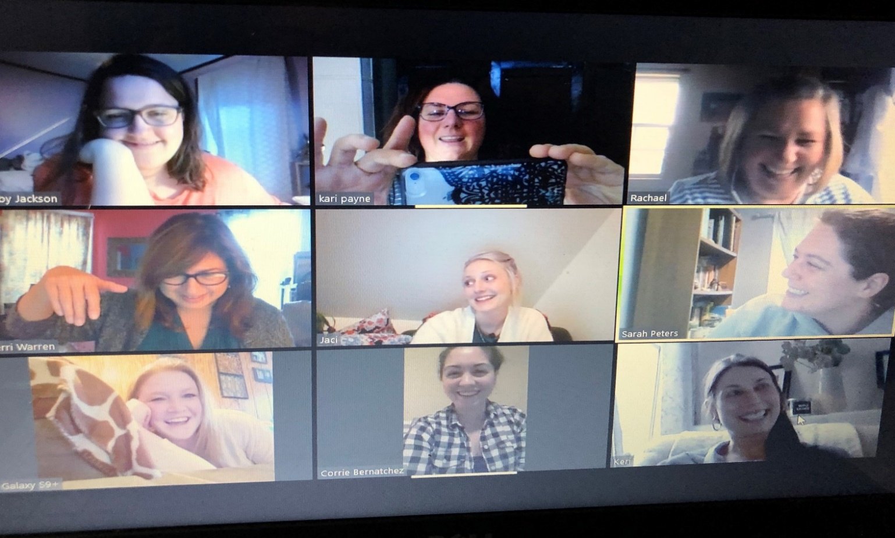
Immersion for Change: A Cultural Discovery Project to Lessen Educator Bias by Increasing Perspective
Kari Payne, M.Ed.
Leadership Mentor: Marnie Morneault, M.Ed.
Introduction to Project
The final Immersion Opportunity was a book club which consisted of four touchpoints: 1) pre survey about cultural competency, 2) discussion half-way through reading The Spirit Catches You and You Fall Down, 3) discussion upon completion of book as a Zoom meeting, 4) post survey after book was finished.
Take Away Concepts
This cultural project focused on increasing cultural competency and lessening implicit bias for both myself and the agency I work for. The process highlighted how important relationships and ongoing connection are when blending the needs of the New Mainer Population with those serving the children in the community.
Difficulty to build on strengths and shared goals between families and professionals due to limited time, language barriers and differences in understandings of education systems and diagnosis.
An identified need to find balance between supporting family culture and beliefs while implementing state/federal guidelines/testing/expectations.
Culturally and linguistically appropriate services are lacking in the early intervention school/therapy settings.
Cultural brokers are needed to created a relationship/shared understanding between professionals and New Mainers.
The Early Intervention education team has a strong desire to support and provide resources for all families but lack knowledge of other cultures.
Cultural Immersion Opportunities
Meeting with CDS NMPHI and LEND trainee/mentor
Identifying gaps in understanding between New Mainers and Child Development Service protocol.
Look beyond sharing information as experts, make connections first.
Cultural Broker would be helpful.
Questions for the survey were coded to determine the participant’s attitudes, beliefs/values, and cultural competency. They were assessed by survey pre/post participation in the book club.
Attitude–are the response that is a result of our core values.
Belief/Value–Assumptions and convictions we hold to be true, often help to guide our behavior.
Cultural Competency–Recognizing and valuing the unique perspective of people, identities, and points of view, and doing so in an environment where all people feel safe and respected.
Level of Change
Min change- less than 20% change Moderate change - 20-30% change Significant change - greater than 30%
New Mainers Public Health Initiative 3rd annual Retreat
Little has been done for cultural competency in special education in the past 30 years.
Gaps in cross-cultural understanding remain.
Interpretation services do not replace relationship and a cultural broker.
Question | Change
I have experienced new Mainers adjusting well to living in our area? | 49% increase
Do you think the most important aspects of New Mainer culture are the same as American culture? | 37% decrease
Do cultural barriers impact how you make decisions in caring/educating young children? | 37% increase
Do you have an understanding of an interpreter vs. a cultural broker? | 67% increase
Is there importance of having both an interpreter and cultural broker? | 68% increase
Are children taught to keep their culture at home in education settings because American Culture is supported more? | 58% increase
Are there times that you think therapists/educators are not successful in supporting families because of their cultural beliefs? | Example of question
Future Action Steps as an Agency
New Mainers Public Health Initiative: Woman's Self Care Group
Identify and increase cultural competency understanding and training.
Learn what illness/treatment/medicine/education look like for families new to Maine from other countries.
Learn how people view our services though a community, educational and medical lens.
Train employees to discuss and advocate for early childhood development by understanding milestones, philosophy and approach in order to effectively partner with families.
Invest in the time and energy needed to bridge gaps to form trusted relationships, regardless of financial benefit to an agency.
Open spots for New Mainers to experience an early intervention preschool or playgroup with little to no cost.
Learn and discover about your own implicit bias and self reflect on changes that need to be made (both personally and as an agency).
Advocate at the board of directors level for formation of subcommittees that increase inclusion of New Mainers within the scope of families we serve.
Aim to become more diverse within the hired staff, professional development opportunities and through collaborations with agencies to include NMPHI, local college students and volunteers.
Ongoing gathering of New Mainers for social support and wellness.
Somali community looks to each other for support, also for information.
Oral cultural for sharing information has greatest impact.
“What struck me most if how often we put Raw on Raw: new teachers or ed techs with the most challenging children or residents helping with the most involved medical cases, how can that work!”
ME Roads to Quality Community of Practice CoP
CoP that supports license exempt daycares.
New Mainers interest in becoming licensed for family childcare.
Approval from landlords for in-home childcare is often denied.
State regulations for training is a concern when English is not first language.
“Just never thought about it at all. Would they want to live elsewhere?
Didn’t realize how much pride they have in their homeland.
How much they used the land, no waste.”
“How do you have an open mind when you have no experience. How do you guide others when they see the issue with negative eyes. Goes beyond culture, are we recommending thing that go beyond the constraints of the household.”
Somali 101 Language Class, Lewiston Adult Education
Allowed myself to be a beginner at a task that is hard in order to perceive how difficult learning an entire culture must be.
Gained humility and improved compassion.
“We need to get better discussing what early childhood development looks likes, milestones, to help teach families. It’s a community investment and we need time to send message.”

