Slide 1
Wireless Data Processing System for IoT-Enabled Devices
Samuel Mercer, Tinh Phuong, Eli Duggan, Orianne Sinclair
Mentors: Timothy Carlin and Jeff Lapak
Innovation Scholars

Slide 2

Motivation
Researchers employ sensors to collect data
Issues with manual data retrieval
  Time and resource cost
  Corrupted or lost data
  Disturbed sensors
  Lagging response
Wireless Transmission System (WiTS)
  Inexpensive
  Flexible
  Wide range
  Easy to implement
Database storage and analysis

Slide 3
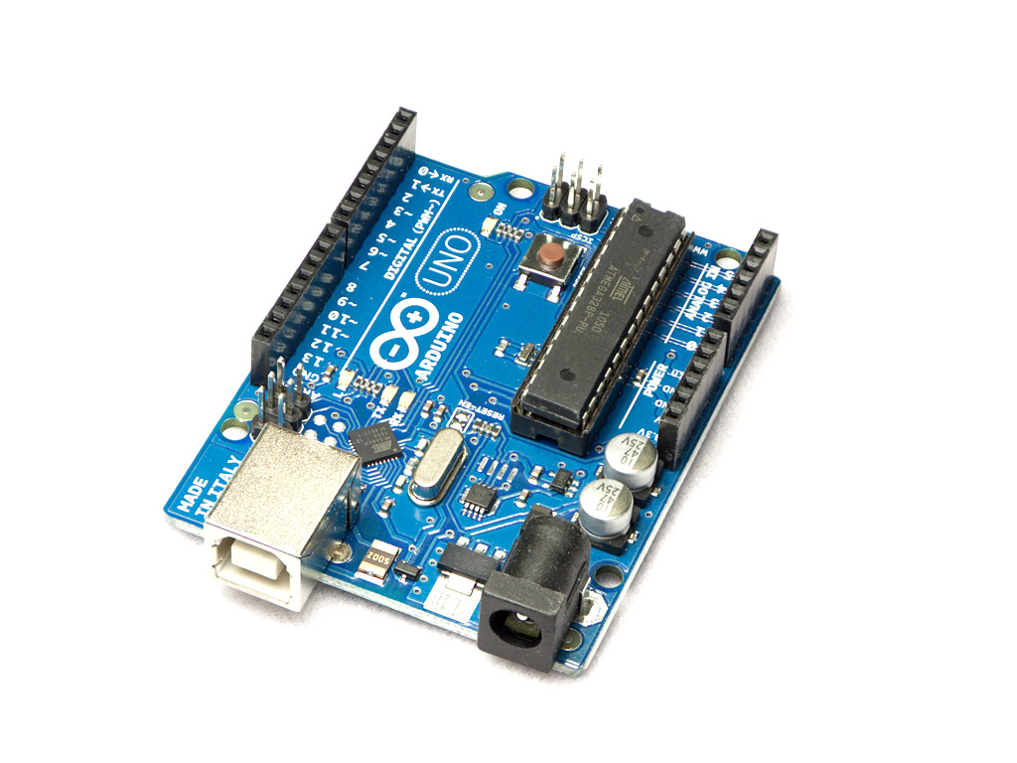
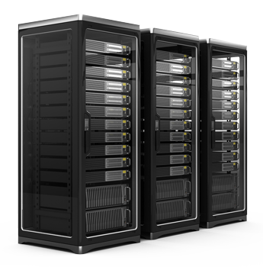
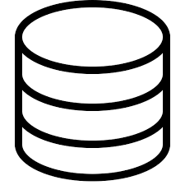
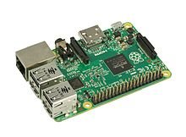


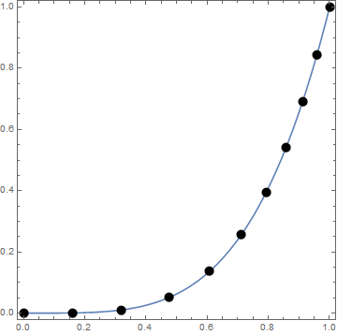
System Design
Web Server
IoT Sensor
Raspberry Pi
Senet Network
Database
Figure 1. WiTS System Design [1][2][3][4][5][6]
End Application

Slide 4
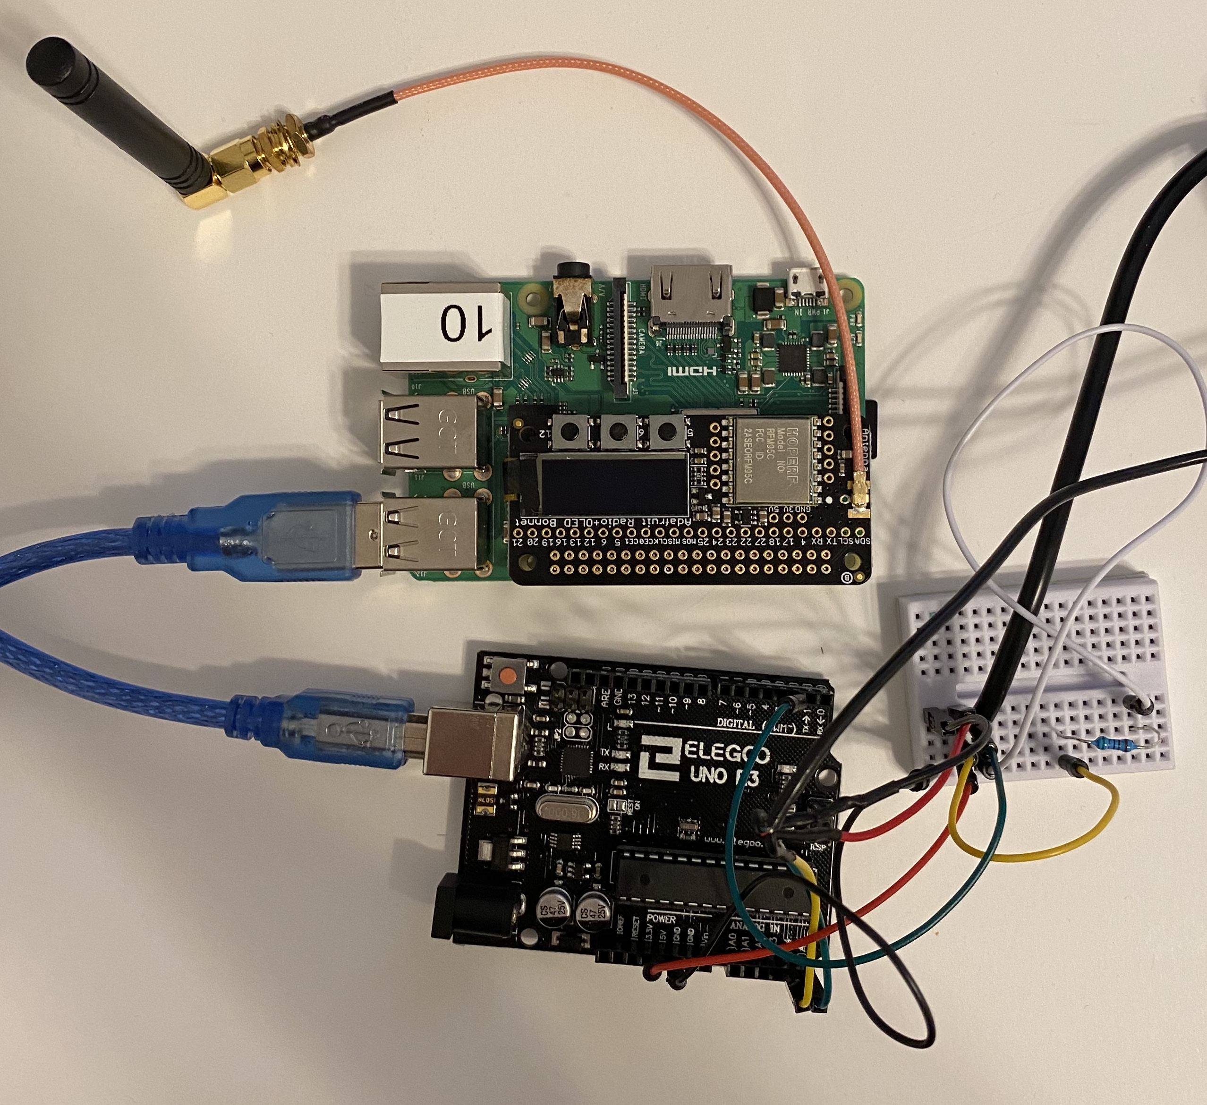
Implementation
Partnered with the ‘Surging Waters in Durham’ Innovation Scholars team
Utilized system with an Arduino sensor as an IoT device
Deployment interrupted, but test data gathered and displayed
Figure 2. Arduino-Pi serial USB connection.

Slide 5
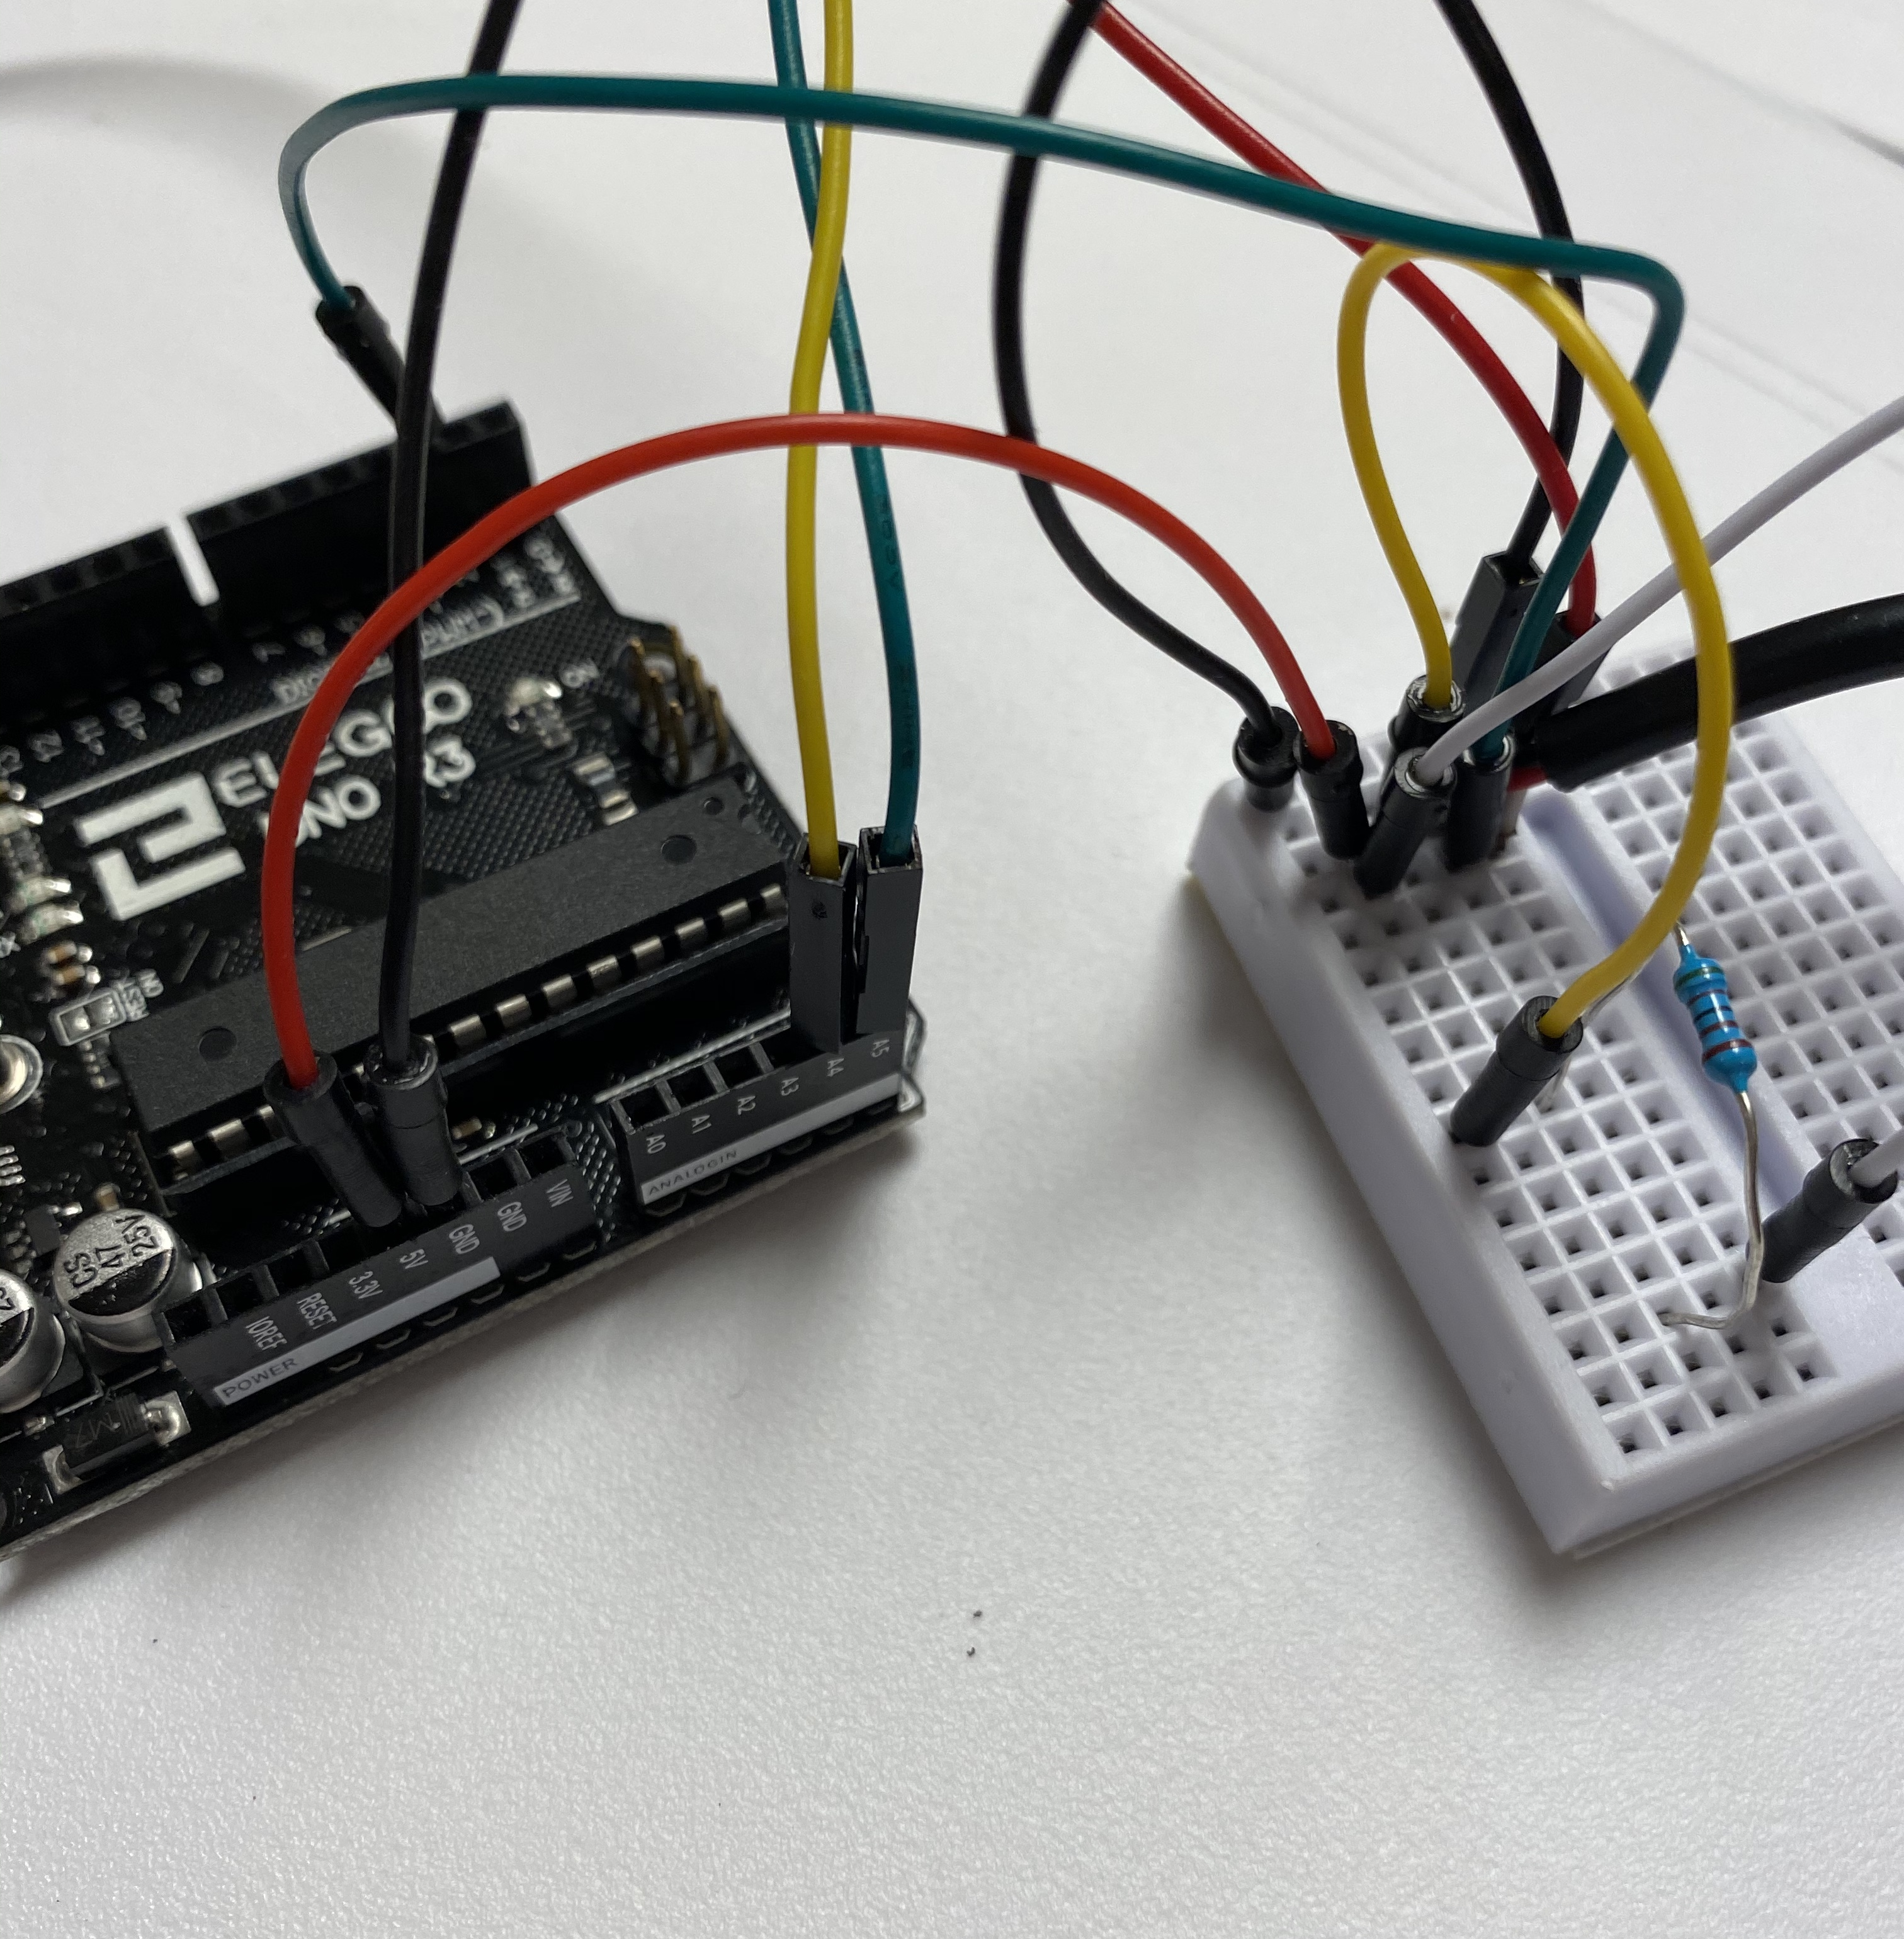
Phase 1:
Data Collection
IoT device collects data
Connected to the Raspberry Pi
Figure 3. ‘Surging Water’ Arduino Sensor

Slide 6
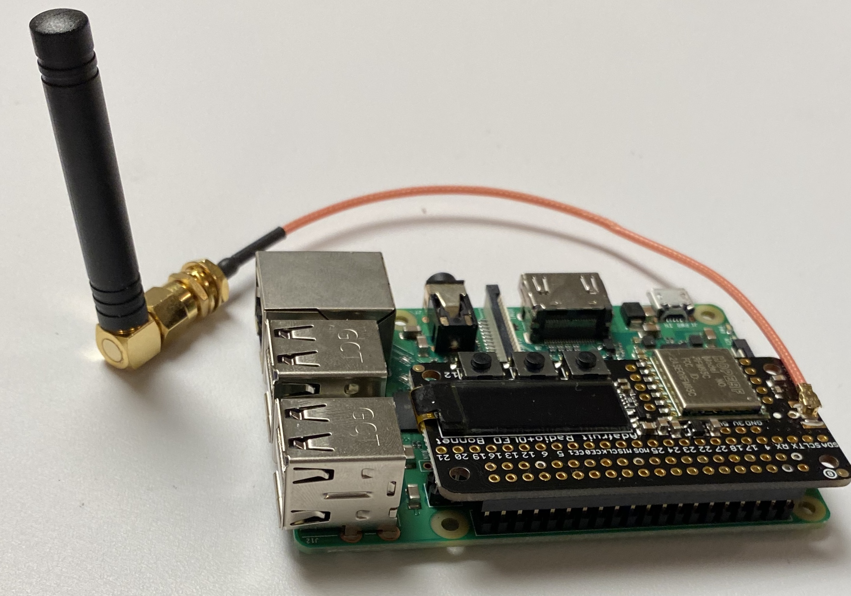

Phase 2:
IoT Device to Pi
Pi synthesizes data from the IoT device
Converts the data to a JSON file format
Encodes the data into bytes for Long-Range (LoRa) transmission
Figure 4. Raspberry Pi equipped with a LoRa antenna.
Figure 5. [7]

Slide 7
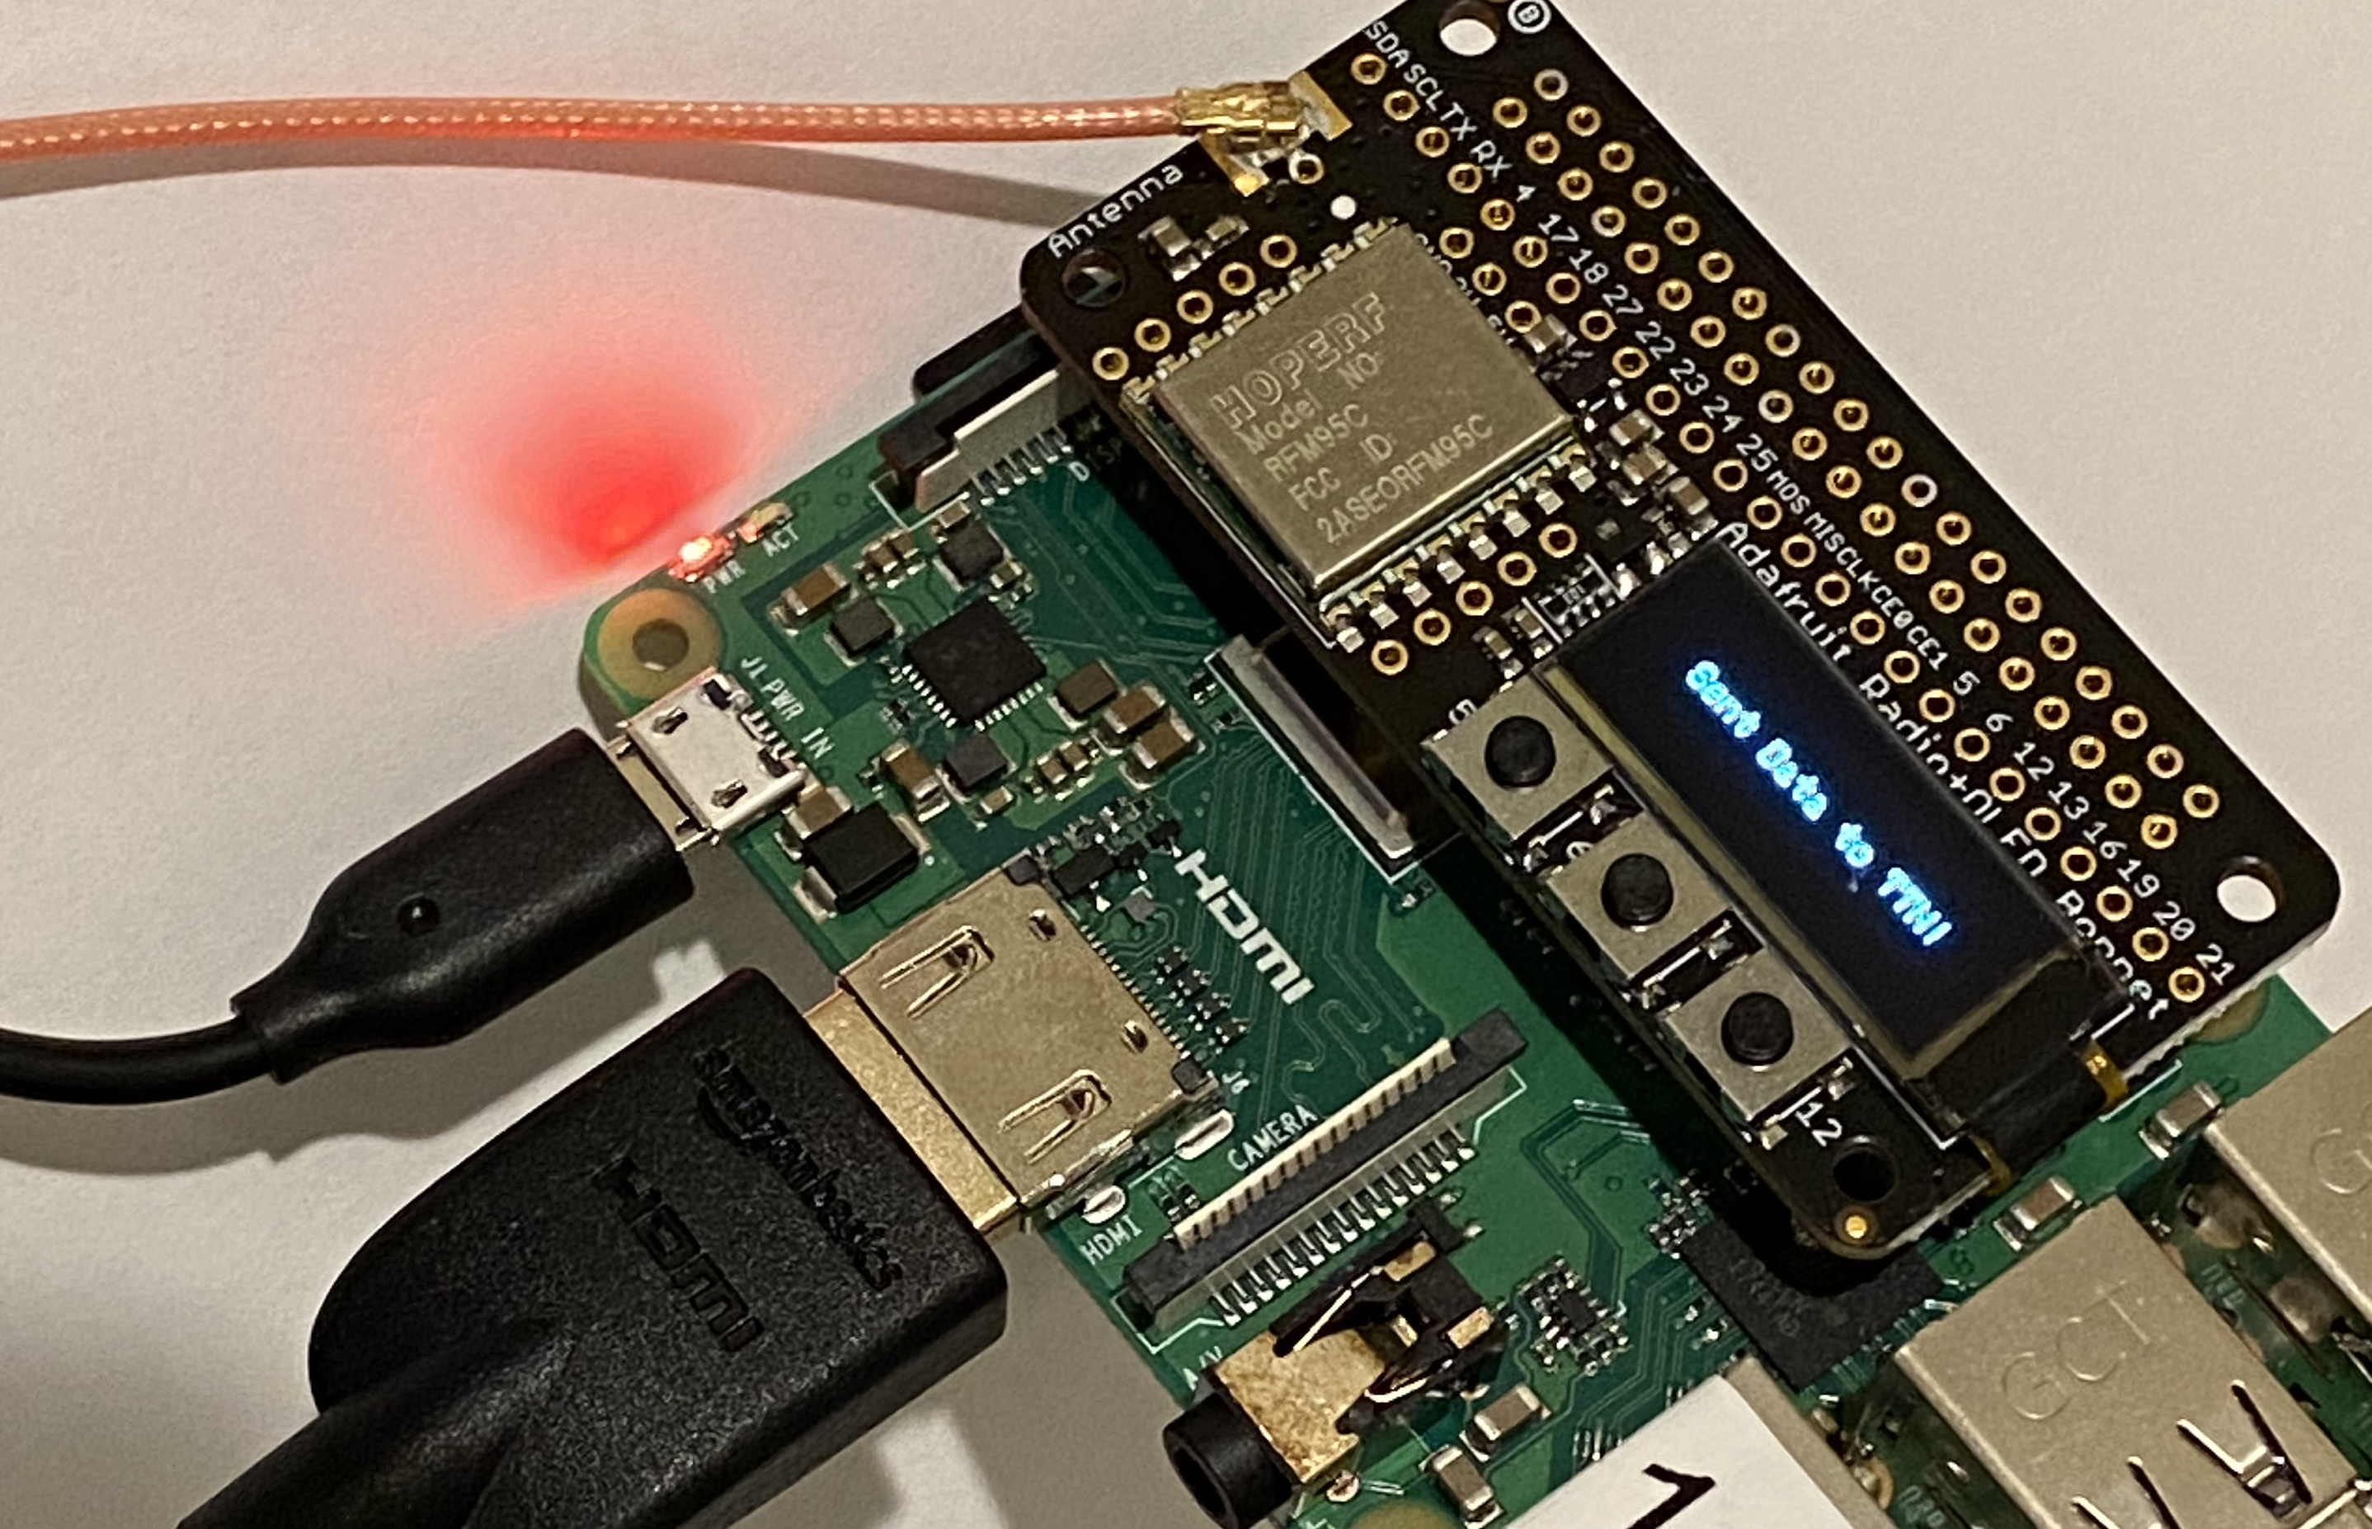
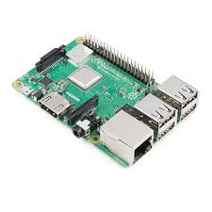


Phase 3:
Data Transmission
LoRa antenna transmits the data packet from the Raspberry Pi to the Senet Network
Senet Network relays the data packet from their system to our server
Figure 6. Raspberry Pi with enabled LoRa antenna
Figure 7. Data transmission from Pi to Senet Network [8]

Slide 8





Phase 4:
Data Retrieval and Storage
Figure 8. [8]
Server accepts the data from Senet
Server decodes the data for storage within an SQLite database
Server communicates through backend (the database) and the frontend (the website)
Figure 9. [3]
Figure 9. [10]
As JSON
Figure 9. [9]
IN IMAGE:
Senet > Server > Database
Then, the Ubuntu server acts as an intermediate between Phase 4 and Phase 5.
Website calls database through
JavaScript > Server > Database
This echoes the data for the graph Database > JSON > HTML > Data Display
Figure 10. [10][11][12]

Slide 9
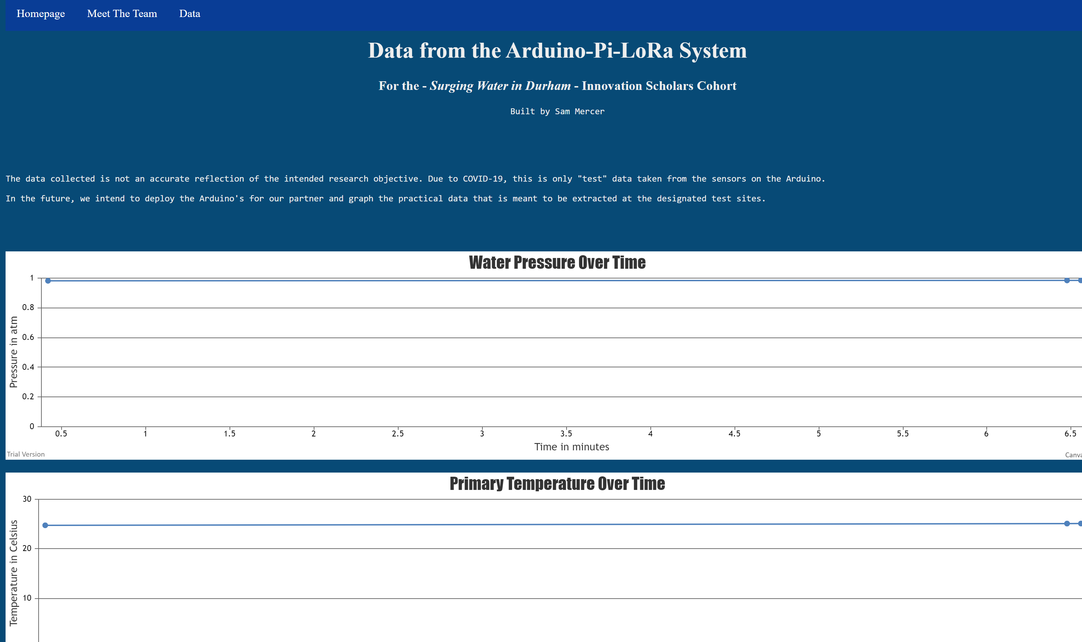
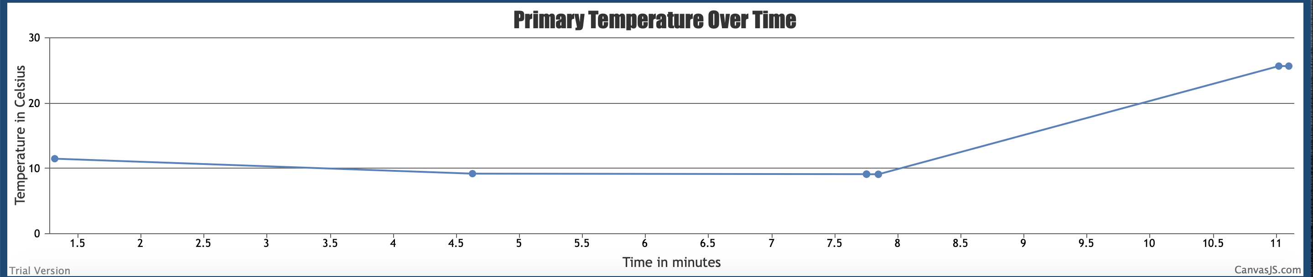
Phase 5:
Data Display
Database stores entire website architecture
Dynamic JavaScript design plots live graphs through JQuery and HTML data echoing
Graph updates on webpage when new data is transmitted
Figure 10. Temperature vs. Time graph. Generated on website.

Slide 10
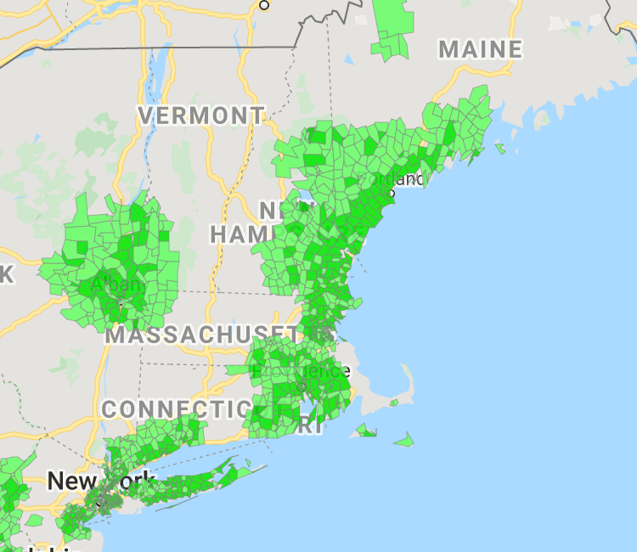
Advantages
Wide range of coverage
Instant sensor feedback
Low-cost
Modular
Organized data
Figure 11. Senet Network coverage [13]

Slide 11
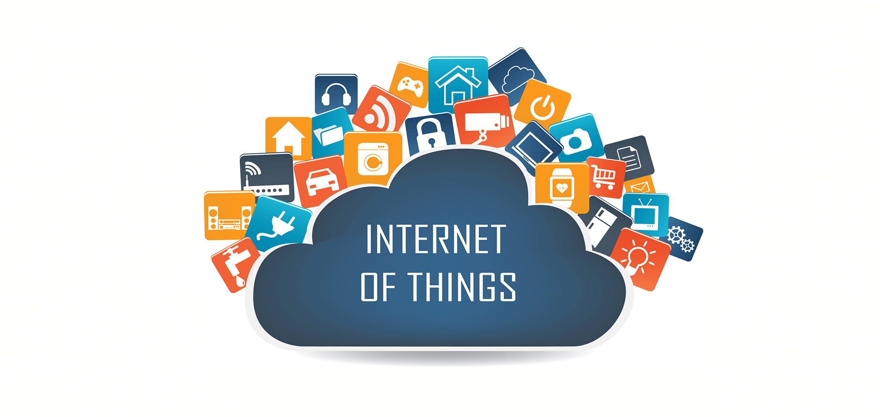
Future Plans
Develop an application for project-specific designs
Enhance usability for inexperienced programmers
Consider alternative LoRa services to enhance coverage
Improve website
End Goal: Make system available to UNH researchers
Figure 12. [14]

Slide 12
Acknowledgements
Thank you to UNH, the UNH-IOL, and the UNH Department of Ocean Engineering for supporting our research.
Further thanks to our advisors, Timothy Carlin and Jeff Lapak, and to Kyle Ouellette and Anthony Pilotte for guiding us through our research and development.
We appreciate the chance to collaborate with the Surging Water in Durham team: Katherine Metzger, Garrett Mallard, Anna Gombas, and Isabel Medeiros.

Slide 13
Image Citations
[1] Arduino Uno. (n.d.). Retrieved from https://www.teachmemicro.com/wp-content/uploads/2018/06/arduino_uno_r3_top.jpg. Reprinted with permission as per CC BY-NC.
[2] Raspberry Pi. (n.d.). Retrieved from https://upload.wikimedia.org/wikipedia/commons/thumb/2/2d/Raspberry-Pi-2-Bare-FL.jpg/220px-Raspberry-Pi-2-Bare-FL.jpg. Reprinted with permission as per CC BY-SA.
[3] Web Server Icon. (n.d.). Retrieved from http://pngimg.com/uploads/server/server_PNG29.png. Reprinted with permission as per CC BY-NC.
[4] Graph. (n.d.). Retrieved from https://i.stack.imgur.com/OGG9j.png. Reprinted with permission as per CC BY-SA.
[5] Website Icon. (n.d.). Retrieved from https://cdn.pixabay.com/photo/2016/11/30/17/10/web-1873373_960_720.png. Reprinted with permission as per CC BY-SA.
[6] Muzzin, J. (2017). Database Icon. Retrieved from https://satwa-jaydenmuzzin.github.io/img/database.png. Reprinted with permission as per CC BY-SA-NC.
[7] Raspberry Pi Logo. (2012). Retrieved from https://www.raspberrypi.org/app/uploads/2012/03/Raspi_Colour_R.png. Reprinted with permissions as per CC BY-NC.
[8] Senet Network Logo. (2015). Retrieved from http://c93fea60bb98e121740fc38ff31162a8.s3.amazonaws.com/wp-content/uploads/2015/06/senet.png. Reprinted with permission as per CC BY-SA.
[9] SQLite Logo. (n.d.). Retrieved from https://upload.wikimedia.org/wikipedia/commons/thumb/3/38/SQLite370.svg/1200px-SQLite370.svg.png. Reprinted with permission as per CC BY-SA.
[10] Django Logo. (n.d.). Retrieved from https://markusholtermann.eu/images/thumb/django-logo-1280x375.jpg. Reprinted with permission as per CC BY-NC-ND.
[11] JQuery Logo. (n.d.). Retrieved from https://upload.Wikimedia.org/Wikipedia/en/thumb/9/9e/JQuery_1ogo.svg/524px-JQuery_logo.svg.png. Reprinted with permission as per CC BY-NC-ND.
[12] JavaScript Logo. (n.d.) Retrieved from https://www.javascript.com. Reprinted with permission as per CC BY-NC-ND.
[13] Senet Network Coverage. (n.d.). Retrieved from https://www.senetco.com/us-coverage/
[14] Iot Image. (n.d.). Retrieved from https://cdn2.hubspot.net/hubfs/80068/iotplanning (2).png

