Slide 1
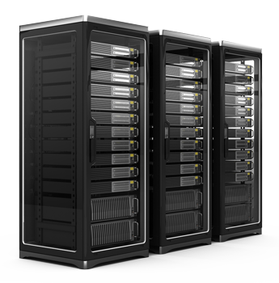
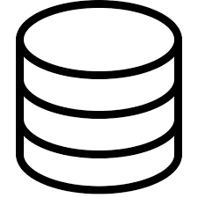
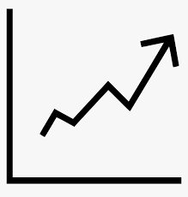
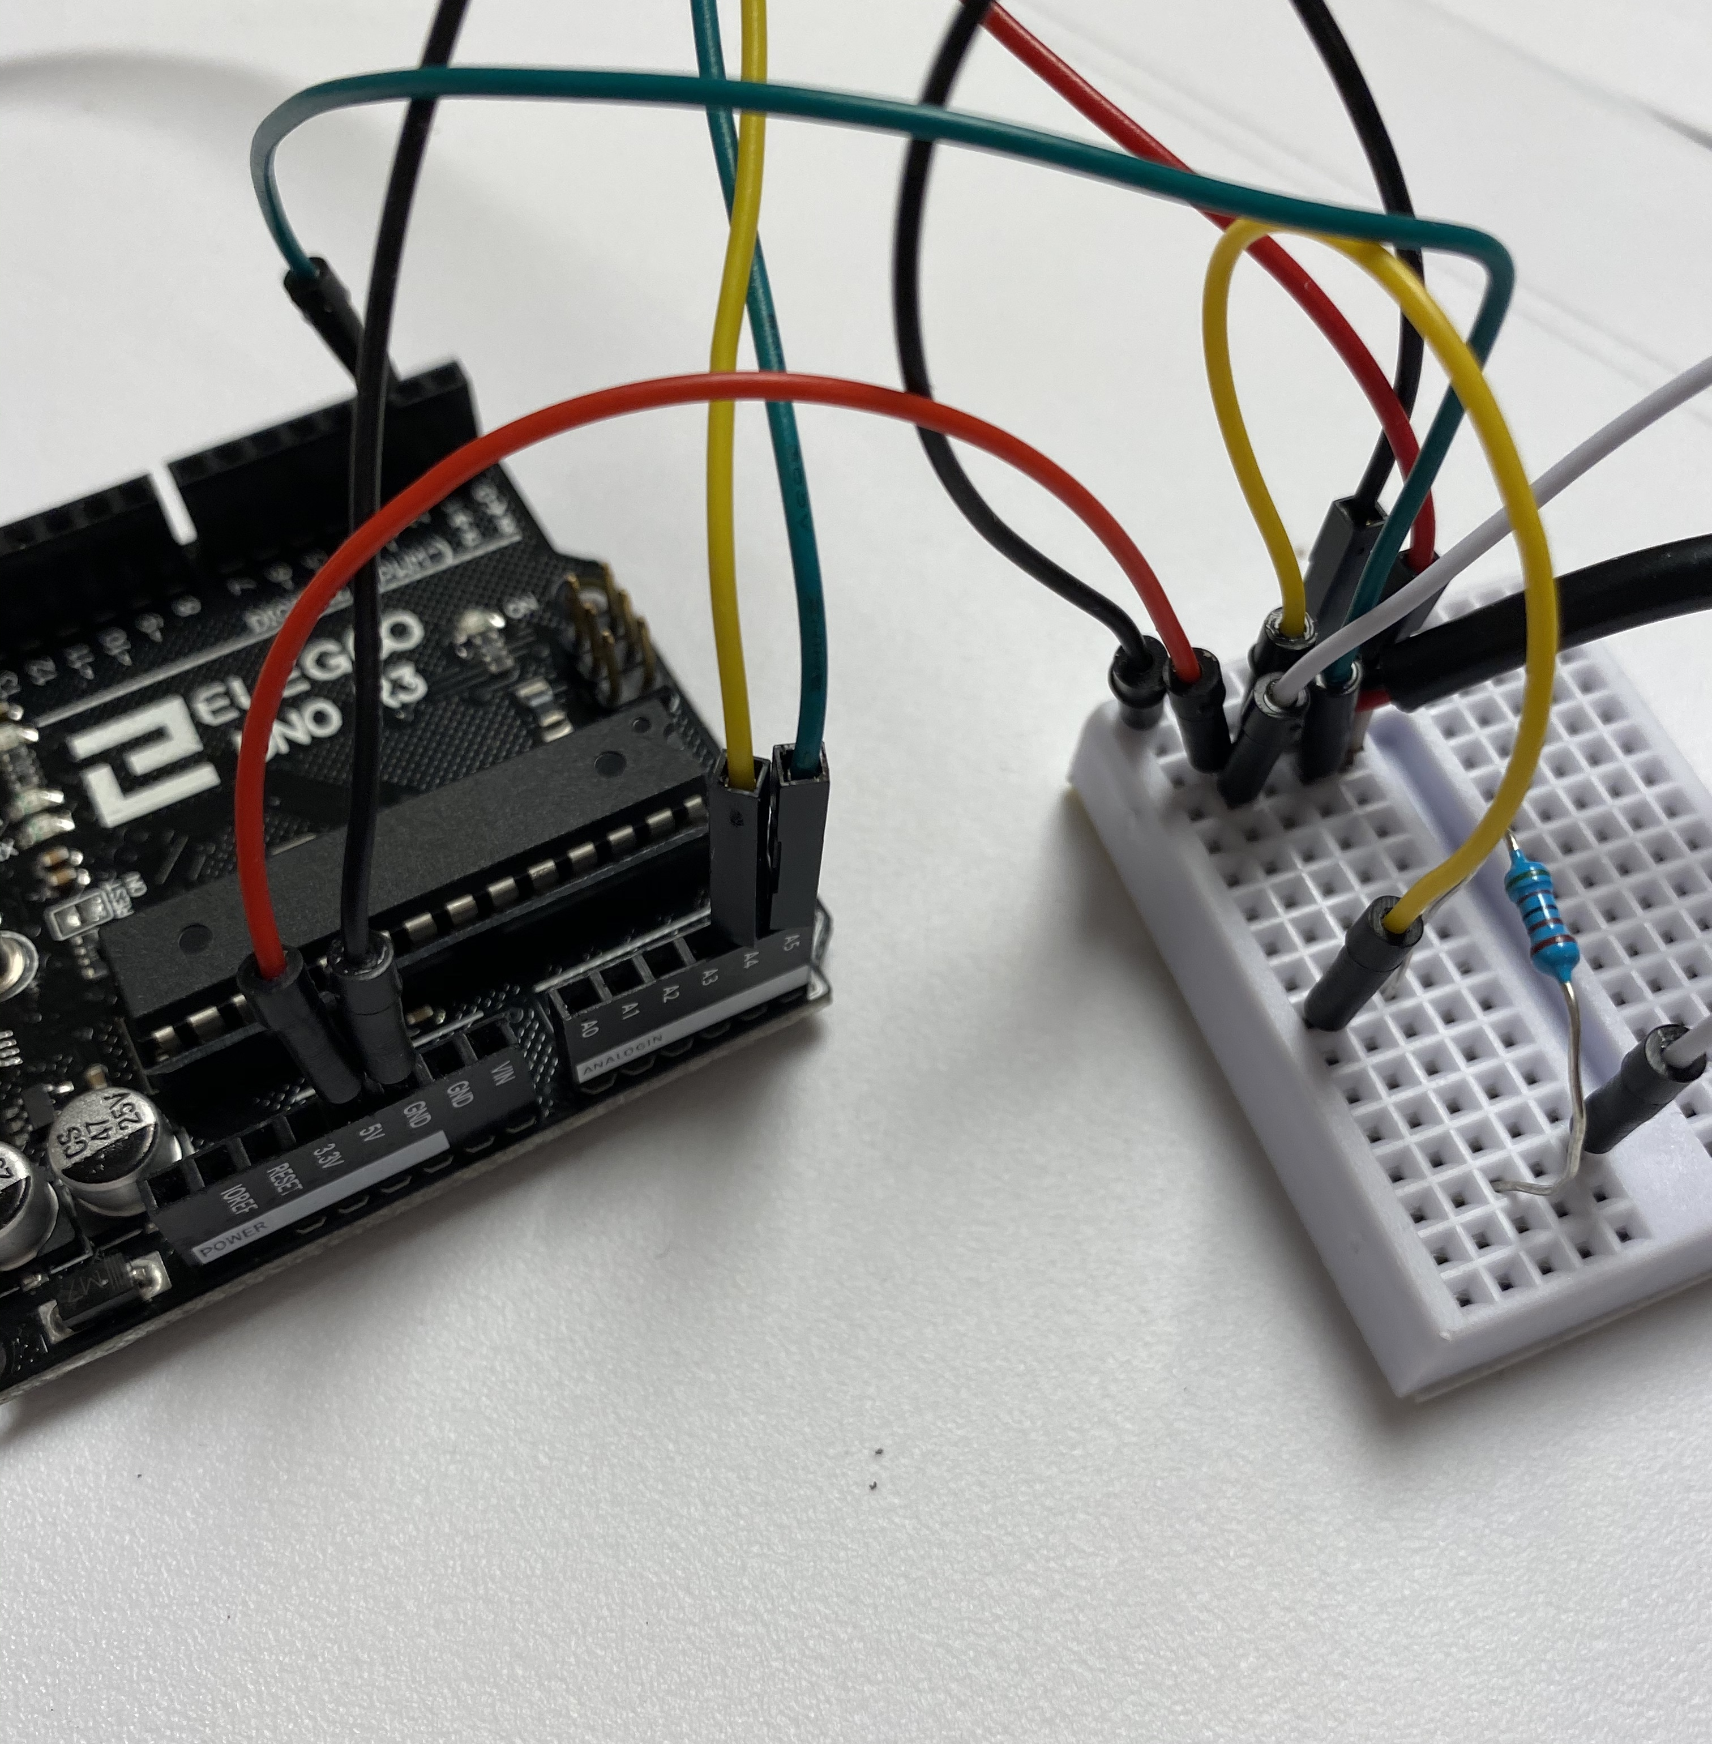
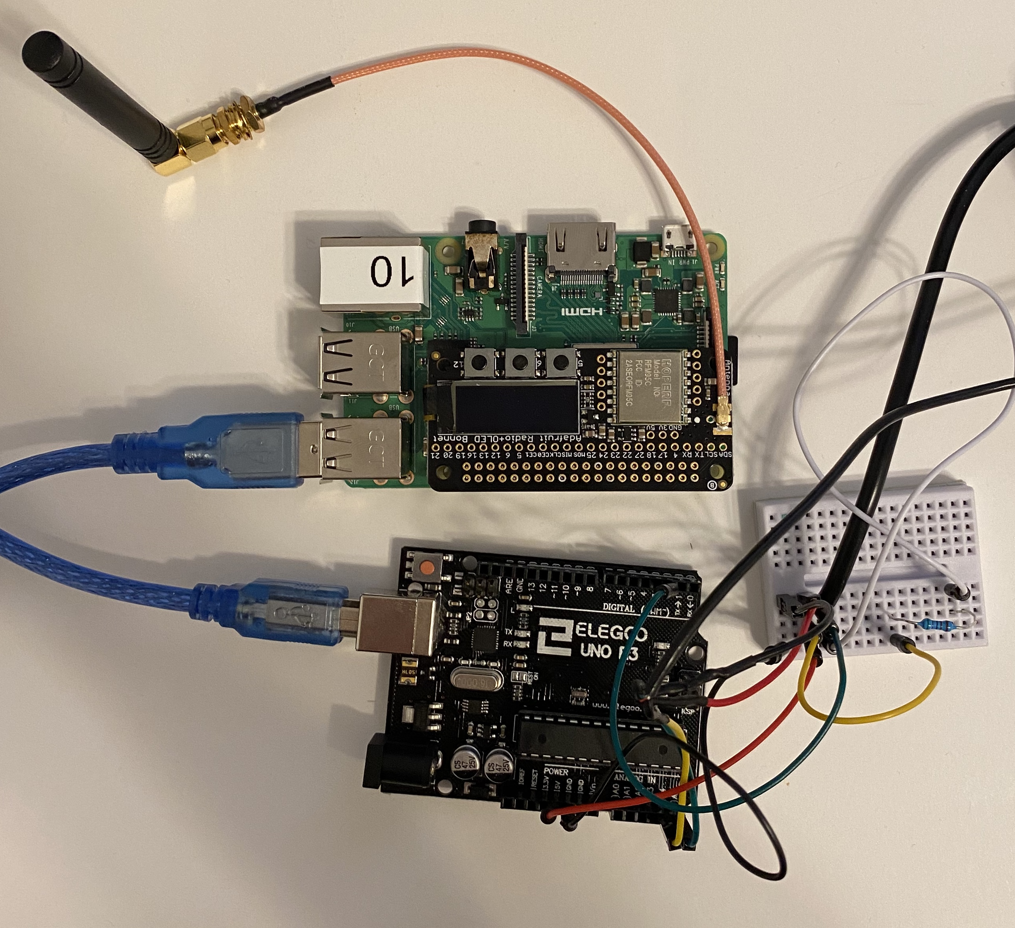
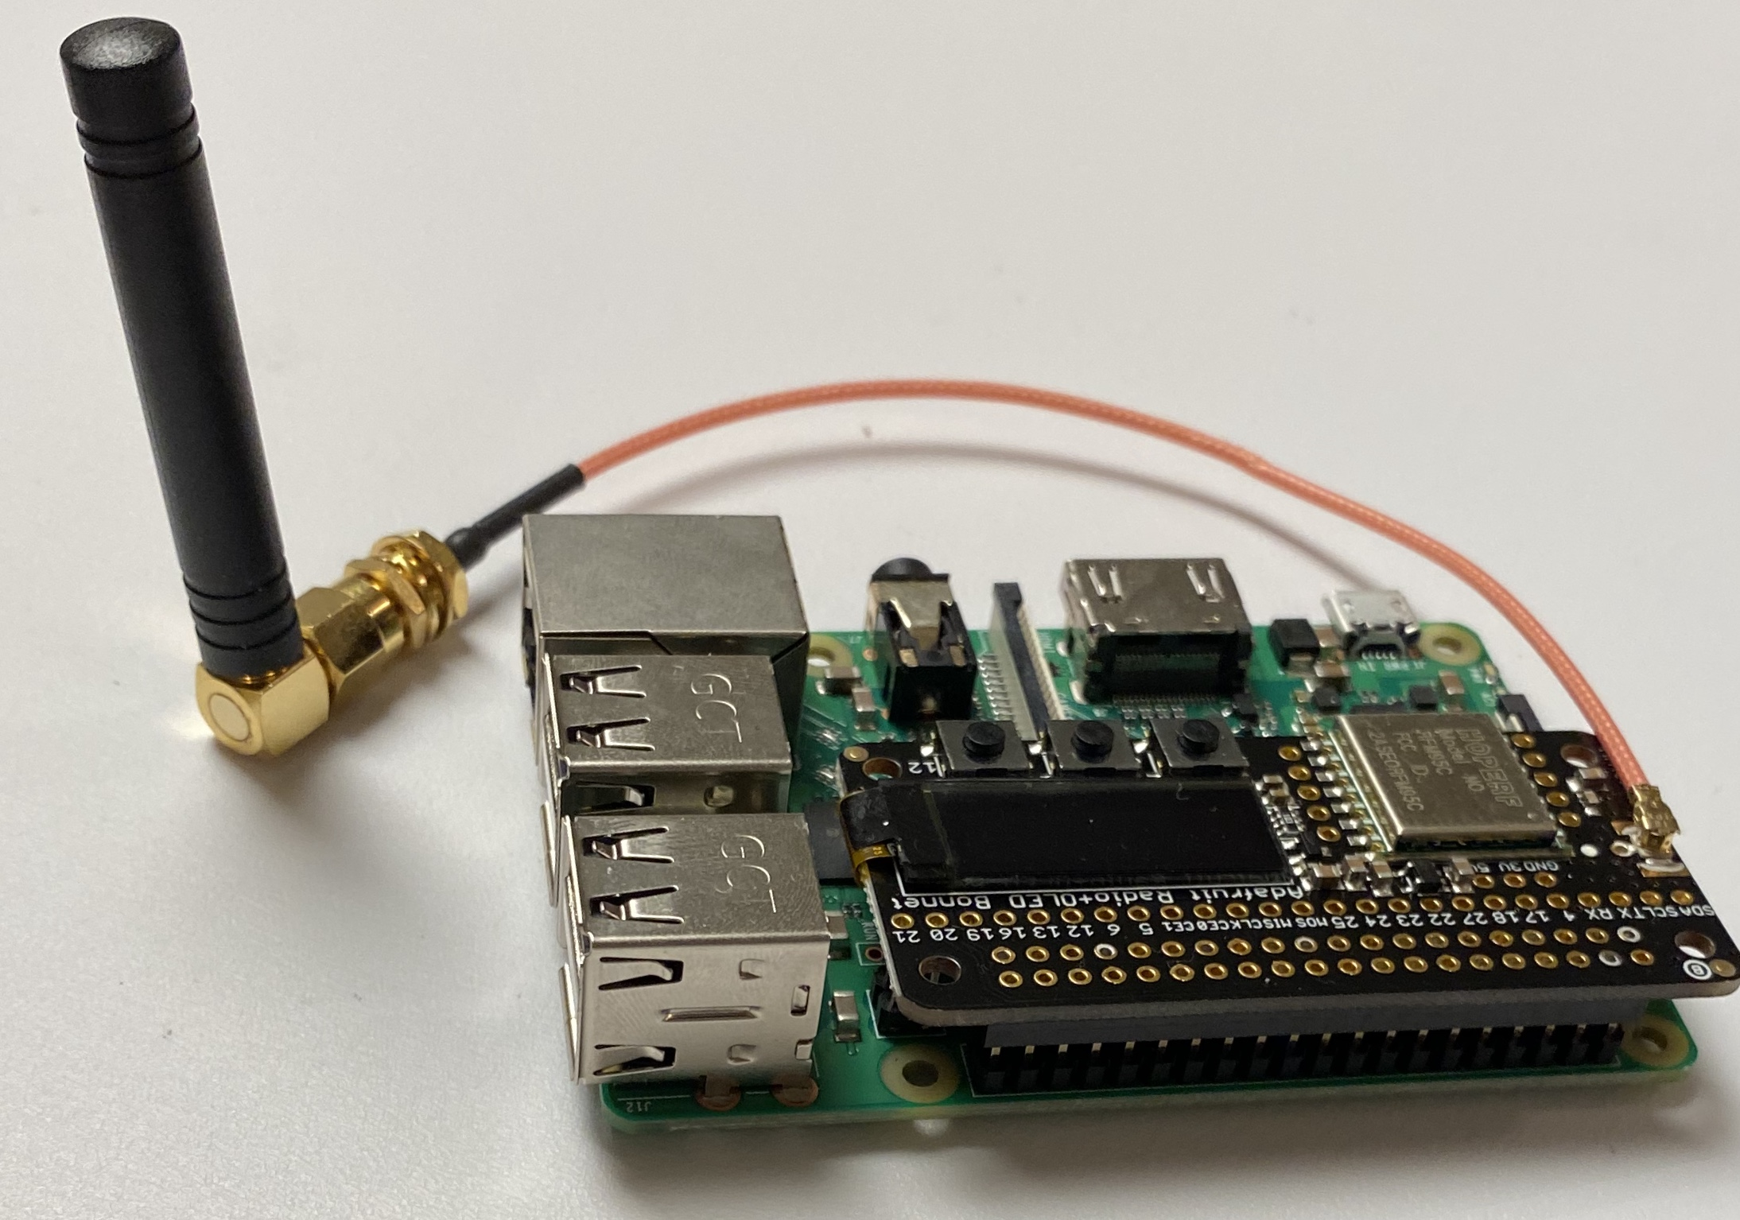
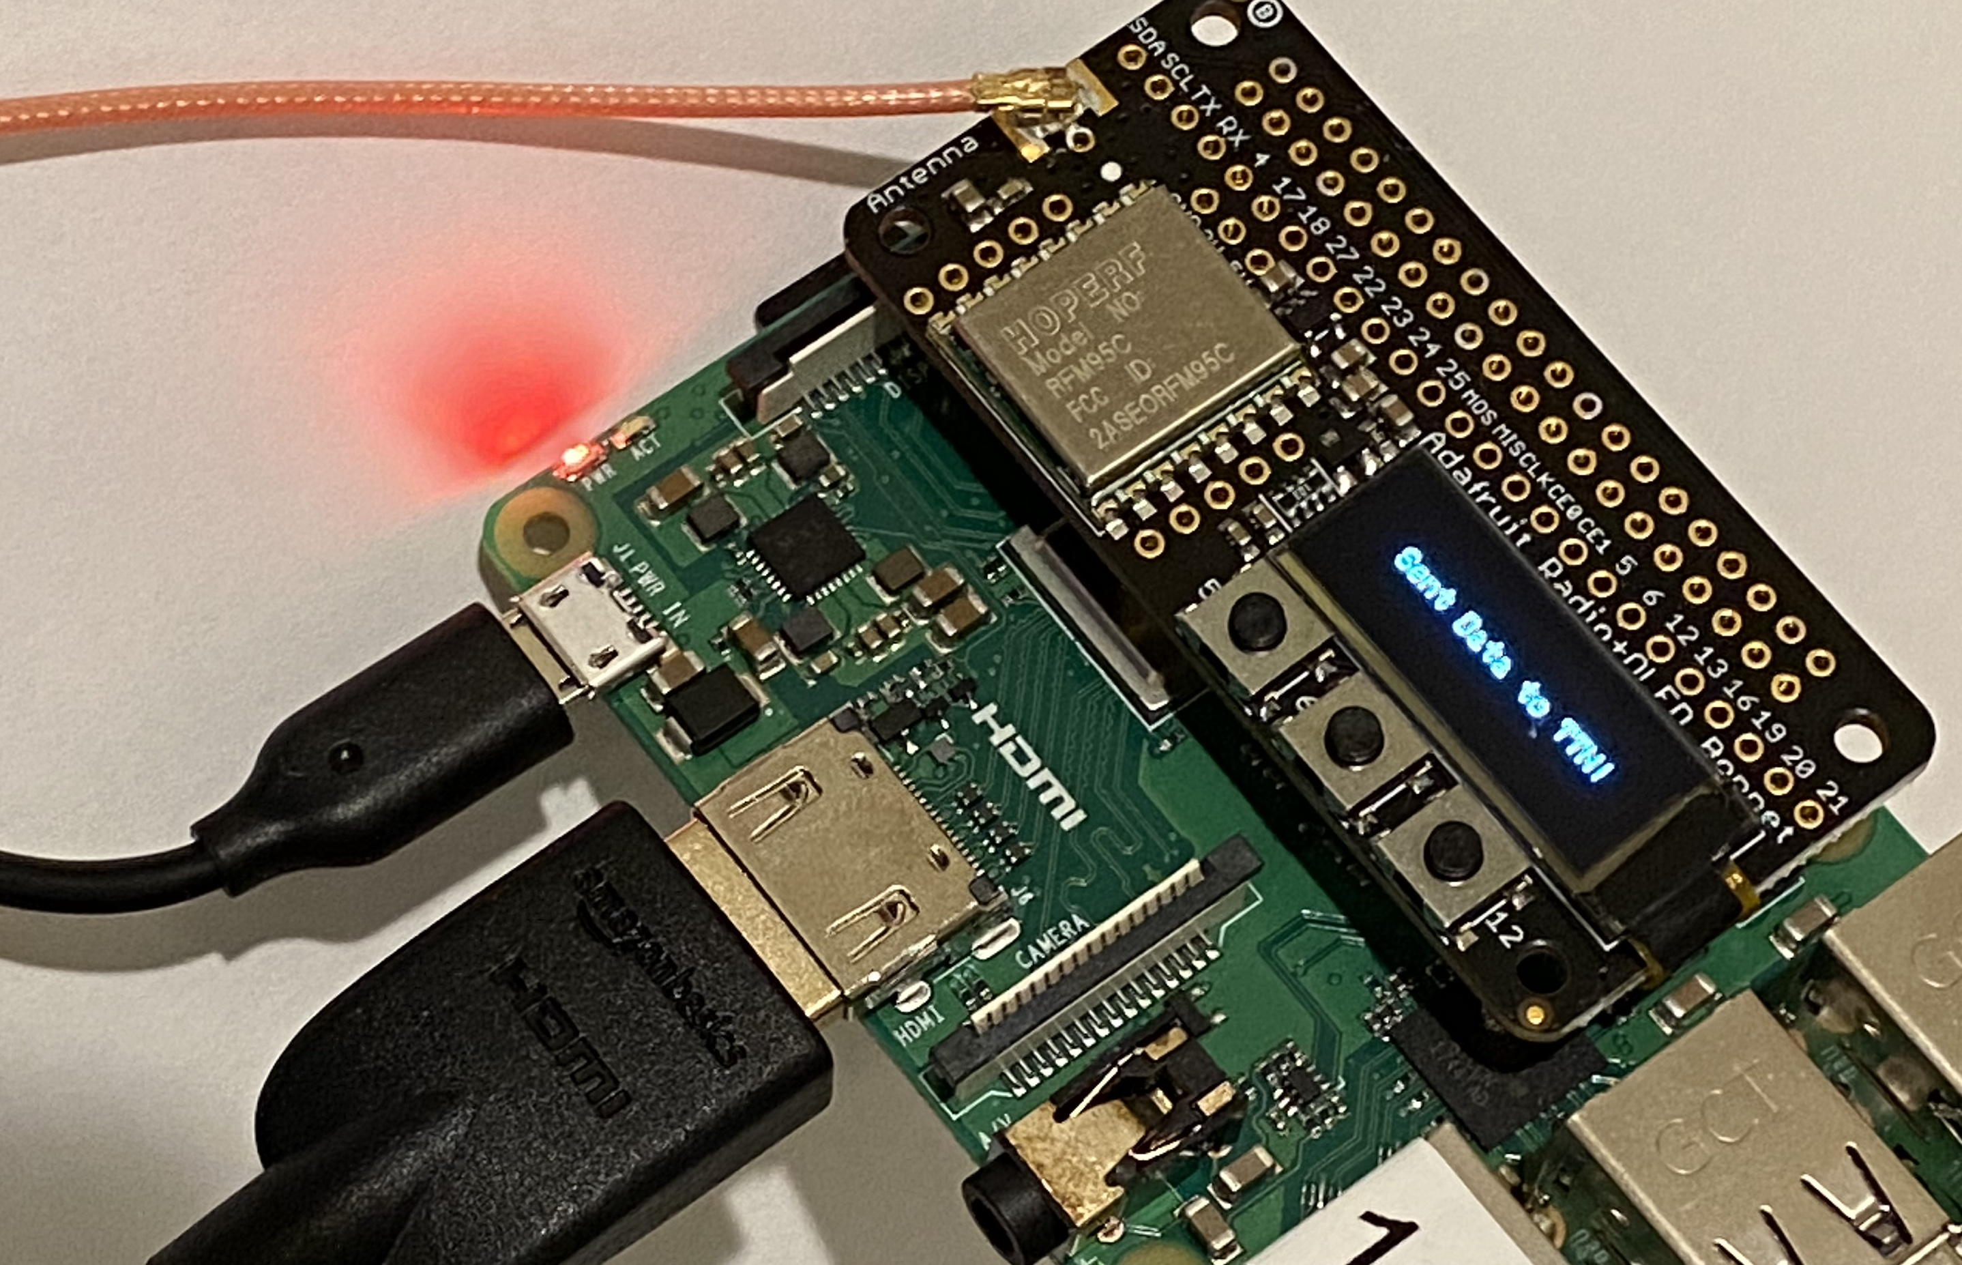
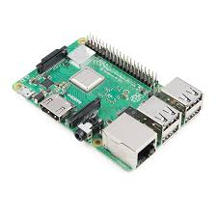
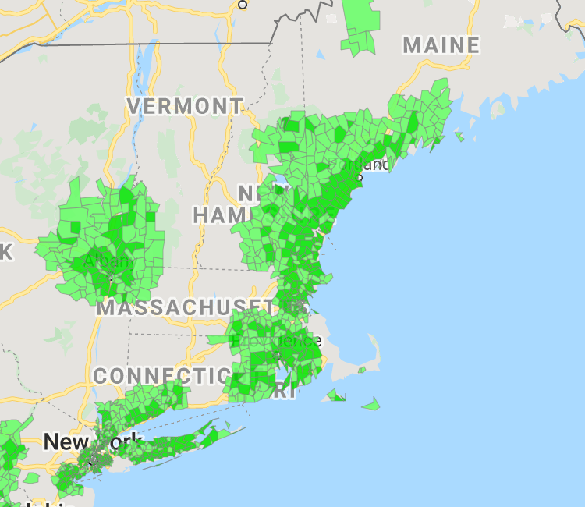
Wireless Data Processing System for IoT-Enabled Devices
Samuel Mercer, Tinh Phuong, Eli Duggan, Orianne Sinclair
Advisors: Timothy Carlin, Jeffrey Lapak
University of New Hampshire Innovation Scholars 2020
Introduction
Approach
Researchers often spend their time and resources to retrieve data manually. Doing so may disturb delicate sensors and risk data loss or corruption.
Our project addresses these issues with an inexpensive, flexible wireless transmission system that transmits data from anywhere within 40 miles of a Senet tower and stores it in a database for end-use applications.
Our project’s aim is to create an adaptable system to wirelessly transmit data from an IoT-enabled sensor to UNH
The system is composed of an IoT sensor, Raspberry Pi, server, database, and end application (website, graphs, etc.)
Core components of the system (Pi, server, database) need minimal modification from project to project
IoT sensor and frontend of server can vary depending on the user’s needs
Transmission to Server (at UNH)
Devices at Location A
Backend of the Server
Frontend of the Server
Implementation
Figure 3. Generalized approach involving how each part of the processing system stockpiles data.
Partnered with ‘Surging Waters in Durham’ team
Implemented system to display project-specific data from Arduino sensors
Design
Figure 1. ‘Surging Water’ Arduino sensor
Advantages
Figure 4. IoT-device paired with Raspberry Pi.
Figure 5. LoRa-equipped Raspberry Pi
Figure 6. Activated LoRa connection.
Wide range of coverage
Instant sensor feedback
Cheap and customizable
Modular
Organized data
Phase 1: IoT Device
Device collects data and sends it to Pi for character conversion and splicing for Python-based files.
Phase 2: File Conversion
Data is written to a JSON file. Most recent line on the JSON file is read and encoded in bytes on Pi.
Phase 3: Transmission
Pi sends data package to the server from its location over the Senet Network using LoRa.
Figure 2: Senet Network coverage
Next Steps
Enhance usability for inexperienced programmers
Create an application for project-specific designs
Expand networking range
Offer use of system to UNH researchers
Acknowledgments
Thank you to UNH, the UNH-IOL, and the Department of Ocean Engineering for their commitment to our research.
Further thanks to Kyle Ouellette and Anthony Pilotte for guiding us through our research.
Figure 8. JavaScript-based graphs generated using sample data from two test runs.
Figure 7. The server design that allows communication between the frontend and the backend.
Phase 5: Website Display
Using jQuery, our website retrieves JSON data from the database while concurrently generating graphs on the server with HTML and JavaScript.
Phase 4: Server Framework and Database
Server collects the data package, decodes it, and appends it to an SQL database. From here, the website calls the backend of the server to echo the data between the two phases.

