Slide 1
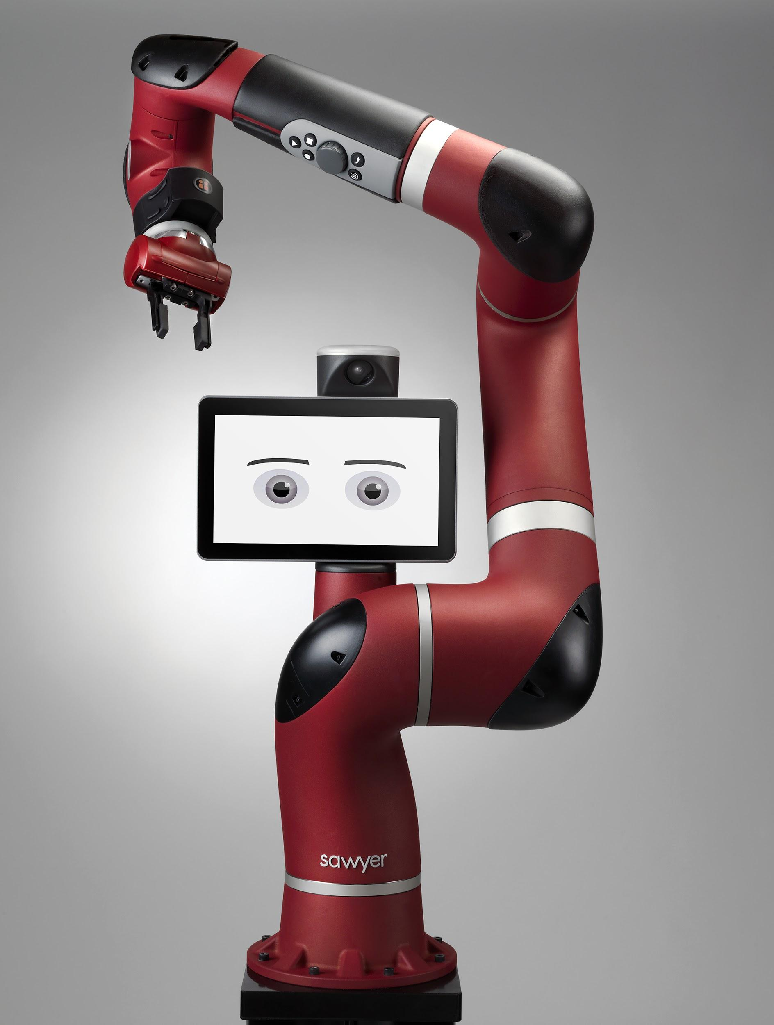
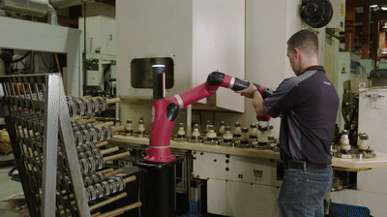
Collaborative Robotics
Hunter Clark, Emilie Leavitt, Thomas Oliver, Kathleen Terwilliger
Innovation Scholars
Spring 2020

Slide 2
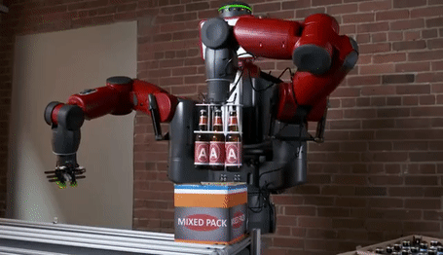
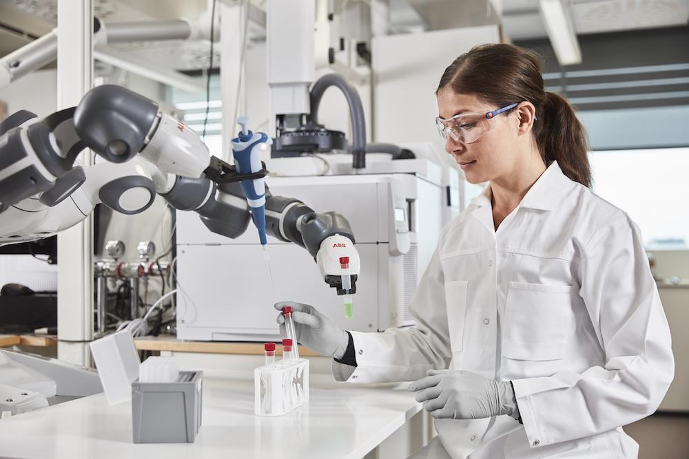
What are Cobots?
Some Characteristics:
No “rigid programming”
Wide range of motion
Multitude of sensors
Cobot Packaging Bottles
Collaborate with humans on shared tasks
Can respond to changes in environment
Cobot Helping Perform a Medical Test

Slide 3
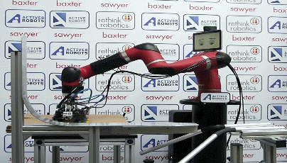
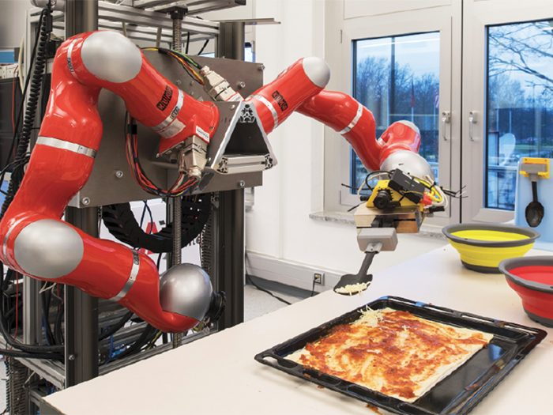
Uses and Benefits of Cobots
Safer and more adaptable
More practical for everyday life
Sawyer Making Boxes
Uses:
Restaurants
Hospitals
Delivery services
Helping the elderly
Cobot Making Pizza

Slide 4
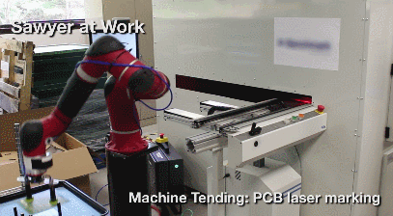
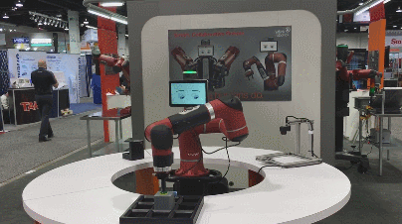
Sawyer
Show Sawyer what to do
Pick and Place
Flexible
Collaborates with humans
Lifetime of 30,000 hours
Weighs 42 lbs
2 cameras
7 degrees of freedom
Sawyer at Work

Slide 5
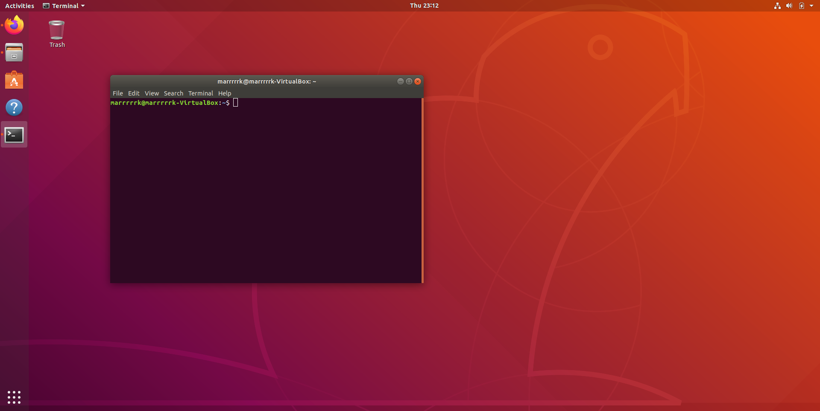


Transition to Remote & Virtual Machines
Remote Research
  Slack
  Zoom
  Virtual operation of Sawyer
Machine Within A Machine
  VirtualBox
  Ubuntu
  Compatibility
Ubuntu Virtual Desktop

Slide 6
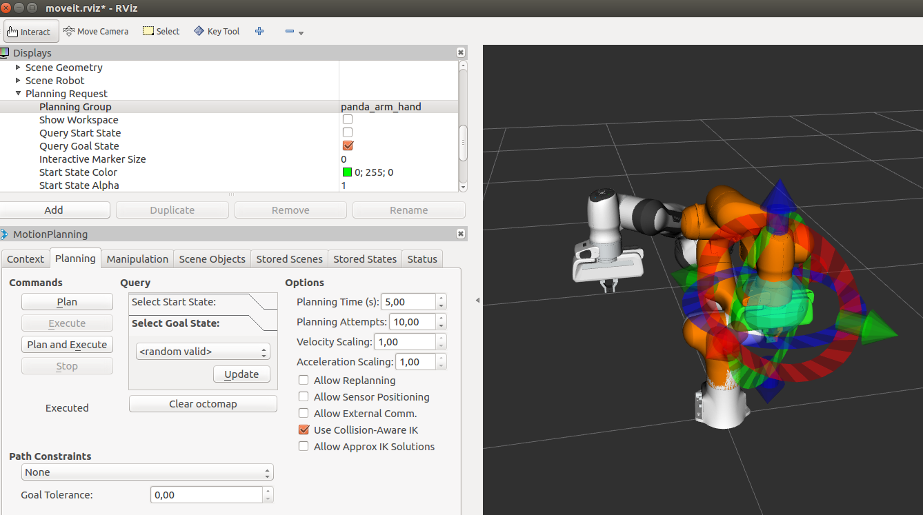
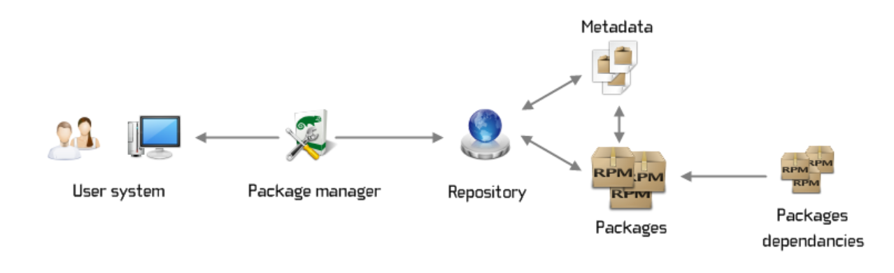
What is ROS?
Robot Operating System
“Middleware”
Flexible low level framework
No language limitations
ROS Visualization Tools and Sawyer
Topics
Services
Actions
Build systems & catkin
Package Management Systems

Slide 7
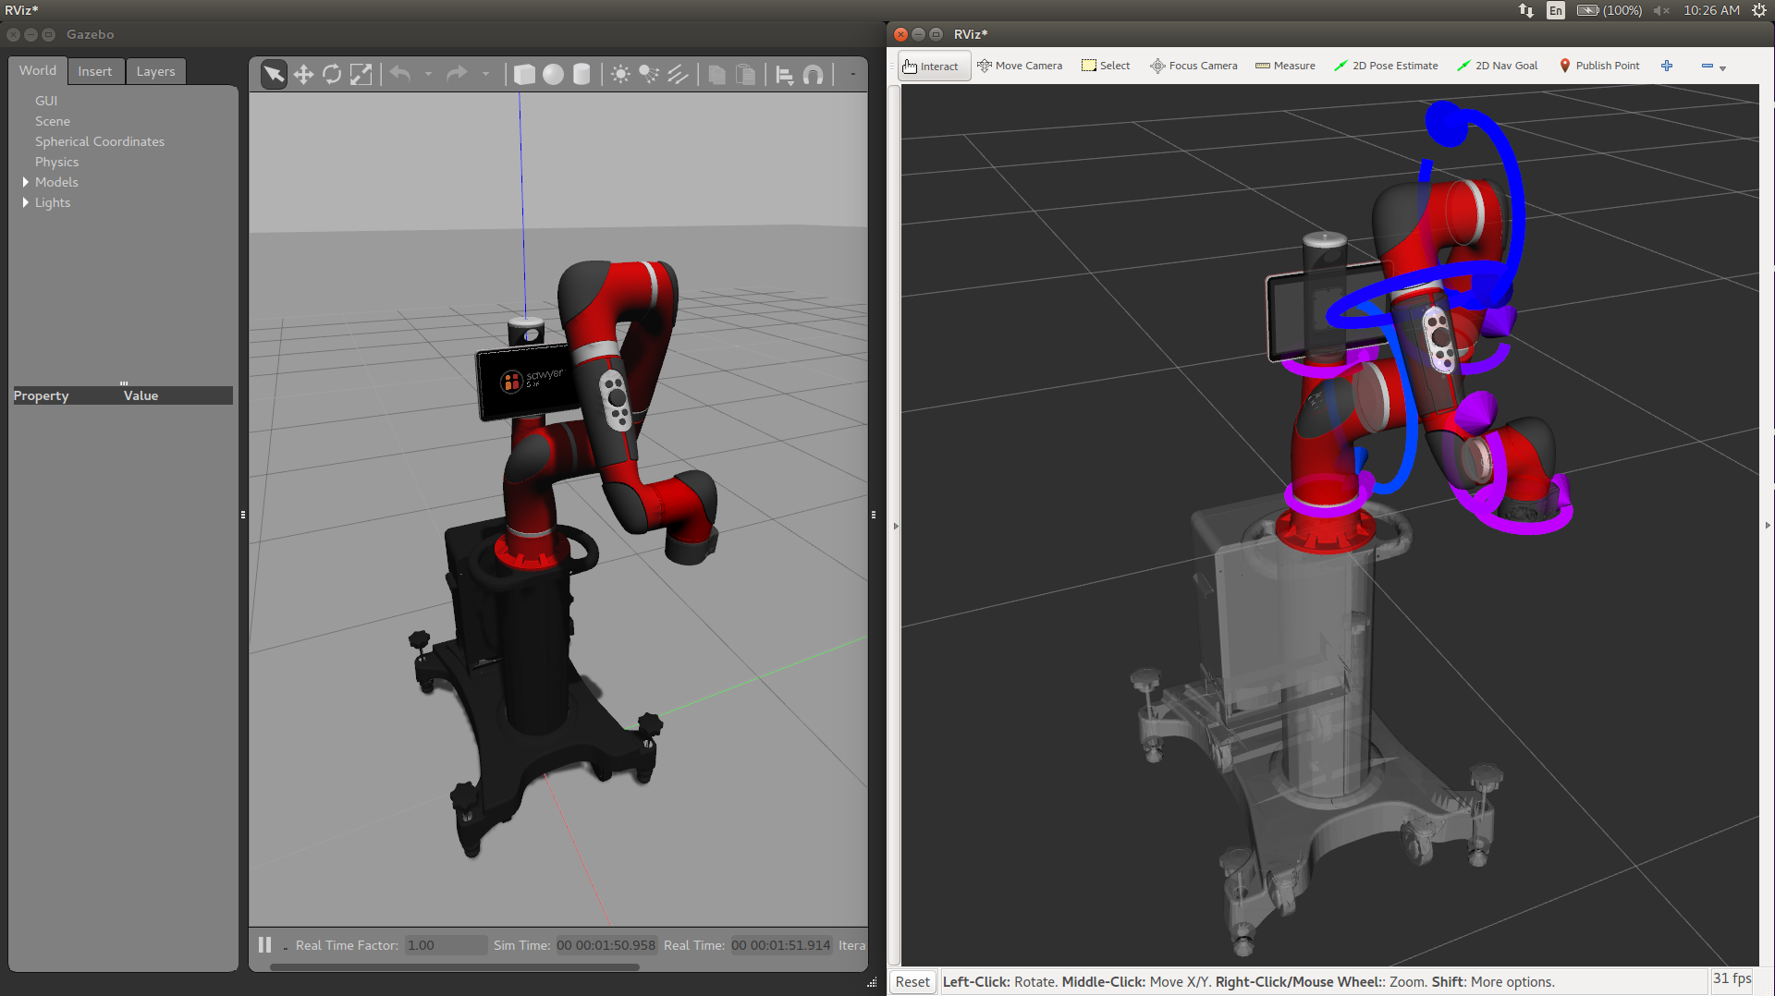
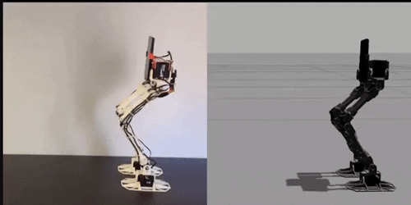
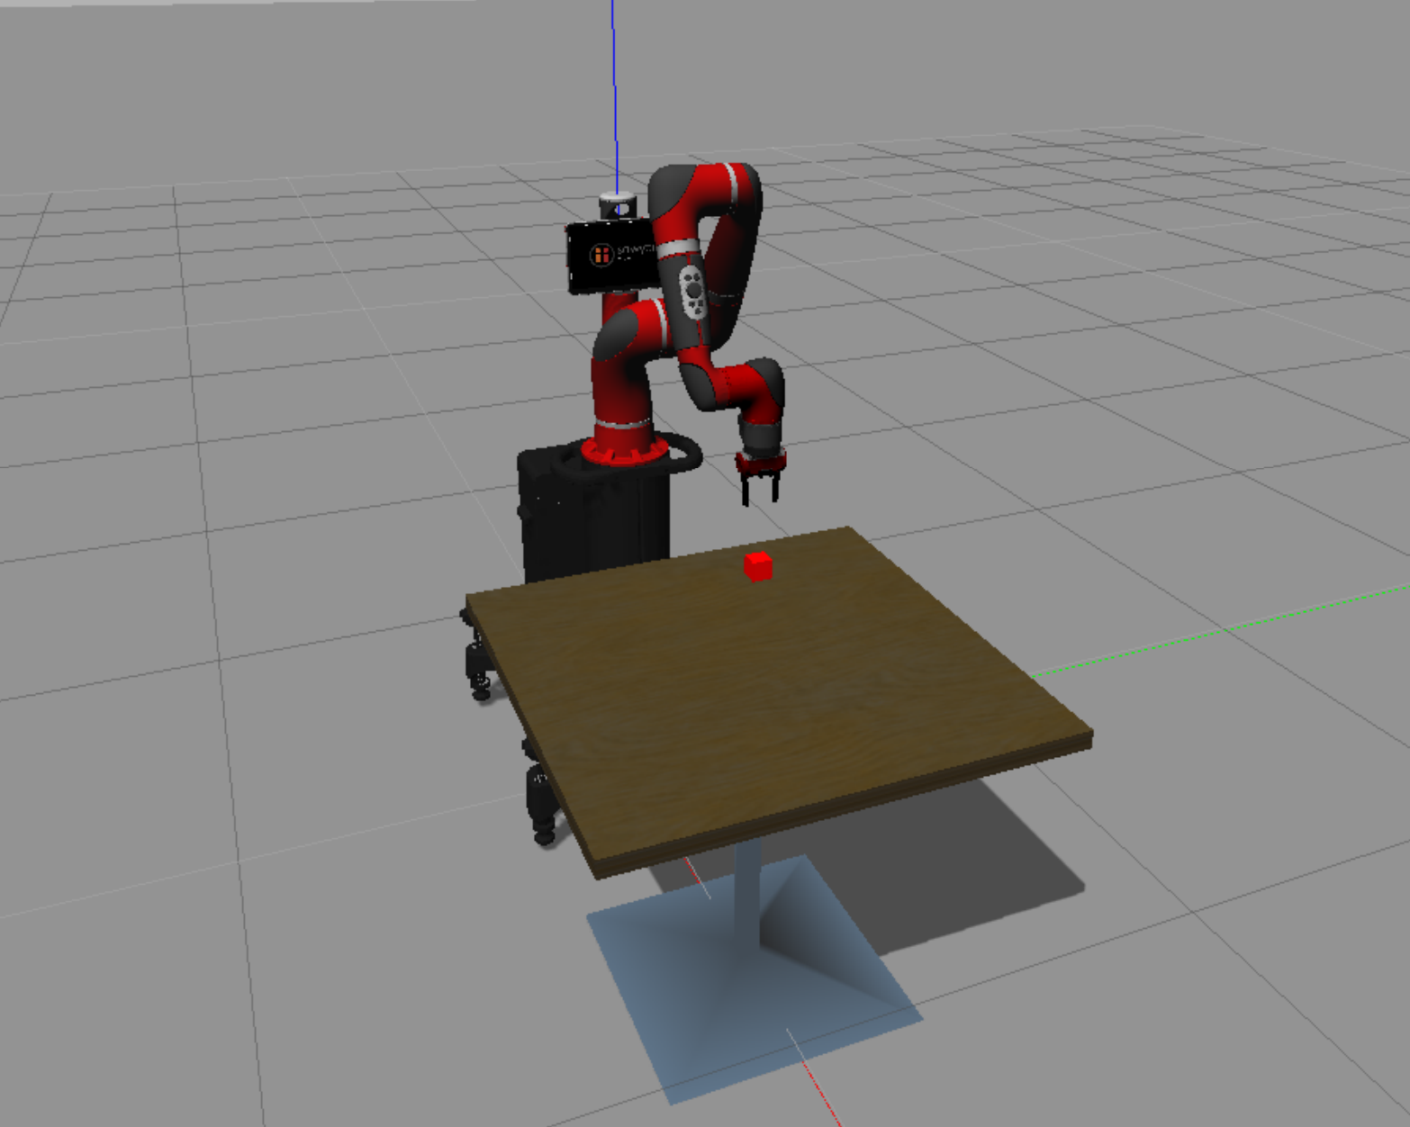
Gazebo
3D Simulation Tool
Works together with ROS
Additional attachments
Faster than running programs on real robots
Gazebo Visualization
Gazebo in Action
Pick and Place Simulation

Slide 8
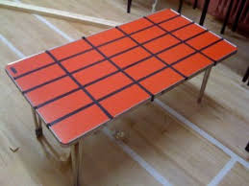
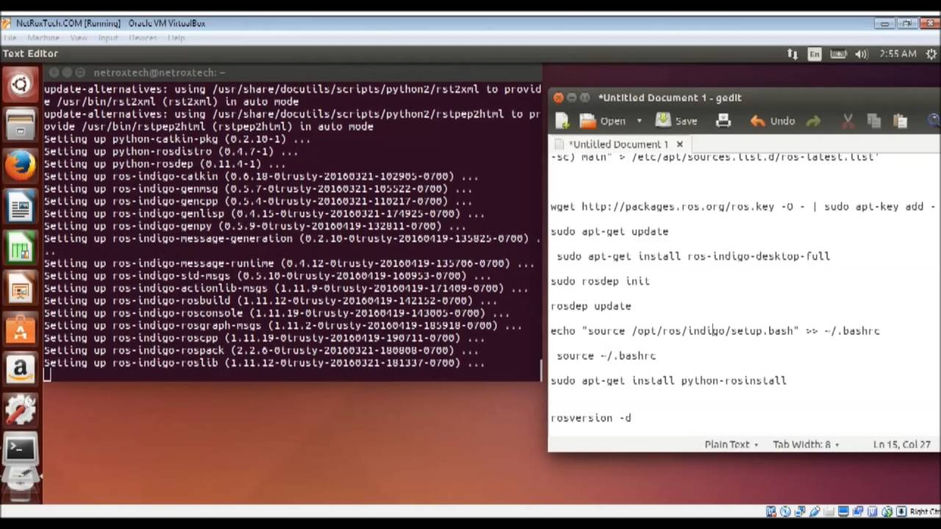

Our Progress
Understanding of the control of the Sawyer robot
Basics of ROS coding
Settled on working through Gazebo that allowed us to virtually simulate Sawyer using ROS
Making an array on a table on which the robot could locate blocks

Slide 9
Conclusions
Retrospective
Configuration of Virtual Machines within a computer
Have predefined achievable goals in mind
Try different methods of how to learn the coding more effectively
Have a more robust computer setup if simulations are to be run
Ubuntu, Linux, and ROS programming
Design of an object matching game
Use of Gazebo allowed for simulation of Sawyer movements without physical access
Future Considerations:
Implementing AI and image processing
Focusing on the collaborative aspects of Cobots

