Slide 1
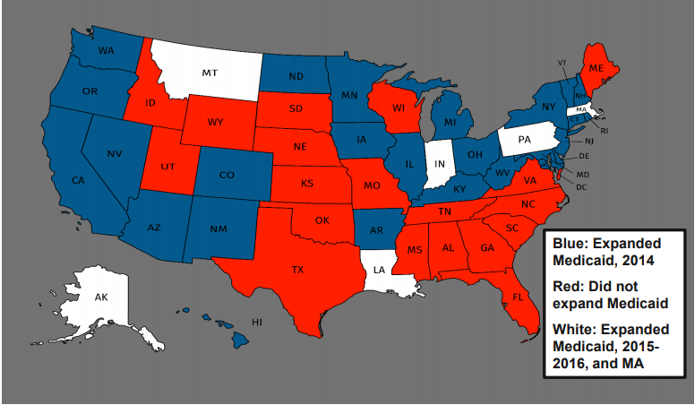
Effect of Medicaid Expansion on Employment among People with Disabilities
Xueting Sun
Mentor: Dr. Andrew Houtenville
Background
DATA
Predicted Results
Pre-Medicaid Expansion
Many people with disabilities are locked into poverty due to strict limits on income and assets to maintain eligibility for Medicaid coverage (Hall et al., 2018)
Beneficiaries that increasing income run the risk of losing of much-needed insurance coverage
Medicaid programs, which may stop people with disabilities from seeking employment (Hall et al., 2018)
Post-Medicaid Expansion
The Medicaid expansion increases the amount of income beneficiaries can earn (Hall et al., 2018)
Medicaid expansion allows individuals to qualify for Medicaid without first going through a lengthy disability determination process and declaring their inability to work to receive Supplemental Security Income (Hall et al., 2018)
Current Population Survey (CPS)
Monthly data between 2008 and 2019
Employment, demographic, and expansion states data
I expect to find a positive effect of Medicaid expansion on employment among people with disabilities, suggesting Medicaid expansion encourages disabled people to seek employment and improve earnings.
I also anticipate the reasons for the mixed results from previous literature might be due to different methods and different datasets.
In addition, reasons such as employment impacts of Medicaid coverage may take longer to materialize and there is uncertainty about ACA’s possible repeal may be the possible explanations for Medicaid expansion have no effect on the employment.
Prior Studies
Method
Conclusion
Objective
investigate the effect of the Medicaid expansion authorized by the Patient Protection and Affordable Care Act (i.e., Obamacare or ACA) on employment among people with disabilities.
Methods
compare differential changes in the employment rate of adults with disabilities in the states that expanded Medicaid to states that did not expand Medicaid
will be replicating prior studies using yet another data source (CPS) that has some advantages over the data sources used in the prior studies
A few studies investigate the effect of Medicaid expansion on the employment of people with disabilities, but the results are mixed
Some studies show Medicaid expansion encourages people with disabilities to seek employment
Hall et al. (2017) found that respondents in expansion states were significantly more likely to be employed than those in non-expansion states; however, this post-expansion difference was not statistically different from the pre-expansion difference find significant
Hall et al. (2018) found the difference in 2017 (several years post-expansion implementation to be statistically greater than the pre-expansion difference
Some studies do not find evidence
Sevak and Hyde (2019) suggests that Medicaid expansion has no effect on employment
This paper investigate the effect of the Medicaid expansion authorized by the Patient Protection and Affordable Care Act (i.e., Obamacare or ACA) on employment among people with disabilities.
It is expected that Medicaid expansion will positively affect the employment of people with disabilities. However, the findings of existing studies are mixed, with Hall et al. (2018) find a positive effect, while Sevak and Hyde (2019), using a different and more credible data source, find no effect.
I will be replicating these studies using yet another data source that has some advantages over the data sources used in the prior studies.
This project is a work in progress and much more work needs to be done in the future.
Contributions
References
My research fills the gaps in the literature by answering following questions:
Why does previous research show mixed results for the effect of the Medicaid expansion on employment among people with disabilities?
Are there differences in the timing of the effects, since Medicaid expansion was not implemented at the same time by expansion states?
We use monthly data from the Current Population Survey (CPS)
which is conducted by the Census Bureau on behalf of the Bureau of Labor Statistics
All prior studies have used annual data
I can look more closely at implementation dates
The CPS contains information on hours worked, which may be more sensitive to Medicaid changes then the act of being employed—existing workers may have adjusted their hours
Hall, J. P., Shartzer, A., Kurth, N. K., & Thomas, K. C. (2017). Effect of Medicaid expansion on workforce participation for people with disabilities. American Journal of Public Health, 107(2), 262-264.
Hall, J. P., Shartzer, A., Kurth, N. K., & Thomas, K. C. (2018). Medicaid expansion as an employment incentive program for people with disabilities. American Journal of Public Health, 108(9), 1235-1237.
Sevak, P. & Hyde, J. S. (2019). Affordable Care Act (ACA) Medicaid Expansions and the Employment of Adults with Disabilities. Retrieved from https://www.disabilitypolicyresearch.org/-/media/internet/files/centers/csdp /20190207/csdp-2-7-2019-webinar-presentation-508.pdf.
Figure 1 State’s Medicaid Expansion Status as of 2016
Source: Sevak and Hyde (2019)
Notes:
To change this poster, replace our sample content with your own. Or, if you'd rather start from a clean slate, use the New Slide button on the Home tab to insert a new page, then enter your text and content in the empty placeholders. If you need more placeholders for titles, subtitles or body text, copy any of the existing placeholders, then drag the new one into place.

