Slide 1


Design of Instrumentation Port for UNH Oscillating Flume
Margaret Enderle
Graduate Student Mentor: Savannah DeVoe

Slide 2
Background

Slide 3
UNH Oscillating Flume
Flume provides details on boundary layer and flow data
Does not provide a pathway for instrumentation for data collection
Prompted the need for an instrumentation port
Would allow for instruments to be inserted into the flume
Notes:
The oscillating flume could provide a great deal of information on boundary layers and flow data. However it does not provide a pathway for instrumentation in the flume for data collection. This prompted the need for an instrumentation port to allow for instruments such as pressure or velocity sensors to be inserted into the flow of the flume.

Slide 4
Motivation
ELD Inc. gave reported velocities for flow in an empty flume
UNH flume contains a thick bed of sediment
New measurements must be taken
Notes:
The company Engineering Laboratory Design (ELD) designed and built the flume. ELD gave UNH a list of reported velocities at different settings of the flume. However, these velocity measurements were taken in an empty flume. The UNH Oscillating Flume contains a thick bed of sediment which will change the velocities, so new measurements must be taken.

Slide 5
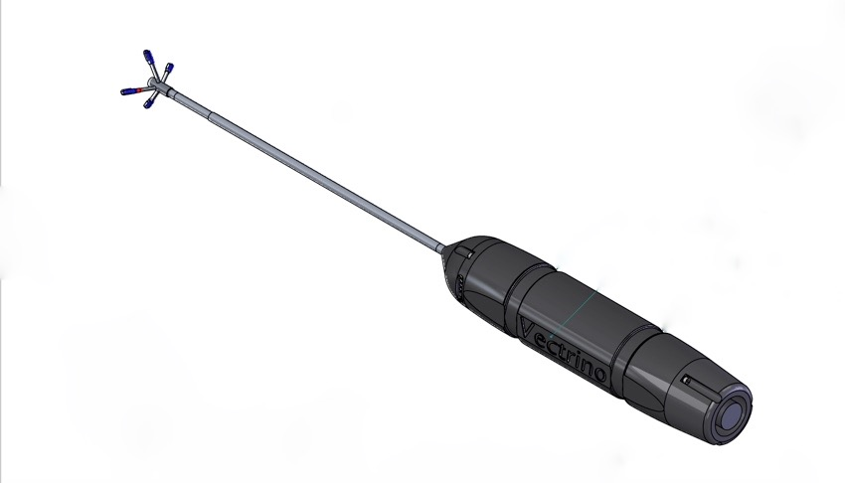
Motivation
Probe
Stem
The instrumentation port was designed for the Nortek Vectrino
Port can be modified for different type of instruments
Body
Notes:
The instrumentation port was designed for the Nortec Vectrino, but it can be modified for any other type of instrument.
The vectrino collects velocity measurements close to the seabed which is similar to how the flume is set up
This is why we chose to design the port for this instrument.
This device is the best instrument to collect the new velocities to create a new spectrum for the capacity of the flume

Slide 6
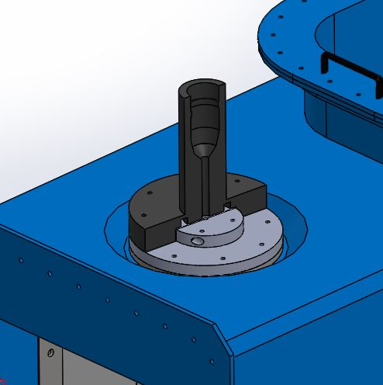
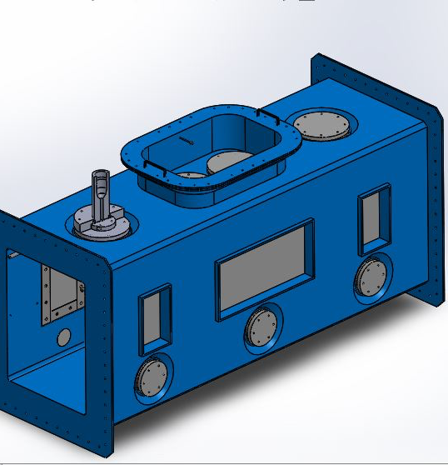
Assembly
Notes:
This is the full assembly of the port that I designed for the Vectrino
It is designed to be put in place of one of the ports on the top of the flume
The assembly is made of 2 acrylic ports and a 3D printed support

Slide 7
Vectrino Port Design
Notes:
I will now go more into more detail about the design of the assembly

Slide 8
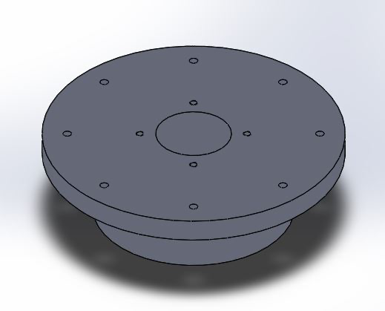
Acrylic Base Port
Mimics the pre-existing ports
Hole in the middle for Mini Port and probe of Vectrino
Attached with threaded rods
Threaded holes around the center hole to attach the Mini Port
O-Ring Slot on the underside for seal
Notes:
The first of the acrylic ports that I designed was the Base Port. It is designed to mimic the top ports that came with the flume. Since the design is so similar it is able to be placed in any top port on the flume. This port has a larger hole in the middle to allow the probe of the vectrino to be inserted into the flow. The plug of the other port fits snugly into this hole. The port attaches to the flume with 8 threaded rods and nuts through the holes that already exist for the pre-existing ports. The same threaded rods are used to attach the 3D printed support that I will discuss in more detail later. There are threaded holes in the top of this port that mimic the ones on the flume that attaches the mini port to the assembly. The base port has a slot on its underside for an o-ring. This o-ring is the same ones used on all the other top ports and creates a watertight seal with the flume.

Slide 9
Acrylic Mini Port
Similar design to Base and pre-existing ports
Center hole for stem of Vectrino
Due to anatomy of the Vectrino, the Mini Port had to be split down the middle
Identical halves
Watertight seal created from neoprene sheet clamped between the two interior faces
Two sides connect with threaded and clearance holes in the flanges
Notes:
The mini port is a smaller version of the base port and flume ports. This center hole is for the vectrino’s 8 mm stem. Unlike the other ports, the mini port is split down to middle because the stem cannot be inserted through this hole due to the drastic change in diameter between the probe and the stem. The hole must be snug around the stem in order to create a watertight seal. This seal is obtained using neoprene sheet that is clamped between the two interior faces. The two halves are attached through holes on the flanges of the port. One flange has a threaded hole and the other has clearance for the neck and the head of the screw to clamp the two sides together. There is a similar o-ring slot on the bottom of this port as well. This o-ring will create a seal with the top face of the base port.

Slide 10
Acrylic Port Assembly
Mini Port plug fits in the center of the Base Port
Mini Port attaches to the Base Port with 4 threaded holes in the top of the Base Port
Mini O-Ring creates a seal with the Base
Sizing of holes in Base and Mini can be adjusted for different instruments
Notes:
The two ports must be used together in order to create a watertight seal in the flume. The plug of the mini port fits into the larger center hole, and attaches with bolts to the threaded holes in the top of the base port. The mini port’s o-ring creates a seal with the top face of the base port and the neoprene sheet creates a seal with the stem of the vectrino. The base port attaches to the flume with threaded rods and nuts and its o-ring creates a seal with the top surface of the flume. The sizes of the center holes in the base and mini ports can be modified to allow other instruments to be inserted into the flume.

Slide 11
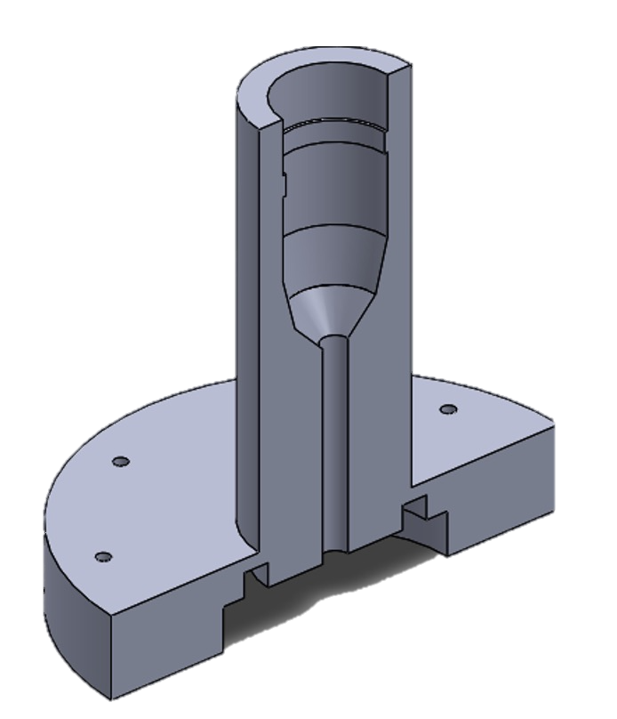
3D Printed Vectrino Holder Design
Supports the body of the Vectrino
Sits on top of the acrylic port assembly
Connects to Flume with threaded rods and same holes as the Base Port
Split to allow for the stem and body of the instrument
Notes:
The 3D printed vectrino holder sits on top of the acrylic port assembly and acts as a support for the body of the vectrino. It connects to the base port with the same threaded rods used to attach the base port to the flume. The support follows the contour of the vectrino and like the mini port is split down the middle to account for the different diameters between the probe, the stem and the body. The split allows the vectrino to nest into the contour. The decline in diameter from vectrino’s body to the stem holds the instrument in place vertically in the flow. The distance between the decline and the bottom of the holder will dictate the vertical position of the probe in the flume. Since this distance is easily modified, the flow can be measured at different heights without difficulty. The clamping of the two sides will keep the instrument normal to the flume and prevent the probe from moving side to side. The bottom of the support leaves space for the cap of the mini port and the bolts that attach it to the assembly.

Slide 12
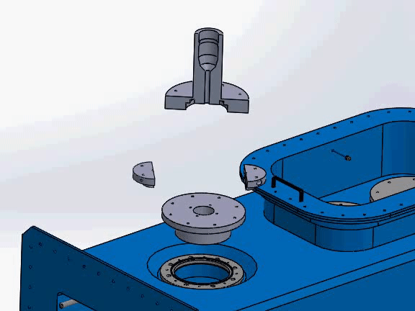
Full Assembly
Notes:
This is how the entire assembly fits together. The base port plugs the hole in the flume. The two sides of the mini port come together around the stem of the vectrino and plug the hole in the base port. The 3D printed support fits on top of the acrylic pieces and nests into the contour of the vectrino to hold instrument in place. This will create a watertight seal in the flume and hold the vectrino in the precise position to take the most accurate measurements possible.

Slide 13
Transition to Remote Work
Notes:
When the COVID-19 crisis hit the University of New Hampshire, all of our work had to be shifted to be remote and we no longer had access to the flume.

Slide 14
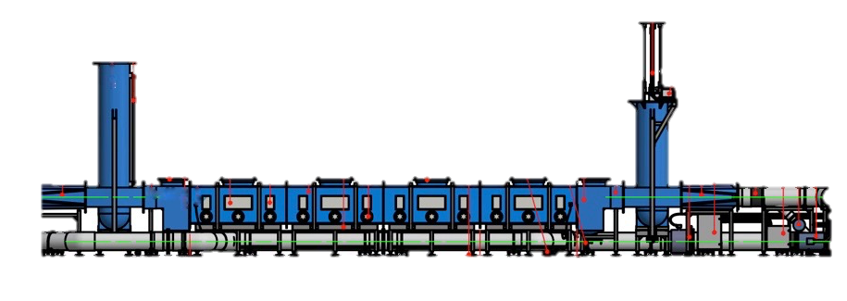
Trial Regimen
Trial # | Pump 1 (Hz) | Pump 2 (Hz) | Pump 3 (Hz) | Expected Velocities (m/s)
1 | 45 | 45 | 45 | 1.75
2 | 45 | 45 | 0 | 1.19
3 | 45 | 0 | 0 | 0.59
4 | 40 | 20 | 10 | -
5 | 40 | 20 | 0 | -
6 | 30 | 20 | 10 | -
7 | 30 | 30 | 30 | 1.20
8 | 30 | 25 | 20 | -
9 | 15 | 15 | 15 | 0.60
10 | 15 | 30 | 45 | -
11 | 15 | 15 | 0 | 0.42
12 | 10 | 0 | 0 | 0.13
13 | 10 | 5 | 5 | -
14 | 5 | 5 | 0 | 0.13
15 | 5 | 0 | 0 | 0.07
40 minutes/trial
32 Hz sampling rate
Measuring mean velocity
Probe placed in the center most port
Repeated trials from ELD
Conducting additional trials from ELD Inc.
Assembly Location
Notes:
Our next steps in the lab would have been to machine the acrylic and grow the 3D printed support, however that changed when we transitioned to remote work. The first thing we did was create a plan for the trials that we will conduct as soon as we can get back into the lab. We will start by conducting 15 trials measuring the mean velocities in the flume. Some of our trials will be repeats of the ELD trials conducted in the empty flume, but some of them will be a combination of settings that have never been executed before. We are expecting the repeat trials to have different velocities than what ELD reported because of the addition of the sediment. For each of the trials, we will place the assembly in the center most port in the flume and will center the probe between the ceiling of the flume and the sediment bed. Each trial will be conducted for 40 minutes and have a sampling rate of 32 Hz.

Slide 15
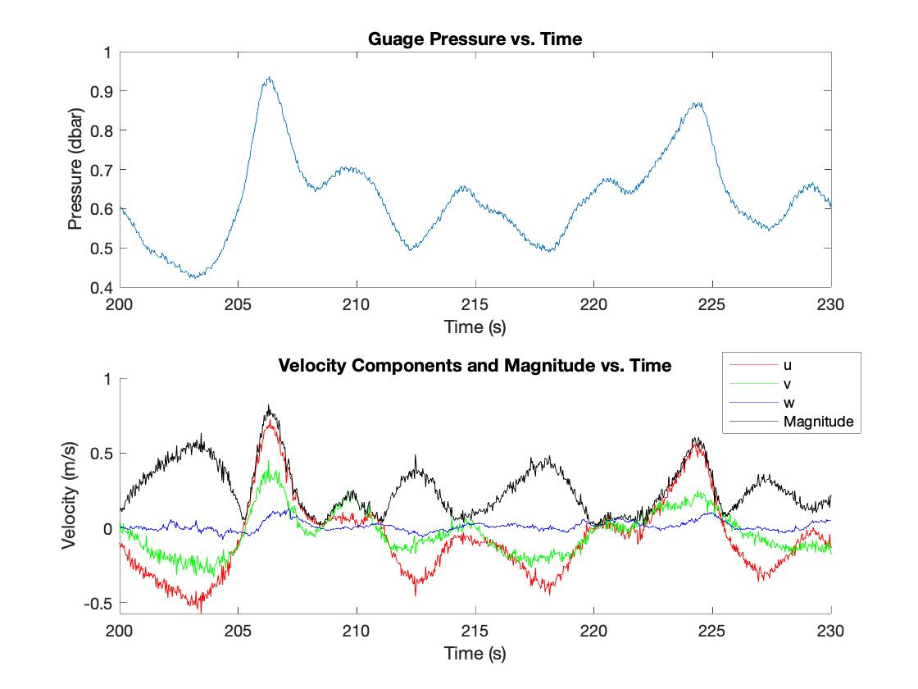
Vector Data Analysis
Data set from Vector (similar to the Vectrino)
MATLAB used to analyze the data set
Notes:
Another task that we undertook while working remotely was conducting data analysis using MATLAB. Since we have not been able to conduct trials with the vectrino, we decided to use data from a similar instrument, the Vector. The data from the vector is similar to what we will see from the vectrino, and the MATLAB analysis will mostly be the same. The top plot looks at gauge pressure vs time. Since the time is in seconds, the variations in pressure seen are individual waves. The bottom plot is a graph of the velocity components and magnitude vs. time. The red line is the u velocity, the green line is the v velocity and the blue line is the w velocity. The u v and w correspond with the x, y, and z directions. The black line is the magnitude of the velocities. Again the time is in seconds so you are able to see individual waves. These graphs were made from data taken in the field, where as the vectrino data we will collect will originally be in the lab. This means that our data will look more uniform. This exercise was a great introduction to data analysis using MATLAB and if there had been more time, we would have dived deeper into velocity data analysis to help prepare for when we have vectrino data to analyze.

Slide 16
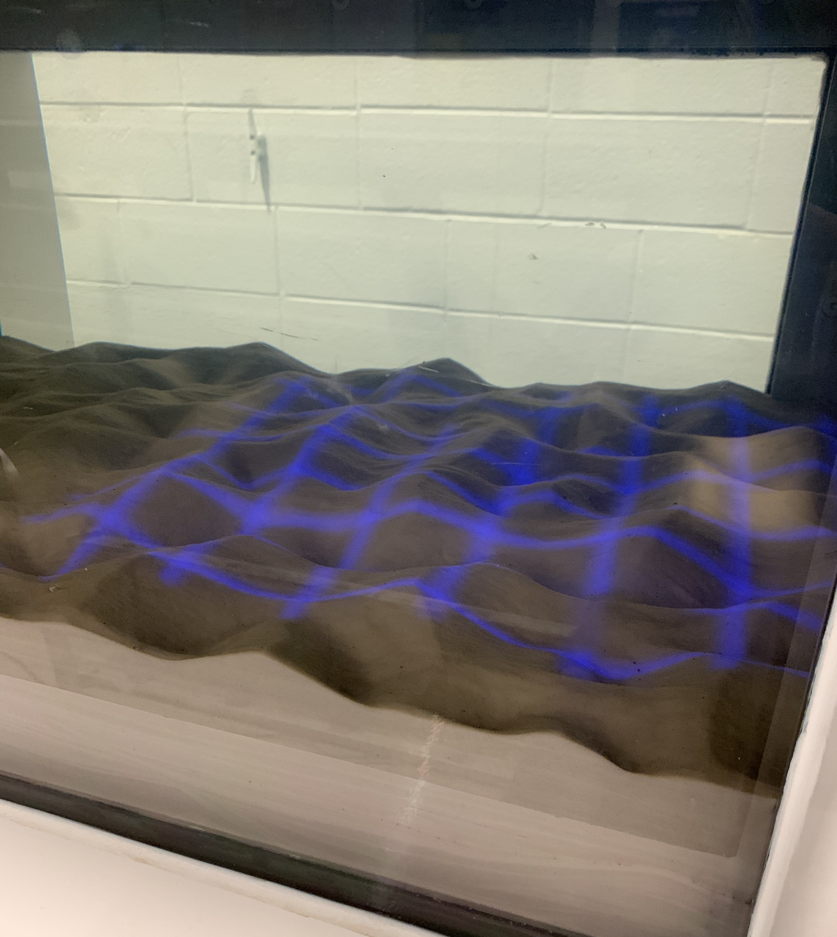
Future Work
Machining the acrylic ports and 3D print
Testing the port design
Conducting trial regimen
Further MATLAB data analysis
Photogrammetry
Repeat design process for different instruments
Notes:
The first thing we will do after the COVID-19 crisis will be to machine the acrylic ports and grow the 3D printed support so that we can start trials. When we start the trials we will follow the regimen previously outlined. After that we will analyze the data collected using MATLAB. Other tasks that we would like to complete in the future are a photogrammetry project, conducting video analysis of the way the sediment bed changes under different conditions, and creating new ports for different instruments, whether it’s modifying the current design or creating a new design to get different types of data from the UNH Oscillating Flume.

Slide 17
Acknowledgements
In addition to the University of New Hampshire and Savannah DeVoe, I would like to thank:
Dr. Diane Foster
Angela Sarni
Salme Cook
The Innovation Scholars Program
The Jere A. Chase Laboratory

Slide 18
References
DeVoe, S. (n.d.). UNH Oscillating Flume Side View. photograph, Durham, NH.
DeVoe, S. (n.d.). Photogrammetry Grid Lines. photograph, Durham, NH.
OSCILLATING FLUME OPERATION AND MAINTENANCE INSTRUCTIONS, ELD INC., Lake City, MN, USA, 2018
Sarni, A. (2020, March 31). Vector Velocity and Pressure Data .
Vectrino. (n.d.). Retrieved April 30, 2020, from https://www.nortekgroup.com/products/vectrino
Working Section Model file courtesy of ELD Inc.

