Slide 1


Using a High-Altitude Balloon to Measure Air Quality and Atmospheric Structure in Urban and Rural New Hampshire
By Maddie Strange, Jeremy Larkin, Sarah Young and Matt Libby

Slide 2
Motivation
Our goal is to use a tethered balloon to compare air quality around New Hampshire
We will compare Urban vs. Rural to investigate industrial impact on air quality
Notes:
Angela's Suggested Talking Points:
Our goal is to use a tethered balloon to compare air quality around New Hampshire
We chose a balloon system because they don't require any existing structures, plus they can reach higher altitudes than most existing structures
This flexibility allows us to select from a variety of deployment environments
We decided to compare Urban Vs. Rural environments to see if we can resolve the industrial impact on air quality

Slide 3
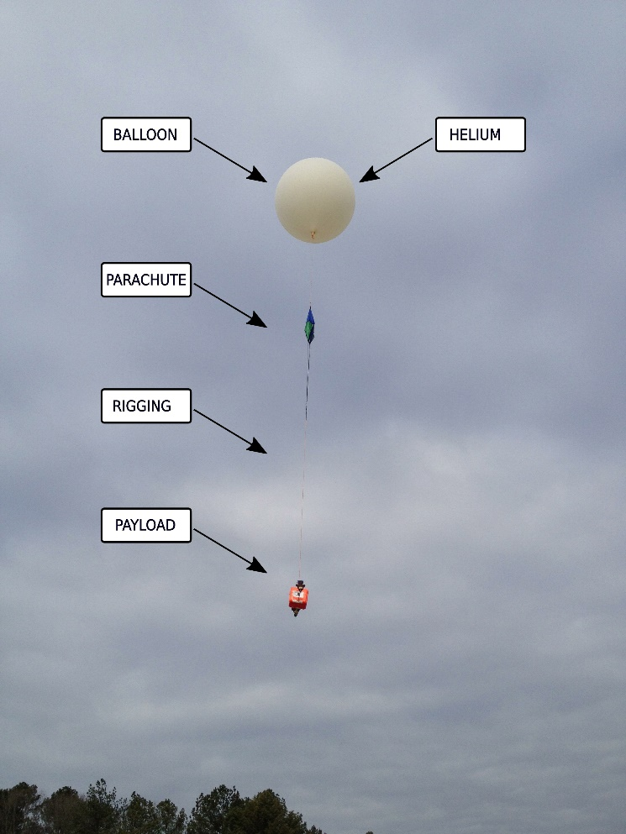
Why a Tethered Balloon?
  Can be deployed at most locations
  Ability to reach high altitudes
  Easy to keep in one spot for a long period of time
  We can control the height for given periods of time
  Easy recovery!
Figure 1: Example of a high-altitude balloon [1].
Notes:
Angela's Suggested Talking Points:
When deciding whether to design an untethered balloon, we discovered they fall under stricter regulations, require sophisticated positional tracking, and would be very difficult to recover (especially near the coast because the air circulation would suck it out to sea)
The tethered design (an example of which is shown in figure one) had numerous advantages including:
Can be deployed at most locations
Ability to reach high altitudes
Easy to keep in one spot for a long period of time
We can control the height for given periods of time
Easy recovery!

Slide 4
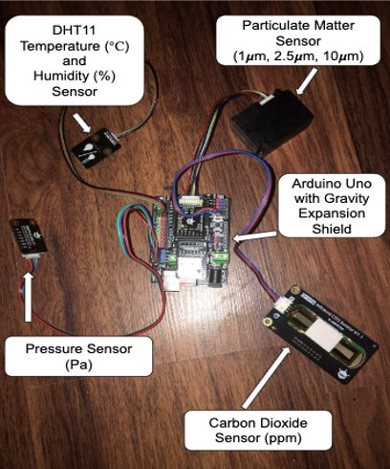

Design
Our sensors are run on an Arduino Uno, and there are four sensors in total.
Our sensors can measure:
  Temperature
  Humidity
  CO₂ levels
  Pressure
  Particulate matter
Figure 2: Labeled photo of the sensors.
Notes:
Angela's Suggested Talking Points:
Our sensors are run on an Arduino Uno, and there are four sensors in total, shown in figure two.
The Gravity Expansion Shield allows each sensor to plug directly into the arduino uno board
Our sensors can measure:
Temperature (in degrees celcius)
Humidity (in terms of a percentage)
CO2 levels (in parts per million)
Pressure (in terms of Pascals)
And Particulate matter (in terms of number of
particles registered among three size classes: 1 micrometer, 2.5 micrometers, and 10 micrometers)

Slide 5

FAA Regulations
When planning our deployment we must follow several regulations:
  Alerting the FAA before deployment
  Maximum Height – 500ft
  Flags on the tether for low flying objects
  Cannot be deployed within 5 miles of
  an airport
Figure 2: Federal Aviation Administration Regulations [2].
Notes:
Angela's Suggested Talking Points:
When considering where we would like to deploy, we had to research the Federal Aviation Administration's, or FAA, regulations
First we would have had to alert the FAA prior to deployment
The maximum height for a tethered balloon, without an automatic-popping mechanism is 500 ft
If we were to design some sort of device that could pop the balloon if it were to break free from the tether, then we could go to higher elevations
The tether must have bright flags along it's length to indicate it's presence
Additionally, the tethered balloon cannot be deployed within 5 miles from any airports

Slide 6
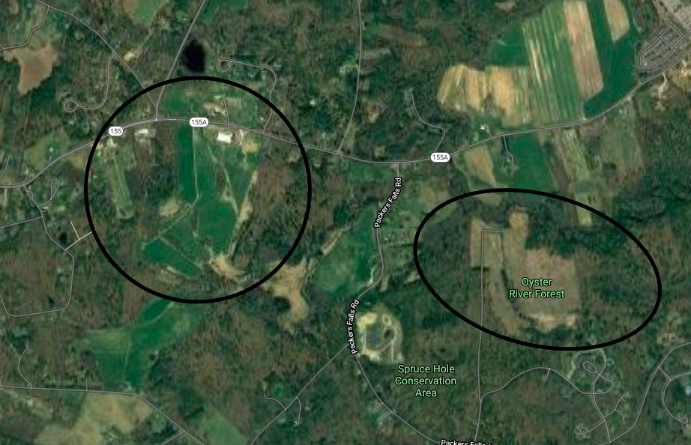
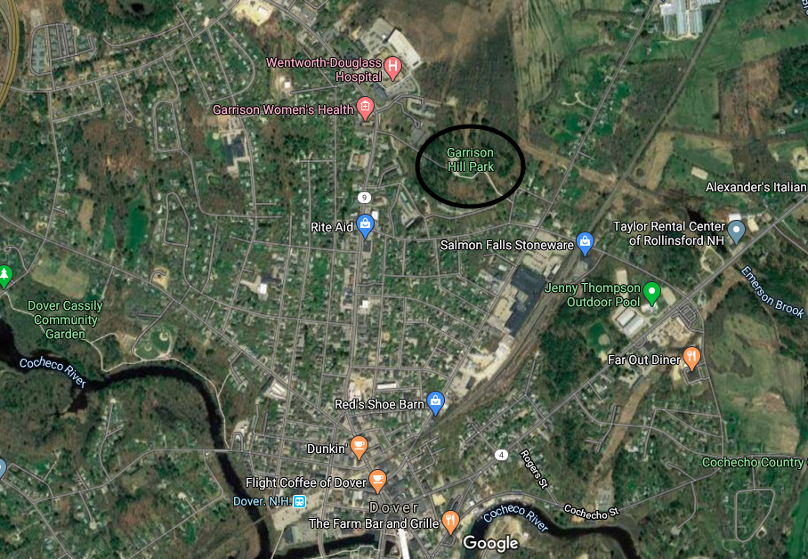
Proposed Deployments
We want to have a deployment in a field to see how our data looks with minimal industrial impact.
We then hope to deploy in a city such as Dover, NH, where we can see if urban life is changing the atmosphere around cities.
Figure 3: Example of a rural deployment area [3]
Figure 4: Example of an urban deployment area [4]
Notes:
Angela's Suggested Talking Points:
As previously stated, we intended to deploy in a rural and urban environment to provide air quality data that could be compared
Following FAA guidelines, we had to select locations that were 5 miles from the Portsmouth International Airport at Pease in Portsmouth, NH (Pease is pronounced like the veggie peas)
Durham has numerous rural environments from forests to agricultural fields (shown in figure 3)
The nearest urban area that is far enough away from the airport would be Dover, NH (shown in figure four)

Slide 7
Deployment Procedure
  Elevate the balloon in 50 ft increments
  Stop at each elevation for 20 minutes (data averaging)
  Once peak height (500 ft) is reached, lower the balloon in the same increments
Notes:
Angela's Suggested Talking Points:
For each deployment we would elevate the balloon in increments by letting the tether out 50 ft at a time
The flags on the tether that are required by the FAA would indicate these locations along the length of the tether
Each time the tether is let out, and the balloon rises to a new elevation, we would hold it there for 20 minutes
This would allow for data averaging during post-processing
Once the peak elevation is reached and held for 20 minutes, we would lower the balloon, stopping for 20 minutes at the same increments
This would provide a second dataset to compare to the way up

Slide 8
Statement On COVID-19
Due to the COVID–19 pandemic we were forced to move our research to home
Since we were not able to complete our proposed deployments, we designed some tests for our sensors that we could do at home
Notes:
Angela's Suggested Talking Points:
Due to the COVID–19 pandemic we were forced to move our research to home
This means we no longer had access to UNH facilities, supplies, or each other
Since we were not able to complete our proposed deployments, we designed some tests for our sensors that we could do at home

Slide 9
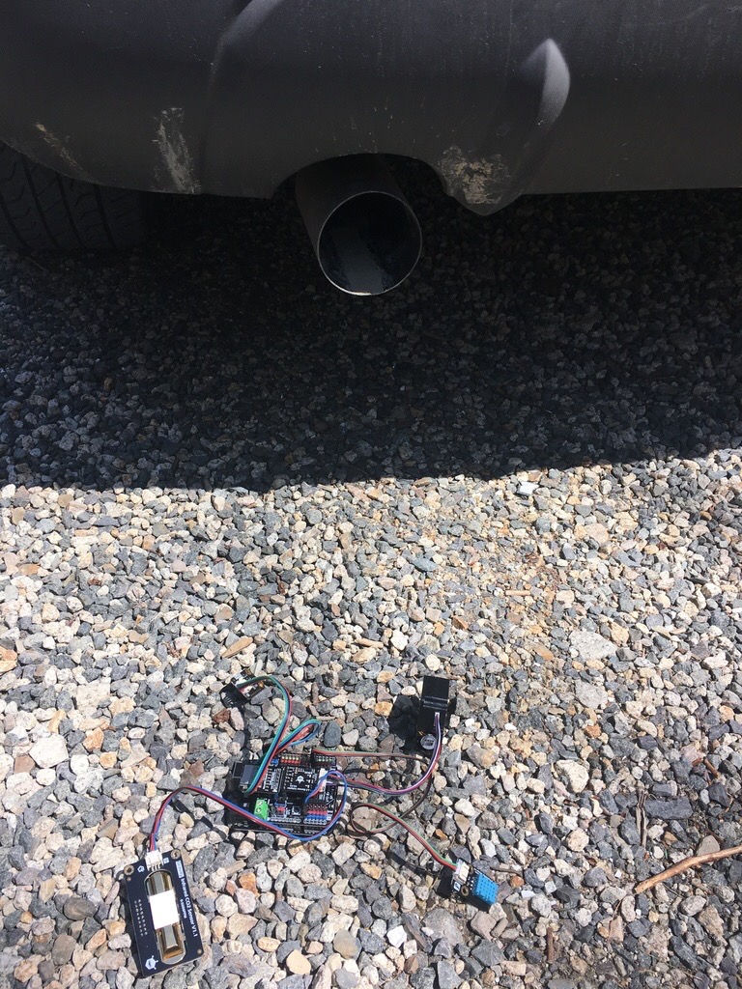
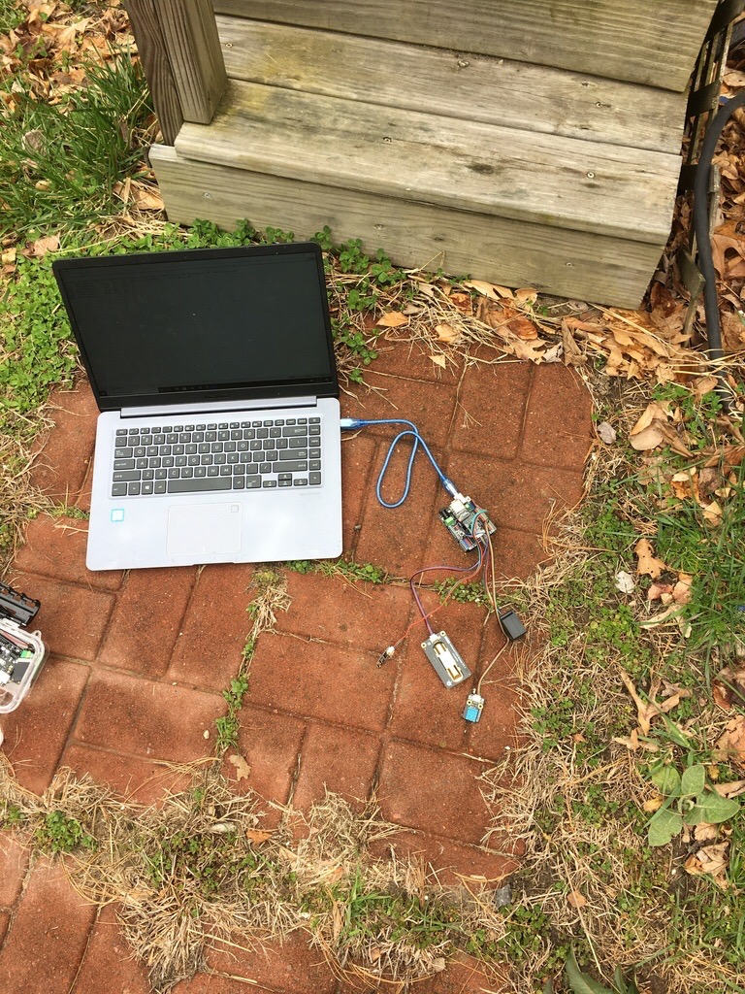
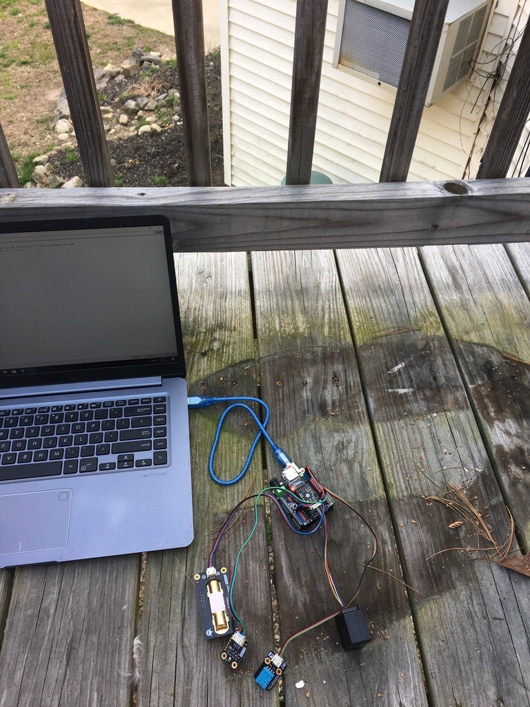
Test Deployments
Car Exhaust Test
Ground Level Test
Elevated Test
Notes:
Angela's Suggested Talking Points:
The tests were designed to ensure the sensors are functioning as expected
We designed three experiments which would each be recorded for over an hour:
Baseline Ground Level Test, shown in the middle figure, the sensors are sitting on the ground measuring the ambient air conditions
Elevation test, shown on the right, the sensors are sitting on a balcony 10 feet above the Ground Level Test
Car exhaust test, shown on the left, the sensors are sitting on the ground with car exhaust emitted directly over them

Slide 10
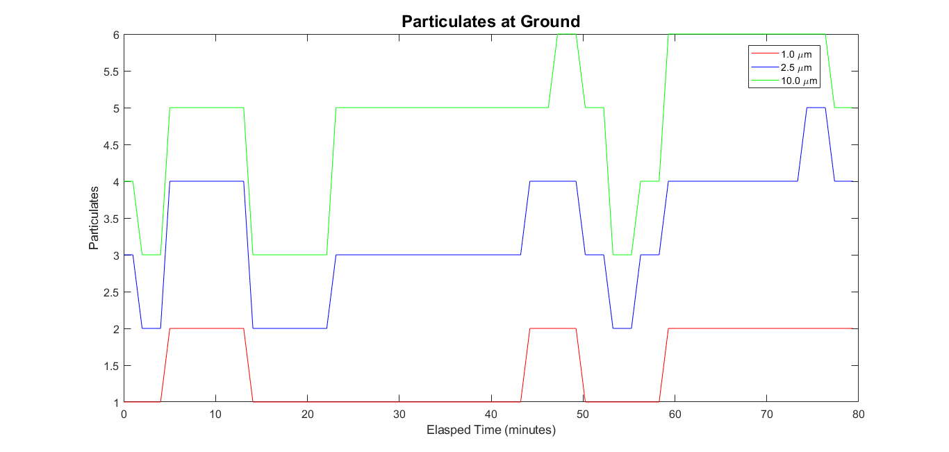
Test Deployment Results
Sensor stopped working after Ground Level Test
Data recording to nearest integer
Ground
Notes:
Angela's Suggested Talking Points:
The particulate matter sensor only recorded data for the ground level test, then it stopped recording during the following two tests
Additionally, the data that was recorded during the ground level test was only showing data points rounded to the nearest integer, which resulted in the plot shown here
Moving forward, this sensor would require further testing before deploying the design

Slide 11
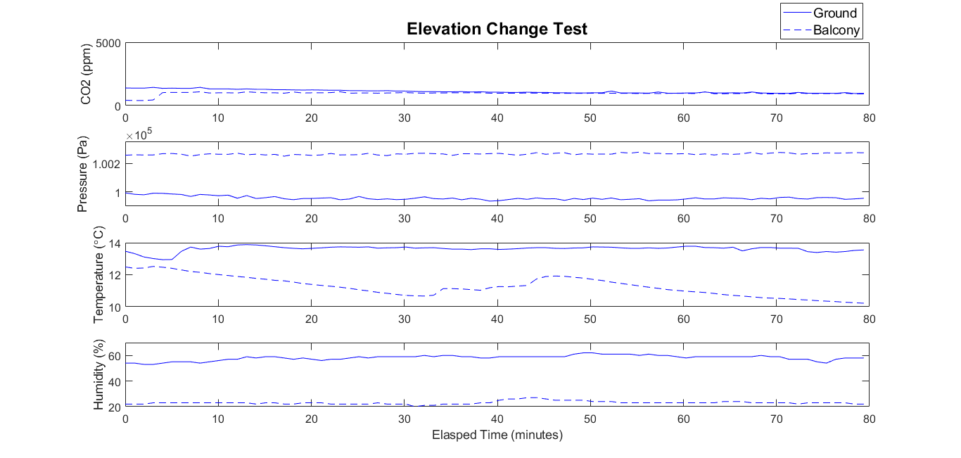
Test Deployment Results
Balcony
Ground
Notes:
Angela's Suggested Talking Points:
These results are comparing data from the Ground Level Test, shown with the solid line, to the Elevated test, shown with the dashed line
We would hope to see a lower pressure on the balcony because it's at a higher elevation
However, these datasets were collected on different days, so the atmospheric conditions were not the same
Changing local weather can affect the pressure, temperature, and humidity levels
The CO2 levels were very similar, which is to be expected because both experiments were conducted at the same household with no increased local emissions

Slide 12
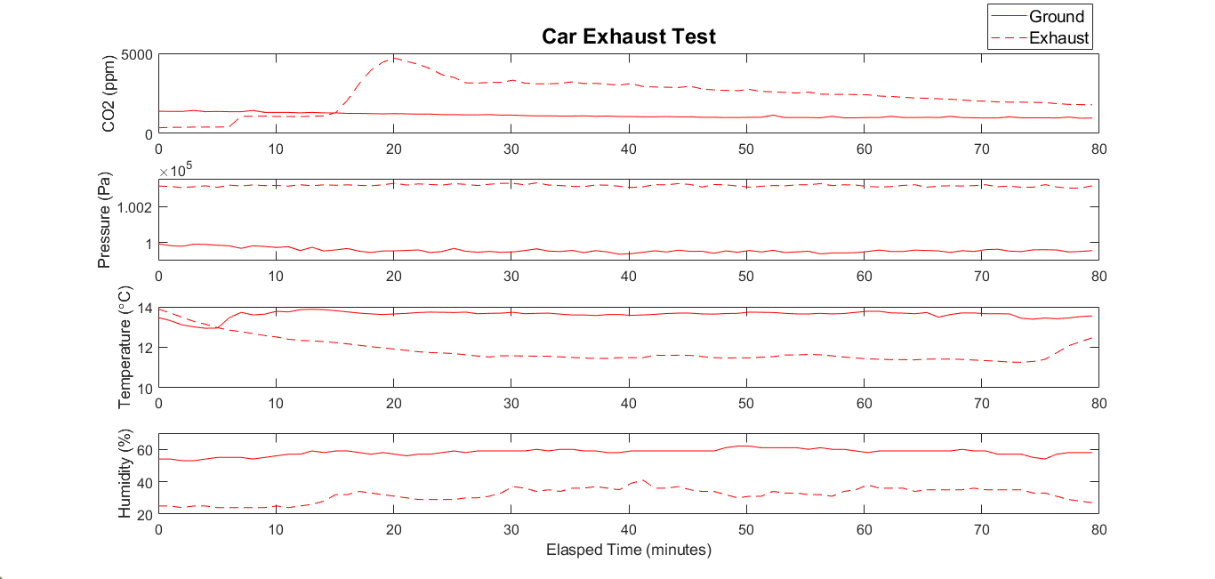
Test Deployment Results
Exhaust
Ground
Notes:
Angela's Suggested Talking Points:
These results are comparing data from the Ground Level Test, shown with the solid line, to the Car Exhaust Test, shown with the dashed line
We would expect to see increased levels of CO2 from the car exhaust which can be seen by the peak in the signal as the car is turned on
Again, the other conditions are difficult to compare because the datasets were recorded on different days
But the measurements are in agreement with the weather that was occurring during the deployment, so the sensors appear to be performing well

Slide 13
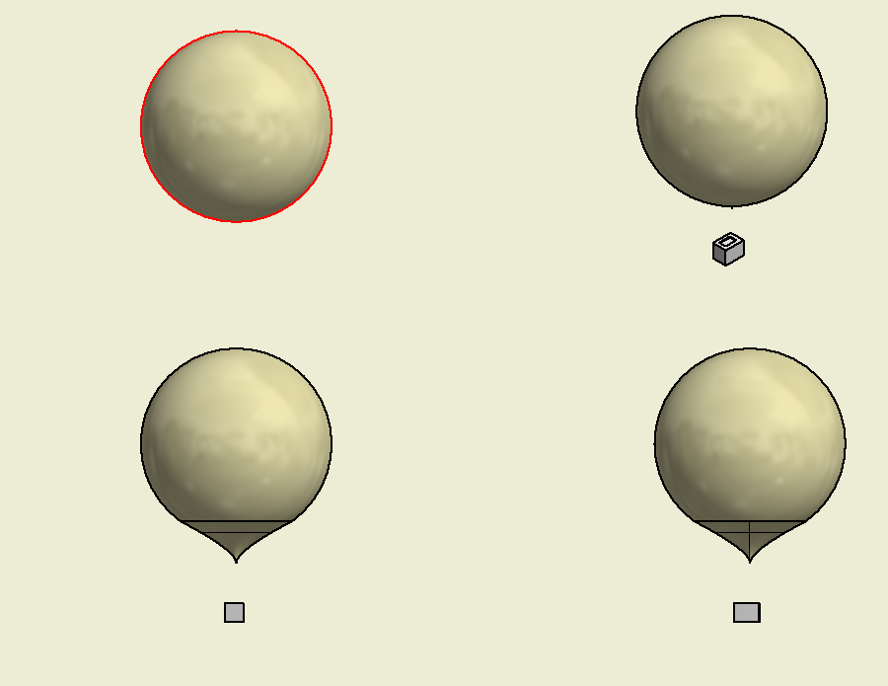
Future Work
Our main goal for the future is to deploy our entire setup.
In order to do this we will need to complete the following tasks:
  Fabricate a housing for our sensors
  Create a reel system for our tether
  Finalize locations for deployments
Notes:
Angela's Suggested Talking Points:
Our goal for the future is to construct and deploy our weather balloon design
In order to do this we will need to complete the following tasks:
Fabricate a housing for our sensors
A lightweight and economical solution would be a styrofoam box
Create a reel system for our tether
Because our system is so light, a smaller balloon can be used, which will have less upward buoyancy force
This would enable us to use an inexpensive manual winch that we would hand-crank
Finalize locations for deployments
Determine exactly where we would deploy and make sure to get the appropriate permissions and follow the FAA regulations

Slide 14
Acknowledgments
Faculty Mentors: Professor Anne Lightbody and Research Professor Charles Smith
Student Mentor: Allison Bickford
Innovation Scholars Mentor: Angela Sarni

Slide 15
References
[1] https://www.basicairdata.eu/knowledge-center/design/introduction-to-weather-balloons/
[2] https://avisav.com/2020/01/28/part-121-vs-135-125-and-91-of-faa-regulations/
[3] https://www.google.com/maps/place/Dover,+NH/@43.1864969,-71.0304452,11z/data=!3m1!4b1!4m5!3m4!1s0x89e296d95b2481e7:0x717c886941631b0!8m2!3d43.1978624!4d-70.8736698
[4] https://www.google.com/maps/place/Durham,+NH+03824/@43.1218468,-71.0534853,11z/data=!3m1!4b1!4m5!3m4!1s0x89e293823121d2fb:0xb98b6315035d65fd!8m2!3d43.1339545!4d-70.9264393

