Slide 1
John Olson Advanced Manufacturing Center Giveaway
Nate McCarvill, Riley Drew, James Wirth
Notes:
Nate

Slide 2
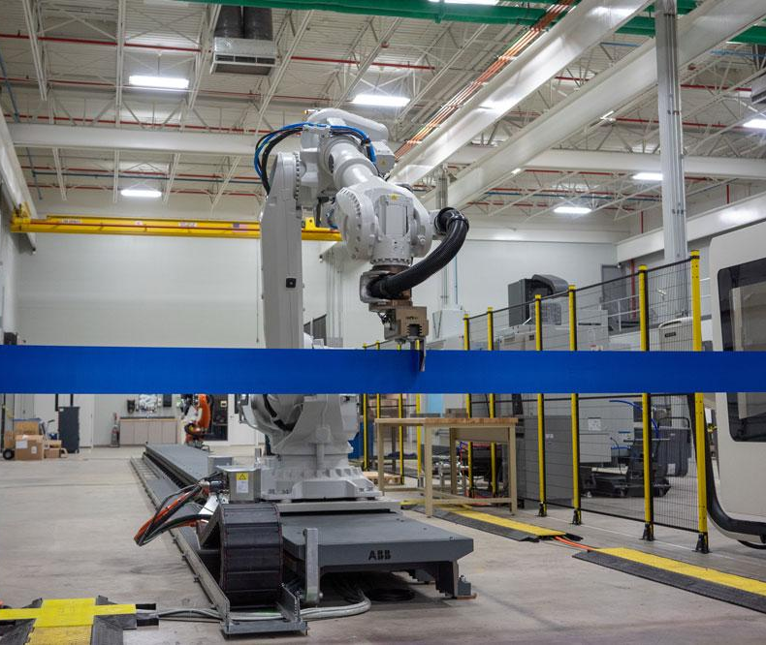
Introduction
The John Olson Advanced Manufacturing Center tasked our team with designing and developing a part that represents the manufacturing capabilities in the facility. This part is intended to be given to individuals who visit the facilities.
Notes:
Nate

Slide 3
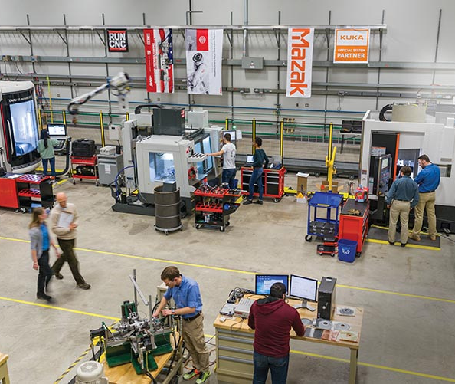
Project Stages
Define Project Requirements
Brainstorm
Research & Generate Ideas
Select Approach
Design
Develop Processes
Manufacture
Notes:
Nate

Slide 4
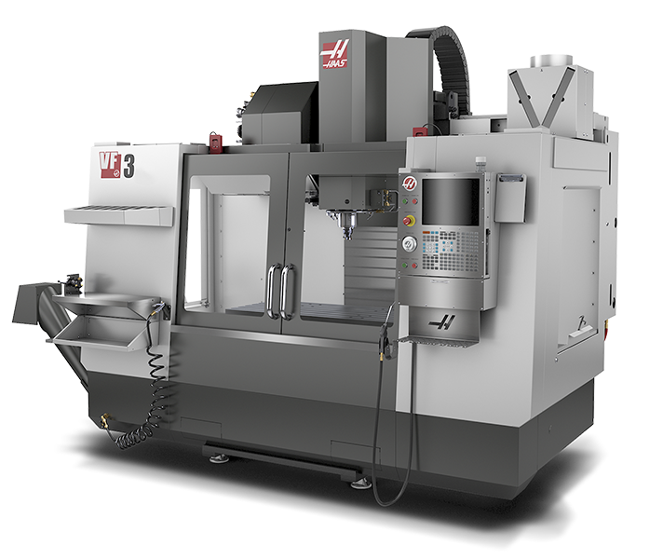
Manufacturing Techniques
To create the parts that will make up the giveaway, we chose to incorporate the following manufacturing techniques:
3D Printing
CNC Milling
Injection Molding
Notes:
Nate

Slide 5
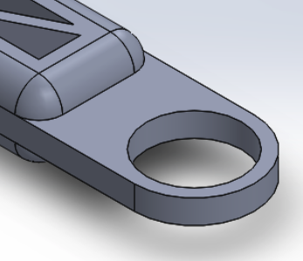
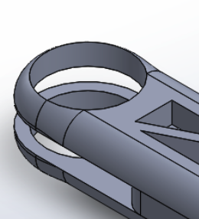
Designed Part
We designed the parts to fit into one another so they can be connected with a 3D printed cylindrical peg very easily. The smaller arm pieces are the same, which makes manufacturing easier.

Slide 6
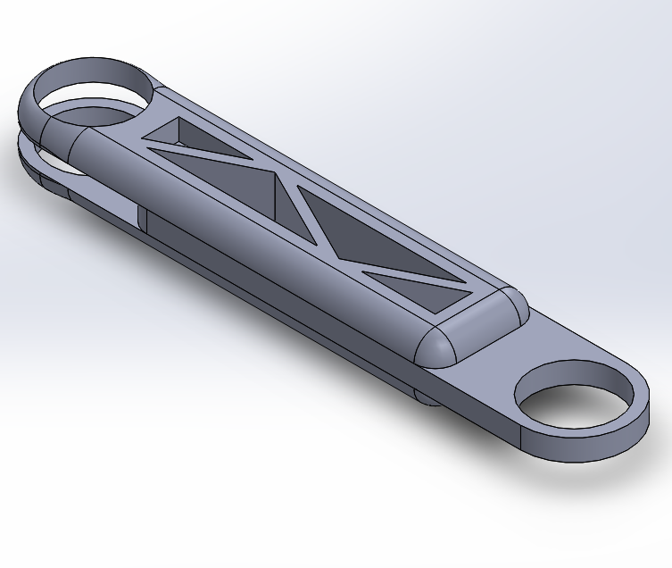
3D Printing
The different parts of the robot that will make up the arm will be made on the 3D printer.
Notes:
Riley

Slide 7
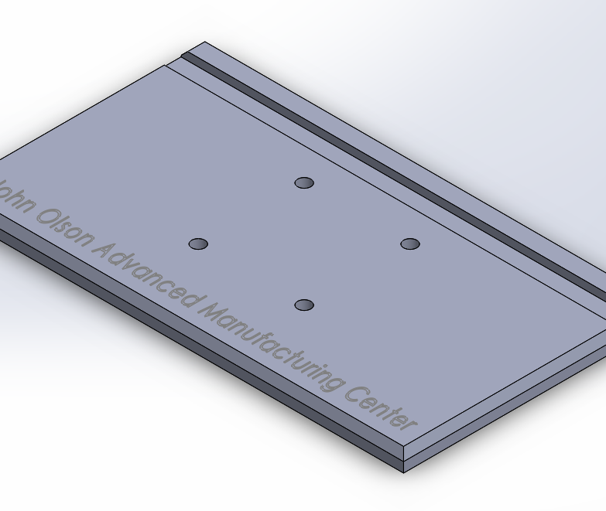
CNC Machining
The base of the robot and the mold for the injection mold will be made on the CNC mill. Our team leveraged the capability of a CAD/CAM software, Autodesk Fusion 360, to make the manufacturing tool paths. The CAD software, SolidWorks, was used to 3D model the parts.
Notes:
Riley

Slide 8
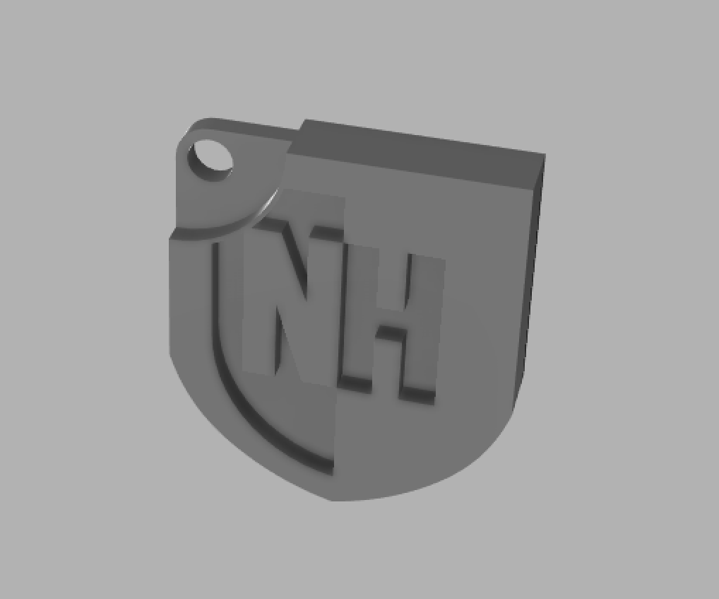
Injection Molding
First step in making the injection mold is to create the actual model that we want as an end product.
Notes:
Jamie

Slide 9
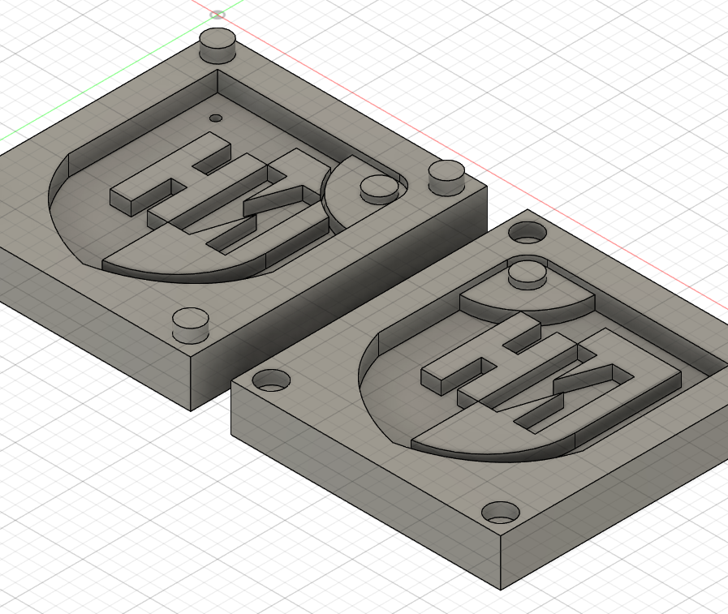
Injection Molding Cont.
Next, Fusion 360 was used to go from the designed model to a manufacturable mold. Our group had to make a model of the shield first, so we could then take a negative for the mold.
Notes:
Jamie

Slide 10
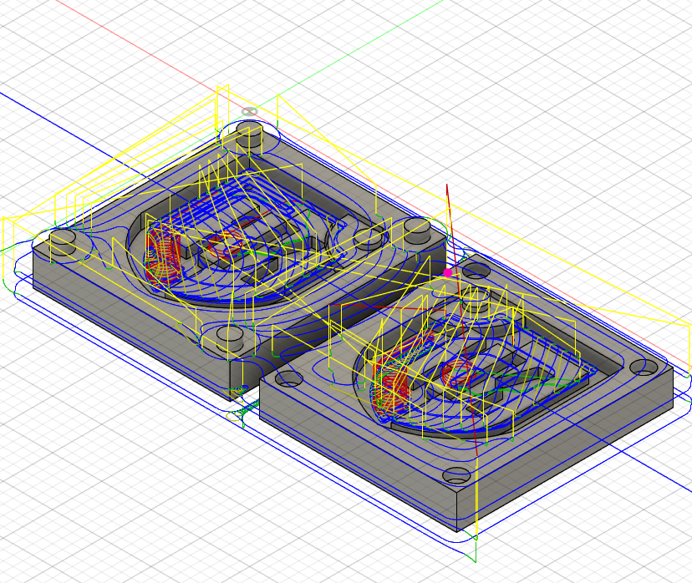
Injection Molding Cont.
Finally, to produce the shield on the injection molding machine, we first need to make the mold. To manufacture the mold, we will use the CNC mill to cut out the shape of the mold.
Notes:
Jamie

Slide 11
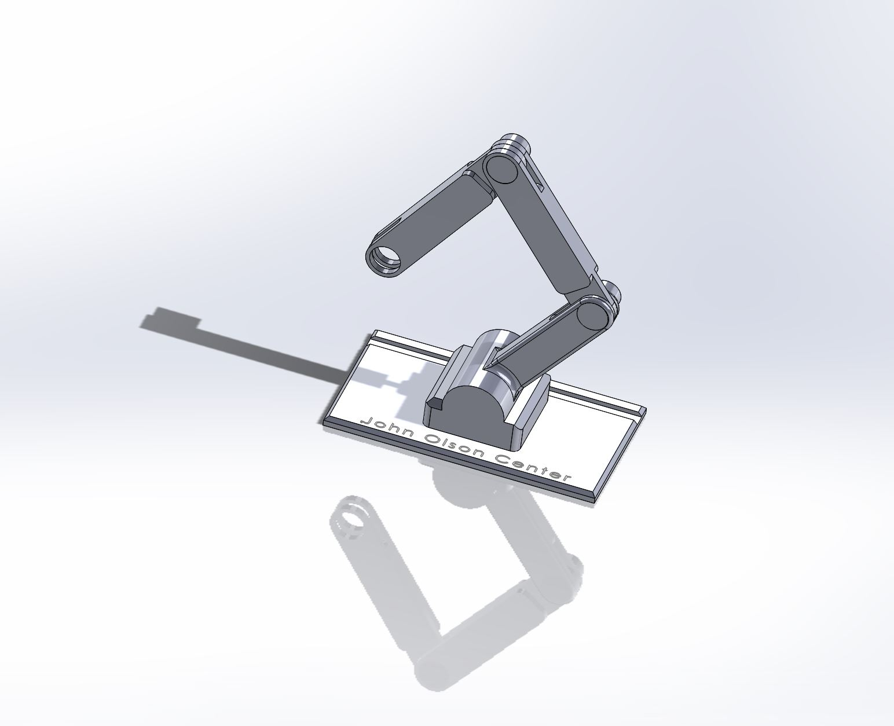
Going Forward
Due to COVID-19, our team’s timeline has been extended. When we’re able to be back on campus, we will make prototypes and alterations as needed.
Another aspect of our project is to create an instructions list on how to build the giveaway and describes the manufacturing processes used.
Notes:
Jamie

