Slide 1



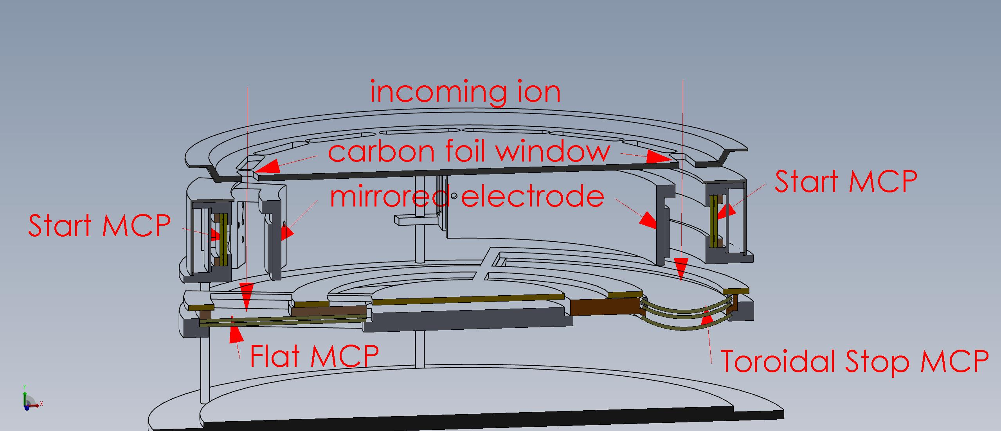
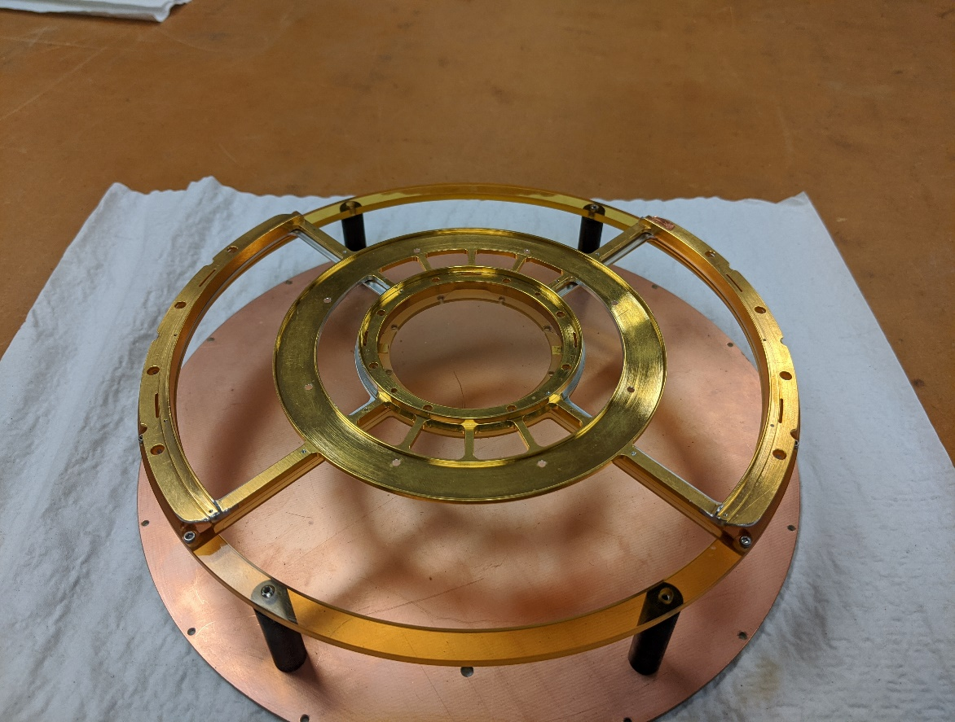
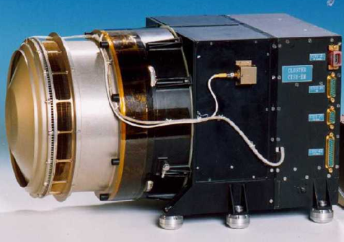
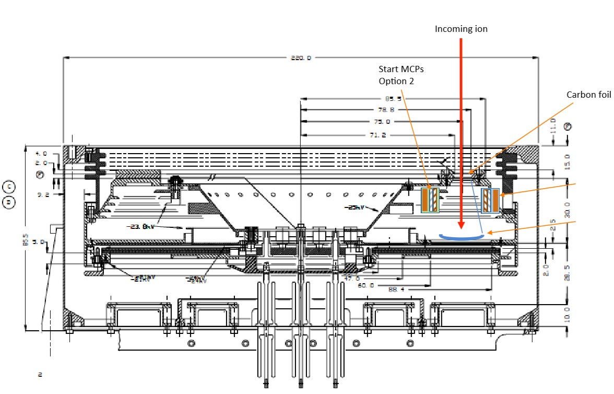
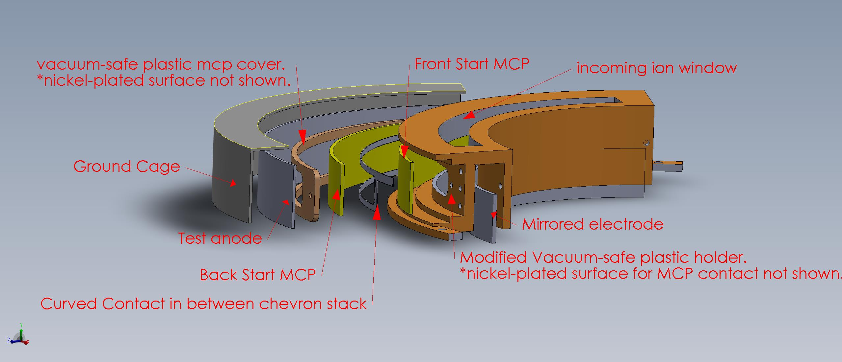
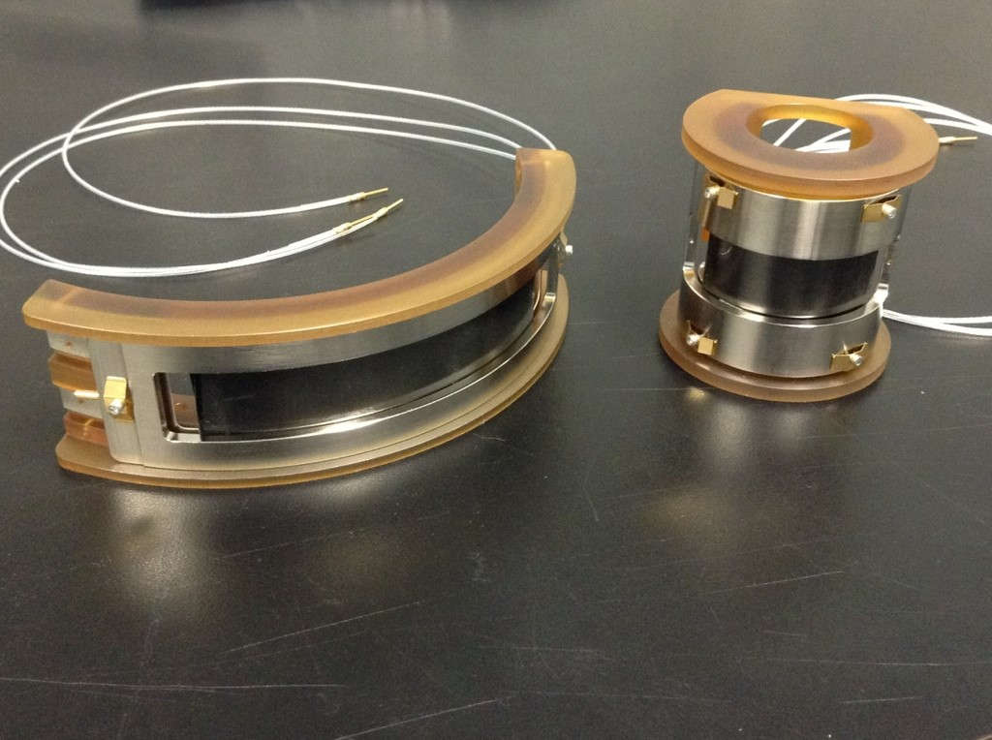
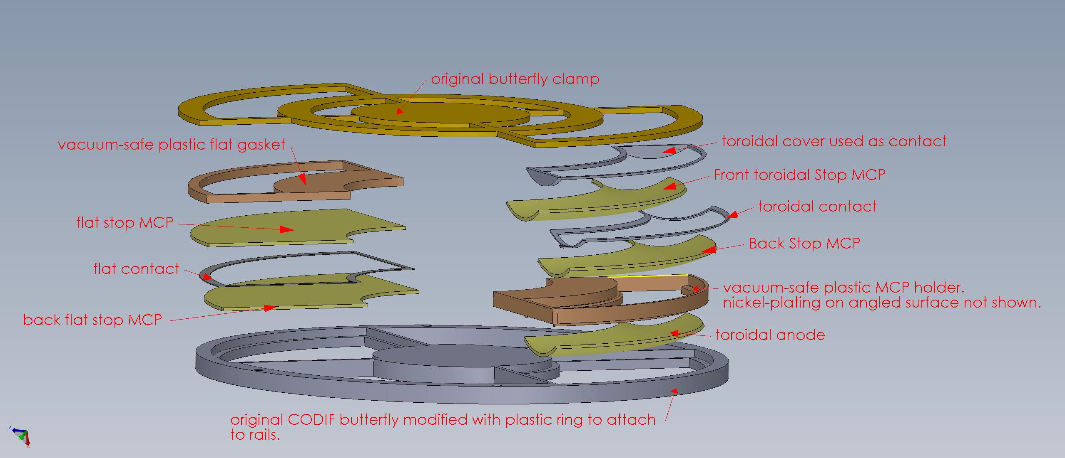
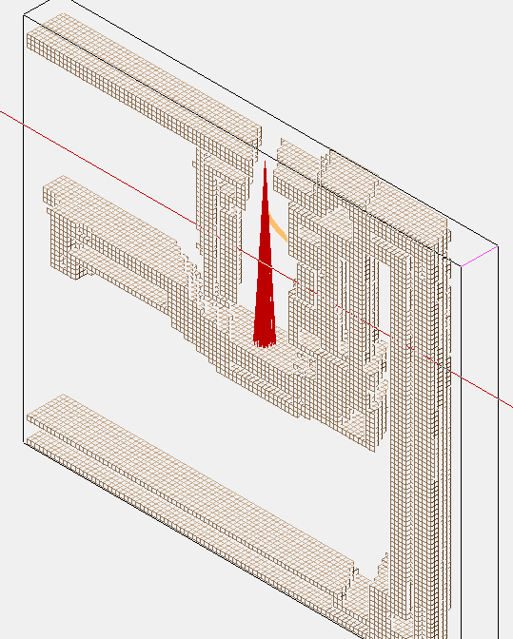
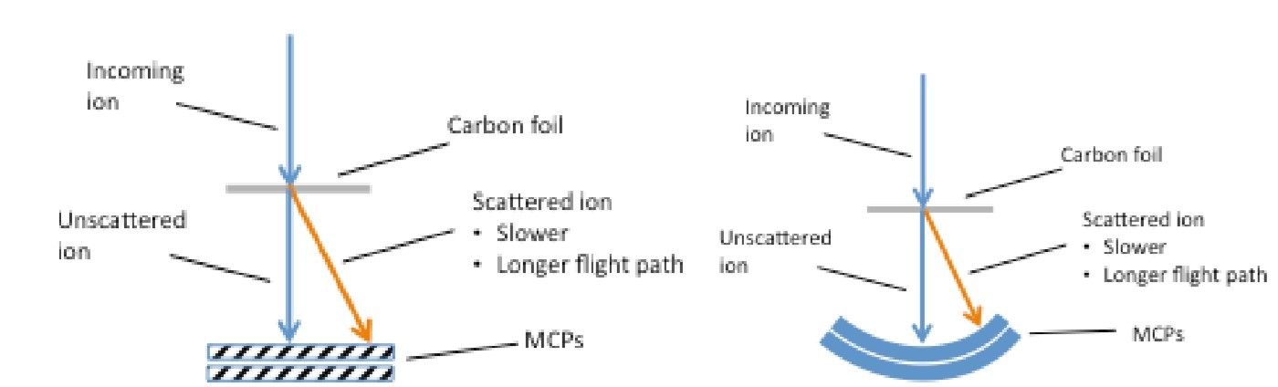
Curved Microchannel Plates for Time-of-Flight Mass Spectrometer
Andrew Griglun
Faculty Advisors: Dr. Harald Kucharek¹ and Dr. Lynn Kistler¹
Nick Lubinsky¹, and Mark Popecki²
¹Department of Physics, University of New Hampshire, Durham, NH 03824
²INCOM (Charlton, MA 01507)
Design Requirements & Challenges
Project Objectives and Introduction
Requirement:
Fabricate MCP holders modified to make use of newly developed MCPs to more efficiently steer the secondary electrons to the MCP and apply a lower attraction high voltage to the face of the MCP.
The CODIF design change will require design and machine shop time.
The design effort requires electrostatic simulations (SIMION) to determine the ion/electron dynamics in the TOF section and to determine the steering voltages for the deflection electrodes
Challenges:
The fixture clamps the MCPs firmly but without damage and allow MCP output charge to reach a test anode without charging the fixture.
Reusing existing components with limited alterations.
Objective: It is planned to modify the TOF enclosure to use a curved Start MCP and a toroidal Stop MCP in one of the four quadrants.. The MCPs are curved to simplify electron steering and accommodate the cylindrical shape of the CODIF. The goal of the bracket system was to secure a curved MCP stack in a modified holder at a desired distance from a toroidal MCP stack.
Introduction: The COmposition and DIstribution Function analyzer (CODIF) is a typical Time-of-Flight (TOF) mass spectrometer that uses thin carbon foils and flat micro-channel plates (MCP) in chevron stacks. CODIF has flown on the CLUSTER and Equator-S missions to collect data on ion masses and their abundance in the Earth’s magnetosphere. It uses an electrostatic analyzer to select incoming ions by their energy/charge ratio. To measure speed of incoming ions a start signal is initiated by secondary electrons from the carbon foil then a stop signal is generated by the MCP chevron assembly a known distance away. The speed and the energy/charge provide the mass/charge ratio of the ion.
Modified CODIF Design
The bracket system created uses vertical rails with standoffs (cylindrical metal spacers) to separate thin plates that hold the start and stop MCP fixtures.
One modified quadrant will feature a curved Start MCP, and the original flat Stop MCP. The other modified quadrant will include both the curved Start and toroidal Stop MCPs.
Electrical components underneath modified TOF enclosure are not shown because they were unaltered and were ignored during design process.
Start Fixture
The CODIF Start MCPs will be 130 mm long and 17 mm wide. They will be bent into a cylindrical shape with an 83 mm radius of curvature
The Start MCP is held at a positive high voltage using the modified nickel-plated holder and cover and a thin nickel contact in the middle of the chevron stack.
The holder uses a brass spring clamping mechanism to prevent damage from securing the MCPs.
The mirrored electrode and anode are used to steer scattered electrons. Placement was determined by SIMION simulations.
Image 4:internal rail fixture holding modified stop butterfly .
Image 3: cross-section of modified CODIF.
Image 1: original CODIF planned to be modified
Image 2: cross-section of original CODIF design.
Stop Fixture
The CODIF Stop curved MCPs will have a toroidal shape, with a large radius of curvature of 75 mm, and a small one of 30 mm.
The toroidal Stop MCP and anode are held in the existing butterfly fixture by using the designed ultem(vacuum-safe plastic) holder that gives the same TOF distance as flat stop MCP.
A thick ultem gasket in the flat MCP stack is used to accommodate for height offset of the butterfly clamp caused by the toroidal MCP.
Voltage is applied to the toroidal MCP with nickel-plated gasket and thin nickel contact in the middle of the stack.
Curved Microchannel Plates
Image 6:prototype holder created for testing curved MCPs in vacuum chamber.
Micro-channel plates are glass capillary arrays coated in a thin film to establish resistance and secondary emission functions.
These new MCPs are curved to simplify electron steering and accommodate the cylindrical shape of the mass spectrometer.
Secondary electrons from the carbon foil are attracted to an MCP held at a high voltage to provide a start timing signal.
The toroidal Stop MCP will improve TOF distributions by equalizing flight path.
Electrostatic simulations are used to evaluate the best radius of curvature for the Start MCP, and the width along the cylindrical axis.
Image 5: modified start MCP holder
Results
The UNH machine shop has made the rail baseplate system and has begun fabrication of the modified plastic start and stop MCP holders.
The thin nickel contacts are being fabricated by Incom.
Once the start and stop fixtures are completed nickel-plating will be applied by an independent company.
Impact of Research Work:
This design allows for improved performance and efficiency of the CODIF instrument and the ability to change flight path length for various testing.
The location of the MCP close to the carbon foil window means that the voltage can be much lower than in the earlier design of the instrument: 200 volts instead of the more typical 1000 volts. This improve high voltage stability.
The lower attraction voltage relieves the power budget and facilitates the collection of the MCP signal to electronics located at ground.
Left: An illustration of an ion penetrating a carbon foil is shown. The ion that loses the most energy by scattering (orange) travels a longer path to the MCP. Right: A curved MCP makes the flight paths the same for scattered and unscattered ions, improving time of flight measurements.
Image 8: Simulation of proton(red) trajectory to Stop MCP and scattered electron(yellow) steering into Start MCP.
Image 7: flat and toroidal MCP stop assembly.
Acknowledgments
Original MCP holder created by Mark Granoff.
UNH Machine Shop: Phillip Demaine and Aaron Bolton.
Abbas, Zain, "Improving the Efficiency and Resolution of Time of Flight (TOF) Mass Spectrometer for Magnetospheric Applications." (2016).Honors Theses and Capstones. 309.

Slide 2
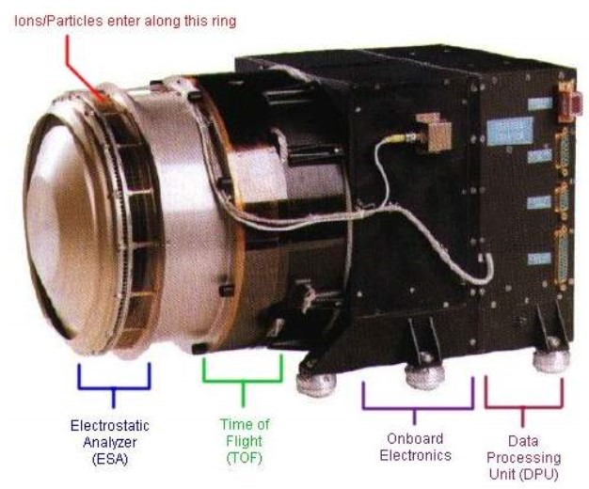
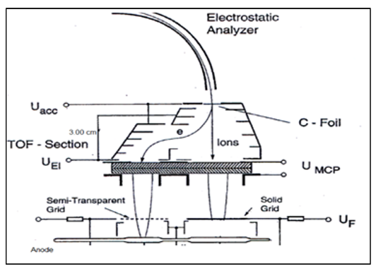
Background
Original CODIF
The COmposition and DIstribution Function analyzer (CODIF) is a typical Time-of-Flight (TOF) mass spectrometer that uses thin carbon foils and flat micro-channel plates (MCP) in chevron stacks.
CODIF has flown on the CLUSTER and Equator-S missions to collect data on ion masses and their abundance in the Earth’s magnetosphere.
Uses an electrostatic analyzer to select incoming ions by their energy/charge ratio.
To measure speed of incoming ions a start signal is initiated by secondary electrons from the carbon foil then a stop signal is generated by the MCP chevron assembly a known distance away.
The speed and the energy/charge provide the mass/charge ratio of the ion.
Notes:
CODIF is a spaceflight mass spectrometer that used to measure the mass/charge ratio of ions. It has been used in missions to the magnetosphere, which is the region around the Earth where the flow of particles is dominated by the magnetic field of the Earth. Outside the magnetosphere, the flow of the solar wind past the Earth strongly affects particle motion.
We want to know the mass/charge ratio of ions, because mass and charge are the two key ingredients by which particles engage with electric fields, and therefore either gain or lose energy. They also control how particles move in a magnetic field.
Ion energy and motion are important because they affect how the Sun’s energy is dissipated in the magnetosphere, particularly when a spectacular solar coronal mass ejection erupts. The aurora is a visible effect of the dissipation, as well as somewhat rare power grid failures.
Ions that gain considerable energy can interact with spacecraft, and potentially cause damage to electronics or astronauts. CODIF helps us understand how the whole solar-magnetospheric system works, and how it affects the way we live our lives on Earth and in space.

Slide 3
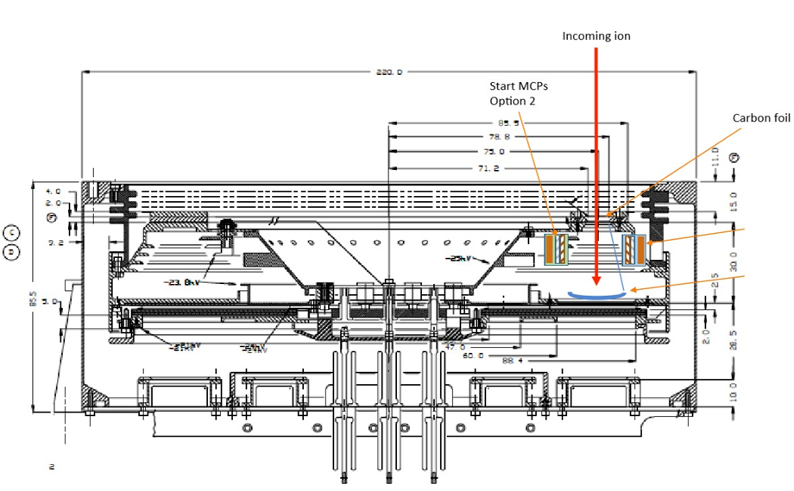
Background
Project Objectives
It is planned to modify the TOF enclosure to use a curved Start MCP and a toroidal Stop MCP in one of the four quadrants.
The MCPs are curved to simplify electron steering and accommodate the cylindrical shape of the CODIF.
The goal of the bracket system was to secure a curved MCP stack in a modified holder at a desired distance from a toroidal MCP stack.

Slide 4

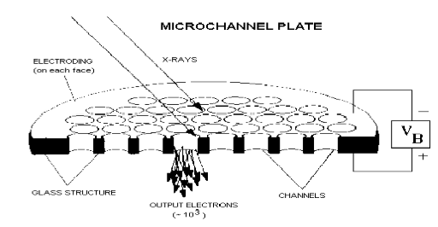
Background
Curved Microchannel Plates
Micro-channel plates are glass capillary arrays coated in a thin film to establish resistance and secondary emission functions.
These new MCPs are curved to simplify electron steering and accommodate the cylindrical shape of the mass spectrometer.
Secondary electrons from the carbon foil are attracted to an MCP held at a high voltage to provide a start timing signal.
The toroidal Stop MCP will improve TOF distributions by equalizing flight path.
Electrostatic simulations are used to evaluate the best radius of curvature for the Start MCP, and the width along the cylindrical axis.

Slide 5

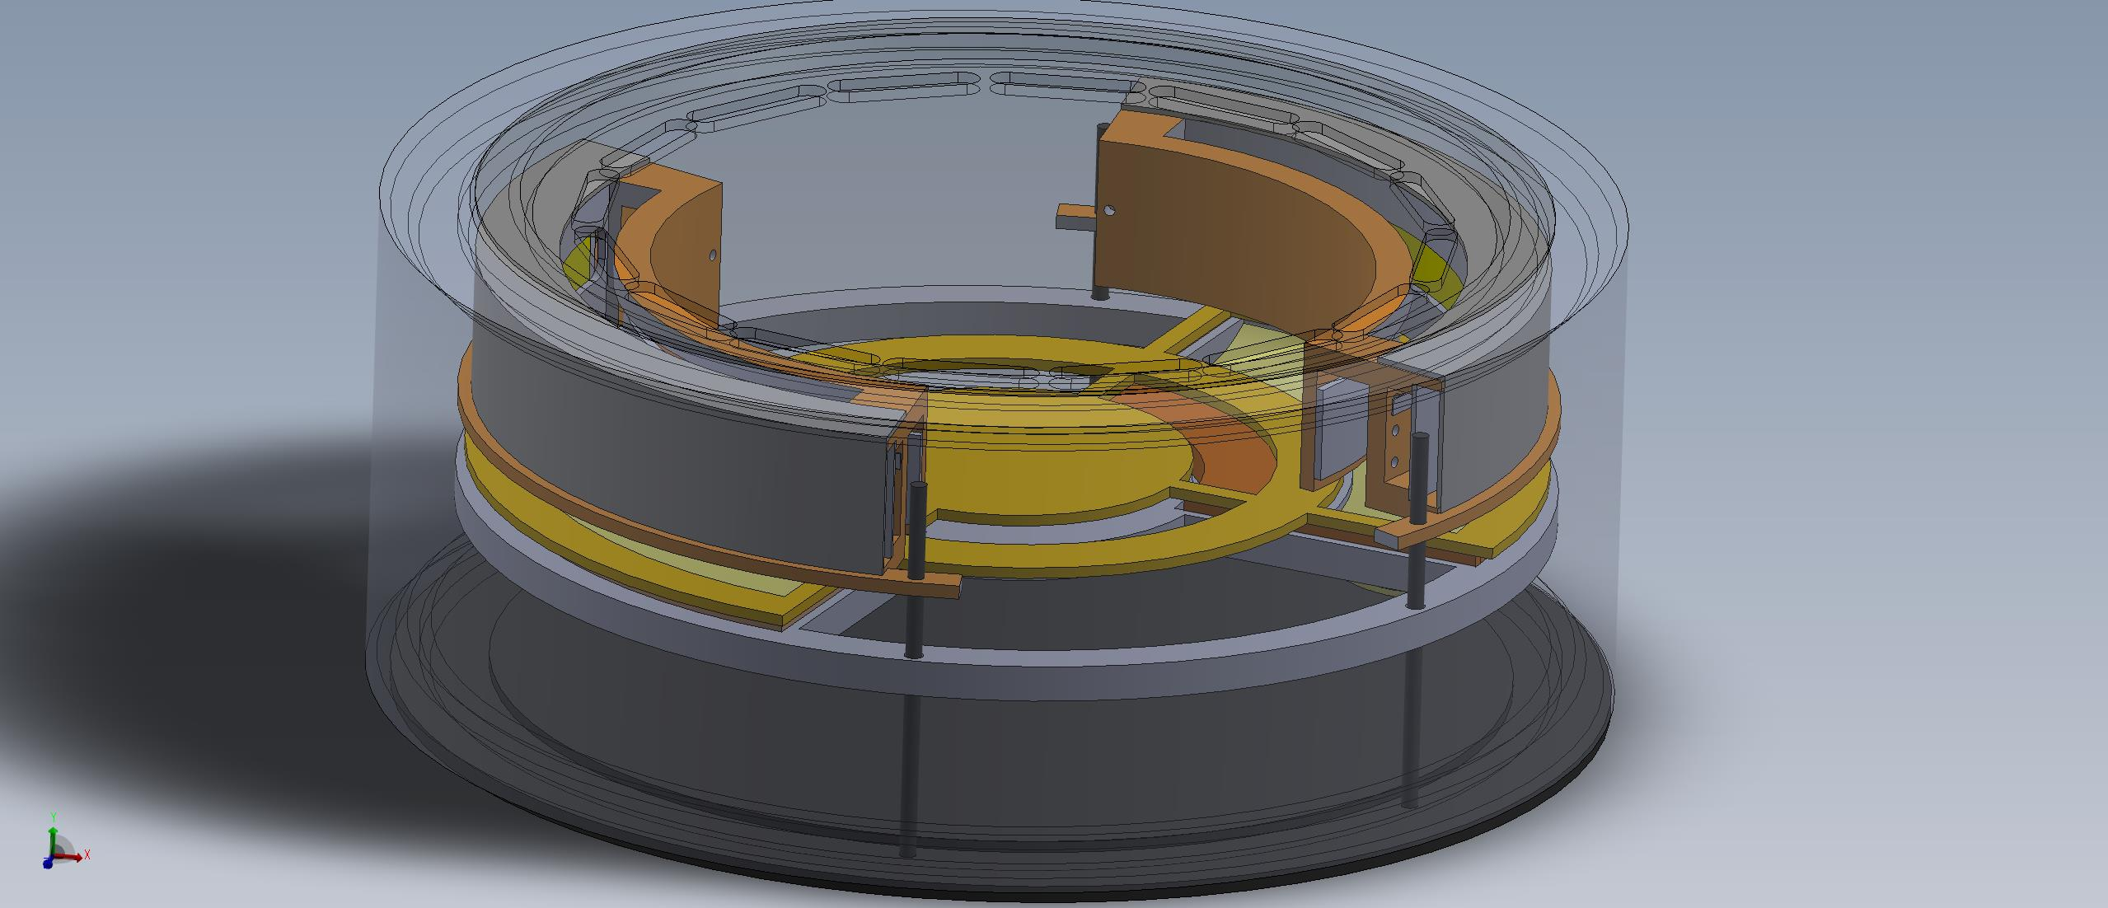
Design
Design Requirements & Challenges
Fabricate modified MCP holders to make use of newly developed MCPs to more efficiently steer the secondary electrons to the MCP and apply a lower attraction high voltage to the face of the MCP.
The CODIF design change will require design and machine shop time.
The design effort requires electrostatic simulations (SIMION) to determine the ion/electron dynamics in the TOF section and to determine the steering voltages for the deflection electrodes.
The fixture clamps the MCPs firmly but without damage and allow MCP output charge to reach a test anode without charging the fixture.
Reusing existing components with limited alterations.

Slide 6

Design
Bracket System
The bracket system created uses vertical rails with standoffs (cylindrical metal spacers) to separate thin plates that hold the start and stop MCP fixtures.
One modified quadrant will feature a curved Start MCP, and the original flat Stop MCP. The other modified quadrant will include both the curved Start and toroidal Stop MCPs.
Electrical components underneath modified TOF enclosure are not shown because they were unaltered and were ignored during design process.

Slide 7
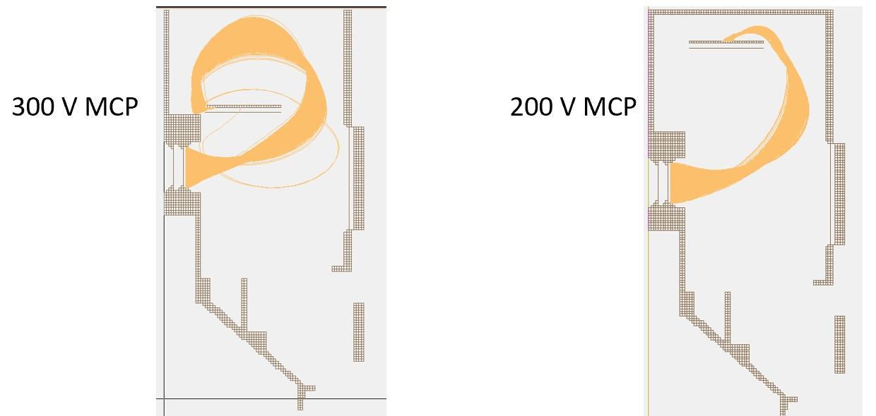
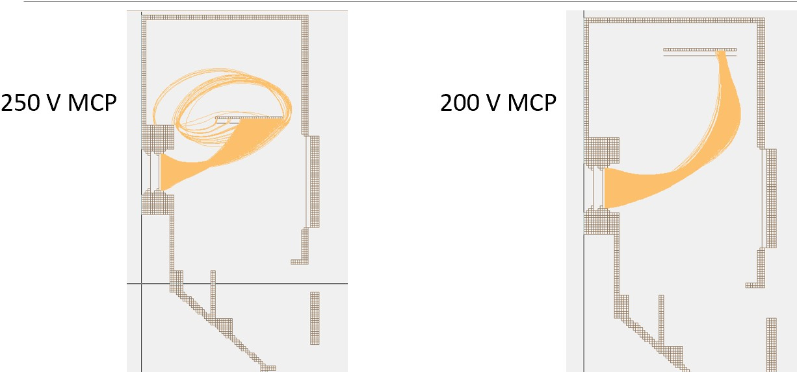
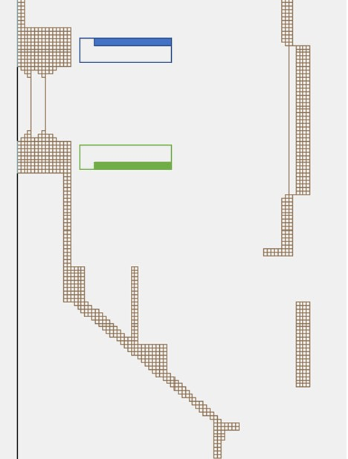
Design
Start Fixture
The CODIF Start MCPs will be 130 mm long and 17 mm wide. They will be bent into a cylindrical shape with an 83 mm radius of curvature
The mirrored electrode and anode are used to steer scattered electrons. Placement was determined by SIMION simulations.

Slide 8
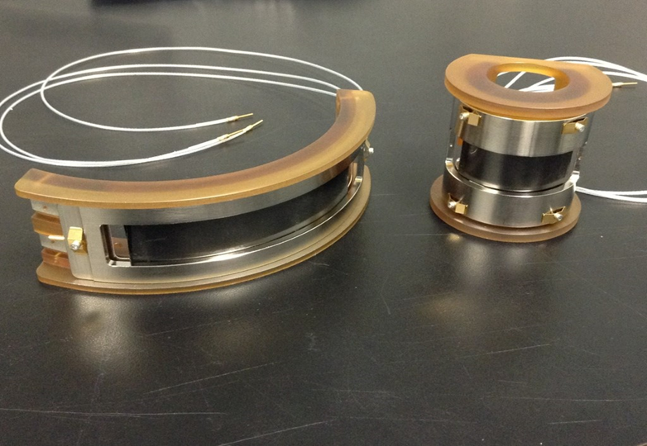
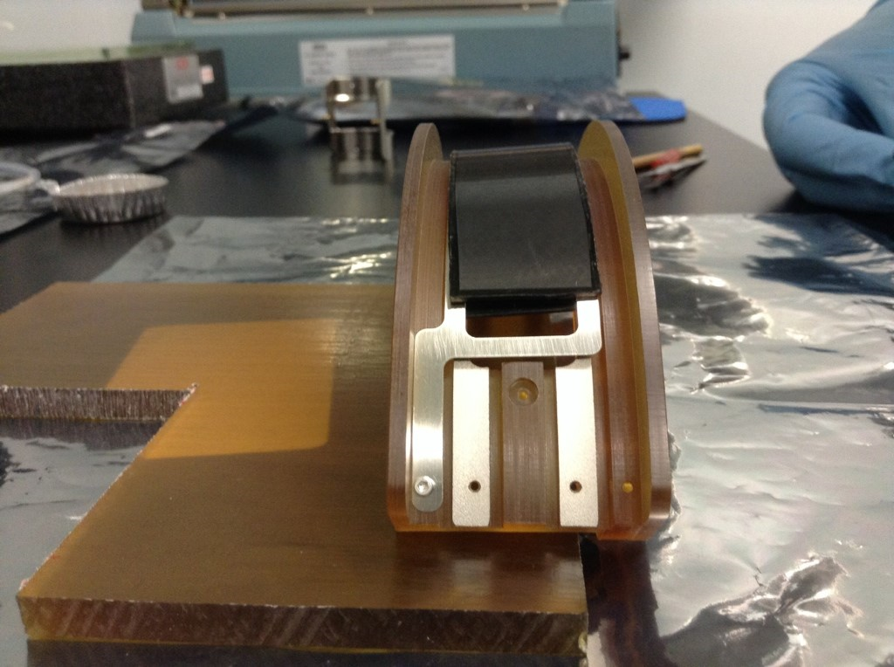
Design
Start Fixture continued
The Start MCP is held at a positive high voltage using the modified nickel-plated holder and cover and a thin nickel contact in the middle of the chevron stack.
The holder uses a brass spring clamping mechanism to prevent damage from securing the MCPs.

Slide 9


Design
Stop Fixture
The CODIF Stop curved MCPs will have a toroidal shape, with a large radius of curvature of 75 mm, and a small one of 30 mm.
The toroidal Stop MCP and anode are held in the existing butterfly fixture by using the designed ultem(vacuum-safe plastic) holder that gives the same TOF distance as flat stop MCP.
A thick ultem gasket in the flat MCP stack is used to accommodate for height offset of the butterfly clamp caused by the toroidal MCP.
Voltage is applied to the toroidal MCP with nickel-plated gasket and thin nickel contact in the middle of the stack.

Slide 10

Results and Conclusions
Stop Fixture continued
The UNH machine shop has made the rail baseplate system and has begun fabrication of the modified plastic start and stop MCP holders.
The thin nickel contacts are being fabricated by Incom.
Once the start and stop fixtures are completed nickel-plating will be applied by an independent company

Slide 11
Results and Conclusions
Project Objectives and Introduction
This design allows for improved performance and efficiency of the CODIF instrument and the ability to change flight path length for various testing.
The location of the MCP close to the carbon foil window means that the voltage can be much lower than in the earlier design of the instrument: 200 volts instead of the more typical 1000 volts. This improves high voltage stability.
The lower attraction voltage relieves the power budget and facilitates the collection of the MCP signal to electronics located at ground.

