Slide 1
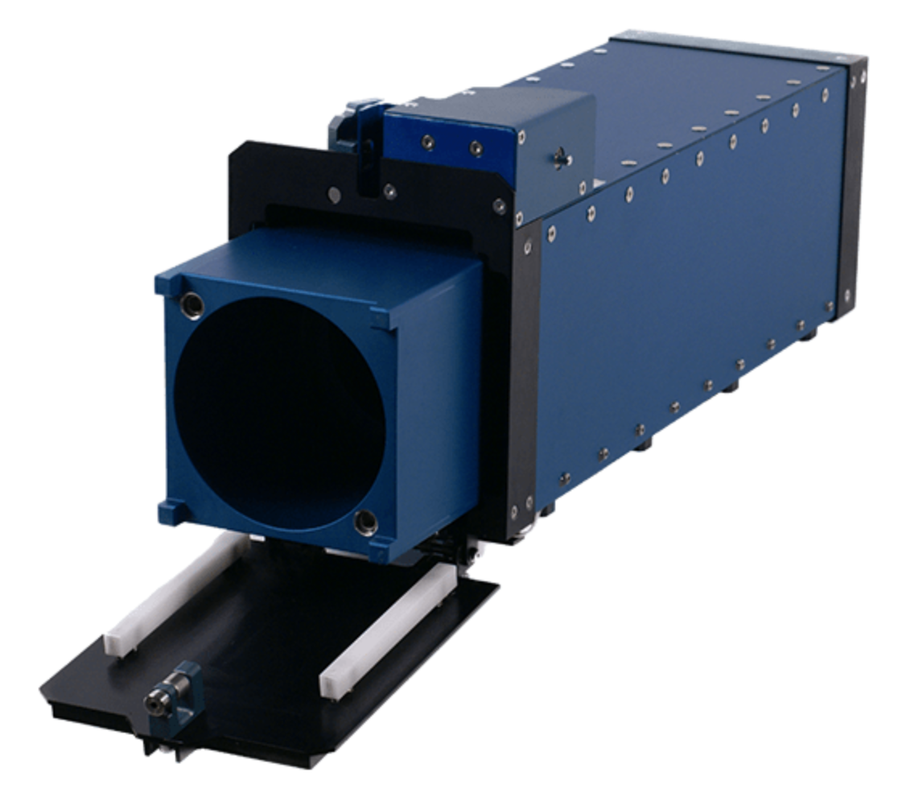
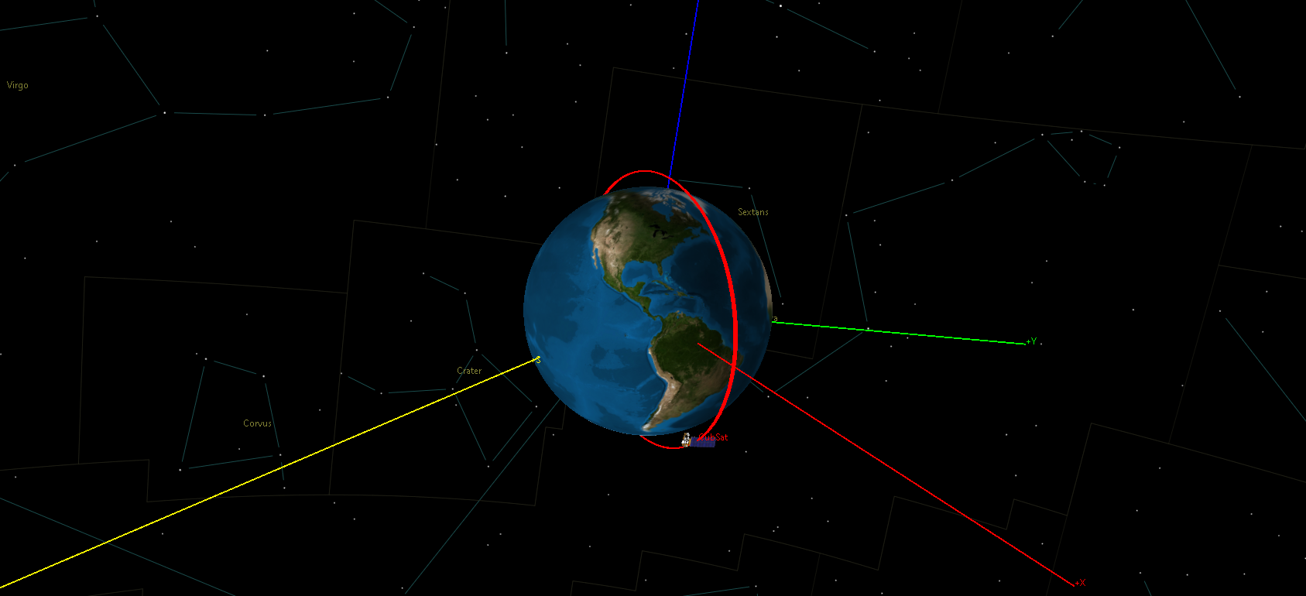
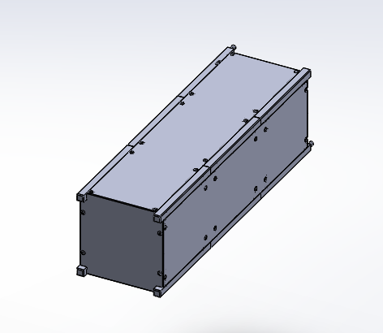
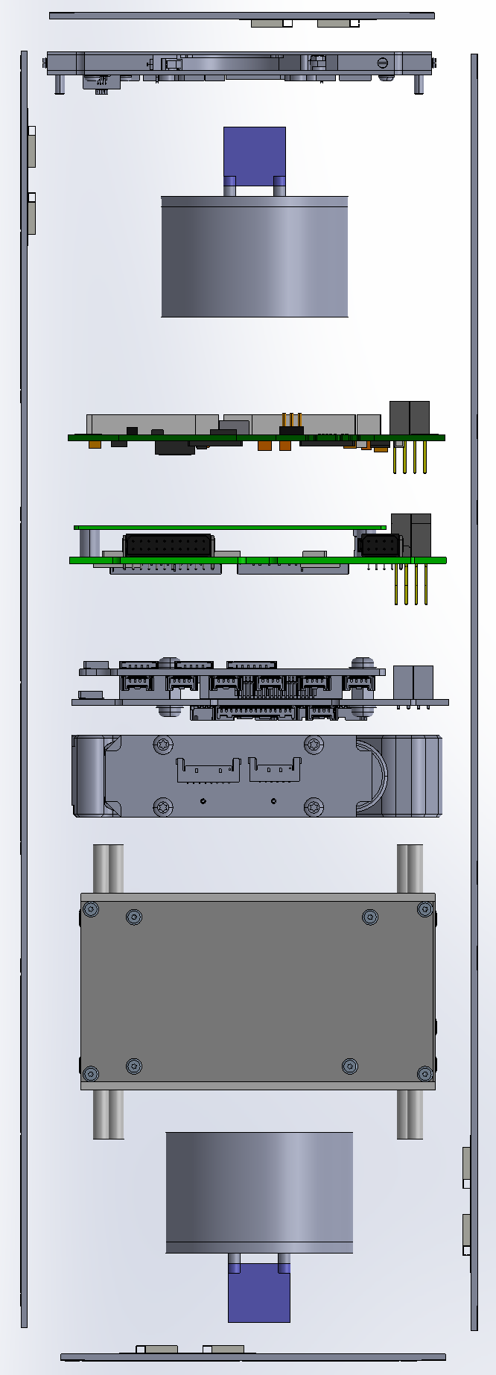
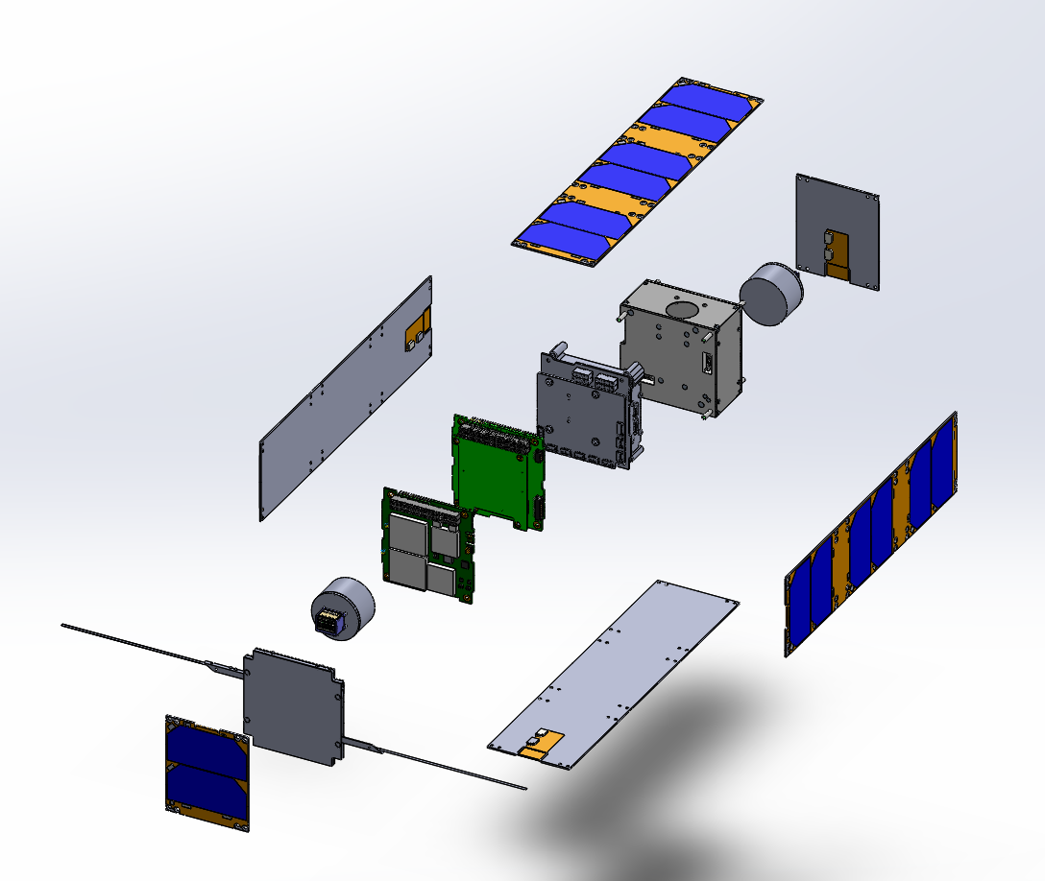
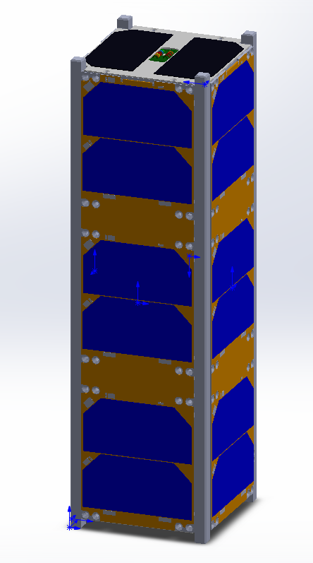
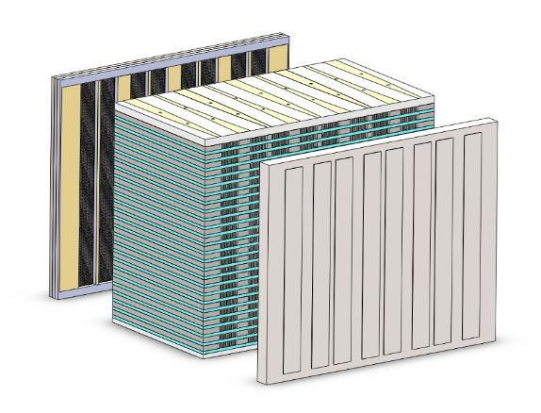
UNH CubeSat Reed Dannar, Cam Lamarre & Robert Wells Physics Department, University of New Hampshire, Durham, NH 03824
Abstract
3-U Cube Satellite
Orbital Design
Geomagnetic storms are temporary disturbances of the Earth’s magnetosphere caused by a solar wind shock wave and/or cloud of magnetic field that interacts with the Earth’s magnetic field. These storms can have various implications that include spacecraft surface charging, blocking radio communications and inducing current in electricity lines. The more we can understand and predict these storms the earlier we can prepare spacecraft and electrical grids to avoid being affected. Dr. Amy Keesee is developing an ultra-compact, low-voltage plasma spectrometer that can analyze the flux of ions and electrons in a plasma. The UNH CubeSat team is developing a 3U Cube Satellite that will house Dr. Keesee’s spectrometer with intentions to fly and collect relevant data to bring the instrument’s Technology Readiness Level (TRL) from a 5 to a 7. This will allow for the instrument to be used on future satellite constellation missions with aspirations to predict space weather. Our CubeSat has stackable subsystems that include the payload, ADCS, power system, communications and command and data handling. The UNH CubeSat has a deployable antenna and solar panels to take advantage of the orbit. The CubeSat’s launch vehicle will be a rocket that allows for the Satellite to achieve a sun synchronous, polar/high-inclination orbit, that we simulated. The next step is to write a proposal to receive funding. Once we receive funding the UNH CubeSat team can begin the building and testing phase with a launch projection of 3 years from now.
.
Cost: $300,000 | Mass: 2.1 kg | Temp. Range: -10 to 60 ℃ | Attitude Control: <0.1° | Lifetime: 1-5 yrs
• Sun Synchronous, Polar/High Inclination, LEO
• Desired: i = 86° (75-105°), altitude = 450 km (400-600 km)
- Must align the spectrometers (z-axis) with Earth’s magnetic field lines to ##collect plasma flux at poles.
• Launch Vehicle
- Rocket
• Launch Device
- Pea Pod
Payload:
• Spectrometer: Low-Voltage, ##Ultra-Compact Plasma Spectrometer
Communications:
• Antenna: ISIS Deployable Antenna System
- Greater than 10 MHz usable bandwidth
- Max RF power: 2W
• Transceiver: ISIS UHF Downlink/VHF ##Uplink Full Duplex Transceiver
- 4W power consumption
- Transmitter:
• Frequency range: 435-438 MHz
• Data rate selectable: 1200-9600 bps
- Receiver:
• Frequency range: 145.8-146 MHz
• Data rate: 9600 bps
• GPS: GPS Receiver
Command & Data Handling:
• OBC: ISIS On Board Computer
- Processor speed of 400 MHz
- 512 kB FRAM
Attitude Control:
• ADCS: KU Leuven ADCS
- Star tracker
- 3 reaction wheels
- 3 magnetorquers
- 3 gyroscopes
- 3 magnetometers (external)
- 6 photodiodes (from solar panels)
- Pointing accuracy <0.1 deg
Power Systems:
• Battery:
- ISIS iEPS Electrical Power System
- 3.3 & 5V regulated buses
- Power Delivered: 20W @ 5V over 4 ###channels
- Energy storage: 22.5 Wh
- iEPS board w/ modular 4-Li-ion cell ###battery pack and daughterboard
• Solar Panels:
- ISIS CubeSat Solar Panels
- Sun sensors
- Temperature sensors
- Deployable to increase surface area in ###sunlight
- Collects 6.9W for 3U and 2.3W for 1U
+Z
CubeSat Orbit
+Y
+X
CubeSat Deployer: ISIS ISIPOD 3-Unit
SUN
Orbital Simulation
Future Work
• Thermal Protection System
- Design a thermal protection system
###to maintain -10 to 60 ℃
• Project Proposal
- Must be selected to receive funding
• Building & Testing Phase:
- Center of Mass
- Moment of Inertia
- Thermal Cycling
- Thermal Vacuum
- Vibration
- Shock
• Launch: Projected Summer 2023
Introduction
• Geomagnetic storms are temporary disturbances of the Earth’s magnetosphere caused by a solar wind shock wave and/or cloud of magnetic field that interacts with the Earth’s magnetic field.
• These storms can have various implications that affect different technologies at Earth.
• These include: surface charging of spacecraft flying at high latitudes, blocking radio and satellite communications and inducing current in electricity lines, which could degrade power grid operations and lead to blowing a transformer.
• The more we can understand and predict these storms the earlier we can prepare our spacecraft and electrical grids to avoid being affected.
SolidWorks CubeSat Frame/Structure:
• Space grade aluminum alloy <285g
Conclusion
To further this project, a thermal protection system needs to be designed and a proposal needs to be written to receive funding. If our project proposal is selected, the UNH CubeSat team can begin the building and testing phases. During this time the team will need to find a suitable launch vehicle (rocket) that will allow the CubeSat to obtain the desired orbit. Completing these final stages will allow for a projected launch date of Summer 2023.
Plasma Spectrometer
SolidWorks CubeSat Subsystems Model
Collimator
Energy Analyzer
Acknowledgements
Need for KeV particle measurement for space weather monitoring
Ions or electrons ~5-20 keV
Voltages < 100V
Volume < 2 cm³
Manufacturing process like computer chips
Price per 25 stack plus detector ≅ $100k
Ideal for future satellite constellation missions
Solid State Detector
Supported by Research Advisor: Dr. Amy Keesee
References
• EnduroSat - Class-leading CubeSat Modules, NanoSats & Space Services. (n.d.). Retrieved from https://www.endurosat.com/
• One-stop webshop for CubeSats & Nanosats. (n.d.). Retrieved from https://www.cubesatshop.com/
Spectrometer
CubeSat SolidWorks Model

