Slide 1
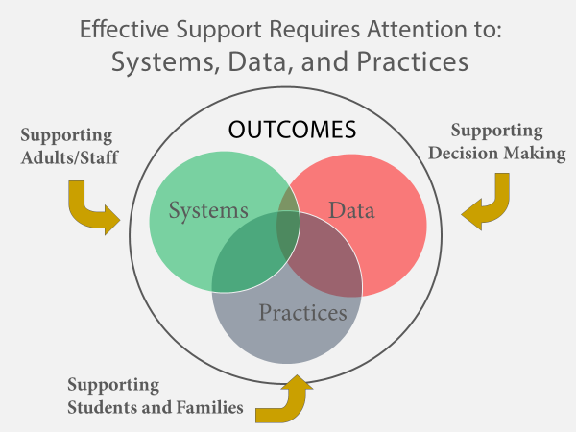
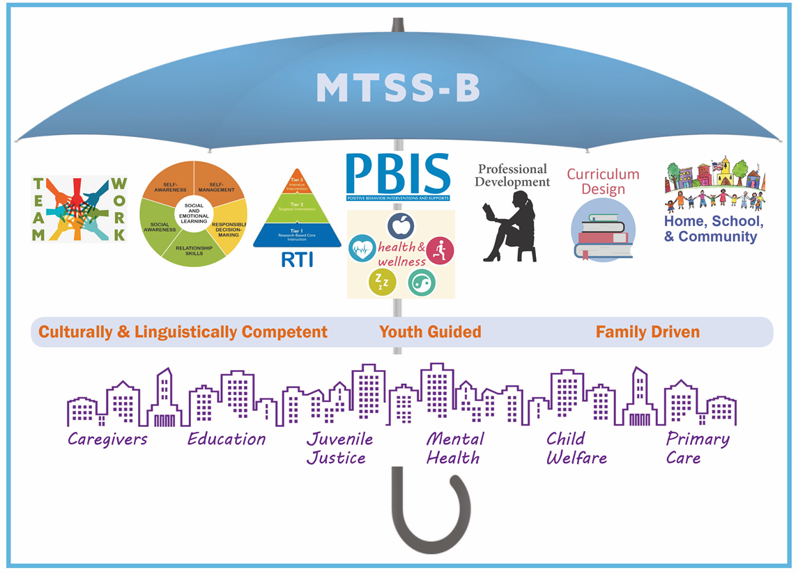
Integrating Multi-Tiered Systems of Support for Behavioral Health & Wellness (MTSS-B) in NH School Systems
Grace Canavan, BSN, RN Nursing Trainee
What is MTSS-B
Project Description
Conclusions/ Effects of MTSS-B
Purpose- create a MTSS-B implementation workbook that provides district/ leadership teams with additional materials and resources to help guide implementation
Work with building level teams through training process to understand commonly asked questions, barriers to implementation, and what resources would be helpful for beginners
Compile helpful resources and activities into a comprehensive manual that implementation teams can refer to (Chapters 1-7)
Ensure workbook is accessible by providing alternative image descriptions throughout manual to be used with screen or text readers for individuals with visual impairments.
The MTSS-B framework is a way to improve school interventions by providing an ongoing continuum of supports. It has been proven to
Decrease lost classroom time related to traditional disciplinary measures
Create school climates and cultures that are positive and inclusive of all students
Improve student academic outcomes and achievements
Reduce behavioral issues in school
Increase student and family engagement
“It isn’t about giving staff more work, its about giving them a way to improve the work they are already doing” –Salem School District
Multi-Tiered Systems of Support for Behavioral Health & Wellness (MTSS-B) is a framework that helps schools to use data to determine which evidence based interventions best support the needs of students in their school/ community, emphasizing preventative and early interventions
The goal of MTSS-B is to:
Implement an evidence-based framework into school systems throughout NH through preventative interventions
Increase focus on the complex social, emotional, and behavioral needs of youth in schools.
Provide staff and students with a continuum of supports that are trauma informed
Next Steps
Present manual to MTSS- B collaborative for further editing
Continue to compile useful resources to be used in manual
Distribute completed manuals to implementation teams for reference throughout MTSS-B roll-out

Slide 2
References
Bradshaw, C.P., Mitchell, M.M., Leaf, P.J. (2010). Examining the effects of Schoolwide Positive Behavioral Interventions and Supports on student outcomes. Journal of Positive Behavior Interventions, 12(3):133–148.
Bradshaw, C.P., Waasdorp, T.E., & Leaf, P. (2012). Effects of School-Wide Positive Behavioral Interventions and Supports on child behavior problems. Pediatrics, 130(5):1136-1145.
Horner, R.H., Sugai, G., Smolkowski, K., et al. (2009). A randomized, wait-list controlled effectiveness trial assessing School-Wide Positive Behavior Support in elementary schools. Journal of Positive Behavior Interventions, 11(3):133–144.

