Slide 1
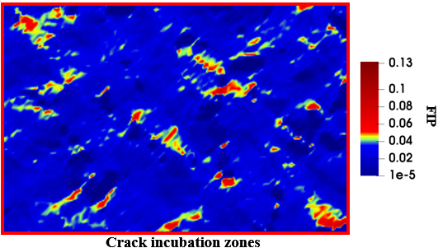
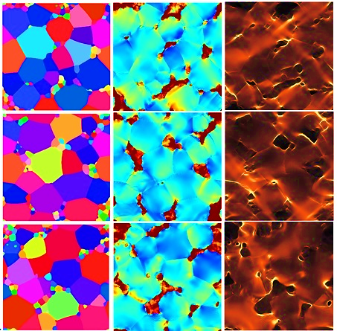
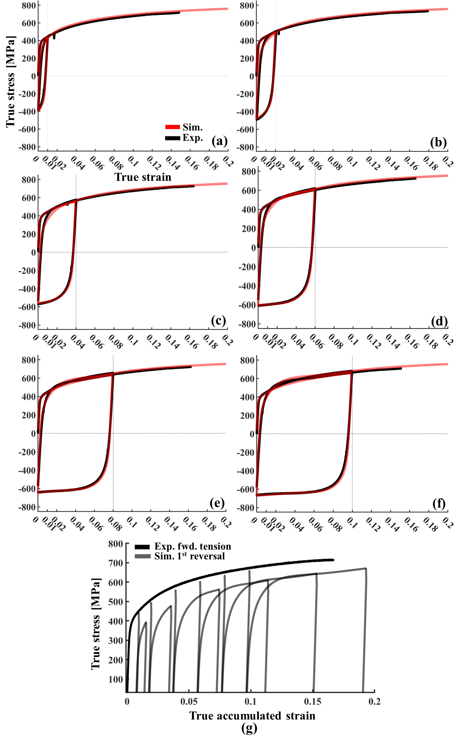
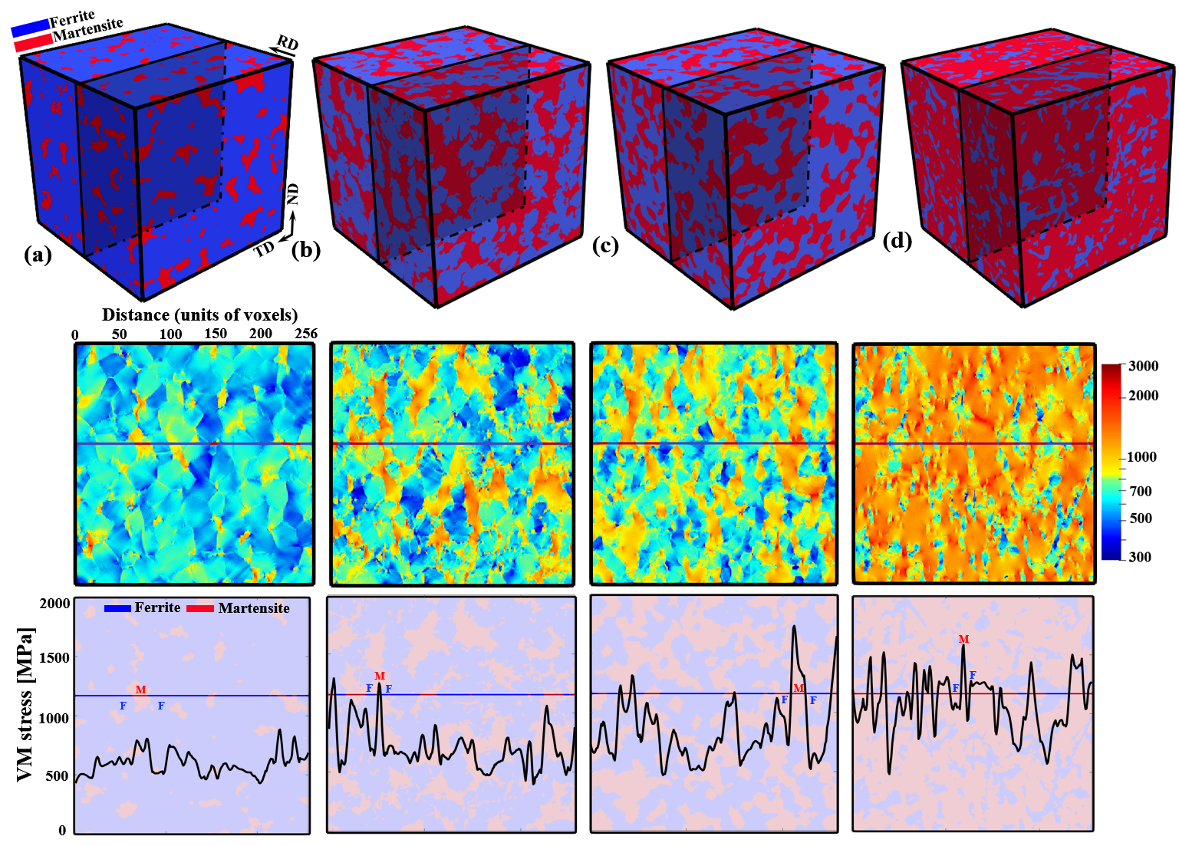
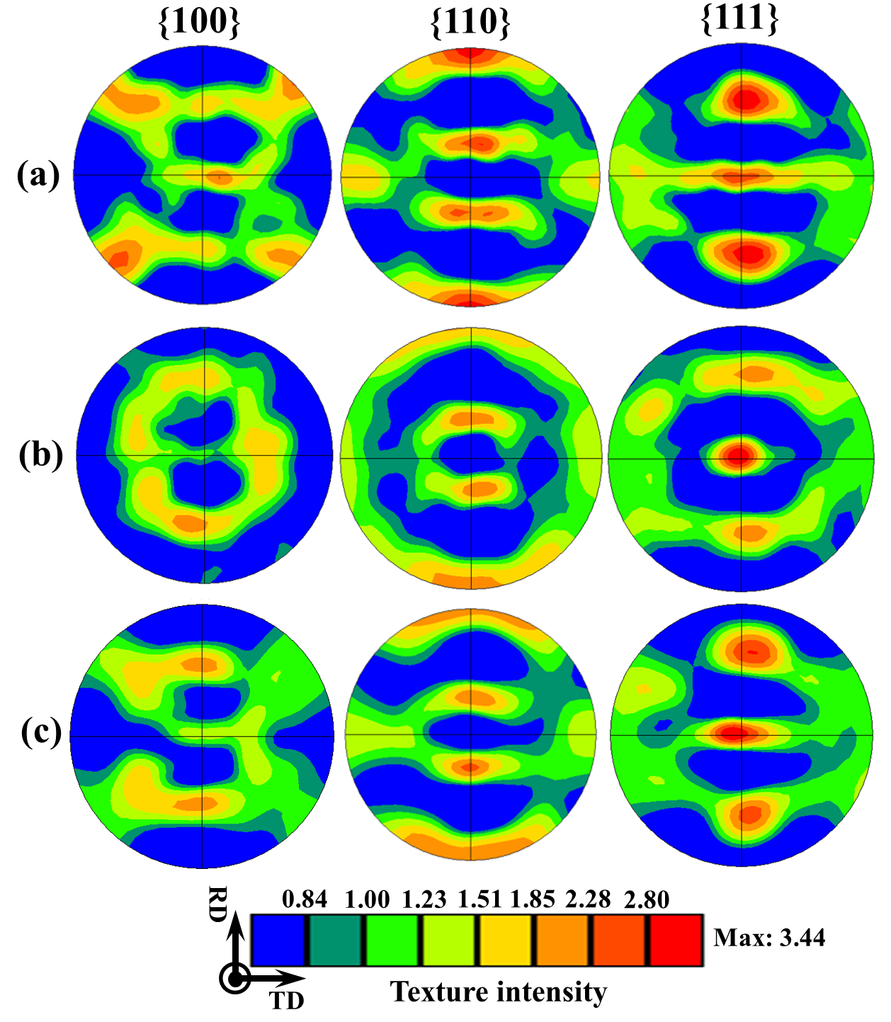
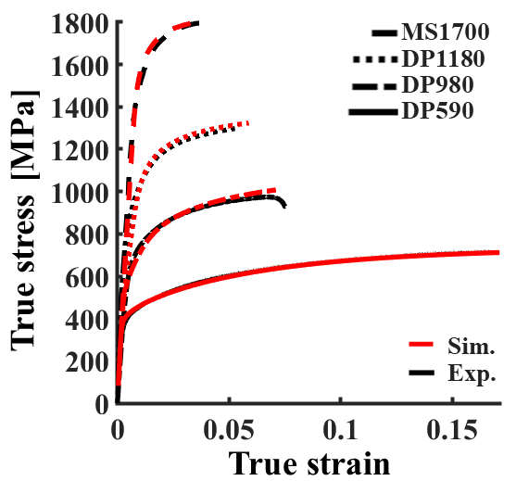
High-performance full-field crystal plasticity with dislocation-based hardening and slip system back-stress laws: Application to modeling deformation of dual-phase steels
Adnan Eghtesad
[Department of Mechanical Engineering, University of New Hampshire, Durham, NH 03824, USA]
Kai Germaschewski
[Department of Physics, University of New Hampshire, Durham, NH 03824, USA]
Ricardo A. Lebensohn
[Materials Science and Technology Division, Los Alamos National Laboratory, Los Alamos, NM 87544, USA]
*Marko Knezevic
[Department of Mechanical Engineering, University of New Hampshire, Durham, NH 03824, USA]

Slide 2
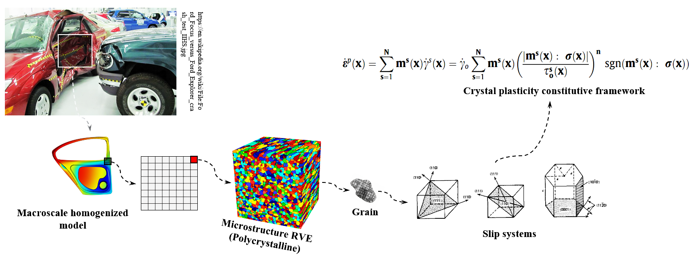
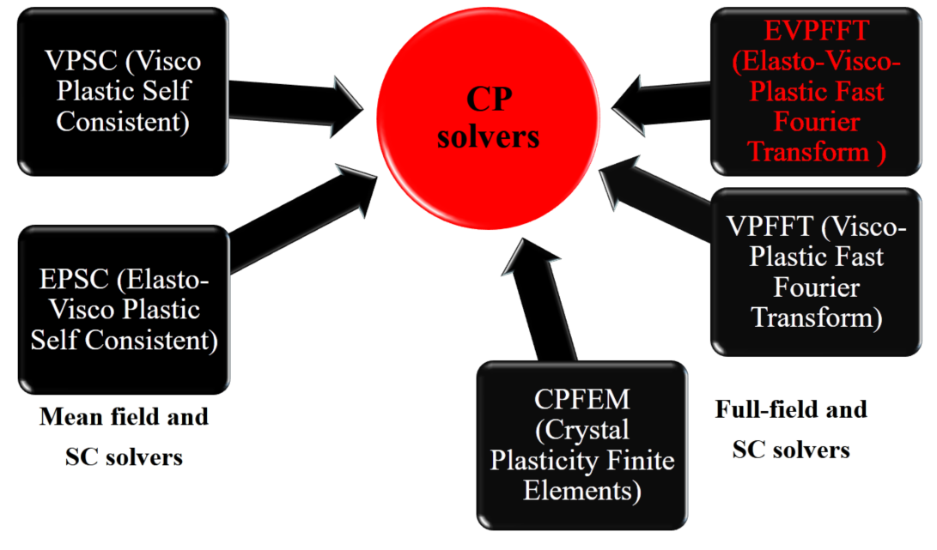
Computational Crystal Plasticity
Marko Knezevic
Miroslav Zecevic
Evgenii Vasilev
Eftekhar Riyad
Adnan Eghtesad
Milovan Zecevic
Timothy J. Barrett
Zhangxi Feng
Sowmya Daroju
Adnan Eghtesad
Adnan Eghtesad
Marko Knezevic
Milan Ardeljan
William Feather
Dan savage

Slide 3
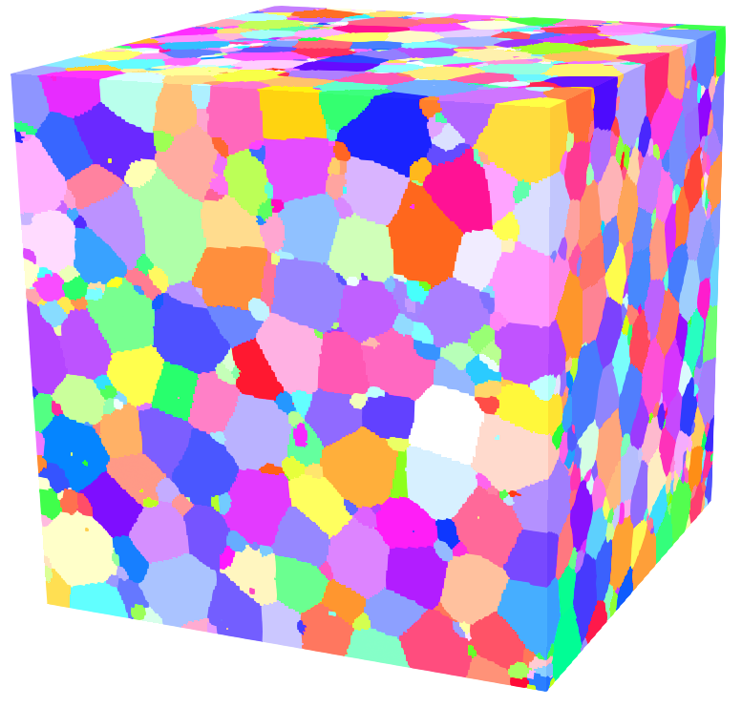
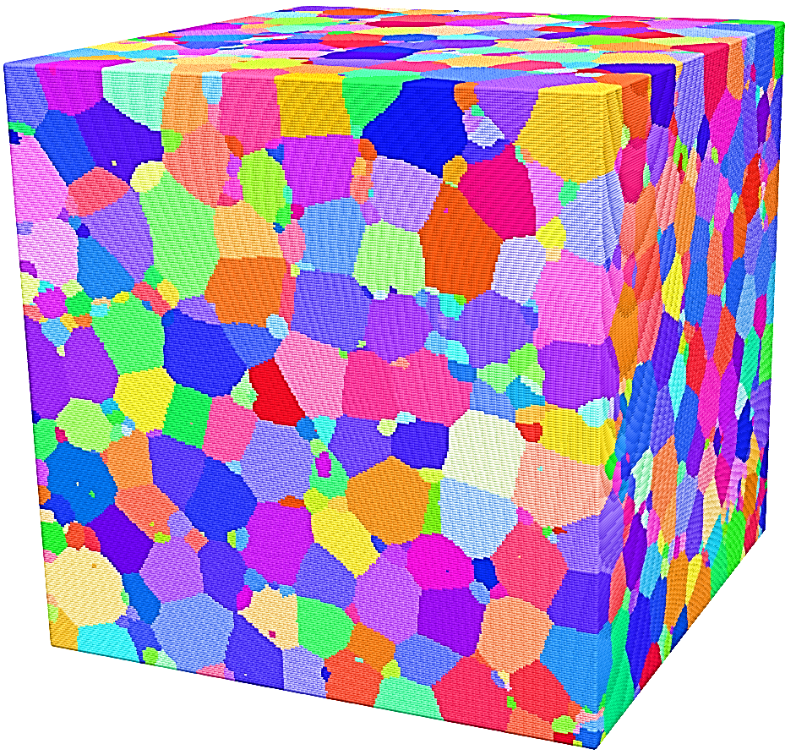
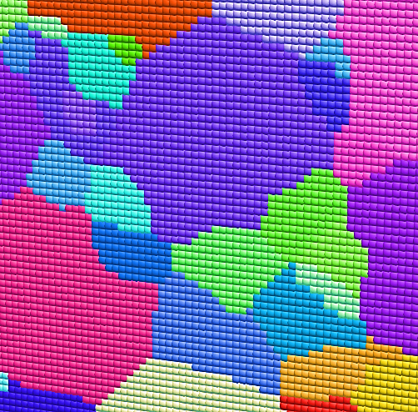
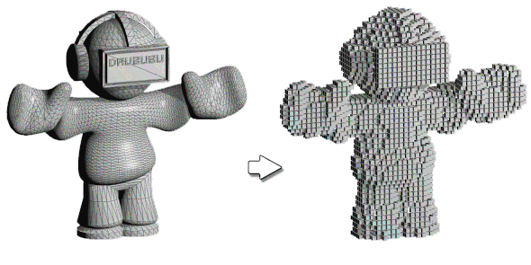
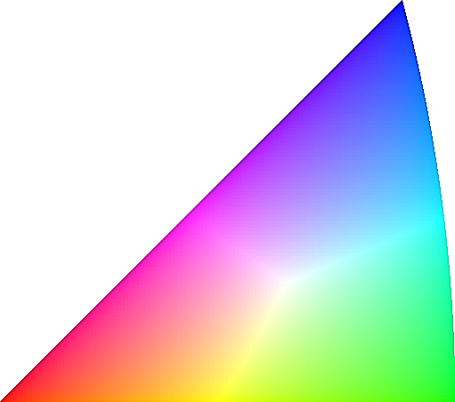
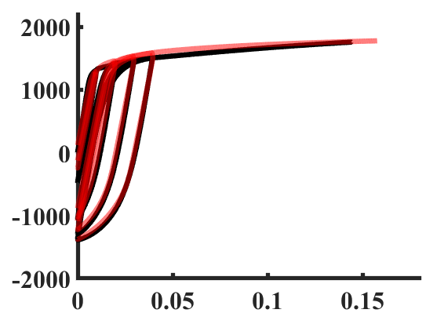
EVPFFT (Elasto-Visco-Plastic Fast Fourier Transform ) micromechanical full-field solver
[111]
[101]
[001]
Grid
Voxels
Solid RVE
Discretized RVE
Voxels
(FFT sampling points)
(a) DP590
(b) DP980
(c) DP1180
(d) MS1700
Texture evolution, monotonic
and cyclic deformation
Qualification and quantification
of micromechanical fields

Slide 4
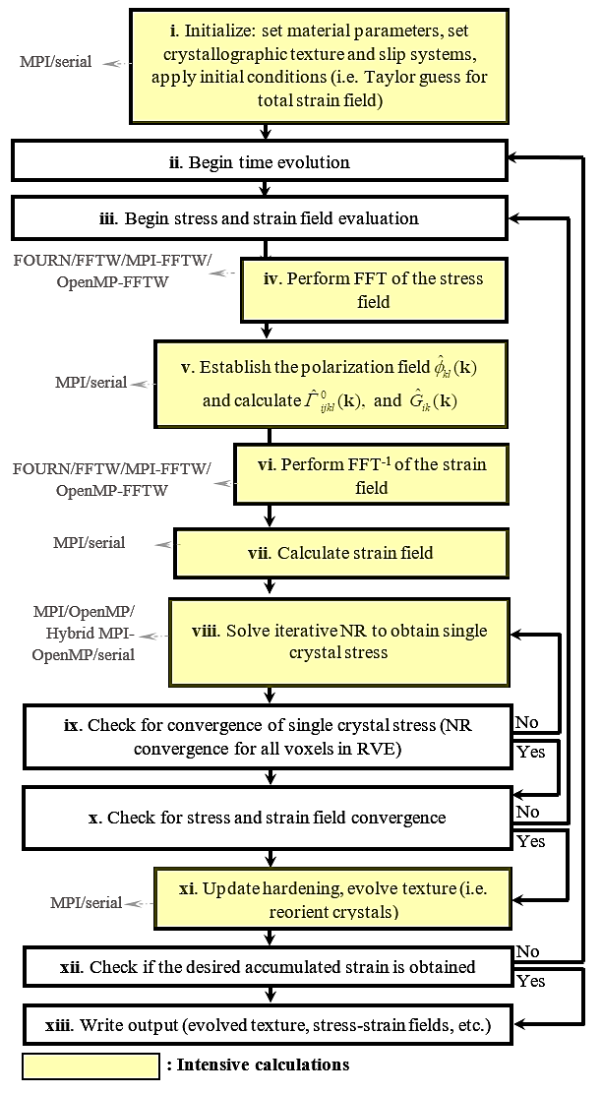
Mathematics behind EVPFFT
Constitutive Equations for CP framework
Physics-based dislocation density hardening law
…
Green’s solution for
displacement field
Texture update

Slide 5
Motivation behind high-performance
computing development of EVPFFT

Slide 6
DP 590 steel microstructure
High-res fields
# of voxels:
Simulating such high-resolution microstructure (~17 million FFT points) will take months of run …
However, such resolution is necessary to capture the field gradients at GB, more accurately.

Slide 7
High-performance EVPFFT on distributed hybrid GPU-CPU architecture
Parallel EVPFFT
MPI
GPU
Multi-GPU
OpenMP
Hybrid OpenMP MPI
Parallel FFTs
MPI FFTW
CUFFT
Threaded FFTW
EVPFFT Parallel versions
Parallel FFTs running within EVPFFT

Slide 8
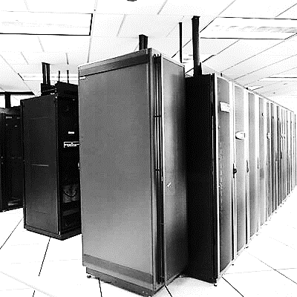
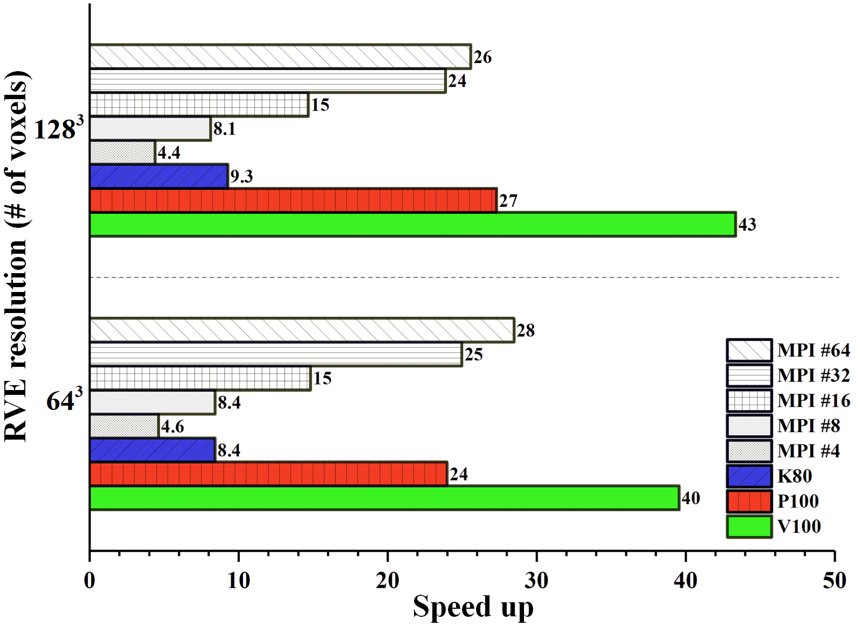
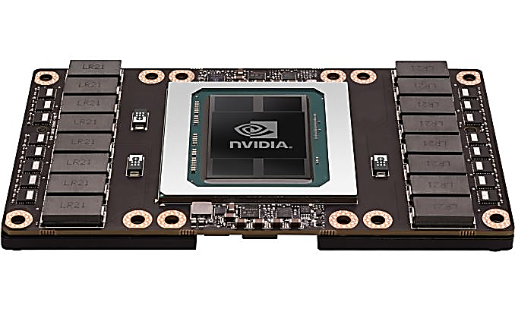
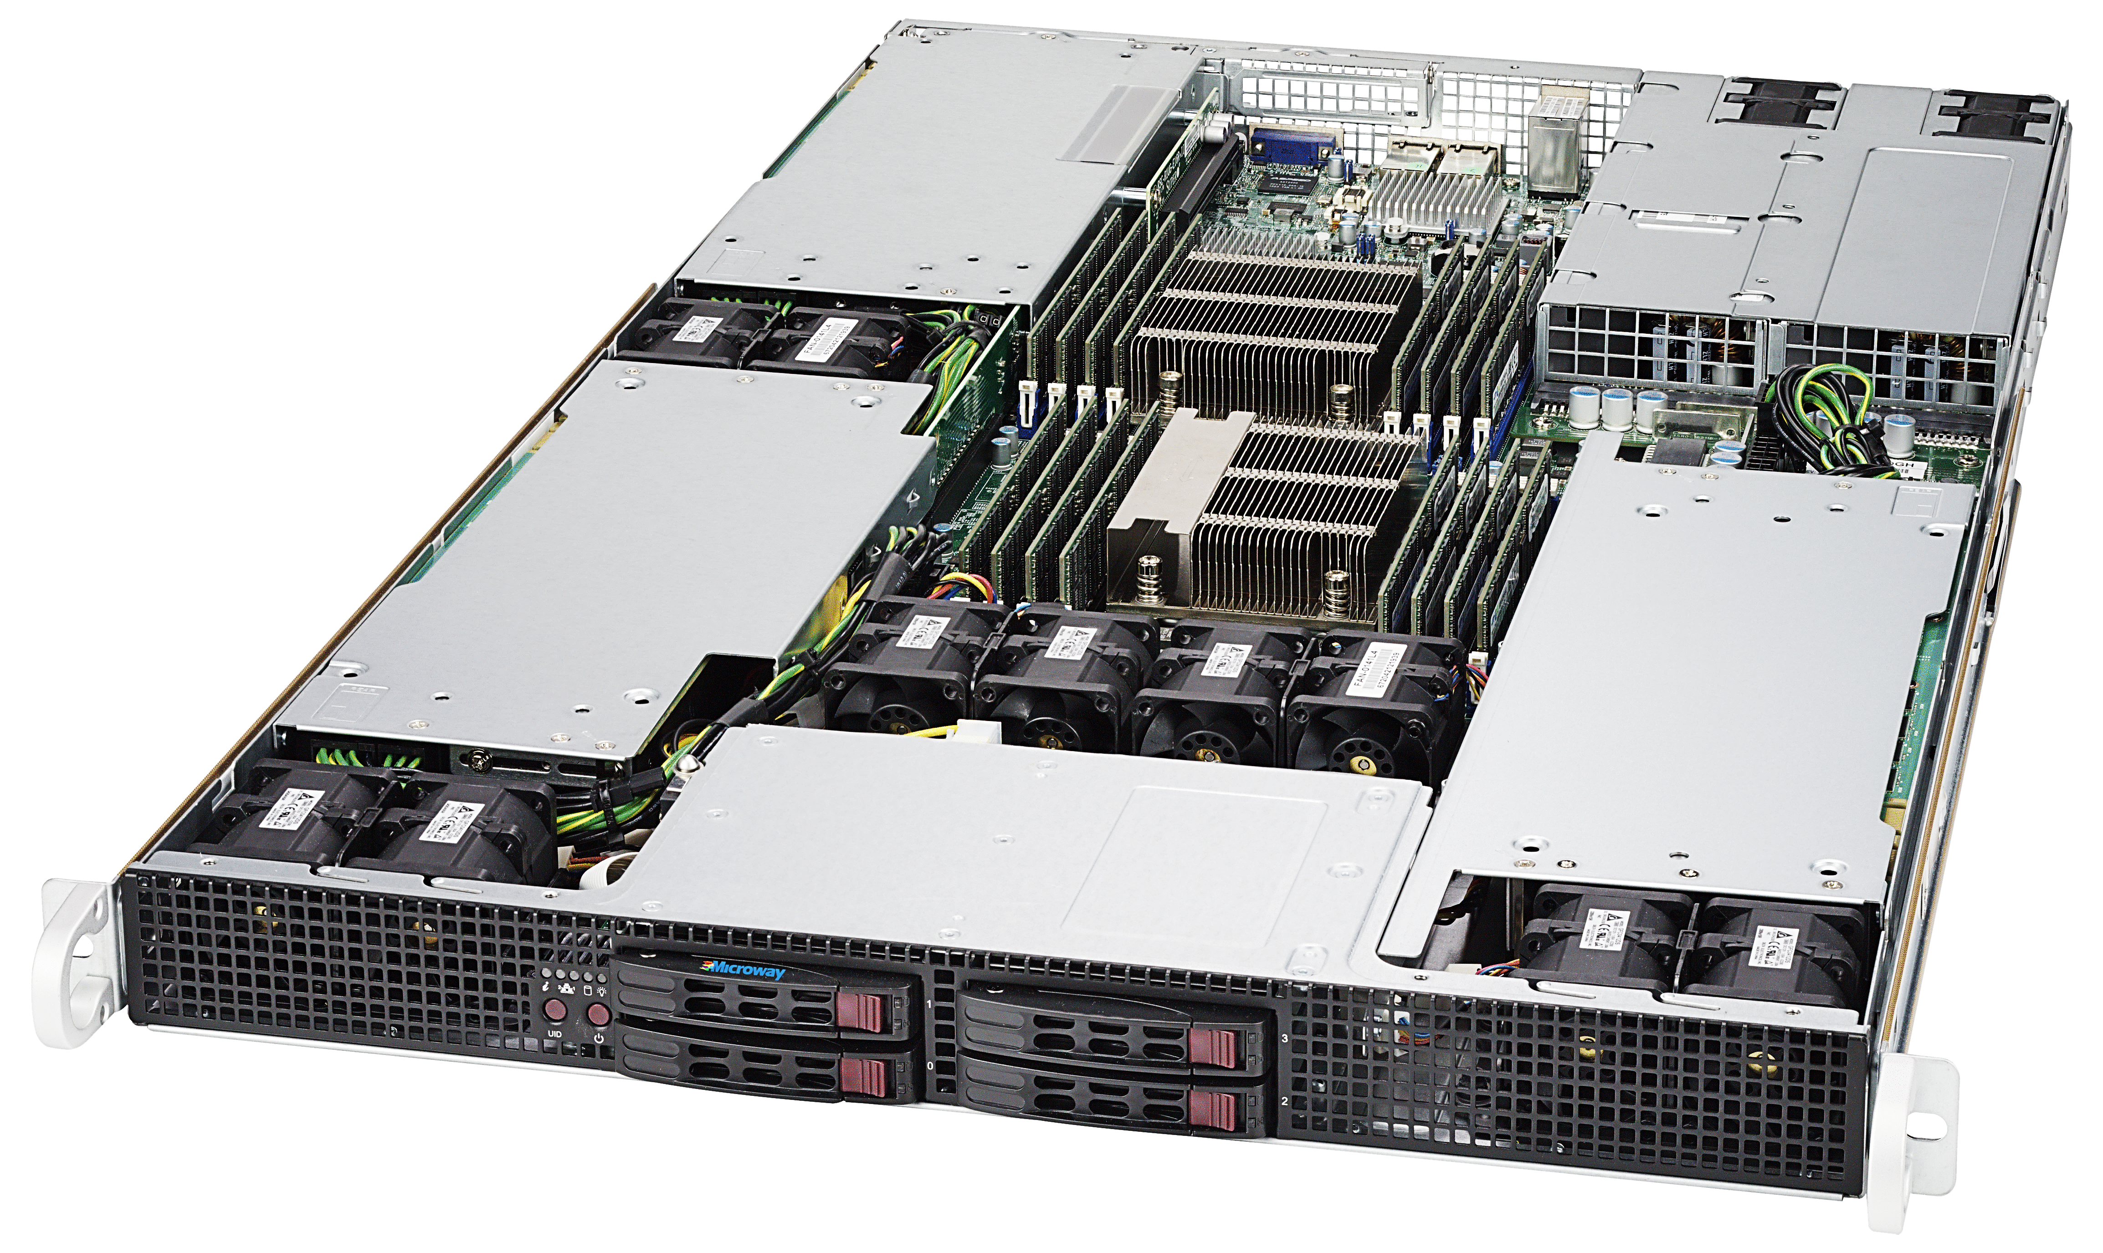
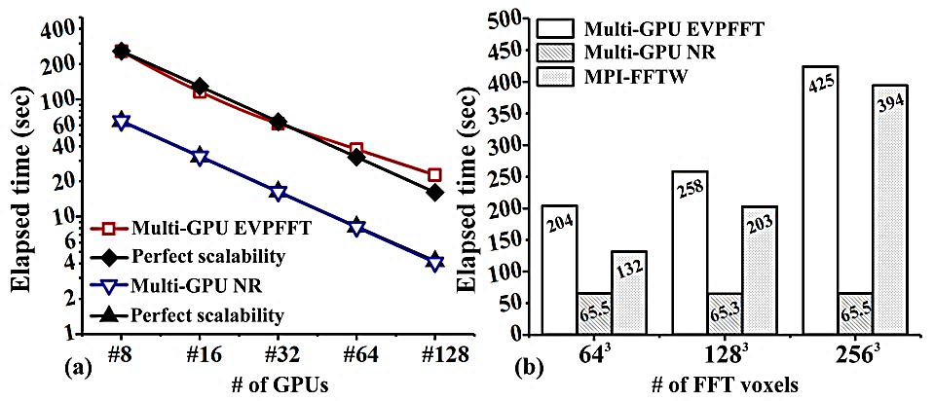
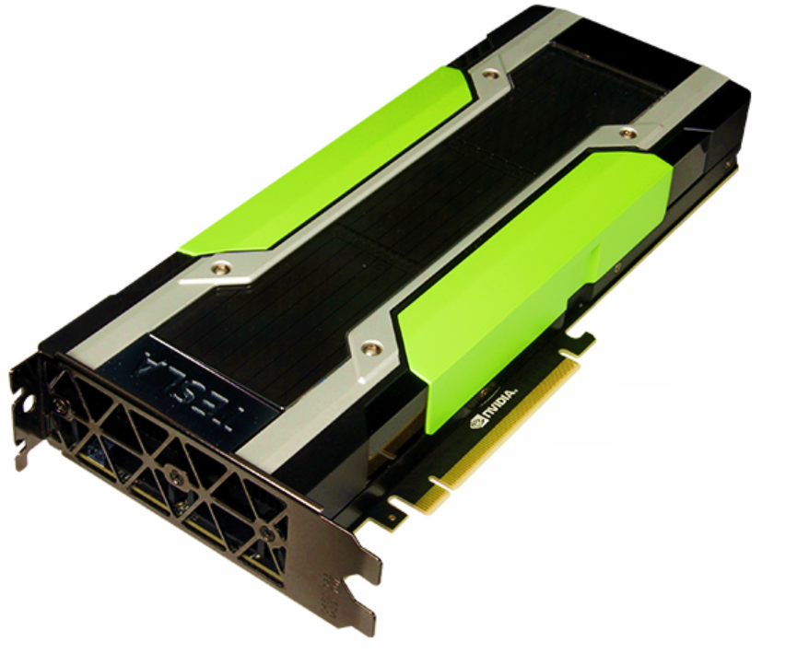
NVIDIA TESLA V100, the current world leading GPU computing architecture [GPU-EVPFFT : up to 43x speedup on single GPU, expected speed up on 10 GPUs: 430X, yet to be tested on BioMade supercomputer]
Perfect strong scalability on Multiple GPUs tested on Titan @ Oak ridge national lab running on 128 K20X GPUs
UNH RCC : Trillian Cray, BioMade, Mech 3-9 servers

Slide 9
Simulation of Martensitic-Ferritic dual phase steels under monotonic and cyclic loading

Slide 10
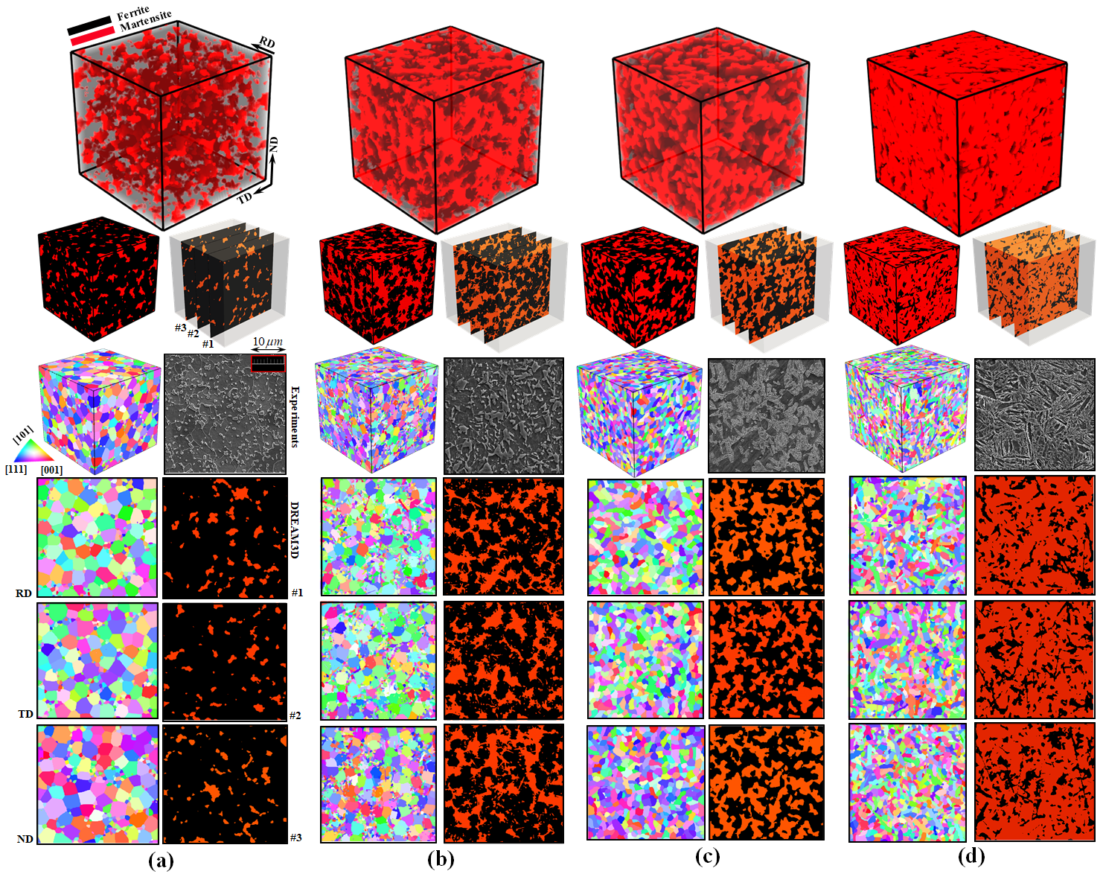
DREAM3D microstructure based on the SEM images of Ferritic-Martensitic phase distributions for
DP590, DP980, DP1180, and MS1700
(a) DP 590 (7.7% martensite)
(b) DP 980 (39% martensite) (c) DP 1180 (45% martensite)
(d) MS 1700 (80% martensite)
Measured textures
(MS1700 is almost uniform)

Slide 11
Prediction of elastic anisotropy based on crystal mechanics
Elastic response:

Slide 12
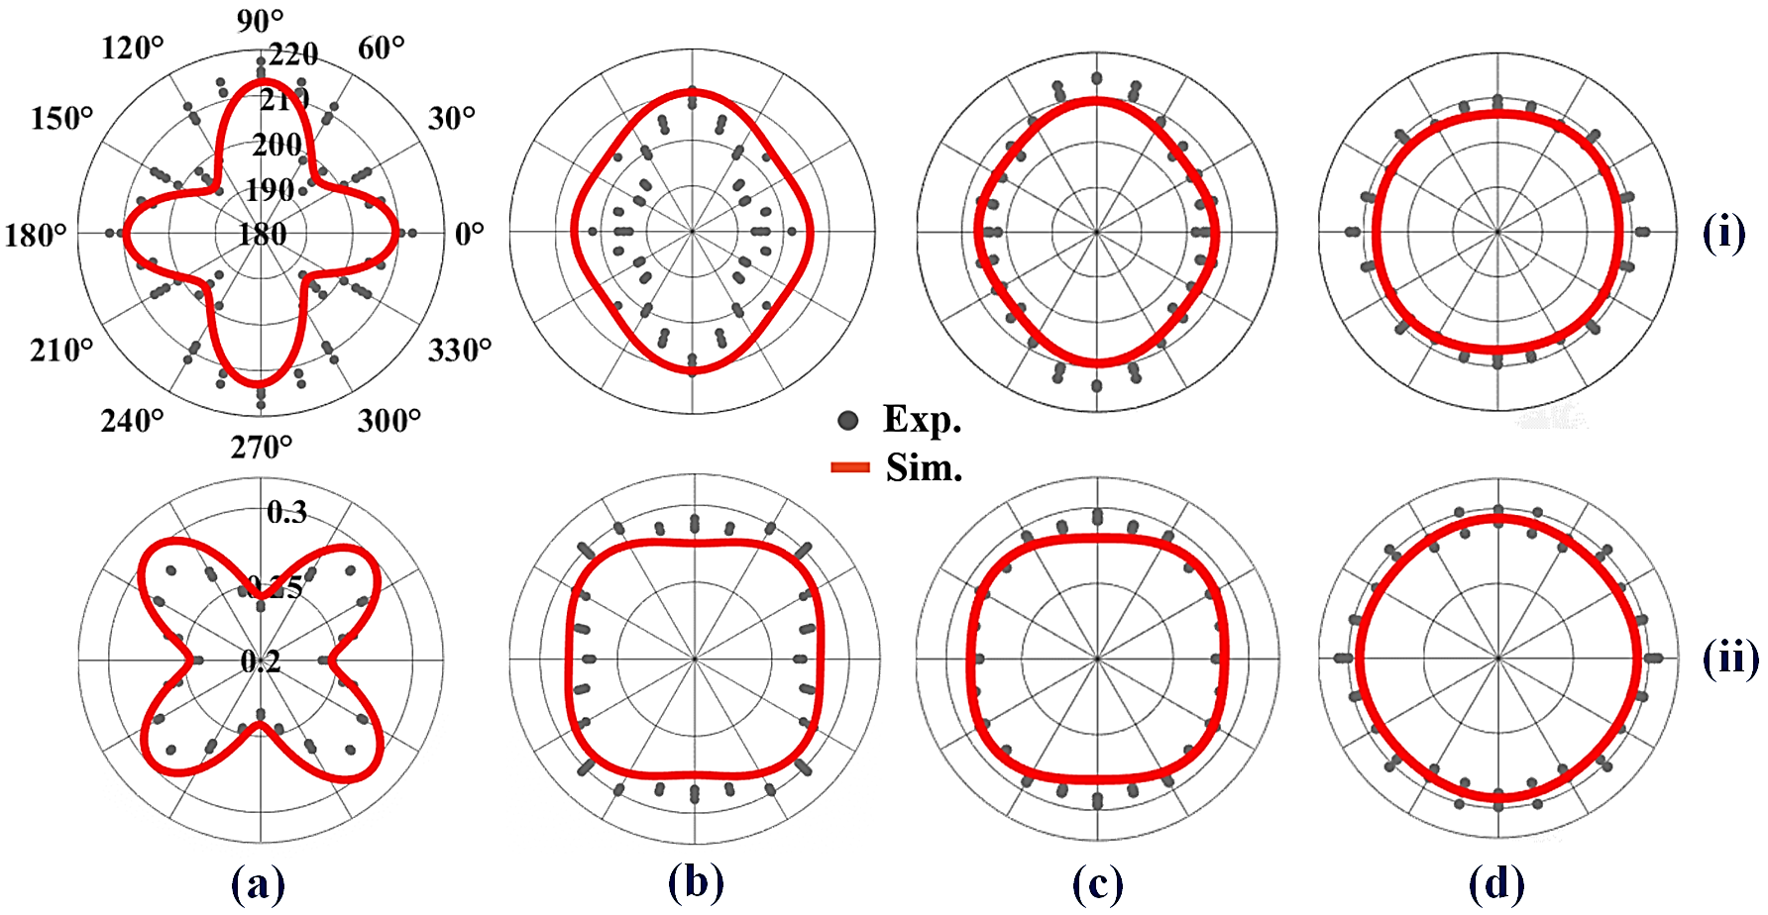
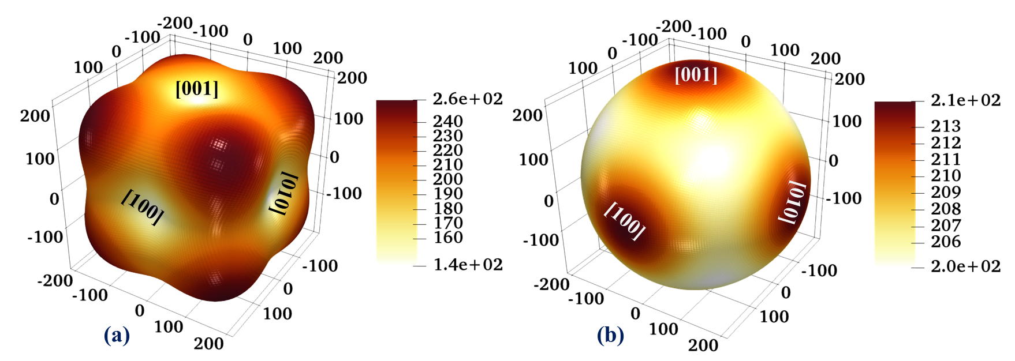
Comparison of measured and calculated variation of effective Young’s modulus and Poisson’s ratio as a function of in-plane sheet orientation. The angle starts from the rolling direction (i.e. 0° = RD).
Contour plots showing anisotropy of Young’s modulus with orientation for single crystalline

Slide 13
Elasto-Plastic response:
Calibration of monotonic loading

Slide 14
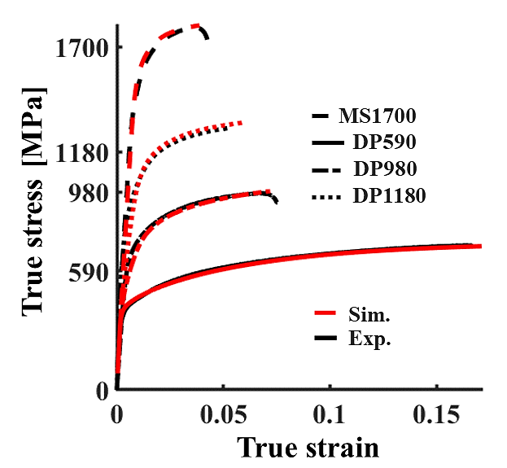
Calibration of monotonic response using single set of DD hardening parameters for all steel variants
Dislocation density hardening parameters for Ferritic and Martensitic phases

Slide 15
Calibration of cyclic loading:
i. Reversibility and dislocation annihilation
ii. Slip-system-level Kinematic Back-stress hardening
and Bauschinger effect

Slide 16
Dislocation annihilation (reversible DD) in EVPFFT
Reversible DD hardening
Dislocation annihilation
Dislocation annihilation
(c)

Slide 17
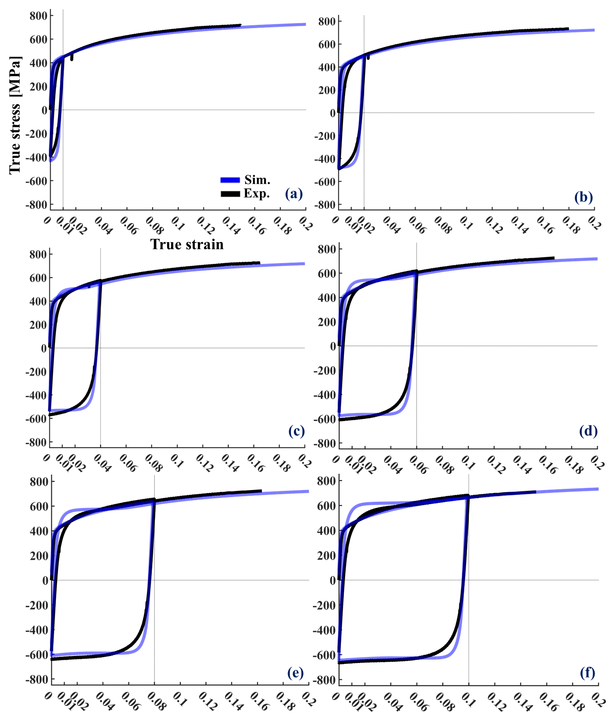
*No BS
Back-stress can help here to account for Bauschinger effect

Slide 18
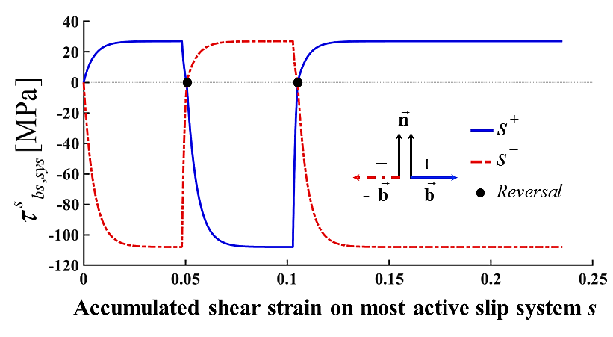
A slip-system-level kinematic piece-wise back-stress phenomenological hardening law in EVPFFT that saturates exponentially and mimics the Bauschinger effect
Back-stress hardening law
Back-stress can either help or hinder resolved shear stress on a slip plane

Slide 19
Back-stress hardening parameters for Ferritic and Martensitic phases

Slide 20
Qualification of Micromechanical fields
(An advantage of EVPFFT as full-field crystal plasticity solver over EPSC [Elasto-plastic self consistent] )

Slide 21
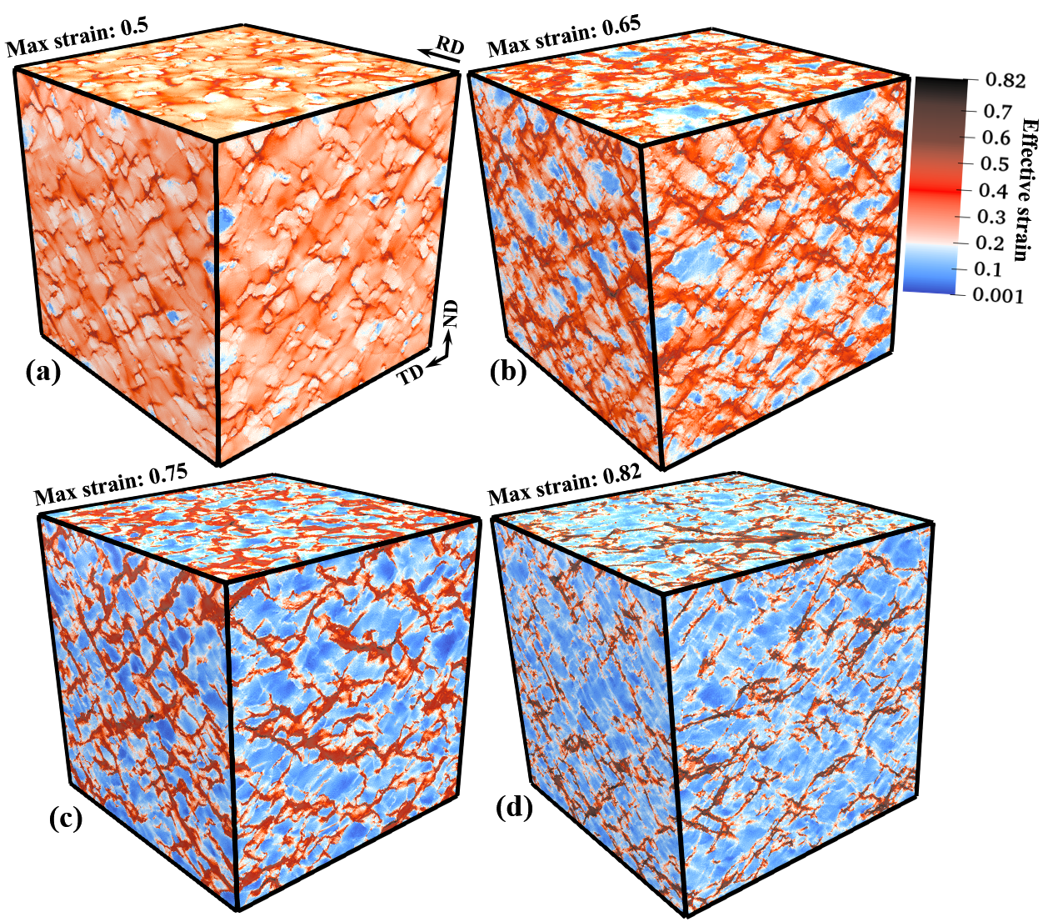

Slide 22
Quantification of field gradient across the inter-granular grain boundaries

Slide 24
Future work
Incorporate the multi-GPU EVPFFT solver to Finite Element
(Accelerated UMAT for ABAQUS). Run the FEM on MPI while
the underlying Microstructure RVE on GPU. This is to facilitate
arbitrary BCs and geometries

Slide 25
